Slide 1

Oregon eWIC
Training for WIC Vendors
Notes:
The Oregon WIC Program is very excited to begin the transition from paper vouchers to the electronic benefit transfer card called eWIC. This training will cover how an eWIC transaction will work at the store. We’ll discuss the process of transitioning from vouchers to eWIC during the pilot and statewide rollout, and who to contact for help.

Slide 2


WIC Vendor Trainers
Michelle Aarhus
Pi Winslow
Notes:
I’m Michelle Aarhus.
<Pi>And I’m Pi Winslow.
And we’re your Oregon WIC Program Vendor Trainers.

Slide 3


eWIC is here!
Notes:
WIC Programs nationally have a federal mandate to convert to eWIC by 2020.
eWIC offers an improved shopping experience because the transaction is faster and more discreet and shoppers can choose to buy just what they need at the time rather than spend a whole voucher. The transaction is much easier for cashiers, since authorized foods will be programmed into the cash register.

Slide 4


Customer service opportunity
Notes:
As participants transition from vouchers to eWIC, there will be a learning curve and things will work a little differently at each store. Please be patient during the transition. Remember, WIC brings a lot of money into your store and into Oregon communities!

Slide 5
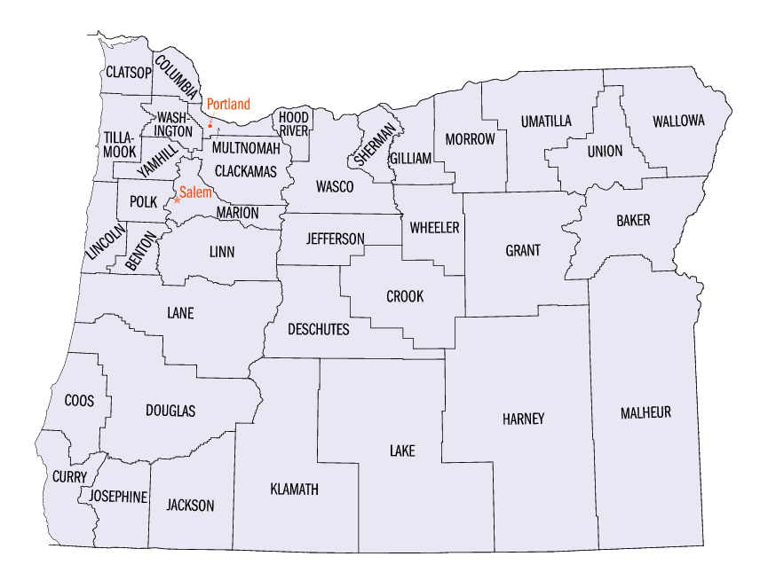
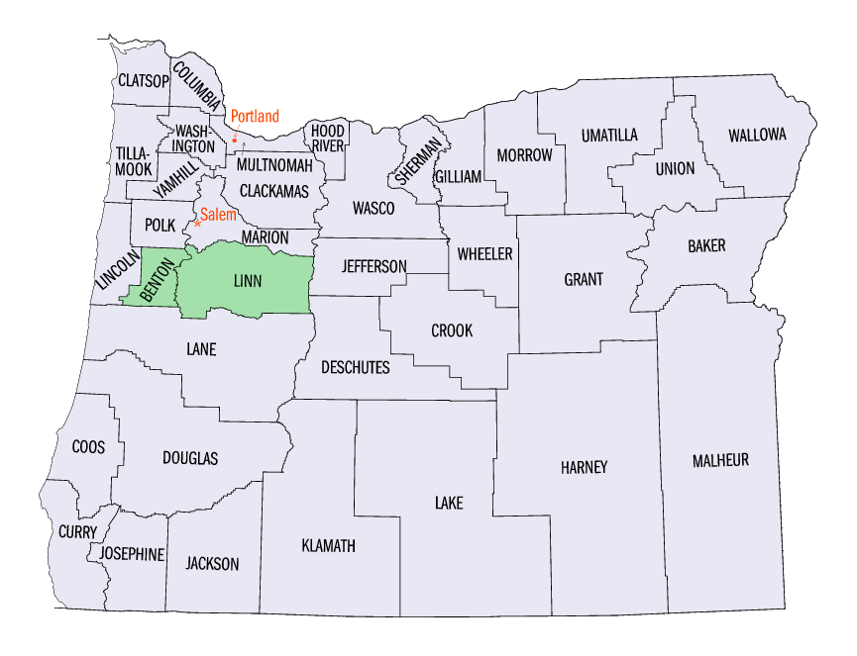
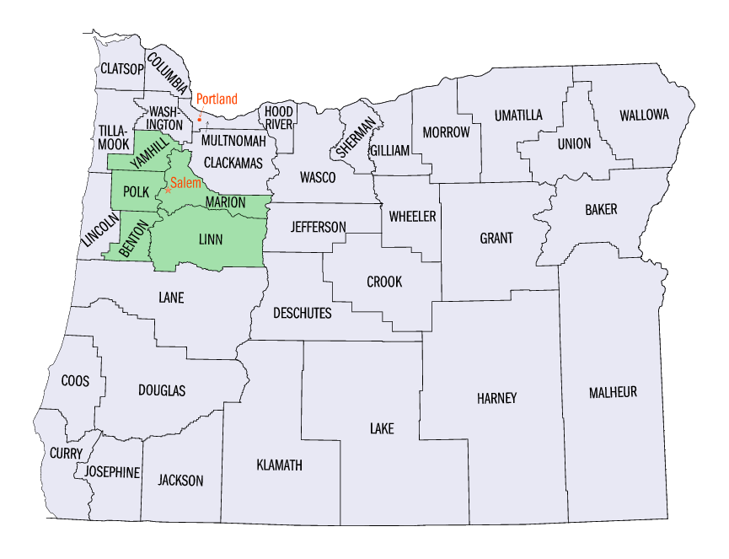
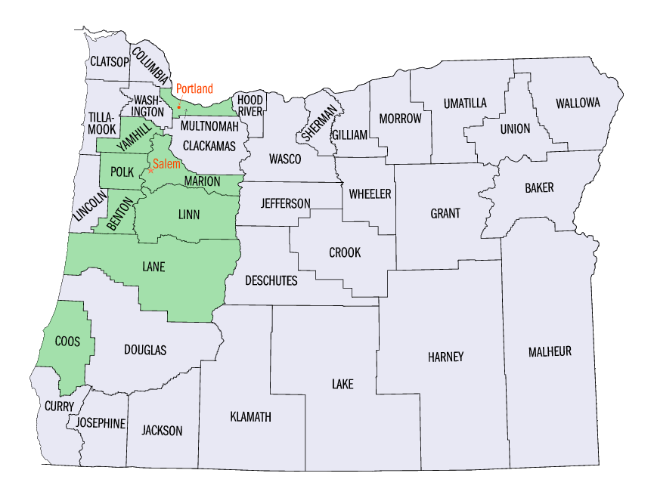
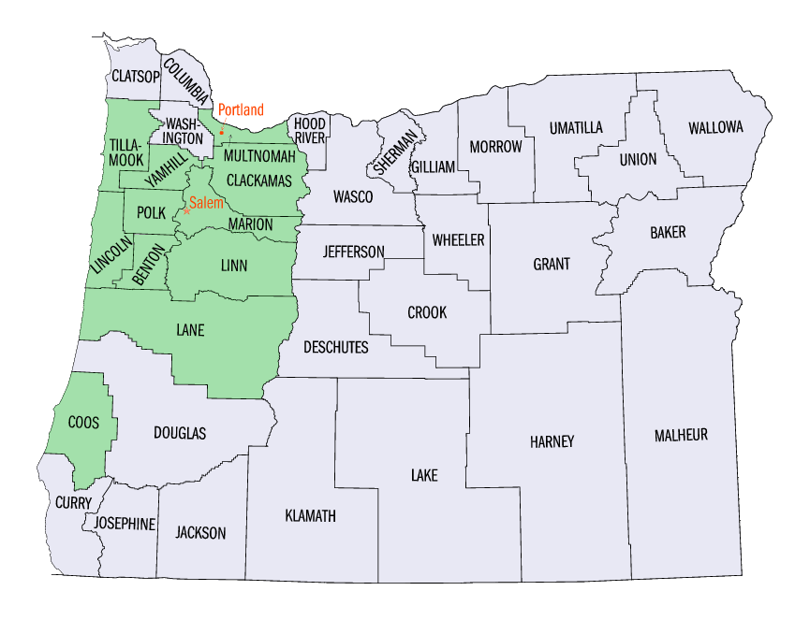
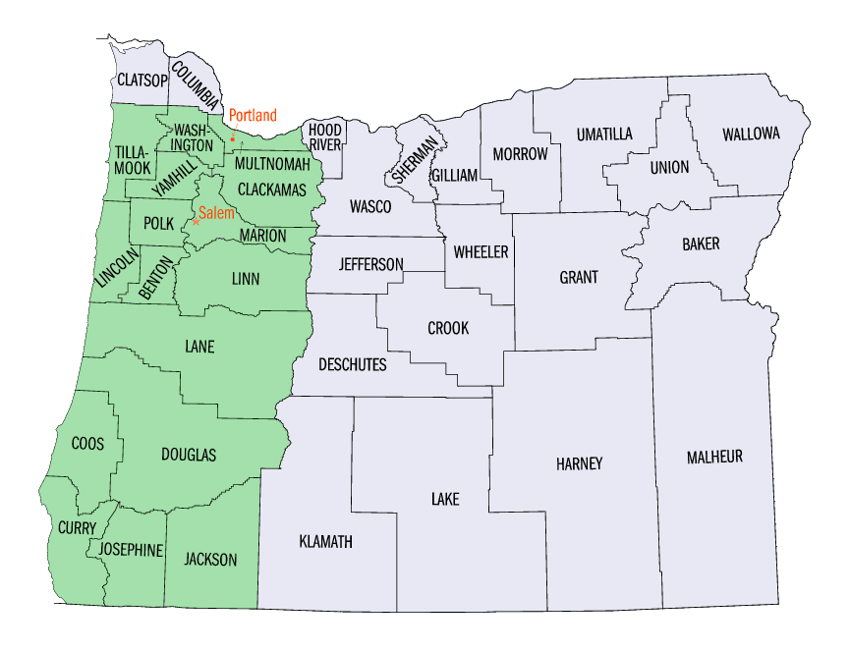
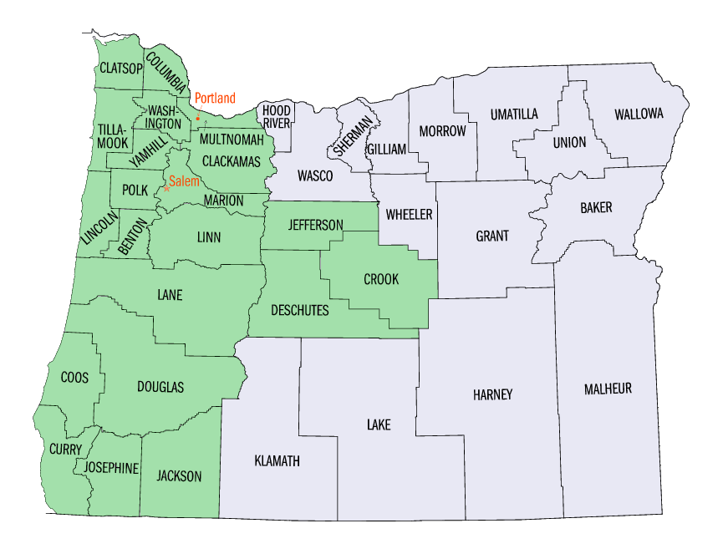
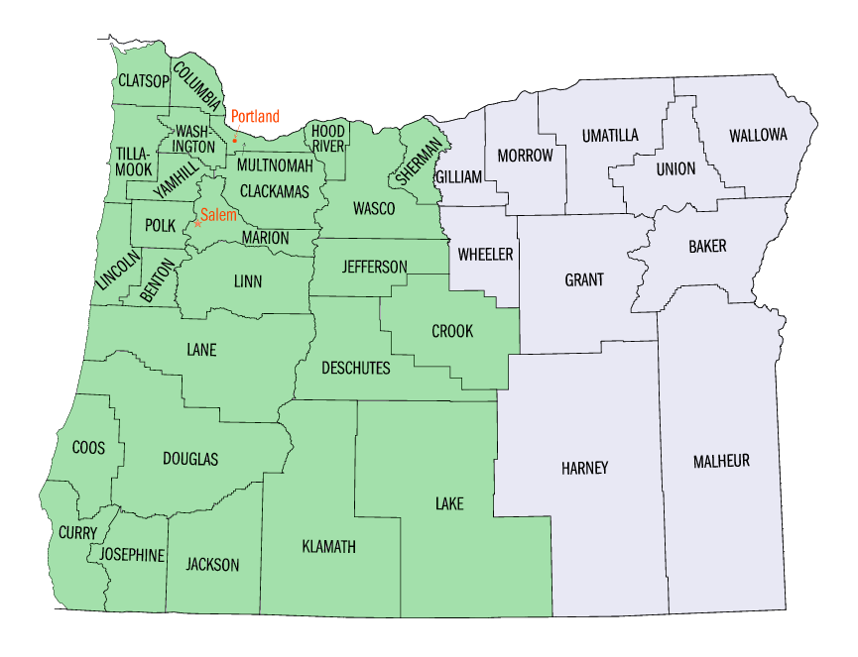
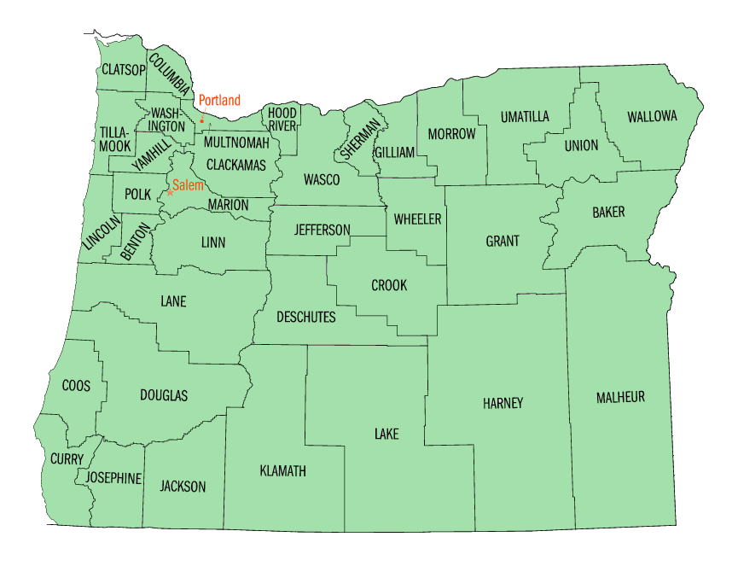
Oregon roll-out schedule
Notes:
So when is all this going to happen?
<CLICK>
The Pilot will begin in Linn & Benton counties on September 14th and run through December 2015. This is a test period in a small area so we can work out any bugs or bumps before we roll out the rest of the state.
<CLICK>
Beginning January 19, 2016, we’ll start an aggressive 8 week roll-out schedule beginning near pilot areas, and moving down the I-5 corridor, converting the larger WIC agency areas first until the entire state has rolled out.

Slide 6
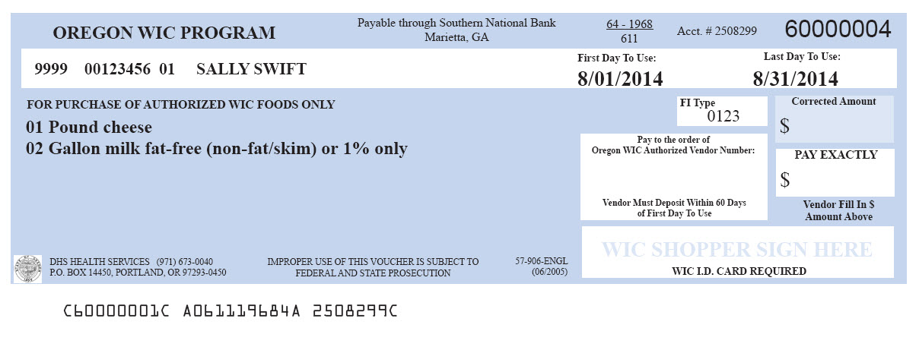
Transitioning – it’s a process!
All vendors must support paper vouchers throughout entire roll-out.
Vouchers may continue to be in circulation into June 2016
Notes:
Pilot and statewide roll-out will be a several month long process.
Stores are required to accept paper vouchers through the entire roll out.
<CLICK>
The last WIC clinics convert to eWIC in early March 2016, which means vouchers will be in circulation through June 2016 due to the three month voucher issuance process.

Slide 7


Shopper transition to eWIC
Shopping habits
Relearning WIC foods
Units of measure
Faster and easier!
Notes:
While stores are dealing with their transition issues, shoppers will be adjusting to new ways to shop for WIC foods.
We’ve learned from other states that have transitioned to eWIC that…
Shopping habits change – with eWIC, shoppers don’t have to buy everything at once. They might continue to, though, until they get used to the new way to shop
Shoppers will be relearning the WIC foods since eWIC ensures that WIC-authorized foods are the only foods able to be purchased with the eWIC card.
Shoppers may need to learn new units of measurement with eWIC and this can be difficult for some shoppers.
The good news is, eWIC is faster and easier to use than vouchers!

Slide 8
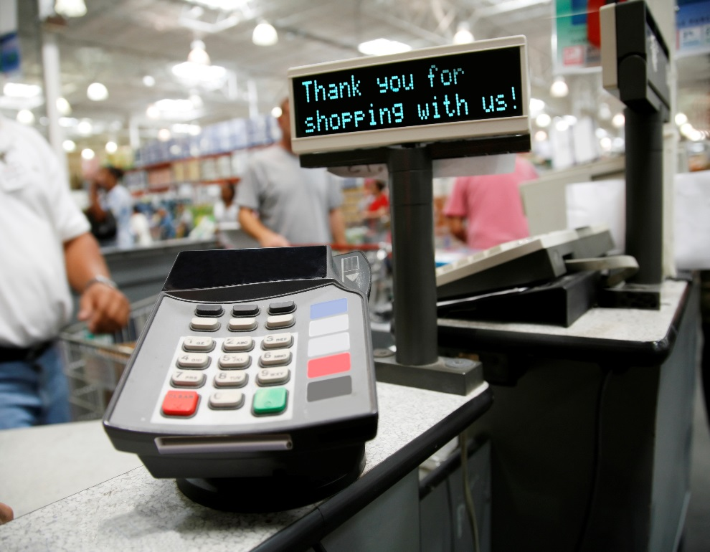
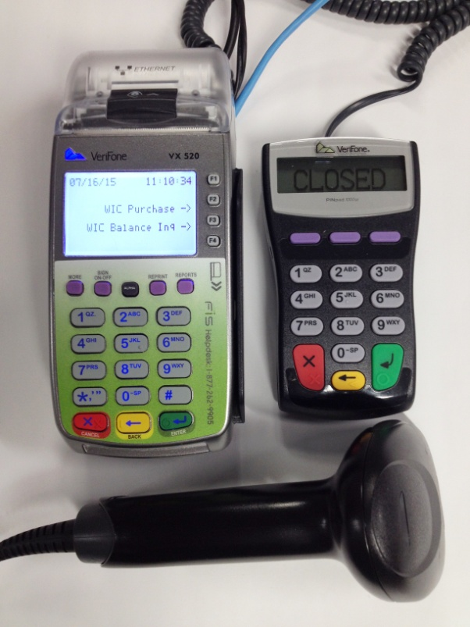
Integrated vs. Stand-beside
Integrated Stand Beside
Notes:
Stores will using one of two different systems to process eWIC. One is called Integrated and one is called Stand Beside. They are both slightly different ways to do eWIC

Slide 9
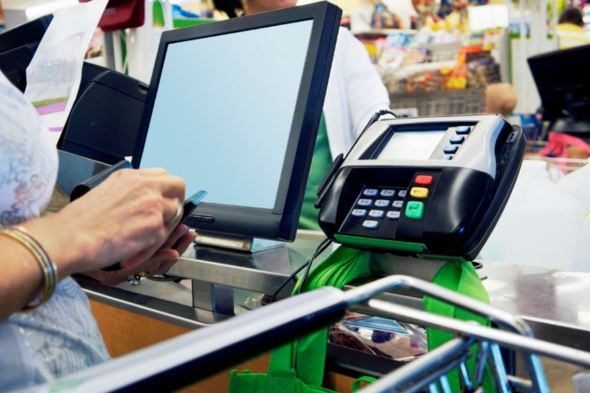
Integrated POS Terminal
Have programmed POS systems that process eWIC
Only requires one scan/entry of WIC items
Capability of doing “mixed basket” transactions – no separating
Notes:
Integrated Point of Sale Terminals will have their registers programmed to recognize the eWIC card and WIC items.
These systems will only require one scan of WIC items. The single scan will ring up the item in both the store’s system and also the eWIC system.
Integrated systems will have the capability of doing “mixed basket” transactions which means shoppers will no longer need to separate their WIC foods from the rest of their purchase.

Slide 10
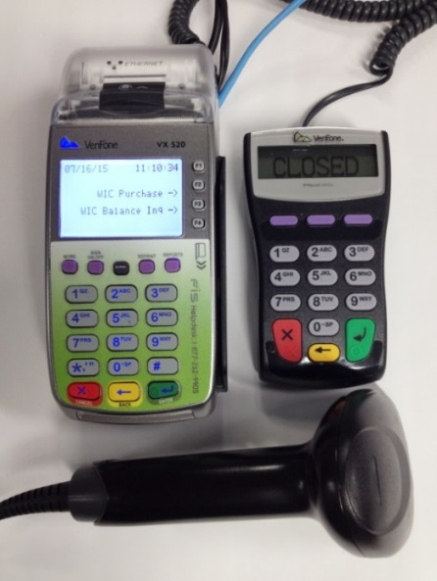
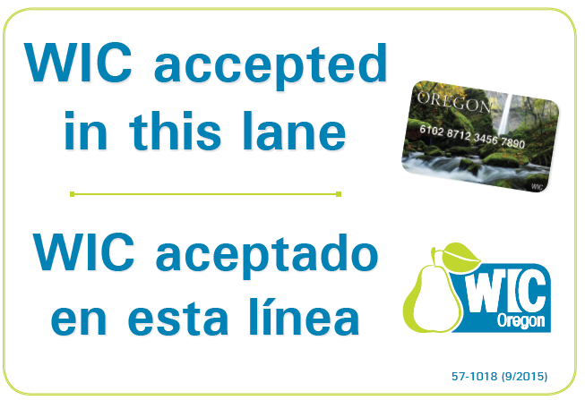
Stand-beside POS Terminal
Stores receive stand-beside POS terminal and equipment training 2-3 weeks prior to roll-out date
Requires two entries of WIC items – must separate
If not all lanes take WIC, lanes that do must be identified by signs
One WIC lane always open
No WIC-only lanes
Notes:
Stores that do not have an integrated system will have a Stand-beside device that will be used to process eWIC.
Stores will receive the equipment and training about 2-3 weeks prior to their area’s roll-out date.
These devices will require a separate scan of WIC items – so shoppers will still have to separate their WIC foods from the rest of their purchase.
Each register will need its own device, so if a store does not have a device for each register, then they are required to post signs at the lanes that accept eWIC so shoppers know which lane to use.
<CLICK>
Here’s an example of a lane sign that will be provided by our office to these stores.
At least one lane that accepts eWIC must be open at all times. Stores are not allowed to have a “WIC-only lane.”

Slide 11
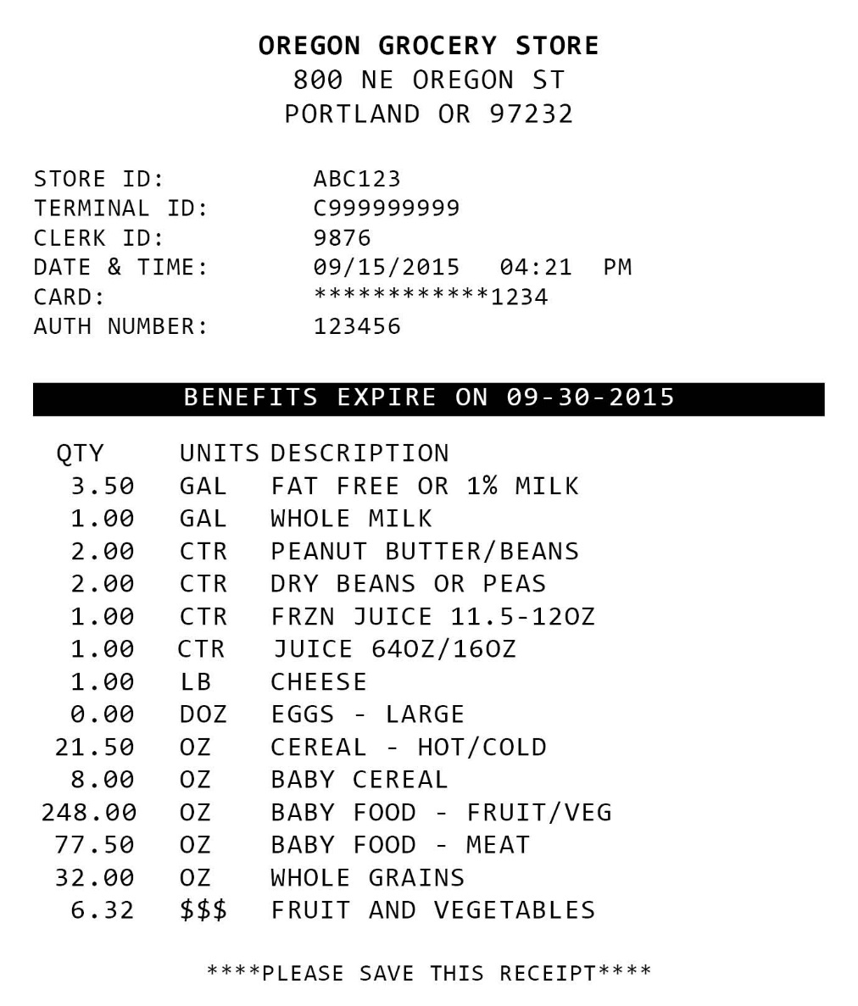

WIC food benefit issuance
Combined household benefits
Automatically loaded and removed
Available food categories and quantities are listed
Fruit & veggie Cash Value Benefit (CVB) listed in dollar amounts
Notes:
With eWIC, if there is more than one person in the family on WIC, food benefits are combined into one account.
Benefits are loaded at 12 a.m. on the 1st of the month. Unused benefits are removed at 11:59 p.m., usually on the last day of the month. This means any late night shopping trips for the month need to be completed by 11:59 on the last day of the month.
<CLICK>
As you can see on the receipt, WIC benefits are added to cards in quantities (such as 3.5 gallons) and food categories like fat free or 1% milk.
<CLICK>
Only the fruit and vegetable benefit, or cash value benefit, is issued in a dollar amount.

Slide 12
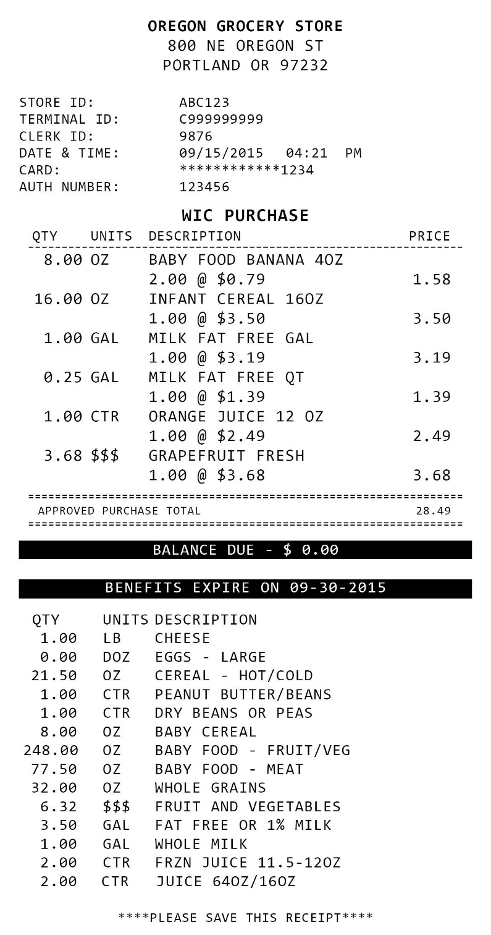
WIC benefit balance
Ways cardholders can
check their balance:
Clinic benefit list
Online
Telephone
Balance inquiry
Receipt
WIC shopper app
Notes:
Since shoppers won’t have vouchers anymore, they can find out their available benefit balance in several ways.
At the clinic, they’ll get a printed benefit balance that shows all the foods for the whole family for up to three months. Then, throughout the month they can check their balance by phone or online. They can ask a cashier to perform a balance inquiry at the store.
Or, at the end of each WIC shopping trip,
<CLICK>
their remaining balance will print on the end of their receipt.
In addition to those ways, Oregon WIC has purchased a WIC shopper app for smartphones that participants can use in the store to find authorized foods and check their balance.

Slide 13
Reading a WIC benefit balance
Food Description | Qty | UOM | Is equal to…
Cheese | 1 | LB | 1 pound
Eggs – large | 1 | DOZ | 1 dozen large eggs
Cereal – hot/cold | 36 | OZ | 36 ounces cereal
Fish – canned | 30 | OZ | 30 ounces canned tuna, salmon, sardines
Whole grains | 32 | OZ | 32 ounces 100% whole wheat bread, soft corn tortillas, brown rice
Fruits and vegetables | 10 | $$$ | $10 fresh or frozen fruits & veggies
Peanut butter/beans | 1 | CTR | 1 container 16-18 oz peanut butter OR 1 container 16 dry beans, peas
Frzn juice 11.5-12oz | 3 | CTR | 3 containers frozen juice
Juice 64 oz / 16 oz | 2 | CTR | 2 containers 64 oz shelf stable or 16 oz frozen juice
Notes:
Keeping track of benefits through the month and reading receipts will be a new concept for shoppers. As a cashier, you’ll need to know how to read eWIC receipts.
<CLICK>
Cheese and eggs are pretty simple to understand. Cheese is still issued in one pound quantities. One dozen eggs remains the only allowable size at this time.
<CLICK>
Some items have ounces, abbreviated OZ as a unit of measure. This is the same as it is on vouchers. The new concept will be seeing the available amount reducing when the shopper only purchases part of their benefit. For example, if they start with 36 ounces of cereal and buy one 18 oz box, they will see a remaining benefit balance of 18 ounces of cereal.
<CLICK>
The cash value benefit for fruits and vegetables, or CVB, is the only item issued in a dollar amount. Shoppers will still be able to pay the difference if their produce purchase goes over their benefit amount.
<CLICK>
The newest unit of measure is containers, abbreviated CTR. A jar of peanut butter and a package of dry beans are issued as CTR. Participants are also issued either containers of 11.5-12 ounce frozen juice or containers of 64 oz shelf stable or 16 oz frozen juice.

Slide 14
Milk and milk substitutes
Food Description | Quantity | Unit of Measure | Is equal to…
Whole milk | 1.00 | GAL | 1 gallon whole milk (1=1 gallon, .5= ½ gallon, .25=quart)
Lowfat milk | 4.75 | GAL | 4 gallons, 1 half gallon, 1 quart fat free or 1% milk
Soy beverage | 4 | GAL | 8 half gallons or 16 quarts of soy beverage
Lowfat goat milk | 4.25 | GAL | 17 quarts fluid lowfat Meyenberg goat milk
Nonfat dry milk | 2 | CTR | 2 25.6 oz. boxes of dry milk
Evaporated whole milk | 24 | CAN | 24 12 oz cans of evaporated milk
Notes:
Milk is issued in gallons, abbreviated GAL. This might be a bit more confusing for some shoppers.
<CLICK>
One GAL of milk is equal to one gallon. .5 GAL is equal to a half gallon, and .25 GAL is equal to a quart.
<CLICK>
The same concept applies for soy beverage and goat milk.
<CLICK>
Dry milk is issued in containers. The only allowable size of dry milk is the 25.6 oz box.
Evaporated milk is issued in cans, and comes in a 12 ounce can size.

Slide 15
Baby food & formula
Food Description | Quantity | Unit of Measure | Is equal to…
Sim Adv PWD 12.4 oz | 9 | CAN | 9 cans 12.4 oz Similac Advance powder
Sim Adv CONC 13 oz | 26 | CAN | 26 cans 13 oz Similac Advance concentrate
Sim Adv RTF 32 oz | 32 | BTL | 32 bottles 32 oz Similac Advance ready to feed
Baby food – fruit/veg | 128 | OZ | 128 ounces baby food fruits & veggies (32 4 oz. jars or 16 4 oz. 2-packs)
Baby food – meat | 70 | OZ | 70 ounces baby food meat (28 2.5 oz. jars)
Baby cereal | 24 | OZ | 24 ounces baby cereal
Notes:
Due to the limited number of characters that can be printed on receipts, formulas are abbreviated.
<CLICK>
Similac Advance Powder will look like this on the receipt.
<CLICK>
Concentrate and Ready to Feed formulas will be abbreviated CONC and RTF. Ready to feed quarts will have bottles as the unit of measure.
To help you assist your WIC customers, our website has a list of WIC formulas showing the short receipt descriptions along side a full description and product UPC.
<CLICK>
Baby food and baby cereal are listed in ounces.
Baby food fruits and vegetables are issued in a large number of ounces, which might be difficult for some shoppers to figure out.
<CLICK>
We’ve made materials for participants to help them understand that 128 ounces of baby fruits and vegetables is equal to 32 4 ounce jars or 16 two-packs.
<CLICK>
For baby food meat, 70 ounces equals 28 of the 2.5 ounce jars.

Slide 16
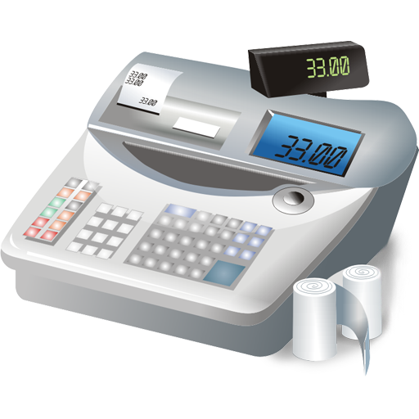
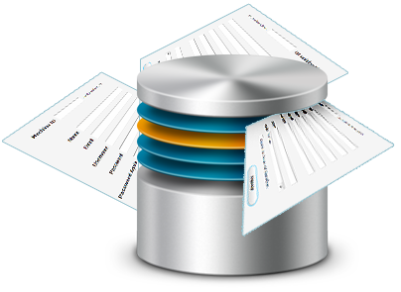

Approved Product List (APL)
Notes:
The Approved Products List, or APL, is a database of all Oregon WIC-approved UPCs and PLUs. The APL identifies what products are WIC approved, and is checked against available category and quantity of a shopper’s eWIC benefit balance.
All eWIC terminals will get an updated version of the APL on a daily basis. The State WIC Program provides this list.
<CLICK>
The APL will be pushed through to stand beside devices nightly – so it’s important that you do not turn your devices off at night.
Integrated stores must download APL daily. This will be an automated process.
Items must be in the APL in order to ring up for WIC.

Slide 17

APL: Why doesn’t it ring up?
  Item is not an approved WIC item
  Customer does not have the benefit available
  Customer does not have enough of the benefit available to make the purchase
  Item is eligible, but not in the APL – store must notify us to add it
      No override!
Notes:
So what happens when a food will not ring up for WIC?
There are four reasons an item may not ring up:
The Item is not an approved WIC item
The Customer does not have the benefit available
The Customer has the benefit, but does not have enough of the benefit available to make the purchase
The Item is eligible, but not in the APL. It’s important to note that there is no override option for items not in the APL.
It will be up to the cashier to help troubleshoot why the item didn’t ring up and help the customer with the best solution, such as getting the correct food, explaining why it didn’t ring up, or notifying our office to add the item to the APL.

Slide 18
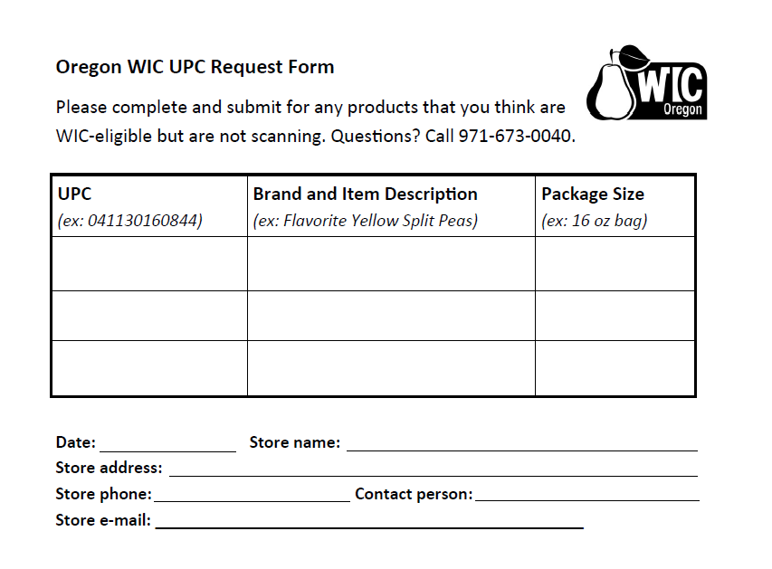
APL: Adding new foods
Procedure for requesting UPC/PLU added to APL
https://public.health.oregon.gov/HealthyPeopleFamilies/wic/Pages/vendorewic.aspx#apl
Notes:
Our website will have a couple of different forms available to request that items be added to the APL.
<CLICK>
We’ve designed a smaller form that can be kept at the register for cashiers to fill out as new or missing food items come through their lanes.
We will make the final determination if a food is eligible to be added to the APL, which could take up to two weeks.

Slide 19
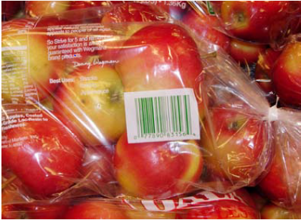
APL: Produce Mapping
Integrated stores must map a fresh or frozen produce UPC to a PLU code
Stand Beside stores just enter the price
Notes:
When produce such as seasonal, local, or store brand items with a UPC shows up at a store for sale, all integrated stores must map the UPC to a known PLU so it will ring up for WIC.
Stand-beside vendors will not need to do any mapping – they will just enter a price for each CVB item.

Slide 20
Helpful system error messages
  Insufficient balance
  Not a WIC item
  Item not recognized
  Error messages will vary depending on your store’s POS system
OH NO!
Some sort of error!
Notes:
If something goes wrong, your store’s system will produce various error messages to help troubleshoot.
Some examples of error messages may include insufficient balance, not a WIC item, or not a recognized item.
<CLICK>
The exact messages will vary depending on your store’s system. This information should be provided to you when you receive training on your system by your store.

Slide 21
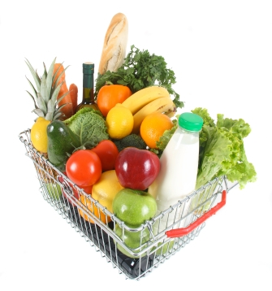
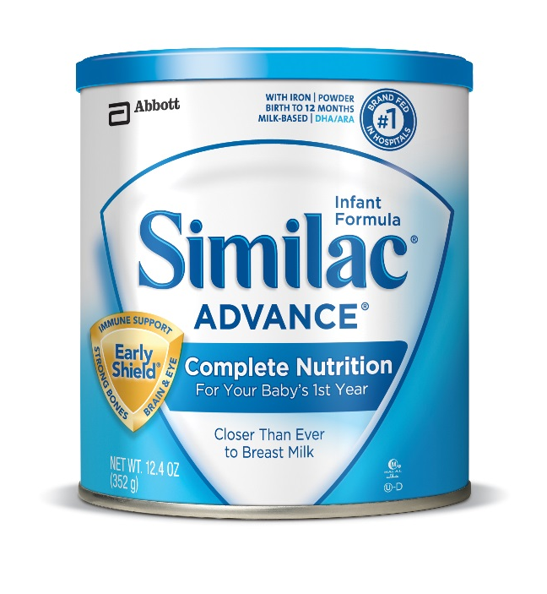

APL: Vendor Types
Notes:
When a shopper uses their eWIC card at a grocery store, they will be able to purchase foods, produce, and formula.
Pharmacies are only authorized to accept WIC for infant, child, and adult formulas. When a shopper swipes their eWIC card at a pharmacy, only formula items will be available for purchase.

Slide 22


WIC Food List
Still important!
Shows allowable brands and sizes
Use to troubleshoot when things don’t ring up
Help customers find the right food
Some larger package sizes
  2 lb. cheese
  16 oz. frozen juice
  Brown rice
  Corn tortillas
  Dry beans, peas, lentils
Notes:
Even though the APL controls what products shoppers can buy, the Food List is still an essential tool because it is the only place that lists allowable brands and sizes of products.
The current version of the Food List,
<CLICK>
dated October 1, 2014 and revised March 2015 will carry us through the transition to eWIC. Since participants benefits will be combined onto one card per family, shoppers will be able to buy larger package sizes for several items. Two of these different package sizes – 2 pound cheese and 16 ounce frozen juice are already in the Food List.

Slide 23
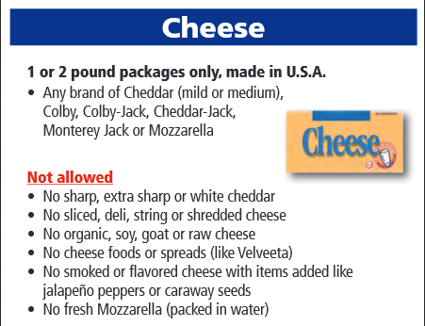

Food List and receipts
Notes:
To illustrate the importance of the Food List, take a look at this receipt –
<CLICK>
it simply shows 1 pound of cheese.
Shoppers and cashiers need to use the Food List
<CLICK>
to figure out what sizes, brands, and types are allowed, and what isn’t allowed. This is useful for shoppers while they’re shopping, and for cashiers when troubleshooting why something doesn’t ring up for WIC.

Slide 24

No WIC ID Card at the store
No checking voucher dates
No writing purchase amount
No signatures
No vendor ID stamp
Less cashier errors!
Saves money for stores!
Goodbye vouchers, hello eWIC!
Notes:
Saying goodbye to vouchers means no more WIC ID Card at the store and no more checking voucher dates. Cashiers will no longer have to write the purchase price or get the customer’s signature. Bookkeepers will no longer need to stamp vouchers before depositing. This means fewer cashier errors and more money for stores!

Slide 25

eWIC Transaction Basics
eWIC card
4 digit PIN
Never ask for a shopper’s PIN
PIN locks after 4 incorrect attempts
When to swipe varies among stores
Notes:
In order to make an eWIC purchase, a shopper just needs their eWIC card and four-digit PIN. If the card isn’t swiping for some reason, you can enter the card number manually. However, never ask a shopper for their PIN. If a shopper incorrectly enters their PIN four times, their card will lock and will not be able to be unlocked until midnight.
Depending on how your store’s system is set up, the shopper might swipe their card at the beginning or end of the transaction. If your store uses a stand-beside terminal, the card must be swiped before ringing up foods.

Slide 26
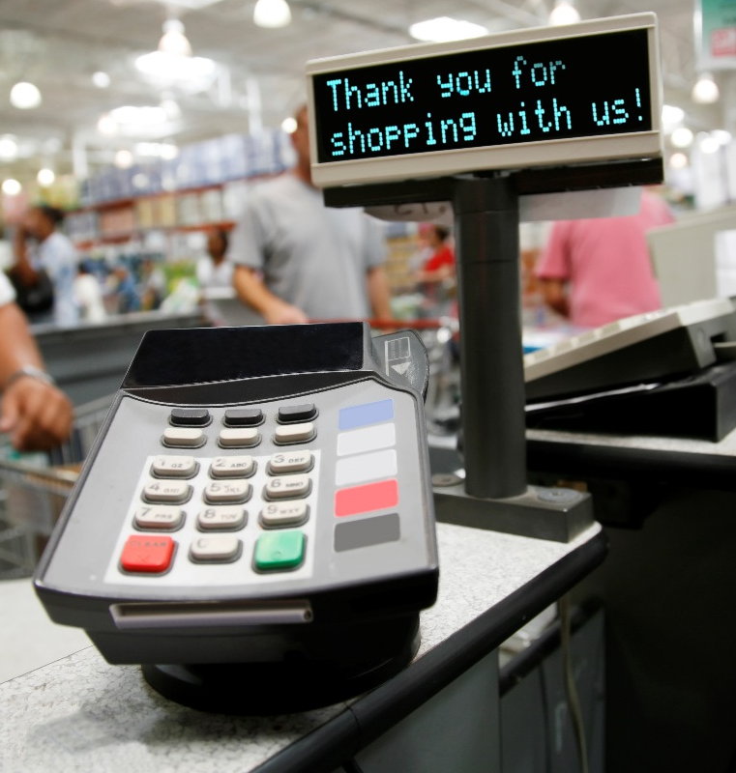



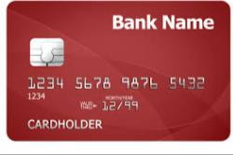
Tender Moments
Tender eWIC first
Then Oregon Trail EBT
Then cash, debit, or credit
Notes:
Stores using stand beside terminals will need to keep WIC separate from other purchases.
Cashiers at integrated stores need to know which order to tender different payment types in mixed basket scenarios.
Tender eWIC first since it is the most restrictive form of payment.
**CLICK** Then Oregon Trail EBT, if they are using that method of payment. Then debit, credit, or cash.
WIC participants will receive training at the clinic on how to use their eWIC card. Clinic staff will tell participants to ask what to do when they use their card for the first time. They will also be told to always use their eWIC card first.

Slide 27


Scanning items
Scan UPC barcode on actual product
If item doesn’t scan, OK to enter UPC manually
NO scan codes, codebooks, or clipboards of UPCs
Quantity function OK for identical items
Notes:
When it comes to scanning items, you’re required to scan the UPC barcode on the actual product.
<CLICK>
If the item doesn’t scan, you can manually enter the UPC.
Using scan codes, code books, or clipboards of UPCs is not allowed.
<CLICK>
Cashiers may use the quantity function for identical items only.

Slide 28

Finalizing the transaction
Review the WIC items being purchased with the customer
Always give the customer their receipt
Receipt shows items purchased and remaining WIC benefit balance
Notes:
Once everything is scanned, review the WIC items being purchased with the customer.
Please remember, it is a requirement to give the receipt to the WIC shopper. The receipt will show what items were purchased, and at what price.
<CLICK>
The bottom of the receipt will show the remaining balance that the shopper can use next time they go to the store.

Slide 29

Oh No! System Down!
No eWIC when the system goes down
Notes:
While there are many benefits to transitioning to an electronic WIC system, unfortunately, there is no manual process for accepting eWIC when the system goes down. The shopper will have to come back later or go to another store.

Slide 30

eWIC Payments
Faster payment
No rejections
Maximum prices calculated by UPC
Adjustments made at point-of-sale
Do not ask shoppers for payment above the price paid by WIC
Notes:
With eWIC payment to stores will happen within two days. Amount-too-high rejections will not happen anymore. Maximum reimbursement amounts will be calculated at the UPC level. Any price adjustments will be made at the point of sale.
Never ask a shopper to pay the difference between the shelf price and the price paid by the WIC Program.

Slide 31
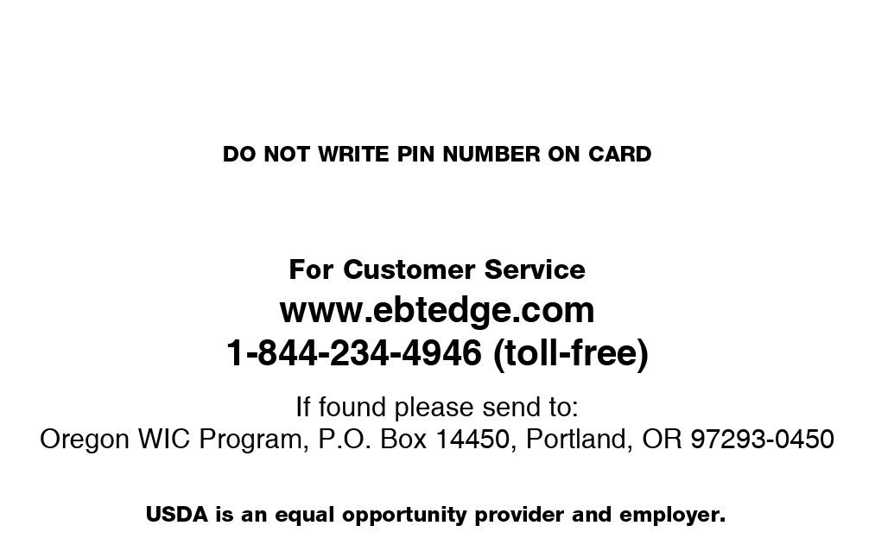

Lost eWIC Cards
Notes:
If an eWIC card is found at your store, it can be mailed to the address on the back of the card.

Slide 32

Cashier Training
State WIC trainers will train store representatives
Store representatives will train cashiers on eWIC and POS system
Stand-beside terminals may use a DEMO mode for training
  REMEMBER to turn DEMO mode off afterwards!
Notes:
Here at the state, we rely on a “Train the Trainer” Model. Meaning the state provides training of WIC program policies to store representatives.
Then we expect those store representatives to return to their locations and train their employees.
Stores throughout the state have different point of sale systems, so your store will have to train cashiers on your specific cash register system. Most integrated stores have some sort of training or practice mode to help with learning the system.
<CLICK>
Stand-beside terminals will have a DEMO mode for practicing eWIC transactions. Just be sure to get out of the DEMO mode before processing real transactions!

Slide 33

Statewide roll-out
Notes:
Some large chain stores may have the ability to accept eWIC prior to their area’s official roll-out date. This will benefit any customers who move to a new area with an eWIC card. If you are part of a large chain store, it will be a good idea to have one or two managers or lead cashiers trained early.
If someone comes in with eWIC card and you don’t know what to do, call the State WIC Office for training assistance.
Stand beside stores and small integrated vendors will not be ready to accept eWIC until their county roll out date.

Slide 34
Who to call for help!
eWIC Vendor Policy or Foods Questions
Vendor Answer Line (VAL)
Monday - Friday 8AM-5PM
1-877-807-0889
Submit possible missing food items
Submit via fax or email using UPC request form
eWIC Payments
Your TPP or
FIS Retailer Help Desk
1-844-234-4947
Notes:
It’s good to know who you can call for help!
For WIC policy or food questions, call our toll-free vendor answer line.
Remember, stores can submit possible items missing from the APL via fax or email.
For information about eWIC payments or disputes, call either your TPP or the FIS retailer help desk.

Slide 35
Who to call for help!
Integrated Systems
ECR Provider or TPP
POS stand-beside devices
FIS Retailer Help Desk
1-844-234-4947
Notes:
For server and network issues, Integrated stores will call their Electronic Cash Register provider or Third Party Processor.
Stores using the stand beside POS will call the FIS retailer help desk.

Slide 36
WIC Vendor Trainers
Michelle Aarhus
971-673-0052
Michelle.A.Aarhus@state.or.us
Pi Winslow
971-254-5669
Pi.V.Winslow@state.or.us
Notes:
If you need help with a training plan for your store or training materials, please contact us, we are here to help you!

Slide 37

Thank you!
Notes:
Thanks to the partnership with our Oregon WIC authorized vendors, we are able to deliver WIC foods to over 90,000 Oregonians. We hope the transition to eWIC is successful and smooth!

