Slide 1
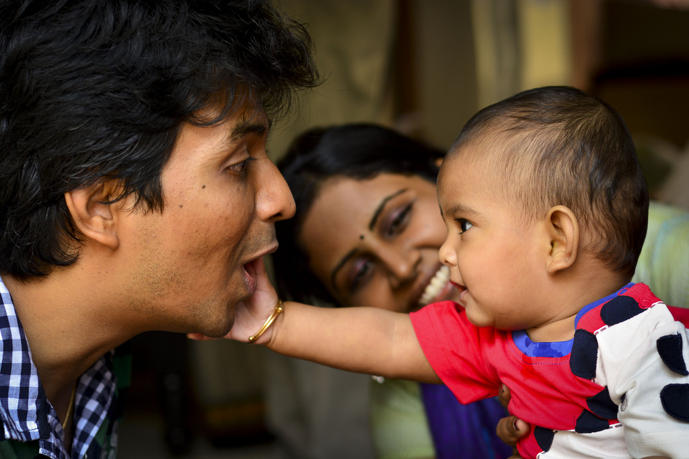
Using VROOM in WIC

Slide 2
Why ?
Follow up to the brain development session and materials provided at the 2016 WIC Statewide Meeting
Provides you with tools to connect parenting and brain development to meal time, snack time, and play time.
Vroom fits as neatly as possible into every family’s frantic, crazy, beautiful life.

Slide 3
Watch this video: https://www.youtube.com/watch?v=MFrtoBkg3QE
Notes:
Ari’s WIC /Vroom video

Slide 4
What did you think?

Slide 5
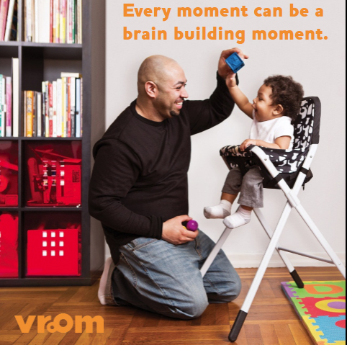
What were key points in the video?
How does “serve and return” work?
How does the Vroom app help parents?
How could you use Vroom concepts and tools in WIC?

Slide 6
Vroom focus
Every caregiver wants to help their child succeed
The first 5 years are when brains grow the fastest
Every caregiver can be a brain builder
Doesn’t take extra money, time, planning or “stuff”
A short conversation with the child during everyday activities is all it takes
The Daily Vroom App appeals to young families
Daily reminders are fun and geared to the age of their child

Slide 7
WIC-specific Vroom tip cards
Take a look at your packet!
Notes:
Distribute WIC Vroom tip cards

Slide 8
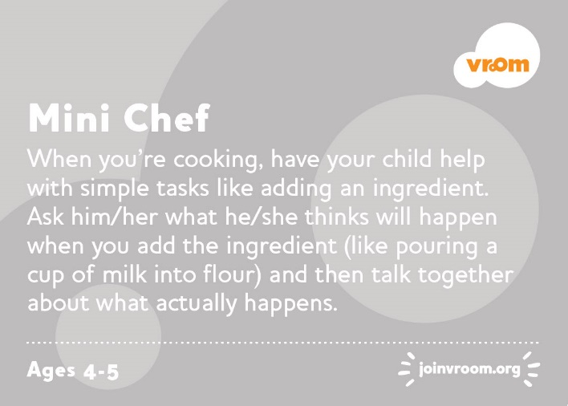
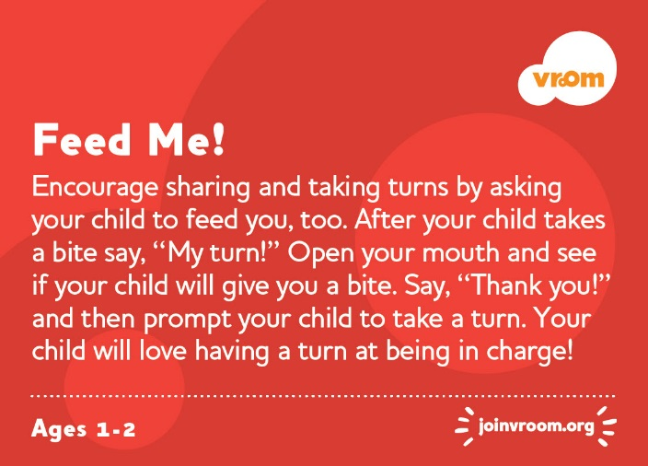
Color coded by age
Developmentally appropriate for each age group

Slide 9
Related to meal time, snack time, and play time
Perfect for WIC nutrition based counseling!

Slide 10
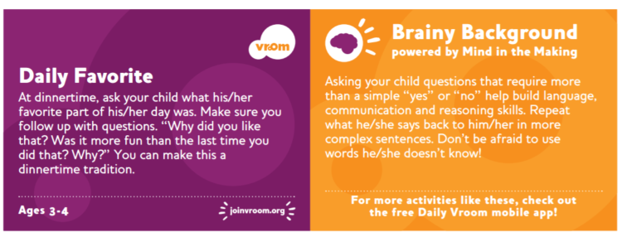
“Serve and Return”
Each Vroom brain building idea gives an example of how caregivers can interact back and forth with their child.

Slide 11
Brainy Background
Parents or caregivers can see how each conversation helps their child’s brain development.

Slide 12
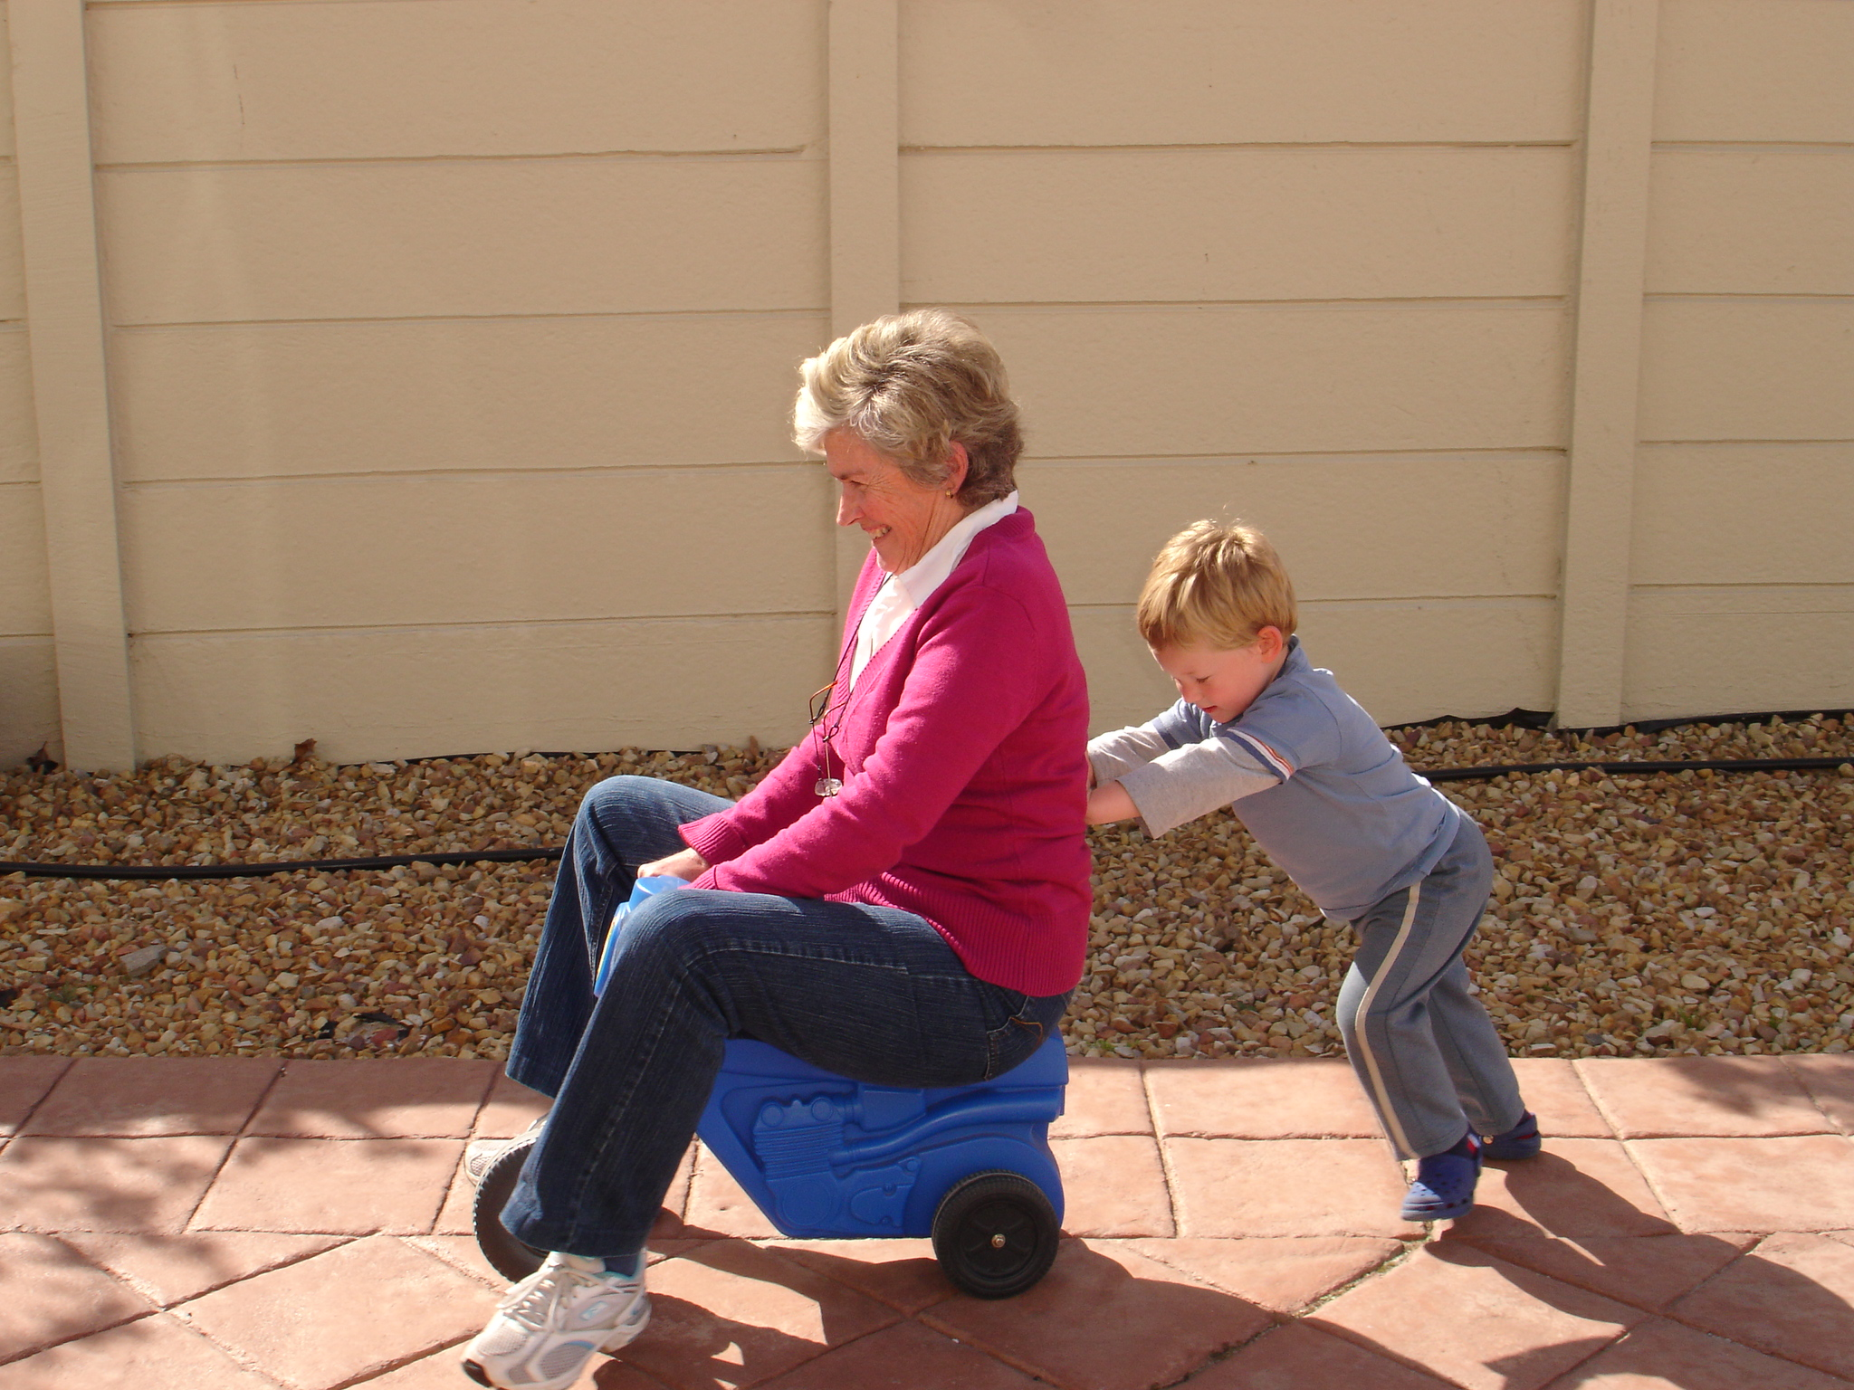
Using Vroom concepts in WIC

Slide 13
Build Confidence – You have what it takes!

Slide 14
How can WIC help?
Watch this video:
https://www.youtube.com/watch?v=PB1Uo9nbIVU
What could you say to caregivers that would help them feel this way?

Slide 15
Bulletin board idea
Look inside for a free “Brain Builder” kit
Use tape and staples to make a hinge for a tag board door
Ribbon or string loop to make a door handle

Slide 16
When the door is opened…
Hang a shatterproof mirror underneath
Consider putting Vroom information nearby, such as sample activities and instructions on how to download the Daily Vroom app.
You already have all it takes!

Slide 17
Case study: Busy Bonnie
Bonnie is in your clinic for Bella’s 6 mo. mid-cert health check. She is feeling overwhelmed trying to start solids for Bella when she also has 2 year old Benny eating at the table. She wants to sit with them while they eat and help them eat better, but feels overwhelmed.
What would you say to Bonnie?
Are there any Vroom tips that might help?

Slide 18
Ideas for
older WIC kids

Slide 19
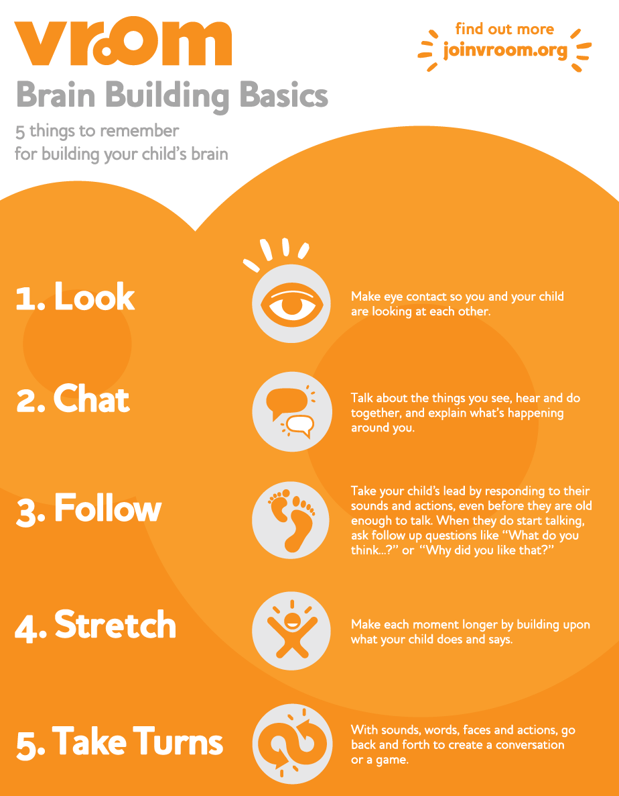
WIC can offer Brain Building Basics
Watch this video
https://www.youtube.com/watch?v=WQNm4ASB7iY

Slide 20
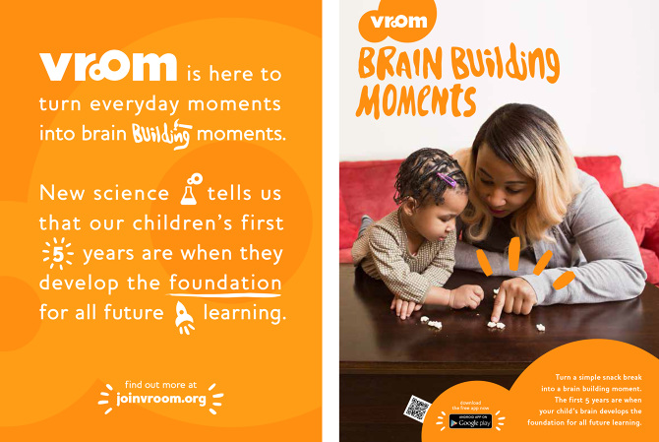
Tip cards for 3-4 and 4-5 year olds
When kids are older, there may be fewer “nutrition concerns”. This gives you a chance to explore meal time as a brain building time.

Slide 21
Case study: Kate’s kids
Kate has been on WIC for a long time with Kiko (3) and Kilea (4). Kiko and Kilea are both normal active kids that keep Kate busy. At today’s certifications, there really are no concerns to speak of.
How might you introduce Vroom concepts to Kate?
What Vroom tips would you offer?
How would you connect meal time and brain development?

Slide 22
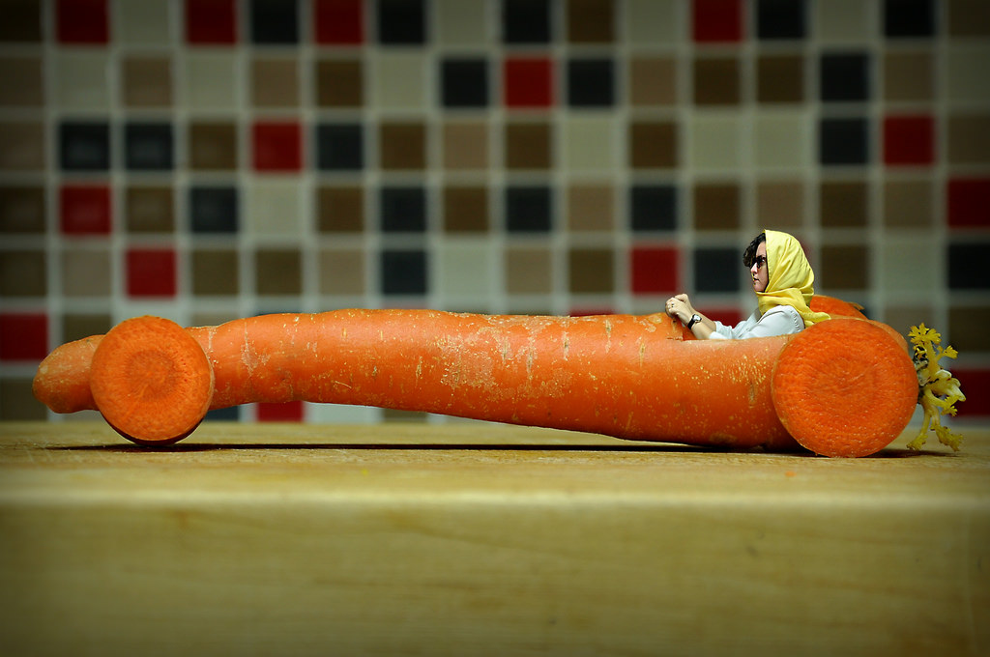
Vroom in NE and groups
Vroom, vroom!

Slide 23
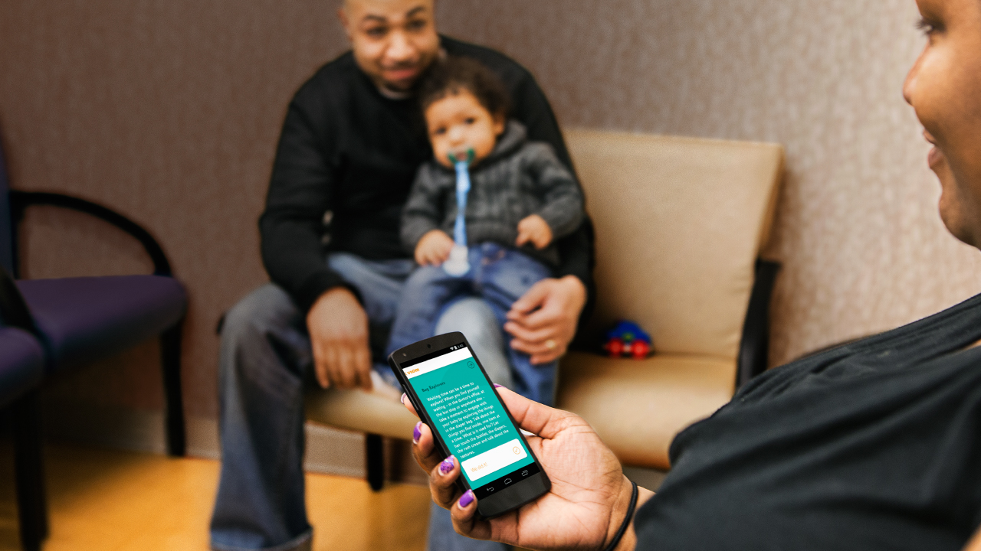
Using the free Daily Vroom App
Watch the video.
https://www.youtube.com/watch?v=trm38G2e5NE

Slide 24
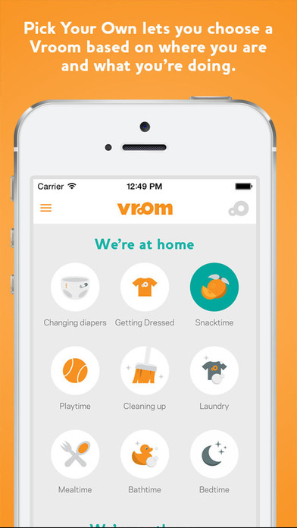
Using the free Daily Vroom App
While the tip cards give examples, the free app gives over 1,000 activity ideas.
A new idea customized for the family is delivered directly to the participant’s phone each day.
Caregivers can look for ideas based on where they are and what they are doing.
Available in English and Spanish

Slide 25
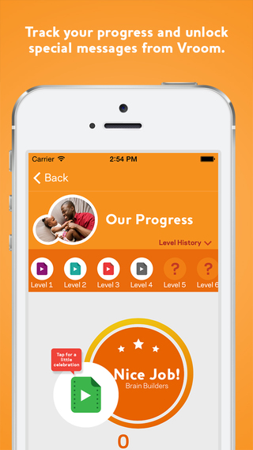
Caregivers get feedback
Everyone likes to be told they are doing a nice job and kids love to earn badges.

Slide 26
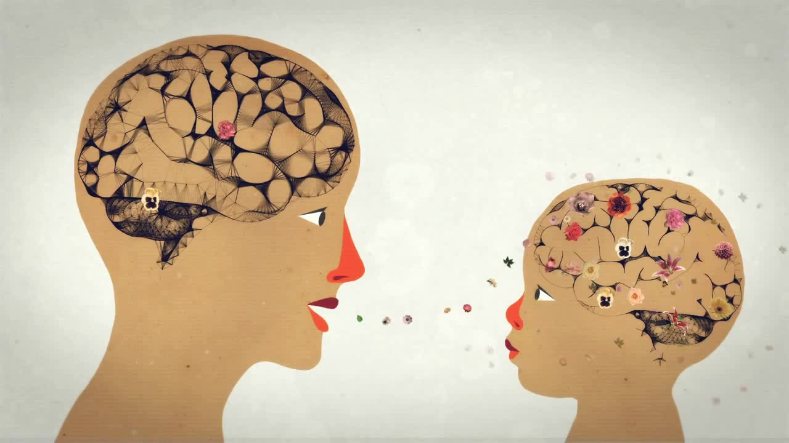
Using Vroom in groups
What groups do you provide that might lend themselves to using Vroom concepts?
How would you include the idea of “serve and return” during a session on family meal times?
How might you use brain building basics in groups?
Look
Chat
Follow
Stretch
Take turns

Slide 27
Ideas
Have caregivers look at WIC tip cards (ages 0-1) in an infant feeding class and ask to find one that works for their family.
Show one of the Vroom videos in a family meal group and ask caregivers to give examples of brain builders that they do with their children at meal time.
Invite folks to download the app and find a movement tip for their child in a physical activity group.

Slide 28
Case study: Gabi’s group
Gabi is leading a NE group on Family Meal Times. She always gets lots of questions about introducing new foods and kids behavior at the table. She usually has 5 or 6 caregivers with their kids in the group.
How could Gabi include Vroom concepts in her group?
What Vroom tools might Gabi use?
How would you connect meal time and brain development in this group?

Slide 29
For more info
For more information or to sign up for the app
http://www.joinvroom.org/parents
Questions? Contact Ari Wubbold at ari.wubbold@state.or.us or 503-378-2572

Slide 30
and
A perfect partnership
A huge thank you to our Vroom partner: Ari Wubbold, Vroom Coordinator/Public Affairs Specialist, Early Learning Division, Oregon Department of Education

