Slide 1

First quarter, 2013

Slide 2

NWI Six Dimensional Model of Wellness
“Wellness is a lifelong journey, an active process of making daily choices and commitments to better health & well-being”.

Slide 3

For some, the wellness journey can feel like a lifelong struggle to balance the six dimensions…

Slide 4

For others, the wellness journey is an exciting opportunity for continuous quality improvement…

Slide 5
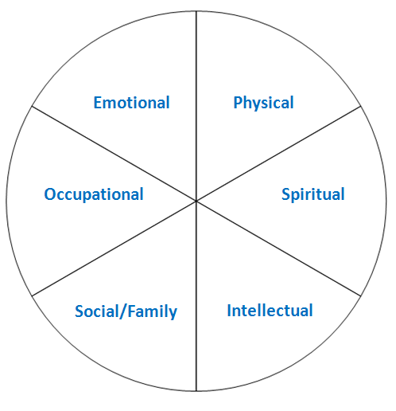
Discovering Your Wellness Wisdom
As we discuss each wellness dimension…...
1. Think about your daily choices and commitments within each dimension
2. Use your crayon and start at the center of the wheel
3. Color in the area to illustrate your satisfaction with each dimension

Slide 6

Emotional
Recognize the need to be aware of and accept your feelings and the feeling of others
Work to be positive and enthusiastic about yourself and life
Maintain satisfying relationships with others as you seek and give assistance
Learn to express feelings freely and manage feelings effectively
Take on risks and challenges recognizing the potential for growth

Slide 7

Physical
30+ minutes of physical activity almost everyday
Eat sensibly –develop an understanding of “your nutrition”
Maintain a healthy body weight
Engage in appropriate use of the medical system and seek age / gender dependent screenings
Understand your body’s warning signs
Take personal responsibility and practice self-care
Get enough sleep and rest

Slide 8

Occupational
Recognize the personal satisfaction and enrichment you gain through work
Find ways to use your unique gifts and talents at work that are meaningful and rewarding
Look for ways to gain job satisfaction and career ambitions
Choose a career that is consistent with your values
Work to develop functional and transferable skills

Slide 9

Spiritual
Believe in something greater than yourself
Recognize your need to search for meaning and purpose
Develop an appreciation for the depth of life and natural forces that exist in the universe
Search for peaceful harmony between internal emotions and rugged stretches of your path
Work at making your actions more consistent with your beliefs

Slide 10

Social / Family
Contribute to your environment to build a better living space and community
Take an active role in improving the world
Encourage and mentor others to live healthier
Initiate better communications with others
Make willful choices to enhance personal relationships and friendships

Slide 11

Intellectual
Recognize your creativity and problem solving abilities
Search to define your gifts and look for ways to share your gifts with others
Develop your intellectual curiosity
Strive to expand and challenge your mind
Grow hobbies that bring joy into your life
Maintain a lifelong learning attitude

Slide 12
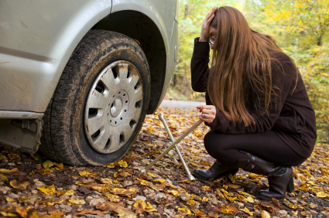
How smoothly does your Wellness Wheel roll?
Some days it may feel like we’re are bumping along on a flat tire.

Slide 13

In joy in the Ride

