Slide 1


28 May 2026
WIC FISCAL OVERVIEW
Part 1: Fiscal 101

Slide 2

Objectives for this training
Be able to utilize the WIC grant award effectively to maximize impact
Understand the fiscal review standards and reporting requirements.
Know where to get technical assistance and answers to questions.
Notes:
2

Slide 3
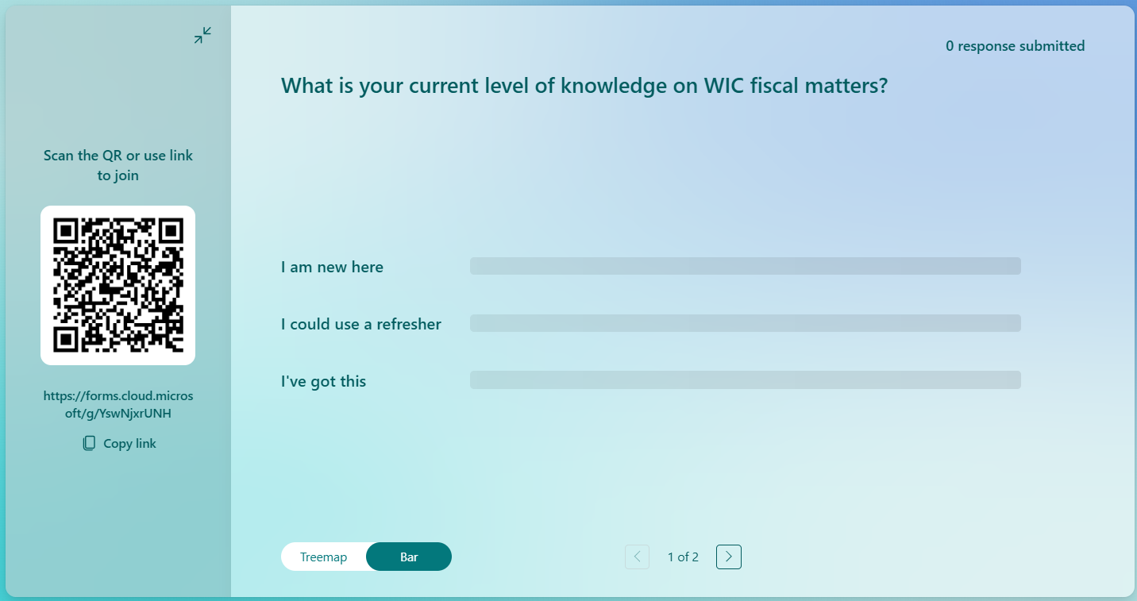
Notes:
2

Slide 4
Where does WIC funding
come from?
    Through FNS regional office
USDA
OHA
    Through PHD
Your agency
Glossary of acronyms
  USDA – United States Department of Agriculture
  FNS – Food and Nutrition Services
  OHA – Oregon Health Authority
  PHD – Public Health Division
Notes:
Funding comes from the USDA United States Department of agriculture, through the FNS or Food and Nutrition services regional office – it comes into the Oregon Health Authority through the Public Health Division then it goes out to your agency.

Slide 5
Where does WIC funding
come from?
USDA
OHA
Your agency
Distributes
    NSA $
    Food $
    BFPC $
    Farm Direct $
Distributes
    NSA $
    Farm Direct $
    BFPC $
Uses
    NSA $
    Farm Direct $
    BFPC $
Notes:
USDA distributes 4 types of funds
NSA (Nutrition Services and Administration) funding is used to pay for things like program administration, staffing, overhead, and paying for WIC services other than food.
Food funding is what the State uses to pay for the WIC food benefits. Food dollars are also used by the State to purchase the breast pumps that the local agencies order.
BFPC dollars don’t apply to most and currently only 4 agencies get these funds in OR.
Farm Direct Dollars.
OHA passes on the NSA, Farm direct and BF Peer Counseling dollars (if applicable) to the Local
agencies for their program operations.
The food dollars don’t pass through to the local agency and do not come out of Local agencies NSA grant. OHA uses food funding to handle all reimbursement of vendors for food benefits.

Slide 6
Other funding – Farm Direct Nutrition Program (FDNP)
USDA
OHA
State GF support for FDNP
Glossary of acronyms
  FDNP – Farm Direct Nutrition Program, also known as WIC Farmers Market
Your
agency
Organization
Funds
Notes:
The NSA and Food dollars are strictly Federal funds
Farm Direct nutrition program is a little different as the State does add some general fund to the USDA award. That means sometimes we have more money and sometimes we have less as the State looks at it every year and decides how much they will add in.
This is the only time we will get State money otherwise all other moneys are federal dollars.
Some agencies, not all, get funds from different organizations to fund their operations.

Slide 7
Other funding
Formula rebates
USDA
OHA
State GF support for FDNP
Notes:
OHA also gets formula rebates.
Oregon is part of a consortium with several other states.
The group goes out for bid with the formula companies, every 5 years unless there is a contract extension, and they will tell the State how much they will provide the formula for and what the formula rebate will be.
The rebate is based on the amount of formula WIC issues and that participants purchase.
The rebate funds are part of the food dollars and not the NSA funds

Slide 8
POLL 2

Slide 9
Assigned caseload
Per participant rate
How is local agency funding determined?
Notes:
How does the State determine how much NSA funds you receive.
One: is Assigned caseload….
Each agency is assigned a caseload number based on how many participants they have been serving and the need in their service area.
It determines your agency funding, and it is set by the state WIC office every year in April for grant funding starting July 1.
Two: is the per participant rate….
- The per participant rate is established by the state WIC office every year in April for grant funding starting July 1.
The per participant rate and your assigned caseload determine the funding for your agency.
Grant funding notification letters are sent from the state WIC office to agencies in May.

Slide 10


Caseload Tiers
Tier 1 – Caseload equal to or greater than 5,000
No additional funding
Tier 2 – Caseload greater than 1,500 and <5,000
No additional funding
Tier 3 – Caseload greater than 1,000 and ≤1,500
$11,000 additional funding per year
Tier 4 – Caseload equal to or less than 1,000
$16,000 additional funding per year
Notes:
In addition to the assigned caseload and per participant rate, smaller agencies receive additional money, and this is based on caseload tiers.
The amount varies each year depending on federal funding. Agencies will be notified of the amount of the tier-based funding in the WIC NSA Funding and Grant letter.
These are the minimum amount agencies will receive.
Tier 1 agencies are the biggest agencies, and they have assigned caseloads of more than 5000 participants. Those agencies don’t receive extra money.
Tier 2 agencies are medium to large and receive no extra funding
Tier 3 agencies are medium to small and get $11,000
Tier4 agencies are the smallest and get an extra $16,000 tier adjustment.
This is based on economy of scale. The smaller agencies find it more difficult to operate and meet all State requirements, so this additional funding is allowed.
These tier adjustment dollars are not permanent, and it is not guaranteed that these dollar amounts will remain, but these are the current tier adjustments we are using. When you get your letter, it would mention this tier funding if you received it.

Slide 11
How do contracts work?
    Covers July 1 through June 30.
    If completed IGAs are not submitted by the deadline, agencies will not receive their WIC funding on time.
Intergovernmental Agreement
Notes:
The contract between the State Public Health OHA office and the local public health or your local agency is sent separately and is known as an Intergovernmental agreement or IGA.
It does not come from the State WIC office but rather the LPHA or Local Public Health Authority office at OHA.
It is sent annually in May or June. The contract is broad and covers July 1 through June 30
Your local agency administrator signs and submits the IGA to the OHA office.
It is important to remember that WIC, FDNP, BFPC are all separate funds and will be listed separately as revenue on the IGA
Warning: If completed IGAs are not submitted by the deadline, agencies will not receive their WIC funding on time.

Slide 12
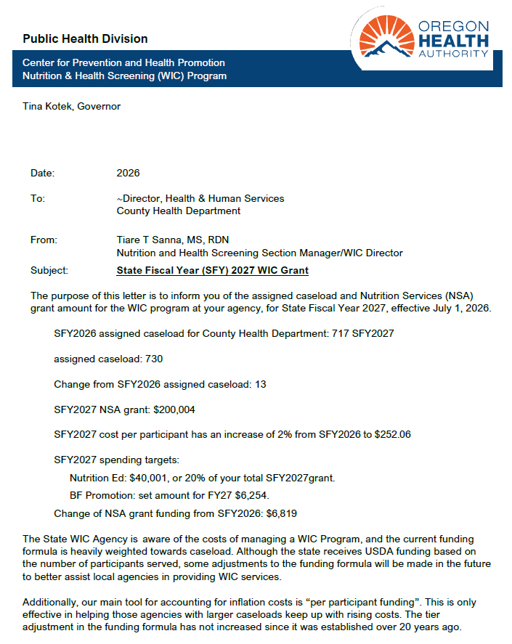
Grant award Letters
Notes:
Grant award letters list the WIC specifics of the IGA contract. This is just a sample
The 1st page will list
The current years caseload
The caseload change for the upcoming fiscal year and the change in caseload
The contract amount for the upcoming fiscal year
This is where you will see the per participant rate we just talked about
In the contract there are specific expenditures for Nutrition Education and Breastfeeding support and promotion, and the contract will specifically say how much your agency needs to spend on Nutrition education and the specific amount required to spend on breastfeeding support and promotion. Now that amount for NE is 20% of total WIC grant and the BF support and promotion is based on a formula that is too complicated, but a specific dollar amount will be listed in your grant award letter.
You will also see those required spending targets for Nutrition Education and Breastfeeding support and promotion divided into the different quarters.
The letter will also let you know if there was an increase or decrease in your funding from the previous year.
12

Slide 13
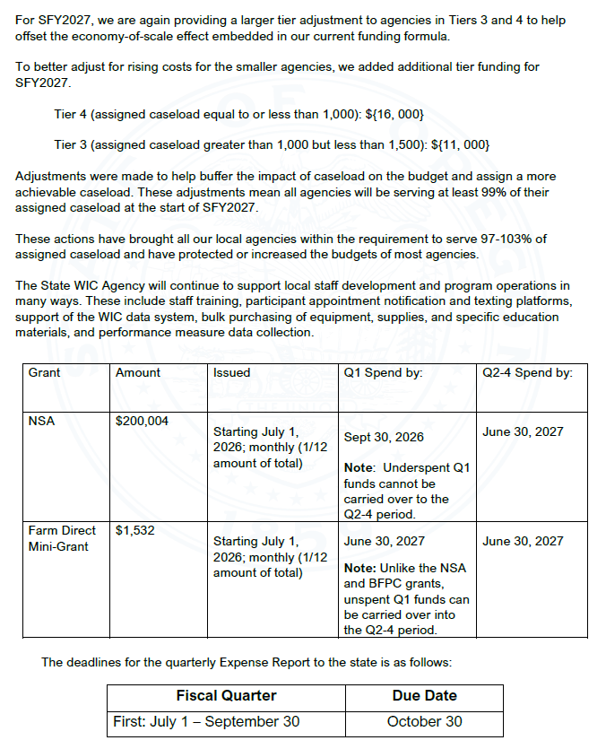
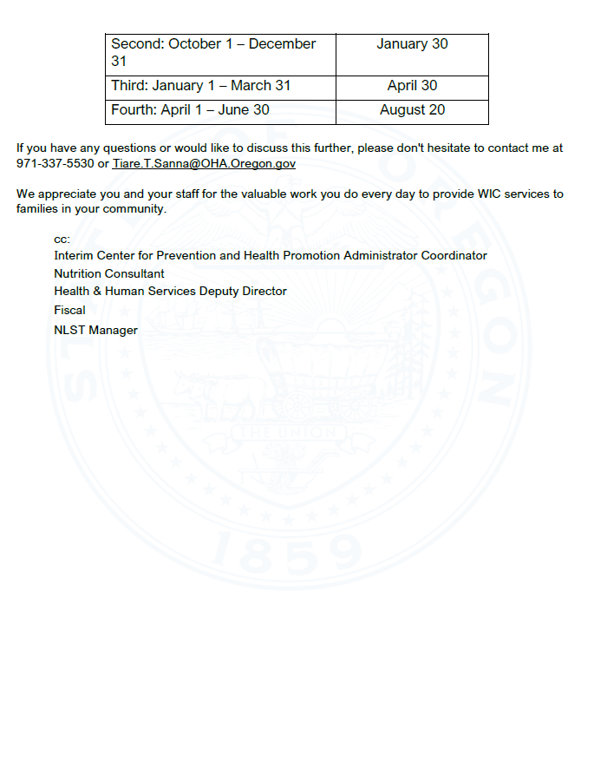
Notes:
The second page will explain Tier adjustments as I previously explained.
The table will list your total grant award as well as your assigned Farm direct mini grant award.
There will always be a table listing when the quarterly expense and revenue reports will be due.
14

Slide 14
How are funds received?
Fiscal Quarter | Report Due Date
First July 1– September 30 | October 30
Second October 1 – December 31 | January 30
Third January 1 – March 31 | April 30
Fourth April 1 – June 30 | August 20
  1/12ᵗʰ of total NSA and BFPC annual funding every month
  1/12th of total Farm Direct funding will be provided on the same schedule as NSA funds starting July 1
  Payments are reconciled quarterly
Notes:
How are funds received by local agencies
Agencies receive 1/12th of their total annual NSA and BFPC (if applicable) funding every month.
- 1/12th of total Farm Direct funding will also be provided on the same schedule as NSA funds starting July 1
These payments are reconciled quarterly when agencies submit Expenditure and Revenue Reports (E&R)
There are certain situations where funds can be carried over to the next month and to understand how this works, you need to understand how WIC fiscal years work.
This is the same table seen on the award letter, and it shows the fiscal quarters and the due date for the expenditure and review reports.

Slide 15
POLL 3
Notes:
16

Slide 16
Understanding the 2 types of WIC fiscal years:
State Fiscal Year
State fiscal year – July 1 to June 30
OHA
The WIC grant and contract (IGA) match the state fiscal year July 1 through June 30.
Through PHD
Notes:
There are 2 types of WIC fiscal year.
The first type is the State Fiscal year that includes all quarters for the dates July 1 – June 30.
Remember WIC is run through a state agency – Oregon Health Authority, Public Health Division – and must follow their fiscal processes and rules.
The WIC grant and contract (IGA) match the state fiscal year July 1 through June 30.

Slide 17
Understanding the 2 types of WIC fiscal years:
Federal Fiscal Year
Federal fiscal year – October 1 to September 30
USDA
Through FNS regional office
State WIC must spend our annual grant within the federal fiscal year October 1 through September 30.
Notes:
The other fiscal year we need to recognize is the Federal fiscal year.
WIC is funded through a federal agency – US Department of Agriculture, Food and Nutrition Services (FNS) and must spend the annual grant at the State within the federal fiscal year October 1 through September 30.
If you are a Tribal agency, please reference your IGA document as you will be using the the calendar year

Slide 18
Understanding the 2 types of WIC fiscal years:
Fiscal Year Overlap
State fiscal year – July 1 to June 30
Federal Overlap
State Overlap
Federal fiscal year – October 1 to September 30
Notes:
There are two 3-month (quarter) overlaps
The 1st quarter for the State July – Sept 30th and 4th Quarter for the Federal year July through September
Funds from one federal fiscal year cannot be used in the next federal fiscal year.
In order to close out the books for the federal fiscal year, funds from July 1 through September 30 (1st quarter) of the state fiscal year must be spent in that quarter and cannot roll-over to the next federal fiscal year.
To summarize: spend the dollars you receive in that 1st quarter of the State fiscal year in that 1st quarter. They cannot roll over into quarter’s 2-4. If you don’t spend them, you lose them
Objective 1 of this training: Local agencies would be able to utilize all the funds that you are entitled to. It can be a little confusing but after you get past that 1st quarter you can spend funds in a way that works best for your agency across the remaining quarters. That 1st quarter is special because of that overlap problem with the State and Federal fiscal years.

Slide 19
POLL 4
Notes:
20

Slide 20
Quarterly Expenditure and Revenue (E&R) Reports
1st Quarter
2nd Quarter
3rd Quarter
4th Quarter
Jul
Aug
Sept
Oct
Nov
Dec
Jan
Feb
Mar
Apr
May
Jun
4th Quarter report due
Aug 20
1st Quarter report due
Oct 30
2nd Quarter report due
Jan 30
3rd Quarter report due
Apr 30
Notes:
The second objective of this training is to talk about the fiscal review standards and reporting requirements.
In other words: Quarterly E&R reports. I’ll give you the high-level basics of these and part 2 will cover this more in detail.
These reports are due 30 days following the end of the first three quarters and 51 days after the end of the fourth quarter.
If any E&R report has not been received by its deadline, the WIC State payment to the local agency could be delayed
21

Slide 21
Public Health
PE 40
Private
PE 140
Tribal Agencies
PE 240
PE40-01
WIC NSA:
July – September
PE140-01
Private WIC NSA: July – September
PE240-01
Tribal WIC NSA: January 1 - September 30th
PE40-02
WIC NSA:
October - June
PE140-02
Private WIC NSA: October - June
PE240-02
Tribal WIC NSA: October 1 - December 30th
Program Element (PE) Numbers in WIC
PE40-03
BFPC:
July - September
PE140-03
Private BFPC:
July - September
PE240-05
Tribal WIC
Farmers Market
PE40-04
BFPC:
October - June
PE140-04
Private BFPC: October - June
PE40-05
WIC Farmers Market
PE140-05
Private Farmers Market
Notes:
There are separate quarterly reports that relate to the different programs and quarters.
PE’s or program element numbers can help you determine which forms apply to you and which ones to use.
It is a Federal requirement to track funds including supplies and personnel costs separately by each grant
WIC, BFPC and Farm Direct.
Blue – PE 40 or local Public Health agencies. (LPHA’s)
PE 40-01 is for that important 1st quarter of WIC funding.
PE 40-02 is for WIC quarters 2-4.
PE 40-03 is for 1st quarter report for the BFPC program and
PE 40-04 for BFPC quarters 2-4
And PE 40-05 is for all Farm direct expenditures. We use the same report for the entire year for Farm
Direct.
Orange –PE 140, These are private organizations/Non-profits
They follow a similar pattern as the LPHA’s reporting
Purple – PE240 are Tribal agencies
- We currently don’t have any tribal agencies offering the BFPC program, so those PEs are not included.

Slide 22
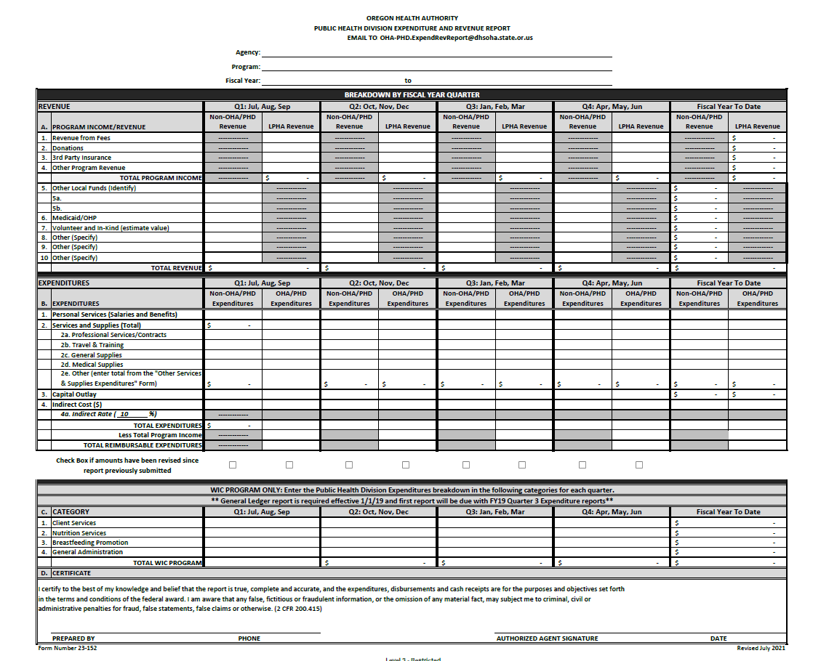
Example of a Revenue & Expenditure report
Notes:
This is an example of a revenue and expenditure report we have been talking about.
WIC Coordinators, this is the report that your fiscal team will complete and submit quarterly. You will likely not see or sign these but if your fiscal team has questions then you won’t be completely confused.

Slide 23
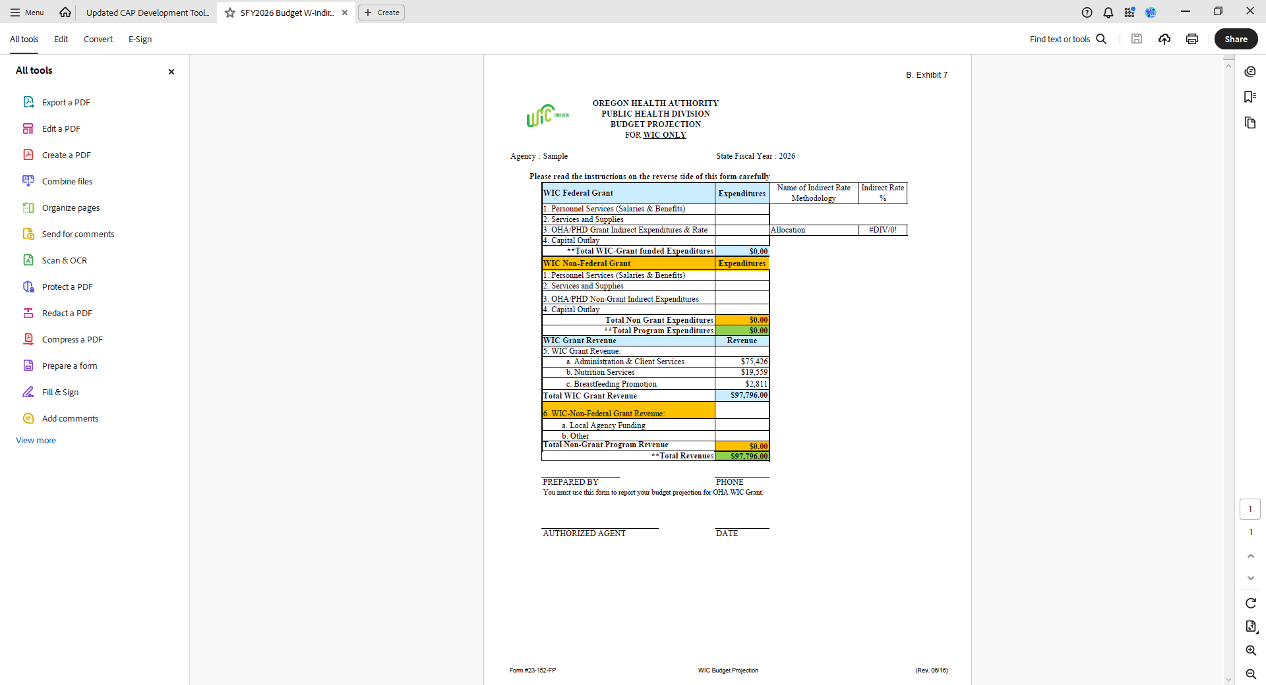
Annual Budget forms
Notes:
Every year in late May after receiving the grant award letter, local agencies get a WIC budget projection form in excel format.
WIC Coordinators, work with your fiscal department to complete these. More information about the specifics will be covered in part 2 today.
We encourage saving a copy of the completed form to help you manage your budget through out the year.

Slide 24
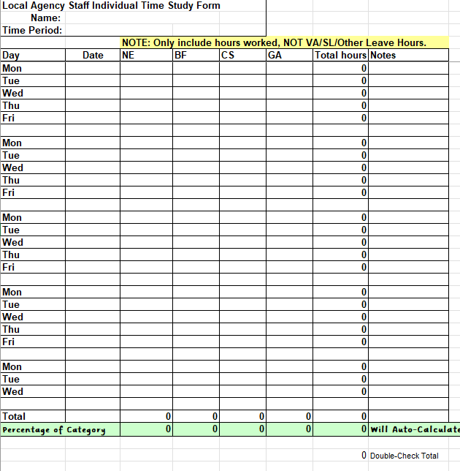
Time Studies
WIC staff work in four categories
Individual time study
Time study summaries
Notes:
Time studies classify WIC work in four categories. The majority of WIC staff time is usually spent in nutrition education and client services. Nutrition
education (NE) Breastfeeding support and promotion (BF) Client services (CS) General administration and payroll (GA)
All staff who are paid indirectly are not required to complete a time study
Staff paid by direct cost allocation are required to complete a time study
Time study summaries must be submitted quarterly for the months of October, January, April and July.
If the agency captures staff payroll by WIC categories NE, BF, CS, GA then individual time studies are not required, only the time study summary
would be required.
Time studies may be used to support local agency expenses related to those 4 areas of WIC services.
Time should be rounded to 15-minute increments, for example If it’s 7 minutes, round down to 0 minutes; if it’s 8 minutes, round up to 15
minutes. If you track total minutes for the day like 6 min for each appointment, then tally those up and put that time in rather than having to round
down to zero and have nothing.
Important to note only NSA allowable WIC time should be reported on the time study. E.g. reporting car seat training time is not an allowable cost
and should not be reflected on the time study. If time is paid by Farm direct funds it should not be included in the NSA time study.
For example:
A full-time CPA attends a Farm Direct issuance event for an 8-hour day in July
The staff person would not include that day’s time on their WIC time study
The staff person’s time sheet for the local agency should reflect the 8 hours as being charged to Farm Direct funds
You will want to work with your agency’s fiscal contact to know when your Farm Direct grant has been exhausted.
Farm Direct activities not paid for by Farm Direct funds are captured on the time study in appropriate categories for each activity (NE, CS, GA)

Slide 25
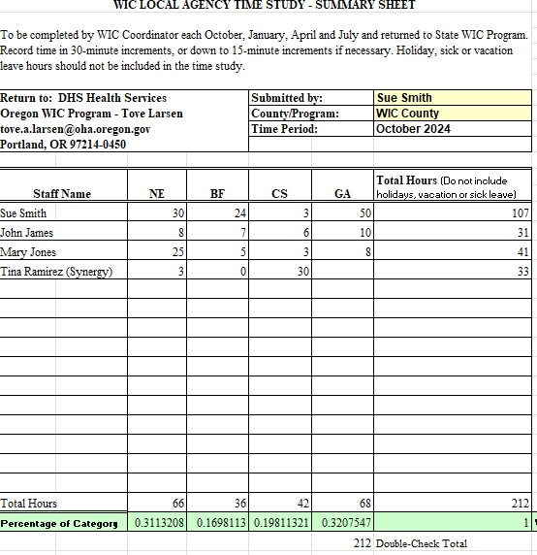
Time Study Summary Reporting
  Report only WIC time
  All staff that are paid for with WIC NSA funds should be listed
  Even if staff worked zero hours during the time study month, they need to be reflected on the summary form
  Please see the FAQ document for more information
Notes:
WIC coordinators
Report only WIC time
All staff that are paid for with WIC NSA funds should be listed
Even if staff worked zero hours during the time study month, they need to be reflected on the summary form
Ensure you haven’t broken any formulas that calculate the percentages when you enter the data into the form for accuracy.
Some agencies fiscal departments use their quarterly time study summary to develop and/or support their Quarterly Expenditure and Revenue Report. These percentages have been added to the bottom of the time study summary form based on the 4 categories. Those percentages are then applied to the total grant amount you are reporting on the Expenditure and revenue report and broken out by the percentage. This is one method that is encouraged as it is most accurate

Slide 26
POLL 5
Notes:
28

Slide 27

Avoid underspending your WIC grant
Things to consider
How many awards do you have from State WIC?
Save your WIC grant award letters for documentation of the exact award amounts.
Do you work closely with fiscal staff?
Notes:
Avoid underspending your WIC grant. Coordinators work closely with your fiscal staff to ensure all WIC funds are properly spent and tracked.
Some Things to consider:
Understand different funding streams: for the WIC programs they are NSA-WIC, FDNP-Farm Direct, and BFPC- Breastfeeding/ Peer Counseling. See slide 21
Save your WIC grant award letters for accurate documentation.
Meet with fiscal staff regularly—quarterly at minimum, monthly if possible.
The State WIC office sends out underspent notices to agencies in early February and May in hopes you can correct it at the end of the 2nd and 3rd quarters. More info in part 2

Slide 28
Avoid underspending your WIC grant
Things to consider
Quarter 1
July - Sept
Quarter 4
Apr - Jun
Quarter 2
Oct - Dec
Quarter 3
Jan – Mar
Notes:
Do you and your fiscal staff know underspent Quarter 1 (Jul - Sept) awards cannot be carried over to Quarters 2-4 (Oct – Jun)?
You must spend the 1st quarter funds in the 1st quarter. Quarters 2 through 4 WIC funds must be spent between Oct 1st and June 30th and cannot be carried over into the following fiscal year which begins July 1st

Slide 29
POLL 6
Notes:
33

Slide 30
Farm Direct requirements
Separate Farm Direct Quarterly Expenditure and Revenue Report
You can use these funds through out the State fiscal year
4ᵗʰ Quarter report
1ˢᵗ Quarter report
2ⁿᵈ Quarter report
3ʳᵈ Quarter report
Notes:
Farm Direct is not 100% federally funded. The amount available to spend on Farm Direct vouchers varies year to year depending on how much USDA and the state legislature allocates, and how many Farm Direct voucher booklets are assigned to your agency.
Local agencies will be notified via email from Maria Menor in April/May for the upcoming fiscal year for:
Voucher booklet allocation
The mini grant administrative funding to support the distribution and other farm direct expenses.
A separate Farm Direct Quarterly E&R report must be submitted each quarter. More about that in Part 2.
Remember from earlier all the funding sources had different PE numbers. The Farm Direct reports will be dash 05 for reference regardless of whether it is PE 40, 140 or 240.
Farm Direct may also be called the WIC Farmers Market mini grant/fresh veggie funding and WIC Farmers Market administrative funds. If it has farm in the name, it is likely all farm direct.
Starting July 1, 2026, farm direct mini grants are authorized for the period of July 1st through June 30th (state fiscal year) and are paid to local agencies in 12 equal payments. This process has already begun January 1, 2026, for tribal agencies.
These funds can be used throughout the fiscal year, do what is easiest for you administratively to support spending the entire mini grant.
Farm direct funds need to be tracked separately by actual costs identified in the agency detailed Ledger.
Farm direct funds cannot be used to subsidize WIC funds.

Slide 31
Allowable WIC Expenses
Intended purchases
    Please check with your finance dept and your assigned NC BEFORE purchasing
Incentive purchases
    Allowed under certain parameters
    Contact your assigned NC
Capital purchases
    Capital Expense Approval Process
    Capital Expenditure Approval Request Form
    Send to your Assigned NC
Notes:
If there is a question about an intended purchases, then please check with your finance and your NC
There are a lot of rules around this
Incentive/promotional items for participant nutrition education are allowed under certain parameters.
See Policy 460 Program Incentive Items.
Contact your assigned NC with any questions
E.g something that comes up a lot on fiscal reviews is say for instance a staff retires after working there for 25 years. They want
to purchase a $600 nice gift because they’ve done a fabulous job, and they want to say thank you for all the years of service.
This could be something that they could buy out of county funds or different agency funds and they would report that under the
non-OHA/PHD revenue to support it and the expense so that it’s not included as a WIC expense because that would be an
unallowable cost.
What is a capital expenditure?
WIC program use of NSA funds to acquire, increase, or extend the life of agency assets. The purchased item must provide a
benefit for a minimum of two years and be exclusively utilized for providing WIC services, unless costs are shared with other
programs.
• Examples:
o All non-computer equipment: e.g.: purchasing a WIC van
o Real estate: e.g.: remodeling a clinic
o Computer equipment
The purchased item must yield a benefit of two or more years.
There are a couple of documents, on the WIC coordinators page under fiscal resources. There is a document that explains what
a capital expense is and then how to request approval for using your NSA funds to make a capital expenditure. Contact your
assigned NC for pre-approval.

Slide 32
Local agency fiscal monitoring and compliance review
Proper internal Controls
Identify & Report
Accuracy and Compliance
Notes:
A fiscal compliance review is conducted at the same time as your local agency review and is to provide assurance that the local WIC agency has an accounting system with proper internal controls
identify and report revenues, expenditures and equipment provided by federal and state funds through OHA.
A period is selected for conducting the review and the accounting transactions for that period will be
evaluated for accuracy and compliance with applicable federal and state regulations, state WIC policies and
local policies and procedures.
Instances of noncompliance, material discrepancies and other irregularities are considered findings of the
review for which management response and corrective action is required.
And these are the 3 different programs that will be reviewed
• WIC
• Farm Direct
• and Breastfeeding Peer Counseling if applicable

Slide 33


Required training and certain meetings (e.g. OWCA).
State WIC uses the state guidelines based on federal GSA rates.
Travel and Training
Pre-approval from the State WIC office may be needed prior to travel.
Must submit reimbursement requests within 4 weeks of the last travel date.
Reimbursed travel expenses should not be included in the local agency Quarterly Expenditure and Revenue Report.
Travel matrix and information (e.g. per diems, mileage rate, 70mile rule)
In-state reimbursement form
Exemption request for travel expenses
Use the following forms and resources:
Notes:
State WIC will reimburse local agencies for expenses incurred for attending required/mandated training and certain meetings (e.g. OWCA).
State WIC uses the state guidelines regarding meal, lodging and mileage reimbursements based on federal GSA rates. Regardless of what staff are being reimbursed at the local level, when you submit for reimbursement to the State we are going to reimburse you at the State meal rate.
If lodging prices in the area of travel are not within the GSA rates, pre-approval from the State WIC office is needed prior to travel. Please contact your NC.
Reimbursement requests must be submitted to the state by the agency within 4 weeks of the last travel date. The state reimburses the agency, not individual travelers. The individual may get their reimbursement before the agency gets their reimbursement from the State. The 4-week timeframe is important to not run into issues with the fiscal year ends (June 30th for state and September 30th for federal).
- Reimbursed travel expenses should not be included in the local agency Quarterly Expenditure and Revenue Report.
- Use the following forms and resources:
Policy 340 – Reimbursement for Travel
Travel matrix and information (e.g. per diems, mileage rate, 70mile rule)
In-state reimbursement form – update this link
Exemption request for travel expenses

Slide 34
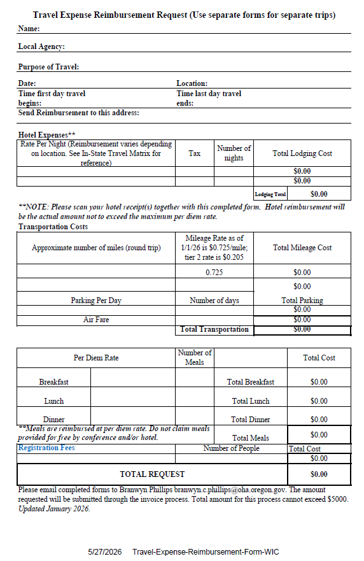
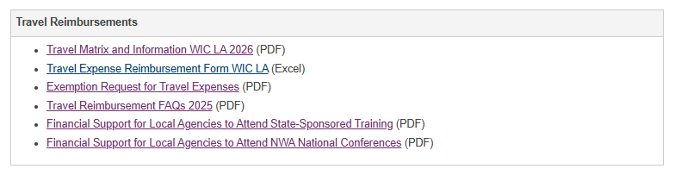
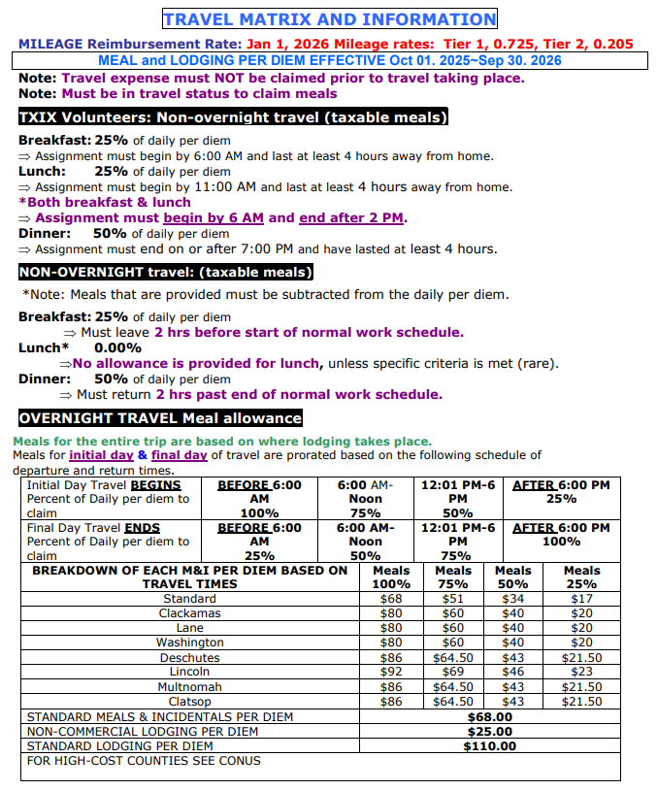
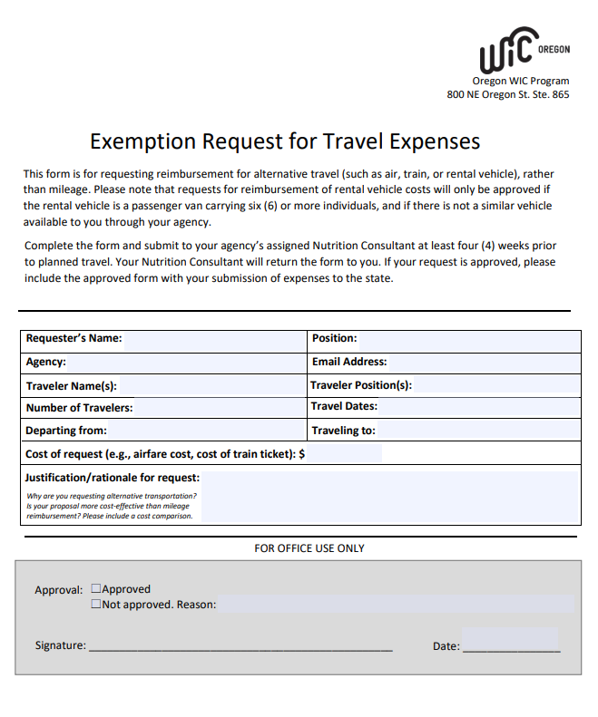
Notes:
This is the format. Coordinators please be sure your fiscal staff receive a copy of this to avoid reporting on the E&R. This is unallowable NSA cost as it is paid by another funding source.

Slide 35


National WIC Association Conferences
Availability based on funding which is evaluated each biennium
What conferences does the state support?
How many are eligible from each agency each biennium?
How often does the state support attendance?
How can Local Agencies verify pre-approval of travel?
Notes:
What conferences does the state support?
NWA conferences
How many are eligible from each agency each biennium?
1 in person or up to 4 for virtual attendance
How often does the state support attendance?
One conference attendance per biennium (every 2 years) per agency. The Current biennium started July1, 2025 and will end June 30th, 2027.
How can Local Agencies verify pre-approval of travel?
Email your assigned Nutrition Consultant to notify the State WIC office. This is to ensure this is only used once per biennium and to receive confirmation that the selected conference travel will be reimbursed.

Slide 36

National WIC Association Conferences
Availability based on funding which is evaluated each biennium
What needs to be paid
out of pocket by the person/agency?
What are allowable expenses?
Who does the form get submitted to?
What is the
reimbursement process?
Notes:
What needs to be paid out of pocket by the person/agency?
The local agency must pay first and then will be reimbursed. State WIC CANNOT reimburse individuals.
What are allowable expenses?
Registration, travel costs (air, baggage, and shuttle/taxi), hotel, and per diem meals. Hotel, mileage and per diem are reimbursed at GSA rates.
Who does the form get submitted to?
Branwyn Phillips
What is the reimbursement process?
Complete the reimbursement form and submit it to Tove Larsen as soon as possible after the conference – and within 4 weeks of attendance. Significantly delayed submission may not be paid.

Slide 37


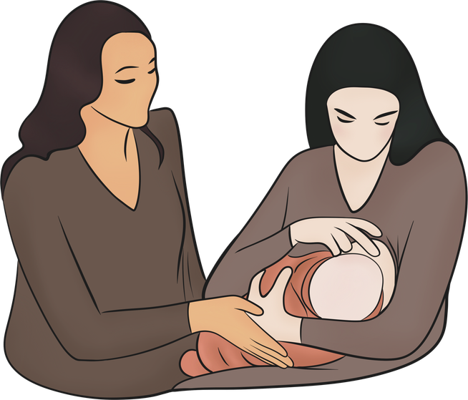
Application for Reimbursement for WIC Nutritionist Training Time
Additional funding in certain circumstances
Clinic Moving and Expansion Grant
International Board-certified Lactation Consultant certification or recertification
One-time funding or mini-grants for specific projects
Notes:
Additional funding in certain circumstances is available (info can be found on the WIC coordinator resource page under fiscal resources)
If your agency is moving or expanding, you can apply for financial support up to $5,000 to make your space more Trauma informed. If an agency isn’t moving or expanding, but a trauma-informed grant is needed, please speak to your NC to learn more about the requirements and application process and see if an exception can be given.
The current grant process is complicated as all purchases must be made by the State office and are restricted by existing purchase agreements. To streamline this, new language has been added to the Local Agency Program Elements (PE) allowing payments to local agencies through grant adjustments twice a year. The expansion grant must remain focused on creating trauma‑informed spaces and can be used to support costs that agencies typically cannot cover. The new application will include examples of trauma‑informed care practices, along with a link to a trauma‑informed checklist to guide agencies. Applications may be submitted at any time throughout the year, but reimbursements will only occur in July and March when contract amendments are processed due to the extensive workload involved. To be included in the appropriate amendment cycle, applications are due by March 15 for a July amendment and December 15 for a March amendment.
Updated applications will be available on the WIC Coordinators page beginning July 1, 2026. Please reach out to your assigned Nutrition Consultants if you have any questions.
Small agencies can apply to receive financial support for training time for a new WIC nutritionist. If you work in a small agency and you need to hire a new nutritionist that is a resource available to you.
Reimbursement for IBCLC (International Board-Certified Lactation Consultant) certification or recertification for qualified WIC staff is also covered. Approval for reimbursement must be obtained by the State WIC office and your assigned NC or Korina Skaff, can facilitate this.
The State WIC office will sometimes offer one-time funding or mini-grants for specific projects. Reimbursement requirements will be provided when the funds are offered.

Slide 38

Policy 300 Fiscal Overview
Policy 305 Funding Formula
Policy 310 Annual Plan/Contract Payment Process for Local Programs
Policy 315 Fiscal Reporting Requirements
Policy 316 Quarterly Breakout of Staff Time
State Fiscal policy links
Policy 320 Fiscal Review of Local Programs
Policy 325 Caseload Management
Policy 330 Penalty for Underspending Food Budget
Policy 340 Reimbursement for Travel
Policy 460 Program Incentive Items
Notes:
These are the state fiscal policies referenced in this presentation.

Slide 39
Title 7 § 246.3 Administration.(B) Delegation to the State agency.
Federal Fiscal policy links
Part 200—Uniform administrative requirements, cost principles, and audit requirements for federal awards
Notes:
All the fiscal policies referenced in this presentation
all the links are active

Slide 40
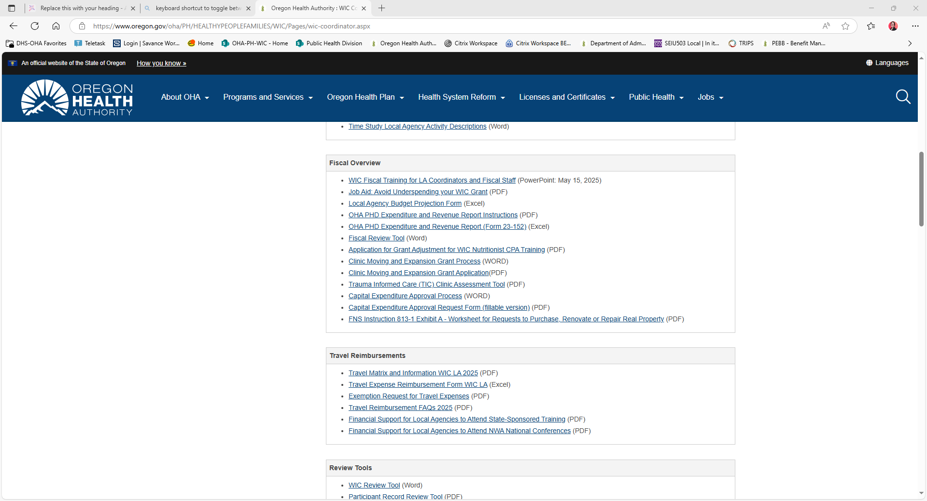
WIC Coordinator Resources
WIC – Coordinator page
Notes:
Link to the coordinator page that is active.
This is what the WIC coordinator page looks like under the fiscal overview section.
All the forms and applications referenced in this training are listed in this section.
45

Slide 41
Who to Contact For more information:
For help with: | State contact
Budget questions | Fiscal Coordinator – Karen Shi
Time studies | Fiscal Analyst – Branwyn Phillips
Travel reimbursements | Fiscal Analyst – Branwyn Phillips
Quarterly expenditure reports | Fiscal analyst at the LPHA team of the Public Health Director’s Office OHA-PHD.ExpendRevReport@odhsoha.oregon.gov
Fiscal monitoring | State Fiscal Compliance Specialist - Toni Silbernagel
Breastfeeding peer counseling | Breastfeeding Peer Counseling Coordinator - Korina Skaff
Farm Direct Grant | Farm Direct lead - Maria Menor
Notes:
Your assigned state nutrition consultant can answer many questions.
For more specific questions, contact the state office to reach the following:
Budget questions - Fiscal Coordinator – Karen Shi
Time studies - Fiscal Analyst – Tove Larsen
Travel reimbursements - Fiscal Analyst – Tove Larsen and Branwyn Phillips
Quarterly expenditure reports - Fiscal analyst at the LPHA team of the Public Health Director’s Office
Fiscal monitoring - State Fiscal Compliance Specialist - Toni Silbernagel
46

Slide 42

Grant overview
Fiscal Standards and reporting requirements
Summary
Resource network

Slide 45
We value your feedback
https://forms.cloud.microsoft/g/sQRd4SgFb5
Notes:
Please let us know what you thought of this training. The link still works even if you are just reviewing the slides. All your input is valued and appreciated.

Slide 46

Notes:
Please let us know what you thought of this training. The link still works even if you are just reviewing the slides. All your input is valued and appreciated.
48

