Slide 1


Part 2:
Deep Dive into Reporting Requirements
Notes:
Welcome back, members of our fiscal team are going to go into a bit more detail about the completion of required forms and reports.
Let’s do some introductions again for those of you just joining us
Christine-
Toni-
Branwyn -
Erica-
Karen- is out today

Slide 2

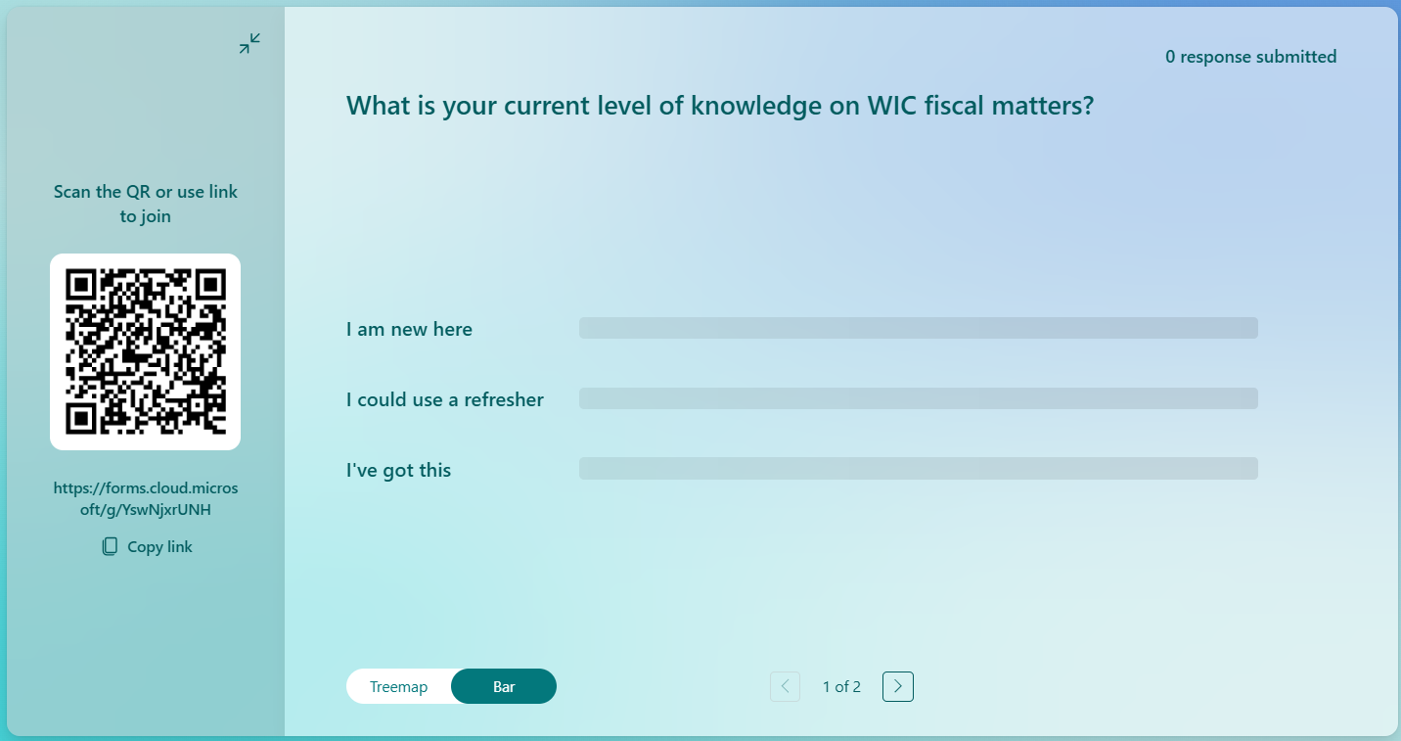

Slide 3

Allocated WIC Expenses
Direct Allocated
Indirect Allocated
For other expenses such as admin and facilities.
Agencies may choose to use the De Minimis rate or retain indirect rate methodology supporting documentation.
Requires a cost allocation plan
Must be able to justify as a direct WIC cost
Necessary and reasonable
When in doubt reach out
For any questions, please reach out to the appropriate OHA staff member
OHA-PHD.ExpendRevReport@odhsoha.oregon.gov
Notes:
Please note that any admin and support staff paid by a direct allocation by WIC funds are required to complete a time study each quarter.

Slide 4
NEW EXPENDITURE AND REVENUE REPORT
COMING FY27: A new Expenditure and Revenue Report will be used.
GUIDANCE WILL BE PROVIDED FROM OHA
FORMAT AND REPORTING REQUIREMENTS WILL BE UPDATED
INSTRUCTIONS WILL BE INCLUDED
AUGUST WIC TRAINING WILL INCORPORATE THE UPDATED FORM
Notes:
Before we move on to the Expenditure and Revenue Reporting please note the Expenditure and Revenue Report is being updated. Instructions will also be included.
The links to the new form and instructions will be included in the FY27 Intergovernmental Agreement.

Slide 5


OREGON HEALTH AUTHORITY
PUBLIC HEALTH DIVISION EXPENDITURE AND REVENUE REPORT
EMAIL TO OHA-PHD.ExpendRevReport@odhsoha.oregon.gov
Agency: WIC County
Program: PE 140-02 WIC
Fiscal Year: July 1, 2025
to June 30, 2026
BREAKDOWN BY FISCAL YEAR QUARTER
Based on award amount of
$225,00.00
REVENUE
Q1: Jul, Aug, Sep
Non-OHA/PHD
Revenue LPHA Revenue
Q2: Oct, Nov, Dec Q3: Jan, Feb, Mar
Q4: Apr, May, Jun
Non-OHA/PHD
Revenue LPHA Revenue
Fiscal Year To Date
Non-OHA/PHD
Revenue LPHA Revenue
A. PROGRAM INCOME/REVENUE
Non-OHA/PHD
Revenue LPHA Revenue
Non-OHA/PHD
Revenue LPHA Revenue
1. Revenue from Fees
-------------
-------------
-------------
-------------
-------------
2. Donations
-------------
No LPHA Revenue should be reported
-------------
No LPHA Revenue should be reported
-------------
No LPHA Revenue should be reported
-------------
No LPHA Revenue should be reported
-------------
No LPHA Revenue should be reported
3. 3rd Party Insurance
-------------
-------------
-------------
-------------
-------------
4. Other Program Revenue
TOTAL PROGRAM INCOME
-------------
-------------
-------------
-------------
-------------
5. Other Local Funds (Identify)
-------------
-------------
-------------
-------------
-------------
-------------
-------------
-------------
$
-------------
-
-------------
5a.
No Revenue should
-------------
-------------
-------------
$
-
-------------
-------------
-------------
-------------
-------------
-------------
-------------
-------------
5b.
be reported to offset
-------------
-------------
-------------
$
-
-------------
6. Medicaid/OHP
allowable WIC
-------------
-------------
-------------
$
-
-------------
7. Volunteer and In-Kind (estimate value)
Award expenditures
-------------
-------------
-------------
$
-
-------------
8. Other (Specify)
-------------
-------------
-------------
$
-
-------------
9. Other (Specify)
-------------
-------------
-------------
$
-
-------------
10 Other (Specify)
TOTAL REVENUE $
- $
-------------
- $
-------------
- $
-------------
$
-
-------------
- $
-
EXPENDITURES
Non-OHA/PHD
Expenditures
Q1: Jul, Aug, Sep
Q2: Oct, Nov, Dec
Q3: Jan, Feb, Mar
Q4: Apr, May, Jun
Fiscal Year To Date
B. EXPENDITURES
OHA/PHD
Expenditures
Non-OHA/PHD
Expenditures
OHA/PHD
Expenditures
Non-OHA/PHD
Expenditures
OHA/PHD
Expenditures
Non-OHA/PHD
Expenditures
OHA/PHD
Expenditures
Non-OHA/PHD
Expenditures
OHA/PHD
Expenditures
1. Personal Services (Salaries and Benefits)
$
52,827.17
$
60,150.00
$
63,250.00 $
- $ 176,227.17
2. Services and Supplies (Total)
$
-
$
- $
7,525.00 $
- $
4,550.00 $
- $
7,350.00 $
- $
19,425.00
2a. Professional Services/Contracts
$
- $
-
2b. Travel & Training
$
25.00
$
50.00
$
2,150.00 $
- $
2,225.00
2c. General Supplies
$
5,000.00
$
1,500.00
$
1,000.00 $
- $
7,500.00
2d. Medical Supplies
2.e Other: Total from tab 2.
$
1,000.00
$
2,000.00
$
3,000.00 $
- $
6,000.00
2e. Other (enter total from the "Other Services & Supplies Expenditures" Form)
$
- $
1,500.00 $
- $
1,000.00 $
- $
1,200.00 $
- $
3,700.00
3. Capital Outlay
- $ - $
$
- $
-
4. Indirect Cost ($)
Line 4.a: Indirect rate
$
9,052.83
$
9,705.00
$
10,590.00 $
- $
29,347.83
4a. Indirect Rate ( 15 %)
percentage or
------------- _{method.}
------------
-------------
-------------
-------------
-------------
-------------
-------------
-------------
TOTAL EXPENDITURES $
------------- -
- $ - $
-
$ - -
- $
69,405.00 $
- $
74,405.00 $
- $
81,190.00 $
- $ 225,000.00
Less Total Program Income
------------- Line 4. Total indirect
------------- dollar amount
------------
-------------
-------------
-------------
$
-
TOTAL REIMBURSABLE EXPENDITURES
reported each quarter
------------
$
69,405.00
-------------
$
74,405.00
-------------
$
81,190.00
-------------
$ 225,000.00
Check Box if amounts have been revised since report previously submitted
WIC PROGRAM ONLY: Enter the Public Health Division Expenditures breakdown in the following categories for each quarter.
** General Ledger report is required effective 1/1/19 and first report will be due with FY19 Quarter 3 Expenditure reports**
C. | CATEGORY | Q1: Jul, Aug, Sep |  | Q2: Oct, Nov, Dec | Q3: Jan, Feb, Mar | Q4: Apr, May, Jun | Fiscal Year To Date
1. | Client Services | Break out by activity utilizing the Time Study Summary. Total matches the Reimbursable amount reported each quarter. |  | $ 13,750.05 | $ 14,740.61 | $ 16,084.81 | $ 44,575.47
2. | Nutrition Services |  |  | $ 21,607.22 | $ 23,163.82 | $ 25,276.13 | $ 70,047.17
3. | Breastfeeding Promotion |  |  | $ 11,785.75 | $ 12,634.82 | $ 13,786.98 | $ 38,207.55
4. | General Administration |  |  | $ 22,261.98 | $ 23,865.75 | $ 26,042.08 | $ 72,169.81
 | TOTAL WIC PROGRAM |  |  | $ 69,405.00 | $ 74,405.00 | $ 81,190.00 | $ 225,000.00
D. | CERTIFICATE
I certify to the best of my knowledge and belief that the report is true, complete and accurate, and the expenditures, disbursements and cash receipts are for the purposes and objectives set forth in the terms and conditions of the federal award. I am aware that any false, fictitious or fraudulent information, or the omission of any material fact, may subject me to criminal, civil or administrative penalties for fraud, false statements, false claims or otherwise. (2 CFR 200.415) Mary Smith 503-111-1111 Jo Jones 8/20/2026 PREPARED BY PHONE AUTHORIZED AGENT SIGNATURE DATE
Form Number 23-152
Revised Oct 2024
Notes:
There is no requirement to report non-grant expenses or revenues. Agencies should focus on reporting allowable WIC expenditures based on the award.
This report example is based on a total award of $225,000 and the agency is using the De Minimis rate for their indirect costs.
Pink highlighted area:
No WIC LPHA Revenues that should be reported.
Line 1: Personal services: Based on expenses developed from the time documented to WIC in the agency time keeping system.
Line 2.Services and Supplies: Total amount for lines 2a-2e.
Orange highlighted area:
Line 2e: Total of other from Tab 2.
3. Capital Assets: Purchases for items over $10,000.00. Indirect costs cannot be applied to capital expenses.
Blue highlighted area:
4. a: List methodology or percent reported for indirect expenditures. If using De Minimis this would be 15%. Please note indirect costs can be up to 15% and are not required to be reported exactly at 15% to utilize the De Minimis rate.
4. Total Indirect amount reported to the program element. 15% applied to the total of lines 1 and 2 (Modified Total Direct Cost)
The green highlighted area notes the totals reported each quarter.
The WIC activities total matches the amounts reported each quarter.
Yellow highlighted area notes the amount reported was within the total grant award amount of $225,000.00

Slide 6
OREGON HEALTH AUTHORITY
PUBLIC HEALTH DIVISION EXPENDITURE AND REVENUE REPORT
 | EMAIL TO: | OHA-PHD.ExpendRevReport@odhsoha.oregon.gov
Agency: | WIC County
Program: | PE 140-02 WIC
Fiscal Year: July 1, 2024 to June 30, 2025
OTHER SERVICES & SUPPLIES EXPENDITURES FORM
BREAKDOWN BY FISCAL YEAR QUARTER
OTHER SERVICES & SUPPLIES EXPENDITURES |  | Q1: Jul, Aug, Sep |  |  |  | Q2: Oct, Nov, Dec |  | Q3: Jan, Feb, Mar |  | Q4: Apr, May, Jun |  | Fiscal Year To Date
2e. | OTHER SERVICES & SUPPLIES* | Non-OHA/PHD Expenditures |  | OHA/PHD Expenditures |  | Non-OHA/PHD Expenditures | OHA/PHD Expenditures | Non-OHA/PHD Expenditures | OHA/PHD Expenditures | Non-OHA/PHD Expenditures | OHA/PHD Expenditures | Non-OHA/PHD Expenditures | OHA/PHD Expenditures
 | Admin Cost Allocation |  |  |  |  |  | $ 1,500.00 |  | $ 1,000.00 |  | $ 1,200.00 | $ - | $ 3,700.00
 | Enter Other S&S Category |  |  |  |  |  |  |  |  |  |  | $ - | $ -
 |  |  | Tab2. Other: Allocated direct admin costs included in the agency Direct Cost Allocation Plan
 | Enter Other S&S Category |  |  |  |  |  |  |  |  |  |  | $ - | $ -
 | Enter Other S&S Category |  |  |  |  |  |  |  |  |  |  | $ - | $ -
 | Enter Other S&S Category |  |  |  |  |  |  |  |  |  |  | $ - | $ -
 | Enter Other S&S Category |  |  |  |  |  |  |  |  |  |  | $ - | $ -
 | Enter Other S&S Category |  |  |  |  |  |  |  |  |  |  | $ - | $ -
 | Enter Other S&S Category |  |  |  |  |  |  |  |  |  |  | $ - | $ -
 | Enter Other S&S Category |  |  |  |  |  |  |  |  |  |  | $ - | $ -
 | Enter Other S&S Category |  |  |  |  |  |  |  |  |  |  | $ - | $ -
 | TOTAL OTHER S&S EXPENDITURES** | $ - |  | $ - |  | $ - | $ 1,500.00 | $ - | $ 1,000.00 | $ - | $ 1,200.00 | $ - | $ 3,700.00
Form Number 23-152 Other S&S Expenditures
*Note: For each line under 2e. OTHER SERVICES & SUPPLIES, enter the type of other expenditures and the amount for both the Non-OHA/PHD Expenditures column and OHA/PHD Expenditures Column.
**Note: The Total Other S&S Expenditures for each quarter here needs to be entered into the corresponding cells in Line 2e. Other under the Expenditure Section of the Expenditure and Revenue Report.
Revised Oct 2024
Notes:
Enter other S&S (services and supplies) expenses on tab two such as utilities, admin cost allocations, printing, etc. This page automatically totals to line 2e. on page one.
The example highlighted in orange shows admin cost allocation, indicating these costs are directly allocated as part of the agency's cost allocation plan.

Slide 7
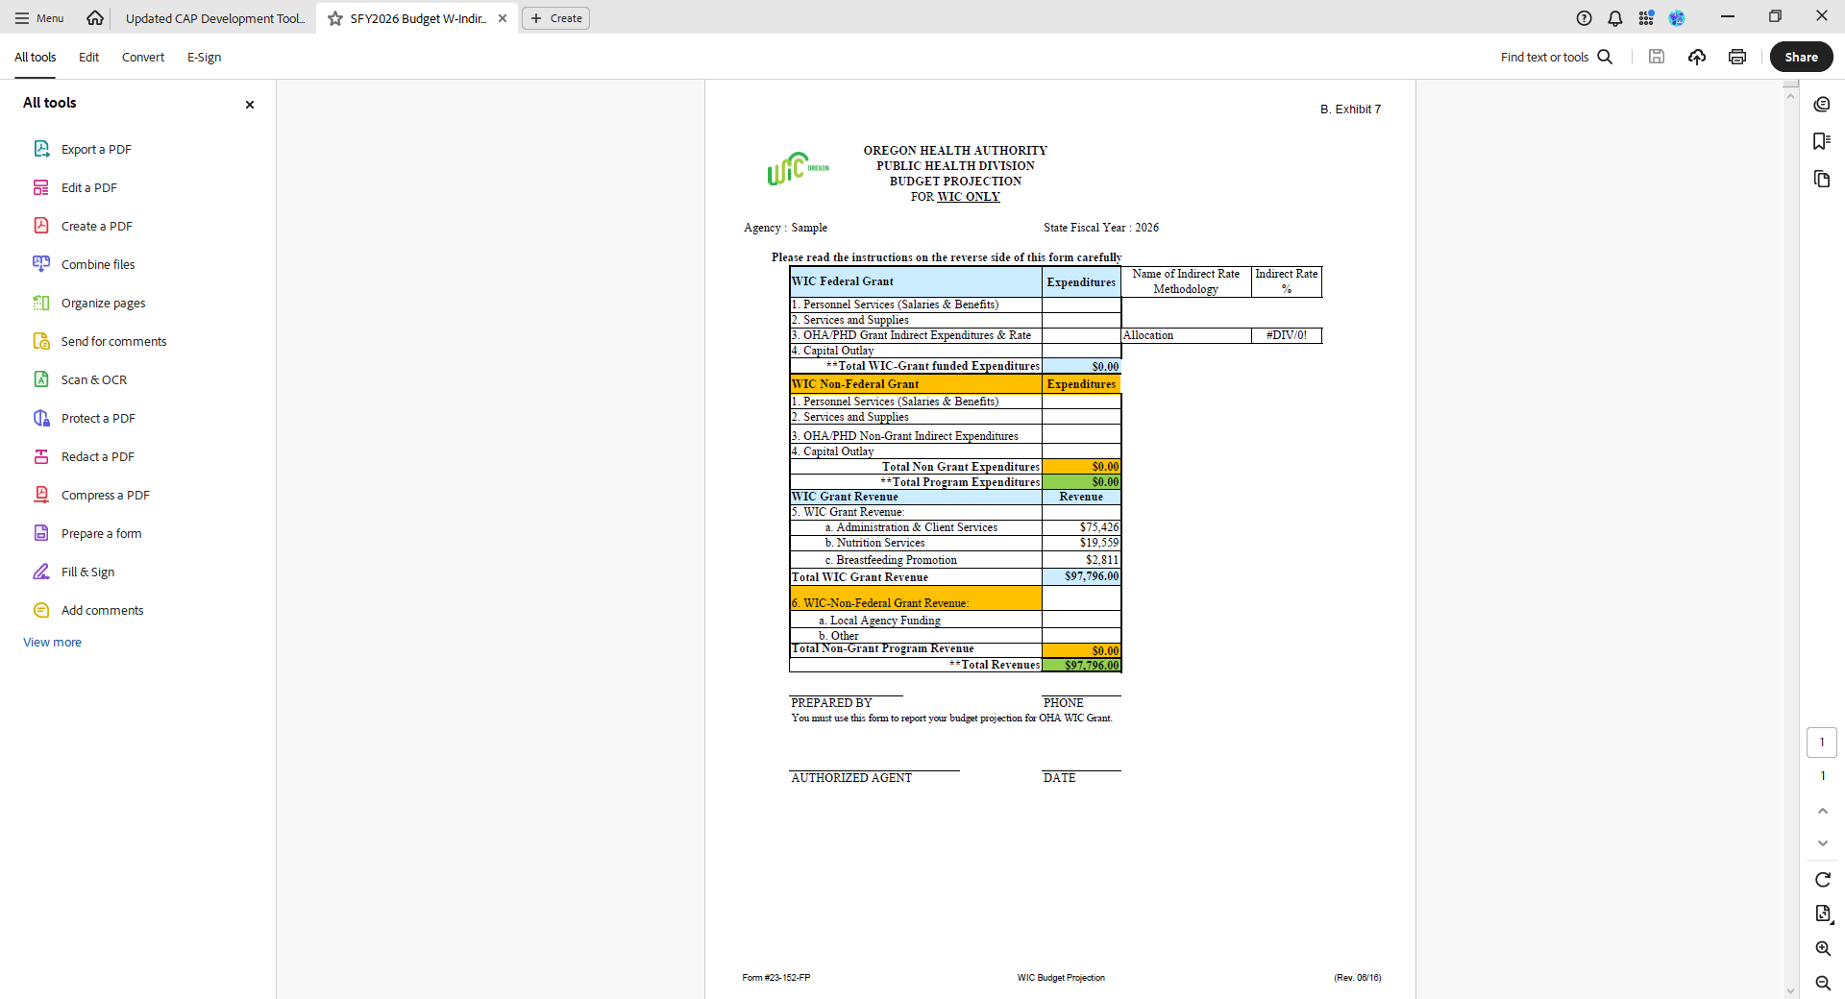
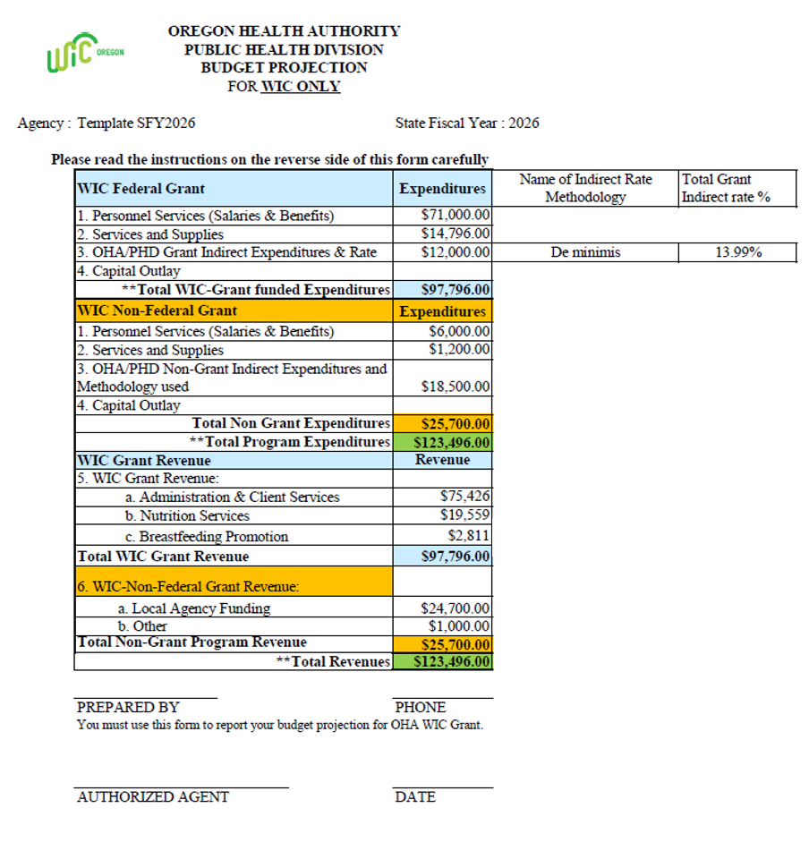
Annual Budget forms
Notes:
Each year in late May, after receiving the grant award letter, local agencies get a WIC budget projection form in excel format. The completed budget must be submitted by June 30th for the upcoming fiscal year, with submission instructions provided at the bottom of the form.
This form is also a tool for tracking your budget throughout the year.
The only portion that is prefilled is in Section 5, the grant award noted as Grant Revenue (shaded in blue) which should match the award letter. (the numbers in this image are examples)
The rest must be completed by the agency.
New to this form are 2 extra columns for Name of Indirect Rate Methodology and Total Grant indirect rate percentage.
No matter which methodology is used the indirect rate percentage of the total grant amount will be automatically calculated. The fiscal staff at the local agency will know which indirect methodology is being applied. The primary purpose of the grant is for direct WIC services and supplies, with reasonable indirect costs allowed.
In this example, the de minimis rate of 15% has been chosen as the methodology used. The percentage of the grant funds used for indirect costs totaled 13.99% which is below the allowable 15%.
This format provides the ability to show the planned budget to ensure that indirect costs are reasonable.
The orange-shaded section is for reporting non-WIC expenditures, such as personnel costs, services, supplies, and indirect expenses not charged to the WIC grant. This helps agencies track local contributions to each expense category.
The following totals should match:
Revenues and expenditures in orange.
WIC grant revenues(total award) and expenditures in blue.
The overall total program revenue and expenditures in green.

Slide 8
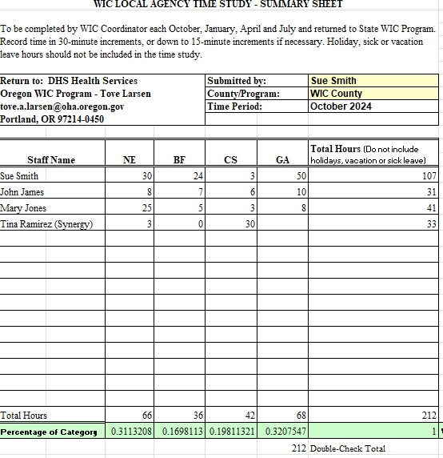
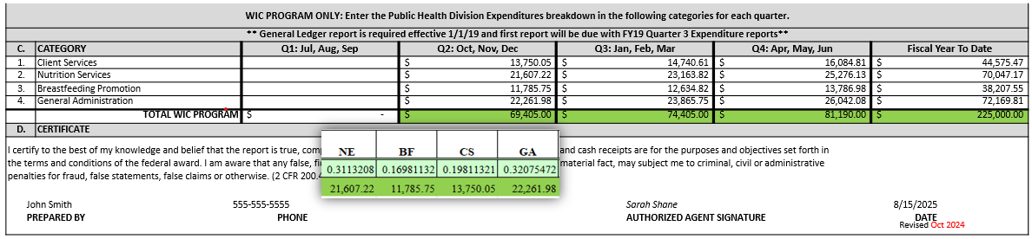
Time Study Summary and Expenditure and Revenue Reporting
Percent applied to each activity based on the Time Study Summary. Q2:
Notes:
Agencies have two options for preparing their Quarterly Expenditure and Revenue Report:
As noted in the example:
Use the quarterly time study summary
Apply the percentages (based on four activities) from the time study summary to the total reimbursable expenditures.
Allocate amounts to the WIC activities.
2. Track expenses in the detailed general ledger by activity – Include personnel, services, supplies, and indirect costs.
FAQ document link available on slide 25 of part 1

Slide 9
Avoid underspending your WIC grant
Things to consider
Missing Quarterly Expenditure and Revenue Reports
Underspent notices
Notes:
Agencies should avoid underspending WIC grants and submit Quarterly Expenditure and Revenue Reports on time to prevent delays. Underspending results in notices sent from the State WIC office in early February and May for corrections to the 2nd and 3rd quarters.
Reports must go to the director’s office (not directly to the WIC fiscal team).
Any correction requests should be cc’d to the appropriate WIC fiscal staff.

Slide 10

Avoid underspending your WIC grant
Things to consider
How many awards do you have from State WIC?
Save your WIC grant award letters for documentation of the exact award amounts.
Do you work closely with fiscal staff?
Are payroll and other expenses correctly charged?
Notes:
Coordinators should work closely with fiscal staff to ensure all WIC funds are properly spent and tracked. Things to consider:
Understand different funding streams and their unique reporting requirements. The funding streams for the WIC programs are NSA-WIC, FDNP-Farm Direct, and BFPC- Breastfeeding/ Peer Counseling.
Save WIC grant award letters for accurate documentation.
Meet with fiscal staff regularly—quarterly at minimum, monthly if possible.
For NSA awards, verify payroll and expenses are correctly documented and charged to the correct activities categories: Nutrition Education (NE), Breastfeeding Promotion (BF), Client Services (CS), and General Administration (GA).
Review expense categories and funding streams thoroughly to avoid misallocations that can create the appearance of underspending.
If underspending seems likely, collaborate with fiscal staff or contact the state Nutrition Consultant and WIC fiscal staff to identify and resolve issues.

Slide 11
Avoid underspending your WIC grant
Things to consider
Quarter 1
July - Sept
Quarter 4
Apr - Jun
Quarter 2
Oct - Dec
Quarter 3
Jan – Mar
Notes:
Underspent WIC Quarter 1, July- Sept awards cannot be carried over to Quarters 2-4, October – June.
1st quarter funds must be spent by September 30th.
Quarters 2 through 4 WIC funds must be spent between Oct 1st and June 30th.
Funding for expenses is not carried over into the following fiscal year which begins July 1st.
Please review excess indirect costs reported or under reporting the grant to ensure the amounts reported are accurate and the grant has been fully utilized when finalizing the fiscal year reporting. (***consider adding detail about when costs are incurred vs when reported)
Please check your Quarterly reports before sending to OHA.
Expenditure and Revenue Reports for Q2-Q4 can be revised if required at any point during the fiscal year.
If a revision is required after the end of the fiscal year reach out to the appropriate state fiscal staff.

Slide 12
Poll 7
Notes:
ANSWER: The only direct cost, not allocated are the office supplies.
Please reference WIC allowable costs for any allocated expense to determine if it is a direct (necessary and reasonable) or indirect allocated expense.

Slide 13
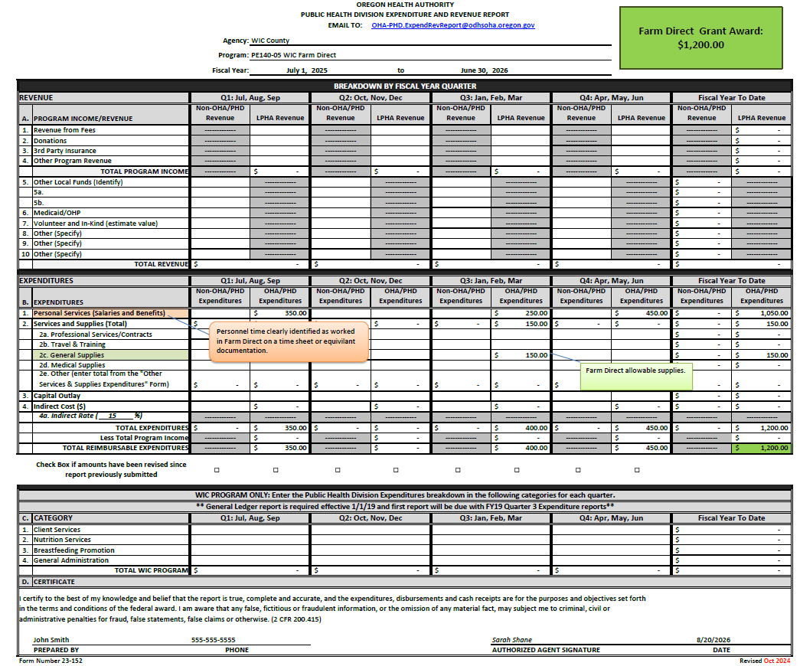
Farm Direct -05 Expenditure and Revenue Report
Notes:
Expenditure and Revenue Reporting of Farm Direct Expenses
There are minor differences between completing the Farm Direct Expenditure and Revenue Report and the WIC Expenditure and Revenue Report
The Farm Direct grant is a separate funding source and therefore all associated expenses must be identified separately from the WIC/NSA grant funded expenses. Farm Direct funds are specific to Farm Direct and may not be used to supplant the WIC program.
Expenses for the Farm Direct program can be reported at any time during the fiscal year.
In this example the agency received $1,200.00 in Farm Direct grant funds: note in Green.
The same requirements to ensure the top of the Expenditure and Revenue Report are completed are required for each program element.
Line 1 Personal Services highlighted in orange: . Report expenses documented by time spent specifically in Farm Direct and not spent in the WIC program.
Line 2c General Supplies highlighted in light green: Allowable Farm Direct supplies.
Please note expenses reported for Farm Direct must follow the guidance noted in Policy 1100-Farm Direct Nutrition Program.
Line 2c totals to line 2.
Double check the totals for the fiscal year to ensure the amounts do not exceed the award.
Completion of the certification area is also required.
Submission of the Expenditure and Revenue Report for Farm Direct is required each quarter even if there was no spending noted in the submitted quarter.
If there are any farm direct questions, please reach out to the Farm Direct contact at the state WIC office.

Slide 14
Farm Direct requirements
Separate Farm Direct Quarterly Expenditure and Revenue Report
You can use these funds through out the State fiscal year
50% of mini grant
50% of mini grant
4ᵗʰ Quarter report
1ˢᵗ Quarter report
2ⁿᵈ Quarter report
3ʳᵈ Quarter report
Notes:
Farm Direct is not 100% federally funded. The amount available to spend on Farm Direct vouchers varies year to year depending on how much USDA and the state legislature allocates, and how many Farm Direct voucher booklets are assigned to your agency.
Local agencies will be notified of their Farm Direct voucher booklet allocation and administrative funding prior to the beginning of the Farm Direct season. You get an email from Maria Menor.
A separate Farm Direct Quarterly E&R report must be submitted each quarter, even if no funds are spent. Use the Expenditure and Revenue Report form instructions for details. Remember from earlier all the funding sources had different PE numbers. The Farm Direct reports will be dash 05 for reference regardless of whether it is PE 40, 140 or 240 depending on what agency you are.
Farm Direct may also be called the WIC Farmers Market mini grant/fresh veggie funding and WIC Farmers Market administrative funds. If it has farm in the name, it is likely all farm direct.
Farm Direct Mini Grants are
Currently authorized for the period July 1st through June 30th (State fiscal year), and are paid to local agencies as follows (2 payments):
First you will get 50% paid July 1st and the 2nd 50% is paid October 1st .
Funds receive on July 1 (first quarter) maybe carried over into the 2-4th quarters without any special approvals.
This is different than WIC NSA funds. So, all those warnings that we’ve been saying about the NSA funds and if you don’t use them in the 1st quarter you lose them, well for the Farm direct funds that is not the requirement as long as you spend them all before the end of the State fiscal year of June 30th.
Tribal agencies receive 1/12 of their payments through out the calendar. And starting in FY 2027, all other agencies will start to receive their Farm Direct funding in 1/12 installments.
What some agencies are doing now is they are waiting to spend the funds in the spring of the following calendar year so that they can get ready for the next Farm Direct season. Do what is easiest for you administratively to support spending the entire mini grant.
Farm Direct funds need to be tracked separately by actual costs.
Quarterly Expenditure and Revenue Reports need to be submitted for every quarter in the fiscal year regardless if Farm Direct funds are expended. The Final Farm Direct Expenditure and Revenue Report is due on August 20th with the other Q4 reports after the end of the State fiscal year.

Slide 16
Policy 300 Fiscal Overview
Policy 305 Funding Formula
Policy 310 Annual Plan/Contract Payment Process for Local Programs
Policy 315 Fiscal Reporting Requirements
Policy 316 Quarterly Breakout of Staff Time
State Fiscal policy links
Policy 320 Fiscal Review of Local Programs
Policy 325 Caseload Management
Policy 330 Penalty for Underspending Food Budget
Policy 340 Reimbursement for Travel
Policy 460 Program Incentive Items
Notes:
These are the state fiscal policies referenced in this presentation.

Slide 17
Title 7 § 246.3 Administration.(B) Delegation to the State agency.
Federal Fiscal policy links
Part 200—Uniform administrative requirements, cost principles, and audit requirements for federal awards
Notes:
All the fiscal policies referenced in this presentation
all the links are active
44

Slide 18
Who to Contact For more information:
For help with: | State contact
Budget questions | Fiscal Coordinator – Karen Shi
Time studies | Fiscal Analyst – Branwyn Phillips
Travel reimbursements | Fiscal Analyst – Branwyn Phillips
Quarterly expenditure reports | Fiscal analyst at the LPHA team of the Public Health Director’s Office OHA-PHD.ExpendRevReport@odhsoha.oregon.gov
Fiscal monitoring | State Fiscal Compliance Specialist - Toni Silbernagel
Breastfeeding peer counseling | Breastfeeding Peer Counseling Coordinator - Korina Skaff
Farm Direct Grant | Farm Direct lead - Maria Menor
Notes:
Your assigned state nutrition consultant can answer many questions.
For more specific questions, contact the state office to reach the following:
Budget questions - Fiscal Coordinator – Karen Shi
Time studies - Fiscal Analyst – Branwyn Phillips
Travel reimbursements - Fiscal Analyst – Branwyn Phillips
Quarterly expenditure reports - Fiscal analyst at the LPHA team of the Public Health Director’s Office
Fiscal monitoring - State Fiscal Compliance Specialist - Toni Silbernagel
Breastfeeding Peer Counseling (BFPC) – Korina Skaff
Farm Direct Lead – Maria Menor

Slide 19
We value your feedback
https://forms.cloud.microsoft/g/sQRd4SgFb5
Notes:
Please let us know what you thought of this training. The link still works even if you are just reviewing the slides. All your input is valued and appreciated.

