Slide 1

WIC Fiscal 101
May 15, 2025

Slide 2
Objectives for this training
Local agency staff can utilize their WIC grant award effectively to maximize program impact.
Local agency staff will understand the fiscal review standards and reporting requirements.
Local agency staff will know where to get technical assistance and answers to questions on different fiscal issues.

Slide 3
Where does WIC funding come from?
USDA
Through FNS regional office
OHA
Through PHD
Your agency
Glossary of acronyms
USDA – United States Department of Agriculture
FNS – Food and Nutrition Services
OHA – Oregon Health Authority
PHD – Public Health Division
Notes:
Funding comes from the USDA United States Department of agriculture, through the FNS or Food and Nutrition services regional office – it comes into the Oregon Health Authority through the Public Health Division then it goes out to your agency.

Slide 4
Where does WIC funding come from?
USDA
NSA $
OHA
NSA $
Your agency
Uses
Distributes
Distributes
NSA $
BFPC $
BFPC $
Farm Direct $
BFPC $
Food $
Farm Direct $
Farm Direct $
Notes:
USDA distributes 4 types of funds
NSA (Nutrition Services and Administration) funding is used to pay for things like program administration, staffing, overhead, and paying for WIC services other than food.
Food funding is what the State uses to pay for the WIC food benefits. Food dollars are also used by the State to purchase the breast pumps that the local agencies order.
BFPC dollars don’t apply to most and currently only 4 agencies get these funds in OR.
Farm Direct Dollars.
OHA passes on the NSA, Farm direct and BF Peer Counseling dollars (if applicable) to the Local agencies for their program operations.
The food dollars don’t pass through to the local agency and do not come out of Local agencies NSA grant. OHA uses food funding to handle all reimbursement of vendors for food benefits.

Slide 5
Other funding – Farm Direct Nutrition Program
USDA
Your agency
OHA
State GF support for FDNP
Glossary of acronyms
FDNP – Farm Direct Nutrition Program, also known as WIC Farmers Market
Organization
Funds
Notes:
The NSA and Food dollars are strictly Federal funds
Farm Direct nutrition program is a little different as the State does add some general fund to the USDA award.
That means sometimes we have more money and sometimes we have less as the State looks at it every year and decides how much they will add in.
This is the only time we will get State money otherwise all other moneys are federal dollars.
Some agencies, not all, get funds from different organizations to fund their operations.

Slide 6
Other funding
Formula rebates
OHA
USDA
State GF support for FDNP
Notes:
OHA also gets formula rebates.
- Oregon is part of a consortium with several other states.
The group goes out for bid with the formula companies, every 5 years unless there is a contract extension, and they will tell the State how much they will provide the formula for and what the formula rebate will be.
The rebate is based on the amount of formula WIC issues and that participants purchase.
The rebate funds are part of the food dollars and not the NSA funds

Slide 7
How is local agency funding determined?
Assigned caseload
Per participant rate
Notes:
How does the State determine how much NSA funds you receive.
One: is Assigned caseload….
Each agency is assigned a caseload number based on how many participants they have been serving and the need in their service area.
It determines your agency funding, and it is set by the state WIC office every year in April for grant funding starting July 1.
Two: is the per participant rate….
- The per participant rate is established by the state WIC office every year in April for grant funding starting July 1.
The per participant rate and your assigned caseload determine the funding for your agency.
Grant funding notification letters are sent from the state WIC office to agencies in May.

Slide 8
Caseload Tiers
Tier 1 – Caseload equal to or greater than 5,000 No additional funding
Tier 2 – Caseload greater than 1,500 and <5,000 No additional funding
Tier 3 – Caseload greater than 1,000 and ≤1,500 $11,000 additional funding per year
Tier 4 – Caseload equal to or less than 1,000 $16,000 additional funding per year
Notes:
In addition to the assigned caseload and per participant rate, smaller agencies receive additional money, and this is based on caseload tiers.
The amount varies each year depending on federal funding. Agencies will be notified of the amount of the tier-based funding in the WIC NSA Funding and Grant letter.
These are the minimum amount agencies will receive.
Tier 1 agencies are the biggest agencies, and they have assigned caseloads of more than 5000 participants. Those agencies don’t receive extra money.
Tier 2 agencies are medium to large and receive no extra funding
Tier 3 agencies are medium to small and get $11,000
Tier4 agencies are the smallest and get an extra $16,000 tier adjustment.
This is based on economy of scale. The smaller agencies find it more difficult to operate and meet all State requirements, so this additional funding is allowed.
These tier adjustment dollars are not permanent, and it is not guaranteed that these dollar amounts will remain, but these are the current tier adjustments we are using. When you get your letter, it would mention this tier funding if you received it.

Slide 9
How do contracts work?
Intergovernmental Agreement
Covers July 1 through June 30.
If completed IGAs are not submitted by the deadline, agencies will not receive their WIC funding on time.
Notes:
The contract between the State Public Health OHA office and the local public health or your local agency is sent separately and is known as an Intergovernmental agreement or IGA.
It does not come from the State WIC office.
It is sent annually in May or June. The contract is broad and covers July 1 through June 30
Your local agency administrator signs and submits the IGA to the OHA office.
It is important to remember that WIC, FDNP, BFPC are all separate funds and will be listed separately as revenue on the IGA
Warning: If completed IGAs are not submitted by the deadline, agencies will not receive their WIC funding on time.

Slide 10
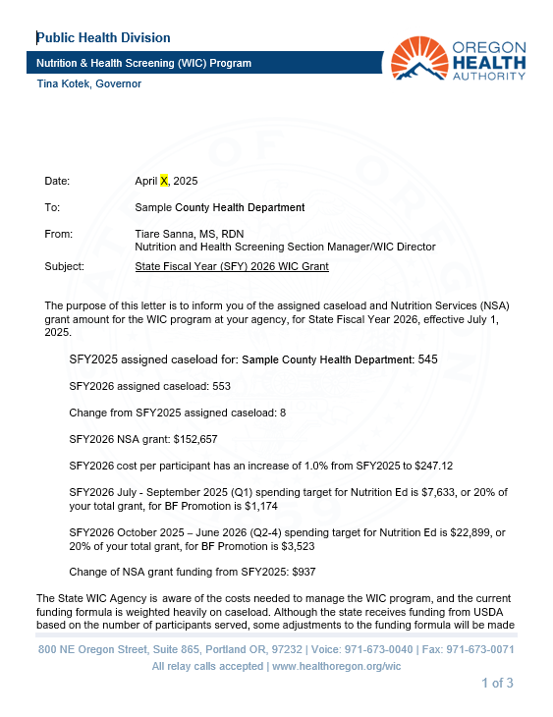
Grant award Letters
Notes:
Grant award letters list the WIC specifics of the IGA contract. This is just a sample
The 1st page will list
The current years caseload
The caseload change for the upcoming fiscal year and the change in caseload
The contract amount for the upcoming fiscal year
This is where you will see the per participant rate we just talked about
In the contract there are specific expenditures for Nutrition Education and Breastfeeding support and promotion, and the contract will specifically say how much your agency needs to spend on Nutrition education and the specific amount required to spend on breastfeeding support and promotion. Now that amount for NE is 20% of total WIC grant and the BF support and promotion is based on a formula that is too complicated, but a specific dollar amount will be listed in your grant award letter.
You will also see those required spending targets for Nutrition Education and Breastfeeding support and promotion divided into the different quarters.
The letter will also let you know if there was an increase or decrease in your funding from the previous year.

Slide 11
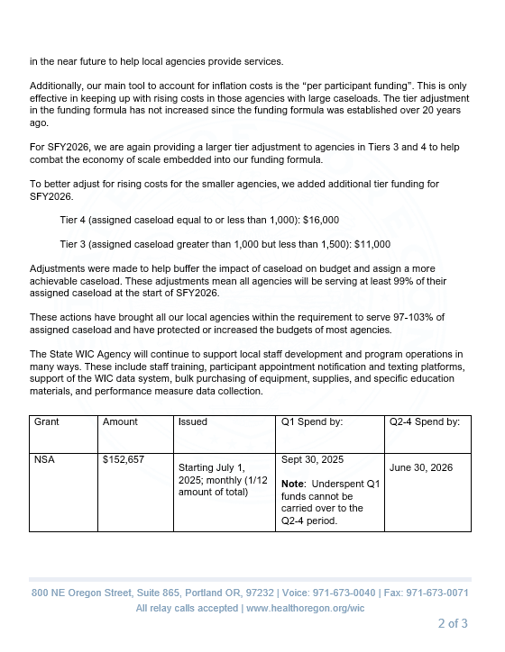
Grant award Letters
Notes:
The second page will list the tier adjustment amounts for smaller agencies
There is a table that will list your overall NSA grant amount and then the spending periods

Slide 12
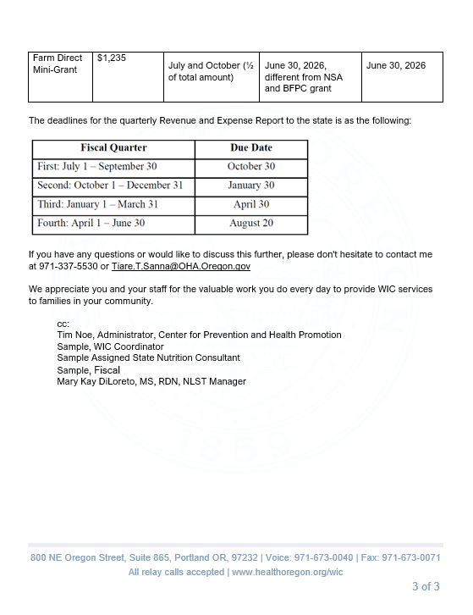
Grant award Letters
Notes:
Following on in that table will be your assigned Farm direct mini grant and the two spending periods
There will always be a table listing when the quarterly expense and revenue reports will be due.

Slide 13
How are funds received?
Fiscal Quarter | Due Date
First July 1– September 30 | October 30
Second October 1 – December 31 | January 30
Third January 1 – March 31 | April 30
Fourth April 1 – June 30 | August 20
1/12th of total NSA and BFPC annual funding every month starting July 1.
Farm Direct funding is provided
July 1 and October 1.
Payments are reconciled quarterly Expenditure and Revenue Reports.
Notes:
How are funds received by local agencies
- Agencies receive 1/12th of their total annual NSA and BFPC (if applicable) funding every month starting July 1.
- Farm Direct funding is provided July 1 and October 1.
These payments are reconciled quarterly when agencies submit Expenditure and Revenue Reports (E&R)
There are certain situations where funds can be carried over to the next month and to understand how this works, you need to understand how WIC fiscal years work.
This is the same table seen on the award letter, and it shows the fiscal quarters and the due date for the expenditure and review reports.

Slide 14
Understanding the 2 types of WIC fiscal years:
State Fiscal Year
June | July | Aug | Sept | Oct | Nov | Dec | Jan | Feb | Mar | Apr | May | June | July | Aug | Sept
State fiscal year – July 1 to June 30
OHA
Through PHD
The WIC grant and contract (IGA) match the state fiscal year July 1 through June 30.
Notes:
There are 2 types of WIC fiscal year.
The first type is the State Fiscal year that includes all quarters for the dates July 1 – June 30.
- Remember WIC is run through a state agency – Oregon Health Authority, Public Health Division – and must follow their fiscal processes and rules.
- The WIC grant and contract (IGA) match the state fiscal year July 1 through June 30 except Tribal agencies.

Slide 15
Understanding the 2 types of WIC fiscal years:
Federal Fiscal Year
June | July | Aug | Sept | Oct | Nov | Dec | Jan | Feb | Mar | Apr | May | June | July | Aug | Sept
Federal fiscal year – October 1 to September 30
USDA
Through FNS regional office
State WIC must spend our annual grant within the federal fiscal year October 1 through September 30.
Notes:
The other fiscal year we need to recognize is the Federal fiscal year.
WIC is funded through a federal agency – US Department of Agriculture, Food and Nutrition Services (FNS) and must spend the annual grant at the State within the federal fiscal year October 1 through September 30.
Starting in January 2026, Tribal agencies are going to use the calendar year.

Slide 16

Understanding the 2 types of WIC fiscal years
Fiscal Year Overlap
June | July | Aug | Sept | Oct | Nov | Dec | Jan | Feb | Mar | Apr | May | June | July | Aug | Sept
State fiscal year – July 1 to June 30
Federal Overlap
State Overlap
New federal fiscal year – October 1 to September 30
Notes:
There are two 3-month (quarter) overlaps
The 1st quarter for the State July – Sept 30th and 4th Quarter for the Federal year July through September
Funds from one federal fiscal year cannot be used in the next federal fiscal year.
In order to close out the books for the federal fiscal year, funds from July 1 through September 30 (1st quarter) of the state fiscal year must be spent in that quarter and cannot roll-over to the next federal fiscal year.
To summarize: spend the dollars you receive in that 1st quarter of the State fiscal year in that 1st quarter. They cannot roll over into quarter’s 2-4. If you don’t spend them, you lose them
Objective 1 of this training: Local agencies would be able to utilize all the funds that you are entitled to. It can be a little confusing but after you get past that 1st quarter you can spend funds in a way that works best for your agency across the remaining quarters. That 1st quarter is special because of that overlap problem with the State and Federal fiscal years.

Slide 17
Quarterly Expenditure and Revenue (E&R) Reports
3rd Quarter
4th Quarter
1st Quarter
2nd Quarter
31 Jan
Feb
Mar
30 Apr
May
Jun
July
20 Aug
Sept
31 Oct
Nov
Dec
2nd Quarter report
3rd Quarter report
4th Quarter report
1st Quarter report
Notes:
The second objective of this training is to talk about the fiscal review standards and reporting requirements.
In other words: Quarterly E&R reports.
These are due 30 days following the end of the first three quarters and 51 days after the end of the fourth quarter.
If any E&R report has not been received by its deadline, the WIC State payment to the local agency could be delayed

Slide 18
Program Element (PE) Numbers in WIC
Tribal Agencies
PE 61 Changes to
PE 240 (1/1/26)
PE61-01
Tribal WIC NSA: July – September
PE61-02
Tribal WIC NSA: October - June
PE61-05
Tribal WIC
Farmers Market
Public Health
PE 40
PE40-01
WIC NSA:
July – September
PE40-02
WIC NSA: October - June
PE40-03
BFPC:
July - September
PE40-04
BFPC:
October - June
PE40-05
WIC Farmers Market
Private
PE 53 changes to
PE 140 (7/1/25)
PE53-01
Private WIC NSA: July – September
PE53-02
Private WIC NSA: October - June
PE53-03
Private BFPC: July - September
PE53-04
Private BFPC: October - June
PE53-05
Private Farmers Market
Notes:
There are separate quarterly reports that relate to the different programs and quarters.
PE’s or program element numbers can help you determine which forms apply to you and which ones to use.
It is a Federal requirement to track funds including supplies and personnel costs separately by each grant WIC, BFPC and Farm Direct.
Blue – This applies local Public Health agencies. (LPHA’s)
PE 40-01 is for that important 1st quarter of WIC funding.
PE 40-02 is for WIC quarters 2-4.
PE 40-03 is for 1st quarter report for the BFPC program and
PE 40-04 for BFPC quarters 2-4
And PE 40-05 is for all Farm direct expenditures. We use the same report for the entire year for Farm Direct.
Orange –These are private organizations/Non-profits
- They follow a similar pattern as the LPHA’s reporting
- The PE number will be changing in 7/1/25 to PE140
Green – Tribal agencies
- The PE number will be changing 1/1/26 to PE 240
- We currently don’t have any tribal agencies offering the BFPC program, so those PEs are not included.

Slide 19

OREGON HEALTH AUTHORITY
PUBLIC HEALTH DIVISION EXPENDITURE AND REVENUE REPORT
EMAIL TO: OHA-PHD.ExpendRevReport@odhsoha.oregon.gov
Agency: WIC County
Program: PE 40-02 WIC
Fiscal Year: July 1, 2024
to
June 30, 2025
BREAKDOWN BY FISCAL YEAR QUARTER
REVENUE |  | Q1: Jul, Aug, Sep |  | Q2: Oct, Nov, Dec |  | Q3: Jan, Feb, Mar |  | Q4: Apr, May, Jun |  | Fiscal Year To Date
A. | PROGRAM INCOME/REVENUE | Non-OHA/PHD Revenue | LPHA Revenue | Non-OHA/PHD Revenue | LPHA Revenue | Non-OHA/PHD Revenue | LPHA Revenue | Non-OHA/PHD Revenue | LPHA Revenue | Non-OHA/PHD Revenue | LPHA Revenue
1. | Revenue from Fees | ------------- |  | ------------- |  | ------------- |  | ------------- |  | ------------- | $ -
2. | Donations | ------------- |  | ------------- |  | ------------- |  | ------------- |  | ------------- | $ -
3. | 3rd Party Insurance | ------------- |  | ------------- |  | ------------- |  | ------------- |  | ------------- | $ -
4. | Other Program Revenue | ------------- |  | ------------- |  | ------------- |  | ------------- |  | ------------- | $ -
 | TOTAL PROGRAM INCOME | ------------- | $ - | ------------- | $ - | ------------- | $ - | ------------- | $ - | ------------- | $ -
5. | Other Local Funds (Identify) |  | ------------- |  | ------------- |  | ------------- |  | ------------- | $ - | -------------
 | County personnel |  | ------------- | $ 45,000.00 | ------------- | $ 25,000.00 | ------------- | $ 25,000.00 | ------------- | $ 95,000.00 | -------------
 |  |  | ------------- |  | ------------- |  | ------------- |  | ------------- | $ - | -------------
6. | Medicaid/OHP |  | ------------- |  | ------------- |  | ------------- |  | ------------- | $ - | -------------
7. | Volunteer and In-Kind (estimate value) |  | ------------- |  | ------------- |  | ------------- |  | ------------- | $ - | -------------
8. | County admin |  | ------------- | $ 2,850.00 | ------------- |  | ------------- |  | ------------- | $ 2,850.00 | -------------
9. | County utilities |  | ------------- | $ 2,250.00 | ------------- |  | ------------- |  | ------------- | $ 2,250.00 | -------------
10 | County supplies |  | ------------- |  | ------------- | $ 2,250.00 | ------------- |  | ------------- | $ 2,250.00 | -------------
 | TOTAL REVENUE | $ - |  | $ 50,100.00 |  | $ 27,250.00 |  | $ 25,000.00 |  | $ 102,350.00
EXPENDITURES |  | Q1: Jul, Aug, Sep |  | Q2: Oct, Nov, Dec |  | Q3: Jan, Feb, Mar |  | Q4: Apr, May, Jun |  | Fiscal Year To Date
B. | EXPENDITURES | Non-OHA/PHD Expenditures | OHA/PHD Expenditures | Non-OHA/PHD Expenditures | OHA/PHD Expenditures | Non-OHA/PHD Expenditures | OHA/PHD Expenditures | Non-OHA/PHD Expenditures | OHA/PHD Expenditures | Non-OHA/PHD Expenditures | OHA/PHD Expenditures
1. | Personal Services (Salaries and Benefits) |  |  | $ 45,000.00 | $ 52,827.17 | $ 25,000.00 | $ 60,150.00 | $ 25,000.00 | $ 63,250.00 | $ 95,000.00 | $ 176,227.17
2. | Services and Supplies (Total) |  |  | $ 5,100.00 | $ 7,525.00 | $ 2,250.00 | $ 4,550.00 | $ - | $ 7,350.00 | $ 7,350.00 | $ 19,425.00
 | 2a. Professional Services/Contracts |  |  |  |  |  |  |  |  | $ - | $ -
 | 2b. Travel & Training |  |  |  | $ 25.00 |  | $ 50.00 |  | $ 2,150.00 | $ - | $ 2,225.00
 | 2c. General Supplies |  |  |  | $ 5,000.00 | $ 2,250.00 | $ 2,500.00 |  | $ 2,200.00 | $ 2,250.00 | $ 9,700.00
 | 2d. Medical Supplies |  |  |  | $ 2,500.00 |  | $ 2,000.00 |  | $ 3,000.00 | $ - | $ 7,500.00
 | 2e. Other (enter total from the "Other Services & Supplies Expenditures" Form) | $ - |  | $ 5,100.00 |  | $ - | $ - | $ - | $ - | $ 5,100.00 | $ -
3. | Capital Outlay |  |  |  |  |  |  |  |  | $ - | $ -
4. | Indirect Cost ($) |  |  |  | $ 9,052.83 |  | $ 9,705.00 |  | $ 10,590.00 | $ - | $ 29,347.83
 | 4a. Indirect Rate ( 15 %) | ------------- | ------------- | ------------- | ------------- | ------------- | ------------- | ------------- | ------------- | ------------- | -------------
 | TOTAL EXPENDITURES | $ - | $ - | $ 50,100.00 | $ 69,405.00 | $ 27,250.00 | $ 74,405.00 | $ 25,000.00 | $ 81,190.00 | $ 102,350.00 | $ 225,000.00
 | Less Total Program Income | ------------- | $ - | ------------- | $ - | ------------- | $ - | ------------- | $ - | ------------- | $ -
 | TOTAL REIMBURSABLE EXPENDITURES | ------------- | $ - | ------------- | $ 69,405.00 | ------------- | $ 74,405.00 | ------------- | $ 81,190.00 | ------------- | $ 225,000.00
Check Box if amounts have been revised since report previously submitted
WIC PROGRAM ONLY: Enter the Public Health Division Expenditures breakdown in the following categories for each quarter.
** General Ledger report is required effective 1/1/19 and first report will be due with FY19 Quarter 3 Expenditure reports**
C. | CATEGORY | Q1: Jul, Aug, Sep | Q2: Oct, Nov, Dec | Q3: Jan, Feb, Mar | Q4: Apr, May, Jun | Fiscal Year To Date
1. | Client Services |  | $ 13,750.05 | $ 14,740.61 | $ 16,084.81 | $ 44,575.47
2. | Nutrition Services |  | $ 21,607.22 | $ 23,163.82 | $ 25,276.13 | $ 70,047.17
3. | Breastfeeding Promotion |  | $ 11,785.75 | $ 12,634.82 | $ 13,786.98 | $ 38,207.55
4. | General Administration |  | $ 22,261.98 | $ 23,865.75 | $ 26,042.08 | $ 72,169.81
 | TOTAL WIC PROGRAM | $ - | $ 69,405.00 | $ 74,405.00 | $ 81,190.00 | $ 225,000.00
D. | CERTIFICATE
I certify to the best of my knowledge and belief that the report is true, complete and accurate, and the expenditures, disbursements and cash receipts are for the purposes and objectives set forth in the terms and conditions of the federal award. I am aware that any false, fictitious or fraudulent information, or the omission of any material fact, may subject me to criminal, civil or administrative penalties for fraud, false statements, false claims or otherwise. (2 CFR 200.415) John Smith 555-555-5555 Sarah Shane 8/15/2025 PREPARED BY PHONE AUTHORIZED AGENT SIGNATURE DATE
Revised Oct 2024
Notes:
This is an example of a revenue and expenditure report
The red box at the top: highlights Agency name, Program Element number and name and below it is the fiscal year.
At the bottom of the page is where you will find the WIC section.
It says WIC program only: Enter the Public Health Division Expenditures breakdown in the following categories for each quarter. The categories listed are
Client Services (CS)
Nutrition Services (NE)
BF promotion (BF)
General administration (GA)
The actual dollar amounts your agency spent on NE, BF, CS, and GA are required fields on the Quarterly Expenditure and Revenue Report

Slide 20
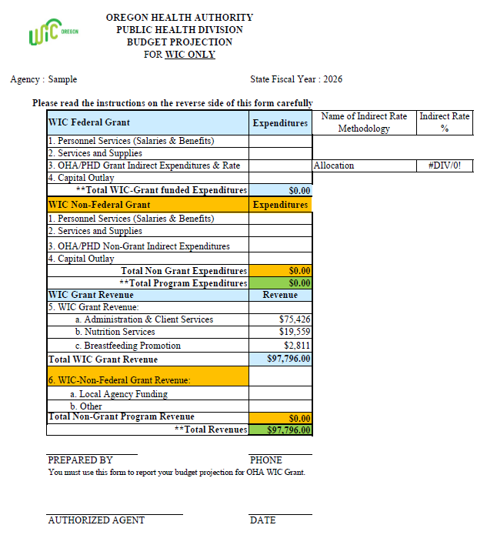
Other fiscal requirements
Notes:
Every year local agencies get a WIC budget projection form in excel format, in late May after receiving the grant award letter.
The only portion that is prefilled in is Section 5, the Grant revenue (shaded in blue) which should match the award letter. (the numbers in this image are examples)
You must complete the rest.
New to this form this year are 2 extra columns for Name of Indirect Rate Methodology and Total Grant indirect rate percentage.
No matter which methodology is used the indirect rate percentage of the total grant amount will be automatically calculated. The fiscal staff at the agency will know which methodology has been chosen.
Indirect costs are very difficult and require a much higher level of conversation so if you are interested in talking more about this, please let us know in the post presentation survey.
There is also space to report the non-WIC expenditures (shaded in orange) for things like personnel costs, services and supplies and any part of the indirect expenses that will not be reported to the WIC grant. This allows agencies to truly track what your agency is contributing and what you're paying for with it.
The orange areas for revenues in and expenditures should match. The blue areas for the WIC grant revenues and expenditures should match, and the overall total program in green revenue and expenditures should also match.
This format provides the ability to show the planned budget to ensure that indirect costs are reasonable.
If an agency contributes agency or other funds to support the WIC program and the indirect rate seems unreasonable expenditures can be moved from the Non-Federal Grant direct services to the WIC Federal grant and more of the supporting indirect expenses moved to the WIC Non-Federal Grant indirect Expenditures to balance the budget.
The form is based on the state’s caseload formula and helps assess whether projected indirect costs are reasonable. The primary purpose of the grant is for direct WIC services and supplies, with reasonable indirect costs allowed.
This form is also a tool for tracking your budget throughout the year.
The completed budget must be submitted by June 30 for the upcoming fiscal year, with submission instructions provided at the bottom of the form.

Slide 21
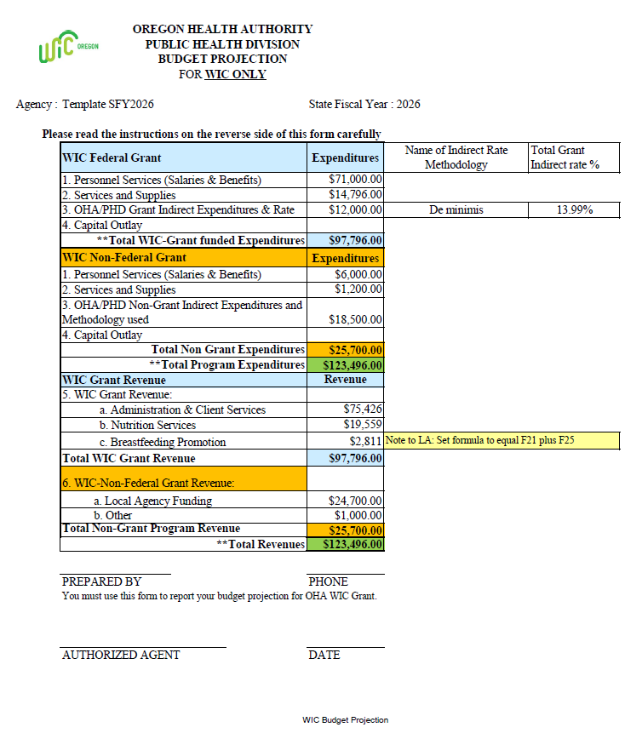
Other fiscal requirements
Notes:
In this example, the de minimis rate of 15% has been chosen as the methodology used. The percentage of the grant funds used for indirect costs totaled 13.99% which is below the allowable 15%.
Once again there is space to report the non-WIC expenditures (shaded in orange) for things like personnel costs, services and supplies and any part of the indirect expenses that will not be reported to the WIC grant.
Remember this allows agencies to truly track what your agency is contributing and what you're paying for with it.
The orange areas for revenues in and expenditures should match. The blue areas for the WIC grant revenues and expenditures should match, and the overall total program in green revenue and expenditures should also match.

Slide 22
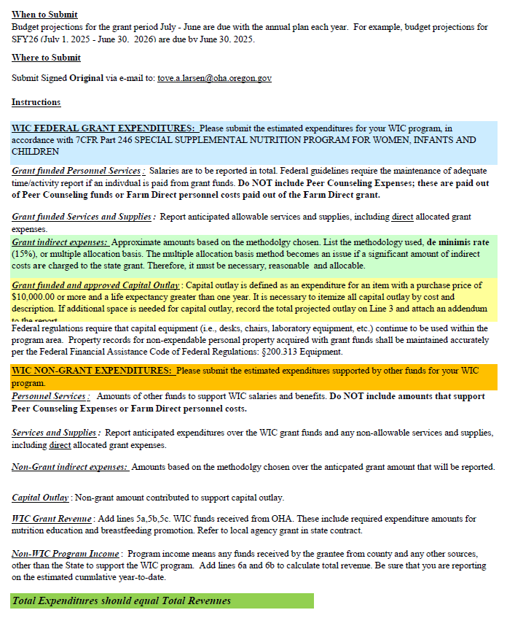
Other fiscal requirements
Notes:
The bottom of the WIC budget projection form lists all the instructions and information needed to complete the form.

Slide 23

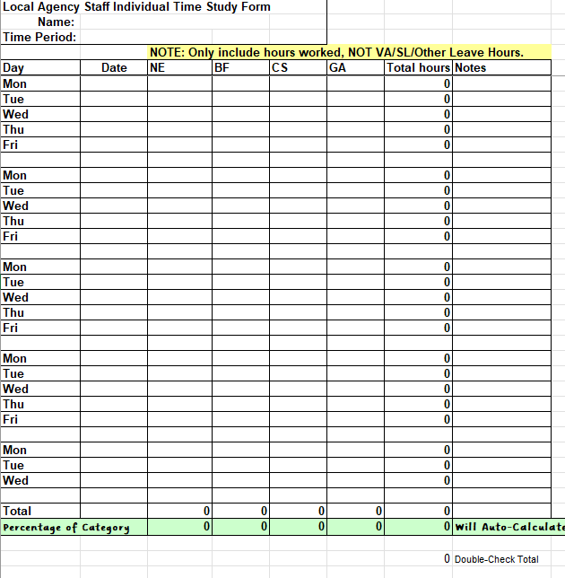
Time Studies
Time study summaries
Individual time study
WIC staff work in four categories
Notes:
Each section is an active link
Time studies classify WIC work in four categories. The majority of WIC staff time is usually spent in nutrition education and client services. Nutrition education (NE) Breastfeeding support and promotion (BF) Client services (CS) General administration and payroll (GA)
All staff who are paid directly (not by cost allocation e.g., folks in administration and not doing direct client services and where a small % of their time is allocated to WIC) by the WIC grant, must complete an individual time study.
Time study summaries must be submitted quarterly for the months of October, January, April and July.
If the agency captures staff payroll by WIC categories NE, BF, CS, GA then individual time studies are not required,
only the time study summary would be required.
Time studies may be used to support local agency expenses related to those 4 areas of WIC services.
e.g. Time should be rounded to 15-minute increments, for example If it’s 7 minutes, round down to 0 minutes; if it’s 8 minutes, round up to 15 minutes. If you track total minutes for the day like 6min for each appointment, then tally those up and put that time in rather than having to round down to zero and have nothing.
Important to note only NSA allowable WIC time should be reported on the time study. E.g. reporting car seat training time is not an allowable cost and should not be reflected on the time study. If time is paid by Farm direct funds it should not be included in the NSA time study.
For example:
A full-time CPA attends a Farm Direct issuance event for an 8-hour day in July
The staff person would not include that day’s time on their WIC time study
The staff person’s time sheet for the local agency should reflect the 8 hours as being charged to Farm Direct funds
You will want to work with your agency’s fiscal contact to know when your Farm Direct grant has been exhausted.
Farm Direct activities not paid for by Farm Direct funds are captured on the time study in appropriate categories for each activity (NE, CS, GA)
Policy 316 Quarterly Breakout of Staff Time

Slide 24
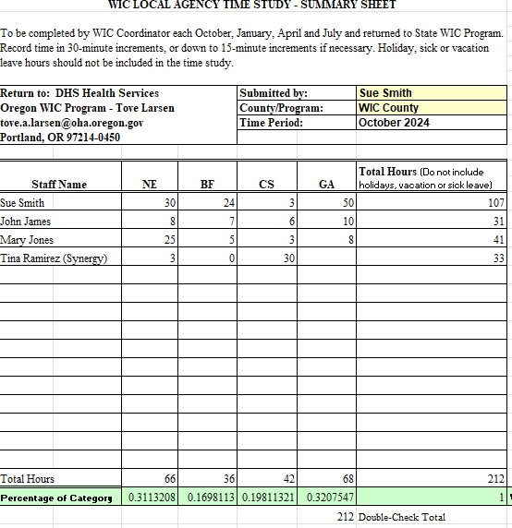

Time Study Summary and Expenditure and Revenue Reporting
Percent applied to each activity based on the Time Study Summary. Q2:
WIC PROGRAM ONLY: Enter the Public Health Division Expenditures breakdown in the following categories for each quarter.
** General Ledger report is required effective 1/1/19 and first report will be due with FY19 Quarter 3 Expenditure reports**
C. | CATEGORY | Q1: Jul, Aug, Sep | Q2: Oct, Nov, Dec | Q3: Jan, Feb, Mar | Q4: Apr, May, Jun | Fiscal Year To Date
1. | Client Services |  | $ 13,750.05 | $ 14,740.61 | $ 16,084.81 | $ 44,575.47
2. | Nutrition Services |  | $ 21,607.22 | $ 23,163.82 | $ 25,276.13 | $ 70,047.17
3. | Breastfeeding Promotion |  | $ 11,785.75 | $ 12,634.82 | $ 13,786.98 | $ 38,207.55
4. | General Administration |  | $ 22,261.98 | $ 23,865.75 | $ 26,042.08 | $ 72,169.81
 | TOTAL WIC PROGRAM | $ - | $ 69,405.00 | $ 74,405.00 | $ 81,190.00 | $ 225,000.00
D. | CERTIFICATE
I certify to the best of my knowledge and belief that the report is true, complete and accurate, and the expenditures, disbursements and cash receipts are for the purposes and objectives set forth in the terms and conditions of the federal award. I am aware that any false, fictitious or fraudulent information, or the omission of any material fact, may subject me to criminal, civil or administrative penalties for fraud, false statements, false claims or otherwise. (2 CFR 200.415) John Smith 555-555-5555 Sarah Shane 8/15/2025 PREPARED BY PHONE AUTHORIZED AGENT SIGNATURE DATE
Notes:
Some agencies may use their quarterly time study summary to develop and/or support their Quarterly Expenditure and Revenue Report.
On the new/revised time study summary forms the percentages have been added to the bottom of the form based on the 4 categories. Those percentages are then applied to the total grant amount you are reporting on the Expenditure and revenue report and then breaking those out by the percentage.
This is one method that is encouraged as it is most accurate

Slide 25
Based on a grant award of $225,000.00 using the 15% De Minimis indirect rate application.
OREGON HEALTH AUTHORITY
PUBLIC HEALTH DIVISION EXPENDITURE AND REVENUE REPORT
EMAIL TO: OHA-PHD.ExpendRevReport@odhsoha.oregon.gov
Agency: WIC County
Program: PE 40-02 WIC
Fiscal Year: July 1, 2024
to
June 30, 2025
Amounts entered in lines 5-10 support expenses over the total grant or items that are unallowable.
BREAKDOWN BY FISCAL YEAR QUARTER
REVENUE |  | Q1: Jul, Aug, Sep |  | Q2: Oct, Nov, Dec |  | Q3: Jan, Feb, Mar |  | Q4: Apr, May, Jun |  | Fiscal Year To Date
A. | PROGRAM INCOME/REVENUE | Non-OHA/PHD Revenue | LPHA Revenue | Non-OHA/PHD Revenue | LPHA Revenue | Non-OHA/PHD Revenue | LPHA Revenue | Non-OHA/PHD Revenue | LPHA Revenue | Non-OHA/PHD Revenue | LPHA Revenue
1. | Revenue from Fees | ------------- |  | ------------- |  | ------------- |  | ------------- |  | ------------- | $ -
2. | Donations | ------------- |  | ------------- |  | ------------- |  | ------------- |  | ------------- | $ -
3. | 3rd Party Insurance | ------------- |  | ------------- |  | ------------- |  | ------------- |  | ------------- | $ -
4. | Other Program Revenue | ------------- |  | ------------- |  | ------------- |  | ------------- |  | ------------- | $ -
 | TOTAL PROGRAM INCOME | ------------- | $ - | ------------- | $ - | ------------- | $ - | ------------- | $ - | ------------- | $ -
5. | Other Local Funds (Identify) |  | ------------- |  | ------------- |  | ------------- |  | ------------- | $ - | -------------
 | County personnel |  | ------------- | $ 45,000.00 | ------------- | $ 25,000.00 | ------------- | $ 25,000.00 | ------------- | $ 95,000.00 | -------------
 |  |  | ------------- |  | ------------- |  | ------------- |  | ------------- | $ - | -------------
6. | Medicaid/OHP |  | ------------- |  | ------------- |  | ------------- |  | ------------- | $ - | -------------
7. | Volunteer and In-Kind (estimate value) |  | ------------- |  | ------------- |  | ------------- |  | ------------- | $ - | -------------
8. | County admin |  | ------------- | $ 2,850.00 | ------------- |  | ------------- |  | ------------- | $ 2,850.00 | -------------
9. | County utilities |  | ------------- | $ 2,250.00 | ------------- |  | ------------- |  | ------------- | $ 2,250.00 | -------------
10 | County supplies |  | ------------- |  | ------------- | $ 2,250.00 | ------------- |  | ------------- | $ 2,250.00 | -------------
 | TOTAL REVENUE | $ - |  | $ 50,100.00 |  | $ 27,250.00 |  | $ 25,000.00 |  | $ 102,350.00
EXPENDITURES |  | Q1: Jul, Aug, Sep |  | Q2: Oct, Nov, Dec |  | Q3: Jan, Feb, Mar |  | Q4: Apr, May, Jun |  | Fiscal Year To Date
B. | EXPENDITURES | Non-OHA/PHD Expenditures | OHA/PHD Expenditures | Non-OHA/PHD Expenditures | OHA/PHD Expenditures | Non-OHA/PHD Expenditures | OHA/PHD Expenditures | Non-OHA/PHD Expenditures | OHA/PHD Expenditures | Non-OHA/PHD Expenditures | OHA/PHD Expenditures
1. | Personal Services (Salaries and Benefits) |  |  | $ 45,000.00 | $ 52,827.17 | $ 25,000.00 | $ 60,150.00 | $ 25,000.00 | $ 63,250.00 | $ 95,000.00 | $ 176,227.17
2. | Services and Supplies (Total) |  |  | $ 5,100.00 | $ 7,525.00 | $ 2,250.00 | $ 4,550.00 | $ - | $ 7,350.00 | $ 7,350.00 | $ 19,425.00
 | 2a. Professional Services/Contracts |  |  |  |  |  |  |  |  | $ - | $ -
 | 2b. Travel & Training |  |  |  | $ 25.00 |  | $ 50.00 |  | $ 2,150.00 | $ - | $ 2,225.00
 | 2c. General Supplies |  |  |  | $ 5,000.00 | $ 2,250.00 | $ 2,500.00 |  | $ 2,200.00 | $ 2,250.00 | $ 9,700.00
 | 2d. Medical Supplies |  |  |  | $ 2,500.00 |  | $ 2,000.00 |  | $ 3,000.00 | $ - | $ 7,500.00
 | 2e. Other (enter total from the "Other Services & Supplies Expenditures" Form) | $ - |  | $ 5,100.00 |  | $ - | $ - | $ - | $ - | $ 5,100.00 | $ -
3. | Capital Outlay |  |  |  |  |  |  |  |  | $ - | $ -
4. | Indirect Cost ($) |  |  |  | $ 9,052.83 |  | $ 9,705.00 |  | $ 10,590.00 | $ - | $ 29,347.83
 | 4a. Indirect Rate ( 15 %) | ------------- | ------------- | ------------- | ------------- | ------------- | ------------- | ------------- | ------------- | ------------- | -------------
 | TOTAL EXPENDITURES | $ - | $ - | $ 50,100.00 | $ 69,405.00 | $ 27,250.00 | $ 74,405.00 | $ 25,000.00 | $ 81,190.00 | $ 102,350.00 | $ 225,000.00
 | Less Total Program Income | ------------- | $ - | ------------- | $ - | ------------- | $ - | ------------- | $ - | ------------- | $ -
 | TOTAL REIMBURSABLE EXPENDITURES | ------------- | $ - | ------------- | $ 69,405.00 | ------------- | $ 74,405.00 | ------------- | $ 81,190.00 | ------------- | $ 225,000.00
Indirect rate of 15% started 10/01/24. 15% multiplied by the total of lines one and two but does not exceed the maximum allowed indirect rate for the total grant.
Check Box if amounts have been revised since report previously submitted
Percent applied to each activity based on the Time Study Summary. Q2:
WIC PROGRAM ONLY: Enter the Public Health Division Expenditures breakdown in the following categories for each quarter.
** General Ledger report is required effective 1/1/19 and first report will be due with FY19 Quarter 3 Expenditure reports**
C. | CATEGORY | Q1: Jul, Aug, Sep | Q2: Oct, Nov, Dec | Q3: Jan, Feb, Mar | Q4: Apr, May, Jun | Fiscal Year To Date
1. | Client Services |  | $ 13,750.05 | $ 14,740.61 | $ 16,084.81 | $ 44,575.47
2. | Nutrition Services |  | $ 21,607.22 | $ 23,163.82 | $ 25,276.13 | $ 70,047.17
3. | Breastfeeding Promotion |  | $ 11,785.75 | $ 12,634.82 | $ 13,786.98 | $ 38,207.55
4. | General Administration |  | $ 22,261.98 | $ 23,865.75 | $ 26,042.08 | $ 72,169.81
 | TOTAL WIC PROGRAM | $ - | $ 69,405.00 | $ 74,405.00 | $ 81,190.00 | $ 225,000.00
D. | CERTIFICATE
I certify to the best of my knowledge and belief that the report is true, complete and accurate, and the expenditures, disbursements and cash receipts are for the purposes and objectives set forth in the terms and conditions of the federal award. I am aware that any false, fictitious or fraudulent information, or the omission of any material fact, may subject me to criminal, civil or administrative penalties for fraud, false statements, false claims or otherwise. (2 CFR 200.415) John Smith 555-555-5555 Sarah Shane 8/15/2025 PREPARED BY PHONE AUTHORIZED AGENT SIGNATURE DATE
Revised Oct 2024
Notes:
Each quarter all agencies are required to submit Quarterly Expenditure and Revenue Reports along with a detailed general ledger.
Expenditure and Revenue Report process
The award amount for this example is $225,000.00
The agency has chosen to use the de minimis rate.
Completing the report:
Enter agency name/PE# and name and the correct fiscal year
Enter total revenue and expenditures
Enter any revenue that may be contributed for unallowable costs or expenses over the total grant amount in lines 5-10. (Shaded in pink)
Enter Personnel Services including temp service employees in line 1.
Enter Expenses in the appropriate line
Enter other S&S (services and supplies) expenses on page two such as utilities, admin cost allocations, printing, etc. This page automatically total to line 2e. On page one.
Enter correct indirect rate on line 4a and the resulting amounts of the indirect costs on line 4. (Shaded in blue)
De minimis rate=15% times the total of lines 1 and 2.
Other rates may be used based on the agency.
As a reminder the primary purpose of the grant funds are direct expenses to provide WIC services and supplies. Reasonable indirect expenses are allowed. When reporting amounts to the Non-OHA/PHD Expenditures or OHA/PHD Expenditures please keep this in mind.
Breakout of the 4 activities using the Time Study Summary percentages, an example of the percentages is noted in the box under Q2. We reviewed this a few slides ago
Ensure the totals match to the total reimbursable expenditures only from section B. (Shaded in green)
Enter the person that prepared the report. Ensure the Authorized Agent who is responsible for reviewing the report legibly signs and dates the report.
Submit both pages of the report to the listed email address on the top of the form.

Slide 26
Avoid underspending your WIC grant
Things to consider
Missing Quarterly Expenditure and Revenue Reports
underspent notices
Notes:
Avoid underspending your WIC grant and things to consider.
At the end of every quarter, there are a few agencies that have not submitted Quarterly Expenditure and Revenue Reports showing they’ve spent their full WIC grant. You don’t want to miss turning these reports in.
When the underspent amount is significant, the State WIC office sends out underspent notices to these agencies in early February and May in hopes they can correct it at the end of the 2nd and 3rd quarters.
The reports don’t go to Karen or Branwyn directly.
We don’t always get information from the local agency folks in as timely a fashion as fiscal unit would like so sometimes, we don’t get them quick enough to warn local agencies in a way that everyone would like.

Slide 27
Avoid underspending your WIC grant
Things to consider
How many awards do you have from State WIC?
Do you work closely with fiscal staff?
Are payroll and other expenses correctly charged?
Save your WIC grant award letters for documentation of the exact award amounts.
Notes:
Asking coordinators to be more in partnership with their fiscal folks. Coordinators in the past may not have known how many awards the program was getting.
Understand the different PE numbers or funding streams, all are different funding sources, and they have different reporting requirements
Nutrition Services Administration (NSA),
Farm Direct Nutrition Program (FDNP),
or for those few select agencies Breastfeeding Peer Counseling (BFPC).
Use this info to help ensure that all the funds are spent, and they can help track that.
- Save your WIC grant award letters for documentation of the exact award amounts.
- Encouraging coordinators and fiscal staff to work together as much as possible. Meet at least quarterly, but monthly could be ideal
- For the WIC NSA award, are payroll and other expenses correctly charged to one of these categories: nutrition
education (NE), breastfeeding promotion (BF), client services (CS), general administration (GA)?
- Occasionally we will have an agency that looks like they are underspent, but they’ll find out upon further inspection, that maybe the categories or a budget line-item was mischarged to a funding stream.
- If it looks like the agency is going to underspend the grant, talk to the agency fiscal staff or call the state NC or fiscal staff to help brainstorm what the cause could be.

Slide 28
Avoid underspending your WIC grant
Things to consider
Quarter 1 July - Sept
Quarter 4 Apr - Jun
Quarter 2 Oct - Dec
Quarter 3 Jan – Mar
Notes:
Do you and your fiscal staff know underspent Quarter 1 (Jul - Sept) awards cannot be carried over to Quarters 2-4 (Oct – Jun)?
You must spend the 1st quarter funds in the 1st quarter.
For Quarters 2 through 4 you can spend funds through out that time as long as it is all spent before the end of the 4th quarter June 30th and cannot be carried over into the following fiscal year starting July 1
If you land in quarter 4 and have reported Non-OHA/PHD Expenditures and a high rate of indirect costs it is recommended to revise the prior reports to move allowable costs such as personnel from the Non-OHA/PHD Expenditures to the Grant (OHA/PHD Expenditure column.)
Please check your Quarterly reports before sending to OHA

Slide 29
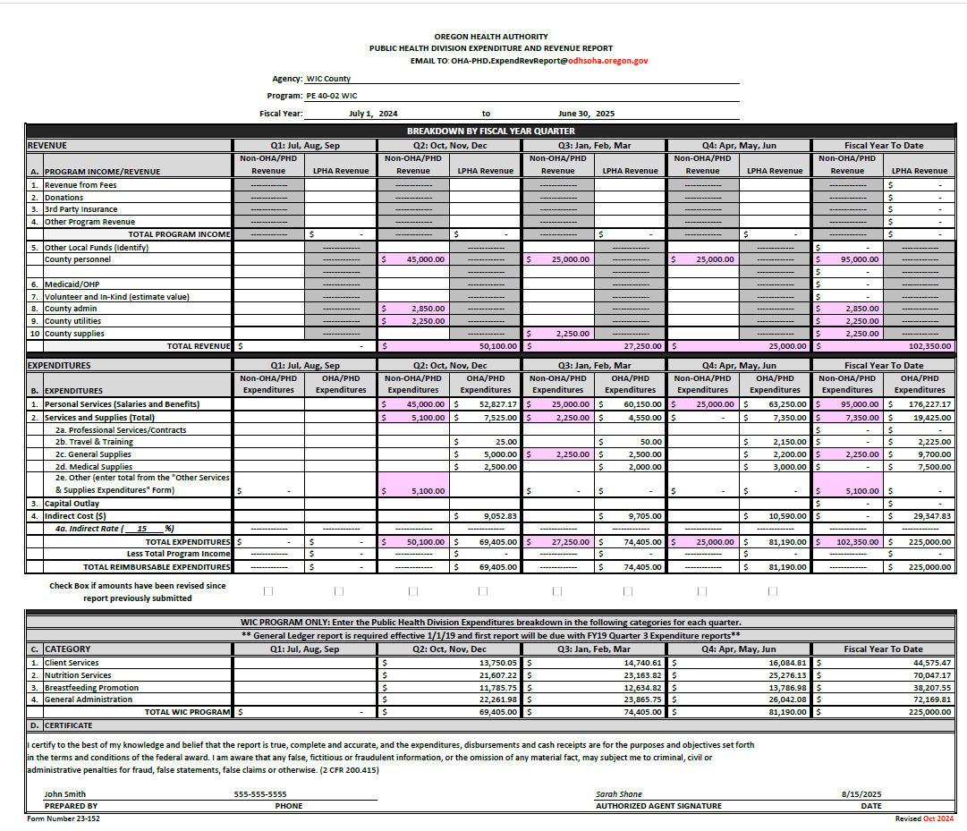
Reporting expenses in excess of the grant
Notes:
Reporting expenses in excess of the grant.
There is a place to record this information on the Expenditure and Revenue report.
- Expenditures and revenues to support WIC which are more than the award amount should be reported in the Non- OHA/PHD Revenue and Expenditure columns.
Enter any revenue that may be contributed for unallowable costs or expenses over the total grant amount in lines 5-10. (Shaded in pink)
Enter Personnel Services including temp service employees in line 1.
Enter Expenses in the appropriate line

Slide 30
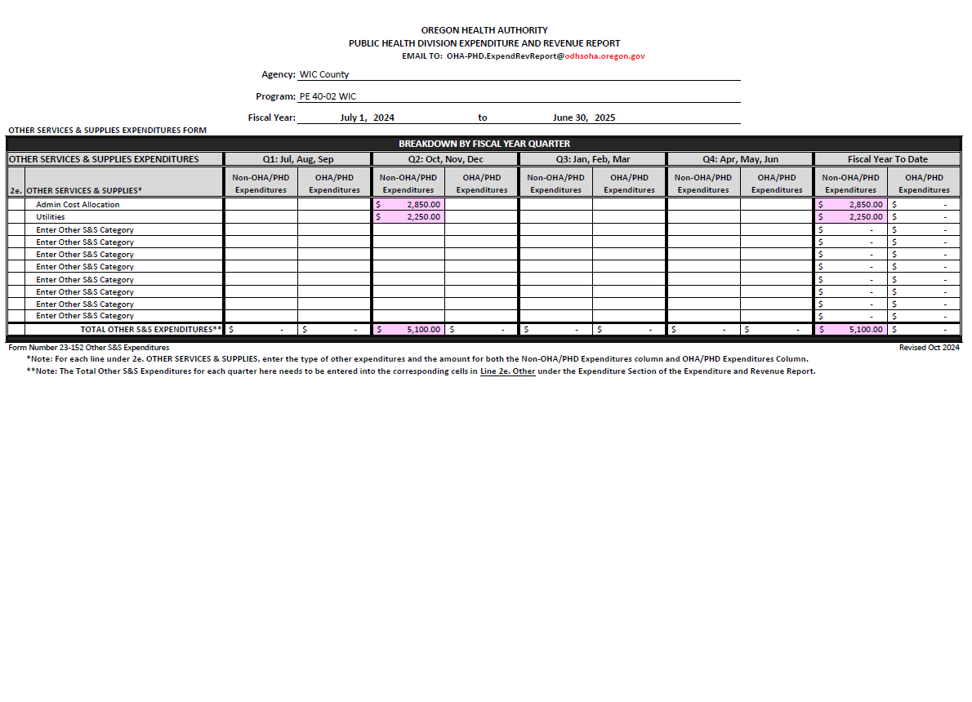
Reporting expenses in excess of the grant
Notes:
Enter other S&S (services and supplies) expenses on page two such as utilities, admin cost allocations, printing, etc. This page automatically total to line 2e. On page one.

Slide 31
Farm Direct requirements
Separate Farm Direct Quarterly Expenditure and Revenue Report
You can use these funds through out the fiscal year
Jan
Feb
Mar
Apr
May
Jun
1 July
Aug
Sept
1 Oct.
Nov
Dec
50% of mini grant
50% of mini grant
2nd Quarter report
3rd Quarter report
4th Quarter report
1st Quarter report
Notes:
Farm Direct is not 100% federally funded. The amount available to spend on Farm Direct vouchers varies year to year depending on how much USDA and the state legislature allocates, and how many Farm Direct voucher booklets are assigned to your agency.
Local agencies will be notified of their Farm Direct voucher booklet allocation and administrative funding prior to the beginning of the Farm Direct season. You get an email from Maria Menor.
A separate Farm Direct Quarterly E&R report must be submitted each quarter, even if no funds are expended. Use the Expenditure and Revenue Report form instructions for details. Remember from earlier all the funding sources had different PE numbers. The Farm Direct reports will be dash 05 for reference regardless of whether it is PE 40, 53 or 61 depending on what agency you are.
Farm Direct may also be called the WIC Farmers Market mini grant/fresh veggie funding and WIC Farmers Market administrative funds. If it has farm in the name, it is likely all farm direct.
Farm Direct Mini Grants are
authorized for the period July 1st through June 30th (State fiscal year), and are paid to local agencies as follows (2 payments):
First you will get 50% paid July 1st and the 2nd 50% is paid October 1st .
Funds receive on July 1 (first quarter) maybe carried over into the 2-4th quarters without any special approvals.
This is different than WIC NSA funds. So, all those warnings that we’ve been saying about the NSA funds and if you don’t use them in the 1st quarter you lose them, well for the Farm direct funds that is not the requirement as long as you spend them all before the end of the State fiscal year of June 30th.
What some agencies are doing now is they are waiting to spend the funds in the spring of the following calendar year so that they can get ready for the next Farm Direct season. Do what is easiest for you administratively to support spending the entire mini grant.
Farm Direct funds need to be tracked separately by actual costs.
Quarterly Expenditure and Revenue Reports need to be submitted for every quarter in the fiscal year regardless if Farm Direct funds are expended. The Final Farm Direct Expenditure and Revenue Report is due on August 20th with the other Q4 reports after the end of the State fiscal year.

Slide 32
Travel and training
required training and certain meetings (e.g. OWCA).
State WIC uses the state guidelines based on federal GSA rates.
Pre-approval from the State WIC office may be needed prior to travel.
Must submit reimbursement requests within 4 weeks of the last travel date.
Reimbursed travel expenses should not be included in the local agency Quarterly Expenditure and Revenue Report.
Use the following forms and resources:
Travel matrix and information (e.g. per diems, mileage rate, 70mile rule)
In-state reimbursement form
Exemption request for travel expenses
Notes:
State WIC will reimburse local agencies for expenses incurred for attending required/mandated training and certain meetings (e.g. OWCA).
State WIC uses the state guidelines regarding meal, lodging and mileage reimbursements based on federal GSA rates. Regardless of what staff are being reimbursed at the local level, when you submit for reimbursement to the State we are going to reimburse you at the State meal rate.
If lodging prices in the area of travel are not within the GSA rates, pre-approval from the State WIC office is needed prior to travel.
Reimbursement requests must be submitted to the state by the agency within 4 weeks of the last travel date. The state reimburses the agency, not individual travelers. The individual may get their reimbursement before the agency gets their reimbursement from the State. The 4-week timeframe is important to not run into issues with the fiscal year ends (June 30th for state and September 30th for federal).
- Reimbursed travel expenses should not be included in the local agency Quarterly Expenditure and Revenue Report.
- Use the following forms and resources:
Policy 340 – Reimbursement for Travel
Travel matrix and information (e.g. per diems, mileage rate, 70mile rule)
In-state reimbursement form – update this link
Exemption request for travel expenses

Slide 33
National WIC Association Conferences and Leadership Academy
Availability based on funding which is evaluated each biennium
What conferences does the state support?
How many are eligible from each agency each biennium?
How often does the state support attendance?
How can Local Agencies verify pre-approval of travel?
Notes:
What conferences does the state support?
NWA conferences and the NWA Leadership Academy
How many are eligible from each agency each biennium?
1 in person or up to 4 for virtual attendance
How often does the state support attendance?
One conference attendance per biennium (every 2 years) per agency. Current biennium is 23/25 will end June 30th 25, Next 24/27 biennium will start July1, 2025 and end June 30th 2027
How can Local Agencies verify pre-approval of travel?
Email your assigned Nutrition Consultant to notify the State WIC office. This is to ensure this is only used once per biennium and to receive confirmation that the selected conference travel will be reimbursed.

Slide 34
National WIC Association Conferences and Leadership Academy
Availability based on funding which is evaluated each biennium
What needs to be paid out of pocket by the person/agency?
What are allowable expenses?
Who does the form get submitted to?
What is the
reimbursement process?
Notes:
What needs to be paid out of pocket by the person/agency?
The local agency must pay first and then will be reimbursed. State WIC CANNOT reimburse individuals.
What are allowable expenses?
Registration, travel costs (air, baggage, and shuttle/taxi), hotel, and per diem meals. Hotel, mileage and per diem are reimbursed at GSA rates.
Who does the form get submitted to?
Tove Larsen
What is the reimbursement process?
Complete the reimbursement form and submit it to Tove Larsen as soon as possible after the conference – and within 4 weeks of attendance. Significantly delayed submission may not be paid.

Slide 35
Additional funding in certain circumstances
Application for Financial Support for Clinic Moving and Expansion
Application for Reimbursement for WIC Nutritionist Training Time
International Board-certified Lactation Consultant certification or recertification
One-time funding or mini-grants for specific projects
Notes:
Additional funding in certain circumstances is available (info can be found on the WIC coordinator resource page under fiscal resources)
If your agency is moving or expanding, you can apply for financial support for State purchased
Items up to $5,000. Work with your assigned nutrition consultant to learn more about the requirements and application process.
The State will purchase items for you.
You send the state a description and item number and all the details and then the state purchaser will order the items and have them shipped to you. This is a newer process as changing a state contract amount is very difficult now.
Amazon is NOT a place the State can use to make purchases.
This grant does not cover building for expansion or remodel. This grant does have limitations about office furniture and equipment that it can cover. Can’t cover building costs e.g for built-in cabinets etc.
Small agencies can complete apply to receive financial support of up to 30 hours of training time for a new WIC nutritionist. If you work in a small agency and you need to hire a new nutritionist that is a resource available to you.
Reimbursement for IBCLC (International Board-Certified Lactation Consultant) certification or recertification for qualified WIC staff is also covered. Approval for reimbursement must be obtained by the State WIC office and your assigned NC or Korina Skaff, can facilitate this.
The State WIC office will sometimes offer one-time funding or mini-grants for specific projects. Reimbursement requirements will be provided when the funds are offered.

Slide 36
Allowable WIC Expenses
Cost allocation
Local program overhead
rent, utilities, legal services, accounting services, administration, personnel/payroll services, county administration, etc.
Necessary and reasonable.
Notes:
Allowable WIC Expenses
Cost allocation – this can include direct and indirect costs
- Local program overhead is often paid by cost allocation.
- Overhead can include rent, utilities, legal services, accounting services, administration, personnel/payroll services, county administration, etc.
- Cost allocation needs to be necessary and reasonable.

Slide 37
Allowable WIC Expenses
Incentive purchases
Allowed under certain parameters
Contact your assigned NC
Capital purchases
Contact your assigned NC for pre-approval
Capital Expenditure Approval Process and Request Form (instructions)
Capital Expenditure Approval Request Form
Notes:
Incentive purchases
There are a lot of rules around this
Incentive/promotional items for participant nutrition education are allowed under certain parameters.
See Policy 460 Program Incentive Items.
Contact your assigned NC with any questions
E.g something that comes up a lot on fiscal reviews is say for instance a staff retires after working there for 25 years. They want to purchase a $600 nice gift because they’ve done a fabulous job, and they want to say thank you for all the years of service. They could be something that they could buy out of county funds or different agency funds and they would report that under the non-OHA/PHD revenue to support it and the expense so that it’s not included as a WIC expense because that would be an unallowable cost.
What is a capital expenditure?
• WIC program use of NSA funds to acquire, increase, or extend the life of agency assets. Examples
include purchasing a WIC van, medical equipment, updating computer equipment.
• The purchased item must yield a benefit of two or more years.
There are a couple of documents, on the WIC coordinators page under fiscal resources. There is a document that explains the process instructions and another to request the capital expenditure. Contact your assigned NC for pre-approval.

Slide 38
Local agency fiscal monitoring and compliance review
proper internal controls
identify & report
accuracy and compliance
Notes:
A fiscal compliance review is conducted at the same time as your local agency review and is to
provide assurance that the local WIC agency has an accounting system with proper internal controls
identify and report revenues, expenditures and equipment provided by federal and state funds through OHA.
A period is selected for conducting the review and the accounting transactions for that period will be evaluated for accuracy and compliance with applicable federal and state regulations, state WIC policies and local policies and procedures.
Instances of noncompliance, material discrepancies and other irregularities are considered findings of the review for which management response and corrective action is required.
And these are the 3 different programs that will be reviewed
WIC
Farm Direct
and Breastfeeding Peer Counseling if applicable

Slide 39
Fiscal policy links
Policy 300
Fiscal Overview
Policy 305
Funding Formula
Policy 310
Annual Plan/Contract Payment Process for Local Programs
Policy 315
Fiscal Reporting Requirements
Policy 316 Quarterly Breakout of Staff Time
Policy 320
Fiscal Review of Local Programs
Policy 325 Caseload Management
Policy 330
Penalty for Underspending Food Budget
Policy 340 Reimbursement for Travel
Policy 460
Program Incentive Items
Notes:
All the fiscal policies referenced in this presentation
all the links are active

Slide 40
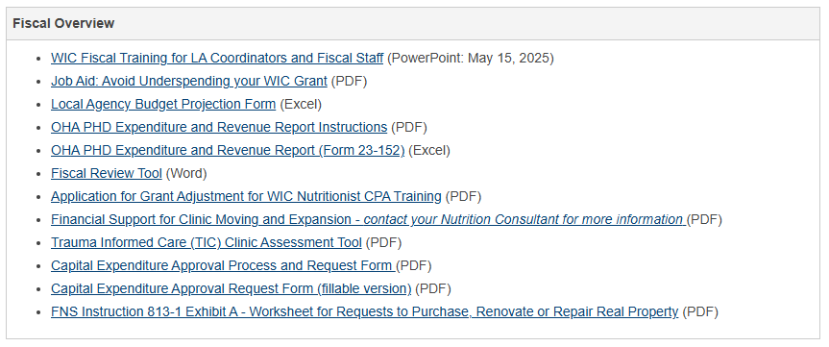
WIC Coordinator Resources
WIC – Coordinator page
Notes:
Link to the coordinator page that is active.
This is what the WIC coordinator page looks like under the fiscal overview section.
All the forms and applications referenced in this training are listed in this section.

Slide 41
For more information:
For help with: | State contact
Budget questions | Fiscal Coordinator – Karen Shi
Time studies | Fiscal Analyst – Tove Larsen
Travel reimbursements | Fiscal Analyst – Tove Larsen and Branwyn Phillips
Quarterly expenditure reports | Fiscal analyst at the LPHA team of the Public Health Director’s Office
Fiscal monitoring | State Fiscal Compliance Specialist - Toni Silbernagel
Notes:
Your assigned state nutrition consultant can answer many questions.
For more specific questions, contact the state office to reach the following:
Budget questions - Fiscal Coordinator – Karen Shi
Time studies - Fiscal Analyst – Tove Larsen
Travel reimbursements - Fiscal Analyst – Tove Larsen and Branwyn Phillips
Quarterly expenditure reports - Fiscal analyst at the LPHA team of the Public Health Director’s Office
Fiscal monitoring - State Fiscal Compliance Specialist - Toni Silbernagel

Slide 42
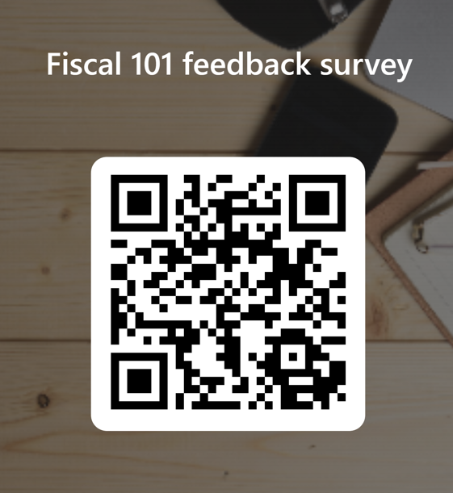
THANK YOU
https://forms.office.com/g/VdeRaDHVTa
Notes:
Please let us know what you thought of this training. The link still works even if you are just reviewing the slides. All your input is valued and appreciated.

