Slide 1
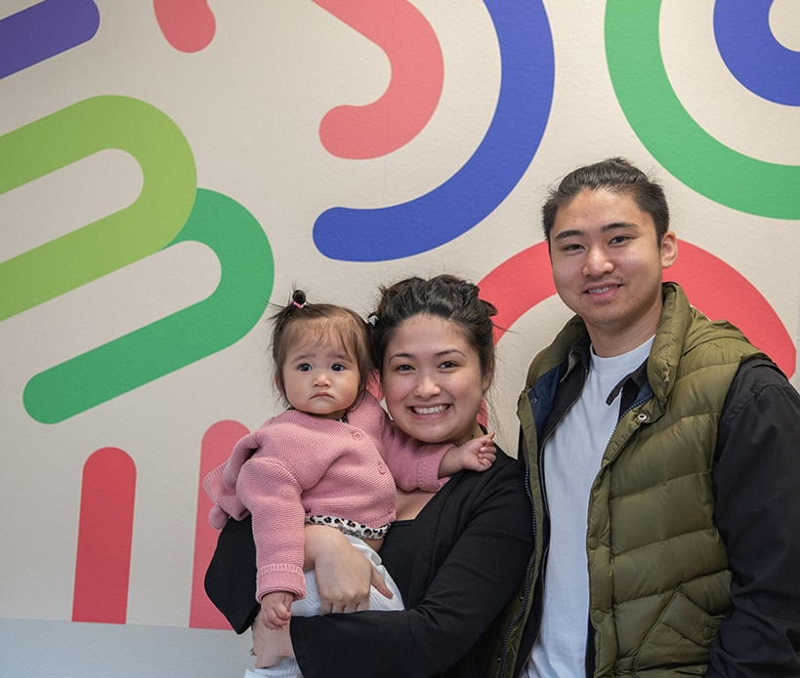
Oregon WIC program
Name, title, date
2020

Slide 2
Serving Oregon families for over 46 years
In the1960s, there was national attention on hunger in the US
Led to creation of Special Supplemental Nutrition Program for Women, Infants & Children (WIC) program
Authorized under the Child Nutrition Act and administered by the USDA
Notes:
In the late 1960s there was national attention to hunger and malnutrition. It lead to the establishment of a pilot federal program in 1972 called the Special Supplemental Nutrition Program for Women, Infants & Children. In 1974, WIC was established by an amendment of the Child Nutrition Act of 1966 and has been operating now in Oregon for over 46 years.
WIC is a discretionary, federally-funded program, and not an entitlement program, for which Congress must appropriate funding regularly.

Slide 3
Oregon WIC’s Vision
To ensure optimal nutrition and lifelong health for every Oregon family.
Notes:
In Oregon, our vision is to ensure optimal nutrition and lifelong health for every Oregon Family.
Optional to share
WIC values:
Every child
Strong relationships
Services delivered with trust and integrity
Oregon’s future
Oregon WIC is administered under the Oregon Health Authority, Public Health Division.

Slide 4
Did you know that last year…
WIC served over 124,000 Oregon participants
Almost half the pregnant women and babies born in rural Oregon were on WIC
73% of WIC families were working
WIC served more women in their 30s than teen moms
Notes:
2019 data in slide
In 2019, WIC served (statewide):
34,195 women
90,026 infants and children
If LA, modify the slide and share your county data and highlight:
Numbers of participants you serve
% pregnant women served by WIC
% of WIC families who are working

Slide 5
WIC is a public health nutrition program serving income eligible:
Pregnant, breastfeeding or postpartum women.
Kids under age 5. This could include grandparents, foster parents, legal guardians, or moms/dads with young kids.
Notes:
(Optional depending on audience)
WIC is a prevention program and research shows WIC has helped in:
Reducing premature births (for every $1 spent on a pregnant women in WIC, more than $3 is saved in Medicaid for her and her newborn baby by reducing the incidence of low and very low birth weigh infants)
Lowering infant mortality
Increasing the likelihood of a women receiving prenatal care
Increasing breastfeeding rates
Improving Kindergarten readiness
Increasing intake of whole grains, fruits and vegetables and consumption of lower fat milk
Reducing household food insecurity

Slide 6
2020 INCOME GUIDELINES I
Number of persons in household | Gross Household Income
 | Annual | Monthly | Weekly
1 | $23,606 | $1,968 | $454
2 | $31,894 | $2,658 | $614
3 | $40,182 | $3,349 | $773
4 | $48,470 | $4,040 | $933
5 | $56,758 | $4,730 | $1,092
6 | $65,046 | $5,421 | $1,251
7 | $73,334 | $6,112 | $1,411
8 | $81,622 | $6,802 | $1,570
For each additional household member add: | + $8,288 | + $691 | + $160
Notes:
If someone is enrolled in Medicaid/Oregon Health Plan, TANF, SNAP/Food Stamps, they would be income eligible for WIC.
To be eligible for WIC:
Live in Oregon
Fit into one of the categories
(pregnant, postpartum or breastfeeding person, an infant, or a child under 5 years old)
Meet these income guidelines (or be enrolled in any of the above programs)

Slide 7
WIC participants are often co-enrolled in other programs
87% in OHP
61% in SNAP
11% in TANF
Notes:
WIC serves many of the same families that access OHP, SNAP or TANF. As you can see, some of the enrollment percentages could be higher. What might be one way we can ensure these families are getting connected to services?
Optional Info: OHP –All of these patient’s are eligible for WIC services. Please refer all your OHP-enrolled pregnant women, infants and children to WIC.
SNAP – SNAP and WIC are often thought of the same programs. How WIC and SNAP differ. WIC has…
A social history with our participants. We have at least 2 contacts with participants every six months (at least 4 a year).
A strong emphasis on nutrition education using motivational interviewing
A prescribed food package that offers specific nutrients for the participant’s needs
TANF stands for Temporary Assistance for Needy Families. The TANF program, which is time limited, assists families with children when the parents or care givers cannot provide for the family's basic needs.

Slide 8
WIC welcomes all
WIC will not ask or keep information about citizenship or visa status.
WIC is not included in the updated public charge ruling.

Slide 9
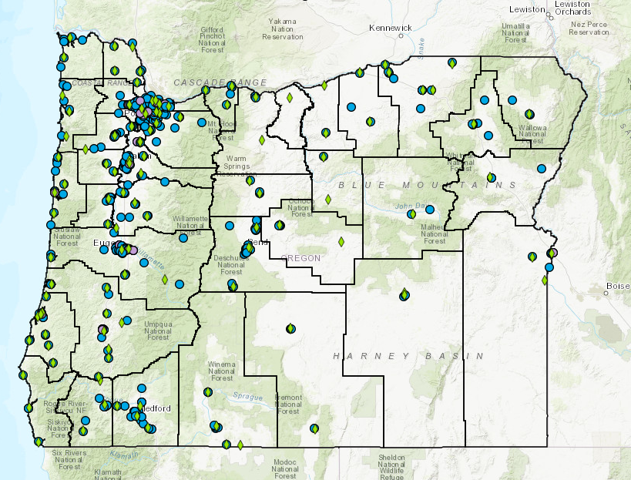
WIC is in all counties
100 WIC
clinic sites
500 WIC food grocers
Link to Oregon WIC map
Notes:
So we have talked about WIC’s reach and who WIC serves, now let’s talk about where WIC clinics and retailers are located.
This map shows WIC clinics (these are the green diamonds) and WIC retailers (blue dots). There are over 100 WIC clinic locations including main clinic sites and WIC satellite clinics (limited hours), and there are over 500 WIC retailers where participants can buy WIC foods.
Note: Pull up the Oregon interactive map and add your zip code to show the locations of WIC clinics, retailers and pharmacies in your area.

Slide 10
Notes:
Many of the photos in this presentation represent Oregon WIC families.

Slide 11
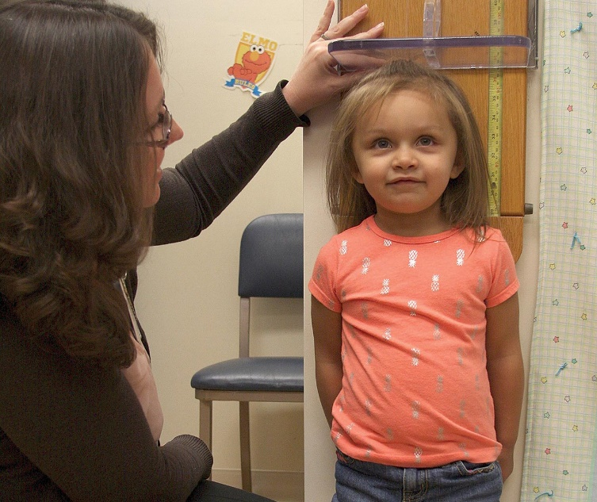
WIC Services
Health and growth screening
Nutrition education
Community referrals
Breastfeeding support
Healthy food
Notes:
WIC offers the following services:
Health & growth screening
Nutrition education
Breastfeeding support
Community referrals
Healthy food

Slide 12
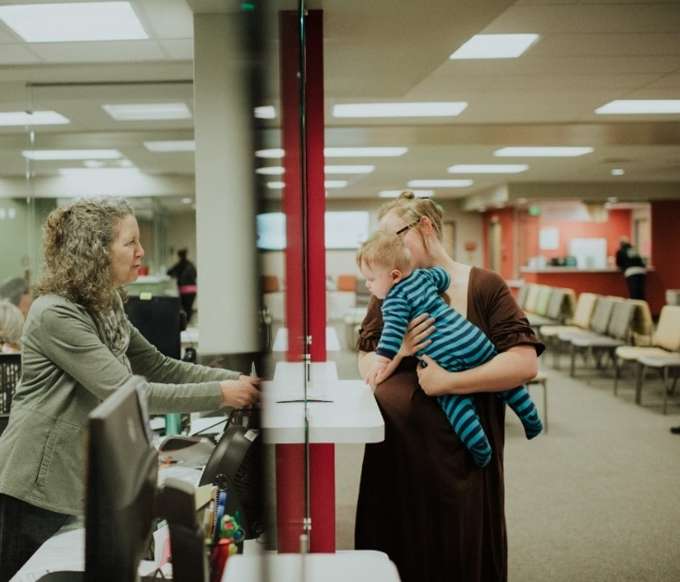
What happens in a WIC visit?
Notes:
Let’s walk through each of the WIC serves.
First, you check in at the front desk. Many WIC offices have upgraded their waiting areas and they are comfortable and engaging.

Slide 13
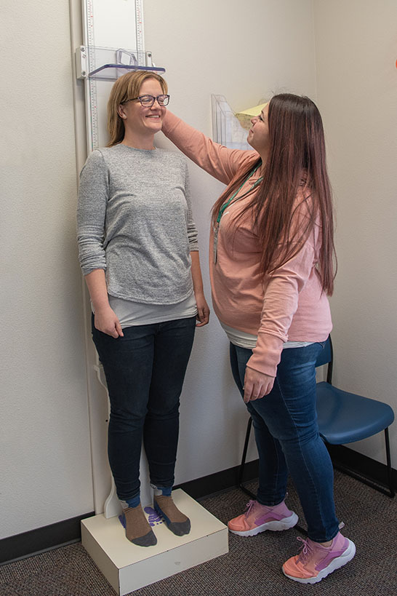
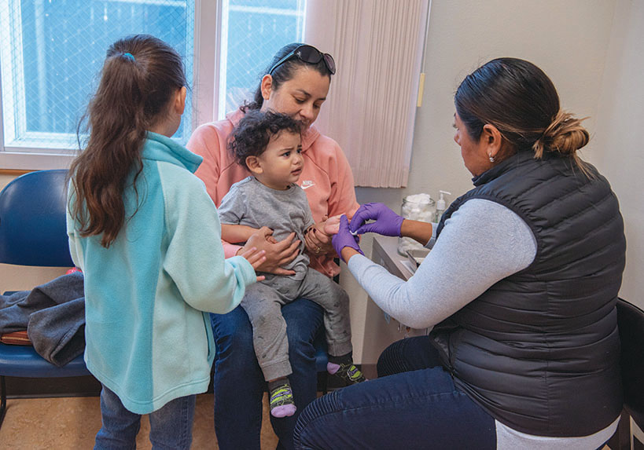
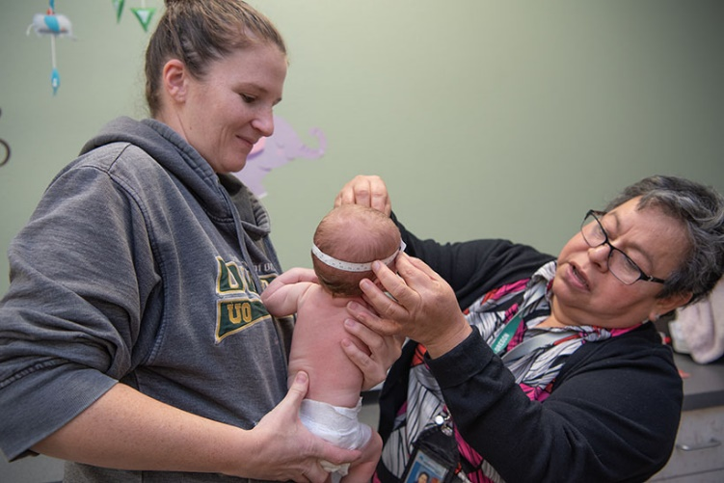
Health and growth screening
Take height and weight
Assess iron levels
Measure head circumference for infants
Notes:
The first part of the visit includes getting heights, weights, checking iron status and getting a head circumference for infants.

Slide 14
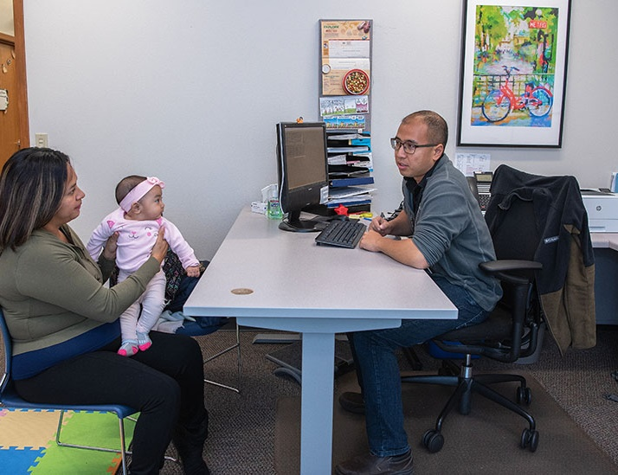
Nutrition education is the cornerstone of WIC
Notes:
Nutrition education is the cornerstone of our program and what sets WIC aside from other supplemental food programs. There are many different ways participants can get nutrition education in WIC. These include
talking one on one with a nutrition assistant or dietitian
Attending a group program
Taking an online class in the comfort of home

Slide 15
Nutrition-focused counseling by trained staff
Talk one-on-one with a trained counselor or dietitian
Staff offer participant-centered ideas to enhance family wellness
Discuss feeding, eating, parenting or breastfeeding questions
Notes:
One form of nutrition education is to meet one-on-one with a either a nutrition assistant or with a WIC dietitian. Often times, participants that have extra health care needs (for example, women with gestational diabetes, food allergies or children with special medical formulas) will meet with the dietitian.
WIC staff go through extensive training to be effective counselors. A typical counselor takes 90 hours of learning modules and an additional 70 hours of observations.
Staff have been trained in motivational interviewing for a strength based approach to counseling and offer participant centered skills where the
WIC participant is at the center of the nutrition-focused counseling process.
WIC counselor helps facilitate behavior change and acts as an advisor to help guide the participant
WIC participant makes decisions based on his/her unique needs
--------------------------------------
Optional info. WIC Dietitian facts:
The term dietitian = registered dietitian nutritionist (RDN) which means the person has a bachelors and often an masters in nutrition, they have participated in a year-long internship and have passed a national credentialing exam.
There are around 50 RDNs working in WIC statewide
Most WIC clinics have a least 1 WIC RDN
RDNs follow-up with participants at higher medical and social risk. Including participants with food allergies, those in foster care, with special health care needs and women with gestational diabetes (are just some examples). RDNs also
monitor children on special medical formulas and help determine WIC approved formulas and foods
Optional info. Courses that WIC staff take to offer the best nutrition education include:
Breastfeeding
Adverse Childhood Experiences (ACEs),
Anthropometric and hematology,
Basic nutrition and nutrition risk
Prenatal and postpartum nutrition
Baby behaviors and understanding toddler behaviors
Infant and Child Nutrition
Responsive parenting

Slide 16
WIC offers online and group classes
Over 20 WIC online nutrition-related courses
Many WIC classes including infant or child feeding, breastfeeding or prenatal nutrition
Notes:
WIC also offer nutrition education online and in a group or peer supported setting.
Common WIC classes include infant feeding, breastfeeding or prenatal nutrition. Share local WIC group class offerings.
Currently, WIC offers 20 different nutrition-related courses to include topics such as:
Life course nutrition,
Breastfeeding,
Baby and me classes,
Infant feeding cues and baby behaviors,
Picky eating behaviors,
Shopping for, storing and preparing fresh fruits and veggies,
Physical activity

Slide 17
Community Referrals
Common WIC referrals:
OHP/SNAP
Oregon Health Plan
Immunizations
Health care
Head Start/day care
Housing and utility assistance
Drug and alcohol support
Notes:
At the end of a WIC visit, the counselor will summarize the conversation and help the participant identify next steps. Sometimes participants could use additional support and resources outside of WIC, so WIC staff make referrals to many community organizations. It is important for WIC to communicate regularly with partners in order to stay up-to-date on the partner program’s eligibility guidelines, services provided and best referral options.
Some common referrals are to…..listed above
Take a minute to discuss one way we can improve either communication or materials sharing to ensure our shared families

Slide 18
Breastfeeding support
WIC promotes, protects and supports breastfeeding as the normative standard for infant feeding.
Notes:
-Breastfeeding provides critical nutrition and protection from infection and disease to help infants achieve their full health potential. Breastfeeding protects mothers too, reducing their risk of diseases such as diabetes, breast cancer, ovarian cancer and CVD.
-Because it’s so important WIC is required by federal regulation to promote breastfeeding beginning at the very first prenatal WIC visit. Staff are trained to help families address barriers and overcome breastfeeding challenges throughout the breastfeeding journey.

Slide 19
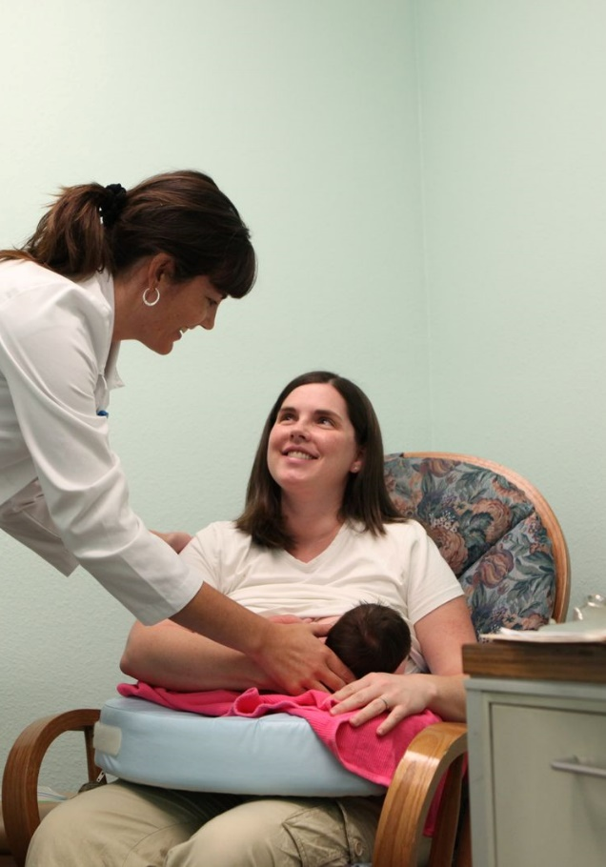
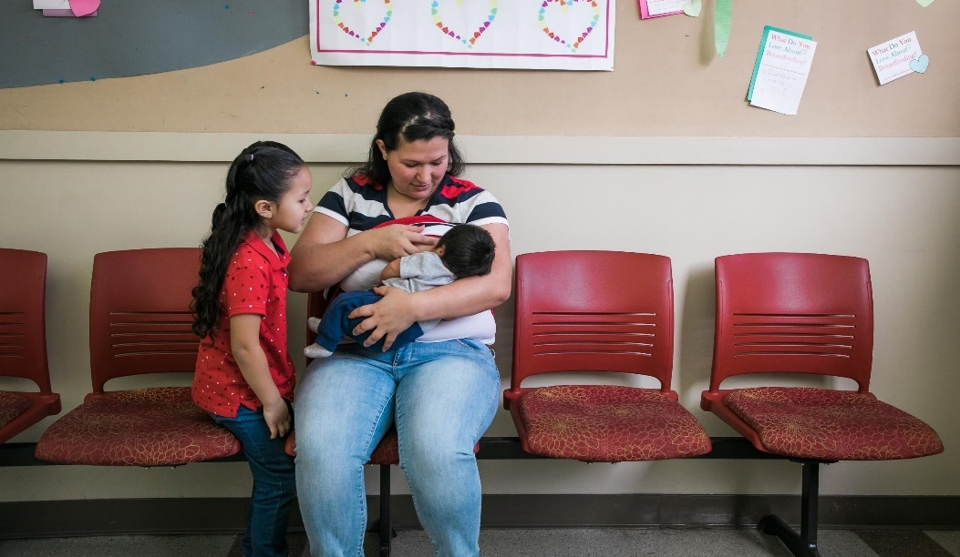
WIC supports breastfeeding families
Trained WIC staff
Breastfeeding friendly clinics
WIC does not routinely issue formula to breastfeeding infants in the first 30 days
Notes:
All WIC staff are required to have a minimum competency in breastfeeding covering many topics which include:
Value of long-term, exclusive breastfeeding
Importance of breastfeeding for health of mom and baby
Planning for feeding the newborn in the hospital
Skin to skin contact after delivery
Basics of breastfeeding anatomy and physiology
Tips for helping moms with milk production
Overcoming challenges
Baby behavior and infant sleep patterns
Some staff have advanced lactation training including those with the International Board Certified Lactation Consultant (IBCLC) credential
WIC clinics welcome moms to breastfeed their babies whenever and where ever they need to. Some have special places to make moms and babies more comfortable when it’s time to nurse. Clinics decorate with breastfeeding photos to show their support. Formula marketing is not allowed.
-------------------------------
Optional info: List of classes that a WIC certifier takes
Helping with a breastfeeding and what to expect in the hospital
The First hour, Skin-to-skin, Value of exclusivity
Early postpartum breastfeeding -Establishing milk production
Maintaining breastfeeding through the first year
Baby behavior, Growth spurts, Adequate milk, Sleep, Stooling, Milk volume, Teething, Returning to work or school
Overcoming Challenges -Focus on physiological issues, from most to least commonly occurring, Low milk production, Engorgement, Sore nipples, Mastitis, plugged ducts, Overactive letdown
The reason WIC does not provide formula in the first 30 days - A major goal of WIC is to improve the health of mothers, infants and children; therefore, WIC families are encouraged to breastfeed infants unless medically contraindicated. The first days and weeks after delivery are a critical time for mothers and infants to establish breastfeeding. Formula supplements interfere with milk production and make learning to breastfeed difficult.

Slide 20
“My breastfeeding peer counselor has helped me to believe that I could overcome the obstacles in my path and has given me the emotional support I needed. I trust her and am so very thankful for her and that this program exists.”
---WIC participant
Notes:
Here is what a WIC participant had to say about the breastfeeding support at WIC. Read quote.
If your agency offers the breastfeeding peer counseling program, offer an overview of how peer counselors provider mother to mother support.
Another testimony for fun:
“WIC is the only place I hear "good job" for nursing my children for the past two years. Not even my doctor says that!“
---WIC participant

Slide 21
WIC Foods
WIC offers a variety of healthy foods that are rich in vitamins, minerals, protein and anti-oxidants
Fruits & Veggies
Whole Grains
Milk; low-fat age 2 and older
Cheese, including
string cheese
Eggs
Peanut Butter and/or beans
Cereal
Juice
Canned fish for fully
breastfeeding moms
Infant Foods
Baby food (organic options)
Tofu and yogurt
Notes:
WIC offers a variety of healthy foods that are rich in vitamins, minerals, protein and anti-oxidants. Each WIC participant is issued a standard food package which is shown in the picture above it includes:
Fruits & Veggies; can be organic; fresh, frozen or canned
Whole Grains; adding options like whole grain pasta and tortillas
Milk; low-fat age 2 and older
Cheese including string cheese
Eggs, any size
Peanut Butter and/or beans; canned or dried
Cereal (In 2019 Oregon removed certain cereals to eliminate any artificial dyes)
Juice (the amount per month averages out to be 4 ounces per day, in line with AAP recommendations, significant source of vitamin C doe participants))
Canned fish for fully breastfeeding moms
Infant Foods (In 2019: Oregon first in the nation to remove infant rice cereal from our food package due to concerns with levels of arsenic in infant rice cereal)
Baby food (including organic options)
Tofu and yogurt (added more options in 2019)

Slide 22
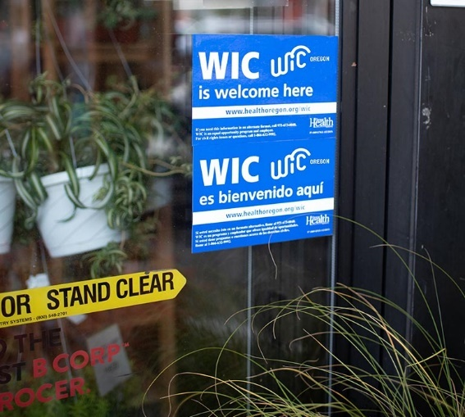
WIC foods options
WIC food packages can be adapted for special diets:
Vegan alternatives such as tofu and a variety of beans
Dairy alternatives such as soy, lactose-free, acidophilus or goat milk
Organic fruits, veggies and baby food options
Notes:
WIC food packages can be altered to meet the dietary needs of the participant.
Questions or concerns about juice. WIC follows the AAP recommendations of 4 oz or less of juice for children
Optional info: Items on the WIC food list are evaluated by:
Nutrient profile analysis
Participant preferences
Price
Availability

Slide 23
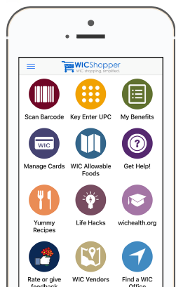
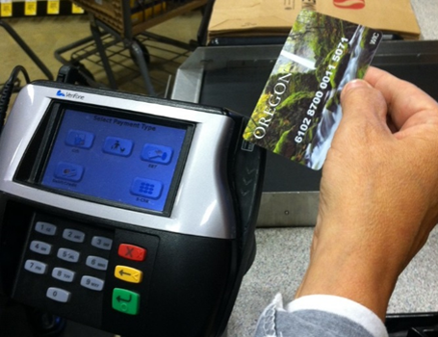
WIC food shopping
eWIC card is used to buy WIC foods
WIC Shopper App simplifies shopping
WIC boosts our economy (48 million in WIC benefits were spent in Oregon’s grocery stores last year)
Notes:
WIC participants are given an eWIC debit card similar to the SNAP trail card but this card has the prescribed WIC foods. The participant takes this card to their nearest WIC authorized grocery store. As noted earlier, there are over 500 grocery stores that take WIC throughout Oregon.
The WIC Shopper App is a great resource that simplifies WIC shopping. This app shows real time benefits, links to healthy recipes and a scan bar code feature which identifies WIC foods.
The average food package value per participant is around $50. (A pregnant mom with a child would get approximately $100 worth of food per month)
WIC boosts the local economy! Share the amount of federal funds that are brought into your community through WIC food purchases!

Slide 24
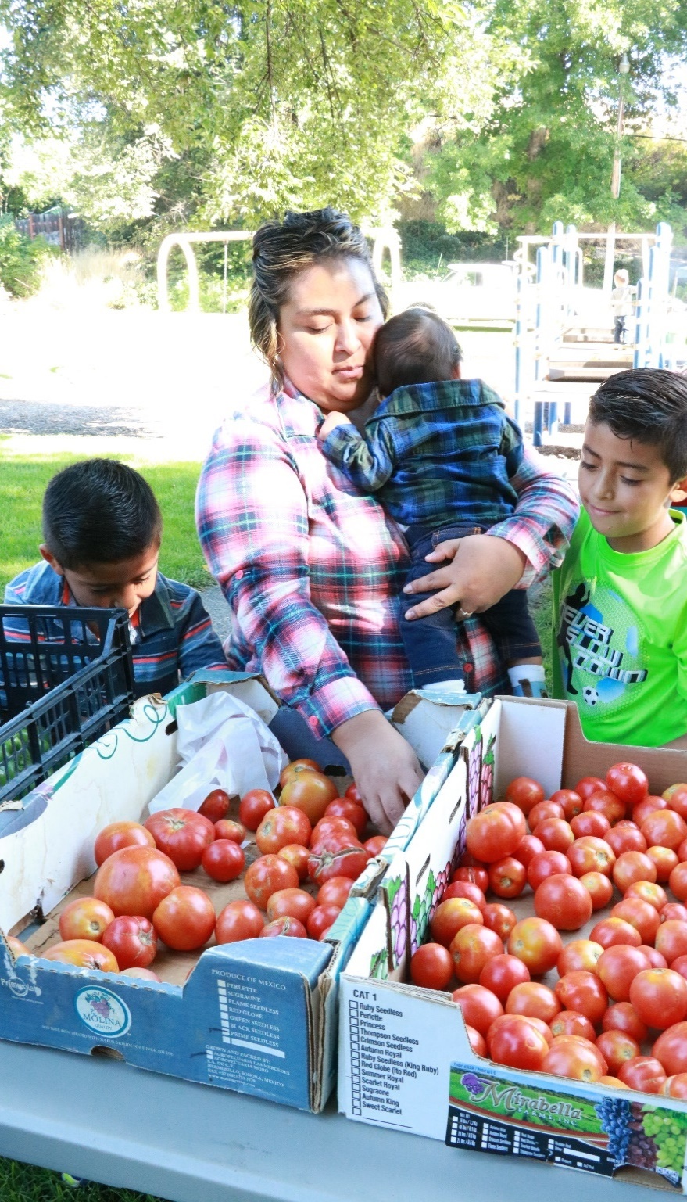
Oregon Farm Direct Nutrition Program (FDNP)
WIC participants get FDNP checks to spend at farmers markets and farm stands:
These checks are used to buy fresh fruit, veggies and herbs
Benefit amount is $28 per WIC participant
Over 700 Oregon produce farmers in FDNP
$823,000 went to Oregon farmers last year
Notes:
Share local FDNP information here.

Slide 25
WIC Outreach Materials
healthoregon.org/wic
Resources for Partners page
Fill out WIC outreach materials form
Brochures and posters

Slide 26
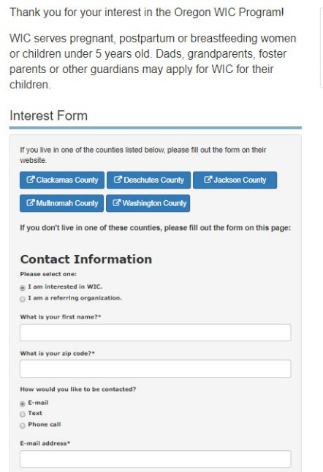
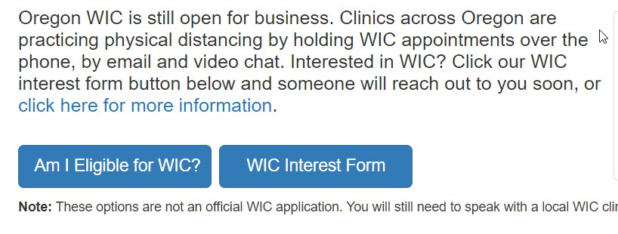
Sign up USING OUR WIC interest Form
Visit: healthoregon.org/wic
Notes:
A fast way to get connected is to sign up through the WIC Interest Form button on our Oregon WIC webpage. Just click on this blue button and fill out the form. The form asks for a name and a phone number or email. Then, WIC staff then reach out within 2 business days to check eligibility and get the person signed up.

Slide 27
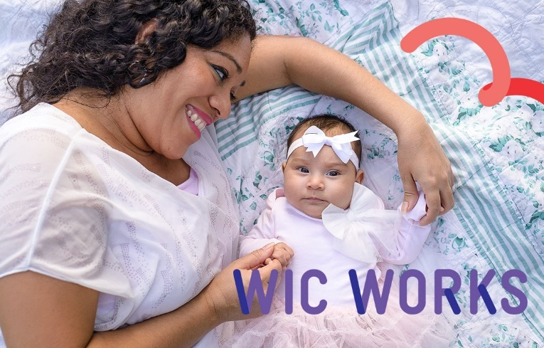
“I just want to thank Oregon WIC. I have been with you for the past 10 years. My twins turned 5 last month and our family thanks you for all your help with the food, the encouragement, the tips & tools, the recipes, and the friendships made over the years. I will miss you all!”
--Lane County WIC Participant
Notes:
This is a quote came through Facebook from a Lane County WIC participant. I feel it sums up well what you get with WIC, and often times it’s more than just food. ☺

Slide 28
Thank you!
www.healthoregon.org/wic
211 information line
Like us on Facebook - Oregon WIC
Contact information

