Slide 1

The Stanley/Brown Safety Planning Intervention: A First Contact Treatment Intervention of Those At-Risk of Suicide
Hosted by Oregon Health Authority Public Health Division’s SBHC Program and Suicide Prevention Program
Trainer: Adam Lesser, LCSW
Deputy Director, The Columbia Lighthouse Project

Slide 2
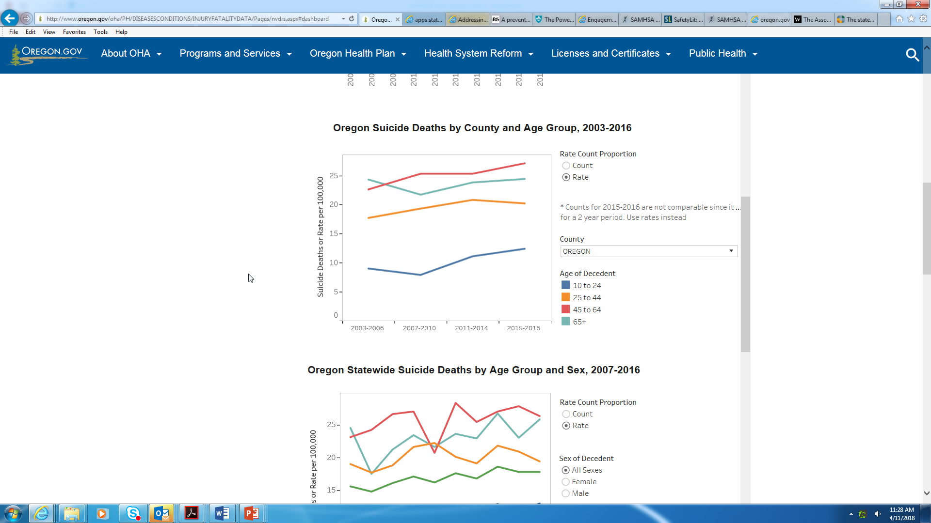
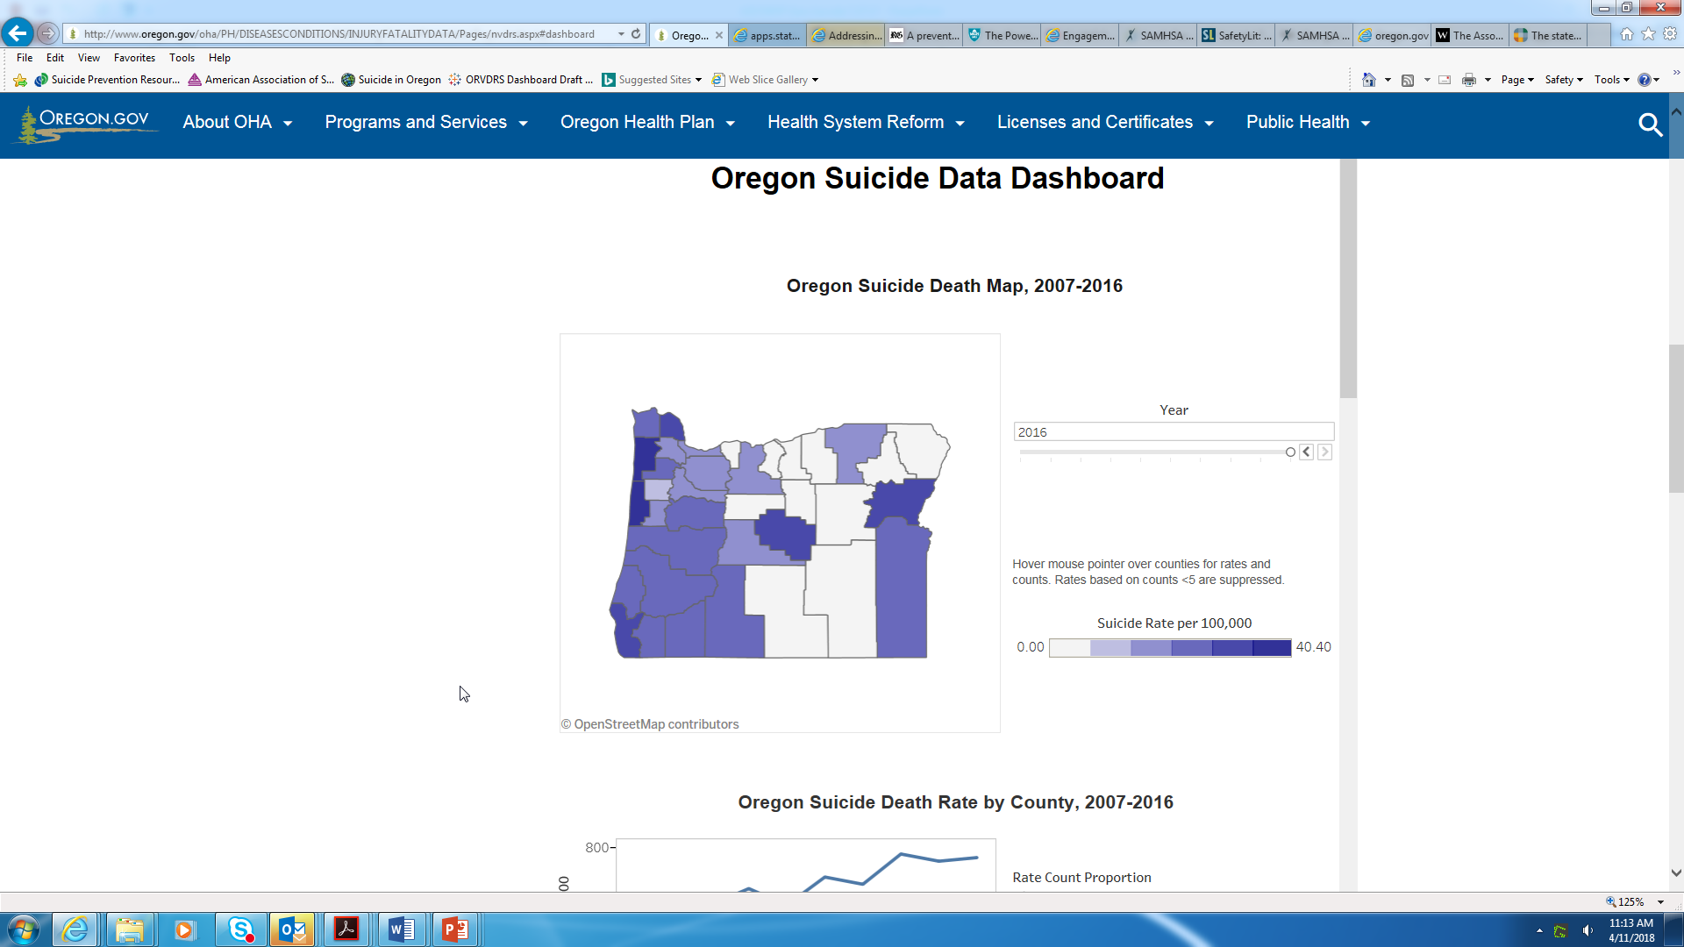
Suicide in Oregon
Access OHA Data Dashboard and Suicide Map Tool at: http://www.oregon.gov/oha/PH/DiseasesConditions/InjuryFatalityData/Pages/index.aspx
In 2016, 771 Oregon residents died by suicide.
98 of these suicides occurred among Oregon youth aged 10-24.
Suicide is the 2nd leading cause of death among Oregonians aged 10-24 years and has been rising since 2011.
Male youth are 4X more likely to die by suicide than female youth.
Rate of OR Suicide Deaths by Age Group
OR Suicide Deaths, 2016
Notes:
Data Dashboards- suicide, opioid use, firearm

Slide 3

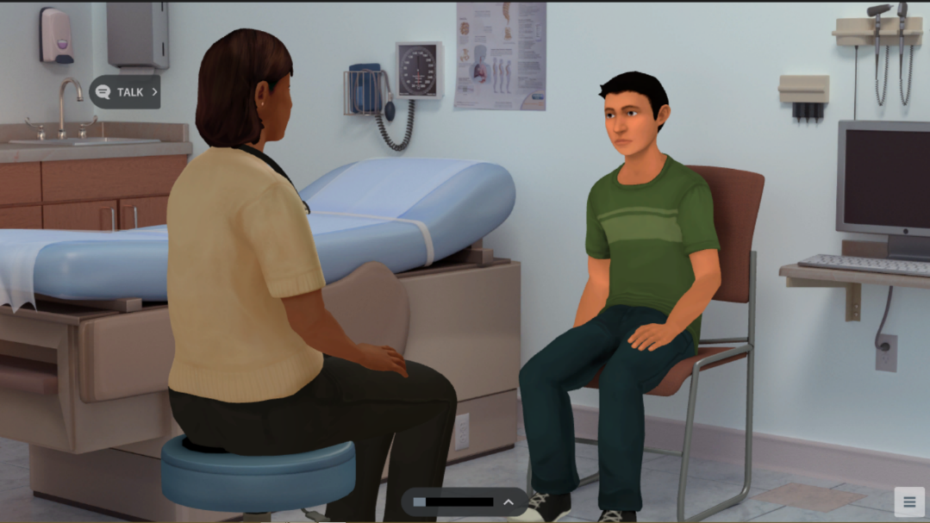
Simulation for Health Care Professionals
20-30 minute online learning experience.
Awards .75 CEUs for physicians, nurses, social workers, and school psychologists.
Promotes integration of behavioral health in the primary care setting.
Includes Virtual Patient role-play conversation.
Incorporates practice using motivational interviewing techniques.
©2016 Kognito. All rights reserved

Slide 4
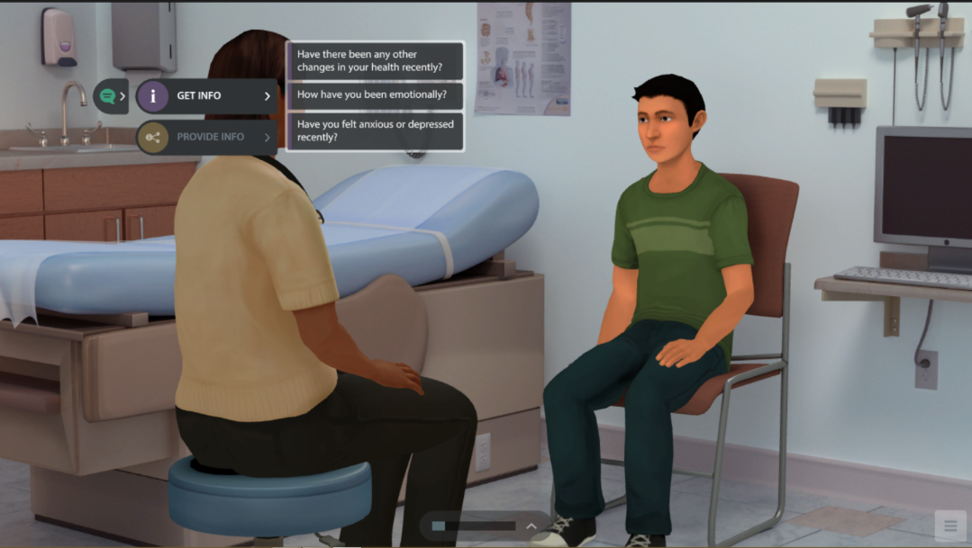
Learning Objectives
After completing the simulations, users will be able to:
Recognize the importance of mental health as part of the role of primary care.
Build rapport with patients using motivational interviewing tactics.
Broach the topic of mental health and correct common misconceptions.
Demonstrate appropriate ways to ask a patient about suicidal ideation.
Take appropriate steps for referral and follow up.
©2016 Kognito. All rights reserved

Slide 5
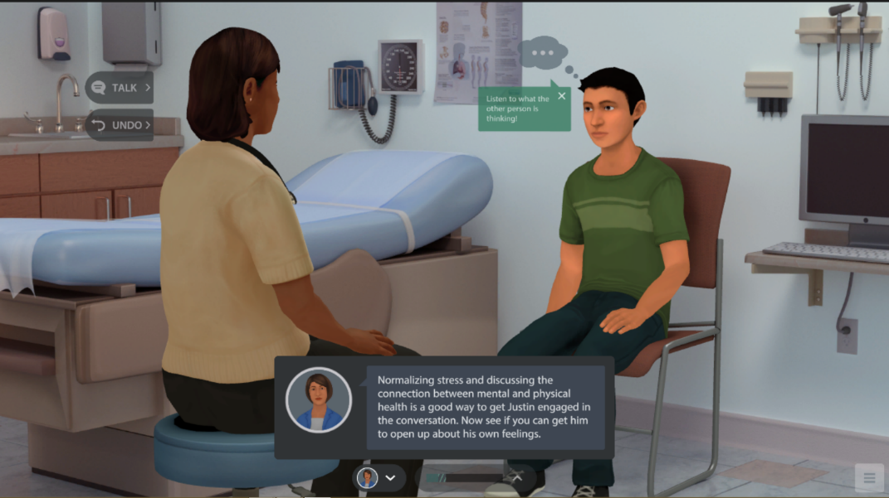
Conversation
Broach topic of mental health and normalize mental health concerns.
Engage Justin in discussion of his mental health and factors that may be contributing to his headaches.
Uncover thoughts of suicide, assess risk.
Motivate inclusion of parents.
©2016 Kognito. All rights reserved

Slide 6
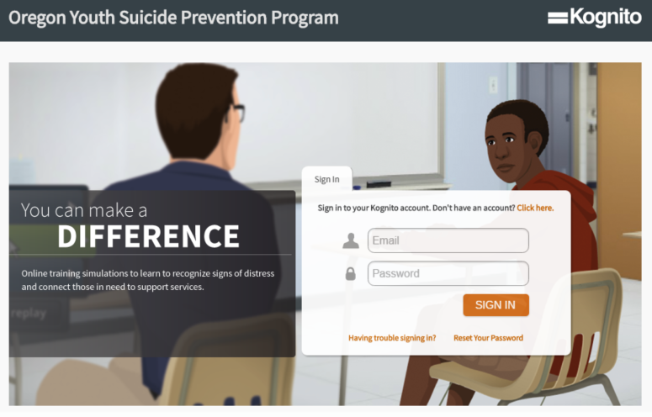

Accessing the Simulations
www.kognito.com/oregon

Slide 7
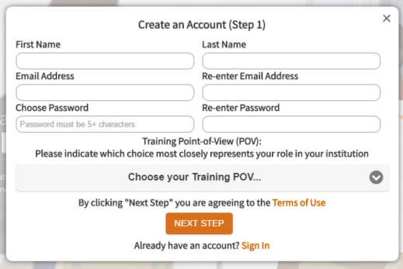
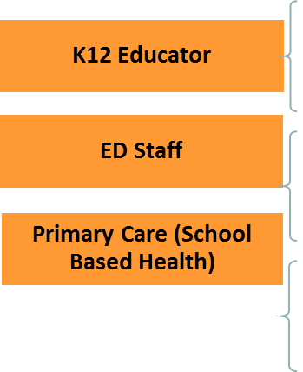
Identify Yourself:
SBHC staff select Primary Care Professional
ED Staff
Primary Care Professional

Slide 8
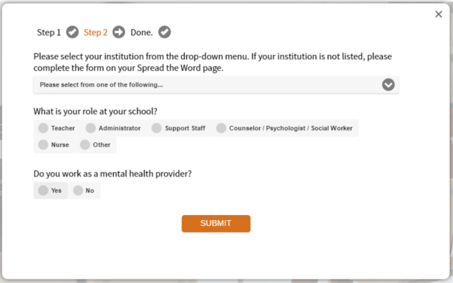
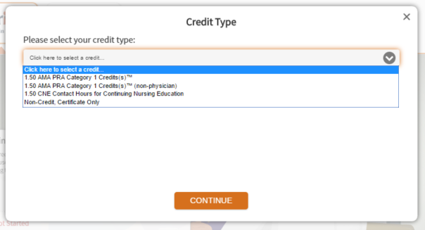
Provide Detailed Information

Slide 9
Oregon Zero Suicide Academy: Sept. 18-19, 2018 &
Oregon Community of Practice for Better Suicide Care
The Zero Suicide Academy® is a two-day training for senior leaders of health and behavioral health care organizations that seek to dramatically reduce suicides among patients in their care. Using the Zero Suicide framework, participants learn how to incorporate best and promising practices into their organizations and processes to improve care and safety for individuals at risk. Zero Suicide faculty provide both interactive presentations and small group sessions, and collaborate with participants to develop organization-specific action plans. The Oregon Zero Suicide Academy is sponsored by the Oregon Health Authority, Public Health Division (OHA PHD).
The will Oregon Community of Practice for Better Suicide Care begin in October 2018 as a member-driven group engaged in virtual learning to hear from state and national experts on their experiences implementing better suicide care practices.
The Zero Suicide Academy and Oregon Community of Practice for
Better Suicide Care application can be found at:
https://zerosuicide.sprc.org/zero-suicide-academy
Notes:
The Zero Suicide Academy® is a two-day training for senior leaders of health and behavioral health care organizations that seek to dramatically reduce suicides among patients in their care. Using the Zero Suicide framework, participants learn how to incorporate best and promising practices into their organizations and processes to improve care and safety for individuals at risk. Zero Suicide faculty provide interactive presentations and small group sessions, and collaborate with participants to develop organization-specific action plans.

Slide 10

Oregon Minor Consent/Confidentiality
In a healthcare setting
Minors 14 years and older may access outpatient mental health, drug or alcohol treatment without parental consent
Providers are expected to involve parents by the end of the minor’s treatment
  Unless clear indicators to the contrary exist, sexual abuse is ID’d, the minor is emancipated, or the parent refuses
No legal “right” to disclosure or confidentiality. Providers use “best clinical judgment”
Mandatory reporter disclosure.

Slide 11
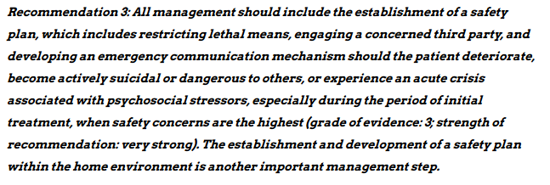

AAP Guidance: Safety Plan in Primary Care
Notes:
Since 2007, AAP has recommended developing safety plans in a primary care setting for youth who have identified depression or suicidality.
Recently AAP updated these guidelines to recommend universal depression screening for adolescents 12-24.
Also includes recommendation to work with schools to develop an emergency plan for students who may experience acute suicidal crises.

Slide 12

Save the Date!
Identification and Triage Using the Columbia-Suicide Severity Rating Scale, Part II
August 8, 2019 7:30-9AM
Webinar will be recorded and available at: www.healthoregon.org/sbhc

Slide 13
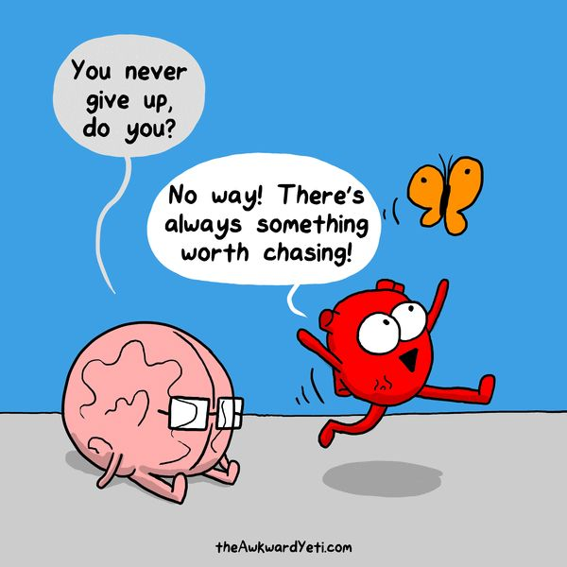
Meghan Crane
Zero Suicide Program Coordinator
Oregon Health Authority
971-673-1023
meghan.crane@state.or.us
Kate O’Donnell
School Mental Health Specialist
Oregon Health Authority
971-673-1054
kathryn.m.odonnell@state.or.us

Slide 14
Safety Planning Intervention with Suicidal Individuals:
A Brief Therapeutic Intervention

Slide 15
Components for Suicide Prevention
Population-based Prevention
Population Screening
Psychiatric Hospitalization
Specialized Psychotherapy and Pharmacological Tx
Emergency Care: ED and Hotlines
Identification & Assessment
Brief Interventions:
Safety Planning
Notes:
Brief Interventions in this area is relatively new

Slide 16
What are brief interventions?
Brief Interventions range from single session to multiple sessions
May or may not include follow-up support
Variety of intervention approaches:
  Psychoeducation
  Crisis response planning
  Cognitive behavior therapy
  Motivational interviewing/treatment engagement
  Outreach follow-up: Letters, postcards, phone calls

Slide 17
Rationale for Brief Interventions
Crisis contact may be the ONLY contact the suicidal individual has with the mental health system
  Suicidal patients are very difficult to engage in treatment. Rudd et al. (1996)
  Up to 60% of suicide attempters do not even attend more than one week of treatment post-discharge from the ED (O’Brien et al., 1987; Granboulan, et al., 2001; King et al., 1997; Piacentini et al.,1995; Trautman et al., 1993; Spirito et al., 1989; Taylor & Stansfield, 1984; Kurz & Moller, 1984; Litt et al., 1983).
  After a year, 73% of attempters will no longer be in any treatment (Krulee & Hales 1988)
Notes:
Replace this with above? (use ref)

Slide 18
Rationale for Brief Interventions
  Ongoing outpatient treatment is not for everyone
    Men and certain cultures - Stigma
    Individuals with Borderline Personality Disorder are at high risk for suicide and suicide attempts, also difficult to engage and maintain in treatment
    Adolescents tend to have attitudes that are inconsistent with long term therapy:
      “The past is the past. It won’t reoccur.”
      When mood improves, it’s hard for them to imagine that it could worsen again.
    Treatment may be unavailable during most high risk time or not at all (waitlist, rural)
Notes:
Replace this with above? (use ref)

Slide 19
Typical Strategy for Crisis Intervention
Assess imminent danger
Refer for treatment
But, given the limited success of ED referrals, alternative strategies that include immediate intervention ought to be considered and may be able to increase its “therapeutic” capacity

Slide 20
At the same time, its important to not expect miracles from brief interventions.
They should be considered one aspect of suicide prevention, e.g. cholesterol lower drugs for cardiac disease.

Slide 21
Safety Planning
Intervention
(SPI)
To reduce suicide
risk and
enhance coping
To increase
treatment motivation
and enhance linkage

Slide 22
Origin of Safety Planning Intervention
(Stanley & Brown,2008;2012)
To maintain safety of high risk patients in outpatient treatment trials (Penn CT study for adults; TASA study for suicidal adolescents)
Compilation and ordering of evidenced-based suicide interventions
Expanded and modified as a stand alone intervention for the VA and in civilian EDs

Slide 23
3‘Theoretical’ Approaches Underlying SPI
Suicide risk fluctuates over time (e.g., Diathesis-Stress Model of Suicidal Behavior, Mann et al., 1999)
Problem solving capacity diminishes during crises---over-practicing and a specific template enhances coping (e.g. fire drills)
Cognitive behavioral approaches to behavior change
    Behavioral strategies to identify individual stressors that have precipitated suicidal behavior in the past.
    Clinician and suicidal individual collaborate to determine cognitive-behavioral strategies patient can use to manage suicidal crises.

Slide 24
Safety Planning Evidence Base
Incorporates elements of four evidence-based suicide risk reduction strategies:
  means restriction
  teaching brief problem solving and coping skills (including distraction)
  enhancing social support and identifying emergency contacts, and
  motivational enhancement for further treatment.

Slide 25
Safety Plan Intervention: Overview
Clinical intervention where the individual at risk creates a one-page document with the help of a clinician to use when in crisis
Written list of coping strategies and resources that includes a step-wise increase in level of intervention from “within self” strategies up to going to psychiatric ER
Although the plan is stepwise, if one step is unavailable, don’t stop and wait till it is available – move on

Slide 26
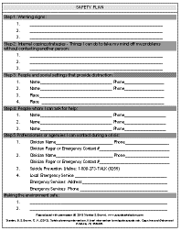
Safety Planning Intervention: Overview
Concrete and tangible
Uses a brief, easy-to-read format that uses the individual’s own words
Can be used as a single session intervention or incorporated into ongoing treatment
Helps provide a sense of control
Similar to a fire drill – “practice makes perfect”

Slide 27
SPI as a ‘Cast’ for Suicidal Patients
Safety Planning Intervention is the equivalent of putting a cast on a broken limb
Provides immediate intervention to those who do not need require inpatient hospitalization
Fills the gap between emergency room discharge and follow up treatment

Slide 28
Safety Plan Intervention: What it’s not
It does not substitute for treatment
It does not help if the individual is in imminent danger of attempting suicide
Safety Plans are not “no-suicide contracts”
No-suicide contracts ask patients to promise to stay alive without telling them how to stay alive – not effective

Slide 29
Target Population for
Safety Planning Intervention
Individuals at increased risk but not requiring immediate rescue (e.g. on phone can’t report that they won’t act on SI)
Patients who have…
  made a suicide attempt
  suicide ideation particularly those in the moderate to high risk range
  psychiatric disorders that increase suicide risk
  otherwise been determined to be at risk for suicide

Slide 30
Beginning the Safety Plan
“Telling the Story”
Have the suicidal individual describe the events and situations and their reactions to these events in as much detail as possible
  Builds rapport
  Creates “buy-in”
Beginning of the story:
  Major decision point associated with increased suicide risk
  Strong emotional reaction to a specific event
    External event such as a significant loss
    Internal event such as an automatic thought
  Follows backwards in time – “What happened just before that?”

Slide 31
“Telling the Story”
Understand the function of suicidal behavior or thinking from the individual’s perspective; that the behavior “makes sense” to the individual in the context of his or her history, vulnerability, and circumstances.
Empathize with the individual’s strong feelings and desire to be reduce distress.
Validate that they were trying their best to get out of a crisis situation
Refrain from trying to solve the individual’s problems before understanding the motivations for suicide.

Slide 32
Developing the Plan
After the risk assessment is done and the patient describes the suicidal crisis, the SPI can be developed
Solicit agreement to develop a plan
Explain the rationale for such a plan and when to use the SPI

Slide 33
Overview of Safety Planning: 6 Steps
Recognizing warning signs
Employing internal coping strategies without needing to contact another person
Socializing with others who may offer support as well as distraction from the crisis
Contacting family members or friends who may help to resolve a crisis
Contacting mental health professionals or agencies
Reducing the potential for use of lethal means

Slide 34
Step 1: Recognizing Warning Signs
Safety plan is only useful if the individual can recognize the warning signs.
The clinician should obtain an accurate account of the events that transpired before, during, and after the most recent suicidal crisis.
“How will you know when the safety plan should be used?”
“What do you experience when you start to think about suicide or feel extremely distressed?”
Be specific! Write down the warning signs (thoughts, images, thinking processes, mood, and/or behaviors) using the individuals’ own words.

Slide 35

Safety Plan: Chart Review (n=100)
Step 1: Warning Signs (Thoughts)
Depressed/Negative Thoughts | 23%
Hopeless Thoughts | 22%
Worthless/Helpless/Purposeless Thoughts | 18%
Reminders of Trauma | 16%
Thoughts of Being Disconnected or Alone | 10%
Suicidal Thoughts | 8%
Thoughts of the Future/Worry | 8%
Misc. Thoughts about Others | 5%
Not Thinking Clearly/Overwhelmed | 5%
Thoughts about Financial Stress | 5%
Thoughts About Being Personally Attacked or Disrespected | 3%
Brown, Stanley, Pontoski, Mahler, Chaudhury, & Biggs, Unpublished data, 2014

Slide 36
Safety Plan: Chart Review (n=100)
Step 1: Warning Signs (Emotions)
Angry/irritable/frustrated/annoyed/agitated | 26%
Depressed | 22%
Stressed/overwhelmed | 14%
Anxious/fearful | 13%
Alone/lonely | 5%
Guilty | 4%
Empty | 3%
Disappointed | 2%
Bored | 2%
Detached | 2%
Other | 5%
Brown, Stanley, Pontoski, Mahler, Chaudhury, & Biggs, Unpublished data, 2014

Slide 37
Safety Plan: Chart Review (n=100)
Step 1: Warning Signs (Physical Sensation)
Panic Symptoms | 14%
Pain/Headaches | 8%
Weakness/Fatigue | 5%
Changes in Appetite | 3%
Unable to Speak | 2%
Other | 5%
Brown, Stanley, Pontoski, Mahler, Chaudhury, & Biggs, Unpublished data, 2014

Slide 38
Safety Plan: Chart Review (n=100)
Step 1: Warning Signs (External Cue)
Stress caused by another person or event | 10%
Financial Stress | 7%
Physical Contact with Another Person | 7%
Military Cue | 3%
Reminder of Past Event or Situation | 2%
Other | 7%
Brown, Stanley, Pontoski, Mahler, Chaudhury, & Biggs, Unpublished data, 2014

Slide 39
Step 2: Using Internal Coping Strategies
List activities that individuals can do without contacting another person
Activities function as a way to help individuals take their minds off their problems and promote meaning in the individual’s life
Coping strategies prevent suicide ideation from escalating
It is useful to try to cope on their own with their suicidal feelings, even if it is just for a brief time
Enhances self efficacy, self reliance, sense of power over their suicidal urges

Slide 40
Step 2: Using Internal Coping Strategies
“What can you do, on your own, if you become suicidal again, to help yourself not to act on your thoughts or urges?”
“How likely do you think you would be able to do this step during a time of crisis?”
“What might stand in the way of you thinking of these activities or doing them if you think of them?”
Use a collaborative, problem solving approach to address potential roadblocks

Slide 41
Safety Plan: Chart Review (n=100)
Step 2: Internal Coping Strategies
Watching TV or Movie | 34%
Taking a Walk | 33%
Listening to Music | 33%
Exercising | 29%
Playing Video Games or Computer Activities | 28%
Reading or Schoolwork | 23%
Praying, Meditating, Deep Breathing | 23%
House Chores | 20%
Creative Pursuits | 19%
Self-care or Self-soothing Activities | 13%
Looking at Photos of Loved Ones | 9%
Taking a Time Out, Distracting, Walking Away | 8%
Spending Time with a Pet or Animals | 7%
Incorrect location on Safety Plan | 21%
Other | 17%
Brown, Stanley, Pontoski, Mahler, Chaudhury, & Biggs, Unpublished data, 2014

Slide 42
Step 3: Socialization as a Means of Distraction and Support
Coach individuals to use Step 3 if Step 2 does not resolve the crisis or lower risk.
Suicidal thoughts are not revealed in this step. Remember: socialization here is designed to “take your mind off your problems.”
Doesn’t burn out friends by always asking for help.
Two options in this step:
  Go to a “healthy” social setting
  Family, friends, or acquaintances who may offer support and distraction from the crisis.

Slide 43
Step 3: Socializing with Family Members or Others
“Who helps you take your mind off your problems at least for a little while?”
“Who do you enjoy socializing with?”
Ask individuals to list several people, in case they cannot reach the first person on the list.

Slide 44
Step 3: Healthy Social Settings
“Where do you think you could go that’s a healthy environment to have some social interaction?”
“Are there places or groups that you can go to that can help take your mind off your problems even for a little while?”
Ask individuals to list several social settings
Remember to emphasize “healthy settings,” e.g. the local neighborhood bar is not usually a “safe” setting for suicidal individuals

Slide 45
Safety Plan: Chart Review (n=100)
Step 3: Social Contacts
Family Member | 50%
Friend, Roommate, or Neighbor | 21%
Spouse or Significant Other | 13%
NA/AA Sponsor or Support Group Member | 10%
Religious Person | 5%
Relationship Unknown (de-identified on SP) | 58%
Brown, Stanley, Pontoski, Mahler, Chaudhury, & Biggs, Unpublished data, 2014

Slide 46
Safety Plan: Chart Review (n=100)
Step 3: Social Settings
Library or Bookstore | 17%
Outdoors (park, city streets, etc.) | 15%
Place of Worship or Community Center | 12%
Theater | 10%
Shopping at a Store or Mall | 9%
Restaurant or Coffee Shop | 9%
Someone Else's Home | 9%
Go to the Gym | 8%
NA/AA Meeting or Support Group | 8%
Other | 7%
Brown, Stanley, Pontoski, Mahler, Chaudhury, & Biggs, Unpublished data, 2014

Slide 47
Step 4: Seeking Help with Suicidal Feelings: Contacting Family Members or Friends
Coach individuals to use Step 4 if Step 3 does not resolve the crisis or lower risk.
Rationale: Help individuals to rely on their natural environment
“How likely would you be willing to contact these individuals?”
Identify potential obstacles and problem solve ways to overcome them.
Encourage that they share their safety plan with family members on the list so they are prepared.

Slide 48
Step 5: Contacting Professionals and Agencies
Coach individuals to use Step 5 if Step 4 does not resolve the crisis or lower risk.
“Which clinicians (if any) should be on your safety plan?”
Identify potential obstacles and develop ways to overcome them.

Slide 49
Step 5: Contacting Professionals and Agencies
List names, numbers and/or locations of:
    Clinicians
    Local ED or other emergency services
    Suicide Prevention Hotlines
  800-273-TALK (8255)
  Text to 741741

Slide 50
Step 6: Reducing the Potential for Use of Lethal Means
Rationale for placement at the end of the safety plan: If individuals have a sense of alternatives to suicidal behavior, they are more likely to engage in a discussion of means restriction
The main idea is to put some distance/time between the suicidal person and the means to kill themselves.
Ask individuals what means they would consider using during a suicidal crisis.
Regardless, the counselor should always ask whether the individual has access to a firearm.

Slide 51
Step 6: Reducing the Potential for Use of Lethal Means
For methods with low lethality, counselors may ask individuals to remove or restrict their access to these methods themselves.
      For example, if individuals are considering overdosing, discuss throwing out any unnecessary medication.

Slide 52
Step 6: Reducing the Potential for Use of Lethal Means
For methods with high lethality, collaboratively identify ways for a responsible person to secure or limit access.
  For example, if individuals are considering shooting themselves, suggest that they ask a trusted family member to store the gun in a secure place.

Slide 53
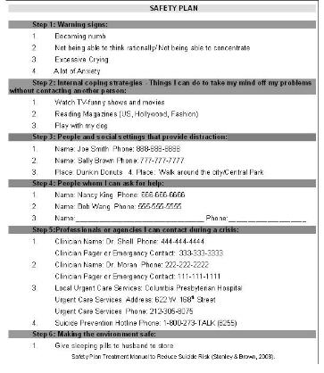

Slide 54
Implementation: What is the Likelihood of Use?
“Where will you keep your safety plan?”
“How will you remember that you have a safety plan when you are in a crisis?”
“How likely is it that you will use the safety plan when you notice the warning signs that we have discussed?”
“How can you fight the urge, if present, to not try to help yourself?”

Slide 55
Implementation: What is the Likelihood of Use?
  “What might get in the way or serve as a barrier to your using the safety plan?”
  Help the individual find ways to overcome these barriers.
  May be adapted for brief crisis cards, cell phones or other portable electronic devices – must be readily accessible and easy-to-use.
  Identify cues to use the safety plan.

Slide 56
Implementation: Review the Safety Plan Periodically
Periodically review, discuss, and possibly revise the safety plan after each time is it used and on follow up calls.
The plan is not a static document.
It should be revised as individuals’ circumstances and needs change over time.

Slide 57
Important Caveats
Individuals may not want to do one step; encourage them to try but don’t insist on completing every step
  Sometimes people can’t think of anything or anyone
  People know that certain strategies “just don’t work for them.”
  Leave it blank and make it a focus of treatment
Let individuals know that this is a tool to help them, and although there are prescribed steps, if they feel in imminent danger they should seek the level of care that will keep them safe.

Slide 58
Demonstration Video

Slide 59
Effectiveness of SPI
Interviewed 100 ‘moderate’ risk Veterans who were given the SPI in a VA ED
Interviewed 3 mo-2 years after ED visit
All remembered the SPI was done in ED
All could say where their plan was currently
91% felt the safety plan was very helpful in making them feel connected to and cared for at the VA

Slide 60
SPI Evaluation
Most Veterans (93%) indicated that they would recommend the interventions to a friend (and 6% had already done so).
No Veteran thought the safety plan intervention was harmful
5% felt it was too long, did not target anger enough or found it difficult to use when depressed.

Slide 61
Evaluation by Veteran Users
When asked which aspects of the safety plan were most useful,
  8.3% recognizing warning signs
  33.3% internal coping strategies
  25% sources of social support
  12% reported that simply having a crisis plan was helpful
  12% reported that having the safety plan enhanced their sense of self efficacy.
  For example, one Veteran noted that “You don't realize what to do when you are in that (suicidal) situation, having planned activities like going to a coffee shop and remembering to breathe are effective.”

Slide 62
Reactions
    “It helped me not to be such a tough guy and actually go for the help that I needed.”
“I would tell them (others at risk) it saved my life.”
“I never thought I could do anything about my suicidal feelings, now I know that I am not at their mercy.”
“How has the safety plan helped me? It has saved my life more than once.”

Slide 63
Reactions cont.
“I think it is very helpful, especially with people going through depression, with showing you and telling you how to use different coping skills…….”
“Gave me the opportunity to more clearly define signs, when my mood is beginning to deteriorate and when to start taking steps to prevent further worsening…...”
“I like the safety plan. I hung it on my wall….it helps me remember how to deal with things.”
“It hadn’t occurred to me before that I could do something about my suicidal feelings.”

Slide 64
Current Uses
VA
  All High Suicide Risk Veterans
  ED demonstration project for moderate risk Veterans not requiring hospitalization
Military---Clinical trial—Walter Reed—suicidal service members hospitalized
NY State OMH Outpatient Clinics---Standard of Care
Crisis Hotlines (NSPL) particularly follow-up calls
EDs, Inpatient Units, Outpatient Clinics (as initial part of treatment with suicidal patients)
Identified as a Best Practice on the SPRC-AFSP - Registry of Best Practices for Suicide Prevention

Slide 65
Safety Planning Intervention Resources
Stanley B & Brown GK, A Brief Intervention to Mitigate Suicide Risk. Cognitive and Behavioral Practice, 19:2, May 2012, 256-264.
Safety Planning in the VA (Stanley & Brown VA Safety Planning Manual, 2008)
SPI designated as a Best Practice by the SPRC/AFSP Registry of Best for Suicide Prevention
Safety Plan template: www.suicidesafetyplan.com
Brenner LA et al. Executive Functioning and Suicidal Behavior Among Veterans with and without a History of Traumatic Brain Injury. Archives of Physical Medicine & Rehabilitation

