Slide 1


Preventing Influenza At
[Name of Tribal Clinic]
Do no harm . . .
Stick out your arm!
Mo. Day, Year
Notes:
The presenter will introduce him/herself and welcome all staff
Also thank them for their dedication to clients and each other for participating in the learning session
Please Note** Tribal clinic populations are at increased risk of severe complications and death from influenza, One of the best ways to protect them is to limit their exposure to potentially infected people, including all staff, volunteers, and contract workers.

Slide 2
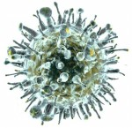

The Pathogen
Influenza, often called “the flu”
Contagious respiratory illness
Symptoms vary
Silent Carriers
Notes:
Influenza is often called the flu and is caused by influenza viruses
Flu season is upon us and it is important for you to know that we here at [Insert Tribal Clinic Name Here] have started our flu campaign
Flu is contagious and symptoms vary but can be severe and potentially life threatening, especially to our clients. (we’ll talk about the symptoms a little more in a bit)

Slide 3
How Bad Is It?
Thousands of flu deaths annually
200,000 people are hospitalized annually
90% of the deaths are people 65 and older
www.cdc.gov, 2015
Notes:
Centers for Disease Control (CDC), reports that flu is responsible for thousands of deaths every year in this country. Estimates range from 3,000 to as many as 49,000 deaths annually. CDC also reports an average of 200,000 hospitalizations annually in the US. Of those deaths 90% are among the elderly.
Silent Carriers: Most flu cases are asymptomatic. Only 23% of people not vaccinated against influenza who had serologic evidence of infection also reported respiratory or flu-like symptoms. "A large number of well individuals mixing widely in the community might, even if only mildly infectious, make a substantial contribution to onward transmission. This might have important implications for the effectiveness of case isolation and social distancing measures in reducing overall transmission rates." *
*Clinical Advisor. March 18, 2014. Most flu cases asymptomatic. Available at: http://www.clinicaladvisor.com/web-exclusives/most-flu-cases-asymptomatic/article/338605/ . Accessed 4 March 2016.
Hayward AC et al. Lancet Respir Med 2014; doi: 10. 1016/S2213-2600(14)70034-7
Hornby PW. Lancet Respir Med. 2014; 201: doi: 10. 1016/S2213-2600(14)70053-0
http://www.thelancet.com/journals/lanres/article/PIIS2213-2600%2814%2970034-7/fulltext

Slide 4
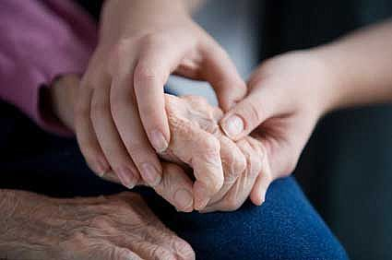
How Can We Protect
Those We Care For?
  You are one of the most important defenses against the flu entering [Name of Tribal Clinic]
Notes:
Healthcare personnel are the most important key to reducing and preventing a flu outbreak at [Insert Tribal Clinic Name Here]
When clients contract influenza, odds are they were infected by staff or by a visitor, as they are the captive audience.
Some people can be infected with the flu virus but have no symptoms. During this time, those persons may still spread the virus to others.
While the flu can make you or me miserable for a week or so, it can be very serious for hospital clients; those being admitted and those accessing medical services. It can be disabling, exacerbate other medical conditions, and could lead to pneumonia and even death. You may be able to combat the flu, BUT your co-workers, family members, and the clients you take care of may not.

Slide 5
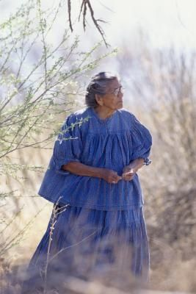
How Can We Stop Flu?
Who should get the shot
        All in-patients and out-patients without contraindications
        All staff; paid and volunteers
        Family and visitors of clients
        Pregnant women and people with chronic health conditions
        Household contacts & caregivers of children < 6 months
        All people from 6 months of age and older without contraindications
Notes:
When we look at who should receive the vaccine, it is clear that healthcare personnel should receive the vaccine to protect themselves, family members at home (especially those of you with small children or elderly relatives living with you), and of course, the clients. We also cannot forget others who work at the tribal health clinic, such as housekeepers, managers, activities, and social services. They can protect clients and their own families by being vaccinated too.

Slide 6

Sign & Symptoms of Flu
    Body aches
    Chills
    Dry cough
    Fever
    Headache
    Sore throat
    Stuffy nose
Notes:
If you get infected by the flu virus, you will generally feel symptoms 1 to 4 days later. You can spread the flu to others before your symptoms start, and for another 3 to 5 days after your symptoms appear. The symptoms start abruptly. Signs and symptoms to watch for are:
Body aches
Chills
Dry cough
Fever
Headache
Sore throat
Stuffy nose
Fatigue
A fever can be high and usually begins to decline on the second or third day
Our young children and elders are at higher risk for developing complications including pneumonia, dehydration, and exacerbation of their underlying conditions

Slide 7


Flu Prevention
Get vaccinated!
Your best protection!
Practice good hygiene
Wash hands often
Cover your mouth/nose when you cough/sneeze
Put used tissues in waste basket
Clean your hands after you cough/sneeze
Avoid touching your face, eyes, nose or mouth
If you are diagnosed with the flu
Stay home
Avoid close contact with others, or wear a mask
Get rest and drink plenty of fluids

Slide 8
Misconceptions
  Reasons why many do not get immunized
  “I don’t think flu shots work”
  I’ve never gotten the flu, so I don’t need the vaccine”
  “Getting the shot will cause the flu”
  “I got the shot last year”
  “I hate needles”
Notes:
There are many reasons why people do not get immunized and also misconceptions about the vaccine and I am here to address them today.
Given a good match between the vaccine and circulating strains, flu vaccine is up to 90% effective in preventing flu in healthy people younger than age 65. It is also 50-60% effective in preventing flu-related hospitalization , and 80% effective in preventing flu-related death in people age 65 or older.
If you have never gotten the flu, it does not mean that you will not get it this year.
The injectable flu vaccine doesn’t contain live virus. You can’t catch flu by taking the shot.
If you received the vaccine last year it does not guarantee that you will not get the flu this year. Each year, a new vaccine is developed to cover the new influenza strains and that is why it is important to receive the vaccine yearly.
The needle used is very fine and the vaccine takes a short time to administer. Remembering the benefits of receiving the vaccine: protecting yourself, your family, and the clients you provide care for, helps to ease the fear.
The intradermal flu vaccine uses a very fine needle that is 90% smaller than the needles used for regular flu shots. This may be helpful for people who don’t like needles.
You may feel some slight effects of the vaccine, but studies have shown that it reduces the chances of you contracting influenza.

Slide 9

  What I can do to prevent the flu?
  Do no harm…
  Stick out your arm!
  “This project is supported by the Health Resources and Services Administration (HRSA) of the U.S. Department of Health and Human Services (HHS) under grant number and title H54RH00049, Rural Hospital Flexibility Program for grant amount $5,000. This information or content and conclusions are those of the author and should not be construed as the official position or policy of, nor should any endorsements be inferred by HRSA, HHS or the U.S. Government.
Notes:
We can not emphasize enough the importance of receiving the influenza vaccine to protect you, your family, and the clients in your facility.
As staff, we are a major carrier of the virus that can infect our clients.
Along with the vaccine please remember that the flu is spread by:
Coughing or sneezing
Unclean hands
To help stop the spread of germs,
Cover your mouth and nose with a tissue when you cough or sneeze.
Wash your hands frequently, especially after contact with clients who have contracted the flu.
If you do not have a tissue, cough or sneeze into your upper sleeve, not your hands.
Put your used tissue in the waste basket.
Clean your hands after coughing or sneezing
Wash with soap and water.
or
Clean with alcohol-based hand cleaner.
Note: You may be asked to put on a surgical mask to protect others if an outbreak has occurred as to not infect others.

Slide 10
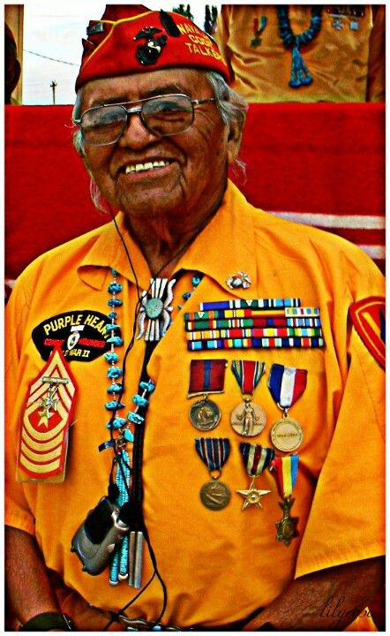
Have you heard?
[Name of Tribal Clinic] will be offering the flu shot [today or mm/dd/yyyy] and also during work shifts
Navajo Code Talker
Rosie the riveter
Notes:
We can not emphasize enough the importance and difference you can make if you receive the vaccine. Please mark your calendar, we will be vaccinating staff, volunteers and contract workers on [Inset date(s) and time(s) here].
Administrators and directors of nursing should set an example and set the expectation at the start of the campaign. One effective method is to have leadership be the first to receive the vaccine in front of staff.
Let’s take the lead in the fight against influenza this year!
Native American images courtesy of Pinterest: https://www.pinterest.com/pin/164029611400644097/

