Slide 1
Treatment of Severe Allergic Reaction
December 2024
Notes:
[general welcome and introductions]
Note to trainer: These slides are intended to be used in conjunction with the Allergy / Epinephrine Protocol Training Manual posted on OHA’s Lifesaving Treatment Protocols webpage. For trainers/settings that do not print the full Manual for trainees, selective printing might be considered. See Training Manual.

Slide 2
Outline
State Laws and Training Program
Allergic Reactions and Allergens
Management of Anaphylaxis
Preparing for and Preventing Anaphylaxis
Addendum: School Medication Administration
Notes:
This training protocol addresses required elements of training per state law. It includes background, practical information, and scenarios.
[Note for trainers of school personnel: the Addendum is intended to address required elements of training per OAR 581-021-0037 for those personnel who have not completed full Medication Administration training and will only be administering epinephrine.]

Slide 3
1. State Laws and Training Protocol
Notes:
The section of training corresponds to the Training Manual Section I: Introduction, and Section II: Background.

Slide 4

Why is This Training Important?
Knowing what to do can save lives.
State laws address epinephrine administration:
eligibility for training
procedures for training, obtaining epinephrine, and administering epinephrine
immunity (legal protections) of persons trained in accordance with state laws
…and this training aligns with state laws.
Oregon Revised Statute (ORS) 433.800-830
Oregon Administrative Rule (OAR) 333-055
Notes:
This training is important for two key reasons: first, it prepares people to act quickly when someone is having a life-threatening allergic reaction. Second, Oregon has state laws that address what’s required, and may provide legal protections to those who complete the training in accordance with those state laws.

Slide 5

State Laws: Administering Epinephrine
Responding with epinephrine
Oregon state law allows trained individuals to administer epinephrine to any person “suffering from a severe allergic response to an insect sting or other allergen.”
“The decision to give epinephrine should be based upon recognition of the signs of a systemic allergic reaction…”
Notes:
Briefly, our state laws are set up to increase the number of people ready to respond to any person suffering from a severe allergic response. The laws emphasize that response should be based on recognition of the signs and symptoms of systemic allergic reaction.
As a note here: there are many related terms to describe a serious allergy, including what you see here, “severe allergic response” and “systemic allergic reaction.” Another common term is “anaphylaxis.” All these terms refer to a serious, potentially life-threatening allergic response, and for the purpose of this training, these terms are considered functionally the same.

Slide 6
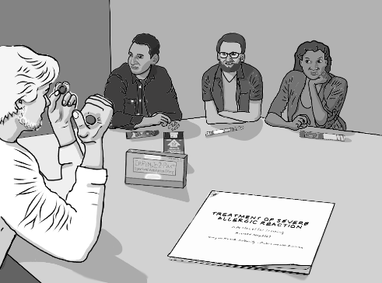

State Laws: Completing Training
Eligibility for training
must be at least 18 and reasonably expect contact with other people for work/volunteering
After training, the instructor issues a Statement of Completion, which includes an Authorization to Obtain Epinephrine.
If signed by a licensed prescriber, this is a prescription
If a pharmacist won’t honor the Authorization as a prescription, call or email the contact listed in the Manual, or cite (ORS) 433.800-830 and (OAR) 333-055
Notes:
Our state laws outline who is eligible for training, and what a trained individual is permitted to do after completing training.

Slide 7


State Laws: Obtaining Epinephrine
Obtaining Epinephrine
The Authorization to Obtain
allows the holder to obtain a 2-pack of epinephrine auto-injectors
can be used for refills 4 times
automatically expires 3 years after the training date
The cost
cannot be billed to insurance
may be reimbursed (verify with employer)
can be expensive ($500 +)
Notes:
If the trainee holds a completed “Authorization to Obtain Epinephrine,” and the Authorization is signed by a prescriber, that can be used as a prescription. The cost of prescription cannot be billed to insurance, because it is not for the individual. Some settings will pay for individuals to obtain epinephrine if needed for their programs.

Slide 8
State Laws
Once you complete this training, Oregon law permits you to…
Administer epinephrine for suspected severe allergic response.
Administer epinephrine to others 3 years at most (then re-train).
This training does not authorize trainees to use epinephrine for other conditions, such as an asthma attack.
This training authorizes administration of epinephrine based on signs and symptoms; you do not need to identify the cause of allergic reaction.

Slide 9
State Laws: True or False?
Once you complete this training, Oregon law permits you to…
give epinephrine for suspected severe allergic response True/False
give epinephrine to someone having an asthma attack True/False
only give epinephrine if a person has a known exposure
to an allergen, such as bee sting or food allergy True/False
give epinephrine to others for the rest of your life True/False
Notes:
Let’s do a quick review of what we’ve shared so far. What is the correct answer to each of these questions?

Slide 10
State Laws: True or False?
Once you complete this training, Oregon law permits you to…
give epinephrine for suspected severe allergic response True
Notes:
This is true.

Slide 11
State Laws: True or False?
Once you complete this training, Oregon law permits you to…
give epinephrine for suspected severe allergic response True
give epinephrine to someone having an asthma attack False
Notes:
This is incorrect. Trainees who successfully complete the training protocol are authorized to administer epinephrine based on signs and symptoms of severe allergic response.

Slide 12
State Laws: True or False?
Once you complete this training, Oregon law permits you to…
give epinephrine for suspected severe allergic response True
give epinephrine to someone having an asthma attack False
only give epinephrine if a person has a known exposure
to an allergen, such as bee sting or food allergy False
Notes:
This is incorrect. Treatment should be based on signs and symptoms. You do not need to determine a cause, and both the law and training protocol emphasizes this: DO NOT DELAY treatment trying to find a cause.

Slide 13
State Laws: True or False?
Once you complete this training, Oregon law permits you to…
give epinephrine for suspected severe allergic response True
give epinephrine to someone having an asthma attack False
only give epinephrine if a person has a known exposure
to an allergen, such as bee sting or food allergy False
give epinephrine to others for the rest of your life False
Notes:
This is false. Trainee authorizations expire three years after the date of training. You must re-train at least every three years to maintain authorization to administer epinephrine.

Slide 14
State Laws
Once you complete this training, Oregon law permits you to…
give epinephrine for suspected severe allergic response
give epinephrine to someone having an signs and symptoms of severe allergic response
give epinephrine if a person has signs and symptoms of severe allergic response even if you don’t know the cause
give epinephrine to others 3 years at most (then re-train)
Notes:
Here are each of those phrases, completed with the correct information.

Slide 15
2. Allergic Reactions and Allergens
Notes:
This section aligns with the Training Manual, Sections III: Allergic Reactions and IV: Allergens and Allergy Triggers.

Slide 16

Severe Allergic Response
This section will focus on recognizing severe allergic response
… which may also be called anaphylaxis or systemic allergic reaction. These terms are considered functionally the same.
What might severe allergic response look like?
Details in a moment.
Notes:
This section focuses on recognizing signs and symptoms. We’re going to discuss what signs and symptoms to look for in just a moment, after reviewing a few of the terms we’ll be using.
As a reminder, we are considering all these terms to have essentially the same meaning: severe allergic response, systemic allergic reaction, anaphylaxis.

Slide 17

Allergen
A protein not normally found in the body
Exposure may cause an allergic response
Examples of allergens
Insect stings
Food
Medications
Latex
Other
Notes:
The term “allergen” refers to a protein not normally found in the body. Exposure to an allergen may cause an allergic response for some people. Common allergens are listed.

Slide 18
Severe Allergic Response
A life-threatening emergency
without treatment, it is fatal!
Signs and symptoms may
extend past one side of the body
involve multiple areas or systems
impact vital organs (breathing, circulation, brain function) – unless treated
Signs may appear and progress rapidly
But can also appear later, from minutes to hours
We’ll review specific examples shortly.
Severe allergic response (anaphylaxis)
Red circle
Notes:
A severe allergic response – or anaphylaxis – is a life-threatening emergency. Key points to remember about signs and symptoms, is that they can impact the whole body if not treated. You might see swelling – for example, a severe response might be hives across the chest, not just a little bump at the site of a bee sting, or you might see symptoms that vital organs like the lungs, heart, or brain are being effected.
We will give specific examples in a moment.
It’s important to keep in mind that reactions can happen very quickly, but they can also take some time to develop. That means, if we know someone has been exposed to one of their allergy triggers, we may need to monitor them even if they don’t react immediately.

Slide 19
Lesser Allergic Responses
Exaggerated allergic reaction
Signs and symptoms may
involve one system (not full body response)
be limited to the affected arm or leg and/or stay on one side of the body
Normal reaction
Exposure to an allergen results in
no signs, or expected, minimal response
Exaggerated response
Orange circle
Normal response
Yellow
circle
Notes:
We focus on severe allergic response throughout this training. For reference, the difference between a severe response and lesser allergic reactions is described here. We’ll share specific examples of what reactions look like to different types of allergens in just a moment. But first, we are going to review the signs and symptoms of a serious, severe allergic reaction.

Slide 20
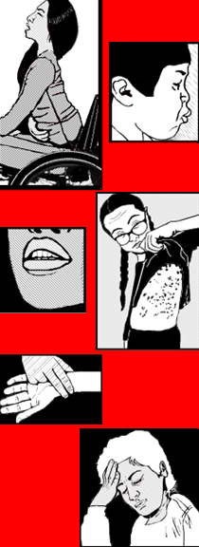
Signs of Severe Allergic Response
A person may have only one sign, or more than one. May include:
Breathing/respiratory changes
Circulation changes
Swelling
Skin changes
Abdominal/digestive changes
Anxiety
Which categories are immediately life-threatening?
What signs and symptoms might be present, in each of these categories?
Notes:
All signs and symptoms should be taken seriously. The 3 signs at the top of this list are major red flags and may become life-threatening quickly. Skin changes are often strong cues. For example, an itching or burning sensation is noticeable for many people as well as swelling or hives. For people with darker skin tones, observing at an angle or shining a light parallel to the skin can help to make swelling and hives more visible. For people with lighter skin, color changes may be a strong cue.
Can you give an example of what you might observe in each category – what would be a concerning respiratory change? (etc.)

Slide 21
Signs of Severe Allergic Response
Breathing | working harder to breath; wheezing sounds; not breathing
Circulation | rapid or weak pulse; dizziness or fainting; pale bluish, greyish, or dusky tint to skin, especially on fingertips or inside eyelids (sign of low oxygen)
Swelling | puffy eyes, lips, face, or tongue; difficulty swallowing, hoarse voice, or coughing (signs of throat swelling)
Skin | hives (blotchy spots) widespread or on the torso and neck; itching or burning, especially on chest or face; sweating or flushed; pale (see Circulation); swelling (see Swelling)
Abdomen | pain, nausea, vomiting, incontinence, diarrhea
Anxiety | fidgety, tense, fearful; may have sense of doom
Notes:
Here are some examples of specific signs and symptoms in each of these categories.

Slide 22
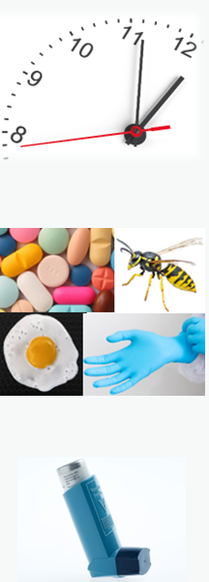
Severe Allergic Response Red Flags
Time of onset
The faster the onset of signs from exposure, the higher risk for severe symptoms and death.
Severe reactions can also have delayed onset.
Prior history
A person’s history of allergy or sensitivity may make them vulnerable.
Severe reactions also occur with no history.
Asthma
Persons with asthma may have an increased risk for anaphylaxis.
Notes:
It’s important to act quickly, as severe allergic response often progress to become life-threating quite rapidly. Other risks are listed here. We’ll talk about preparation and prevention later on, but for now it’s important to note that many serious allergic events have no known cause – it’s important to act quickly when signs and symptoms are present, no matter when they occur.

Slide 23
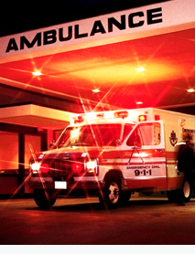
Recognize and Respond Quickly
The faster the onset of signs from exposure, the higher risk for severe symptoms and death.
One or more signs of anaphylaxis require immediate administration of epinephrine.
Call 9-1-1.
Notes:
It cannot be emphasized enough: if signs and symptoms are seen, respond immediately. Give epinephrine and call 9-1-1.

Slide 24
Causes of Anaphylaxis
The decision to give epinephrine should be based on signs and symptoms.
You do not need to determine the cause.
Knowing the cause may help planning to avoid the allergen.
Many cases have no identified cause.
Notes:
We’re going to spend a little time talking about common allergens. As we talk about specific causes, please keep in mind: you do not need to know the cause of a reaction, to treat the reaction. If there is a known cause, this can help with future prevention efforts, but many cases have no identified cause.

Slide 25

Allergens: Insect Venom
Insect stings
10-20% of all cases of anaphylaxis
Typical offenders
Yellow jackets
Honeybees
Wasps
Hornets
Special Consideration:
Multiple Stings
High levels of venom in the body can cause a toxic reaction, especially 10 or more stings
Any type of response may occur from localized to severe
Monitor closely
Be prepared to give epinephrine
Call 9-1-1
Notes:
First on our list of allergens is insect stings. Special Considerations (p.11):
If a sting occurs around the eye, nose, or throat, the reaction may be more severe and may need immediate medical attention. Around the nose and throat, even minimal swelling may cause obstruction. Around the eyes, long-term damage is possible. Seek medical care for these types of stings.
Toxic reactions can result from multiple stings, usually 10 or more, such as when a person steps on a yellow jacket nest. These types of stings need immediate medical attention: call 9-1-1 right away. Observe for reaction and treat as for any case of anaphylaxis. Toxic reactions may be delayed. Medical attention and observation are strongly recommended.

Slide 26

Allergic Reaction Severity: Insect Stings
Normal reaction
swelling, redness, pain, itching
may grow to the size of a quarter
stays confined to sting site
Localized allergic reaction
swelling, redness, pain, itching
grows to an area larger than a quarter
may extend over a major joint
Anaphylaxis
Reaction spreads to multiple areas or full body, such as widespread hives, nausea, or difficulty breathing
If untreated, changes to airway, breathing, and circulation may occur
Give Epinephrine
Notes:
This slide gives examples of normal, exaggerated, and severe allergic response to an insect sting. … [review] … Key take-away: if signs or symptoms of severe reaction are present, give epinephrine.

Slide 27

Allergens: Food and Drink
Food Allergies
35-55% of all cases of anaphylaxis
Most common food allergens
Peanuts
Tree nuts (walnuts, hazelnuts, cashews, etc.)
Fish or crustaceans (shellfish)
Milk
Eggs
Other food allergens
Soy
Fruits especially strawberry, banana, or citrus
Many others
Notes:
Nearly any food can trigger an allergic reaction at any age. Foods commonly associated with severe allergic reactions are listed.
It is important to note that most fatal food allergy cases have no prior history – be prepared to respond based on signs and symptoms, even if the person has no known allergy.

Slide 28

Allergic Reaction Severity: Food and Drink
Normal reaction
No reaction (normal digestion)
Food sensitivity or intolerance
Usually confined to the digestive system
Often dose dependent: worse with more exposure
Anaphylaxis
Reaction spreads to multiple areas or full body, such as widespread hives, nausea, or difficulty breathing
Often not dose dependent: occurs with any amount of exposure
If untreated, changes to airway, breathing, and circulation may occur
Give Epinephrine
Notes:
This slide gives examples of normal, exaggerated, and severe allergic response to food and drink. … [review] … Key take-away: if signs or symptoms of severe reaction are present, give epinephrine.

Slide 29

Allergens: Medications, Latex
Medications
Roughly 10% of people have a medication allergy
Any medication, any route. Most common:
Antibiotics
non-steroidal anti-inflammatory drugs (NSAIDs)
acetaminophen (Tylenol, Excedrin, other products)
Special consideration: side effects versus allergies
Latex
Rare in general population, but common in high-exposure groups such as healthcare workers and medically fragile individuals
found in products that use natural rubber latex: certain medical supplies; balloons; art supplies
Notes:
Other common allergens include medications, and latex.
There’s a special consideration with medications, which is the idea of a side effect versus a reaction. Most side effects are mild, but if there are concerning symptoms and there is any doubt, give epinephrine.
With latex, the allergy is less common for most people, but certain populations are at high risk for this allergy. Prevention strategies are important in all cases, including using latex-free products when possible. The Manual offers prevention strategies for each category of allergen, which we will review later.

Slide 30

Allergic Reaction Severity: Latex
Normal reaction
No reaction
Localized allergic reaction
Swelling, redness, pain, itching
Limited to area of contact such as rash on hands
Anaphylaxis
Reaction spreads to multiple areas or full body, such as widespread hives, nausea, or difficulty breathing
If untreated, changes to airway, breathing, and circulation may occur
Give Epinephrine
Notes:
This slide gives examples of normal, exaggerated, and severe allergic response to latex exposure. … [review] … Key take-away: if signs or symptoms of severe reaction are present, give epinephrine.

Slide 31

Other Causes and Situations
Severe responses requiring epinephrine may also be due to:
Cold urticaria
hives and/or breathing difficulty especially after sudden temperature change
Exercise-induced anaphylaxis
heightened immune response with vigorous activity
Idiopathic anaphylaxis
“idiopathic” means “unknown cause”
Remember: many cases have no identified cause.
Notes:
There are additional causes and situations that may result in a severe allergic response. Whatever the cause, the key takeaway is the same: if signs or symptoms of severe reaction are present, give epinephrine.

Slide 32
Allergic Reactions and Allergens Review
Notes:
The next few slides provide practice scenarios
Read each scenario and determine if the person is suffering from anaphylaxis
Debriefing slides will discuss the key points of recognition and treatment of the reactions

Slide 33

Scenario #1: Bee Sting
A 15-year-old was stung by a bee on his calf
An area the size of a nickel is red and swollen on his calf
No swelling or redness found anywhere else
No hives are seen
He tells you this is the first time he has ever been stung
Is this person suffering from severe allergic response or at immediate risk for anaphylaxis?

Slide 34
Scenario #1 Debrief
Normal reaction
The signs did not expand beyond the size of a quarter
What is his risk for developing anaphylaxis?
Appears to be a low risk at this point
Recommended action:
Follow protocol for treating normal reaction to insect stings

Slide 35
Treatment for Normal Reactions to Insect Stings
Reassure and calm the person
Remove the stinger if present
Scrape it away with a fingernail or plastic card.
Do not squeeze the stinger, as this can release more venom into the body
Cleanse the sting site
Apply an ice pack for local pain relief
Observe the person for at least 30 minutes
Notify the parent or guardian if applicable
Remember: fatal anaphylaxis cases often have no prior history. Monitor and respond to signs even if no history is known.

Slide 36

Scenario #2: Hives
An 8-year-old has hives on her neck and chest
She is scratching at them
She appears to be breathing normally
She ate a cookie 30 minutes ago
A friend gave it to her
She has a history of allergies to peanuts
She has an EpiPen Jr.
Is this person suffering from severe allergic response or at immediate risk for anaphylaxis?

Slide 37
Scenario #2 Debrief
Severe allergic response
The signs are widespread or entire body (hives on her neck and chest)
What is her risk of anaphylaxis?
High risk
She has a prescription for epinephrine (EpiPen Jr.).
This tells you that her peanut allergy is severe
Should you administer epinephrine?

Slide 38
Scenario #2 Debrief
When should a person with a history of allergic rection be given epinephrine?
Persons with a history of anaphylaxis have strong likelihood of developing it again
Epinephrine should be given when any signs of severe allergic reaction appear
Recommended action:
Administer epinephrine and call 9-1-1

Slide 39

Scenario #3: Wasp Nest
An elementary school student tells you that another child was poking at a wasp nest with a stick
The child was stung in the face, near the mouth
The child who was stung is screaming “It hurts!” repeatedly.
The child has a swollen upper lip and cheek
Is this person suffering from severe allergic response or at immediate risk for anaphylaxis?

Slide 40
Scenario #3 Debrief
Localized allergic reaction
Swelling is bigger than a quarter but correlates with the sting locations
What is the child’s risk for developing anaphylaxis?
Appears low risk
Sting location may increase risk of breathing difficulty related to swelling
Recommended action:
Seek medical attention due to the sting location.
In the meantime, follow protocol for treating normal reaction to insect stings
Monitor the child. Be prepared to administer epinephrine if the child develops signs of severe reaction
Notes:
“Treatment for normal reaction to insect stings” is covered on slide 34.

Slide 41

Scenario #4: Adult Coworker
A colleague directs you to help a 24-year-old coworker
His lips are swollen
He is struggling to breathe
You hear wheezing sounds
He feels dizzy and wants to pass out
He also feels like he is going to throw up
Is this person suffering from severe allergic response or at immediate risk for anaphylaxis?

Slide 42
Scenario #4 Debrief
Severe allergic response, anaphylaxis
Wheezing, dizzy, nausea, swollen lips, faint or wanting to pass out
Recommended action:
Administer epinephrine and call 9-1-1
Do not waste time trying to find the cause

Slide 43
3. Management of Severe Allergic Response
Notes:
This portion of the training corresponds to Training Manual Section V: Management of Severe Allergic Response.
Now we are going to review action steps. Quickly recognizing the signs of severe allergic response and administering epinephrine are critical actions. We’ll start by reviewing the Treatment Protocol, then some background information about epinephrine, and then more details about the steps for administering epinephrine using an auto-injector.

Slide 44
Treatment Protocol 1 of 4
Determine if the person has symptoms of severe reaction.
Maintain airway and breathing. Begin CPR if needed.
Have the person sit or lie down. Minimize walking or movement.
Select the proper dose of the epinephrine or use what is available.
Adult, pediatric, infant/toddler
If no epinephrine is available, immediately call 911
Notes:
The Treatment Protocol includes 12 steps. Here are the first 3. [review]

Slide 45

Treatment Protocol 2 of 4
Administer the epinephrine.
Note the time when epinephrine was administered. If there’s enough help to do so, set a 5-minute timer.
Call 9-1-1 or have someone else call. Do not leave the person unattended.
Check and maintain airway and breathing.
Administer CPR if necessary.
Notes:
Step 4: in a moment we will fill in specific details of how to administer epinephrine.
Note to trainer: The manual Section V “Treatment Protocol” and “Using and Epinephrine Auto-Injector” are formatted so they could be printed as stand-alone reference pages.
Step 5: Call 9-1-1: Although epinephrine is very fast acting, its beneficial effects are short-lived (approximately 20 minutes). The life-threatening reaction may resume after epinephrine wears off, so it is vitally important to call 9-1-1 immediately.
When checking breathing: If the person has stopped breathing and does not respond to rescue breathing, they may have severe swelling of the throat, which closes the airway. Continue compressions and CPR efforts.

Slide 46
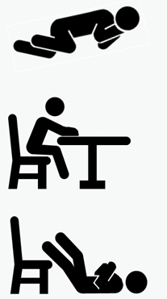
Treatment Protocol 3 of 4
Position for safety. Remove stinger if present (slide 34).
Monitor for changes in the person’s condition.
After 5 minutes, if the person’s condition does not change or gets worse, administer a 2nd dose of epinephrine.
Around 10% of cases require a second 2nd dose
2% - 3% of cases require a 3rd dose
Notes:
Step 7. Examples of positioning: Lay the person on their left side (“recovery position”) to protect against aspiration in case of nausea/vomiting. If confused or losing consciousness, elevate legs to get more blood to brain and heart. If alert but having difficulty breathing, may try other positions such as leaning forward (“tripod”) or arms elevated.
Slide 34 gives details about stinger removal.
Step 8. Do not leave the person alone. CPR may be needed.
Step 9. A new epinephrine dispensing device is needed to administer a second dose (Pre-filled devices provide a single dose per dispensing device.) If a second dose is not available, inform EMS when they arrive.

Slide 47

Treatment Protocol 4 of 4
When EMS arrives, advise them of the person’s symptoms before and after epinephrine was given, and dose time(s).
If the individual has asthma and respiratory symptoms, may use their own inhaler.
12. Follow up
Ambulance transport is recommended.
Person / family should notify primary care and follow instructions.
Notes:
Step 11. For some settings, including schools, administering an inhaler requires additional training. Encourage the person and assist if permitted in your setting.

Slide 48
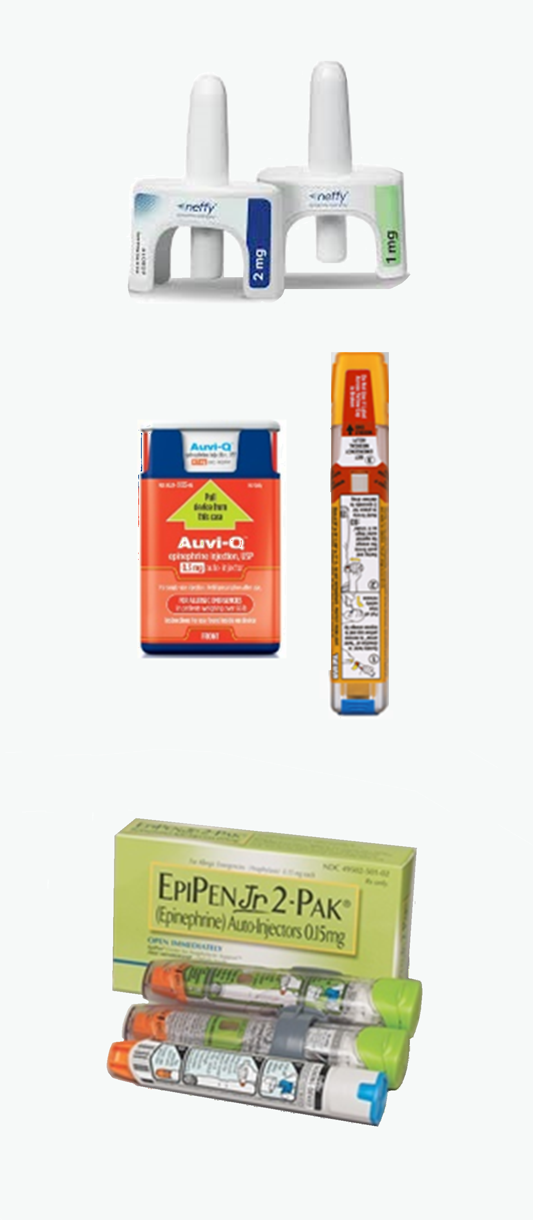
Understanding Epinephrine
Epinephrine…
Is a powerful drug
Requires a prescription
Treats the life-threatening problems of severe, systemic, allergic responses
Is easy to give via pre-measured dose devices
Check labels. Be sure the device and dose is intended to treat severe allergic reaction. Epinephrine is sometimes prescribed for other reasons, such as congestion or severe nosebleeds.
Notes:
Epinephrine is a well-tested, effective treatment for severe allergic response.
Epinephrine has been used medically for over 100 years, and epinephrine autoinjectors have been on the market since the 1980s.
The trainee should be aware that there are epinephrine products that have lower doses and will NOT be effective (examples: Adrenalin spray for congestion; L.E.T gel for severe nosebleeds). Be sure the device and dose is intended to treat severe allergic reaction.

Slide 49
The Work of Epinephrine
Reduces swelling
Opens lower airways
Constricts blood vessels
Why is epinephrine effective to treat a severe allergic response?
Notes:
[ask]

Slide 50
The Work of Epinephrine
Epinephrine treats the allergic reaction!
drops
blood
pressure
causes
swelling
constricts
lower
airways
raises
blood
pressure
reduces
swelling
opens
lower
airways
Allergic Reaction
Epinephrine
Notes:
Epinephrine acts on the body by constricting blood vessels and raising the blood pressure, relaxing the bronchial muscles and reducing tissue swelling. The actions of this drug directly oppose the life-threatening effects of anaphylaxis.

Slide 51
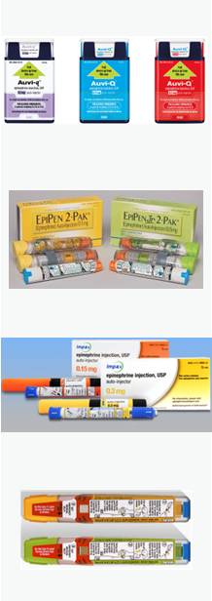
Epinephrine Auto-Injectors
Pre-measured dose in each
Trigger device
Injects epinephrine automatically
Automatically retracts needle (most brands)
Multiple types
Read instructions
Be familiar with version(s) used in your setting
Notes:
A pre-measured dose of epinephrine is delivered via an auto-injector into the middle of the outer thigh. This location is a safe site for injection. The auto- injector is designed to work through clothing for all ages.
Whenever possible, it is important to know which epinephrine auto-injector you will be using since the method for administration differs between manufacturers. Practicing (using training models) can increase confidence and accuracy during an event.

Slide 52
Instructions for Specific Devices
If possible, review device instructions before a crisis occurs. Here are some examples.
Auvi-Q® (kaleo) Manufacturer website
EpiPen® (Mylan / Viatris) Manufacturer website
Generic for Adrenaclick® (Amneal) Manufacturer website
Generic Autoinjector (Teva) Manufacturer website
Notes:
Epinephrine auto-injectors are not all the same. If possible, review device-specific instructions before an emergency occurs.

Slide 53
Epinephrine Auto-Injector Examples
Do not delay to verify weight or age. If unknown, estimate.
Auto-injector name (and color as of 2025) | Dose | Weight range | Age range
Auvi-Q® (orange/red) EpiPen® (yellow) Amneal (yellow) Teva (yellow) | 0.3 mg | over 65 pounds | Adult 9-10 years or older
Auvi-Q® (blue) EpiPenJr® (green) Amneal (orange) Teva (green) | 0.15 mg | 35-65 pounds | Child From 3 years to 9-10 years
Auvi-Q (pale purple) | 0.1 mg | 16.5-33 pounds | Infants and toddlers
Notes:
The following table gives guidelines for choosing the adult versus the pediatric version of the epinephrine auto-injector. However, it must be emphasized: don’t delay by weighing!!
The epinephrine dose for children or small individuals is half the dose for an adult, based on weight.
The typical dose of epinephrine for adults via autoinjector is 0.3 milligrams. The typical dose for a child or small person is 0.15mg for people approximately 35-65 pounds.

Slide 54
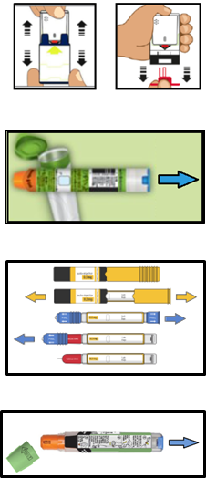
Auto-Injector General Procedures 1 of 3
The following expands on step 4 of the Treatment Protocol: “Administer the epinephrine.”
4.a) Remove the auto-injector from its protective case
4.b) Remove the safety caps of the injector
4.c) Hold the injector firmly and keep fingers away from the tips of the device
Notes:
[see Training Manual p.17]

Slide 55

Auto-Injector General Procedures 2 of 3
4.d) Position the device at a 90-degree angle against the thigh
Push hard enough to cause a click for some devices
Push down on the trigger for other devices
4.e) Hold the device firmly against the thigh for 3 to 10 seconds during administration
Consult product directions
Epinephrine may be administered through clothing via all standard auto-injector devices.
Notes:
[See Training Manual p.17]

Slide 56
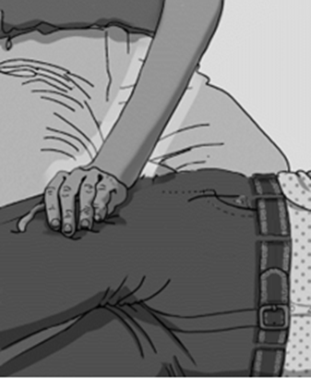
Auto-Injector General Procedures 3 of 3
4.f) Remove the device and place it back into its protective case (when applicable)
4.g) Massage the skin at the injection site for 10 seconds
Note the time the dose was given
If enough help is available, set a 5-minute timer
Continue to step 5 of the Anaphylaxis Treatment Protocol
Call 911; Protect airway; Monitor for changes; etc.
Notes:
[See Training Manual p.17]

Slide 57
Key Points of Administration
Instruction
Step 3.
Select the correct dose based on approximate weight
Step 4.b
Remove all safety caps prior to injecting.
Step 4.d
Place the device against the outside of the thigh
Rationale
Notes:
[review]

Slide 58
Key Points of Administration
Instruction
Step 3.
Select the correct dose based on approximate weight
Step 4.b
Remove all safety caps prior to injecting.
Step 4.d
Place the device against the outside of the thigh
Rationale
It is more likely to work correctly if it’s the right dose
It won’t work with the cap on!
Large muscle, lower risk of hitting something you shouldn’t
Notes:
[review]

Slide 59
Key Points of Administration
Instruction
Step 4.e
Keep firm contact between the auto-injector and the thigh during administration.
Remove the device after 3-10 seconds depending on device instructions.
Step 4.f
Place the used auto-injector back into its case, if applicable.
Step 4.g
Massage the injection site
Rationale
Notes:
[review]

Slide 60
Key Points of Administration
Instruction
Step 4.e
Keep firm contact between the auto-injector and the thigh during administration.
Remove the device after 3-10 seconds depending on device instructions.
Step 4.f
Place the used auto-injector back into its case, if applicable.
Step 4.g
Massage the injection site
Reduces risk of needle stick, in case the needle didn’t fully retract.
DO NOT hold the case while re-capping; should rest on a surface until tip of device covered.
Encourages faster absorption of epinephrine.
Rationale
Ensures medication is fulling injected.
It takes time for the liquid to flow out of the syringe!
Notes:
[review]

Slide 61
Side Effects of Epinephrine
Rapid heart rate
Feeling of nervousness
Tremors
Nausea and/or vomiting
Sweating
Headache
Pale skin
Side effects usually resolve quickly with rest. They may last 5 to 20 minutes.
Notes:
Side effects are temporary and will subside with rest and reassurance. Some of the possible side effects of epinephrine may resemble symptoms of anaphylactic shock; however, symptoms related to injection of epinephrine are temporary. Reassurance and a calm demeanor by the responder are important.

Slide 62

Epinephrine Storage and Handling
Store in a dark place at room temperature
Protect from extreme heat: not in a car glovebox
Protect from extreme cold: not in a refrigerator
Protect from light: opaque container or cabinet
Transport in an insulated case or bag
Protect from heat, cold, and light
Notes:
Epinephrine should be stored in a dark place at room temperature (between 59 – 86 degrees F). Exposure to sunlight, or to extreme heat or cold, will hasten deterioration of epinephrine more rapidly than exposure to room temperatures.

Slide 63
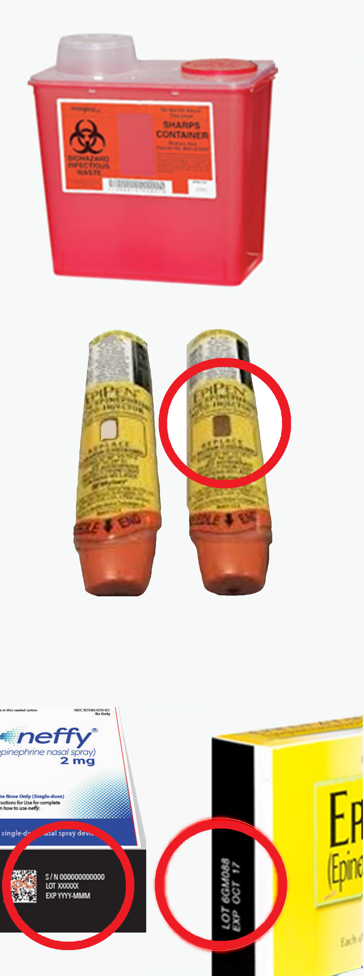
Epinephrine Restocking and Disposal
Check and re-stock routinely
Check the expiration date: should not be expired
Check autoinjector solution: should be clear, no particles
Replace if used or discolored, or near expiration date
Disposing of autoinjectors
Used: put in sharps container, or give to EMS on arrival
Unused (expired or discolored): put in sharps container or return to a pharmacy
Notes:
Regularly inspect your supply of epinephrine.
Inspect each auto-injector for the following:
The solution should be clear and without particles. Solution that appears cloudy, discolored (brown) or with particles must be replaced.
The auto-injector should be current and not expired.
Verify your setting’s plans to replace doses prior to expiration, such as ordering 3 months ahead.
Expired autoinjectors should be discarded. Follow instructions for discarding medications. Expired medication may not retain full potency and may fail to work.
Doses near expiration should be replaced promptly, and expired doses discarded, to ensure epinephrine administered during an emergency has maximum effect. However, if the only epinephrine available during an emergency has expired, as long as it is still clear and without particles, it is better to give it than nothing at all.

Slide 64
4. Preparing for and Preventing Severe Allergic Response Corresponds to Training Manual Section VI
Notes:
Advanced planning is important to reduce the risk of severe allergic response.
Detailed measures to reduce risks related to specific types of allergens are listed in the Training Manual, Section IV: Allergens and Allergy Triggers

Slide 65

Prevention
Plan ahead to reduce the risk of severe allergic response.
Example practices:
Insect stings: avoid flowering plants, fragrant lotions, outdoor trash, and exposed skin, including walking outside without shoes.
Food allergens: read labels on food and skin care products; inform food staff of known allergens; avoid cross-contamination such as on cutting surfaces or utensils; encourage hand washing.
Additional examples are listed in Section IV of the Manual.
Notes:
[review; reference Section IV]

Slide 66
Preparation: Review Local Plans
Where the epinephrine is kept
What to do
Routinely review steps for the delivery devices in your setting
Who is trained in first aid and CPR (ideally – you are!)
How to get emergency help
How long does it normally take EMS to respond?
Where is the nearest hospital?
When epinephrine doses are replaced
Who to notify that a dose was used
Who checks expiration dates, clarity of solution
Notes:
Verify the emergency response plan for your setting. Review and practice it at least annually.

Slide 67
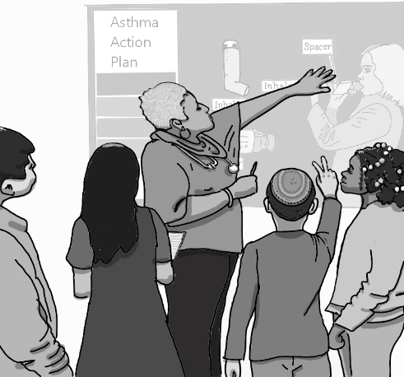
Preparation: Identify Individuals
Identify those who are at risk of severe allergic response
People with a prescription for epinephrine
People with a history of allergic reactions
People with a history of asthma
Get a signed consent for emergency treatment (if applicable to your setting)
When possible, educate those at risk for allergic reactions with prevention strategies
Notes:
Make every effort beforehand to identify individuals at higher risk, including those with a history of allergic reactions, and what signs and symptoms they experienced with prior reactions. In settings with consistent groups of children, ensure each child with known anaphylaxis risk has an emergency care plan in place.* If possible, collaborate with parents/guardians to ensure plans address individualized symptoms and needs.
(*required in schools per Oregon Revised Statutes 339.866 Self-Administration of Medication by Students ORS 339.866) If your role includes education for individuals at risk, key topics include (1) Avoid exposure to known allergens (2) Carry their emergency epinephrine (3) Wear a Medic Alert® bracelet/necklace or other identification (4) Keep applicable plans and permission forms up-to-date

Slide 68

Scenario #5: Prevention and Preparation
A group of 10-to-12-year-olds will be taking a hike in an area with meadows and forests.
They will be eating a picnic lunch together afterward.
Some of the young people require medications at lunchtime, and two of them have asthma inhalers.
What are some prevention and preparation strategies planners could use, before and during this activity?
Notes:
[discuss, review]

Slide 69
Scenario #5 Prevention and… Debrief
Identify potential allergen risks in the setting
Insect stings, food allergies, medication allergies, other?
If possible, identify known allergies among the group
Identify individuals who may be at higher risk.
Implement multiple strategies to reduce risk
Insect allergies: Avoid areas with stinging insects. Establish policies: no scented lotions, closed-toed shoes, etc.
Food allergies: Strongly discourage food sharing.
Medication allergies: Trained personnel ensure safe administration to correct individuals.
Notes:
[discuss, review] What else? See Manual.

Slide 70
Scenario #5 …Preparation Debrief
Ensure one or more group leader is trained in
CPR
Epinephrine administration
How to active EMS 9-1-1
Ensure group leaders have epinephrine available
Know the symptoms of concern
Know how to respond quickly
Notes:
[discuss, review] To follow protocol, ideally medication administrators will have 2 adult doses and 2 pediatric doses available.
Consider reality for your setting; what other preparation is needed?

Slide 71
Summary: Preparation Saves Lives
Maintain your skills. Keep training current and be ready to respond quickly.
Know the signs of severe allergic response.
Take a first aid / CPR class.
Know your local emergency plan.
where are doses
what steps to follow
who knows CPR
how to contact EMS
when doses are replaced
Prevent or minimize exposure to allergens with risk assessment and planning.
Notes:
[See Section VII: Summary and Review.]

Slide 72
Summary: Respond Quickly
Severe allergic response is a life-threatening event.
.
Epinephrine is the life-saving treatment.
Recognizing signs and symptoms is critical.
A person could have one sign or many signs.
Do not hesitate to give epinephrine!
Do not hesitate to give epinephrine!
Notes:
Anaphylaxis is a severe, potentially fatal systemic allergic reaction. It is characteristically unexpected and rapid in onset. Immediate injection of epinephrine is the single action most likely to save a life under these circumstances

Slide 73
Demonstrations
Notes:
Trainees perform return demonstrations of epinephrine injection via trainer devices.
Trainers may utilize additional demonstration methods such as group scenarios.

Slide 74
Knowledge Verification
Notes:
Approved trainers may select preferred options for knowledge verification.
Examples include Manual “Summary and Review” section, Scenarios beginning on slide 31, or the evaluation examples on the following slides.
Use selected assessment tool(s) to verify trainee knowledge, skills, and abilities.

Slide 75
Optional Content
The following slides may be used at the discretion of the approved trainer
Knowledge verification is required. These slides are one option, but other options may be selected.

Slide 76
1. Question
Give an example of specific signs or symptoms in each category.
Breathing
Circulation
Swelling
Skin
Abdomen
Anxiety
Notes:
See Manual: Signs and Symptoms of Severe Allergic Response, p.8.

Slide 77
1. Answer
Breathing | working harder to breath; wheezing sounds; not breathing
Circulation | rapid or weak pulse; dizziness or fainting; pale bluish, greyish, or dusky tint to skin, especially on fingertips or inside eyelids (sign of low oxygen)
Swelling | puffy eyes, lips, face, or tongue; difficulty swallowing, hoarse voice, or coughing (signs of throat swelling)
Skin | hives (blotchy spots) widespread or on the torso and neck; itching or burning, especially on chest or face; sweating or flushed; pale (see Circulation); swelling (see Swelling)
Abdomen | pain, nausea, vomiting, incontinence, diarrhea
Anxiety | fidgety, tense, fearful; may have sense of doom
Notes:
See Manual: Signs and Symptoms of Severe Allergic Response, p.8.

Slide 78
2. Question
Provide details for specific steps of the protocol.
Step 1: Signs and symptoms include: ____
Step 3: Epinephrine dose options include: ____
Step 4: Steps of using an autoinjector include: ____
Step 7: Positioning examples include: ____

Slide 79
2. Answer
Step 1. Identify signs and symptoms. See page 8 and slides 19-20.
Step 3. Select the proper dose. Options include
Adult: age 9-10 years or older; approximately 65 pounds or more
Child: age 3 to 9 or 10 years; approximately 35-65 pounds
Infant/toddler: less than 3 years; approximately 16-30 pounds
Step 4. Steps of using an autoinjector: Remove from packaging. Remove safety caps. Hold firmly. Press into outer thigh at 90-degree angle. Push firmly for 2-10 seconds. Remove device. Massage the area.
Step 7. Positioning examples: If confused or losing consciousness, elevate legs slightly. Turn to left side in case of nausea or vomiting. If alert but having difficulty breathing, may try other positions (leaning forward; arms elevated).

Slide 80
Scenario
Read the following scenario and answer the next two questions.
You are finishing the lunch hour potluck at work with several colleagues when you notice one of the participants, Vladdie McHivesy, holding their abdomen.
Vladdie’s lips look pale. Hives are present on both arms and around the neck.
You ask, “Are you okay?”
Vladdie replies, “I might have to throw up.”

Slide 81
3. Question
Choose the correct statement regarding Vladdie’s signs and symptoms.
All the signs and symptoms point to a normal allergic response.
All the signs and symptoms point to an exaggerated allergic response.
All the signs and symptoms point to a severe allergic response.

Slide 82
3. Answer
Choose the correct statement regarding Vladdie’s signs and symptoms.
c. All the signs and symptoms point to a severe allergic response.

Slide 83
4. Question
You ask if Vladdie might be having an allergic reaction. Vladdie says, “I’m allergic to bees, but I haven’t been stung today.”
Based on this training, this information:
Is helpful, but not necessary for the decision to give epinephrine.
Is necessary because an epinephrine auto-injector cannot be used unless a person has a history of allergic reactions.
Is confirmation that Vladdie’s signs are symptoms are not related to an allergic response, and epinephrine is not needed.

Slide 84
4. Answer
You ask if they think they are having an allergic reaction. Vladdie states, “I’m allergic to bees, but I haven’t been stung today.” Based on this training, this information:
Is helpful, but not necessary for the decision to give epinephrine.

Slide 85
5. Question
An adult dose of epinephrine is twice as strong as the child dose.
True
False

Slide 86
5. Answer
An adult dose of epinephrine is twice as strong as the child dose.
True.
Notes:
Typical doses
Epinephrine autoinjector: 0.3mg for adult, 0.15mg for child.
Epinephrine nasal spray: 2mg for adult, 1mg for child.

Slide 87
6. Question
A responder should hold the auto-injector against the thigh for 3-10 seconds after initiating the epinephrine injection.
True
False

Slide 88
6. Answer
A responder should hold the auto-injector against the thigh for 3-10 seconds after initiating the epinephrine injection.
True.
Holding the syringe in place ensures medication is fulling injected. It takes time for the liquid to flow out of the syringe.
Check device instructions. When in doubt, hold longer (10 seconds).

Slide 89

Medication Administration Addendum for Schools

Slide 90
Supplemental Content: General Medications
This Addendum provides a brief overview of the content required by OAR 581-021-0037 for school personnel who administer medication to students.
Approved trainers of OHA and ODE protocols may incorporate Addendum content into trainings for school personnel at their discretion.
This content is intended to supplement medication-specific trainings in the school setting, such as epinephrine, glucagon, medication to treat adrenal crisis, or seizure medications. School personnel with broader medication duties should complete more thorough medication training.
Notes:
For Epinephrine, general medication training content is partially covered within the 2024-25 OHA SAR/Epinephrine training protocol. Slide notes say Epinephrine and identify the SAR/Epinephrine protocol slides that cover the same content. Some slide notes begin, “School-specific.” Those slides address content that is exclusively related to the school setting. That content may be incorporated into the protocol training and/or covered separately by the approved trainer.
For Glucagon, general medication training content is not covered in the 2018 training protocol. Updates anticipated after the 2025-26 school year are expected to cover this content. Until then, Addendum content may be incorporated or covered separately by the trainer approved to provide both OHA and ODE trainings.

Slide 91

Training Intent
This addendum provides a brief overview of training content required for school personnel who are designated to administer medication to students.
Oregon Department of Education
Oregon Health Authority
Notes:
School-specific
Required content for Medication Administration training for school personnel is outlined in state law. [OAR 581-021-0037].
For epinephrine, most required topics are covered within the Lifesaving Treatment Protocols training itself. This addendum adds school-specific details.

Slide 92

Training Content
Safe Storage, Accessibility, Availability
Student Self-Carry
Medication Administration “Rights”
Handling and Disposal
Medication Accessibility During an Emergency
After Administering Medication: Monitoring and Other Actions
Emergency Response Procedures
Record Keeping and Confidentiality
Reporting a problem or error
Knowledge Assessment
Oregon Department of Education
Oregon Health Authority
Notes:
School-specific
These five (5) content areas are required for school personnel per Medication Administration law. [OAR 581-021-0037]
Approved trainers may adapt content to ensure alignment with current law.
Excerpt (current as of August 2025):
(C) Training for designated personnel to administer medications to students must align with the ODE Medication Administration Training and at a minimum include a discussion of applicable district policy, procedures and materials, and include the following elements:
(i) Safe storage, administration, handling, and disposing of medications;
(ii) Accessibility of the medication during an emergency;
(iii) Record keeping;
(iv) Whether response to medication should be monitored by designated personnel and the role of designated personnel in such monitoring;
(v) Emergency medical response procedures following administration of the medication;
(vi) Confidentiality of health information; and
(vii) Assessment of gained knowledge.

Slide 93
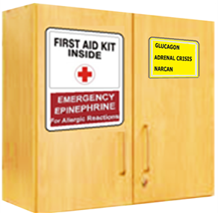
Safe Storage: Accessibility, Availability
Store safely.
Store in original containers. Never repackage.
Verify storage locations: room(s), go-bags, student self-carry.
Consider rapid access in emergency: signage, key protocols.
Refrigerate if required per label instructions.
Monitor supplies. Ensure non-expired doses.
Plan for access during predictable events such as staff absence, field trips, fire drills.
Oregon Department of Education
Oregon Health Authority
Notes:
See Medication Administration Training Manual: Staff Resource Manual: Medication Management.
Epinephrine
Key differences between Epinephrine and other common medications in schools:
“Safe storage” may mean easy access (i.e. no locks) for emergency medications such as epinephrine, naloxone, and medications that students self-carry, such as inhalers, epi pens, and diabetes supplies.
Refrigeration: Epi: Slide 57. Do not refrigerate epinephrine autoinjectors.
Monitoring: Epi: Slide 58. Ensure timely notification to re-stock.
Locations: Epi: Slide 57. Verify local protocols: Do any students self-carry?
Predictable events: Who is trained? Who transports medications?

Slide 94

Student Self-Carry
Medications may be self-carried by students when policies permit
See OAR 581-021-0037 and school district protocol
Self-carry still requires emergency assistance
Some students may self-administer. Be prepared to assist.
Call EMS and notify school nurse, parent/guardian, building administrator, others per school protocols.
Monitor for changes and repeat treatments per individual medication protocols.
Oregon Department of Education
Oregon Health Authority
Notes:
School-specific
Epinephrine, glucagon, and asthma inhalers are common examples of medications that students sometimes self-carry.

Slide 95

Medication Administration “Rights”
Right person
Right medication (type, reason)
Right time (schedule, frequency)
Right route (site, method)
Right dose
Right documentation (and communication)
Oregon Department of Education
Oregon Health Authority
Notes:
School-specific
Medication “RIGHTS” should be checked to ensure safe medication administration. (See Medication Administration Manual p.9 for more details.)
Epinephrine
The “RIGHTS” can be applied to epinephrine administration as follows:
Right person : person with signs/symptoms of severe allergic response
Right medication (type, reason) : Epinephrine, for severe allergic response
Right time (schedule, frequency) : immediately when symptoms are noted
Right route (site, method) : auto-injector; intra-muscular injection to side of thigh
Right dose : adult versus pediatric
Right documentation (and communication) : refer to local protocols see “Record Keeping”

Slide 96

Handling and Disposal
Use standard precautions, including handwashing and surface cleaning.
Follow process and precautions for specific medications and routes.
Expired doses, end of year, and used devices:
Sharps containers for syringes with needles
Give to pharmacy or EMS
Return to family and/or school personnel witness disposal
Oregon Department of Education
Oregon Health Authority
Notes:
Standard practice may include gloves in some settings if gloves don’t delay in emergency care.
For disposing medications, ambulance personnel responding to an event may accept used auto-injector for disposal.
If a medication is student-specific, be sure to document the use, return, or disposal of the medication on the student’s Medication Administration Record (MAR) or per school protocols.
Epinephrine
Process & precautions: see “Management of Severe Allergic Response” beginning on Epinephrine Slides 43. (Other medications: see Medication Administration Manual, pp. 13-20.)

Slide 97
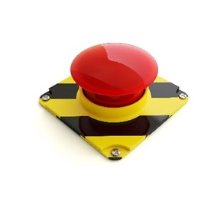
During an Emergency
Emergency impacting school: fire drill, lockdown, flooding, etc.
Grab and go plan for medications; storage system, “go bag”
Emergency related to individual student
Designated school personnel respond, treat
Students with known risk should have Emergency Care Plan. Trained personnel follow individual plan if available.
After initiating emergency care, notify school nurse, parent/guardian, and other emergency response personnel per local protocol.
Oregon Department of Education
Oregon Health Authority
Notes:
School-specific
Ensure emergency medications remain accessible. See pp. 21-22 of ODE Medication Administration Manual.
District policy must ensure necessary medications are available to students, even when participating in off-campus school-sponsored events.

Slide 98

After an Emergency
Verify required actions as a care provider
Monitoring, reporting, follow-up.
Communicate with parent/guardian
The parent/guardian should consult the student's primary care provider.
If a student-specific dose was used, the parent/guardian is responsible for obtaining replacement medication dose(s).
Oregon Department of Education
Oregon Health Authority
Notes:
Epinephrine
See Treatment Protocol for epinephrine on slides 44-47, and in SAR/Epinephrine Manual p14.
“Monitoring and treatment”: the general protocol for epinephrine monitoring and treatments is, “After 5 minutes, if no improvement, give second dose of epinephrine.”
If you are giving a student-specific dose, follow the student’s individual treatment plan/Emergency Action Plan as soon as the plan is available. Do not delay treatment if anaphylaxis is suspected and the treatment protocol is not easily accessed.

Slide 99

Record Keeping
Document during/after an emergency
Symptoms recognized
Dose, time, and if applicable, site of injection
Time that EMS was called and arrived
Transfer of care to parent/guardian or EMS
Other information required by setting
Keep information confidential
Exceptions for school personnel with “legitimate education interest” and emergencies (911 / EMS, public health)
Retain records per district and state policy
Oregon Department of Education
Oregon Health Authority
Notes:
School-specific
See Medication Administration Manual p.23. Refer to district-specific expectations for documenting.

Slide 100

Record Confidentiality
Keep information confidential.
Exceptions sometimes apply.
School personnel with “legitimate education interest”
Emergencies (911 / EMS, public health)
Records must be retained per district and state policy.
Oregon Department of Education
Oregon Health Authority
Notes:
School-specific
See Medication Administration Manual p.23. Refer to district-specific expectations for documenting.

Slide 101

Reporting a Problem or Error
Timely and accurate reporting is critical.
Verify policy and process for your school setting.
Errors will occur.
Addressing errors quickly may prevent harm.
Identifying what led to an error may prevent future problems.
In a culture of safety, “We don’t get in trouble for making mistakes, we get in trouble for hiding them.”
Oregon Department of Education
Oregon Health Authority
Notes:
School-specific
From Medication Administration manual p. 23:
If there is a problem or error, promptly notify the school RN, administrator, parent/guardian per local protocols, after 9-1-1 if needed. Document and notify individuals on the same day unless other instructions apply.
Timely and accurate reporting is critical. Communicating a problem or error can ensure
medication reactions are identified
rapid response is activated when needed
medical orders and treatments are changed when needed
gap areas are identified (staffing, supplies, training, etc.)
future problems are reduced or prevented

Slide 102
Know Your School Setting
What signs and symptoms indicate an emergency?
How do you activate school emergency response?
Who calls 911 during an emergency?
Who alerts the school nurse, response team, building administrators?
Who notifies parent/guardian?
What are your responsibilities after an event (notifications, etc.)?
When (to whom) are you permitted to share information?
Which members of care team, teachers, coaches, etc.
Which emergency situations
Notes:
[Optional for trainers: review local protocols and expectations]

Slide 103
Supplemental Content: Specific Medication
The following slides may be used at the discretion of the approved trainer
The slides expand on administration routes and methods for epinephrine and glucagon.
Approved trainers may incorporate content into trainings for school personnel as applicable to their setting.
Please note that these slides contained limited information. The content is an optional addition, not a replacement, for OHA Lifesaving Treatment protocols.

Slide 104
Optional addition: Epinephrine slides
Notes:
This content follows slide 49 of the OHA epinephrine training protocol.

Slide 105
Administering versus Obtaining Epinephrine
As laws are currently written, a successful trainee may administer epinephrine via pre-measured dose devices.
Dose devices are described in next slides.
A trainee who intends to obtain epinephrine by using the training certificate should be aware that, based on the way laws are written as of August 2025, an Oregon pharmacist may dispense epinephrine in autoinjector form only, when presented with the signed Authorization to Obtain Epinephrine.
Notes:
Distinction between authorization to administer versus authorization to obtain.
As laws are currently written, a successful trainee may administer epinephrine via pre-measured dose devices
Route of administration is not limited by law (may include injectable route, nasal route, etc.)
Source of epinephrine is not limited by law (may include an individual’s prescription, school stock doses, etc.)
However, until laws are updated, a successful trainee using the Authorization to Obtain may only obtain epinephrine in injectable form from an Oregon pharmacy
Oregon pharmacists are limited by law to dispense epinephrine in injectable form when the Authorization to Obtain is presented.

Slide 106
Epinephrine Devices
For the OHA severe allergic reaction/epinephrine protocol, a dose delivery device must provide a pre-measured dose appropriate for the treatment of severe allergic response.
Multiple types of delivery device are available and under development
Auto-injectors
Nasal spray
Other pre-measured doses (sublingual, buccal)
Oregon Department of Education
Oregon Health Authority
Notes:
Epinephrine has been used as a medical treatment for over a century.
The first epinephrine autoinjector device was available in 1984.
The first epinephrine nasal spray for anaphylaxis was approved in August 2024.
As of August 2025, additional non-injectable options are under development including a sublingual form (under the tongue).

Slide 107
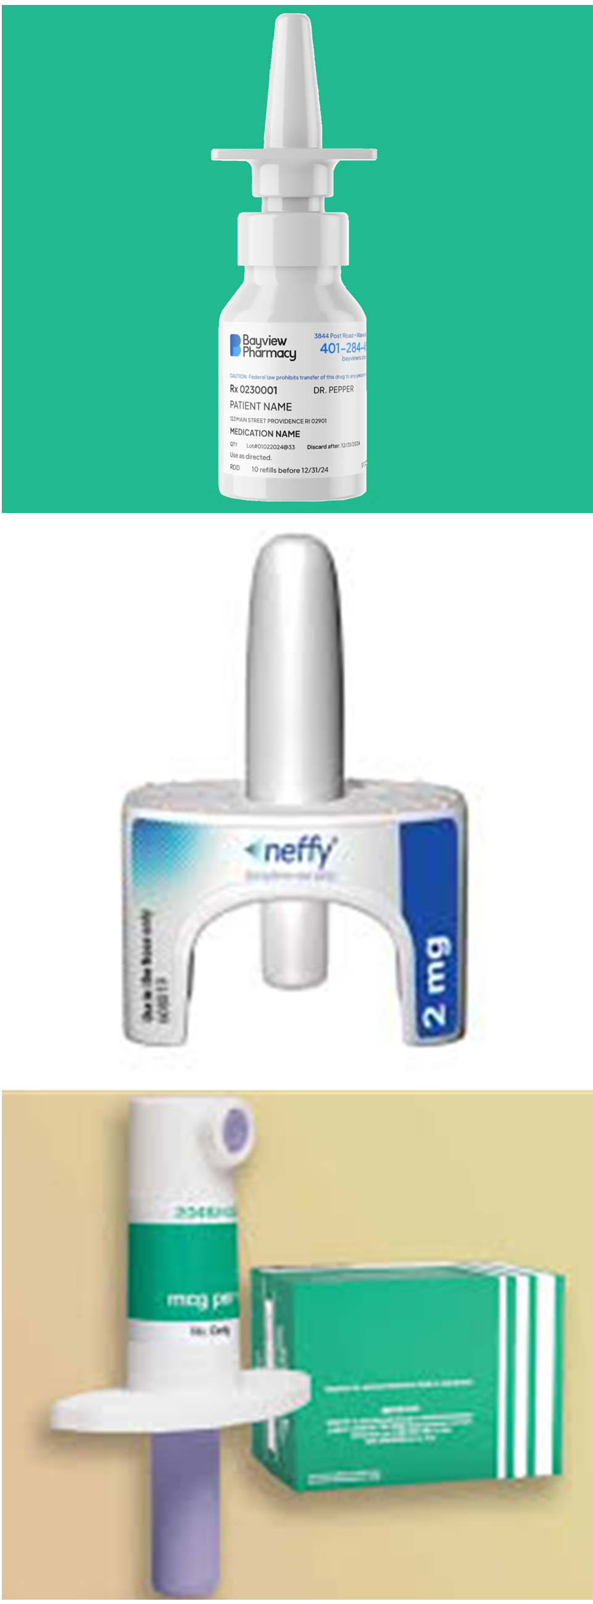
Epinephrine Nasal Spray
Pre-measured dose administered into the nose
If possible, review device instructions before a crisis occurs.
Example
Neffy (ARS Pharmaceuticals) Manufacturer website
Oregon Department of Education
Oregon Health Authority
Notes:
A pre-measured dose of epinephrine may be delivered via nasal spray. (Reminder: check the product, to be sure it is intended to treat severe allergic response.)
Whenever possible, it is important to know which epinephrine device you will be using since the method for administration may differ between manufacturers. Practicing (using training models) can increase confidence and accuracy during an event.

Slide 108
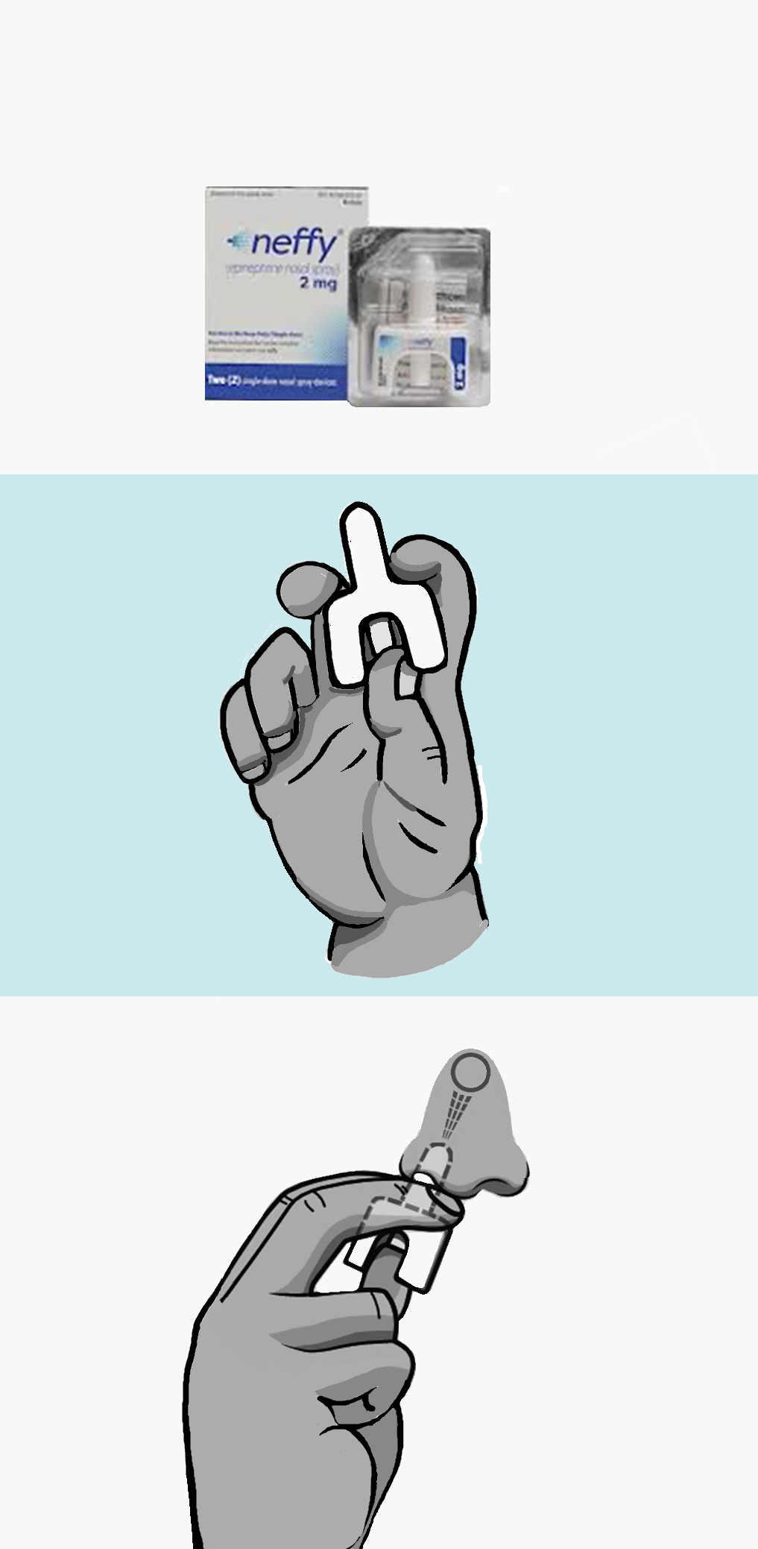
Epinephrine Nasal Spray 1 of 2
The following expands on step 4 of the Severe Allergic Reaction Treatment Protocol: “Administer the epinephrine.”
4.a) Remove the spray device from its packaging
4.b) Hold with two fingers and thumb as shown. Do NOT test spray.

Slide 109
Epinephrine Nasal Spray 2 of 2
4.c) Insert nozzle into nostril until fingers touch the nose.
Hold straight; do NOT angle toward side of nose or septum (center divider inside nose).
4.d) Press plunger firmly. No inhalation required.
4.e) Give second spray if indicated by device instructions.
Example: one spray for person 30 to 65 pounds; 2 sprays for person 65 pounds or more.
Continue to step 5) of the Treatment Protocol
Call 911, protect airway, monitor for changes, etc.

Slide 110
Optional addition: Glucagon slides
Notes:
This content follows slide 28 of the 2018 Glucagon Protocol.
Updates to the OHA Glucagon protocol are underway during the 2025-26 school year. Those updates are expected to include this content.

Slide 111
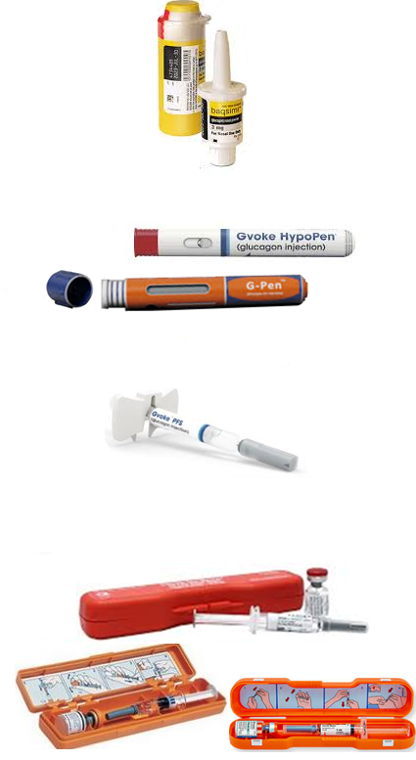
Glucagon Delivery Devices
Nasal spray (2019)
Auto-injector (2020)
Ready to use; needle retracts automatically
Pre-filled syringe (2019)
Ready to use; needle does not retract
Glucagon Kit (since 1960s)
Requires mixing; keep separate until use
Bottle of glucagon powder
Syringe filled with diluting fluid
Notes:
Glucagon is manufactured in multiple ways, including a standard 3mg nasal spray and standard 1mg pre-filled injections.
The person’s healthcare provider will determine the appropriate dose. This information is included on the prescription label of the glucagon delivery device or emergency kit.
For injectable glucagon, if available an alcohol swab and gloves should be used to administer the dose.
Glucagon delivery devices
Glucagon doses comes in a package with supplies needed for administration.
Glucagon can only be obtained by prescription by the individual affected by diabetes or child’s parent/guardian.
It is the responsibility of the person for whom glucagon is prescribed, or in the case of a child, the parent/guardian, to provide the original and any replacement glucagon delivery device / emergency kit for use by the emergency glucagon provider.
Glucagon nasal spray and auto-injectors come ready to use.
A glucagon Emergency Kit contains components that must be prepared:
• a bottle of glucagon in powder form
• a syringe filled with special diluting liquid

Slide 112
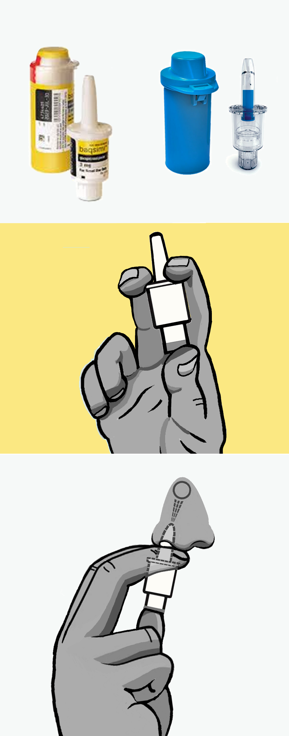
Glucagon Nasal Spray
If available, put on gloves. Remove the spray device from its packaging.
Hold with two fingers and thumb as shown. Do NOT test spray.
Insert nozzle into nostril until fingers touch the nose.
Hold straight. Do NOT angle toward side of nose or septum (center divider in nose).
Press plunger firmly. No inhalation required.
Discard the nasal spray device in trash or per local protocol.
Continue rescue measures, CPR as needed.

Slide 113
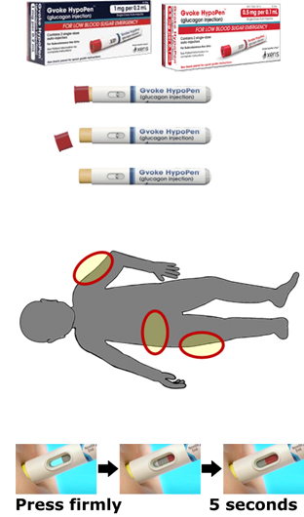
Glucagon Autoinjector 1 of 2
If available, put on gloves. Take device out of packaging. Remove the protective cap at the needle end.
Prepare injection site.
Select location with some fat: upper arm (back side), lower abdomen (at least 2 inches away from “belly button”), or upper leg (front or side of thigh).
If available, use alcohol swab to clean selected site.
Stabilize the site with one hand and press firmly onto bare skin. Hold syringe in place for 5 seconds, until the fluid is fully injected.

Slide 114
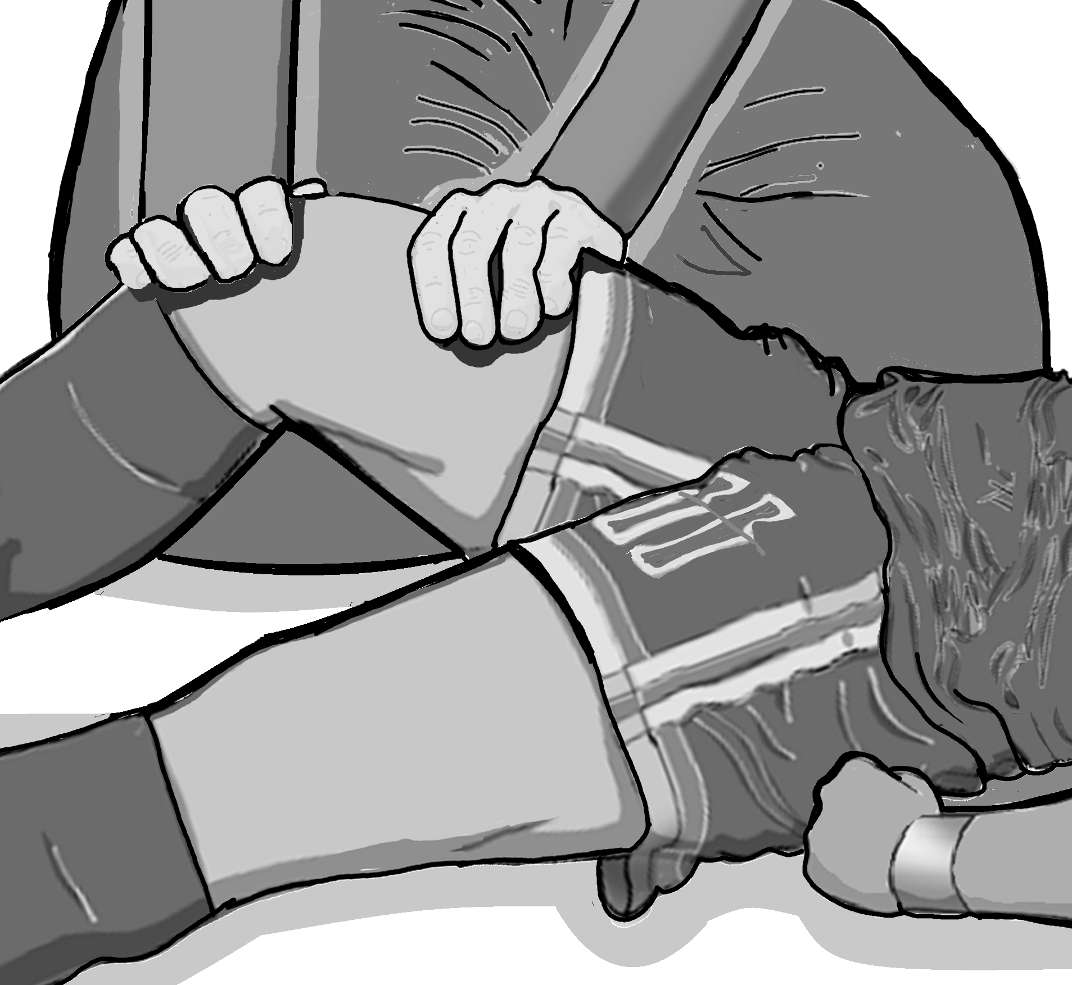
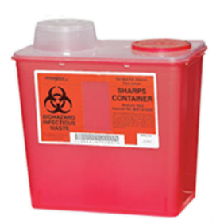
Glucagon Autoinjector 2 of 2
After injecting, remove device. Press the site with a gloved hand, gauze, cotton, or adhesive bandage.
Discard the needle safely.
Place the used syringe back into its box, case, or needle cover until it can be discarded.
If covering the needle, DO NOT hold the case or cover. The cover should rest on a surface until tip of device covered.
Continue rescue measures, CPR as needed.

Slide 115
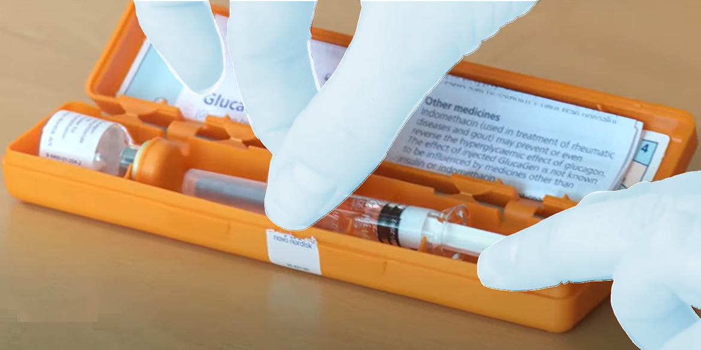
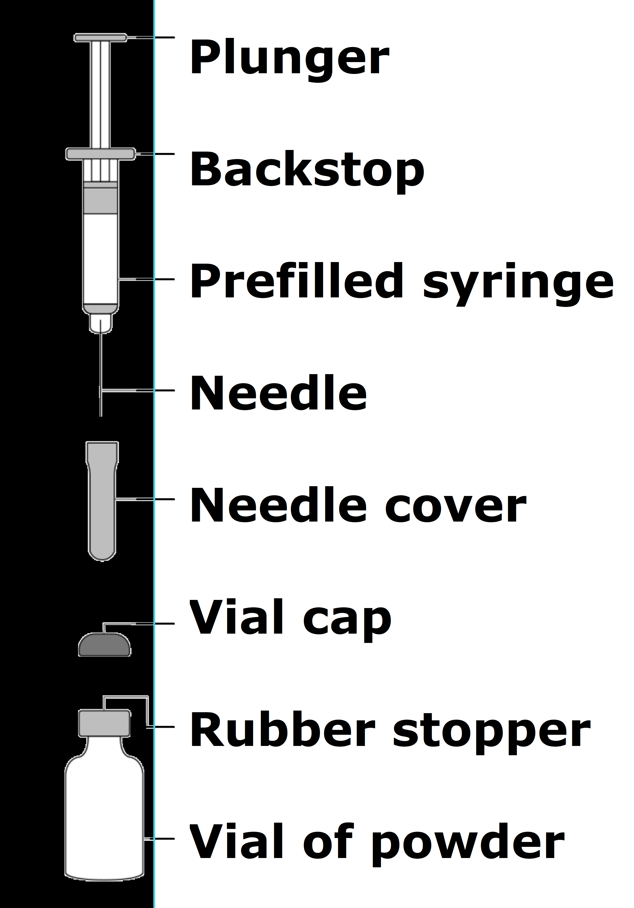
Glucagon Emergency Kit 1 of 4
If available, put on gloves. Take out the kit components.
Prepare the glucagon for injection.
Remove the vial cap (flip-off seal).
Remove needle cover from syringe. Do not remove plastic clip from syringe, if present.
Insert the needle into the vial. Push through the rubber stopper all the way into the vial.
Push the plunger all the way to the syringe backstop to inject all the liquid into the vial.
Notes:
To Prepare Glucagon for Injection
1. Remove the flip-off seal from the bottle of powdered glucagon.
2. Remove the needle cover from the syringe filled with diluting fluid. DO NOT REMOVE THE PLASTIC CLIP FROM THE SYRINGE.
3. Insert the needle into the center of the rubber stopper on the vial of powdered glucagon.
4. Push the plunger on the syringe to inject the entire contents of the liquid solution into the vial of powdered glucagon.

Slide 116
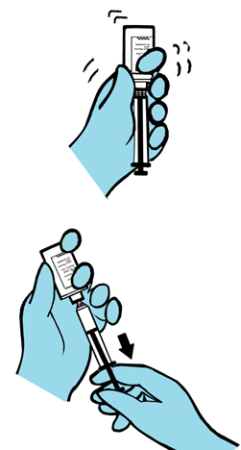
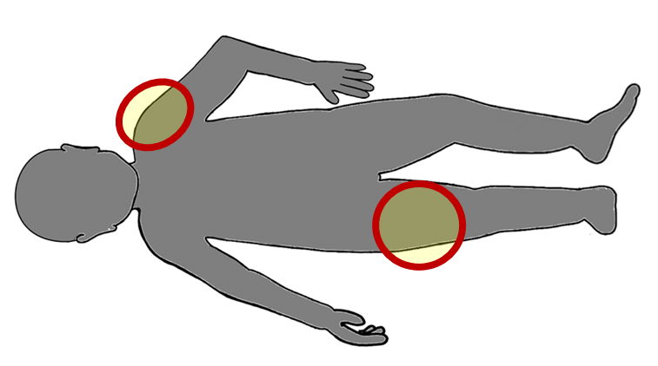
Glucagon Emergency Kit 2 of 4
f. Leave the needle in the vial and gently shake until the powder dissolves.
h. Pull back on the plunger to draw up the right amount of medication. Check individual instructions.
Example: 0.5 mg (half dose) if less than 60lbs
1 mg (full dose) if greater than 60lbs
3. Prepare the injection site.
Select a location with muscle: upper arm near the shoulder, or upper leg at the front or side of the thigh.
If available, use an alcohol swab to clean selected site.
Notes:
Prepare Glucagon (cont.)
5. Leave the needle and syringe in the vial.
If the glucagon solution is not clear and water-like, do not administer. Monitor the person for absent pulse/respiration, or seizure activity until rescue personnel arrive.
Shake bottle gently until glucagon powder dissolves and the solution becomes clear.
6. Withdraw the prescribed amount of medication per provider’s order.
7. Cleanse the injection site on the upper arm or thigh with alcohol swab if available.

Slide 117
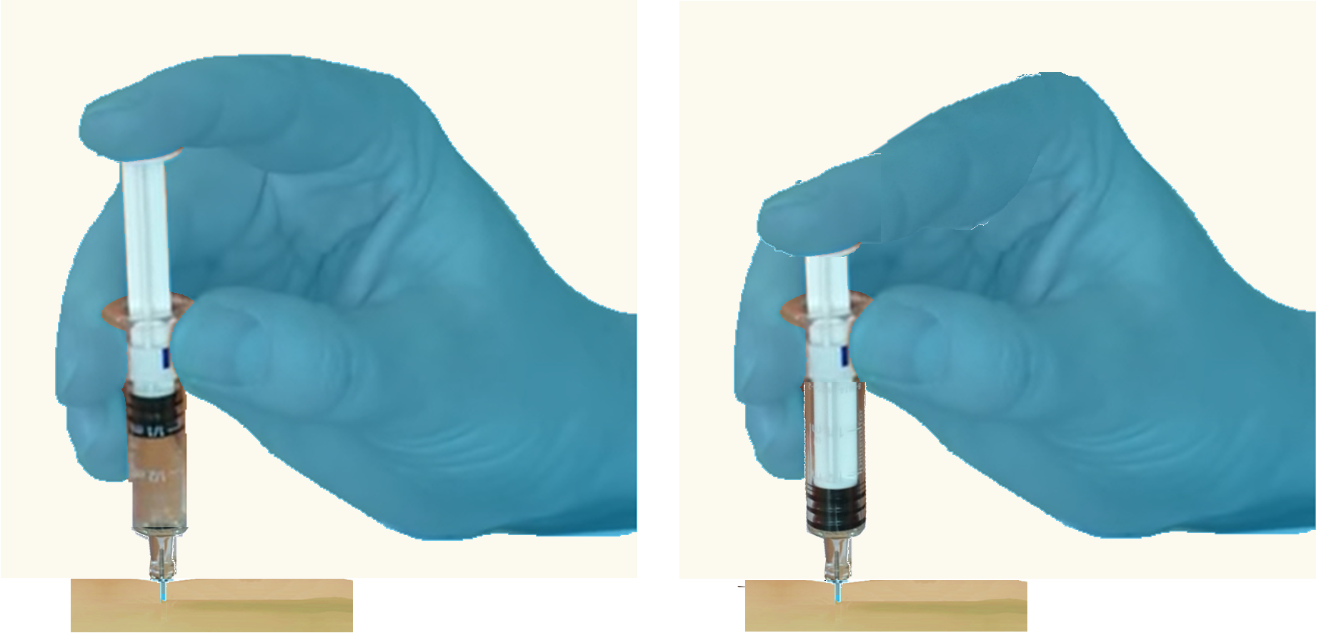
Glucagon Emergency Kit 3 of 4
4. Inject the glucagon.
Stabilize the person’s arm or leg near the selected site.
Insert the needle into the skin/muscle at a 90⁰ angle.
Press plunger down firmly to administer all the medication.
Carefully withdraw the needle at the same angle.
Press firmly against the site with a gloved hand, gauze, cotton ball, or adhesive bandage.
Notes:
Prepare Glucagon (continued)
8. Stabilize the limb and insert the needle at a 90 degree angle into the upper arm or thigh
9. Administer all of the prescribed medication.
10. Carefully withdraw the needle at the same angle without releasing the person’s limb.

Slide 118
Glucagon Emergency Kit 4 of 4
Discard the needle safely.
Place the used syringe back into its box, case, or needle cover until it can be discarded.
If covering the needle, DO NOT hold the case or cover; cover should rest on a surface until tip of device covered.
Continue to rescue measures, CPR as needed.

Slide 119
Medication Administration Knowledge Verification
Notes:
Knowledge Verification is a required component for school personnel Medication Administration trainings.
For Epinephrine: see Knowledge Verification options in the Manual, section VII Summary and Review pp.22-27 or in the PowerPoint beginning on slide 75.
For general medication training, see Medication Administration Manual, Training and Evaluation Resources beginning p.32; and/or Medication Administration slides, “Demonstration and Knowledge Verification” beginning slide 39. NOTE: some content will not apply unless you are training personnel for general medication administration. Select applicable content.

Slide 120
You can get this document in other languages, large print, braille or a format you prefer free of charge. Contact Jason Free at jason.free@oha.oregon.gov.
Public Health Division
Emergency Medical Services Program
Health Care Regulation and Quality Improvement Program 800 NE Oregon Street, Suite 465 Portland, OR 97232
OHA EMS/Health Care Programs
Notes:
For citations please see the SAR/Epinephrine training manual.

