Slide 1

Child Development and Procedural Pain Management
Traci Brown, MA,CLS
Certified Autism Specialist

Slide 2


Slide 3
Let’s see where we are:
What is your comfort level/ experience in caring for pediatric patients?
A. Hardly any experience- they scare me!
B. Some experience- but only comfortable with certain ages.
C. Lots of experience- I enjoy working with any age!
Notes:
Polling Question #1

Slide 4



Do all of these faces look familiar?
According to the World Journal of Clinical Pediatric:
The most frequently reported emotional responses to hospitalization are:
Anxiety
Stress
Fear
WHY?
Level of brain development.
Limited understanding of their illness and
the clinical experience.
Limited coping strategies.
Lerwick JL. Minimizing pediatric healthcare-induced anxiety and trauma. World Journal of Clinical Pediatrics. 2016;5(2):143-150. doi:10.5409/wjcp.v5.i2.143.
Notes:
Having a basic understanding about Child Development and how the brain changes as a child grows is like learning a different language. As adults we can’t go back and unlearn the things we already know. And as adults hopefully we have some positive coping skills that help us when we get anxious or stressed. Many of the skills adults use to navigate the world around them had to be learned and experienced over time.
This short video is a quick reminder of how important and critical it is that we understand the basics or the “Language” of child development so we can meet the needs of our pediatric patients.

Slide 5

Learning about Child Development is like learning to speak a different language.

Slide 7
Newborns and Infants
2. In working with newborns and infants my biggest concerns or challenges are:
A. Their condition can change and decline rapidly.
B. Newborns and infants are fine, it’s the parents and caregivers that stress me out.
C. Starting IVs or drawing blood on such tiny humans.
D. All the above.
Notes:
Polling question #2

Slide 8


Newborns: 0- 12 weeks
Developmental Themes
Sucking Reflex
Focus on objects 8-12 inches away
Startle reflex – when moved or hear loud noises
Hospital/Clinical Stressors
Startles to loud noises or sudden movements
Eyes Blink frequently with bright lights
Impaired and interruption of basic needs
Coping Behaviors
Crying
Sucking- nutritive and non-nutritive
Looking away when over stimulated
Interventions
Encourage parent participation and model touch and holding
Decrease noise level and bright lights
Avoid hunger and maintain warm temperature
Soothes to swaddling, soft voices, soft music
Notes:
Fun fact about babies: Newborns and ear development- Newborns ears develop completely in utero. So imagine hearing as you do now but not having the brain development to detect what the sound is. Can you imagine how distressing this would be? Think about how loud hospitals and clinics can be.

Slide 9
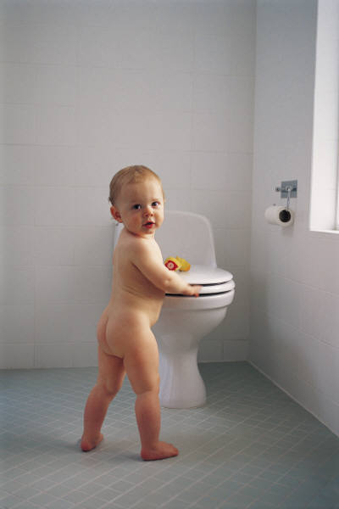

Infant: 3 mo. to 12 mo.
Developmental Themes
Attachment to Primary caretaker
Development of trust
Learns through senses and environment
Minimal language
Hospital/Clinical Stressors
Separation from parents / Stranger anxiety
Impaired and interruption of basic needs
Coping Behaviors
Crying, fussing
Hand/mouth activity
Rocking or swaying, repetitive play (peak- a- boo)
Interventions
Encourage parent participation and care
Involve parents in “comfort positions” for care
Decrease number of caregivers
Talk in soft tones and talk before touch and use play to interact
Notes:
#1 Coping is Crying
Ever wonder why it is so difficult to ignore the sound of a crying baby? Scientists have found that our brains are hard- wired to respond strongly to the sound. Our bodies are triggered into alert mode. Study was done on parents and non-parents alike and all are the same.
Fun fact: Babies use facial expression of adults to decide how they feel.
This is especially difficult now since we are wearing masks all the time. We recommend maybe printing a photo of your self and laminate it so you can show your pediatric patient what you look like behind the mask. May be print a photo of you doing something fun or with a family pet.

Slide 11
What is your comfort level/ experience in caring for pediatric patients?
A. Hardly any experience- they scare me!
B. Some experience- but only comfortable with certain ages.
C. Lots of experience- I enjoy working with any age!
Toddlers 1-3 years
3. Toddlers can be the most challenging age group because:
A. They lack language skills.
B. They fear of strangers and new situations.
C. They can be uncooperative- not holding still, crying, meltdowns.
D. All the above.
Notes:
Polling question # 3

Slide 12


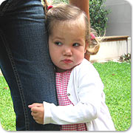

Toddlers: 1-3 years
Developmental Themes
Seeks Independence
Developing language skills
New motor skills- walking or potty training
Short attention span
Threatened by change
Mobility is means of learning about the world
Hospital /Clinical Stressors
Separation from parent and fear of abandonment
Stanger anxiety
Loss of mobility, autonomy- hates being force to lay down
Change in routine
Coping Behaviors
Regression of recently learned skills to get immediate needs met
Clinging behavior
Melt downs
Attachment object
Interventions
Encourage parent participation and presence
Allow for motor activity
Offer choices when possible
Use distraction to lesson anxiety with cares - utilize attachment object for comfort
Notes:
Fun Fact:
Around 18 months of age a toddler experiences a “word spurt” adding new words (several per day) to their vocabulary.
By the time they are out of toddlerhood their brains are almost full size.

Slide 14
In working with newborns and infants my biggest concerns or challenges are:
A. Their condition can change and decline rapidly.
B. Newborns and infants are fine, it’s the parents and caregivers that stress me out.
C. Starting IVs or drawing blood on such tiny humans.
D. All the above.
Preschool age 3-5 years old
4. To a preschooler, being taken to the hospital usually means:
A. They will get a shot.
B. They are being punished for something they’ve done wrong.
C. They will be separated from mom and dad and left alone.
D. All the above.
Notes:
Polling question # 4

Slide 15


Preschoolers: 3 to 5 years
Developmental Themes
Egocentric
Increased language skills
Limited concept of time
Learn best by doing
Hospital/Clinical Stressors
Sees hospitalization as a punishment
Misconceptions develop from lack of understanding – literal meanings
Loss of competence
Coping Behaviors
Regression- attachment to object and clinging
Anger – due to confusion, not cooperating
Interventions
Involve parents in “comfort positions” for care
Offer choices when possible
Encourage child to participation in care- give child a specific job such
holding the temperature gage while you take their temp
Medical play – great age for this
Distraction play- focused attention
Notes:
In other words, children can’t put themselves in someone else’s shoes, and believes everyone else thinks exactly as they do. This means seeing things from another’s viewpoint is actually a developed ability.
Egocentrism refers to the child's inability to see a situation from another person's point of view. According to Piaget, the egocentric child assumes that other people see, hear and feel exactly the same as the child does
This age does a lot of projection into inanimate objects (such as toys and teddy bears) have human feelings and intentions. This thinking can also be helpful to children so they don’t get extremely overwhelmed by what they don’t know. Psychologists also think that animism is a way that children express their imagination and process how objects really work in a fashion that's easy for them to understand. Most children know that inanimate objects really aren't alive.
Fun Fact: Studies have shown that if a kid watches more than 3 hours of videos or TV programs a day, they may have a greater chance of emotional, relationship, and conduct problems when they reach 7 years of age.

Slide 16
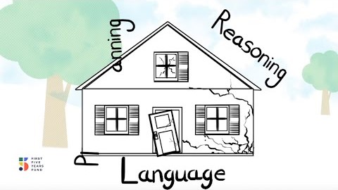
First 5 years of Brain Development

Slide 18
What about school age kids 6-12 years old?
5. What do school age kids most fear about hospitalization?
A. Loss of Privacy.
B. Loss of peer interaction.
C. Fear of pain.
Notes:
Polling question #5

Slide 19


School age: 6- 12 years
Developmental Themes
Develops concrete thinking
Active learners, invent and design things
Increased participation in care
Importance of peers beginning
Hospital/Clinical Stressors
Loss of bodily control or function
Loss of competence
Loss of privacy
Fear of pain
Coping Behaviors
Regression
Depression, withdrawal
Hyper- focus on distractions (video games , artwork= zoning out)
Interventions
Teach effective coping strategies (deep belly breathing)
Give more specific information about body or part effected
Provide age appropriate distraction
Notes:
Concrete thinking- thinking and reasoning is more logical and organized. They establish a sense of self based on their abilities. Example: Legos

Slide 20


What’s the deal with LEGOS anyway?
Teamwork and communication
Patience and organizational skills
Constructive problem solving
and lateral thinking
Fine motor skills development
Adventure and experimentation
Increases spatial awareness
Better focus and concentration

Slide 22
6. What influences a teen the most when making positive choices?
  A. Peers or peer pressure- fear of embarrassment
  B. Taking away their privileges if they rebel. (Such as cell phones)
  C. Rewards for good behaviors or decisions.
  D. Their parents or guardian.
Notes:
Polling question #6

Slide 23



Adolescent: ages 13 -18 yrs.
Developmental Themes
Socialization and peers most important
Rapidly changing body image-body image relates to self esteem
Need for privacy
Increasing independence and responsibility
Hospital/ Clinical Stressors
Separation from peers and support system
Restriction of physical activities
Threat of bodily competence
Fear of death
Coping Behaviors
Uncooperative behavior
Withdrawal or overly connected on social media
Interventions
Respect and maintain privacy
Involve them in care and decisions
Allow peers to visit
Communicate honestly and openly
Provide for expression of feelings and thoughts
Notes:
Since toddlerhood this is the second most dramatic brain growth spurt.
1. Due to the increase in brain matter, the teen brain becomes more interconnected and gains processing power, Johnson said.
Adolescents start to have the computational and decision-making skills of an adult –if given time and access to information,Has the decision making skills of an adult if given time to access information.
2. Their brains rely more on the limbic system (emotional part) then the rational part – prefrontal cortex
Because of the rise of the limbic system- teens often misread parents and adults and get upset easily. Adults get confused when working with teens because they have the ability to make higher levels of decisions but can respond overtly emotionally.
FUN FACTS:Young teens are likely to interpret harsh verbal discipline as "indicative of rejection or scorn," the researchers said in their study. This interpretation can result in the child developing of a hostile view of the parent-child relationship, a negative view of them self, or low self-control.
When it comes to our children, many think the most dangerous age is 2, or at the very least it's terrible! But experts put the most risky age our kids reach is 14. A neuroscientist says that adolescence is a time of big change, from the beginning of puberty around 11 or 12 to the late teens/early 20s and it brings about a host of brain and behavioral changes. Scans of brains found that teens are not only more prone to embarrassment, they’re also less likely to respond to punishment and are more visually creative than adults and this peaks around 14. That risky behavior continues into our early 20s. Adolescents don’t always take risks but are more prone to do so around friends. Probably the biggest shocker in the study was that teens are less likely to learn from punishments. The study asked two groups of people, 12 to 17 and 18 to 32, to choose symbols that were associated with rewards and punishments. While both groups were equally good at spotting the winners, the adolescents fared much worse in picking out the losers. This suggests that a reward-based approach, rather than punishment, might be more likely to benefit an adolescent learning.

Slide 24
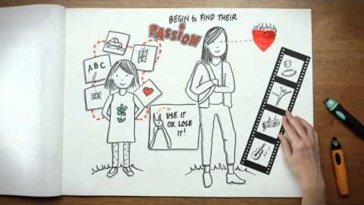
Adolescent Brain Development

Slide 25
Procedural Pain Management

Slide 27
7. What are the main ideas when managing procedural pain?
A. Getting a procedure done as fast as possible is the best way.
B. Using topical anesthesia doesn’t help for needle pain.
C. Always involve the parents or caregivers when doing a painful procedure on a pediatric patient.
D. Crying is a sign that a procedure was not successful.
Notes:
Polling question #5

Slide 28
What are children most afraid of when coming to the hospital or other medical services?
  Needle procedures!
  These procedures performed in childhood are a substantial source of distress AND are the #1 fear.
  Based on studies, anxiety and fears over painful procedures like blood draws, IV starts and vaccinations were even greater than any separation from care giver.
  Why is managing procedural pain so important?
  Untreated pain can have long-term consequences including:
  Pre-procedural anxiety and increase need for anxiety meds (VERSED)
  Avoidance of health care
  Mistrust of care providers
  Inadequate pain control for initial procedures in children diminishes the effect of adequate pain control over time in subsequent procedures.
  So what’s the bottom line?
              S. Friedrichdorf, 2012, Myths to Magic Conference

Slide 29
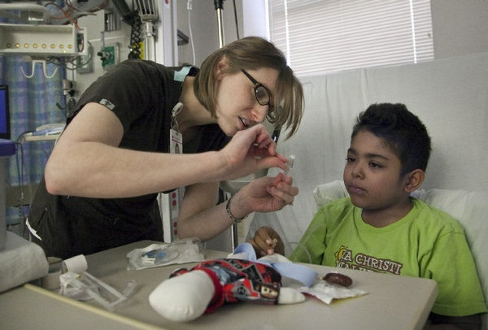
Procedures have both Physical and Emotional Pain
We must treat both!
The communication and preparation using accurate, developmentally appropriate language prior to a healthcare experience along with a procedural pain management protocol helps to:
  Decreases anxiety
  Clears misconceptions
  Allows child to process information
  Increases child’s cooperation
Best Practice Evidence Show:
Children ages 0-18 years old that receive developmentally appropriate support and pain control
led by caregiver, medical staff or nurses for IV placement, immunizations, blood draws, laceration repair, or any other stress inducing procedures, interventions and preparation show a significant reduction of procedural
related distress and anxiety.
Procedural Pain Management: A Position Statement with Clinical Practice RecommendationsCzarnecki, Michelle L. et al.
Pain Management Nursing , Volume 12 , Issue 2 , 95 - 111
It’s the right thing to do!

Slide 30
ALWAYS USE ONE VOICE!!
Best Practice for Procedures
O- One voice should be heard during the procedure:
Or as few voices as possible!
One person should be designated to do most of the speaking during a procedure.
It can be the nurse, the parent, a child life specialist or a childcare partner etc.
It's OK for the parent/ cargegiver to always be a voice of comfort to the child as it’s not disruptive.)
N- Need for parental/ caregiver involvement:
Parents or caregivers are the most important people in a child's world; They NEED to be present. If they cannot be present another person should be assigned to fill that role during the
procedure, usually another staff member or a Child Life Specialist.)
E- Educate the patient and the family:
Educate before the procedure; explain what is going to happen.
MAKE A PLAN!
Notes:
- First lets talk about the ONE VOICE protocal for procedures. Why is it important: To decrease the level of anxiety in the room. We must help to set a supportive environment immediately prior to a procedure.
It takes 2 min to set up a plan. 1. Get your team in place. Also includes care giver and patient. 2. Who’s the one voice. 3. Give care giver and or patient a job. 4. Choose Numbing
5. Comfort position 6. Choose distraction

Slide 31
The 4 Non-Negotiables for Painful Procedures:
PLUS: One Voice Protocal
ALWAYS offer Topical Anesthetics:
  ELA-MAX cream- No Doctor order needed. See attached Pain Management for vascular access.
  J-Tip - No Doctor order needed. See attached Pain Management for vascular access.
  Cold Spray
  Shot Blocker- Not a topical- but a tool for vaccines.
Comfort Positioning:
See handout sheet on comfort positioning examples.
Distraction- Age Appropriate
Sucrose- on Infants 0 -12 months of age along with topical
Notes:
This is the expectation: That these best practices are followed whenever procedural pain (w/ needle) is expected for a pediatric patient.
What is non-negotiable is that the team assess each of these best practices to benefit the patient and minimize trauma.
The goal is not for the child to not cry, the goal is did we do everything we could/use all of our tools, to minimize trauma for this child.
- Often, even when the child did not cope well with a procedure…the parents see the efforts we went to and are appreciative of the interventions we implemented.
- Even at night- these should be practiced.
Consistency is Key.
All ages from our youngest to our oldest patients must be treated with the same care.
FOR NIGHTS:
Don’t be afraid to ask physician- Can these cares be bundled? Is there any flexibility in the timing of the labs? Is the child getting surgery the next morning? If so- can we wait for that IV to be placed and have anesthesia do it after mask induction? CL often helps with asking these questions and advocating for a new plan when we see a need for this.

Slide 32
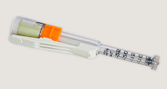
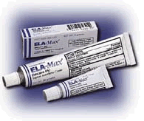
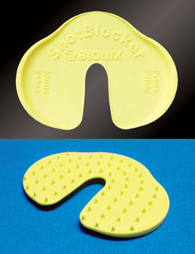
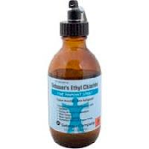
Topical Anesthetics
Protocol 912.600: Pain Management for Vascular Access
  Provides guidelines to facilitate appropriate use of topical anesthesia
  Outlines process for ordering and documenting use—No LIP order needed
J-tip
ELA-Max Cream (lidocaine 4%)
Shot-Blocker
Ethyl Chloride
Notes:
Nurses can initiate all of these orders.

Slide 33


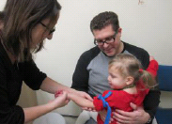
Comfort Positioning
Allow patient to sit up whenever possible—decreases child’s anxiety and increases cooperation.
Allow patient to choose
Empower and engage caregiver
Assign a “Comfort Coach”
Use “One Child, One Voice, One Team” approach
  Decreases chaos and noise in the room
  One person is responsible for talking during the procedure
Notes:
- Intranet- Just For Nurses- RCH Nursing Resources- IV Resources
Take out your handout and lets review the different kinds of comfort positions.
- Other staff can step in of when parents are not there to help.
Ask parents to keep an eye on other hands/body parts rather than restrain if possible.
- The idea is to “support’ instead of “hold”.

Slide 34

Comfort Positioning
Notes:
https://www.youtube.com/watch?time_continue=1&v=YPi3xT6UCOs

Slide 35
The Art of Distraction
Why use distraction?
Distraction is the most common type of cognitive-behavioral method.
It is an intervention that is often used to guide attention away from painful stimuli .It is most effective when adapted to the patient’s developmental and cognitive level.
What’s the best part?
  Does not require advanced training for
  providers.
  Works with all developmental levels.
  Involves parents and caregivers during
  stressful times.
Current research indicates that distraction can lead to reduction in procedure times and number of staff required for procedures, especially in children. Researchers hypothesize that children “can not attend to more than one significant stimulus at a time.”
K.A. Birnieet al. Mechanisms of distraction in acute pain perception and modulation. Pain Journal 2017;158(6):1012-1013

Slide 36



Age- Appropriate Distraction
Create distraction kits for units, carts or in vehicles
Interventions:
  Bubble blowing
  Comfort Items
  Music/ Sound books
  Singing
  I-pad
  Spinning Light Toys
  Belly Breathing
Distraction Kits for Pain Management of Children Undergoing Painful Procedures in the Emergency Department: A Pilot Study.
Ballard A¹, Le May S², Khadra C³, Lachance Fiola J¹, Charette S⁴, Charest MC⁴, Gagnon H⁴, Bailey B⁵, Villeneuve E⁶, Tsimicalis A⁷.
Notes:
Parents often come with their own phones. Helpful with toddlers: parents can pull up videos on their phone that the child likes to look at (familiar faces, things).
CL has own procedural distraction bags.
- Can also touch on prep books on ipad, simply sayin app, and prep kits/dolls.

Slide 37

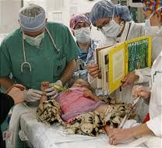
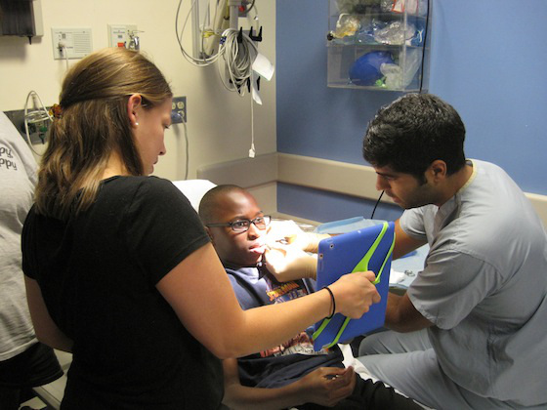

Slide 38
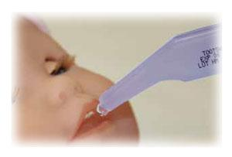
Sucrose
Reduces pain and cry during painful procedures
Administer 2 minutes prior (loading dose) to mild-moderate painful procedures, right before procedure and 2 minutes into the procedure
Dose: 24% sucrose; 0.05mL-2mLs
Notes:
- Babies learn sucking in the womb. Natural coping skill.
Always offer 0-1yr. Promotes sucking as a self-soother.
Offer in conjunction with topical anesthetic.
Ask parents if they want to hold paci while you administer sucrose. Or you can ask parent if you can offer baby pacifier or gloved finger.

Slide 39
Child Friendly Language
Word | In the hospital
I.V. | Tiny straw for medicine or water
Take your vitals | See how warm your body is, how fast your blood is moving in your body, how strong your heart is
Stretcher | A bed on wheels
Move to the floor | To a different room on another level of the hospital
Vein | Tiny Blue lines
Tourniquet | Tight hug
“The vein blew” | Sometimes a vein doesn’t want to cooperate
Flush | To give your body a drink of water
This chart is adapted from: Gaynard, L. et al (1998). Psychosocial care of children in hospitals: A clinical practice manual from the ACCH child life research project. Rockville, MD: Child Life Council.
Notes:
Avoid saying things like: “Owie, Owie Owie”
‘I am soryy”
“One two three”
“Here comes the poke”
“Almost Done”

Slide 40
Questions?

Slide 41


