Slide 1
Public Health Data and Science
Katrina Hedberg, MD, MPH
Health Officer & State Epidemiologist
PUBLIC HEALTH DIVISION New Employee Orientation

Slide 2
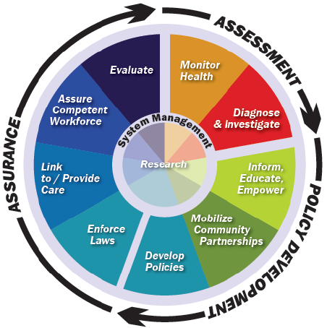

Slide 3
State Health Profile
70+ population health indicators
Array:
social context
disease outcomes
Behaviors
healthcare access
disparities

Slide 4
Key Data Sources
Vital Statistics (birth, death)
Service receipt (immunize, hospital d/c, WIC)
Reportable conditions (infectious disease, cancer)
Surveys (BRFSS, OHT, PRAMS)

Slide 5
Notes:
Data represents the top seven reasons for YPLL-75 in 2013. Liver Disease = Chronic Liver Disease & Cirrhosis. Lung Disease = Chronic Lower Respiratory Disease. Percents are the number of years-of-potential-life-lost or deaths from a particular cause divided by the total years-of-potential-life-lost or deaths.

Slide 6
Notes:
Number of deaths in 2012

Slide 7
Current cigarette prevalence

Slide 8
New BRFSS weighting method began in 2010.
Notes:
When we look at trends … specifically for … obesity over time … in Oregon … we see that …
Between 1995-2009: there was about a 67% increase … in the prevalence of obesity … among adults …
And from … 2001-2009: there was more than … a 50% increase in obesity among 8th graders

Slide 11
Specific Populations
Race/ ethnicity
Low SES

Slide 13
Cigarette smoking by SES, Oregon
44%
Low SES
29%
New BRFSS weighting method began in 2010.
19%
Not Low SES
13%
Notes:
Source: Oregon BRFSS
Oregon adults who have not completed high school or who have incomes below the federal poverty line are 1.8 times more likely to smoke than those Oregonians with higher incomes and higher educational attainment.
In 2014, smoking prevalence of adults:
with yearly incomes less than $15,000 per year was 32.4%.
with yearly incomes of more than $50,000 was 10.5%.
on the Oregon Health Plan was 30.5%
No on the Oregon Health Plan was 14.2%.

Slide 14
Questions?

Slide 15
Contact information
Katrina Hedberg, MD, MPH
971-673-1050
Katrina.hedberg@state.or.us

