Slide 1















Slide 2
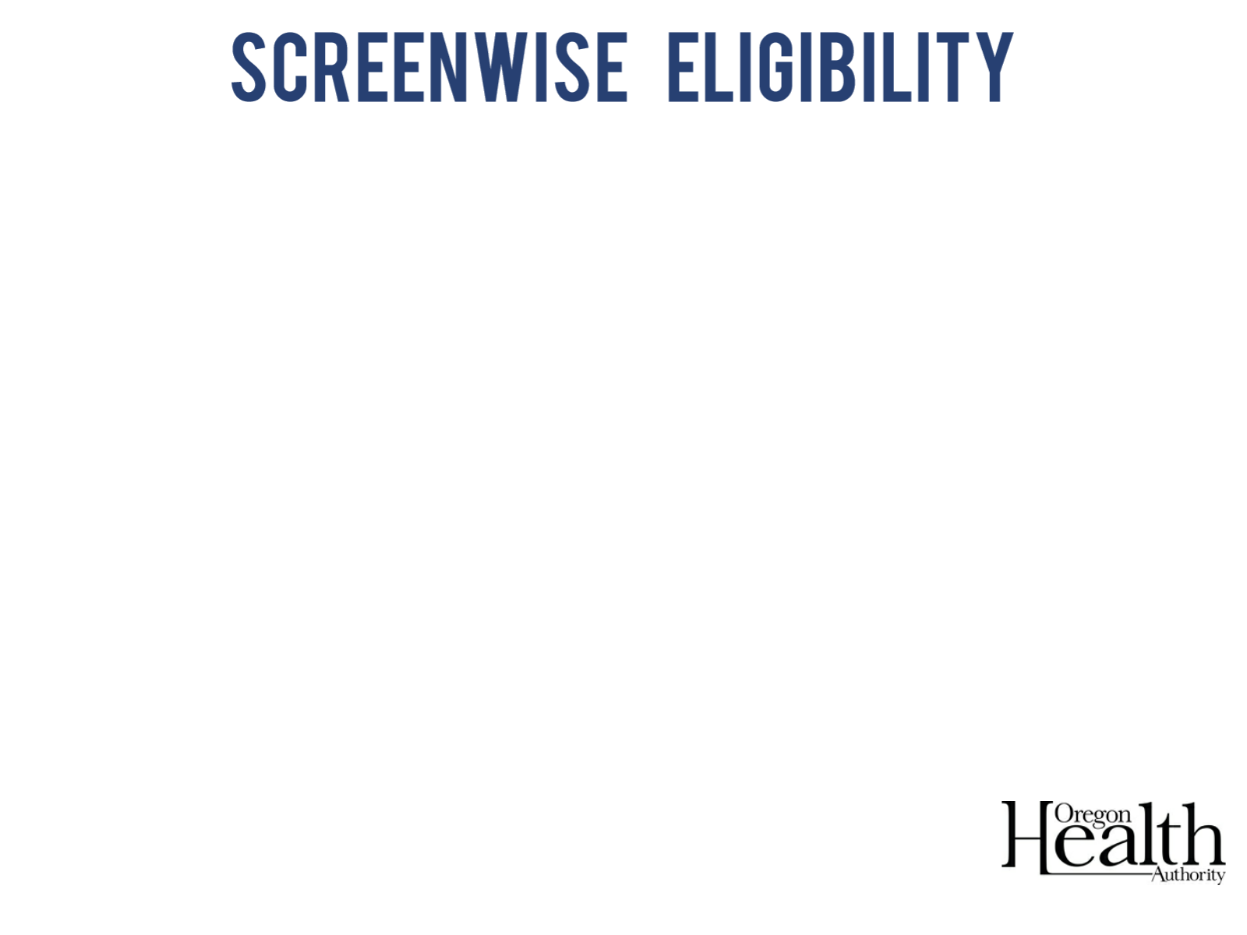
 |  | Clinically recommended services the patient may be eligible for
 |  | Breast | Cervical | Genetics | Heart Services (WOMEN ONLY)
Age | 21-39 | ✓ | ✓ | ✓
 | 40+ | ✓ | ✓ | ✓ | ✓
Notes:
Most ScreenWise patients are cisgender women ages 21 - 64.
However, clinically recommended services may include:
Breast services for cisgender males with breast cancer symptoms
Breast, cervical or genetics services for transgender women or men. (for example a transgender woman taking hormone
Cisgender/cis: term for someone who exclusively identifies as their sex assigned at birth. The term cisgender is not indicative of gender expression, sexual orientation, hormonal makeup, physical anatomy, or how one is perceived in daily life. Transgender/Trans: encompassing term of many gender identities of those who do not identify or exclusively identify with their sex assigned at birth. The term transgender is not indicative of gender expression, sexual orientation, hormonal makeup, physical anatomy, or how one is perceived in daily life.

Slide 3
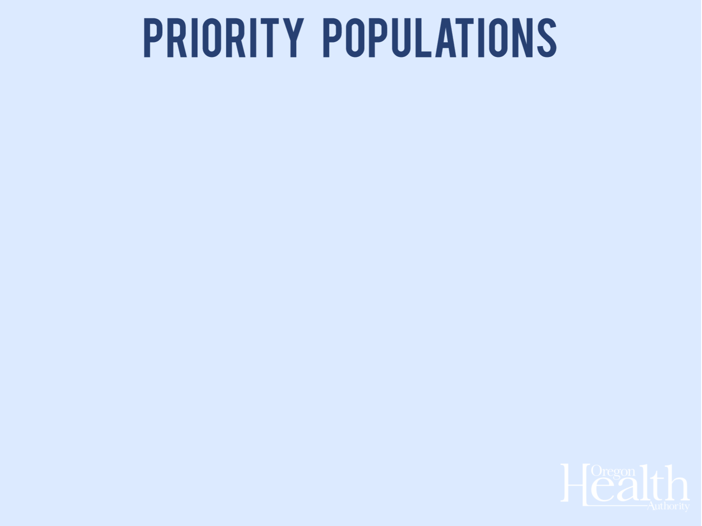
Rarely & never screened women
Ages
50+ for mammograms
Communities of color
Rural communities
Women experiencing disabilities
LGBTQ communities

Slide 4
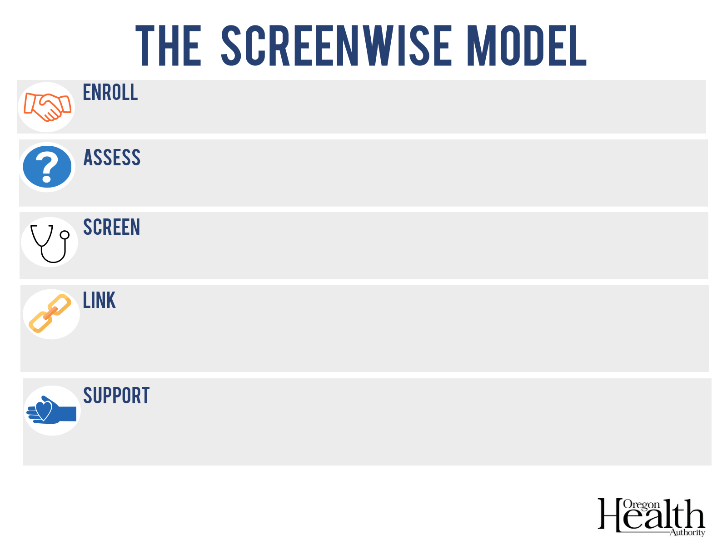
Enrollment
Assessment, $35
Screening, $126
Breast Follow-Up
Link to treatment $60
Age 40+ Heart Health Check, $86 *
Cervical Follow-Up
Link to treatment $60
Age 40+ Health Coaching * up to $279 for 3.25 hrs
Age 40+ Post-Health Coaching Survey*, $28
* Service not required to be face-to-face (may be telephone, Skype, or other form of telemedicine)
 SW ancillary providers are available to support this effort

Slide 5
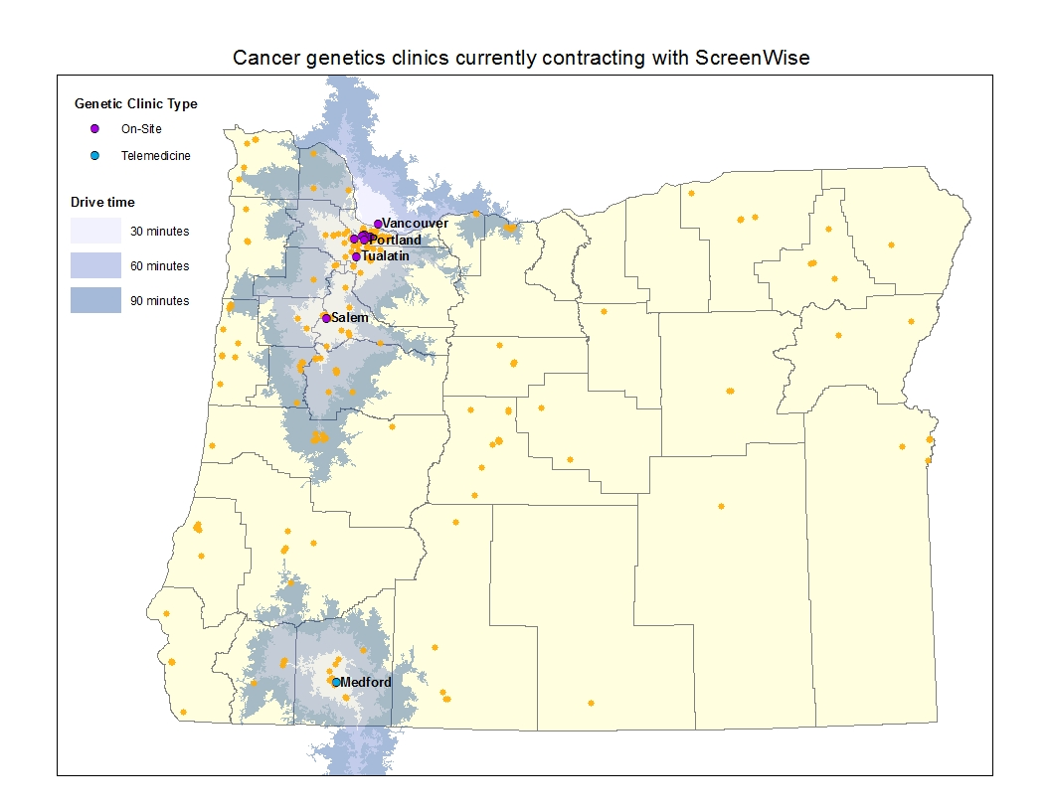

Slide 6


