Slide 1
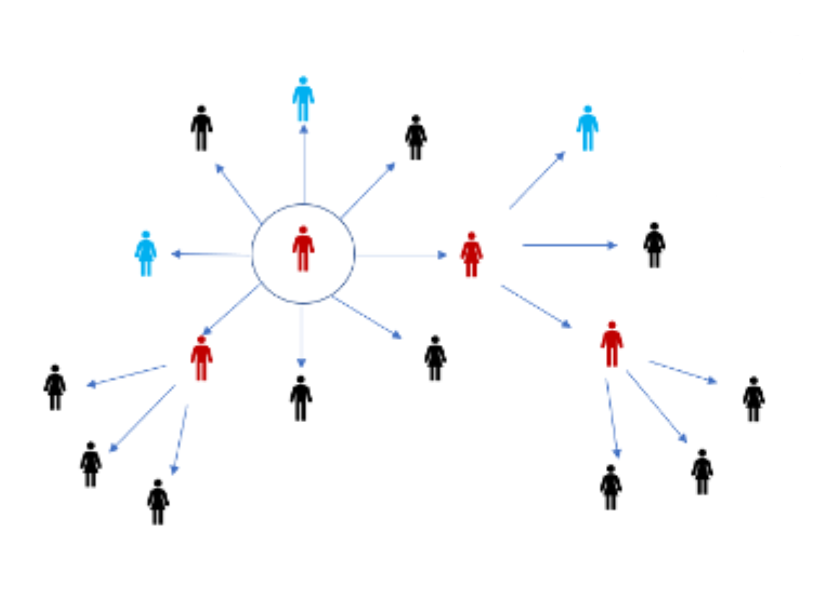
COVID-19 Crisis Management

Slide 2
Training Schedule
Introduction
Crisis
Crisis Management
Planning for Crises

Slide 3
Crisis
Notes:
Explain Maslow’s….

Slide 4
Topics
What is Crisis?
The Toll
Cope and Lead Through It
The Reality

Slide 5
What is Crisis?
Events that produce significant stress
Traumatic change in an individual’s life that affect cognition and emotional levels.
Turning point for better or worse
State of instability
Notes:
Concept of a crisis? Invite participants to share their ideas about it.
In science – A particular theoretical system is overcome with many anomalies and it is perceived to be failing. Therefore, the search for a better theoretical system is under way. Thomas Kuhn (1922-1996).

Slide 6
The Toll
Decision Making: concentration is reduced, creativity is limited and processing information becomes difficult. Risk to miss opportunities and the message of hope to keep the team focused.
Becoming rigid and trying to control the crisis response on your own increases personal stress levels.
Irritability, impatience with others affects the work environment and professional relationships and can narrow a leader’s perspective.
Sleep disturbances and deprivation lead to being less cooperative and less aware of your responses to others.
Display of emotions such as anger and irritability where trust is reduced.
Notes:
Toll of a Crisis:…

Slide 7
Cope & Lead Through It
For better reception of input, step back, pause, focus and re-assess the situation. To increase awareness of potential signs of stress, take a break every hour.
Practice self-care through movement, exercise, indoor/ outdoor activities, healthy nutrition and communication with others.
Sleep Hygiene: quality of sleep matters!
Implement break times to support team members who may be in need.
Share and/or delegate responsibilities: Learn to rely on others so you’ll have time and mind-space to look ahead strategically.
Recognize positive things during challenging times. Acknowledge and celebrate successes (big and small).
Notes:
We are able to cope and lead through a crisis taking into consideration:…..

Slide 8
The Reality
Stress is a regular part of our lives
COVID-19 has intensified the stress around us
Effective leaders have the experience to manage stress during decision-making processes
Even effective leaders feel worn down during the pandemic
Practicing stress management & self-care builds resilience and the ability to manage future crises.
Notes:
The world as a reality where experiences are:…….

Slide 9
Crisis Management
Notes:
Explain Maslow’s….

Slide 10
Topics
What s Crisis Management?
Crisis Management Elements
Crisis Management Components
Critical Brain Areas (Video)
Information Processing
Crisis Management Steps
Post-Crisis Resilience

Slide 11
What is Crisis Management ?
Organization and mobilization of resources to:
Overcome difficulties introduced by unexpected threats
May reduce the information-processing
Important when considering possible solutions
Notes:
Concept of management. Invite participants to share their comments about it.
Risks of a crisis: 1-4

Slide 12
Crisis Management Elements
Honesty
Truthfulness
Empathy
Proactive
Establish Rapport
Notes:
In order to cope and lead in time of crisis, an effective leader needs the following elements:

Slide 13
Crisis Management Components
Crisis Center – facility/setting established for emergencies.
Crisis Intervention – seek improvement or to mitigate the situation. Prevents more serious consequences.
Crisis Intervention Service – services typically provided by government or social service agencies during emergencies/disasters and personal crises (hot-lines, drop-in services, on-site intervention).
Crisis Team – group of professionals trained to help individuals cope during and after an emergency.
Notes:
Take into consideration the following components……

Slide 14
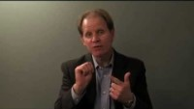
Video (2:31) Dr. Dan Siegal- a Hand Model of the Brain

Slide 15
Information Processing
During a crisis, people’s ability to process information may be compromised. Consider the following strategies:
Overcome over-simplified or missed information by applying simple and clear communication.
Overcome resistance to change by utilizing credible sources.
Messaging may be reinforced with information or resources provided by other sources or organizations, but credibility and accessibility should should be confirmed before sharing.
In the absence of information or communication, credible speculation may be applied but it should be simple and consistent.
Notes:
Remember people have different ways to process a crisis where information-processing may become compromised……

Slide 16
Crisis Management Steps
Develop a pre-crisis process:
Planning & preparation (identify resources, trainings, establish partnerships, apply needs assessment)
Gather information about what happened
Separate facts from rumors
Provide clear and timely communication
Coordinate with other groups
Monitor intensity of the event
Listen to partners and team members
Incorporate feedback
Explain rationale/justify recommendations
Notes:
Recommendations step to follow:
Initiation Stage- when you have initial moment, what is happening a. b.
Ongoing stage- provide clear & timely communication to team members

Slide 17
Crisis Management – continued…
Results and Evaluation
Debrief the situation from start to finish
Promote actition within your organization
Assess performance
Document lessons learned
Plan activities to improve the crisis plan
Notes:
During the crisis….
3. After the crisis……..

Slide 18
Post-Crisis Resilience
Experiencing crisis can result in positive outcomes. Survivors often gain:
A new understanding of risks and ways to manage crisis in the future.
A sense of strength and empowerment
New skills to manage challenging times
Opportunities for personal, group and community growth
Notes:
What do we expect after the crisis: positive responses such as:…..

Slide 19
Planning for Crises
Notes:
Explain Maslow’s….

Slide 20
Topics
Small-Group Discussion
Developing A Plan

Slide 21
Small Group Discussion
Apply the Steps of Crisis Management:
Telephone
A Case or Contact tells you they are having suicidal thoughts. What will you do to support this person?
In-person
A co-worker is very irritable and tells you they are having problems at home and their stress level is at its highest point. What will you do to support this person?
Remote
You are on a Zoom call and your colleague turns their camera off, states they are under a lot of pressure, and stops talking for a significant amount of time. What will you do to support this person?
Notes:
We would like to breakout into small in groups and give you an opportunity to discuss what a crisis management plan would look like for you in the workplace.
Please take the time to discuss these questions as you think through what your crisis plan might look like.
Assist groups sharing: Crisis management Steps 16-17 slides
GROUP Debrief:
What did you learn?
What is the plan that you developed?

Slide 22

Breakout
15 Minutes
22
Notes:
Part One
Privacy and Confidentiality
Demographics

Slide 23
Developing A Plan
Pre-crisis stage:
Document your emergency contacts.
Identify emergency resources available in your setting (shelter, water, food, etc.)
Plan your crisis management steps:
Who is the designated leader?
Who will perform specific support roles?
Who will assist those who need help?
What is the first, second, third action will you take, etc.
How will events that occurred be debriefed with a supervisor or colleague?
Notes:
Things to consider:
Is there a de-escalation room that is available?

Slide 24

Questions? Comments?
24

Slide 25
Training Calendar
Additional Workshops:
De-escalation Skill Building
Motivational Interviewing
Cultural Responsiveness
Accessing Interpreter Services
Pandemic Specific Resources
Notes:
QPR (Question, Persuade, Refer) additional t raining through iLearn- is highly recommended

Slide 26
THANK YOU!
We are grateful for your investment in keeping Oregonians safe!

