Slide 1
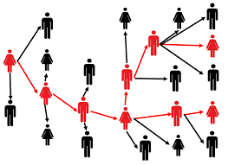
De-escalation Workshop and Practice Session

Slide 2

VIDEO AND MICROPHONE CHECK!
It’s best if you have access to video and audio
Feel free to keep your camera turned off, but please turn it on for breakout sessions to engage with others
Please mute yourself when you are not talking
Please “raise your hand” or use the chat box to ask questions
Please let us know if you need any support

Slide 3
CRRU Training Team is committed to:
  Bringing a trauma-informed approach with a lens of cultural humility
  Delivering trainings that equitably support and embrace access to quality services and elimination of avoidable disparities
  Establishing trust and a sustainable dialogue with all training partners and participants.
  Being a trusted and valued resource to support Oregon’s public health workforce
  Offering a safe physical and virtual space to all participants, facilitators, and staff

Slide 4
Workshop & Practice
Welcome and Introductions
Training Team
Topics
      Building Rapid Rapport – review
      Behavior is Communication
      Practice: Scenario 1- Emotions/behaviors
      Diffuse Anger & Avoid Aggression
      Practice: Scenario 1- Questioning authority
      Terminating Conversation
      Practice: Scenario 3- Transferring or ending conversation
Notes:
Objectives-
- to get practice working through an escalated conversation
What topics or scenarios do you want to discuss today?

Slide 5
Building Rapid Rapport- review
Build and maintain trust
  Discuss confidentiality
  Share how the information will be used
Take your time asking questions
Pay close attention to their response
  Don’t make assumptions
  Ask for clarification
  Repeat back to the contact what you hear them say
Allow for silence
Adjust the script/question timing or flow to meet the needs and concerns of the Case or Contact
Be supportive of information omission
Notes:
Building rapid rapport isn’t easy. We cover all of this in our Fundamentals training and now that you’ve been working for a little while we want to take the time to address the specifics around De-Escalation.

Slide 6

What are some of the concerns people have or pushback you are hearing from the field?

Slide 7
Concerns and pushback
May feel blamed or judged because of being involved in spreading the disease
Sick people and parents of ill children worry about loss of income if they take time off work
May feel threatened by you (or any government representative)
May feel upset about the Governor’s orders and government overreach
Upset and tired about face-coverings and changing rules
May feel the call is about pushing vaccination
Notes:
Go over what was not discussed and briefly acknowledge if an answer was given during the BRAINSTORM. (NTH)

Slide 8
Behavior is communication
8

Slide 9
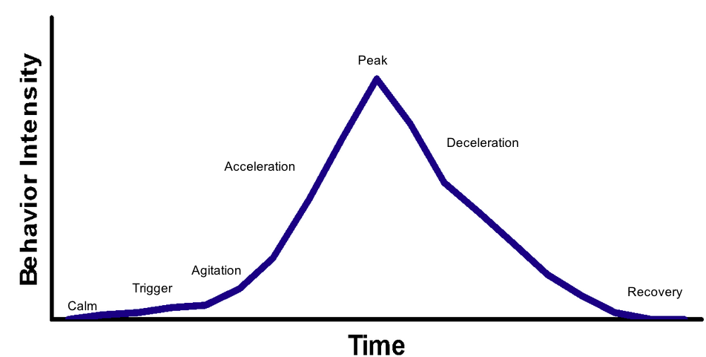
Behavior intensity
Source: Responding to non-responders: Managing escalations
Notes:
It’s important to recognize that an individual’s behavior can change very fast. Often times catching us off guard. You don’t have any clue what may trigger someone so you have to be prepared.
This graph is based on a model used in school settings with educators and students. It’s still very applicable with how conversations might go in contact tracing and case investigation.

Slide 10
Behavior is communication
The responsibility lies with us in the de-escalation process.
How does trauma show up in people?
- Behaviors
-anger (negative tones, rudeness)
-silence
-reluctance to speak, resistance
-selective memory/ intentional forgetfulness
-frustration
Notes:
How else have you seen trauma show up in your calls?

Slide 11
Getting through the interview
Bridging
- Active Listening
- Empathy
- Shift in energy
Possible response: “I hear you”
Possible response: “Do you need me to ask this in a different way”
Possible response: “Thank you for your patience”
Possible response: “I hear your concern”

Slide 12
Getting through the interview
Staying present
    Listening without solution- knowing what you can and can’t do
    Not in a space to problem solve
    Offering resources
Possible response: “I’ve just shared a lot of information with you. I can send you that information again after our call.”
Possible response: “Here’s the information I can provide”

Slide 13
Role Play and Practice
Agitated: Not sure why they are being contacted: Example- initial call, case/contact doesn’t know why they are being contacted by Case Investigator or Contact Tracer
Silence/Annoyed: Example- SOGI individual is getting very upset about why they are being asked about sexual orientation and gender identity
Frustration/Rudeness: individual wants to know “What are going to do with this information?”

Slide 14
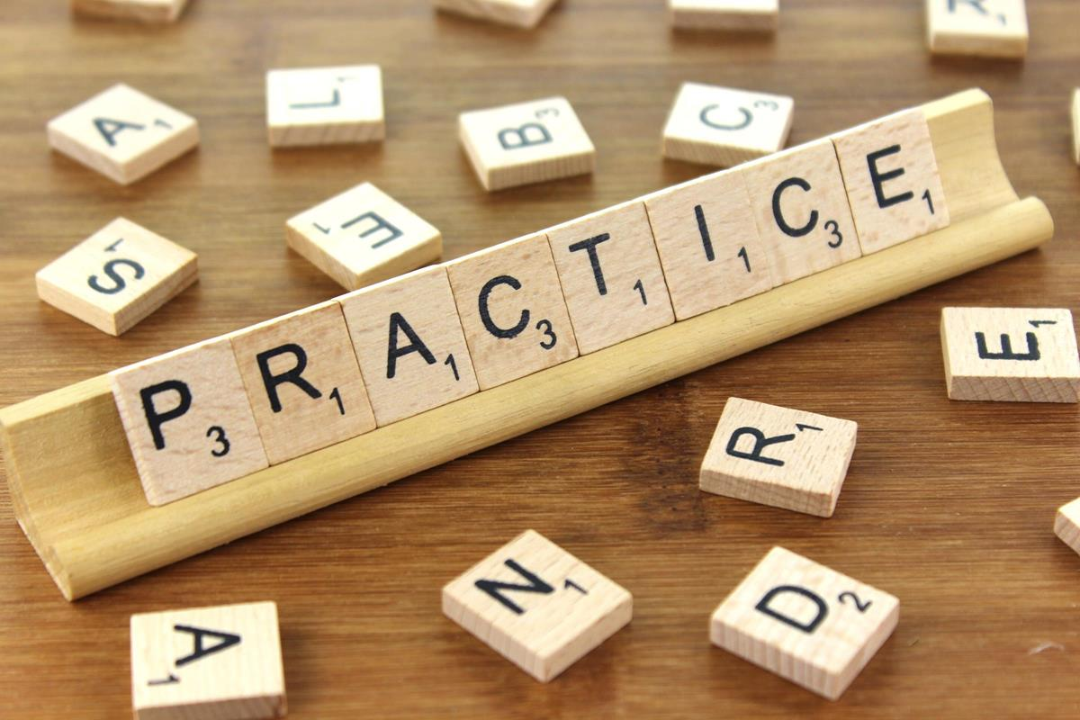
Practice
10-15 Minutes
SCENARIO ONE
Behavior is Communication
14

Slide 15
De-Escalation
Defuse Anger and Avoid Aggression
15
Notes:
Now, with the current times we are living in the ability to de-escalate a conversation that has gone awry is definitely something we need to think about. Let's talk about some tips. (NTH)

Slide 16
De-Escalation Tips
Use positive and helpful statements
Listen to concerns and acknowledge feelings
Possible response: “Help me understand what you need.”
Possible response: “What has helped you in the past?”
Possible response: “Tell me if I have this right.”
Not: “Tell me how you feel.”
Notes:
Dialysis/activated- venting- allow for this to a certain degree
Say something- help to ground them
Breathe- increasing circulation, decrease cortisol (stress hormone)
Some people have trouble identifying how they feel about what’s happening to them.

Slide 17
De-escalation Tips
Be empathetic and non-judgmental
Respect personal space
Keep your tone neutral
Avoid over-reacting
Possible response: “I understand you are ___________, but it’s not okay to yell at staff.”
Allow time for decisions
Possible response: “I’ve just shared a lot of information with you. What questions do you have for me?”
Notes:
Remain calm, rational, and professional. While you cannot control the person’s behavior, how you respond to their behavior can affect whether the situation escalates or defuses. Empathize with feelings, not behavior.

Slide 18
Establish Authority
Scenario: You call a Case or a Contact and the person immediately asks:
“Why are you calling me?”
“Who gave you my number?”
“Is this even legal?”
“You people are trying to take away our rights”
Similar topics
-Power of attorney
-Children 15-17
Notes:
Now, let's take some time to discuss how you would establish your authority with contacts on the phone. How would you handle these questions? Let's talk about this as a group- What will you say? (NTH)

Slide 19
Practice
10-15 Minutes
SCENARIO TWO
Questioning Authority
19

Slide 20
Terminating Conversations
20
Notes:
Now, with the current times we are living in the ability to de-escalate is important. It’s also important to recognize that now every conversation is going to be productive, so let’s talk about how we might need to consider terminating a conversation.

Slide 21
Terminating conversations
Not meeting resistance with resistance-
- We don’t meet negative tones with negative tones
- We don’t meet reluctance with reluctance
- We don’t meet aggression with aggression
Possible response: “I’m getting the sense that this is not the best time for this conversation”
Possible response: “Is there another time to call or would you like to speak with someone else”
Trauma and Triggers- “
- We may not know what will bubble up for people

Slide 22
Terminating conversations
If the de-escalation isn’t working, STOP, and reach out to your supervisor
  You are not required to tolerate racism, abuse, insults, or other harmful/violent behavior while doing this work
No person, group or set of conditions can guarantee that a conflict will proceed constructively
No one ever wants to do this but sometimes it’s necessary
Determine whether terminating a call is necessary
How will you do this gracefully?
Notes:
- No one ever wants to terminate a call, but sometimes it’s necessary. Remember it’s not a failure on anyone’s part for you or the case/contact. Sometimes the communication breakdown is too much to keep going.
- Ask participants: When is it appropriate to terminate a call?

Slide 23
Practice
10-15 Minutes
SCENARIO THREE
Terminating Conversation
23

Slide 24

Questions?
24

Slide 25

THANK YOU!
We cannot control what happens in the world.
We can control how we respond to it.

