Slide 1
Welcome! We will start soon…
For phone audio, make sure your number is linked to your ZOOM Participant ID# using the
or button

Slide 2
VIDEO AND MICROPHONE CHECK!
It’s best if you have access to video and audio
Feel free to keep your camera turned off, but please turn it on for breakout sessions to engage with others
Please mute yourself when you are not talking
Please “raise your hand” or use the chat box to ask questions
Please let us know if you need any support

Slide 3
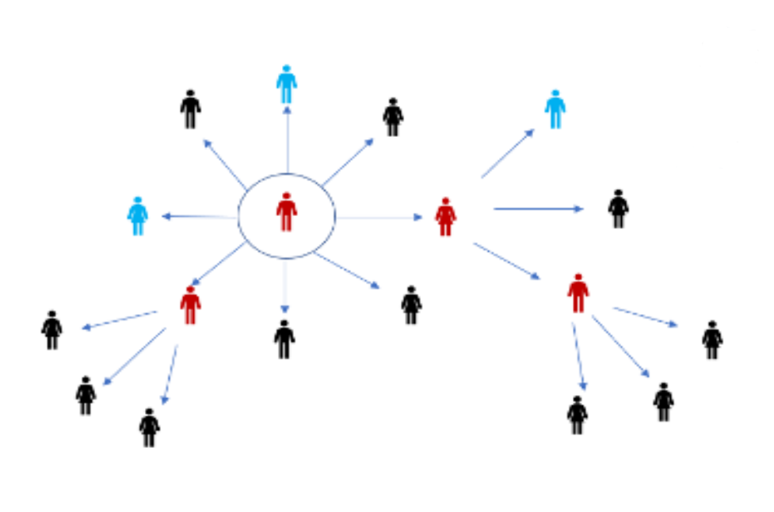
COVID-19 Motivational Interviewing Workshop

Slide 4
Vaccine Hesitancy and Vaccine Resistance
Unsure vs. Absolutely Against

Slide 5
Hesitancy = Unsure
Vaccination hesitancy refers to delay in acceptance or refusal of vaccination despite availability of vaccination services
Vaccination hesitancy is complex and context specific, varying across time, place and vaccines
It is influenced by factors such as complacency, convenience and confidence
Notes:
Murphy, J., Vallières, F., Bentall, R.P. et al. Psychological characteristics associated with COVID-19 vaccine hesitancy and resistance in Ireland and the United Kingdom. Nat Commun 12, 29 (2021). https://doi.org/10.1038/s41467-020-20226-9

Slide 6
Resistance = Absolutely Against!
Vaccination resistance refers to the entrenched resolve against vaccination, within a population
Vaccination resistance is multi-faceted
Hysteresis is a powerful force that is difficult to break at a societal level
Loop phenomenon caused by questions related to the risk and effectiveness of vaccines.
Negative experiences or perceptions related to vaccination impact the trend of uptake over time.
Once people question the safety or effectiveness of a vaccine, it can be very difficult to get them to move beyond those negative associations. Hysteresis is a powerful force that is difficult to break at a societal level

Slide 7
Vaccination Concerns
Safety (developed rapidly)
Negative impacts to fertility
Taking time off work to get vaccinated
Side effects will result in time off from work
Cost and/or lack of health insurance
Social Security number or government-issued ID required
Unable to obtain vaccination from a trusted place
Travel to vaccination site
Notes:
KFF
Fu, et al, Dartmouth
Murphy, J., Vallières, F., Bentall, R.P. et al. Psychological characteristics associated with COVID-19 vaccine hesitancy and resistance in Ireland and the United Kingdom. Nat Commun 12, 29 (2021). https://doi.org/10.1038/s41467-020-20226-9

Slide 8
Health Belief Model
Factors That Influence Health Behaviors

Slide 9
Health Belief Model
Perceived Threat of Illness or Disease (perceived susceptibility)
Belief of consequence (perceived severity)
Potential positive benefits of action (perceived benefits)
Perceived barriers to action, exposure to factors that prompt action (cues to action)
Confidence in outcome/ability to succeed (self-efficacy)
Notes:
Perceived threat: COVID isn’t dangerous – if I haven’t gotten it by now, I must be immune.
Belief of Consequences: I know people who have had it and it didn’t even slow them down!
Positive positive benefits: I think the risks outweigh the benefits – if I were to get it, I don’t believe I’ll get that sick and the vaccine has a lot of side effects.
Perceived barriers: This whole thing is a hassle and I don’t think it’s worth the effort.
Self-efficacy: Aren’t people who have been vaccinated getting sick?

Slide 10
Health Belief Model
Smoking Cessation
Why it is so difficult to quit?
Diabetes Prevention
Why aren’t people moved when a close family experiences adverse outcomes?
Breastfeeding
Why do some people they can’t breast feed?
COVID Vaccination
Why do some people believe the COVID vaccines are unsafe?
Notes:
We’d like to discuss a few common examples of how the Health Belief Model can be used to deconstruct health behaviors and give us insight into how to support an individual in taking steps toward positive behavior change.

Slide 11
Transtheoretical Model
Stages of Change

Slide 12
Transtheoretical Model (TTM)
The TTM is a model based on the stages of human behavior change. Stages of change take into account thinking, feelings, behaviors, relationships, and many other factors.
Stages of change include:
Precontemplation – stuck on the cons of changing
Contemplation – considering change in the near future (within 6 mos)
Preparation – ready to take action (30 days)
Action – practicing new health behaviors
Maintenance – sustained behavior change (6 mos)
Termination – no desire to return to former behavior
Notes:
Stages are significant because they allow us to categorize the behavioral stage for people who are vaccine hesitant or resistant.
Understanding which stage an individual has reached, allows you to decide on intention strategies and techniques to engage them.
Individuals in the Precontemplation have no intention of taking action in the foreseeable future.
Individuals in the Contemplation stage recognize their current behavior as problematic and have begun considering the pros and cons of changing.
Individuals in the Preparation stage are determined to take action. This includes considering their options and they may take small steps toward behavior change.
Individuals in the Action stage are working their way through the mechanics of their process of change.
Individuals in the Maintenance stage have sustained their behavior change for at least 6 months.
Individuals in the Termination stage have no desire to return to their former behaviors.
Understanding which stage an individual has reached allows you to engage strategically.

Slide 13
Resistance = Precontemplation
A resistant individual is typically in the precontemplation stage. They are either not ready or are unwilling to acknowledge that there is a problem behavior that needs to be changed.
A person in the Precontemplation stage is:
Often unaware that their behavior is problematic or produces negative consequences.
Often underestimate the pros of changing behavior
Place too much emphasis on the cons of changing behavior.

Slide 14
Hesitancy = Contemplation Preparation
A hesitant individual is typically between the Contemplation and Preparation stages. They are aware of the need to change and are ready/willing to make a change.
A person in the Contemplation stage:
Recognize their behavior may be problematic
More thoughtful in considering pros and cons of changing
May still feel ambivalent toward changing
A person in the Preparation stage:
Preparing to take action within 30 days
Believe changing behavior can lead to a healthier life
Begins taking small steps toward changing

Slide 15
Shift from Pre- to Contemplation…
Strategies for encouraging a shift from precontemplation to contemplation stage:
Establish rapport and build trust.
Raise concerns about risk of Case or Contacts’ vaccination status to self and community.
Elicit the Case or Contacts’' perceptions of their level of risk.
Elicit the Case or Contacts’ perceptions of their community’s level of risk with respect to safety, well-
being, and health.
Explore the benefits and risks of illness and treatment, including the timetable of hospitalization.
Express concern and remain empathetic.

Slide 16
Shift from Contemplation to Preparation…
Strategies for encouraging a shift from contemplation to preparation stage:
Help Case/Contact understand ambivalence about change is normal.
Elicit and weigh reasons to change and not to change, including consequences to themselves/community.
Emphasize Case/Contact’s free choice, responsibility, and self-efficacy for change.
Elicit self-motivational statements of intent and commitment of Case/Contact.
Elicit ideas regarding Case/Contact’s perceived self-efficacy and expectations.
Elicit ideas for the community well-being and safety.

Slide 17
Knowledge Base
Shared Understanding
17
Notes:
Let's talk about the importance of Motivation Interviewing as a tool for skillfully guiding a Case or Contact through a conversation where you help them to appreciate the gravity of their situation and increase their readiness to accept vaccination.

Slide 18
Vaccine Effectiveness
Pfizer and BioNTech (95%)
synthetic mRNA; stored at ultra-cold temps (6 months), regular freezer temps (2 weeks) and regular refrigerator temps (30 days)
Age 12 and up; 2-doses, 3-weeks apart
Moderna (94%)
synthetic mRNA; stored at regular refrigerator temps (30 days)
Age 18 and up; 2 doses, 4-weeks apart
Johnson and Johnson/Janssen (72%)
Adenovirus; stored at regular refrigerator temps (6 months)
Age 18 and up; single dose
Notes:
Present current information about vaccine development and distribution
(As of 1/12/2021)
COVID-19 vaccine trials have been completed by four pharmaceutical companies and so far, the vaccines developed by Pfizer and BioNTech and Moderna, have been approved for use by the FDA.
Wht is most
The effectiveness of vaccines is typically an indication of how well they prevent infection but, these vaccines have also proven to prevent severe disease, hospitalization and even death.
Maximum protection is reached at 7-14 days after the last dose is administered.
Duration of effectiveness has yet to be determined—drug trial participants will be tracked for 5-10 years and new guidance will be provided as information is gained.
Trials are currently being conducted on individuals below the age of 16
We should all continue to follow CDC guidance until a majority of the population has been vaccinated:
Herd immunity is estimated to occur at 75-86%
Additional Topics
mRNA technology – Introduces synthetic mRNA that directs the body to produce a small amount of the spike protein. Once the immune system detects the protein, the body begins producing protective antibodies. The use of messenger RNA in vaccines is new but researchers have been studying and working with mRNA for decades.
Adenovirus technology – Delivers the genetic instructions forSARS-CoV-2 antigens directly to the body’s cells, stimulating a robust immune response. The use of adenovirus in human vaccines is new but it is currently used in veterinary vaccines for rabies in animals.
Vaccine distribution – Cold-chain must be maintained during transportation. Ultra-cold temperature recommendations have been revised to utilize existing vaccine handling and distribution logistics that are built upon maintaining regular refrigerator or freezer temps
Priority/Equity – CDC has issued guidelines but, individual states are encouraged to refine to meet their population needs.

Slide 19
COVID-19 Vaccination Benefits
Prevent Death
All of the vaccines prevent death
Prevent Hospitalization
Hospitalization is less likely with all of vaccines
Lessen severity of infection
All of the vaccines reduce severity of infection
Show the spread of COVID-19
All of the vaccines significantly slow transmission of the disease
Notes:
Each of the vaccines is almost 100% effective at preventing death.
People who are vaccinated are 94% less like to be hospitalized
Each of the vaccines lessens the severity of infection, and:
They are all effective at slowing the spread of the disease.
As the virus continues to spread, it will give mutate into additional variants. The Delta variant is emerging as a concern and is being closely monitored. The Delta variant is currently responsible for 10% of new infections in the US!

Slide 20
Information sources…
OHA Immunization Provider Information
https://www.oregon.gov/oha/PH/PREVENTIONWELLNESS/VACCINESIMMUNIZATION/IMMUNIZATIONPROVIDERRESOURCES/Pages/COVIDProvToolkit.aspx
OHA COVID-19 Vaccine Facts
https://sharedsystems.dhsoha.state.or.us/DHSForms/Served/le3528.pdf
Notes:
OHA Immunization Provider information contains links to relevant CDC content:
Talking to Patients
Answering Patients’ Questions about COVID-19 and Vaccnation

Slide 21
Skillful Conversations
Increasing Readiness to Shift
21
Notes:
Let's talk about the importance of Motivation Interviewing as a tool for skillfully guiding a Case or Contact through a conversation where you help them to appreciate the gravity of their situation and increase their readiness to accept vaccination.

Slide 22
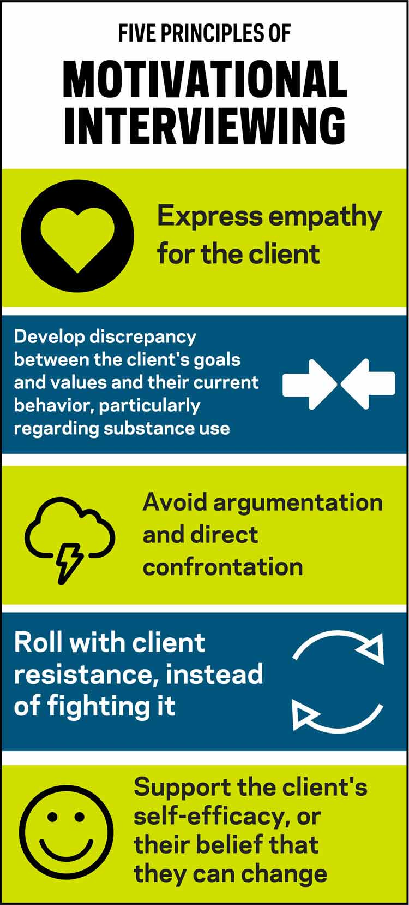
Five Principles of MI
Motivational Interviewing is an interview process to help the person you are working with move through a process of change:
Express empathy while practicing reflective listening
Help the Case or Contact understand the difference between their goals and values and their current behaviors
Avoid arguing and confrontation
Adjust to the Case or Contact’s resistance, rather than opposing them
Support self-confidence and optimism
https://belonging.berkeley.edu
https://www.hazeldenbettyford.org/education/bcr/addiction-research/adolescent-motivational-interviewing-cs-1017
Notes:
During your initial Case Investigation and Contact Tracing fundamentals training, we introduced the five principles of motivational interviewing. We’re certain you’ve all tried to incorporate these principles into your conversations but with varying degrees of success.
We’re certain, by now, you all appreciate how difficult it can be to:
Express empathy while practicing reflective listening;
Help the Case or Contact bridge the gap between their goals and values;
Avoid confrontation;
Adjust to the Case or Contact’s resistance; and
Support their self-confidence.

Slide 23
Empathy with Reflective Listening
Compassionate Inquiry
Ask open-ended questions
Reflect-back thoughts
Affirm feelings
Summarize what you heard
Notes:
Every Case or Contact is unique. Begin the conversation with curiosity and be open to the process – be prepared to follow where it leads…
Examples of breaking the ice:
Start with questions about something that’s easy to share.
Ask about things that are not so easy.
Ask about things ay be a little uncomfortable.
Save intimate or personal questions for last.

Slide 24
MI Techniques
OARS
Open Ended Questions
Affirmation
Reflective Listening
Summarize what you’ve heard
Notes:
The specific techniques we described were OARS and Elicit-Provide-Elicit.
Now that you’ve had time to become comfortable with the flow of the Case or Contact interview, we’d like to help you strengthen your motivational interviewing skills.
First, we’d like to know how much you know about either of these two techniques.
Does anyone have practical experience beyond your experience as a Case Investigator or Contact Tracer?

Slide 25
OARS Activity
Open Ended Question
Are you comfortable sharing any of your reservations about the COVID vaccine?
Affirmation
Validate and support
Reflective Listening
Confirm
Offer resources
Summarize
Actionable information
Notes:
Conversation may be uncomfortable because the Case or Contact may be struggling with shame or fear of stigma OR they may be distrustful of strangers.

Slide 26
MI Techniques
Elicit-Provide-Elicit
Ask detailed questions
Respond with information
Ask how they interpret it
Neutral language:
Unconditional
Avoid I/You statements
Notes:
Discuss the target behavior

Slide 27
Elicit-Provide-Elicit Activity
Clarification of Goals
Have you thought about how your situation would be different if you had taken the vaccine?
Uncover obstacle(s) to action by identifying the behavior stage
Select a strategy or approach
Utilize stage-appropriate techniques
Offer explanation without shaming
Offer support without judgement
Notes:
It may be difficult for the Case or Contact to articulate the goals because they may be uncertain of their motivation to change. This can result in them feeling ambivalent about changing.

Slide 28
Resistance and Adjustment
Avoid direct confrontation
Not a wrestling match!
No need to coerce!
Inquire about fears
Validate Case or Contact’s views and/or perspectives
Notes:
Explain your role: “As a part of our Public Health work in OR, we reach out to everyone who has been (Exposed to/tested positive for) COVID-19. I’m calling to see how you are doing and to see if you have any questions about what to do next.
Asking skillful questions allows the Case or Contact to engage in self-reflection often results in lowering level of resistance.
We all have different views or perspectives that are based on different information and experiences. Validate the Case or Contacts lived experiences by moving at their pace.
Resistance may be overcome with information about vaccine benefits and ease of access:
People may not know that vaccination is FREE to everyone.
People may not understand the primary benefits of vaccination:
Prevent Death
Prevent Hospitalization
Show the spread of the disease (prevent the development of variants)

Slide 29
Stories from the field…
What have you encountered?
What where the challenges?
How did you overcome them?
What could you have done differently?
Next time, what will you do differently?
Others are invited to share their experiences.
Notes:
Summarize expectations with the Case or Client by confirming what will happen when the phone call ends.
For example:
Remind the Case or Contact of the discontinuation date of their isolation or quarantine period;
Remind the Case or Contact that they will receive written guidance via the delivery method they selected, e-mail or snail mail;
Confirm resource referrals have been written down correctly by confirming phone numbers; and
Remind Contacts that they will receive a daily monitoring survey or call, depending on the method they selected;
Refer presumptive cases to Case Investigation; and
Submit requests for additional services like employer letters.

Slide 30
Questions?
30
Notes:
We now want to hear from you! Please share some of your experiences and any conversational challenges you’ve experienced. We will demonstrate how to apply Motivational Interviewing techniques to some of the more difficult scenarios.

Slide 31
Evaluation
Please complete the evaluation!
We can only improve with your feedback!

Slide 32
THANK YOU!
We are grateful for your dedication and commitment to keeping our communities healthy.

