Slide 1
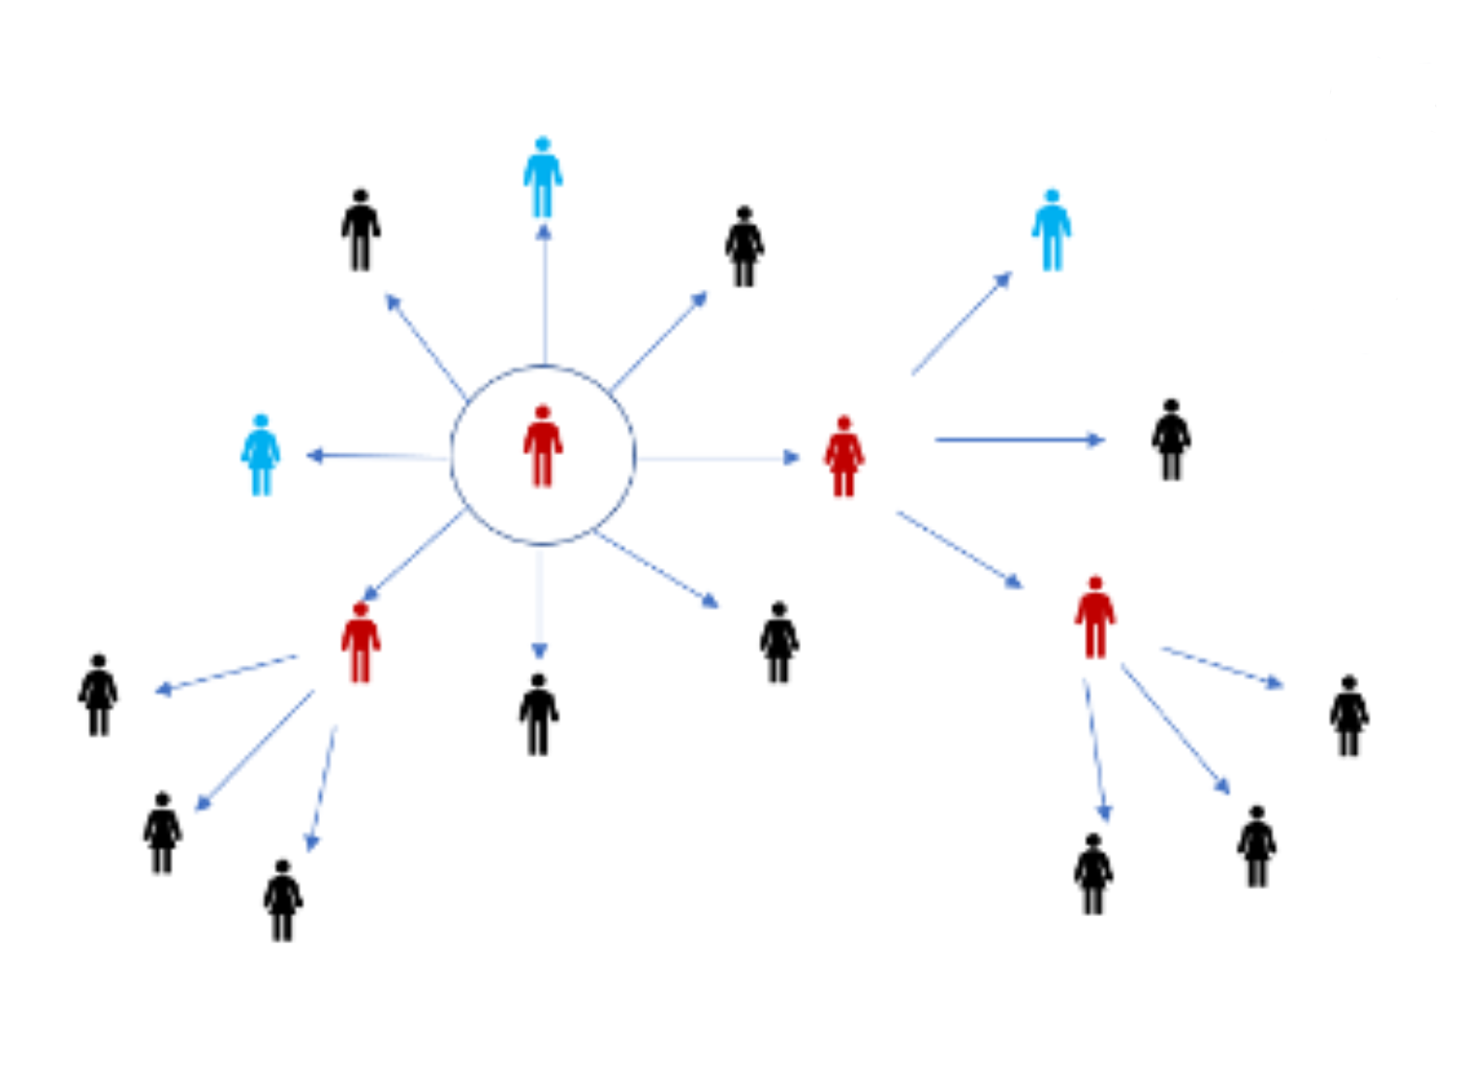
Pandemic Relief
Programs and Services

Slide 2
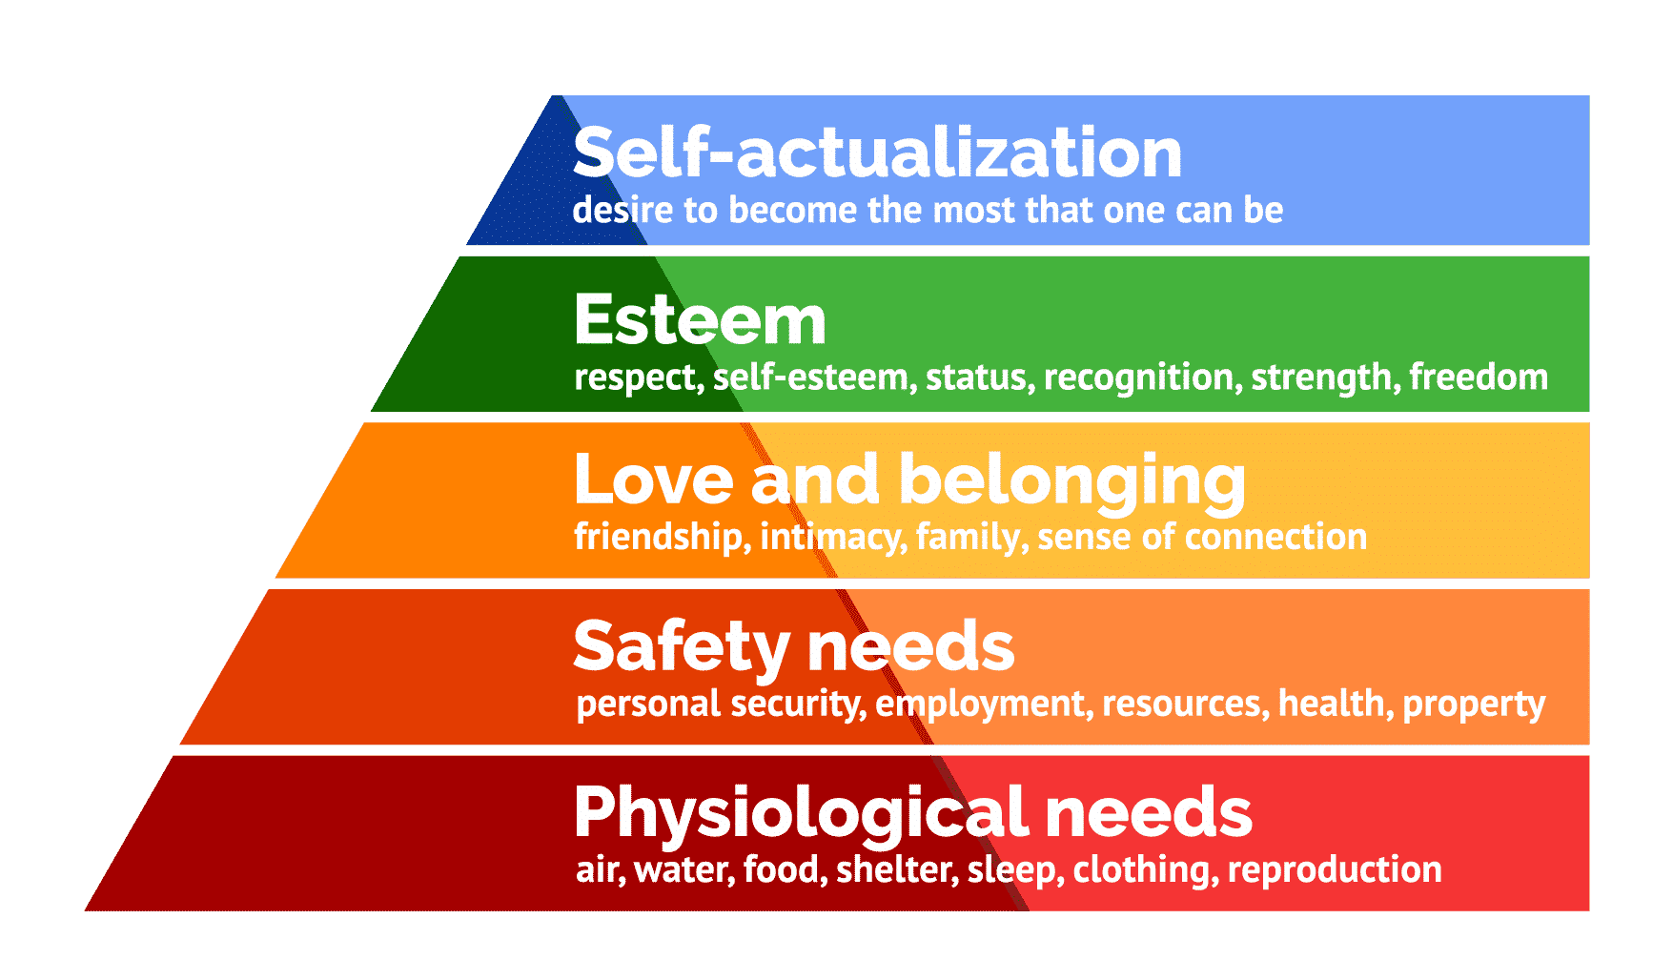
Isolation/Quarantine Compliance
Information and Support
Notes:
Explain Maslow’s….

Slide 3
Needs and Resources
Reinforce Guidance
Isolation
Cases
10 days
Quarantine
Close Contacts
14 days
Common Concerns
Lost or reduced wages and risks to employment
Food Security
Energy Bills
Housing security
Notes:
It may be necessary for COVID-19 notifiers to clarify or reinforce isolation or quarantine guidance.
Many of us have been impacted by the pandemic in ways that many make it difficult to comply with stay home guidance. Those concerns include lost wages or even job loss, unstable housing, changes in food access and the inability to provide basic necessities which might require referrals to pandemic relief program and services.

Slide 4

Pandemic Relief
Programs and Services
Employment Protections and Paid Time Off
Food and Nutrition
Cash Assistance
Housing, Rent and Mortgage Assistance
Notes:
To support those who have been impacted by the pandemic, last year’s CARES Act and this year’s American Rescue Plan Act established several pandemic-specific relief programs and services and provided additional funding to some of the existing social supports that you many already be familiar with.
Those programs include employment protection, cash assistance, nutrition assistance and housing supports. Many of which, may be accessed through local Community Action organizations.

Slide 5
Employment Protections and Paid Time Off

Slide 6
Family First Coronavirus Response Act
Employees are eligible for:
  Two weeks (up to 80 hours) of paid sick leave at the employee’s regular rate of pay when the employee is unable to work because the employee is quarantined and/or experiencing COVID-19 symptoms
  Two weeks (up to 80 hours) of paid sick leave at two-thirds the employee’s regular rate of pay because the employee is unable to work because of a need to care for an individual or a child whose school or child care provider is closed or unavailable for reasons related to COVID-19
  Up to an additional 10 weeks of paid expanded family and medical leave at two-thirds the employee’s regular rate of pay where an employee, who has been employed for at least 30 calendar days, is unable to to care for a child whose school or child care provider is closed or unavailable for reasons related to COVID-19.

Slide 7
Employment
Paid Time Off
  COVID-19 Temporary Paid Leave Program
    Emergency paid sick leave and expanded FMLA
    Maximum benefit of $1200 ($120 x 10 days)
    Vaccination appointments and recovery from any side effects (employer tax credit)
  Oregon Worker Relief Fund
    Temporary financial assistance for immigrant workers who have lost their jobs.
    Temporary financial assistance for agricultural workers -
    $430 for one week/ $860 for two weeks
Employment Protections
  Oregon Bureau of Labor and Industry (BOLI)
    Sick Child Leave (OFLA) – Permanent provision for employees with a child whose school or childcare provider is closed in conjunction with a statewide public health emergency.
Notes:
Under the Emergency Health Powers Act, Govern Brown has authorized financial support for Oregonians who are impacted by COVID-19 and have no paid leave.
The COVID-19 Temporary Paid Leave Program supports workers who are directed to isolate or quarantine. In addition to taking time off to care for themselves, they may also take protected time off to care for a family member.
The Oregon Worker Relief Fund provides financial support directly to Oregonians who have lost their jobs and aren’t eligible for Unemployment Insurance and federal stimulus relief due to their immigration status. Financial assistance is also available to workers who are directed to isolate or quarantine.

Slide 8
Unemployment
Unemployment Insurance
  Weekly Benefit (up to 26 weeks)
    Original benefit = $151-$468 per week
    Enhanced benefit = $171 - $733 per week
  Federal Pandemic Subsidy
    $600 per week (March, 2020 thru March, 2021)
    $300 per week (March, 2021 thru September 6, 2021)
Notes:
State and federal unemployment insurance is funded by employer taxes.
Unemployment benefits are a joint state and federal program.
During times of crisis the federal government can, and often does, fund extension in the length of benefits eligibility and increase the amount. All funded by federal dollars.

Slide 9
Food and Nutrition

Slide 10
Nutrition Assistance
SNAP Emergency Allotment
  The Federal Families First Act requires states to increase monthly SNAP benefits by 15% for all current recipients.
  EBT card may be used for grocery delivery
School Lunch Program – P-EBT
  Students eligible for free or reduced-price breakfast and lunch at school can get food benefits. This is in addition to their pickup meals at school
  Automatically issued as a one-time payment on new or existing Oregon EBT card
  Unused P-EBT benefits will expire after one year
NeedFood.Oregon.GOV
  Consumer-focused information about existing and expanded food resources
Notes:
Under the Emergency Health Powers Act, Govern Brown has authorized an increase in benefits to Oregonians who are already enrolled in nutrition assistance programs.
All current SNAP recipients will receive a 15% increase in their monthly benefit and may now use their benefit to have groceries delivered. This includes services like Safeway, Amazon Fresh and Instacart.
All families who qualify for free or reduced-lunch, automatically received a one-time payment to either an existing EBT card OR were issued a NEW card with the one-time payment.
The NeedFood webpage is a consumer-focused website that describes existing and expanding resources where individuals and families can access food supports.

Slide 11
Cash Benefits

Slide 12
Cash Assistance
Can be issued as cash on Oregon Trail card!
Temporary Assistance for Needy Families (TANF)
  Pregnant women and families with low income.
Refugee Relief Program
  (Public Charge Waiver) Qualifying individuals are typically eligible for benefits eight months after their refugee status was granted but that requirements is waived for pandemic relief.
Notes:
Cash assistance is also available thru TANF for pregnant women and lower-income families.
There is typically a public charge waiver in place for people who received refugee status with n the past 8 months but it has been waived for pandemic relief programs.

Slide 13
Energy/Utility Assistance
COVID-19 Utilities Relief
  Large utilities, like Portland General Electric and Pacific Power will not disconnect services due to non-payment or collect late fees during this time.
Oregon Energy Fund
  Assistance paying gas or electric bills.
Low-Income Energy Assistance Program (LIEAP)
  Assistance paying energy bills. 2-1-1 or local Community Action Agency can provide information.
Emergency Broadband Benefit (FCC)
  Discount of $50 per month towards broadband service
  Up to $75 per month for households on qualifying Tribal lands
  One-time discount of up to $100 to purchase a laptop, desktop computer or tablet
Notes:
The Oregon Energy fund can help households to pay and/or catch up on their utility bills.
The ILEAP has received additional funding to support households in paying and/or catching up on their utility bills.
Large utility companies in Oregon have have suspended service disconnection and late fees.
Emergency Broadband Benefit
Eligibility requires income at or below 135% of the Federal Poverty Level; OR eligibility for free or reduced lunch; OR received a federal Pell grant during the current school year; OR anyone who experienced income or job loss during pandemic. Contact local broadband provider for information.

Slide 14
Housing, Rent and Mortgage Assistance

Slide 15
Housing Resources
Eviction Moratorium (CDC)
  Extended to June 30, 2021
  Not rent forgiveness (making partial rent payments)
  Eviction would result in homelessness
  Landlord Assistance (for tenants in arrears)
Emergency Rental Assistance (HUD)
  Rent and utility assistance
  Qualify for unemployment, or
  Experienced financial hardship, or
  Demonstrate a risk of experiencing housing instability
Mortgage Relief (HUD/FHA, USDA, or VA loans)
  Initial 6-month reduction or full deferment
  Additional 6-months, if requested
Notes:
HUD’s Emergency Rental Assistance program supports renter households who are unable to pay rent and utilities and qualify for unemployment, have experienced financial hardship or demonstrate a risk for housing instability may receive assistance with paying for rent and utilities.
The eviction moratorium has been extended through June, 2021 and is intended to assist households who are capable of paying a portion of their rent. This program does not provide financial assistance or rent forgiveness. It Is designed to prevent tenants from becoming homeless or forcing them into living situations that may increase their exposure to COVID-19.
Mortgage borrowers with federally-backed loans may request assistance from their loan servicer. They may receive up to 6 months of reduced or deferred payments and if requested, an additional 6 months may be granted.
Many of these services can be accessed through local Community Action organizations and may be available to undocumented inviduals and mixed-documentation families.

Slide 16
Referral Resources

Slide 17
Federal Programs
Eviction Moratorium (CDC)
  Extended to June 30, 2021
  Not rent forgiveness (making partial rent payments)
  Eviction would result in homelessness
  Landlord Assistance (for tenants in arrears)
Emergency Rental Assistance (HUD)
  Rent and utility assistance
  Qualify for unemployment, or
  Experienced financial hardship, or
  Demonstrate a risk of experiencing housing instability
Mortgage Relief (HUD/FHA, USDA, or VA loans)
  Initial 6-month reduction or full deferment
  Additional 6-months, if requested
Notes:
The Oregon Health Authority has contracted directly with community-based organizations across the state to provide wrap-around services to Oregonians.
ese community-based organizations have direct contracts with the O

Slide 18
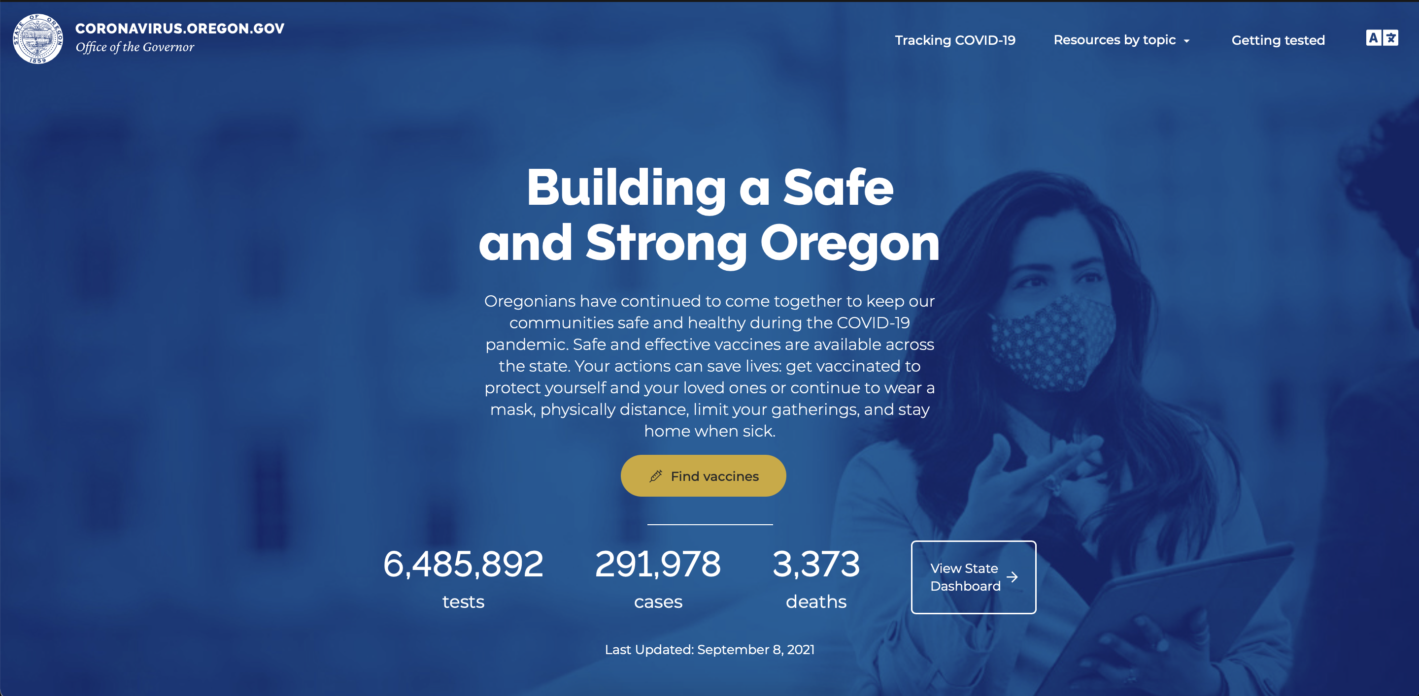
https://coronavirus.oregon.gov
18
Notes:
The Oregon coronavirus website has links to programs and services that can support those who receive guidance to isolate or quarantine. Available supports include employment protections, income replacement, food assistance, rent moratorium, mortgage and bill deferments, help with utilities, testing, and vaccination resources.

Slide 19
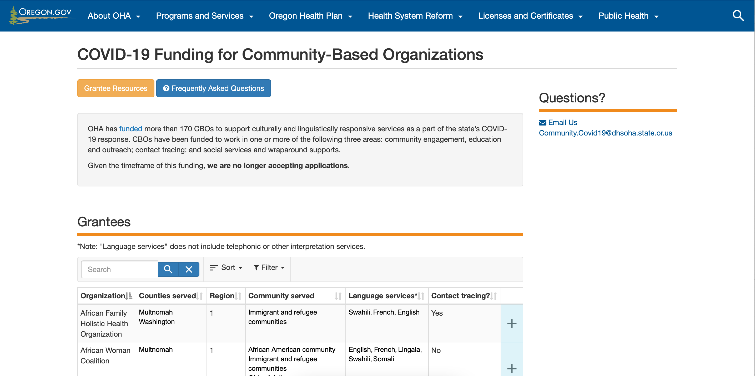
https://www.oregon.gov/oha/PH/ABOUT/Pages/Community-Engagement.aspx
19
Notes:
The Oregon coronavirus website has links to programs and services that can support those who receive guidance to isolate or quarantine. Available supports include employment protections, income replacement, food assistance, rent moratorium, mortgage and bill deferments, help with utilities, testing, and vaccination resources.

Slide 20
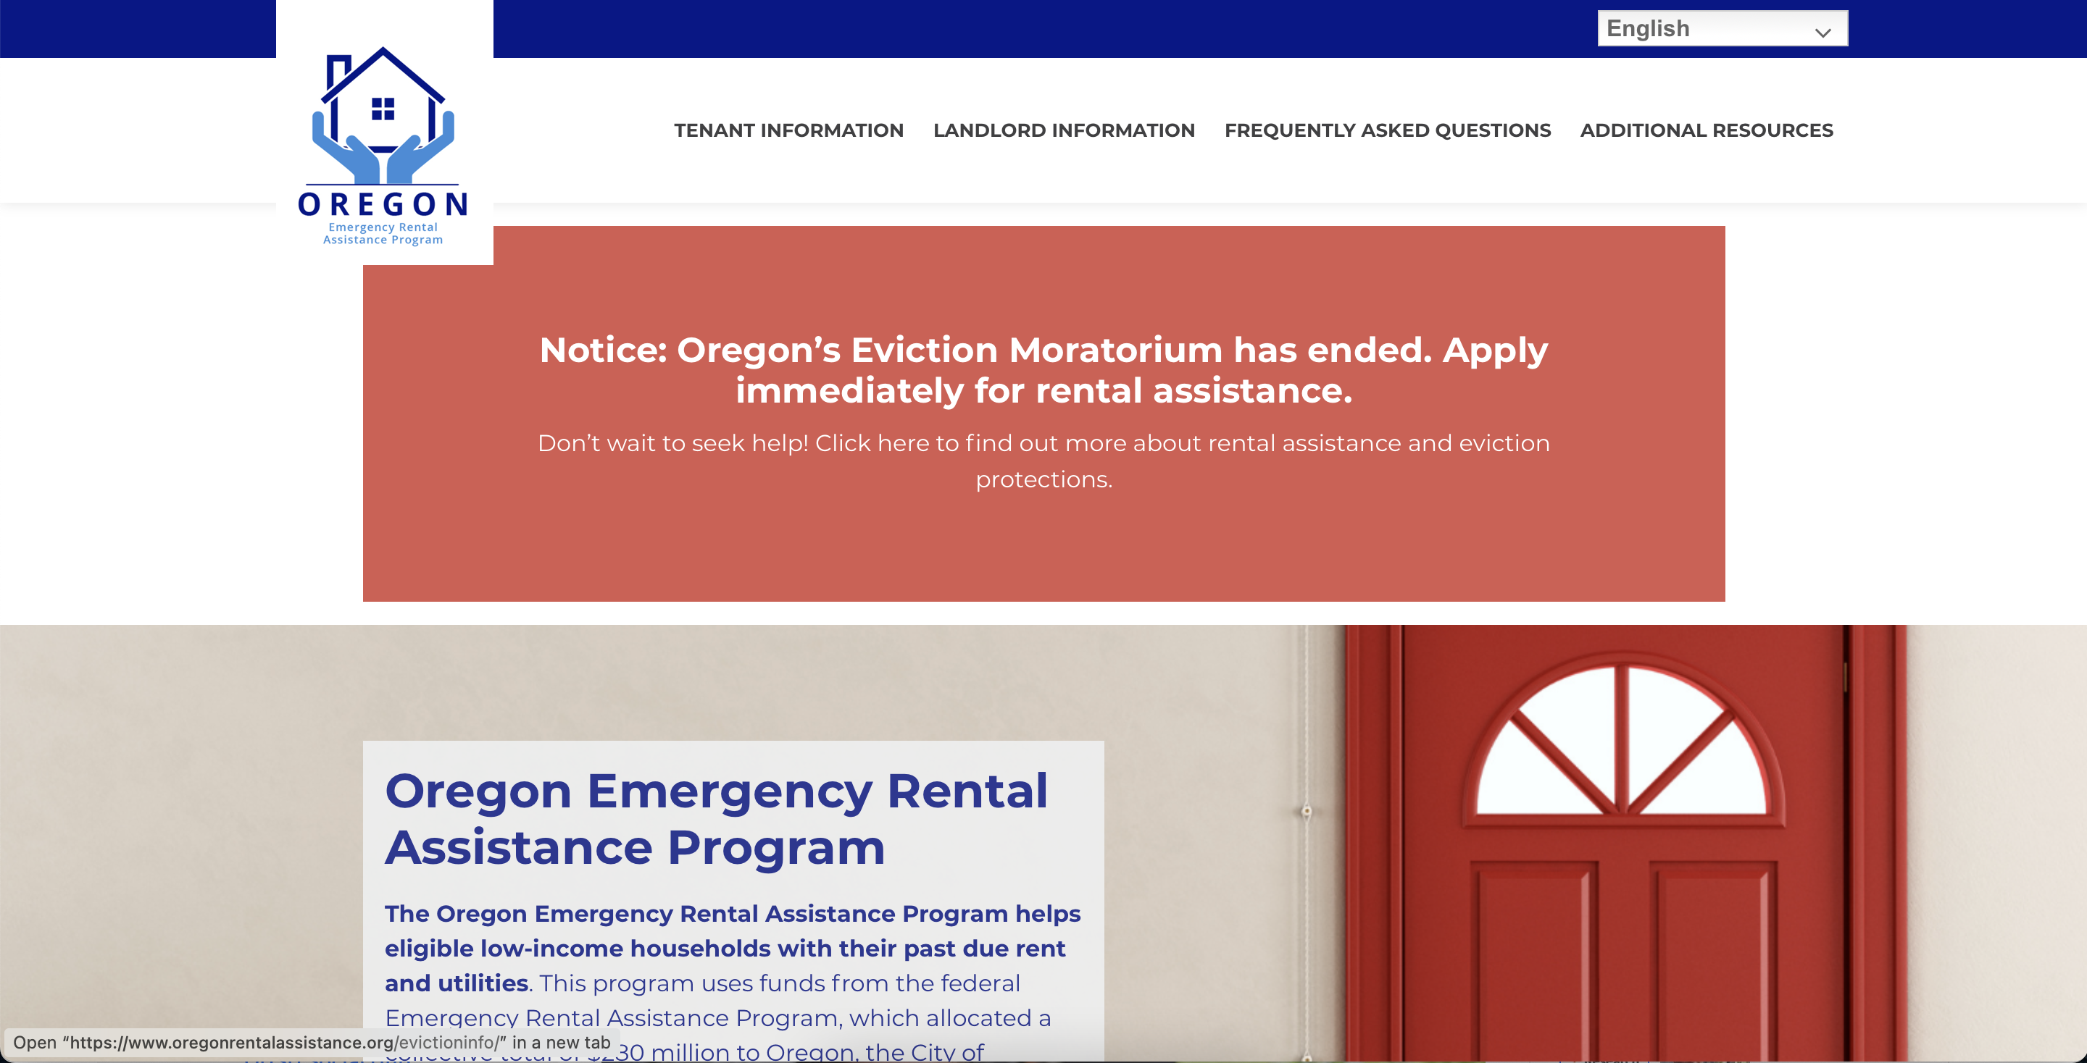
https://www.oregonrentalassistance.org
20
Notes:
The Oregon coronavirus website has links to programs and services that can support those who receive guidance to isolate or quarantine. Available supports include employment protections, income replacement, food assistance, rent moratorium, mortgage and bill deferments, help with utilities, testing, and vaccination resources.

Slide 21

Questions?
21

