Slide 1
Oregon eWIC Showcase Oregon eWIC 101
Portland, OR
March 21, 2017
Notes:
Ok, before we dive into all of the awesome sessions our team has planned for you, we wanted to give you some background and a brief overview of our eWIC implementation and talk about some of the project and resource management strategies we used here at the state office.

Slide 2
Oregon WIC Program
42 state program staff + 3 state MIS developers
5 home teams
Nutrition and Local Services
Vendor Management
Data Services
Business Administration
Evaluation
34 local agencies, covering all 36 counties
~ 90,000 participants per month
Fixed (calendar) month benefit issuance
Notes:
In addition to our program staff we have 3 in house MIS developers
We have 5 home teams
34 local agencies covering all 36 Oregon counties through a mix of local health departments, tribal organizations, a migrant health center, and one Head Start organization
Around 90,000 participants
We’re on a fixed or calendar month benefit schedule

Slide 3
Oregon WIC Program
466 grocery vendors
70 pharmacy vendors
1 Formula Warehouse vendor
665 FMNP farmers
2 eWIC farmers
Notes:
Here’s a breakdown of our various types of vendors
Anyone familiar with the formula warehouse vendor concept? We have a contract with the Home Medical Equipment division of a local health system to provide home delivery of medical formulas to WIC families throughout the state.
And we’re anxiously awaiting a system to get our farmers on eWIC, since in the voucher world more than 70% of our farmers took both FMNP and WIC CVB, but now we only have 2 farmers taking eWIC (they have brick and mortar stores we could set up with a stand beside device)
Any questions about our program in general before we dive into eWIC?

Slide 4
Oregon eWIC Project
“Phase 1”
With JP Morgan (June 2012 – Jan 2014)
“Phase 2”
With FIS-CDP (July 2014 – present)
Notes:
So over the next 2 days you may hear Phase 1 and Phase 2
Phase 1 was our 18 months with JP Morgan
Then they decided to get out of the business
Luckily we were able to start working with FIS-CDP within 6 months and kick-off Phase 2

Slide 5
Oregon eWIC Project
For both Phase 1 and Phase 2:
Maximus was QC + consulting services contractor
Separate QA contractor through the state

Slide 6
Oregon eWIC Project
Pilot: September 14 – December 14, 2015
(Phase 1 planned Pilot start May 8, 2013)
Rollout: January 19 – March 7, 2016
Last vouchers spent by June 30, 2016
Notes:
More than 2 years off our original pilot schedule! It was a long road to pilot for us, from June 2012 – September 2015

Slide 7
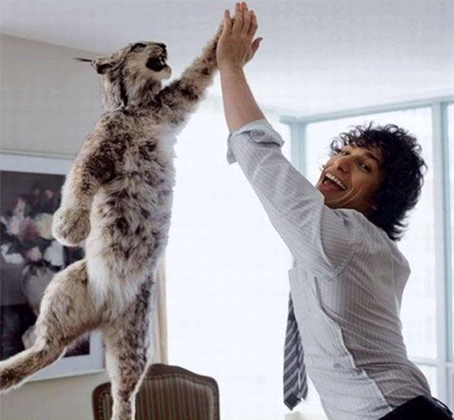
Some Tips for Success

Slide 8
#early&often
Notes:
Ok, I know you’ve heard this a million times, but I can’t go without mentioning it. ☺
It’s a theme you’ll hear in the other presentations too, so I just want to focus on two pieces:
Communication and Engagement

Slide 9

Communication
Notes:
You want everyone to know that eWIC is coming

Slide 10
Communication
All stakeholders, every chance you get
WIC EBT 101
Information sharing at internal and partner meetings
Emailed and posted monthly status reports

Slide 11

Engagement
Notes:
Ask for input and participation from the beginning and all along the way
It’s really worth it to make an effort to do this

Slide 12
Engagement
Vendors
Encourage them to share eWIC information with their:
Electronic Cash Register (ECR) distributors
Third Party Processors (TPPs)
Corporate offices
Notes:
Some examples include:

Slide 13
Engagement
Local Agencies
Design/planning phase JAD sessions for:
MIS
Clinic operations and policies
Training
Materials
Voted on card design – selected winner from 4 options
Notes:
We were lucky that the start of Phase 1 coincided with one of our statewide meetings, so we were able to have local agency staff vote on our card design. The chose a winner from 4 design options.
Just be sure you’re happy with the card designs you have them vote on – you could be surprised by what they choose!

Slide 14

State Agency eWIC Workgroups
Notes:
Another thing you can do early on to keep your internal folks engaged is to put together workgroups.

Slide 15
State Agency eWIC Workgroups
Started with 17(!) and consolidated as the project progressed
APL
MIS
Testing
Vendor
Pilot Selection
Clinic Operations
Formula Warehouse
Training
Policy
Compliance
Shopper Ed
Communications
Marketing
Financial
Logistics
Evaluation
Emergency preparedness
Notes:
We went a little crazy at first, but narrowed things down as time progressed. One of your handouts has the descriptions of the various workgroups, which was helpful to put together in the beginning and refer to along the way.
Have any of your programs done something similar? How is that going?

Slide 16
eWIC Leadership Team
Comprised of workgroup leads + program and project managers
Met 2x month and ad hoc as needed
Developed a decision making process, guidelines, and recommendation form
Workgroup leads brought recommendations to the group for approval

Slide 17
Issues for Leadership Team
Issues that:
Had a negative and/or significant impact on project:
Cost
Quality
Schedule
Stakeholders
Were politically sensitive
Would result in a radical departure from current practices or policies
Notes:
Had a formal process for determining what kinds of decisions needed to go to the Leadership team vs. the workgroup being able to decide on their own

Slide 18
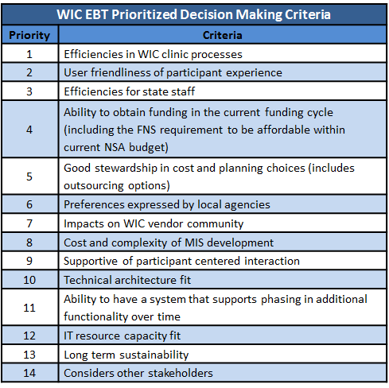
Notes:
We also created criteria to guide the decision making process
There’s a handout of these too
Having these defined and ranked really helped us a lot

Slide 19
Leadership Decision Recommendation Form (see handout)
Description of Issue
Recommendation from the group
Key reasons for the recommendation
Alternative options considered
Parties consulted
Pros and Cons
Follow-up issues/questions
Approval Status
Notes:
Workgroups had to do their research and leg work and fill out a form before bringing a recommendation to the leadership team

Slide 20
Leadership Team Decisions
2 cardholders (see handout)
Partial package calculation
Infant CVB
Milk container sizes
Spanish Benefit List in MIS
WE with twins food package (same each month vs. alternating)
Tailoring food packages
Notes:
Here are some of the issues that went to the leadership team for a decision

Slide 21
Work During Contract Negotiations
Contract negotiations can be lengthy
Check with FNS and your state oversight for guidance on what work you can do in the meantime
Review processor standard “Product” documents instead of state-specific “Project” documents
Notes:
One of the things that saved us during our lengthy contract negotiation period was being able to review standard processor “Product” documents that were the same for all of their state clients:
System Documentation
Vendor Certification Specifications
Business Continuity Documentation
And then the documents and deliverables that were custom to our project could wait until after the contract was signed

Slide 22
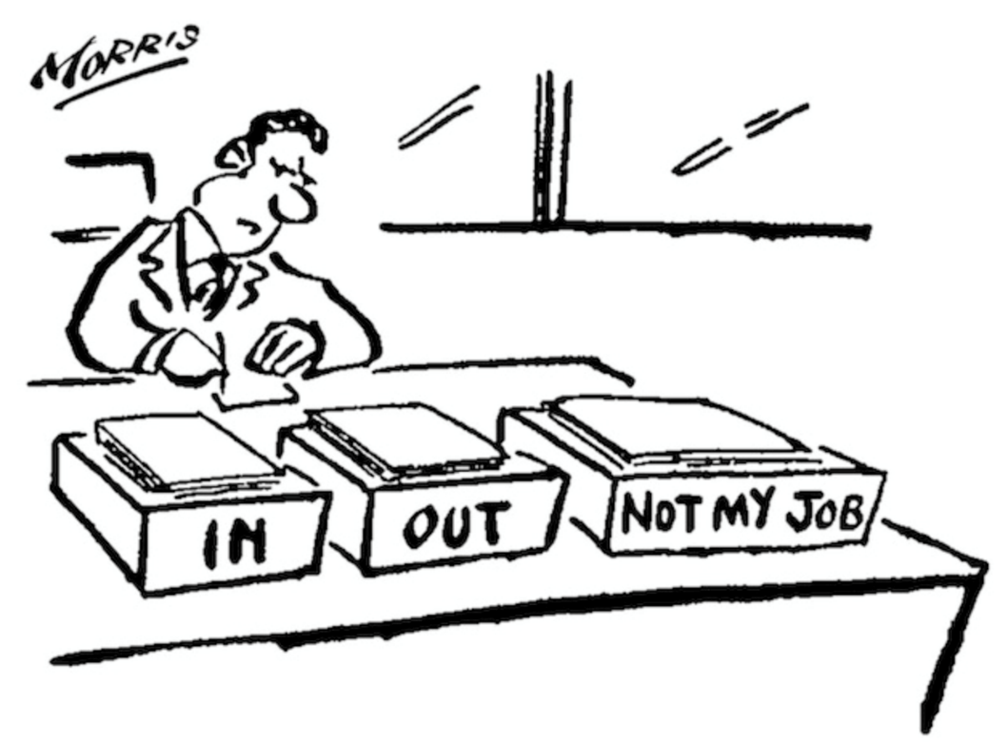
Clearly Define Roles & Responsibilities
Program Managers
Project Managers
QC/QA
SMEs
Testers
Workgroups – purpose, scope, etc.
Document well and revisit often!
Notes:
Ok, one of the things we struggled with the most was roles and responsibilities. We had a lot of cooks in the kitchen! We revisited this a lot, and made attempts to document clearly, but with the fast pace of Phase 2, we weren’t always successful.

Slide 23

Be Flexible
Plans and decisions made during feasibility study, RFP/contract writing, etc. may not be reasonable during implementation
Information and ideas from JADs with local agencies could alter plans
Balance collaboration with forward progress
Notes:
Another top tip – be flexible!
You want to be collaborative and inclusive, but make sure not to let that derail or delay your progress.
“…we could do this survey…” but it will take x weeks to get responses and results…

Slide 24
Workload Management
Prioritizing Projects
Staffing Patterns
Work Out of Class
Limited Duration Positions
Administrative
Fiscal
Notes:
As Kim just shared, a lot of staff time and effort went into planning and preparing for eWIC. I am going to share how we managed staff workloads to make sure everything got done.
Early in the planning phase for eWIC, we made a commitment to not take on initiatives and activities that weren’t mandatory or critical. We prioritized projects so most staff could devote time and efforts to focus on eWIC.
For example, we decided not to have a statewide meeting before and during eWIC implementation. We also decided not to make major changes to our authorized food list or do a full food review until eWIC rollout was well underway.
We also postponed the option of one year certs for children until after eWIC rollout.
In order for some staff to take on tasks that were above their position descriptions, we requests Work Out of Class status.
We used limited duration positions to hire additional personnel to back fill for the staff that that were working out of class.
We already had one contractor position primarily testing functionality and incidents with our MIS system. This testing continued as that system was modified for eWIC.

Slide 25

Expect the Unexpected
Staff Retiring
Staff Moving
Hiring Pause
Notes:
Given all the planning and preparation that goes in to a project, things still happen unexpectedly.
For us it was staff retiring and moving out of state, plus going through a hiring pause where we were unable to recruit and fill those positions.
Our staff really pulled together and did whatever was necessary to keep the project going forward.

Slide 26

Staffing with eWIC
No positions eliminated
Same Same only different
Notes:
No positions were eliminated.
The basic functions staff do are the same, how it gets done may be different.

Slide 27


