Slide 1
New foods for a new food list
Not these, silly! These are already on there.
10/1/2016

Slide 2
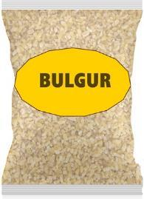
How about these?

Slide 3
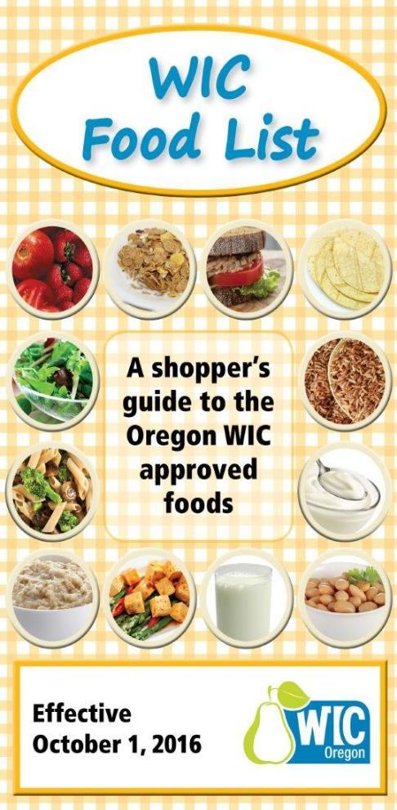
Let’s talk about…
Why we changed the food list
What has changed on the food list
Assigning new foods in TWIST
How to share with cardholders
Troubleshooting potential shopping issues

Slide 4
Why did we change the food list?
What do you think needed changing?

Slide 5

Goals for the 2016 change in the Food List
Enhance the appeal of the WIC food package
  Include foods that appeal to older children
  Add food choices that are used commonly in different cultures
  Decide if WIC can afford organic milk, organic baby food or cage-free eggs
Update the foods available, such as the cereal options
Embrace eWIC and decrease shopping issues, e.g. juice confusion

Slide 6

Nutritional Requirements
Foods must meet federal nutrition and food package requirements.
Acceptability
Local agency staff and participants surveyed
Price surveys conducted throughout the state.
Variety of types/brands
Cultural beliefs, preferences, and special food needs considered
Brands considered to contain costs
Availability
Stores throughout the state surveyed
Product must be available through major distributors
Cost
It takes a lot to authorize new foods for the food list!

Slide 7
How did we do?
Review a copy of the new food list and see what you think.

Slide 8
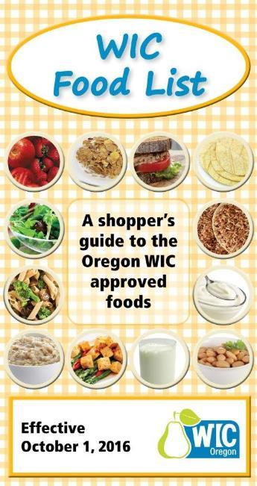

Let’s take a closer L k

Slide 9

More shopping help
Prevents shopping issues at the store

Slide 10

Find the shopping tips
eWIC shopping
Whole grains
Milk
Cereal
Baby food
Fish
Tip:
How might you use these?

Slide 11
Find the size help
Milk
Yogurt
PB and beans
juice
Choose the right size!
How can you use these to help explain the allowed size containers?

Slide 12
Find the nutrition information
Oats
Canned beans
Juice
Baby food
Food facts!
How might these support nutrition education?

Slide 13
Find the buy or don’t buy?
Instead of “allowed” or “not allowed”
BUY
 DON’T BUY

Slide 14
Find the foods that require “these brands:”
Brand and type specific
Any brand
Whole grain pasta
Tortillas
Goat and soy milk
Tofu
Yogurt
Cereal
Juice
Baby food and cereal
Fish
Fruit and vegetables
Oats
Whole wheat bread
Brown rice
Bulgur
Cow milk
Beans and peanut butter
Eggs
Cheese

Slide 15
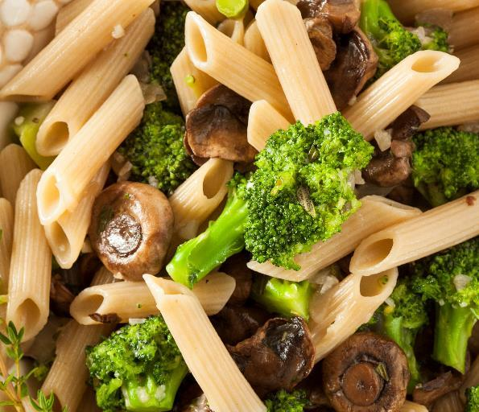

whole grains

Slide 16
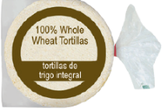
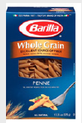
5 new whole grain options
Oats
Instant brown rice
Bulgur
Whole grain pasta
Whole wheat tortillas
With enough benefit balance cardholders can buy multiple types of grains.

Slide 17
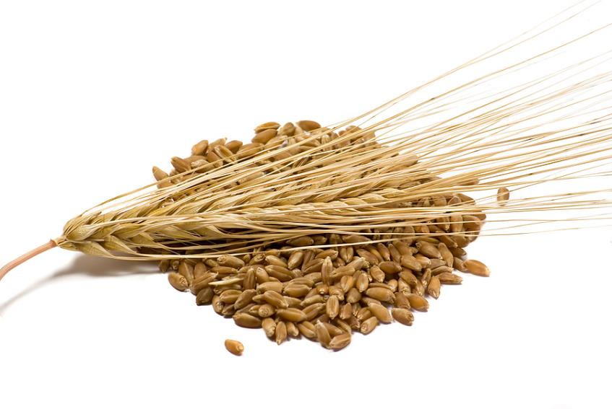


Change to benefit description
Benefits List and App description = “100% whole wheat bread or whole grains”
Receipt description = “Whole grains”

Slide 18
Oats
Cereal or whole grain?
Oatmeal in instant single serving packets = cereal
Oatmeal in a box, bag, or tub = whole grain
Includes quick, regular, or old fashioned oats
Most containers of oats are 18 or 42 oz. which makes it difficult to buy.
Look for brands that come in 16 oz. containers in your area.
  E.g. Mom’s Best

Slide 19
Instant brown rice
How might instant brown rice help WIC families? How is it different than regular brown rice?

Slide 20
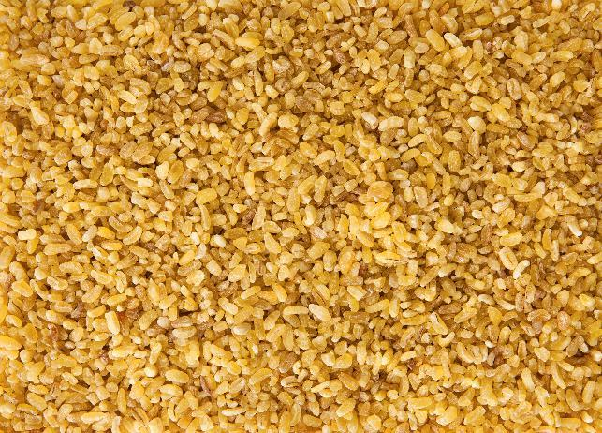
Bulgur
What recipes have you heard of for bulgur?
Tabbouleh?
Salads?
In place of rice?
Did you know that bulgur is whole wheat that has been cracked, partially cooked, and then dried?

Slide 21
Whole grain pasta
What brands in the food list are you familiar with?
Where can you find these different brands?
Only specific brands and types allowed
The sizes we know will be on the Approved Products List are the 13.25 to 16 oz. boxes.

Slide 22
Whole wheat tortillas
What brands in the food list are you familiar with?
Where can you find these different brands?
Specific brands allowed

Slide 23
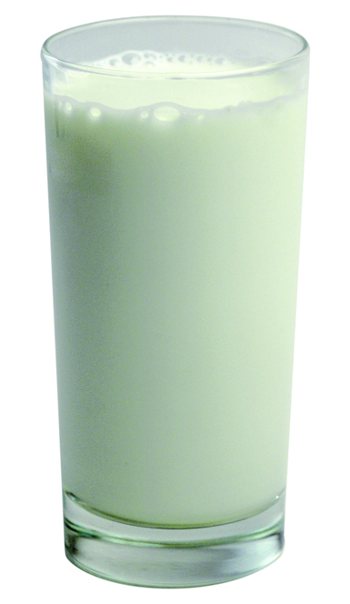
Milk and milk alternatives

Slide 24

New in this food list
Graphics showing the sizes of evaporated and dry milk
Illustrations of the specific available goat milk types and container sizes
Addition of tofu and yogurt to replace one quart of milk

Slide 25
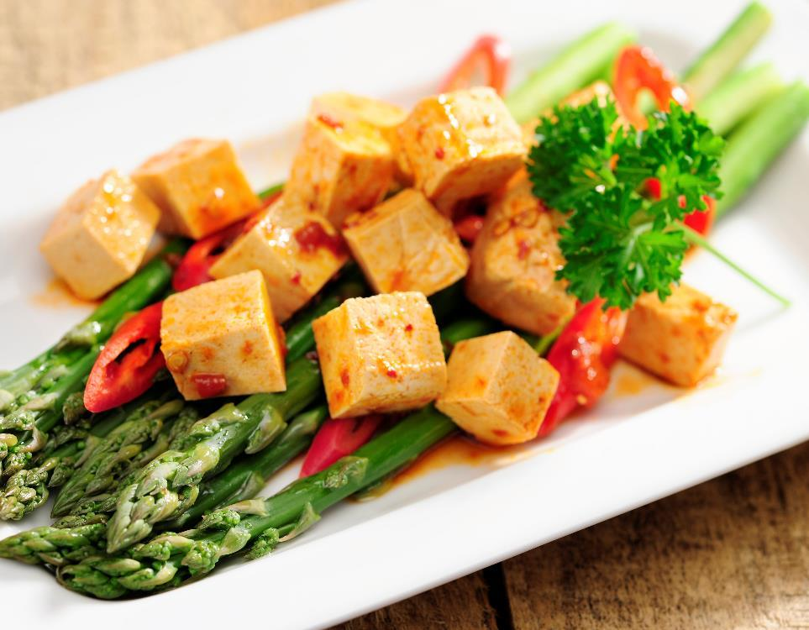
tofu

Slide 26
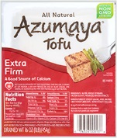
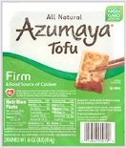
Tofu
1 lb. (16 oz.) tofu replaces 1 quart of milk
  Maximum that can be assigned is 1 lb. of tofu
Specific brands and textures only which meet nutrition requirements (e.g. calcium-set)
    Azumaya (firm & extra firm)
    House Foods (firm, med firm, extra firm)

Slide 27

yogurt

Slide 28
Yogurt
1 container (32 oz. ) yogurt replaces 1 quart of milk
  Maximum that can be assigned is 1 container (32 oz.) yogurt
Can only get the quart size – no smaller containers allowed
Only certain brands meet the sugar limit for an 8 oz. serving
  USDA criteria 40 g; Oregon criteria <35 g
  12 g of the sugar is from the milk itself
Flavors available: Plain, vanilla, and strawberry

Slide 29

Getting the right yogurt
The new standard milk template for women and children 2 years and older will include 1 container of low or nonfat yogurt.
1 year old children can be assigned a milk module with 1 container of whole milk yogurt.
Check out the food list!
What brands and flavors are available in whole versus lowfat or nonfat yogurt?

Slide 30
canned beans

Slide 31
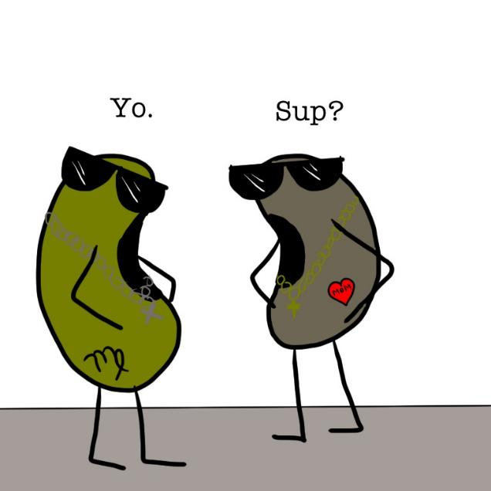

Change to benefit description
Benefits List and App description = “Peanut butter/dry or canned beans”
Receipt description = “Peanut butter/beans”

Slide 32
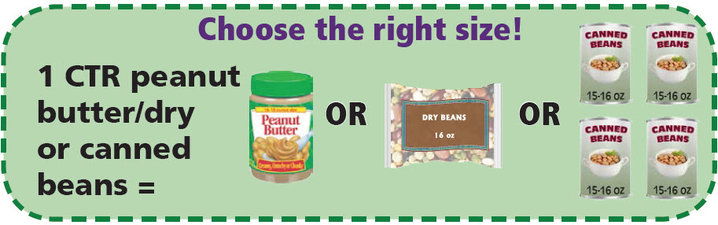
Canned Beans
4 cans of beans can be purchased instead of 1 lb. of dry beans or 1 jar of peanut butter.
Note: If a cardholder chooses canned beans, they will need to get 4 cans, because they can’t get ¾ jar of peanut butter or less than 1 lb. of dry beans.

Slide 33
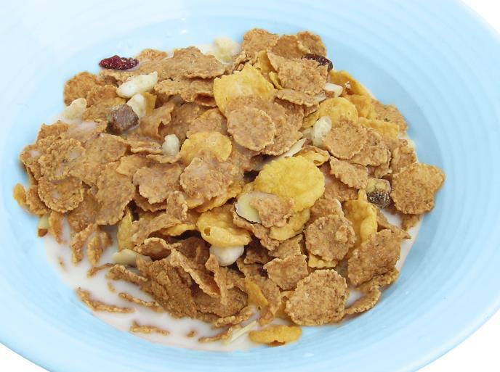
Cereal updates

Slide 34


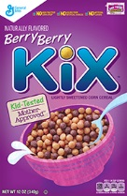

cereals
These cereals were most preferred between English and Spanish text survey respondents and met our cost criteria

Slide 35


Cereal being removed
Frosted Mini-Wheats “Big Bite”
Gluten Free Rice Krispies
Banana Nut Crunch
Sunbelt Granola
Cinnamon Honey Bunches of Oats
Great Value Instant Oatmeal
Store brand Crispy Rice

Slide 36
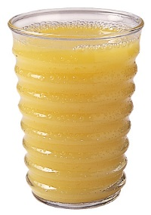
Juice

Slide 37
Juices
Check out the new juice layout on the food list.
16 oz. frozen juice has been removed to reduce confusion
  Standard juice for women is 11.5 to 12 oz. frozen.
  Standard juice for children is 64 oz. bottled.
  You can select a template for the other type, although it will be fewer total ounces.
  The benefit balance will be for one or the other.
Some store brand juice blends with low redemption have been removed.

Slide 38
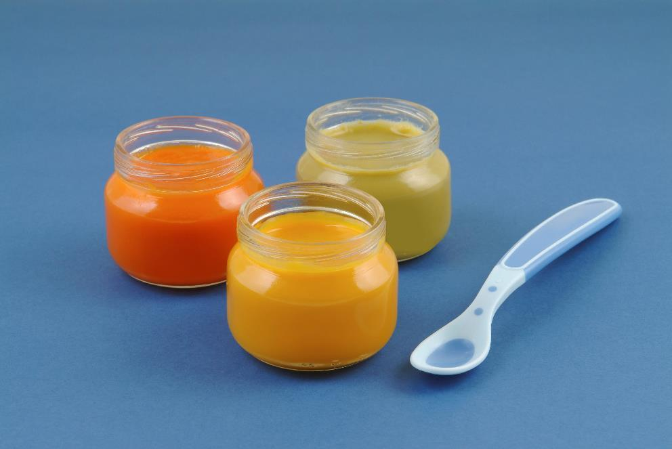
Baby food

Slide 39
baby food options
Adding organic options and Beech-Nut 100% Naturals to baby food category (organic in bold):
  Baby food fruits & vegetables: Beech-Nut (Classics and 100% Naturals, non-organic), Earth’s Best, Gerber (non-organic) and O Organics
  Baby food meat: Beech-Nut, Gerber, O Organics
  Baby cereal: Beech-Nut, Earth’s Best, Gerber

Slide 40

Some foods are still cost-prohibitive
Organic milk in Oregon costs 2 to 3 times the amount of non-organic milks, making organic milk cost-prohibitive. Milk produced by Oregon farmers, however, has no growth hormones (rbGH) and is a healthy choice for families.
We determined that the cost impact of offering eggs marketed as being “cage free” outweighed the benefit of providing these in WIC. All eggs provide the same nutrition benefit, but cage free eggs did not support our commitment to fiscal responsibility.

Slide 41
Remind me what was removed?
Review the handout “Discontinued – List of foods coming off the Food List Oct. 1, 2016”

Slide 42

Assigning in TWIST

Slide 43

Standard packages and templates
Review the “Standard Food Packages” job aid
Review the “Food Package and Template Codes” job aid
What’s different?

Slide 44

Templates in TWIST
Most new foods will be available for the cardholder to select without a change in food templates:
  Whole grains
  Canned beans
  New cereals
  New baby food options

Slide 45

Changing to a new Standard Food Package
The new standard milk template for women and older children will include yogurt.
The new standard will forecast in TWIST automatically at the participant’s next recert appointment.
You can change to a new template at any time, forecast, and reissue benefits.
  If benefits have been spent but there is adequate milk benefit left, you can use the “Modify” function to assign yogurt and/or tofu.

Slide 46


Templates in TWIST
Y
A milk template will need to be selected to provide yogurt or tofu.
  Yogurt templates will have a “Y” in the template code
  Tofu templates will have a “T” in the template code
All milk types will have a template available with yogurt or with yogurt and tofu, with and without cheese.
You will need to use the modify function to assign acidophilus milk or tofu without yogurt.
T

Slide 47
How will you talk with cardholders?
“What makes Oregon WIC foods so special?”

Slide 48

Make a plan
How will you share information about the new food list with cardholders?
When will your agency offer to change to a new milk template with yogurt or tofu?

Slide 49

How can you market the changes to the food list to families?
Review the “What makes Oregon WIC foods special?” handout.
Consider:
  Which of the food list changes might appeal to families with older children?
  What foods might help address some specific parent concerns you have heard?

Slide 50

Troubleshooting shopping issues

Slide 51


New foods will mean new shopping issues
We can expect that there will be missing UPC’s for new foods that are not brand specific.
  Oats
  Instant brown rice
  Bulgur
  Canned beans

Slide 52

New foods will mean new shopping issues
We can expect that there will be confusion about the specific brands or sizes of new foods.
  Whole grain pasta
  Whole wheat tortillas
  Tofu
  Yogurt
  Cereal
  Baby food and cereal

Slide 53

New foods will mean new shopping issues
We can expect that cashiers may not be familiar with the new foods.

Slide 54
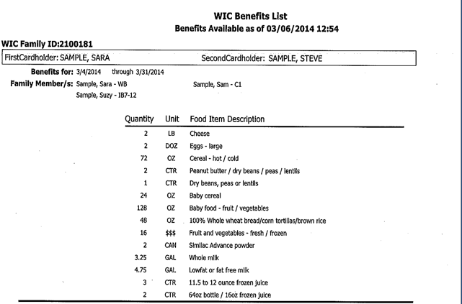
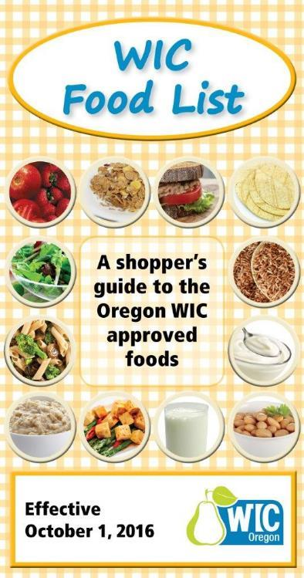
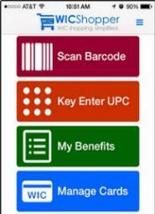
What can you do to help prevent shopping issues?
Shopper education is key.
  Food list
  Benefit balance (Benefits List, WICShopper app, website or customer service line)

Slide 55
How can you help if a cardholder reports an issue?
Review the “Troubleshooting shopper issues” handout.
Use a recent issue you heard from a cardholder as a case study. Investigate the issue using the steps on the handout?
  What was the issue?
  How did you handle it?
  What information, if any, did you need to solve the issue?

Slide 56
Your three choices for documentation
Enter a complaint in TWIST
Used for issues specific to a vendor
Requires specific information about the issue or no action can be taken.
Submit a UPC to wic.upc@state.or.us
Requires specific UPC data or no action can be taken
Pictures are really helpful
Document in the participant’s chart
Can be used to note shopper education provided or “cardholder errors”
Do not use it for missing UPC info

Slide 57

Remember: The cashier only knows 3 things
The balance for the benefit is there – or not
The UPC scanned is in my system – or not
The eWIC card and PIN either works – or not
And the cashier can’t change any of these things!

Slide 58
Make sure cardholders know they don’t have to buy it, if they don’t want to!
1. Check the mid-transaction receipt before approving the purchase.
2. Ask to remove/void any foods that don’t ring up as WIC before approving the purchase.
3. Return items purchased for a refund if not paid for by WIC.

Slide 59
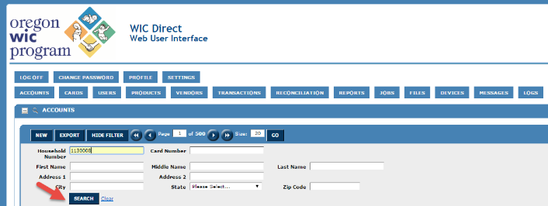
New tool for troubleshooting – WIC Direct
Each agency will be given an opportunity to obtain a login for limited access to WIC Direct, our banking contractors secure website to check participant transaction details.
You will not be able to change anything in WIC Direct.
Find out who in your agency has access to WIC Direct.

Slide 60

WIC Direct versus TWIST
Remember:
  TWIST shows the same information as WIC Direct for benefit balances and card/cardholder information.
  TWIST is much easier to access and understand.
  The only information in WIC Direct that is not in TWIST is specific transaction information or PIN attempts (card locks.)
  You will still need to contact App Support or submit a complaint if you want or need to verify an issue in WIC Direct.

Slide 61
Case Study 1 – Winona at Winco
Winona tried to buy bulk whole wheat spaghetti at Winco. When she got to the checkout stand, her spaghetti didn’t ring up as a WIC food. She had plenty of whole grain benefit balance and couldn’t figure out why she couldn’t buy her pasta.
What steps would you take to investigate this?
What was the issue?
What help would you offer Winona?

Slide 62
Case Study 2 – Sophia at Safeway
Sophia had 128 oz. of baby food fruits and veggie benefits when she went to Safeway. She knew that she could get organic baby food now. She took 16 jars of Gerber organics to the check stand and was told that she would have to pay for them with her own money.
What steps would you take to investigate this?
What was the issue?
What help would you offer Sophia?

Slide 63
Case Study 3 – Walter at Walmart
Walter had asked for yogurt for his 15 month old son. When he went to Walmart, he brought a 32 oz. container of Dannon Whole Milk Strawberry yogurt to the cashier. He was told that he didn’t have enough benefits to get that yogurt, even though his balance showed yogurt.
What steps would you take to investigate this?
What was the issue?
What help would you offer Walter?

Slide 64
Case Study Answers
You can not buy bulk items with WIC. Pasta is brand and type specific. (Shopper error)
Baby food is brand specific and Gerber Organics are not approved. Sofia could have purchased O Organics baby food, a brand that Safeway carries, or ask to have the baby food removed before she approved her WIC purchase if she didn’t want to pay for it with some other tender. (Shopper error)
Walter’s son is under 2, so he needs whole milk yogurt. There are very limited whole milk yogurts available because of the sugar limit. There is no strawberry and the only Dannon flavor is plain. Cashiers may give incorrect reasons why the food was denied since they don’t get those details from their system. (Shopper error)

Slide 65


And please call if you have other questions!

