Slide 1
Niani Dunner
April 1, 2015
Notes:
LOAD VIDEO!!

Slide 2
Six Dimensions of Wellness
Social
Intellectual
Physical
Occupational
Emotional
Spiritual
Emotional
Awareness of your feelings and the feelings of others
Maintain relationships
Express feelings freely and manage them effectively
Cope with stress
Experience relaxation
Positive and enthusiastic!
Notes:
Emotional wellbeing shows that you can:
Be aware of and accept your feelings, and the feeling of others.
Maintain relationships with others, based upon a foundation of mutual commitment, trust and respect.
Learn to express feelings freely, and manage feelings effectively.
Possess the ability to cope effectively with stress, and experience relaxation.
Work to be positive and enthusiastic about yourself, and life!

Slide 3
Thoughts on the video?
Notes:
The thing is, it can be hard to stay positive and optimistic, am I right? Especially if you’re faced with constant stressors balancing work, home and family life, personal health issues, etc.
Did you all get the link to the video I sent yesterday? Ok, for those who didn’t watch it, let me play it. **play video**
https://www.youtube.com/embed/aa6UlTgwZCg
April Fools! Sometimes, to practice emotional wellness, we just need to laugh. My real presentation is on …..

Slide 4
Gelotology:
the science of laughter, and its benefits to our
social, mental and physical well-being.
Nose candy: the hunt has just begun!
Notes:
Gelotology : the science of laughter, and its benefits to our social, mental, and physical well-being.
Gelos – from the Greek term gelos (to laugh).
Humor: International Journal of Humor Research.
https://scholarsbank.uoregon.edu/xmlui/bitstream/handle/1794/7422/laughter.pdf
http://www.scientificamerican.com/article/a-healthy-laugh/

Slide 5
Psychoneuroimmunology:
the science of studying the benefits of laughter to our immune system.
This bunny didn’t have time to dispose of the last kid.
Notes:
Psychoneuroimmunology:
the science of studying the benefits of laughter to our immune system.
Benefits of laughter are similar to health benefits of aerobic exercise, both psychological and physiological.
Laughing out loud exercises and relaxes muscles; increases circulation and respiration, and burns calories.
According to one study, laughing aloud (either real or fake) 20 times, is the cardiovascular equivalent to a 3-minute workout on a rowing machine.

Slide 6
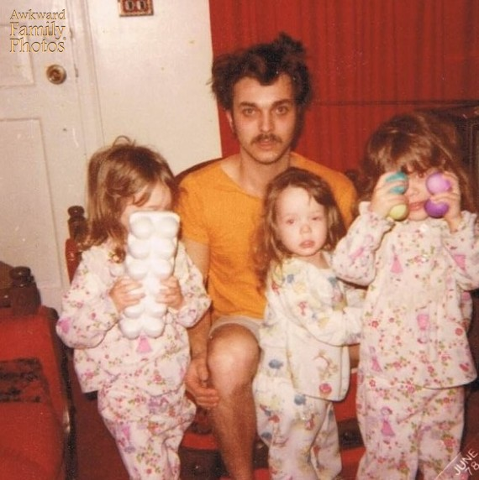
The Hangover, 1978
Notes:
Laugher improves:
Immune system defenses,
mental functioning and memory,
releases endorphins and
increases tolerance to pain… All of which this guy could use.

Slide 7
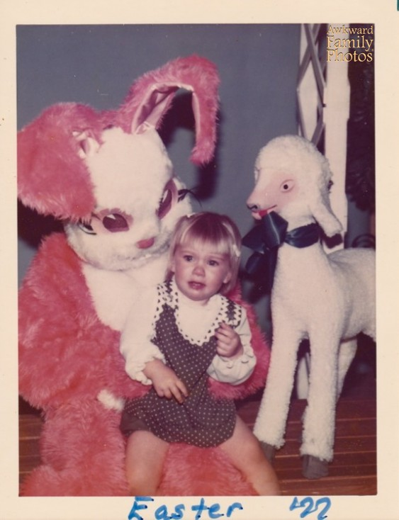
If the red eyed devil bunny didn’t get you, the possessed lamb was waiting in the wings
Notes:
According to Dr. William F. Fry, from Stanford University, and author of numerous scientific journal articles on the subject: “The incidence of heart attack while shoveling snow, for persons with impaired heart function, is alarmingly high. But…the incidence of heart attacks suffered while laughing is surprisingly low, despite the occasional greatly elevated heart rate. Occurrence is so infrequent, there is no medical literature on mirth-provoked heart attacks."
There may be evidence of scary Easter bunny heart attacks, however.
“Miller, M., & Fry, W. F. (2009). The Effect of Mirthful Laughter on the Human Cardiovascular System. Medical Hypotheses, 73(5), 636.

Slide 8
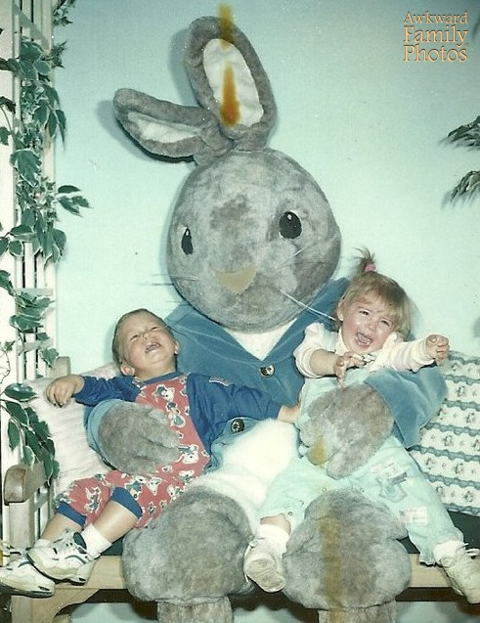
Resistance is futile!
Notes:
The psychological benefits of laughter include:
Reduced anxiety, tension, stress, depression, and loneliness.
Humor improves self-esteem, restores hope and energy, and provides a sense of empowerment and control. . . Unlike these children.

Slide 9
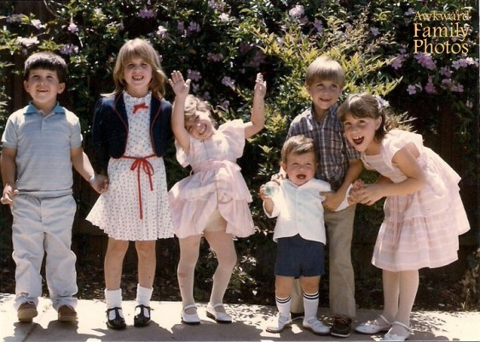
Throw your hands in the air, and wave them like you just don’t care!
Notes:
Laughter begins as an uncontrollable reflex beginning at four months of age. Soon babies may giggle up to 400 times a day.
Anyone know why??
Humor is believed to be an adaptive coping strategy—possibly to combat stress and increase social cohesion and support. It eases tension and brings people together, often by poking fun at common dilemmas. And it’s contagious!
During the break, write down a funny movie, book, website, quote, joke—whatever you turn to for a good laugh—and share it with the rest of us.

