Slide 1
Part 2
Confirmation Letter to Closing a Review & New Forms!!!

Slide 2
Confirmation Letter
What we require—everything is listed in the letter you will receive, which lists the items you need to submit prior to our review
READ the letter…READ all of the letter!
This letter tells you what we need, when the items need to be turned into your Compliance Officer, and when the review will be conducted. All items should be submitted to your Compliance Officer (not uploaded to Google Docs)

Slide 3
What is needed PRIOR to a Review
Items typically requested:
Management Review Questionnaire (updated in 2016)
Resident Services Program Report
Utility Allowance Source Documentation (include UA calculations per unit size) & ensure it is the most current!
Tenant Selection Plan, Waiting List, AFHMP
Rent Roll or Tenant Data Sheet indicating; tenant name, household income, move-in date, etc.
Vacancy Report for past 12 months (include move-out, rent ready & move-in dates)
HOME Monitoring Report / Elderly Bond Monitoring Report /OAHTC Passthrough Documentation (new spreadsheet !!!)

Slide 4
Reports to be Completed by YOU
Blank reports for YOU to fill out will be attached to the confirmation email, such as:
Management Review Questionnaire (MRQ)
Resident Services Program Report
HOME Monitoring Report
Elderly Bond Monitoring Report
Everything above should be completed & returned to your CO no later than the due date listed in the confirmation letter (or a non-compliance letter may be sent to you & the Owner)
Ask your CO if you have questions!
Notes:
HOME (if you have that funding), and Elderly as applicable

Slide 5
Management Review Questionnaire
This is a critical document to fill out in its entirety, which aids in a comprehensive review to be conducted by your assigned CO
Don’t leave anything blank (use N/A as appropriate)
Complete this with the most current, complete & factual information, as well as including supporting documentation for items such as:
Capital Needs Assessment
Pest infestation remediation support
Notes:
Provide details for CAN or items identified for next 5 years

Slide 6
It’s in the DETAILS…
In the MRQ, ensure there is no conflicting information: “UNIT TURNOVER” vs “VACANCY”
Prepare a vacant unit for occupancy/Unit Turnover (pg.3): The time from when the tenant moves out and when you have made the unit rent-ready (it might not be occupied yet)
Vacancy (pg.8):The time from when the tenant moves out (gave you their keys) to the time a new tenant moves in. This is the number of days from “vacate to occupancy”
Notes:
OR READY TO RENT versus OCCUPIED!! We often see conflicting information regarding turnover status/timeframe and the vacancy status/timeframe (switched/not matching)…like someone says the unit took 45 days to prepare a vacant unit for occupancy, yet they say it was re-rented in 30 days

Slide 7
New & Updated FORMS
There has been a lot going on in our industry and we are working diligently to make sure you have the best guidance & updated forms to be successful at managing compliance at your properties
It’s important to check our website often & begin using new/updated forms once they are released, as well as becoming familiar with the current manuals & guidance, as it applies to your specific funding types

Slide 8
FORMS, continued
For Tax Credit alone, there are at least seven (7!) forms that were updated last month
We’ve been listening to you & incorporating edits into existing forms to enhance compliance efforts
It’s easy to tell which forms are updated, as they will no longer have a number associated with them; they will simply have the form TITLE, and our site also lists “NEW 5/2017” next to each
A lot has changed and it’s up to you to modify what you are doing to meet the requirements

Slide 9
NEW Forms in May 2017
Applicant/Tenant Questionnaire
Under $5,000 Asset Certification
Income Status Certification
OHCS Programs Self-Certification
Property Staff/Employee Unit Request
Staff/Employee Certification (BRAND NEW: accompanies Property Staff/Employee Unit Request)
Self-Employment Income Verification

Slide 10
Staff Units-Submit BOTH forms!
Property Staff/Employee Unit: Updated request form! Begin using now!
Staff/Employee Certification: NEW FORM!
This is a required form to accompany the Staff/ Employee Unit Request form
NOTE: This form is required when the employee is NOT income-qualified
OWNER is Required to SIGN!

Slide 14
Updated Forms, continued
Self-Employment form is updated and is consistent with the updated LIHTC Manual language
The Tenant Questionnaire – UPDATED!
The HOME Lease Compliance Form has been updated too!

Slide 15
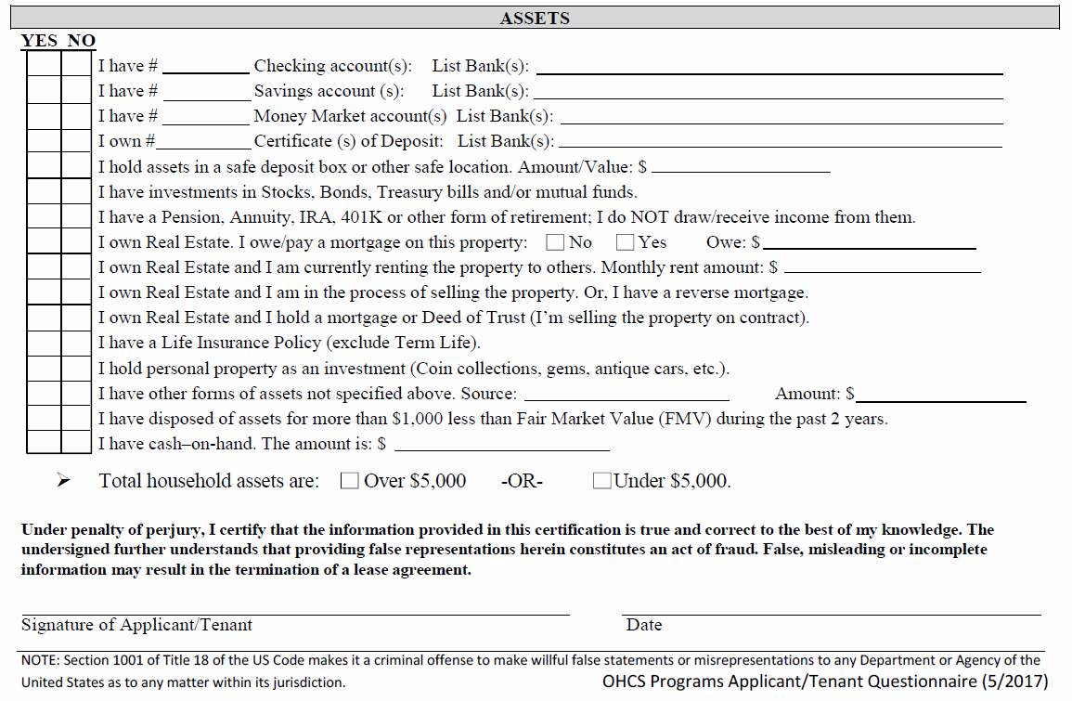

Slide 16
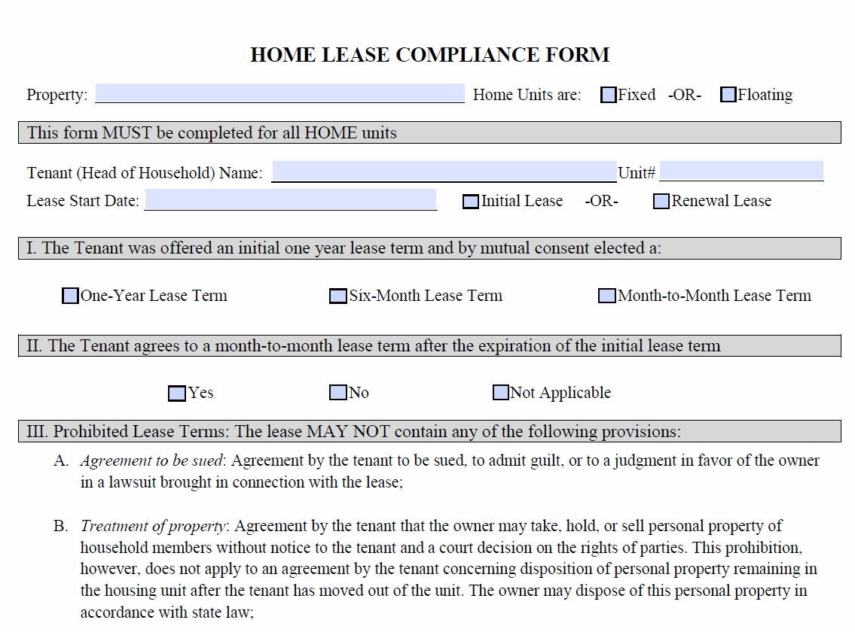

Slide 17
OHCS Issued the Report…now what?
Once you receive the report from your CO, it is important to READ all of it. We have made many important changes to the reporting & it should be clear to the receiver what needs to be addressed & returned to OHCS
The report lists the date that the response is DUE in the cover letter…this is very important!
If you need an extension, contact your CO immediately and do not wait until the day the response is due

Slide 18
TIPS for SUCCESS
You should always audit your own files
If you discover a finding/error before you receive notice of an OHCS Review, AND YOU CORRECT IT, then in most cases it will not be a reportable finding when we conduct our review
You should always have a second set of eyes to ensure your files are complete & accurate
Don’t wait until you hear from us before you get your files in the best shape possible!

Slide 19
ACTION ITEMS
Within the report, you might see ACTION items:
These action items are bolded and require an ACTION on your part. Ensure you complete the action(s) and submit any requested supporting documentation with your response
Please note that HOME funded properties may require submittal of additional documentation & this will be noted in the specific reports
Ensure that all items are responded to completely and on time
Include all dates of correction - a blank line is listed to the left of the item that needs a completion date filled in – fill in the completion date on the blank line!
“Anticipated Date” has been removed
Include all requested supporting docs

Slide 20
Submitting Your RESPONSE
Responses to reports should be sent to:
ohcsresponses@oregon.gov
You need to include response to all ACTION items, as well as requested supporting documentation
If you don’t think you can make the deadline, notify your CO right away & request an extension BEFORE THE DUE DATE; do not wait until after the deadline has passed
If not turned in on time, this will affect your rating –
the response you turn in should be complete, accurate & timely
Notes:
Now on to Jen to talk about the RATINGS!

