Slide 1
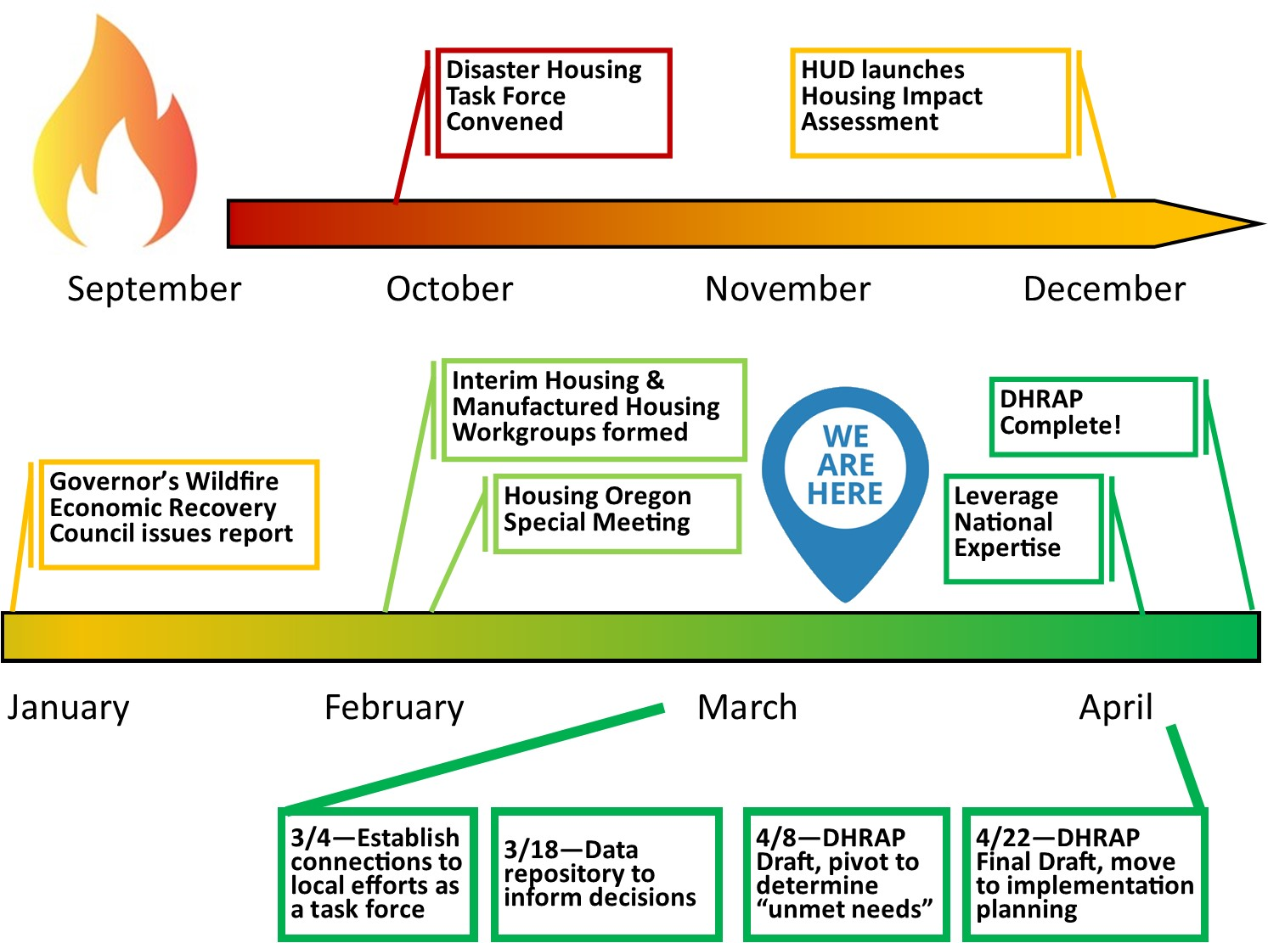

Slide 2
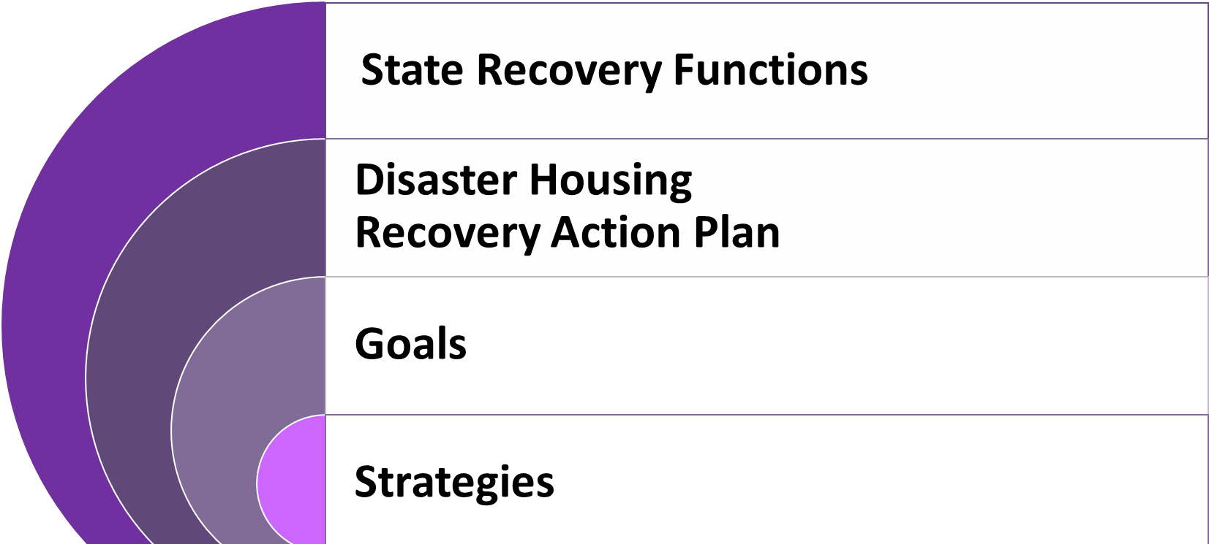
Recovery Plan in Context

Slide 3
Recovery Plan Construct: State Recovery Functions
The organization of SRFs is intended to focus capacities and resources in domains specifically relevant to recovery purposes, even though the inherent overlap among and between them is recognized.
SRF 1:
Community Building & Capacity Building
SRF 2:
Economic Recovery
SRF 3:
Health Services
SRF 4:
Social Services
SRF 5:
Disaster Housing
SRF 6:
Infrastructure System
SRF 7:
Natural & Cultural Resources

Slide 4
Recovery Plan Construct: State Recovery Functions
SRF 1:
Community Building & Capacity Building
SRF 4:
Social Services
SRF 5:
Disaster Housing
SRF 1 provides support to augment the capacity-building and community planning resources of local and tribal governments so that they may effectively plan for, manage, and implement disaster recovery activities.
SRF 4 assists locally led recovery efforts in restoring social services networks to promote the resilience and well-being of affected individuals and communities; restores basic social services functions; and identifies critical areas of need for social services including services for populations with access and functional need.
SRF 5 addresses pre- and post-disaster housing issues; coordinates and facilitates the delivery of state resources to assist local and tribal governments in the rehabilitation and reconstruction of destroyed and damaged housing, and the development of other new accessible, long-term housing options.

Slide 5
Disaster Housing Recovery Action Plan Outline
Introduction & Executive Summary
Impact of 2020 wildfires on pre-existing housing shortage
Planning Process
Elements of the Disaster Housing Recovery Action Plan
Recovery Vision
Core Values
Goals & Strategies
Success Measures
Goals
Create Interim Housing Solutions
Bolster Local Capacity
Expedite Delivery of Permanent Housing Solutions
Build Community & Family Resilience
Implementation Highlights

Slide 6
Oregon Disaster Housing Recovery Action Plan:
Permanent Housing Solution Strategies
Goals
Create Interim Housing Solutions
Bolster Local Capacity
Expedite Delivery of Permanent Housing Solutions
Build Community & Family Resilience
Manufactured Homes & Parks
Homeownership
Rental Housing
Cross-cutting Strategies

Slide 7
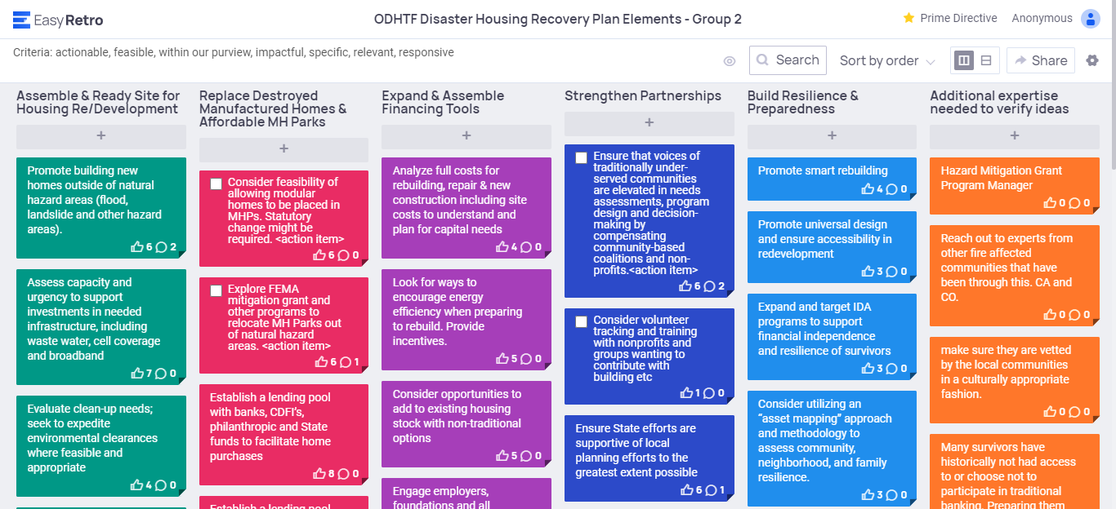
Strategy Development

Slide 8
Strategy Development

Slide 9
Oregon Disaster Housing Recovery Action Plan:
Permanent Housing Solution Strategies
Goals
Create Interim Housing Solutions
Bolster Local Capacity
Expedite Delivery of Permanent Housing Solutions
Build Community & Family Resilience
Manufactured Homes & Parks
Homeownership
Rental Housing
Cross-cutting Strategies

Slide 10
Goal:
Expedite delivery of permanent housing solutions
Strategy: Manufactured Homes & Parks
“Storefront” aid to survivors
Development readiness
Legislative & executive
actions/investments
Start now for long term

