Slide 1
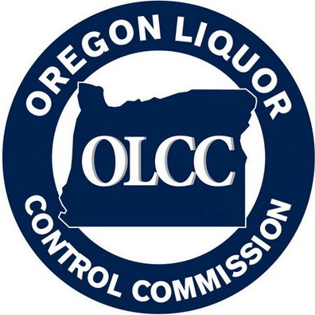
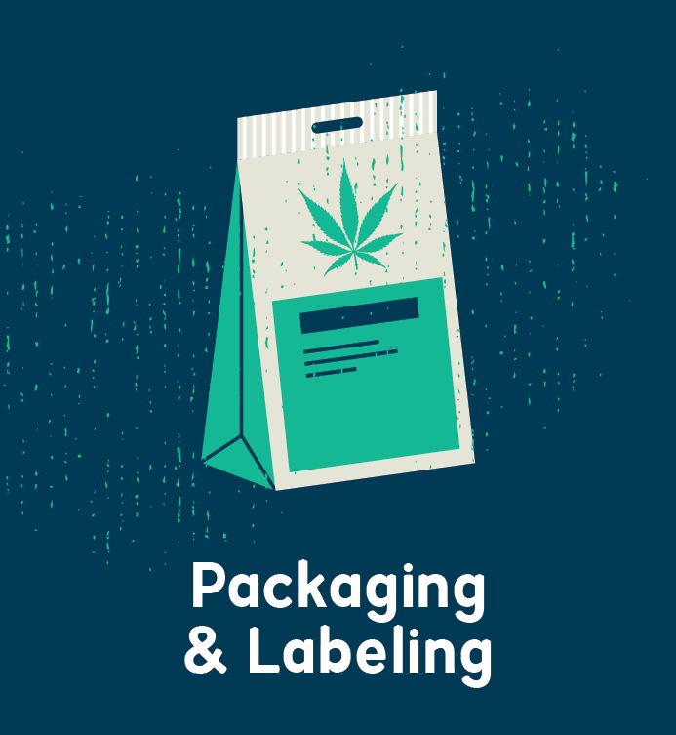
Packaging and Labeling The Path to OLCC Approval
December - 2018

Slide 2
Metrc Product Categorization
Recreational Marijuana Product and Tax Categorization Guide.
Consolidates definitions for purposes of taxation, labeling, and testing/concentration limits – Metrc categories “roll up” appropriately
What should be in Metrc as “combined category”?
“Combined Category” = “Other Cannabinoid Product”
e.g. Infused Pre-Rolls
What should not be “Combined Category”?
Non-Infused Pre-rolls
Co-mingled flower and shake is still usable marijuana

Slide 3

Metrc – Unique Identification Number
What is the “UID” in the labeling rules?
Metrc package tag at the time the product is labeled for sale to consumer

Slide 4
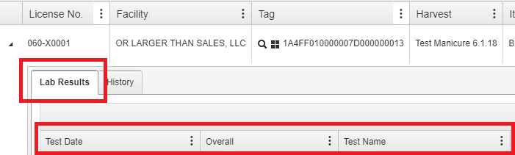
Metrc – Lab Test Information
Data of record for testing is Metrc – OLCC uses lab results in Metrc for audit purposes

Slide 5
Packaging and Labeling The Path to OLCC Approval
December - 2018

Slide 6
What Will be Covered Today:
Why does Oregon have packaging and labeling rules?
High level overview of packaging and labeling rules
How does the online licensing system work?
Sell down period of labels approved prior to August 15, 2018
Common issues (incorporates August 15, 2018 rule changes)
Other Cannabinoid Product labeling guidance
Best practices – how to get it right the first time
Contact & Consultations
Q&A
What won’t be covered today? Testing and licensing related questions

Slide 7
Disclaimer
This presentation assumes attendees have a basic understanding of the OLCC’s packaging and labeling rules and does not cover all aspects of the packaging and labeling rules. In some instances, the rules are abbreviated and are not discussed at length.
Licensees and persons creating packaging and labeling on their behalf are ultimately responsible for understanding and following the rules.
The packaging and labeling rules can be found in OAR 845-025-7000 – 7190 (Division 25).

Slide 8
Pop Quiz
Are there any special warnings OLCC licensees must put on advertising?
YES! The following statements must be on all print, billboard, television, radio and internet advertising (instagram and facebook):
“Do not operate a motor vehicle or machinery under the influence of this drug”
“For use only by adults twenty-one years of age and older”
“Keep out of the reach of children”
See OAR 845-025-8040 for specific advertising restrictions and requirements.

Slide 9
Pop Quiz Continued…
It is OK put farm logos on your approved label without seeking pre-approval – True or False?
FALSE! The addition of a farm logo to an approved label requires resubmission.
Always submit additional farm logos when you are submitting a label application, even if you don’t intend to use them.
Farm logos must still be compliant with the rules (attractive to minors, no organic claims, displaying consumption of marijuana).
Most changes to approved packaging and labeling require pre-approval. See OAR 845-025-7160(7).
Generally changes in “variable” information do not require resubmission and pre-approval (lab dates, test results, strain names, etc…)

Slide 10
Pop Quiz Continued…
Which of the following strain names are attractive to minors?
Candy Land?
Yes. This is a brand or name of a consumer product typically marketed to minors.
Gorilla Glue?
No. This is not a product that is typically marketed to minors.
Captin Crunch Berries?
Yes. This is a brand or name of a consumer product that is typically marketed to minors.
Solutions? Don’t use strain names that are attractive to minors or abbreviations or acronyms, ie “Cvndylvnd” or “CCB”

Slide 11

Why Packaging and Labeling Rules?
Statutorily mandated to protect the public health and safety
Truth in advertising and consistency
Prevention of unintended marijuana consumption.
Child resistant packaging
Clearly labeling containers holding a marijuana items

Slide 12
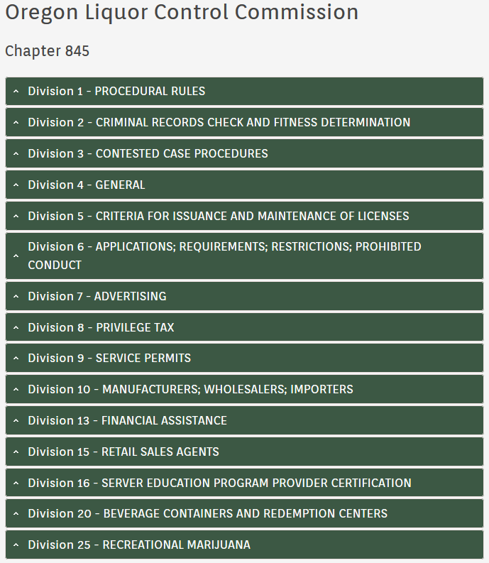
Where to Find the Rules
The best source for the rules is the Oregon Secretary of State’s website under Division 25 – Recreational Marijuana https://go.usa.gov/xEq99
Click here

Slide 13
Brief Overview of Packaging Rules
This is not an exhaustive list of the packaging rules
What is a package? The receptacle that holds the marijuana item that will be ultimately sold to a consumer
There can be multiple parts of a package. For example, an extract jar placed in a box
Package applications only cover the physical structure holding the marijuana item – NOT THE LABEL
Package approval never covers the label. You must submit separate package and label applications

Slide 14
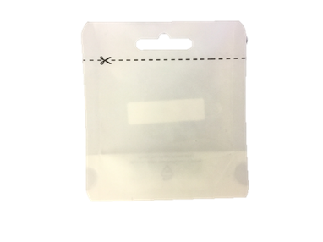
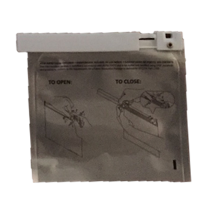
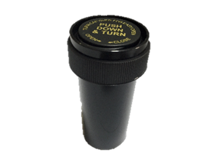
Packages – Child Resistance
All marijuana items, except immature plants and seeds, must be sold in a child resistant package or leave the retail store in an approved child resistant exit package.
There are two types of child resistant packages: single use or re-sealable and continuously child resistant.
If the package is not child resistant, it must leave the retail store in an approved child resistant exit package.
Only usable marijuana can leave the retail store in a single use child resistant package.
Child Resistant – Single Use
Re-sealable & Continuously Child Resistant
Child Resistant Exit Package

Slide 15
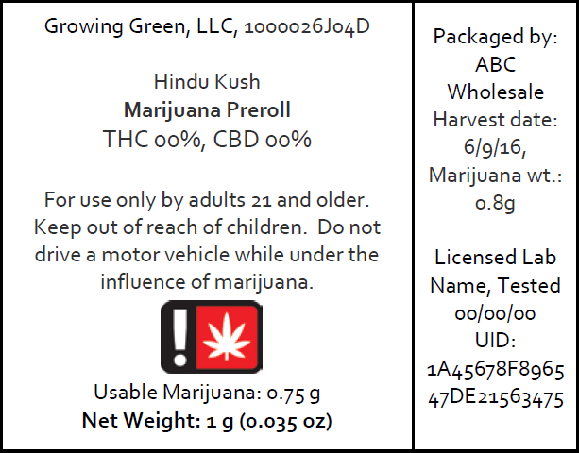
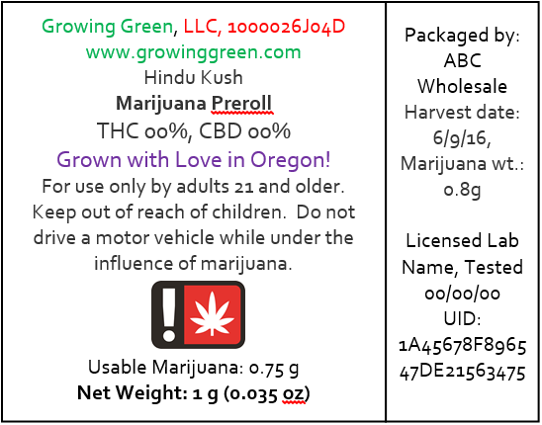

Labeling – Pre-Approval
Any label that is not generic must be submitted for pre-approval through the online licensing system before it can be offered for sale to a consumer, patient, or designated primary caregiver.
Generic labels have no pictures, logos, colors, social media icons, websites, or graphics. They only contain the information required by rule.
Only OLCC licensees, license applicants, and medical registrants may submit packaging and labeling.
Colors
Marketing language
Generic
Non-Generic
Social media icon

Slide 16
How Does the Online System Work?
Once a licensee formally completes the submission of a label or package application (by paying the required fee, digitally signing, and submitting) the application status shows as “New.”
While the label is being reviewed, the status will show as “Under Review.”
When the OLCC requires a licensee to make changes to a package or label, the status will show “Resubmission Required”

Slide 17
How Does the Online System Work?
Once a licensee submits changes, the status changes back to “Under Review.”
If, and only if, the status is “Approved,” the package or label can be used.
All package and label applications are reviewed on a first come, first served basis.

Slide 18
How Does the Online System Work…Status & Who can Make Edits?
Draft – The application has not been formally submitted and can be edited by the licensee and not the OLCC.
New – The application has been formally submitted and cannot be edited by the licensee.
Under Review – The OLCC is reviewing the application and cannot be edited by the licensee.

Slide 19
How Does the Online System Work…Status & Who can Make Edits?
Resubmission Required – The application requires changes and cannot be edited by the OLCC.
Approved – The application is approved and cannot be edited by the licensee, but can be edited by the OLCC.
Denied – The application has formally been denied and may not be used.

Slide 20
How Does the Online System Work…?
When submitting digital files in the online system:
File size limit is 5mb.
Clearly name and date your files
Delete or rename old files.
Applications with files that are too blurry to read will automatically be flipped to “Resubmission Required” status. This is a result of low resolution images being uploaded.

Slide 21
How Does the Online System Work…?
You can submit similar product variants under the same label application.
OK – a chocolate bar with three different flavor variants or an extract label with different color variants.
Not OK – a tincture and an extract.

Slide 22
Change Request Form & Application Denial
All requests to make changes to an approved package or label application will need to be made through the Change Request Form and submitting a $25 change fee for each application.
Once the OLCC receives the form and processes the fee, the application(s) will be unlocked.
For each package or label application that you want to change, you must submit a separate fee and form.
The form and fee can either be hand delivered to the OLCC’s Milwaukee office or mailed to the address listed in the form.

Slide 23
Change Request Form & Application Denial
Applications will be denied after two failed attempts and the applicant will have to submit a new application and pay the $100 fee again.
Applicants will be given two submissions to get their application approved by the OLCC.

Slide 24
Sell Down Period
New packaging and labeling rules took effect August 15, 2018.
Labels approved prior to August 15, 2018 were automatically changed to “Resubmission Required” status.
Labels approved before August 15, 2018 may not be transferred for sale to an OLCC retailer on and after April 1, 2019.
On and after April 1, 2019 – retailers can no longer accept products containing labels approved prior to August 15, 2018.
If you are updating your label under an existing label application, there is no new fee required.

Slide 25
Sell Down Period
Retailers have until January 1, 2020 to sell through the old label inventory.
DO NOT wait until March, 2019 to resubmit your labels. I anticipate a lengthy delay in label pre-approval during that time.

Slide 26
Common Issues – Label ID
All labels that have been pre-approved must have a Label ID prominently displayed on the label of the outermost container.
When a label is submitted in the online system, a unique Label ID number gets generated. This ID number is unique to each individual label application.
You must use the format “Label ID:”
Generic labels don’t have a Label ID.
When you submit a label application, you can use placeholders – “Label ID: 0000”

Slide 27
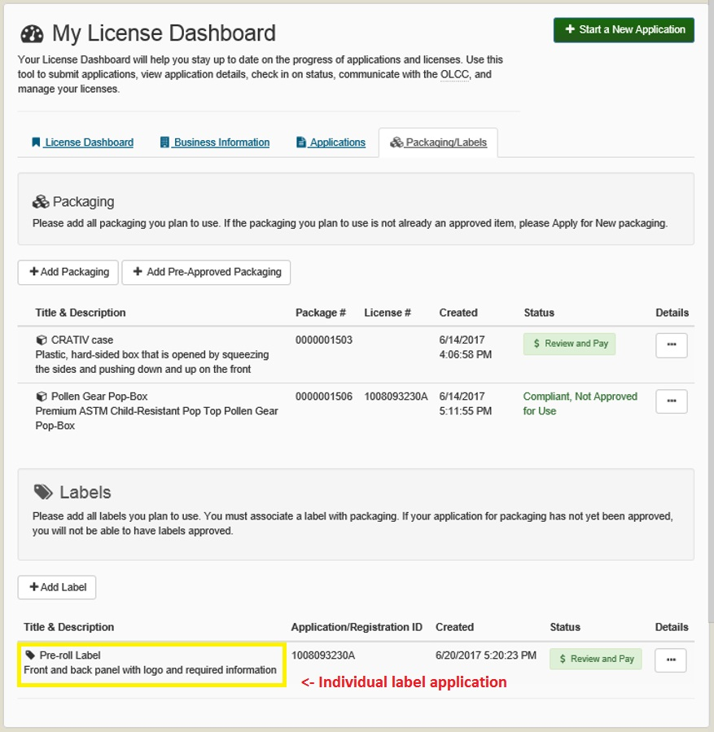
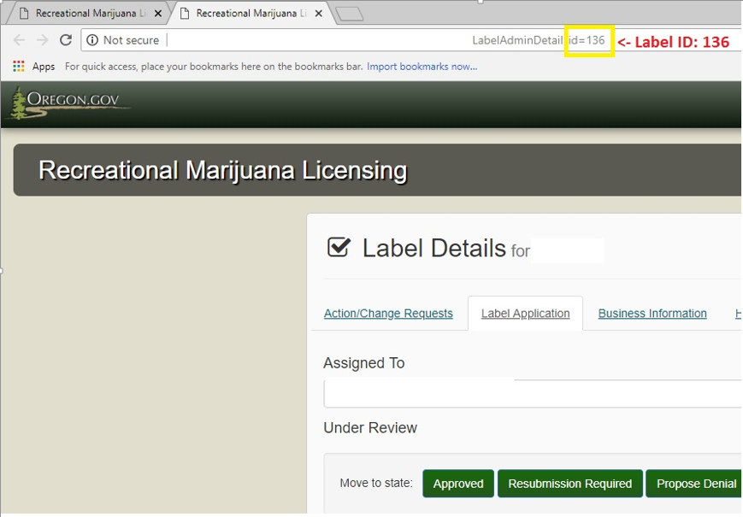
Where is the Label ID!?!?!
Browser’s Address Bar
The Label ID number can be found within each individual label application at the end of the URL in your browser’s address bar.

Slide 28
“This package is not child resistant.”
If the container holding the marijuana item is does not meet the child resistant standards in the rules, the outermost label must have the statement - “This package is not child resistant.”
If the package you list under “Packages” in your label application is not certified child resistant, you must use this warning.

Slide 29
This package is not child resistant…
For example: you have an plastic jar inside of a box, neither has been approved as child resistant in the OLCC’s online system.
The outermost label on the box must have the statement.
However, if the plastic jar has been approved as child resistant in the OLCC’s online system, the box would not need the warning. Why? The container holding the marijuana item meets the child resistant standards.

Slide 30
Common Issues – Adults & Driving Warnings
The rules that went into effect on August 15, 2018 slightly changed both of these warnings.
From “For use by adults 21 and older” to “For use only by adults 21 and older.”
From “It is illegal to drive a motor vehicle while under the influence of marijuana” to “Do not drive a motor vehicle while under the influence of marijuana.”
All required warnings and statements must exactly match the text of the rule. No abbreviations or slight variations.

Slide 31
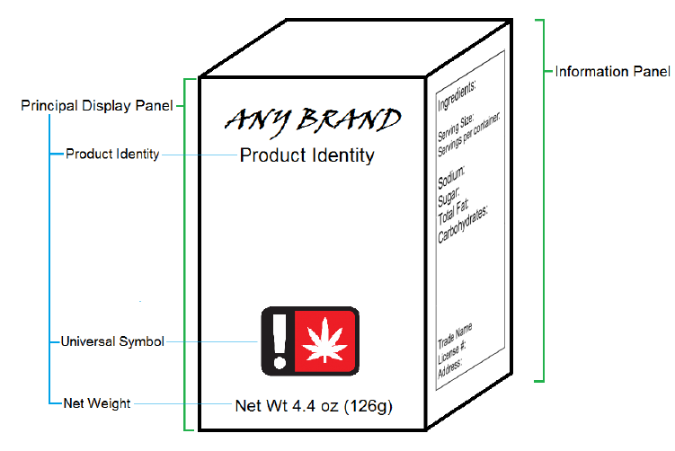
What is the principal display panel?
The principal display panel or PDP is the part of a label on a package or container that is most likely to be displayed presented, shown or seen under customary conditions of display for sale or transfer.
Typically the PDP must have: universal symbol, product identity, and net quantity of contents (net weight or fluid measurement.

Slide 32
Confusing Weight and Volume
Weight is expressed in grams and ounces (sometimes milligrams)
For example – 1 gram (0.04 oz)
Always put Net Weight or Net Wt. before grams and ounces
Liquid is expressed in fluid ounces and milliliter
For example – 1 fl oz (29.6mL)
DO NOT put Net Weight before fluid measurements.

Slide 33
Product Identity
The product identity is the truthful or common name of the product that is contained the package.
The product identity must clearly identify whether the item is derived from marijuana or hemp. “Cannabis” may be used in place of “marijuana.”
Marijuana Edible
Hemp Tincture
If the product is a cannabinoid extract or concentrate, the product identity must clearly identify it as such.
Marijuana Concentrate
Cannabis Extract

Slide 34

Hemp
If the item is solely derived from hemp the label must:
Have a product identity that clearly indicates the product is derived from hemp.
“Hemp Tincture,” “Hemp CBD Chocolate Bar,” or “Hemp Extract.”
Have the following warnings in place of the other required warnings: “This product is derived from hemp and could contain THC. Keep out of reach of children.”
You must still have the “FDA Statement.”
The rules specifically call out what “warnings” are.

Slide 35
Hemp
If the item is a hemp extract, concentrate, topical, or a hemp product other than an edible, tincture, or capsule, the label shall contain the warning, DO NOT EAT in bold, capital letters.
Use the hemp symbol on the principal display panel instead of the universal symbol.
If the product contains both marijuana and hemp, it is labeled as a marijuana item.

Slide 36
Pre-rolls
Pre-rolls must list two weights
1)the net weight and 2) weight of usable marijuana.
The net weight is the weight of the usable marijuana + paper + filter/tip.
The net weight must be on the bottom 30% of the principal display panel.
The weight of usable marijuana must be listed in grams.
Multi-packs of pre-rolls must make it clear how much usable marijuana is in each pre-roll.
For example “Contains (5) ½ gram usable marijuana pre rolls.

Slide 37
Health Claims
Health claims describe a relationship between a substance and a reduced risk of a disease or health related condition.
You may not make health claims on your label if it is not supported by the totality of publicly available scientific evidence…
A statement claiming that the product or an ingredient in the product can cure, mitigate, or treat any disease or health-related condition cannot be made or implied.
Examples of impermissible health claims:
“Rick Simpson oil will reduce your risk of cancer.”
“This cannabis tincture helps with chronic inflammation.”
Chronic inflammation is a symptom of rheumatoid arthritis.

Slide 38
Organic Claims
To state the product is organic or use the USDA organic seal, the product needs to be certified organic.
The USDA does not certify marijuana or products containing marijuana as organic.
Certified Kind or Clean Green Certification is fine as long as the product is actually certified by one of those organizations.
Do not make misleading equivalents between these certifications and USDA certifications.

Slide 39
Listing Organic Ingredients
The OLCC follows the USDA’s rules and guidelines related to labeling products with organic ingredients.
See the USDA’s website - https://www.ams.usda.gov/rules-regulations/organic/labeling
“Made with organic *****” statement – if the product contains at least 70% certified organic ingredients (not including salt or water), the label may include a statement such as “made with organic wheat” that lists the specific organic products.
The organic ingredients must be identified in the ingredients list. The label must also identify the USDA-accredited certifying agent on the information panel.
The generic statement “made with organic ingredients” is not allowed.

Slide 40
Organic Ingredients – Specific Ingredients
If the product contains less than 70 percent organic contents, the specific organic ingredients may be listed in the ingredient statement.
You may only, on the information panel, identify the certified organic ingredients as organic and the percentage of organic ingredients.
You cannot include the USDA organic seal anywhere or use the word “organic” on the principal display panel.

Slide 41
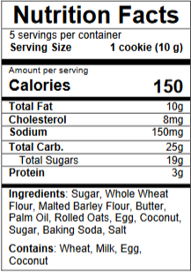
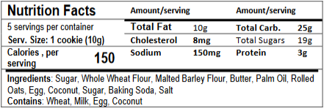
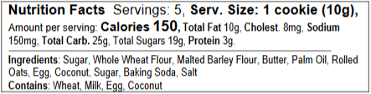
Edibles – Nutrition Templates
Labels must use the nutrition templates provided by the OLCC, which can be found on the packaging and labeling website.
The templates must exactly match the ones provided by the OLCC.
When listing serving size on the nutrition template, the weight of the serving should follow the suggested serving size.
For example “Serving Size: 1 cookie (10g)
The tabular and linear displays should only be used on small containers that do not have enough space for a full label.
Vertical Display
Tabular Display for Small Packages
Linear Display for Small Packages

Slide 42
Small and Tiny Containers
All containers holding a marijuana item must have a label.
Labels must be affixed to the container holding the marijuana item.
The small container rules can be found at OAR 845-025-7030(11).
The tiny container rules can be found at OAR 845-025-7030(12).
See page 9 of the Label Checklist and Generic Label Examples.

Slide 43
Small and Tiny Containers…
The small/tiny container labeling rules are abbreviated, the label on the outer container must contain all the information required by rule.
For small and tiny jars holding extracts, the lid is typically the principal display panel.
All other required information can be placed on a wrap around label or a circular label attached to the base of the jar.

Slide 44
Topical Labeling
The concentration of THC and CBD in the container must be listed as a percentage.
You can list the mg afterwards or elsewhere on the label, but you must list the percentage.
OHA’s recreational concentration limit is 6%
You must provide an amount suggested for use by a consumer at any one time.
“a dime sized amount”
“a tablespoon”

Slide 45
Moonrocks, Asteroids, Infused Joints, etc…
If a marijuana item has “added substances” as defined by OAR 845-025-7000 it is labeled as an “Other Cannabinoid Product” under OAR 845-025-7120.
Among other requirements, 7120 requires the label to list the processor’s place of address and packager’s address, if different from processor and the ingredients in descending order of predominance by weight or volume.

Slide 46
Moonrocks, Asteroids, Infused Joints, etc…
All “Other Cannabinoid Products” must be tested for final potency (THC and CBD).
These potency values and the lab that performed the test and test date must be prominently displayed on the label.
The product identity must clearly identify the product as being derived from marijuana or industrial hemp.

Slide 47
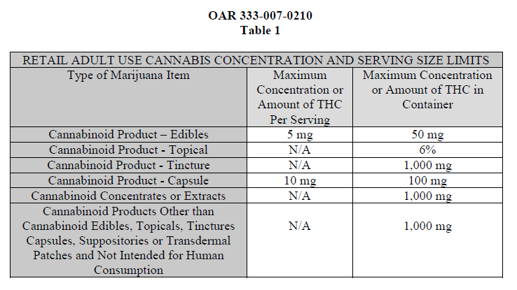
Concentration and Serving Size Limits
The Oregon Health Authority (OHA) sets the concentration and serving size limits.
Capsules are labeled
under the tincture rules.
Suppositories are subject
to the edible limits and are
as an “Other Cannabinoid
Product.”
Transdermal patches are
subject to edible limits but
are labeled as a topical

Slide 48
Other Cannabinoid Product Guidance
This discussion generally refers to cannabinoid concentrates and extracts that contain “non-marijuana” terpenes.
This is not an exhaustive discussion of how to label cannabinoid extracts and concentrates with “added substances.” See Compliance Bulletin CE2018-09 for specific requirements.
If a cannabinoid concentrate or extract contains “added substances” as defined by OAR 845-025-7000, it must be labeled according to OAR 845-025-7120 as an “Other Cannabinoid Product.”

Slide 49
Other Cannabinoid Product Guidance Continued…
OAR 845-025-7120 requires, among other things, to list the ingredients that are present in the final product.
The ingredient list must fully and accurately capture all of the ingredients present in the final product.
This includes “non-marijuana derived terpenes,” artificial and natural flavors (as defined by 21 CFR 101.22), and “carriers” such as propylene glycol, MCT oil, and vegetable glycerin.
“Non-marijuana terpenes” are more accurately labeled under the FDA’s definition of artificial and natural flavoring in 21 CFR 101.22.

Slide 50
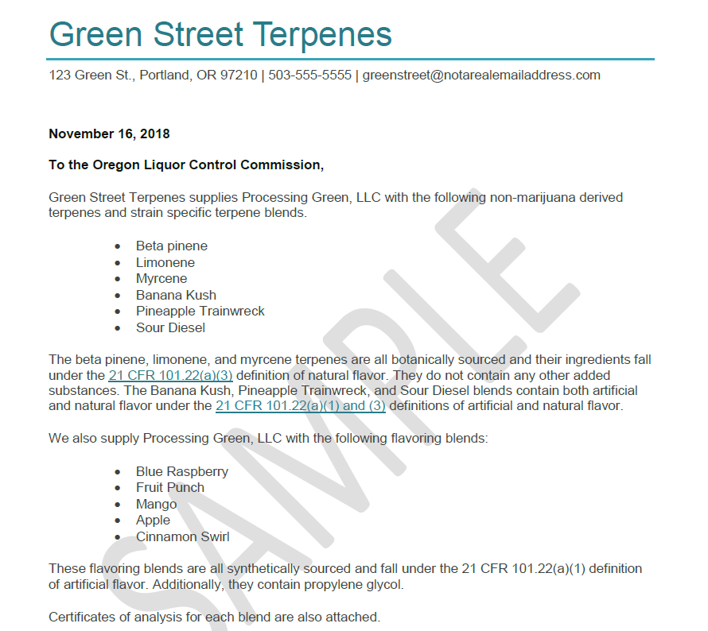
Other Cannabinoid Product Guidance Continued….
The product identity must adhere to the formats provided in Compliance Bulletin CE2018-09.
“Marijuana Extract with Non-Marijuana Derived Terpenes”
“Blue Dream Flavored Marijuana Concentrate”
Ingredient documentation must match the requirements in the guidance. Incomplete documentation will be rejected.
See the guidance for an example letter.
Certificates of Analysis – these are only for the added
substances not the product containing marijuana items.

Slide 51
Best Practices for Packaging and Labeling Submissions
Use the digital resources on the Packaging and Labeling Portion of the OLCC’s recreational marijuana website.
Label Checklist and Generic Label Examples.
Packaging and Labeling Guide.
Guide to Package and Label Pre-Approval Process.
Packaging and Labeling Rules – OAR 845-025-7000 – 7190.
Sign up for Gov. Delivery.
Review compliance bulletins.

Slide 52
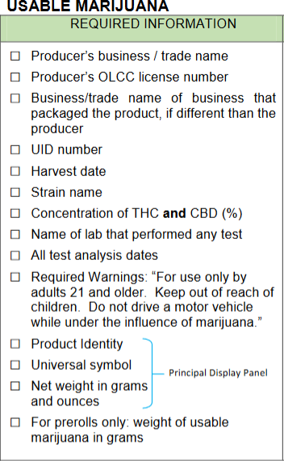
Best Practices for Packaging and Labeling Submissions…
Use the label checklist!
Keep in mind the checklist does not capture every aspect of the packaging and labeling rules(Label ID, this package is not child resistant, etc…)
Walk through the checklist before you formally submit a label application (I do it went reviewing your label applications).

Slide 53
Contact
Marijuana.packaging@Oregon.gov or 503-872-5459.
Email is typically faster.
When communicating via email, please include your business name and license number. This helps speed the process up.
When leaving voicemail, please state your name and business name as well as a call back number.
As a courtesy, you may submit via email label applications before you formally submit them online for critique.
Please be considerate when submitting labels for review (not a large amount and adopt my comments).
Please avoid requests for expediency. All applications are reviewed in the order received. Plan for a lag time when working on product development.

Slide 54
Consultations
I am happy to provide in person consultations at the OLCC’s main office in Milwaukee or your place of business, if in the Portland metro area.
Please be considerate and schedule consultations well in advance.
Consultations are subject to availability.
Licensees are ultimately responsible for complying with the rules.
If visiting the OLCC, keep in mind there is no public WiFi at the OLCC so make sure to bring all your files digitally or print them out.
Please make sure not to bring any marijuana items to the OLCC’s offices.

Slide 55
Advertising
A lot of what applies regarding packaging and labeling carries over to advertising restrictions
The advertising restrictions are guardrails to keep licenses in bounds:
Don’t target people under the age of 21
Don’t encourage illegal activity, including interstate transportation
Don’t make false claims about product safety, curative or therapeutic effects
Don’t display consumption of marijuana items or encourage excessive or rapid consumption

Slide 56
Advertising
Advertising restrictions:
Don’t advertise with handbills distributed in public areas
Don’t utilize television, radio, billboards, print media or internet advertising where more than 30 percent of the audience is under the age of 21
Don’t use location targeted marketing (e.g. smart phones) unless the marketing app is installed on the device by its owner who is 21 years of age or older and includes a permanent and easy opt-out feature

Slide 57
Advertising
Do include on all print, billboard, television, radio and internet advertising in font size legible to a consumer
“Do not operate a vehicle or machinery under the influence of this drug”
“For use only by adults twenty-one years of age and older”
“Keep out of the reach of children”
Do use an age gate on your web site

Slide 58
Advertising
What else?
Discounting - yes, BOGO - no
Customer loyalty programs for cannabis – no; customer loyalty programs for non-regulated items - yes
Refer to:
Compliance Education Bulletin CE2017-03 (Advertising Restrictions)
Compliance Education Bulletin CE2017-05 (Sales to Medical Cardholders, Discounting Marijuana Items)
Rules: 845-025-8000 to 845-025-8080

Slide 59
Q&A…
Questions?
Marjuana.packaging@Oregon.gov
503-872-5459

