Slide 1
Packaging and Labeling The Path to OLCC Approval
January - 2019

Slide 2
What Will be Covered Today:
High level overview of packaging and labeling rules
How does the online licensing system work?
Sell down period of labels approved prior to August 15, 2018
Common issues (incorporates August 15, 2018 rule changes)
Other Cannabinoid Product labeling guidance
Best practices – how to get it right the first time
Contact & Consultations
Q&A
What won’t be covered today? Testing and licensing related questions

Slide 3
Disclaimer
This presentation assumes attendees have a basic understanding of the OLCC’s packaging and labeling rules and does not cover all aspects of the packaging and labeling rules. In some instances, the rules are abbreviated and are not discussed at length.
Licensees and persons creating packaging and labeling on their behalf are ultimately responsible for understanding and following the rules.
The packaging and labeling rules can be found in OAR 845-025-7000 – 7190 (Division 25).

Slide 4
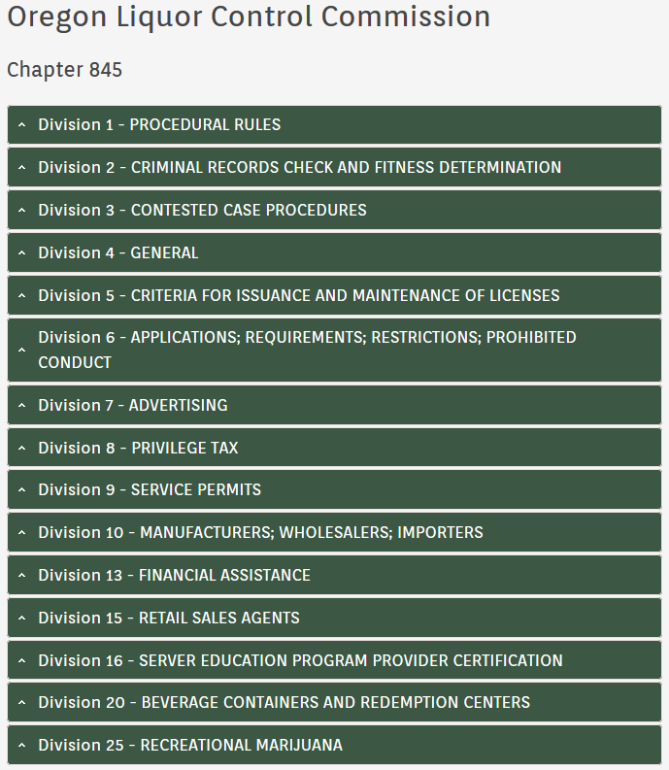
Where to Find the Rules
The best source for the rules is the Oregon Secretary of State’s website under Division 25 – Recreational Marijuana https://go.usa.gov/xEq99
Click here

Slide 5
Brief Overview of Packaging Rules
This is not an exhaustive list of the packaging rules
What is a package? The receptacle that holds the marijuana item that will be ultimately sold to a consumer
There can be multiple parts of a package. For example, an extract jar placed in a box
Package approval only cover the physical structure holding the marijuana item – NOT THE LABEL
Package approval never covers the label. You must submit separate package and label applications.
If your package is approved but your label is not, you will not be in compliance with the rules.

Slide 6
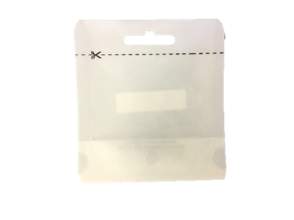
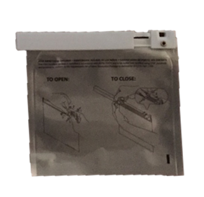
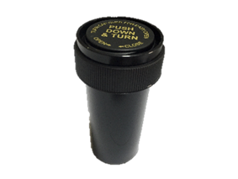
Packages – Child Resistance
All marijuana items, except immature plants and seeds, must be sold in a child resistant package or leave the retail store in an approved child resistant exit package.
There are two types of child resistant packages: single use or re-sealable and continuously child resistant.
If the package is not child resistant, it must leave the retail store in an approved child resistant exit package.
Only usable marijuana can leave the retail store in a single use child resistant package.
Child Resistant – Single Use
Re-sealable & Continuously Child Resistant
Child Resistant Exit Package

Slide 7
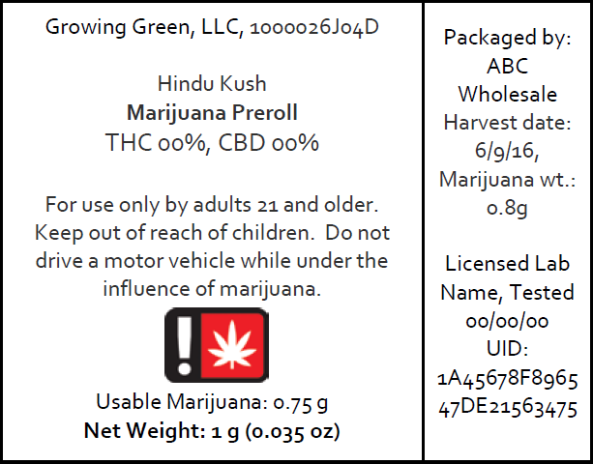
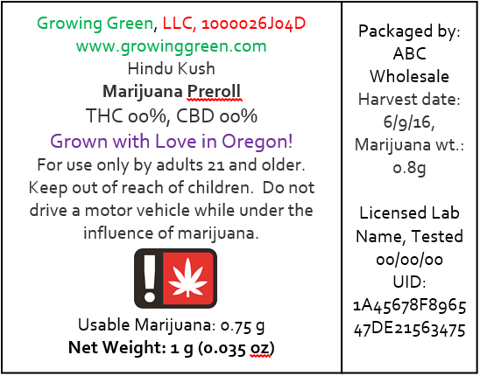
Labeling – Pre-Approval
Any label that is not generic must be submitted for pre-approval through the online licensing system before it can be offered for sale to a consumer, patient, or designated primary caregiver.
Generic labels have no pictures, logos, colors, social media icons, websites, or graphics. They only contain the information required by rule.
Only OLCC licensees, license applicants, and medical registrants may submit packaging and labeling.
Colors & Website
Marketing language
Generic
Non-Generic
Social media icon

Slide 8
How Does the Online System Work…Status & Who can Make Edits?
Draft – The application has not been formally submitted and can be edited by the licensee and not the OLCC.
New – The application has been formally submitted and cannot be edited by the licensee.
Under Review – The OLCC is reviewing the application and cannot be edited by the licensee.

Slide 9
How Does the Online System Work…Status & Who can Make Edits?
Resubmission Required – The application requires changes and cannot be edited by the OLCC.
Approved – The application is approved and cannot be edited by the licensee, but can be edited by the OLCC.
Denied – The application has formally been denied and may not be used.

Slide 10
How Does the Online System Work…?
When submitting files in the online system:
File size limit is 5mb.
Clearly name and date your files.
Delete or rename old files. If you are resubmitting after making changes, first remove the old files.
Applications with files that are too blurry to read will automatically be flipped to “Resubmission Required” status. This is a result of low resolution images being uploaded.

Slide 11
How Does the Online System Work…?
All applications are received on a first come first served basis.
Please avoid requests for expediency.
Factor in a 3 – 5 week lag time for package and label approvals.

Slide 12
Changes to Approved Labels
Generally speaking, licensees can only make minor changes to “variable” information to approved labels, such as lab results, test dates, and harvest dates. See OAR 845-025-7160(7) for a complete list of changes that can be made without seeking pre-approval.
If you add information to an approved label that is not permitted in OAR 845-025-7160(7) you will be in violation of the rules.
Farm / partner logos – The addition of additional logos or text almost always requires resubmission. When making an initial submission, you can submit a “proof sheet” of farm logos as long as they don’t violate the rules and you clearly indicate where they will be placed.

Slide 13
Change Request Form & Application Denial
All requests to make changes to an approved package or label application will need to be made through the Change Request Form and submitting a $25 change fee for each application.
Once the OLCC receives the form and processes the fee, the application(s) will be unlocked.
For each package or label application that you want to change, you must submit a separate fee and form.
The form and fee can either be hand delivered to the OLCC’s Milwaukee office or mailed to the address listed in the form.
Applications will be denied after two failed attempts and the applicant will have to submit a new application and pay the $100 fee again.

Slide 14
Sell Down Period
New packaging and labeling rules took effect August 15, 2018.
Labels approved prior to August 15, 2018 were automatically changed to “Resubmission Required” status.
Labels approved before August 15, 2018 may not be transferred for sale to an OLCC retailer on and after April 1, 2019.
On and after April 1, 2019 – retailers can no longer accept products containing labels approved prior to August 15, 2018.
If you are updating your label under an existing label application, there is no new fee required.

Slide 15
Sell Down Period
Retailers have up to January 1, 2020 to sell through the old label inventory.
DO NOT wait until March, 2019 to resubmit your labels. I anticipate a lengthy delay in label pre-approval during that time.

Slide 16
Common Issues – Label ID
All labels that have been pre-approved must have a Label ID prominently displayed on the label of the outermost container.
When a label is submitted in the online system, a unique Label ID number gets generated. This ID number is unique to each individual label application.
You must use the format “Label ID:”
Generic labels don’t have a Label ID.
When you submit a label application, you can use placeholders – “Label ID: 0000”
If you have the wrong Label ID on your label, you will be in violation of the rules.

Slide 17
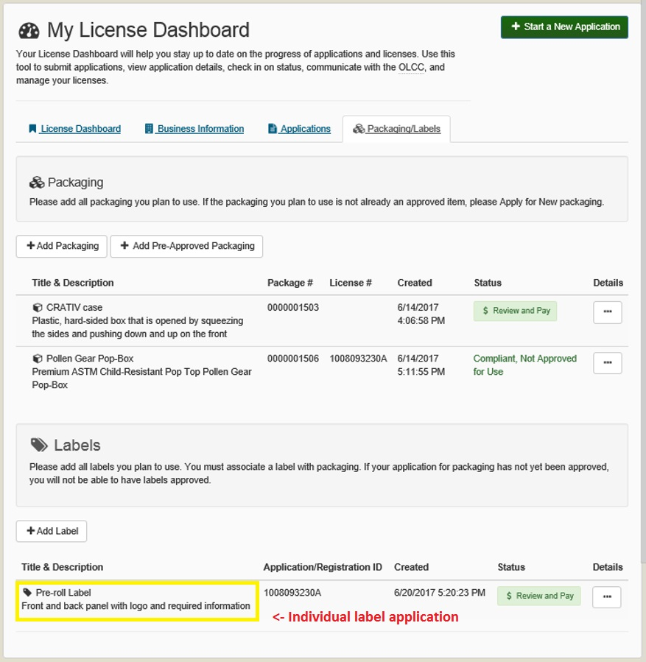
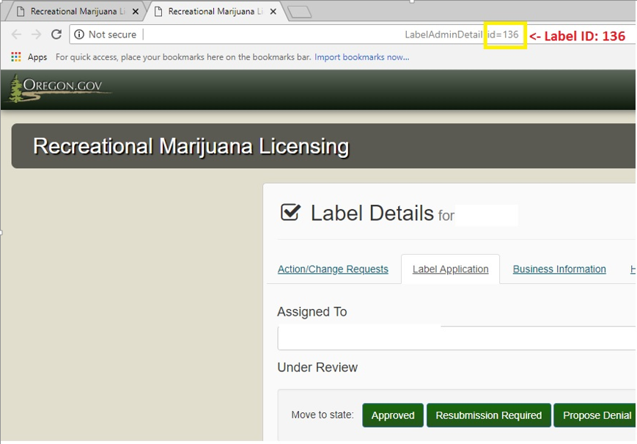
Where is the Label ID!?!?!
Browser’s Address Bar
The Label ID number can be found within each individual label application at the end of the URL in your browser’s address bar.

Slide 18
“This package is not child resistant.”
If the container holding the marijuana item is does not meet the child resistant standards in the rules, the outermost label must have the statement - “This package is not child resistant.”
If the package you list under “Packages” in your label application is not certified child resistant, you must use this warning.

Slide 19
This package is not child resistant…
For example: you have an plastic jar inside of a box, neither has been approved as child resistant in the OLCC’s online system.
The outermost label on the box must have the statement.
However, if the plastic jar has been approved as child resistant in the OLCC’s online system, the box would not need the warning. Why? The container holding the marijuana item meets the child resistant standards.

Slide 20
Common Issues – Adults & Driving Warnings
The rules that went into effect on August 15, 2018 slightly changed both of these warnings.
From “For use by adults 21 and older” to “For use only by adults 21 and older.”
From “It is illegal to drive a motor vehicle while under the influence of marijuana” to “Do not drive a motor vehicle while under the influence of marijuana.”
All required warnings and statements must exactly match the text of the rule. No abbreviations or slight variations.

Slide 21
Confusing Weight and Volume
Weight is expressed in grams and ounces (sometimes milligrams)
For example – 1 gram (0.04 oz)
Always put Net Weight or Net Wt. before grams and ounces
Liquid is expressed in fluid ounces and milliliter
For example – 1 fl oz (29.6mL)
DO NOT put Net Weight before fluid measurements.
Weight / Volume must be bolded and on the bottom 30% of the principal display panel.

Slide 22
Product Identity
The product identity is the truthful or common name of the product that is contained the package.
The product identity must be in lines generally parallel to the base of the container.
The product identity must clearly identify whether the item is derived from marijuana or hemp. “Cannabis” may be used in place of “marijuana.”
Marijuana Edible
Hemp Tincture
If the product is a cannabinoid extract or concentrate, the product identity must clearly identify it as such.
Marijuana Concentrate
Cannabis Extract

Slide 23
Hemp
If the item is solely derived from hemp the label must:
Have a product identity that clearly indicates the product is derived from hemp.
“Hemp Tincture,” “Hemp CBD Chocolate Bar,” or “Hemp Extract.”
Have the following warnings in place of the other required warnings: “This product is derived from hemp and could contain THC. Keep out of reach of children.”
You must still have the “FDA Statement.”
The rules specifically call out what “warnings” are.
If the product contains both marijuana and hemp, it is labeled as a marijuana item and most likely as an “Other Cannabinoid Product”
Use the hemp symbol on the principal display panel instead of the universal symbol.

Slide 24
Pre-rolls
Pre-rolls must list two weights
1)the net weight and 2) weight of usable marijuana.
The net weight is the weight of the usable marijuana + paper + filter/tip.
The weight of usable marijuana must be listed in grams.
Multi-packs of pre-rolls must make it clear how much usable marijuana is in each pre-roll.
For example “Contains (5) ½ gram usable marijuana pre rolls.

Slide 25
Pet Food
OLCC licensed retailers cannot sell pet or animal food, treats, or other pet or animal products containing hemp or marijuana.
See OAR 845-025-2800.
Labels will not be approved for products that appear to violate this prohibition.
Licensees may be in violation of the rules if the market their products in a manner that suggests or implies the products are for pets or animals.
This includes encouraging bud tenders to market products these ways, websites, leafly, and social media.

Slide 26
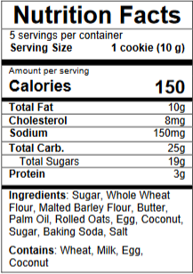
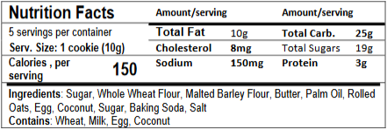
Edibles – Nutrition Templates
Labels must use the nutrition templates provided by the OLCC, which can be found on the packaging and labeling website.
The templates must exactly match the ones provided by the OLCC.
When listing serving size on the nutrition template, the weight of the serving should follow the suggested serving size.
For example “Serving Size: 1 cookie (10g)
The tabular and linear displays should only be used on small containers that do not have enough space for a full label.
Vertical Display
Tabular Display for Small Packages
Linear Display for Small Packages

Slide 27
Small and Tiny Containers
All containers holding a marijuana item must have a label.
Labels must be affixed to the container holding the marijuana item.
The small container rules can be found at OAR 845-025-7030(11).
The tiny container rules can be found at OAR 845-025-7030(12).
See page 9 of the Label Checklist and Generic Label Examples.

Slide 28
Small and Tiny Containers…
The small/tiny container labeling rules are abbreviated, the label on the outer container must contain all the information required by rule.
For small and tiny jars holding extracts, the lid is typically the principal display panel.
All other required information can be placed on a wrap around label or a circular label attached to the base of the jar.

Slide 29
Topical Labeling
The concentration of THC and CBD in the container must be listed as a percentage.
You can list the mg afterwards or elsewhere on the label, but you must list the percentage.
OHA’s recreational concentration limit is 6%
You must provide an amount suggested for use by a consumer at any one time.
“a dime sized amount”
“a tablespoon”

Slide 30
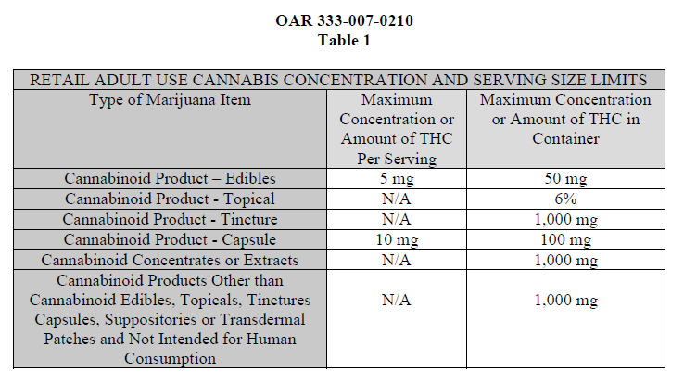
Concentration and Serving Size Limits
The Oregon Health Authority (OHA) sets the concentration and serving size limits.
Capsules are labeled
under the tincture rules.
Suppositories are subject
to the edible limits and are
labeled as an “Other
Cannabinoid Product.”
Transdermal patches are
labeled as a topical but are
subject to edible limits.

Slide 31
Moonrocks, Asteroids, Infused Joints, etc…
If a marijuana item has “added substances” as defined by OAR 845-025-7000 it is labeled as an “Other Cannabinoid Product” under OAR 845-025-7120.
Among other requirements, 7120 requires the label to list the processor’s place of address and packager’s address, if different from processor and the ingredients in descending order of predominance by weight or volume.

Slide 32
Moonrocks, Asteroids, Infused Joints, etc…
All “Other Cannabinoid Products” must be tested for final potency (THC and CBD).
These potency values and the lab that performed the test and test date must be prominently displayed on the label.
The product identity must clearly identify the product as being derived from marijuana or industrial hemp.

Slide 33
Other Cannabinoid Product Guidance
Extracts & Concentrates with “added substances” – this typically includes “non-marijuana terpenes” have specific labeling requirements.
See Compliance Bulletin CE2018-09 for the requirements.

Slide 34
Advertising
OLCC licensees are subject to advertising restrictions. See OAR 845-025-8040.
The following statements must be on all print, billboard, television, radio and internet advertising in font size legible to the viewer:
“Do not operate a vehicle or machinery under the influence of this drug.”
“For use only by adults twenty-one years of age and older.”
“Keep out of reach of children.”
This includes social media, ie Instagram and Facebook.

Slide 35
Advertising…
Among other things, advertising cannot be attractive to minors.
This includes online menus, such as Weedmaps and Leafly
Listing strain names that are attractive to minors is a violation of this rule!
Licensees who advertise via web page must have an “age gate” which asks if users are 21+ years or older (or a valid OMMP cardholder)
See OAR 845-025-8060 for the specifics.

Slide 36
Best Practices for Packaging and Labeling Submissions
Use the digital resources on the Packaging and Labeling Portion of the OLCC’s recreational marijuana website.
Label Checklist and Generic Label Examples.
Packaging and Labeling Guide.
Guide to Package and Label Pre-Approval Process.
Packaging and Labeling Rules – OAR 845-025-7000 – 7190.
Sign up for Gov. Delivery.
Review compliance bulletins.
Metrc Product Categorization & Tax Guide.

Slide 37
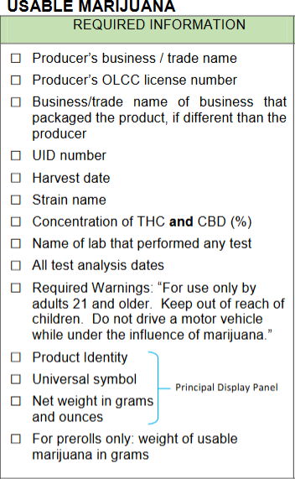
Best Practices for Packaging and Labeling Submissions…
Use the label checklist!
Keep in mind the checklist does not capture every aspect of the packaging and labeling rules(Label ID, this package is not child resistant, etc…)
Walk through the checklist before you formally submit a label application (I do it went reviewing your label applications).

Slide 38
Contact
Marijuana.packaging@Oregon.gov or 503-872-5459.
Email is typically faster.
When communicating via email, please include your business name and license number. This helps speed the process up.
When leaving voicemail, please state your name and business name as well as a call back number.

Slide 39
Contact
As a courtesy, you may submit label applications before you formally submit them online for critique via email to marijuana.packaging@oregon.gov.
Please be considerate when submitting labels for review.
Review the checklist before submitting labels for review.
Do not submit a large batch of labels.
Avoid requests for expediency.
All applications are reviewed on a first come first served basis.
Plan a realistic lag time between submission and approval.

Slide 40
Consultations
I am happy to provide in person consultations at the OLCC’s main office in Milwaukee or your place of business, if in the Portland metro area.
Please be considerate and schedule consultations well in advance.
Consultations are subject to availability.
Licensees are ultimately responsible for complying with the rules.
If visiting the OLCC, keep in mind there is no public WiFi at the OLCC so make sure to bring all your files digitally or print them out.
Please make sure not to bring any marijuana items to the OLCC’s offices.

Slide 41
Q&A…
Questions?
Marjuana.packaging@Oregon.gov
503-872-5459

