Slide 1
OMD Safety Policy Training
Aerial Lifts &
Scissor Lifts

Slide 2
Standards that Apply
OMD POLICY: AGP-99.200.11 (revised 9.30.2025)
OSHA Standards:
29 CFR 1910.67, 29 CFR 1910.269(p), 29 CFR 1926.21, 29 CFR 1926.453 (Scaffolding), 29 CFR 1926.502.
American National Standards Institutes Standards: ANSI/SIA A92.2-1969, ANSI/SIA A92.3, ANSI/SIA A92.5, ANSI/SIA A92.6.
OR-OSHA 437-003-0073, Boom Supported Elevating Work Platforms. 437-003-0074, Scissor Lifts.

Slide 3
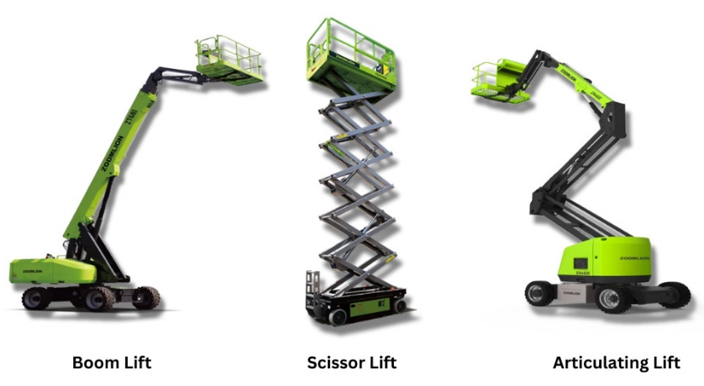
Aerial Lifts & Scissor Lifts
An aerial lift is any vehicle-mounted device used to elevate personnel, including:
• Extendable boom platforms,
• Aerial ladders,
• Articulating (jointed) boom platforms,
• Vertical towers, and
• Any combination of the above.
Notes:
Aerial lifts are commonly used in place of ladders and scaffolding on many job sites due to their mobility and versatility. They can be made of metal, fiberglass-reinforced plastic, or other durable materials. Aerial lifts may be powered or manually operated and are classified as aerial lifts regardless of whether they can rotate around a primarily vertical axis.
Each year, many workers are injured or killed while operating aerial lifts. Between 2011 and 2014, 87 workers died as a result of using an aerial or scissor lift. Of these fatalities, 48 were due to slips, trips, and falls from one level to another.

Slide 4
Hazards
The following hazards, among others, can lead to personal injury or death:
Fall from elevated level,
Objects falling from lifts,
Tip-overs,
Ejections from the lift platform,
Structural failure,
Electric shock,
Entanglement hazards,
Contact with objects, and
Contact with ceilings and other overhead objects

Slide 5
Training
Only trained and authorized persons are allowed to operate an aerial lift.
Notes:
Training should include:
Explanations of electrical, fall, and falling object hazards;
Procedures for dealing with hazards;
Recognizing and avoiding unsafe conditions in the work setting;
Instructions for correct operation of the lift (including maximum intended load and load capacity);
Demonstrations of the skills and knowledge needed to operate an aerial lift before operating it on the job;
When and how to perform inspections; and
Manufacturer’s requirements

Slide 6
Retraining
Workers should be retrained if any of the following conditions occur:
Accident
Hazards Identified
Different equipment used
Employers are also required to retrain workers who they observe operating an aerial lift or scissor lift improperly.
Notes:
Workers should be retrained if any of the following conditions occur:
An accident occurs during aerial lift use,
Workplace hazards involving an aerial lift are discovered, or
A different type of aerial lift is used.

Slide 7
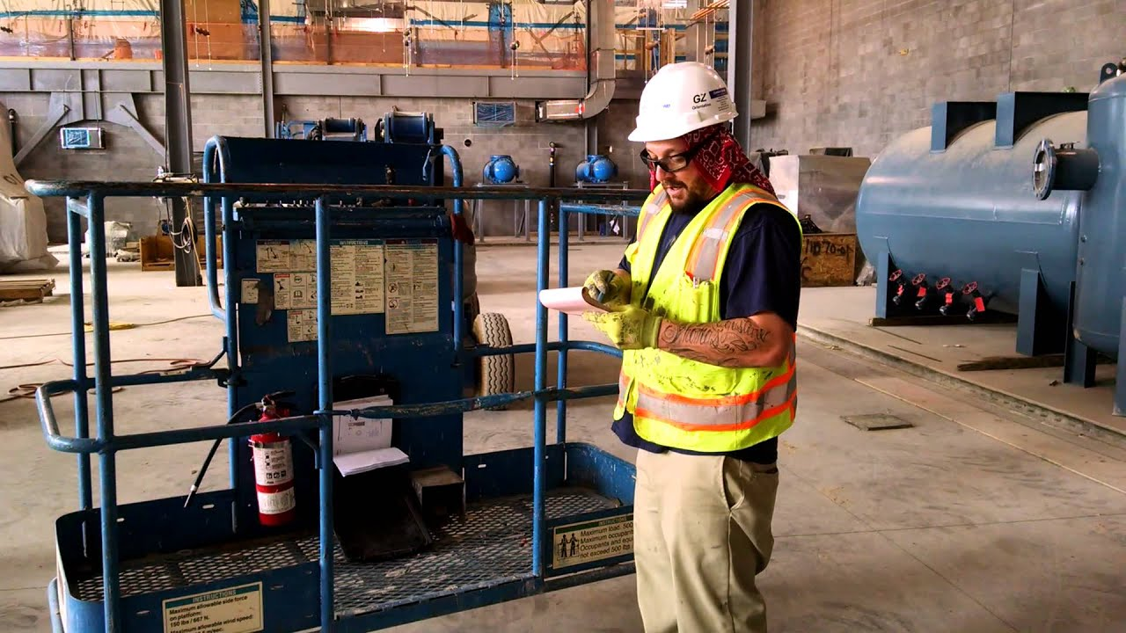
Pre-Operation Inspection
Prior to each work shift, conduct a pre-start inspection to verify that the equipment and all its components are in safe operating condition.

Slide 8
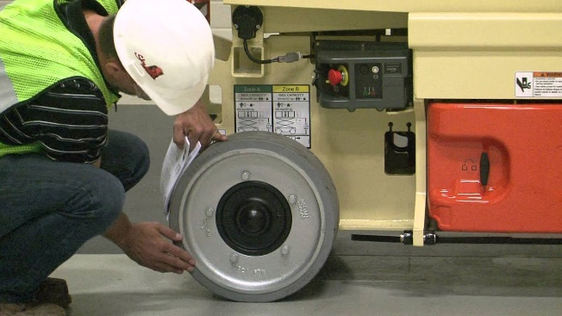
Pre-Operation Inspection
A pre-start inspection should include a check of:
Vehicle Components:
Proper fluid levels (oil, hydraulic, fuel and coolant);
Leaks of fluids;
Wheels and tires;
Battery and charger;
Lower-level controls;
Horn, gauges, lights and backup alarms;
Steering and brakes
Lift Components:
Operating and emergency controls;
Personal protective devices;
Hydraulic, air, pneumatic, fuel and electrical systems;
Fiberglass and other insulating components;
Missing or unreadable placards, warnings, or operational, instructional and control markings;
Mechanical fasteners and locking pins;
Cable and wiring harnesses;
Outriggers, stabilizers and other structures;
Loose or missing parts;
Guardrail systems

Slide 9
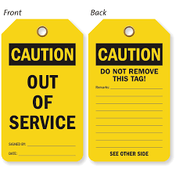
Pre-Operation Inspection
Do not operate any aerial lift if any of the inspected components are defective until it is repaired by a qualified person. Remove defective aerial lifts from service (tag out) until repairs are made.

Slide 10
Work Zone Inspections
Employers must assure that work zones are inspected for hazards and take corrective actions to eliminate such hazards before and during operation of an aerial lift. Items to look for include:
<Read list located in notes>
Notes:
Drop-offs, holes, or unstable surfaces such as loose dirt;
Inadequate ceiling heights;
Slopes, ditches, or bumps;
Debris and floor obstructions;
Overhead electric power lines and communication cables;
Other overhead obstructions;
Other hazardous locations and atmospheres;
High wind and other severe weather conditions, such as ice; and
• The presence of others in close proximity to the work.

Slide 11
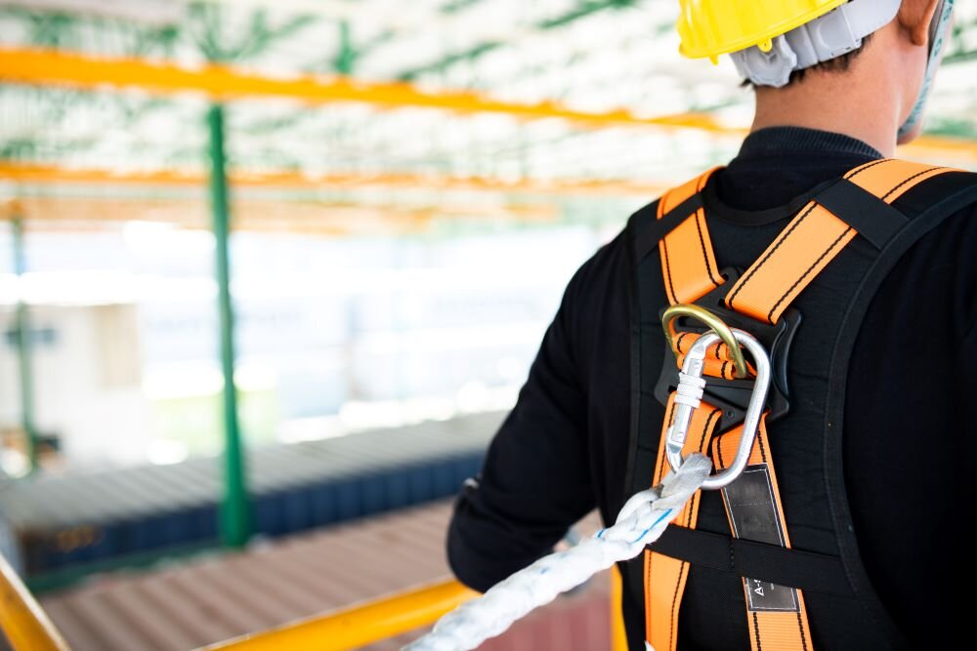
What to Do While Operating an Aerial Lift
Fall Protection:
Ensure that access gates or openings are closed.
Stand firmly on the floor of the bucket or lift platform.
Do not climb on or lean over guardrails or handrails.
Do not use planks, ladders, or other devices as a working position.
Use a body harness or a restraining belt with a short, fixed lanyard attached to the boom or bucket to prevent falling out (fall restraint system)
Do not belt-off to adjacent structures or poles while in the bucket.

Slide 12
What to Do While Operating an Aerial Lift
Operation/Traveling/Loading:
Do not exceed the load-capacity limits. Take the combined weight of the worker(s), tools and materials into account when calculating the load.
Do not use the aerial lift as a crane.
Do not carry objects larger than the platform.
Do not drive with the lift platform raised (unless the manufacturer’s instructions allow this).
Do not operate lower level controls unless permission is obtained from the worker(s) in the lift (except in emergencies).
Do not exceed vertical or horizontal reach limits.
Do not operate an aerial lift in high winds above those recommended by the manufacturer.
Do not override hydraulic, mechanical, or electrical safety devices

Slide 13
What to Do While Operating an Aerial Lift
Overhead Protection:
Be aware of overhead clearance and overhead objects, including ceilings.
Do not position aerial lifts between overhead hazards if possible.
Treat all overhead power lines and communication cables as energized and stay at least 10 feet (3 meters) away.
Ensure that the power utility or power line workers de-energize power lines in the vicinity of the work.

Slide 14
What to Do While Operating an Aerial Lift
Stability in the Work Zone:
Set outriggers on pads or on a level, solid surface.
Set brakes when outriggers are used.
Use wheel chocks on sloped surfaces when it is safe to do so.
Set up work zone warnings, such as cones and signs, when necessary to warn others

Slide 15
Qualified Person Checklist
Attachment 4 of the OMD Aerial Lift Policy has a “Qualified Person Checklist for Aerial Device / Scissor Lift Operation and Repair.” Ensure a copy of this is signed and filed on site and with the OMD Safety Manager.

Slide 16
Sources
OSHA: https://www.osha.gov/sites/default/files/publications/aerial-lifts-factsheet.pdf
CDC:
Aerial Lift Safety | Falls | CDC

Slide 17
Questions?

