Slide 1
OMD Safety Training
Asbestos Awareness

Slide 2
Outline
Asbestos Awareness
What is Asbestos?
Health Effects of Asbestos
Avoid Exposure
Locations of ACM and PACM
Recognition of Damaged or Deteriorated ACM or PACM
Emergency Response Procedures
Regulatory Requirements
Points of Contact
Questions / Discussion

Slide 3
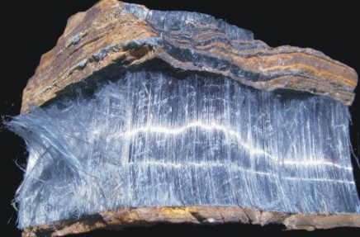
What is Asbestos?
Group of 6 naturally-occurring fibrous minerals
found in certain types of rock formations and include:
Serpentine Group
Chrysotile (White)
Amphibole Group
Amosite (Brown)
Crocidolite (Blue)
Anthophyllite
Tremolite
Actinolite
Notes:
All asbestos occurs naturally in underground deposits.
Of these six types of asbestos, three are commonly encountered in building materials, including:
Chrysotile (white)
Amosite (brown)
Crocidolite (blue)
Asbestos is the generic term for a group of naturally occurring fibrous minerals with high tensile strength, flexibility, and resistance to thermal, chemical, and electrical conditions.
Asbestos fibers can easily become airborne when disturbed. This can happen during use of asbestos products, mining for asbestos or during normal job duties in industries where asbestos was used. Fibers can also become airborne during natural disasters, renovations, or demolition.
Asbestos is still present as contaminants.

Slide 4
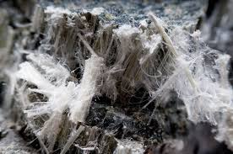
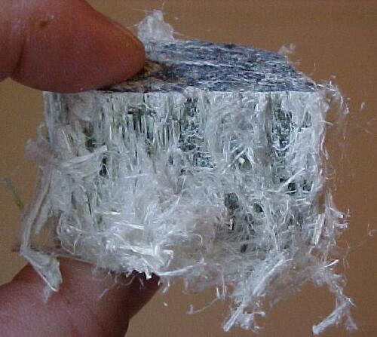
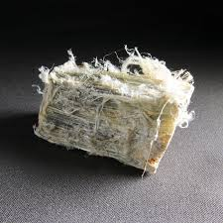
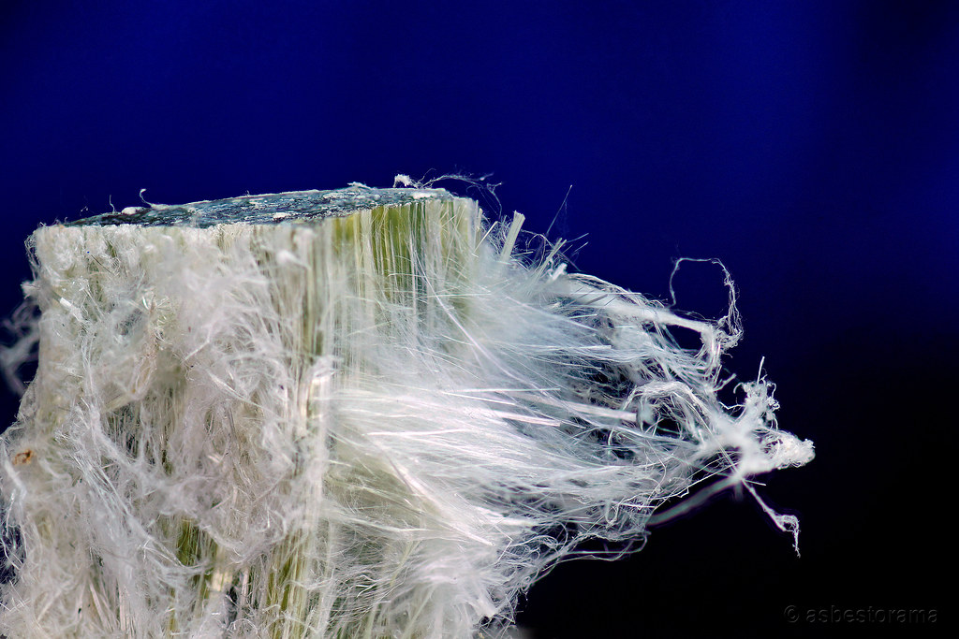
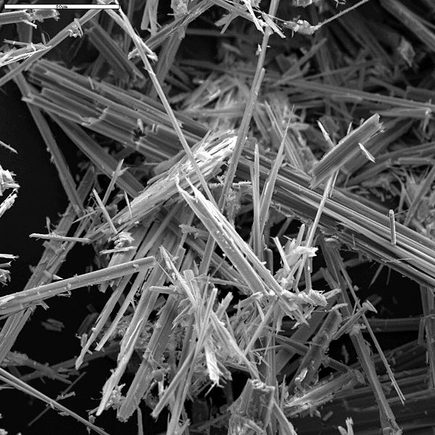
What is Asbestos?
Notes:
Many environmental and safety regulations refer to asbestos products as either Asbestos-Containing Materials (ACM) or Presumed Asbestos-Containing Materials (PACM).
The Oregon Department of Environmental Quality (ODEQ) and Oregon Occupational Safety and Health Division (OR-OSHA) define an ACM as any material containing more than 1% asbestos by weight.

Slide 5
What is Asbestos
Asbestos is often found below applications. (Not a full list)
Building products
Adhesives
Ceiling/Wall texture and ‘popcorn ceiling’
Cement product (siding, roofing shingles)
Floor tile and mastic
Boilers
Pipe insulation
Sprayed-on fire proofing
Brake linings and clutch pads
Notes:
Some common types of ACMs include:
Building Products such as:
Wall and ceiling insulation
Floor and ceiling tiles and mastic adhesives
Troweled-on surfacing materials
Roofing products, roofing felts, flashing, and flues
Cement roofing, siding and pipes referred to as transite
Window glazing compound, gaskets, gypsum wall board and joint taping compound, fireproof drapes and curtains.
Sprayed-on fire proofing and insulation in buildings
Insulation on boilers, pipes and valves
Brake linings and clutch pads

Slide 6
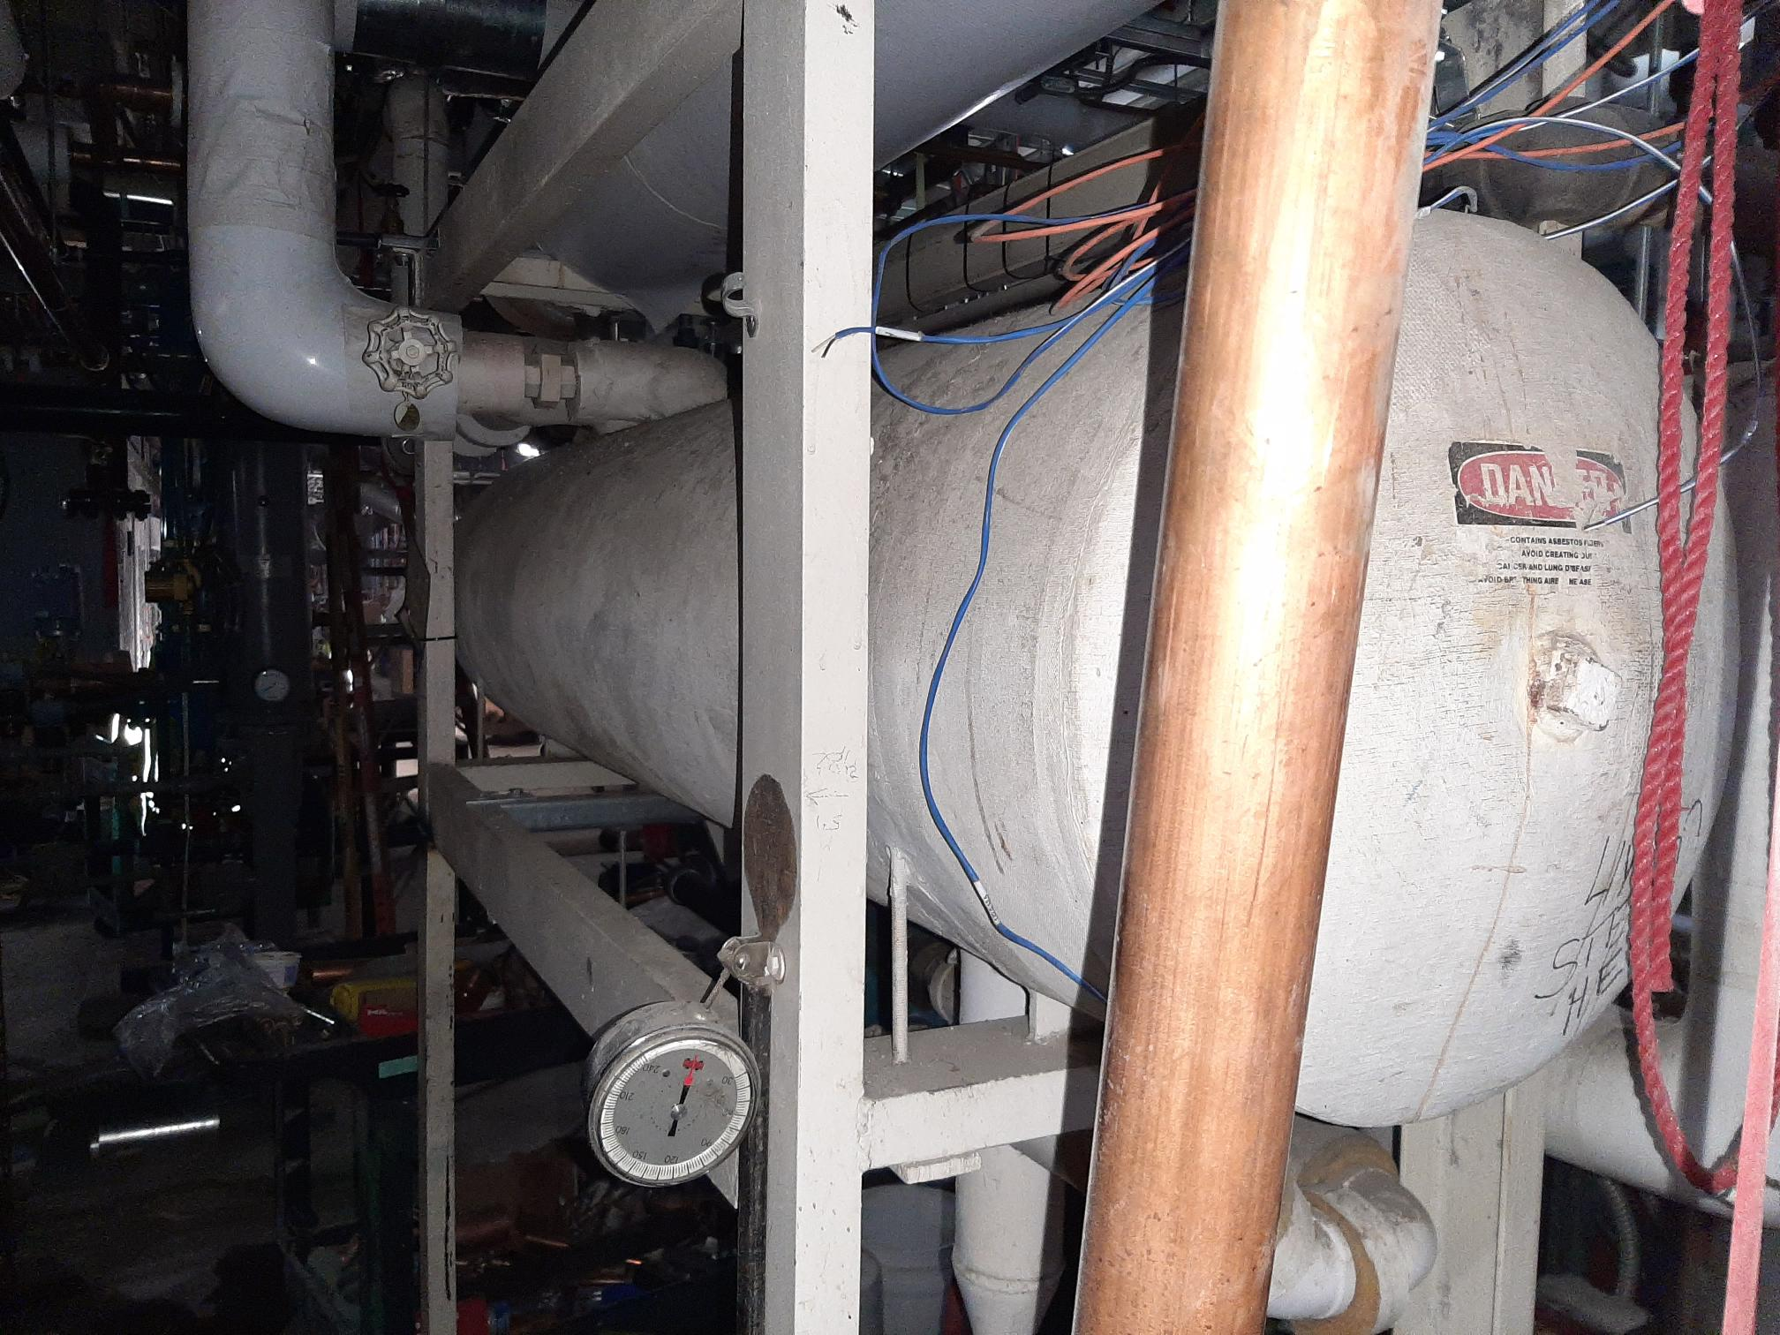
Properties of Asbestos
Resistant to heat & electrical current
Notes:
Characteristics of Asbestos Fibers:
Virtually indestructible and resistant to chemicals and heat
Do not evaporate in air, dissolve in water and are not broken down over time
Superior insulator and has been used in thousands of products
Break into very small fibers that must be identified using a microscope and may be up to 700 times small than a human hair
Once released into the air, fibers may remain suspended for hours or days

Slide 7
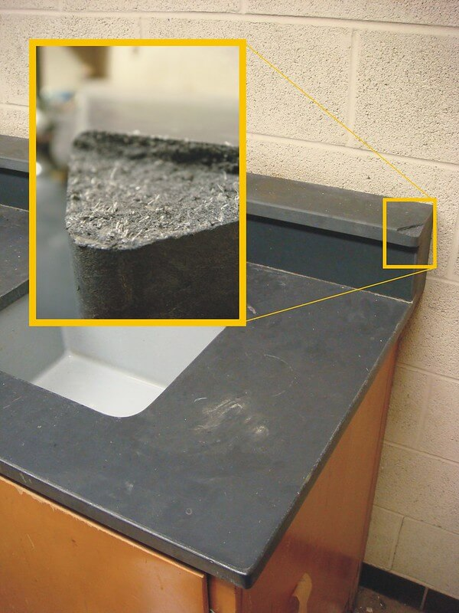
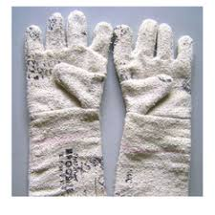
Properties of Asbestos
Resistant to chemicals / Won’t easily break down or dissolve

Slide 8
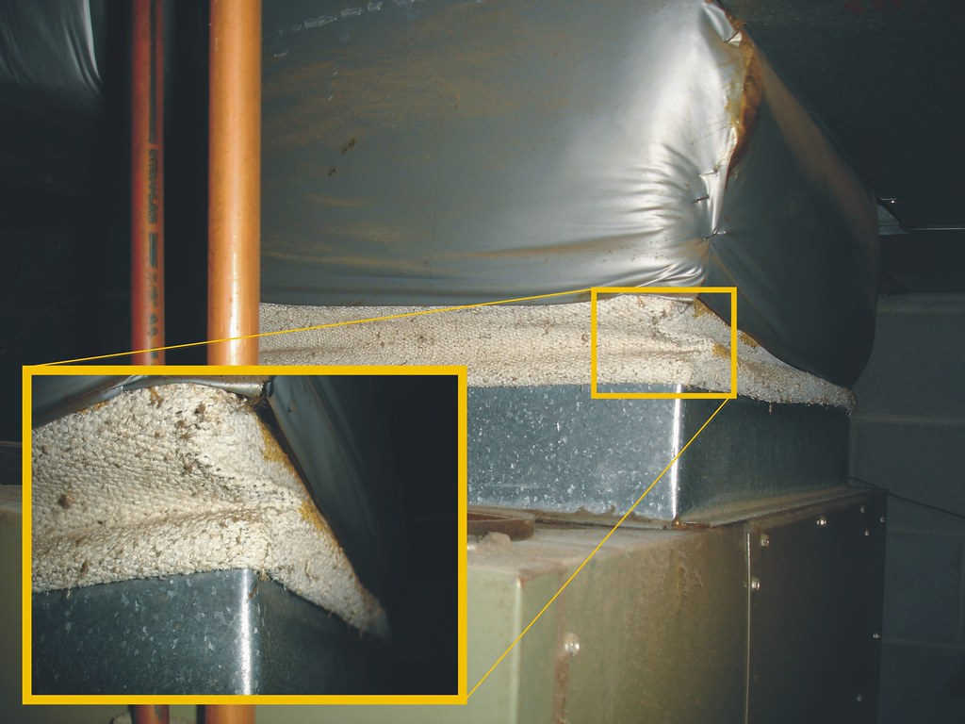
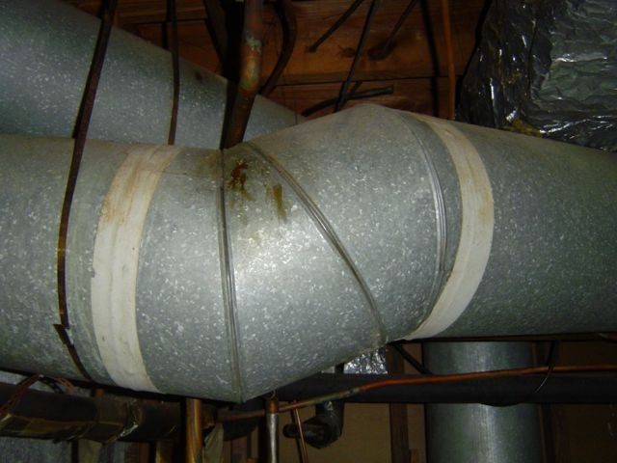
Properties of Asbestos
Tensile strength / Flexible

Slide 9
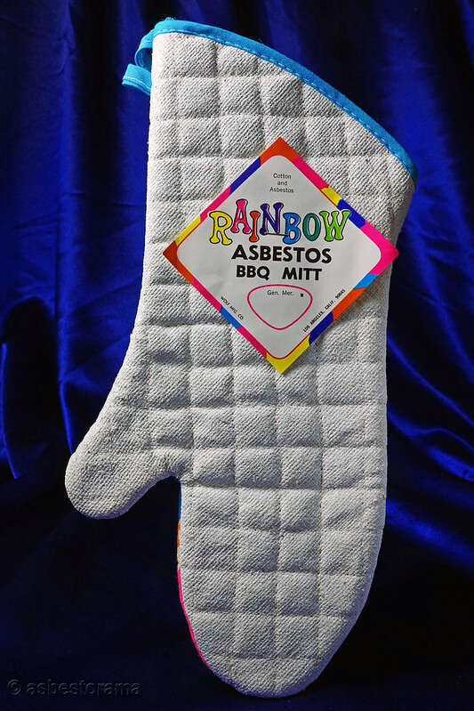
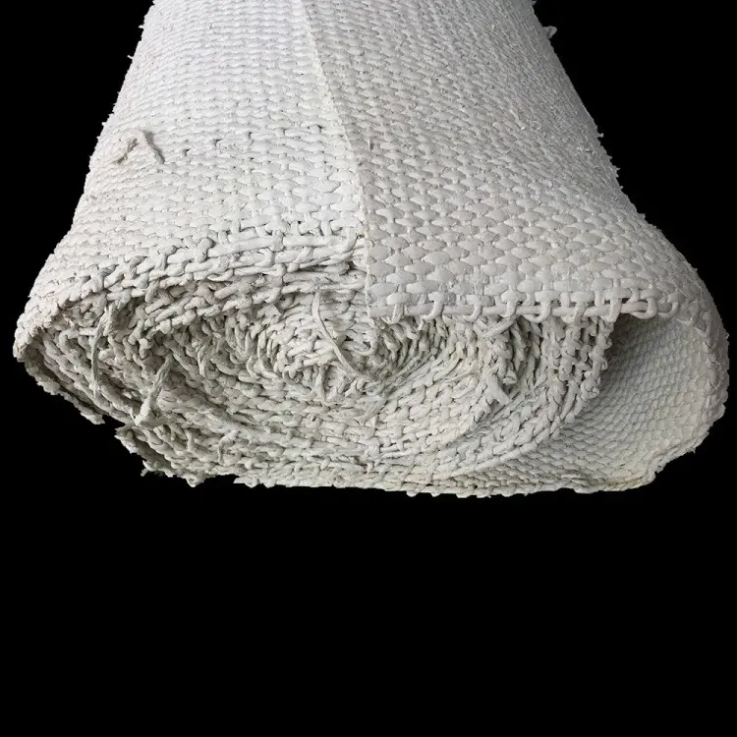
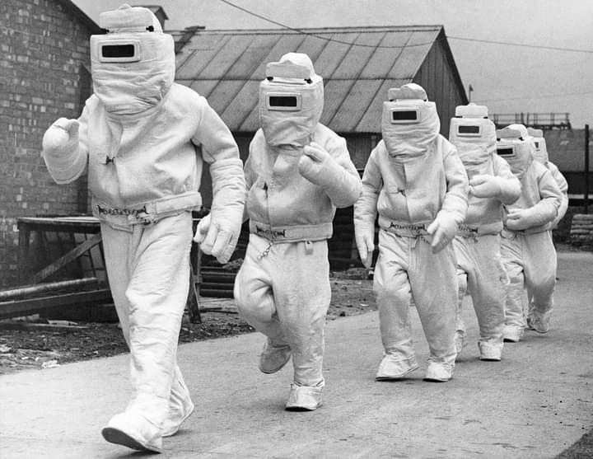
Properties of Asbestos
Easily woven to make fabric
Notes:
Historically, many household and industrial items used asbestos to make fabrics.

Slide 10
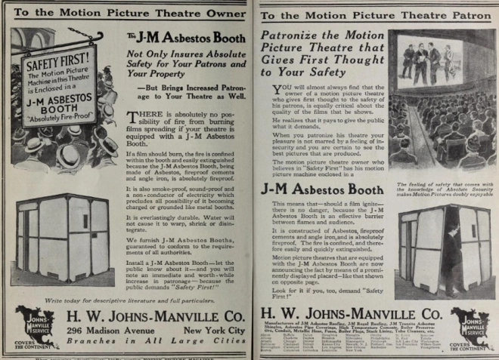
Properties of Asbestos
Absorbs sound / Fire resistant

Slide 11
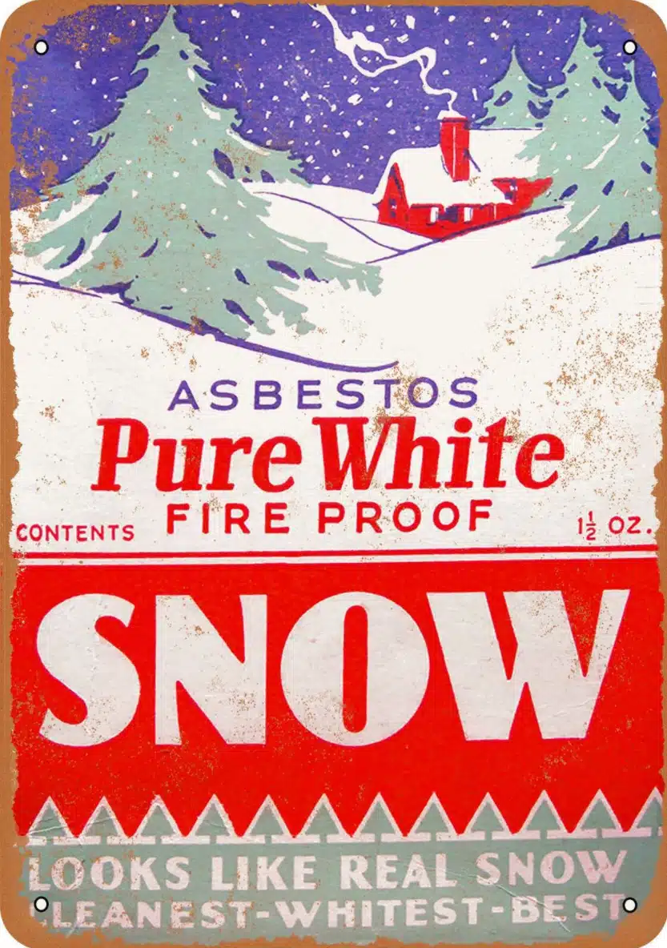
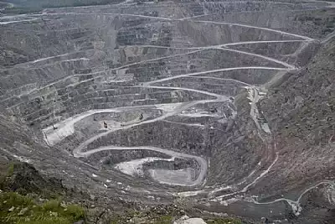
Properties of Asbestos
Cheap to produce
Notes:
The snow in the original Wizard of Oz movie was all asbestos.

Slide 12
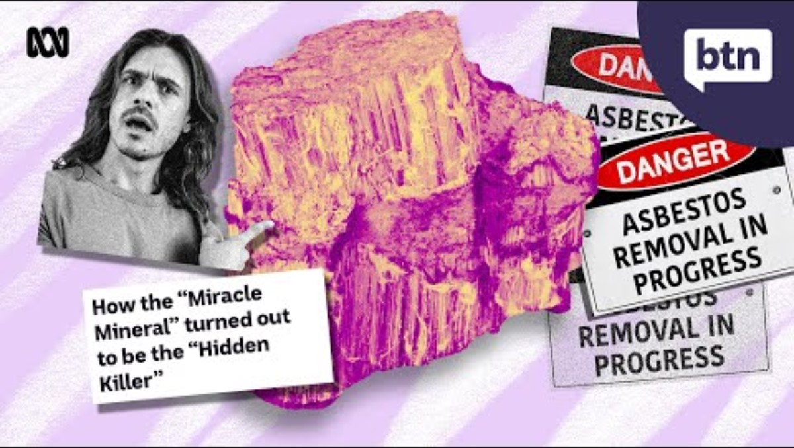
History of Asbestos

Slide 13
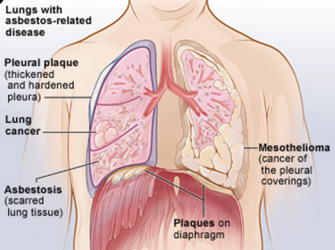
Health Effects
Notes:
The most common way for asbestos fibers to enter the body is through breathing.
Generally, ACM is not considered harmful unless it is releasing dust or fibers into the air where they can be inhaled or ingested.
Many fibers are trapped in the mucous membranes of the nose and throat where they can be removed, or some may pass into the lungs, or, if swallowed, into the digestive tract. Some fibers may remain permanently.
Exposure to asbestos can cause disabling or fatal diseases
Asbestosis
Scarring of lung tissue
Lung cancer
Mesothelioma
Cancerous tumors
Gastrointestinal cancer

Slide 14
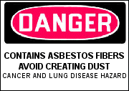
Health Effects
Risk of related diseases increase with:
Concentration of exposure (“Dose” Relationship)
Duration of exposure
Frequency of exposure
Latency period of ~10-40 years
Can result in people taking risks with asbestos
Difficult to identify specific project or job which lead to exposure
Notes:
Because asbestos fibers are so resilient, the body cannot break them down or remove them once they are lodged in lung or body tissues. Exposures are known to cause asbestos-related diseases.

Slide 15


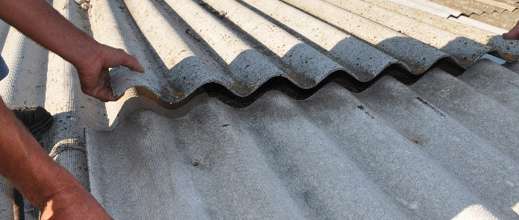
Friable vs. Non-Friable
Friable: material can be easily crumbled or pulverized by hand
Non-Friable: generally bound in a matrix and will not release fibers unless damaged or disturbed. Can become friable!
Floor tiles
Cement asbestos
Asphaltic mastics
Notes:
The physical state of ACMs falls into two categories as described below:
“Friable Asbestos” is any ACM that hand pressure can crumble, pulverize or reduce to powder when dry. Pipe insulation, boiler jackets, and weathered cement building siding are in this category.
“Non-Friable Asbestos” is any ACM that cannot be crumbled, pulverized or reduced to powder by hand pressure. Vinyl floor tile in good condition may meet this definition, but asbestos fibers could be released by cutting, grinding, or breaking.
Friable asbestos is more hazardous than non-friable asbestos.
ACMs that are non-friable, not damaged and not deteriorated, and that are left alone will not release asbestos fibers unless they are disturbed.
ACMs will become damaged or disturbed and may release fibers by actions including cutting, sawing, breaking, grinding, drilling, buffing, vibration, or weathering from exposure to water or air currents.

Slide 16
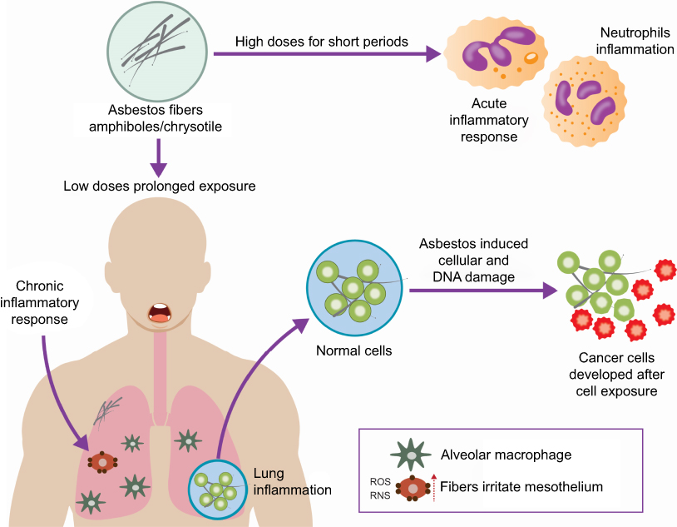

Slide 17
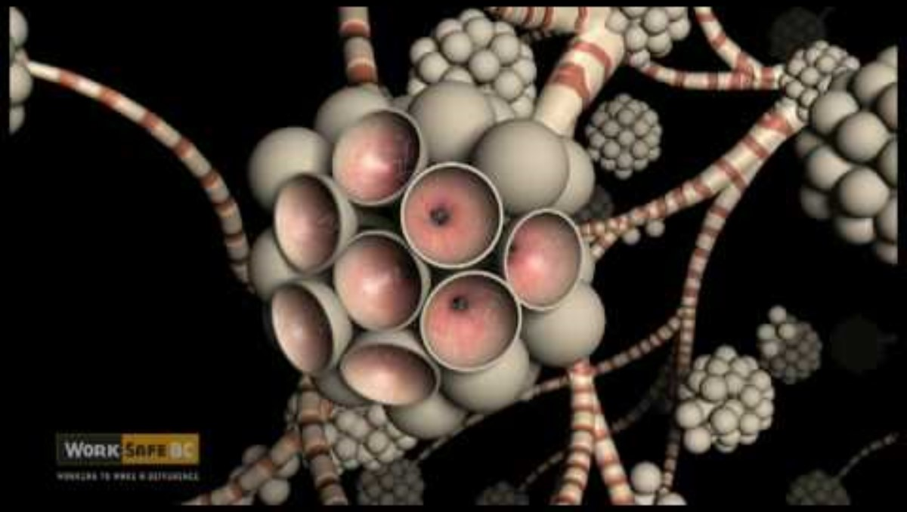
Health Effects

Slide 18
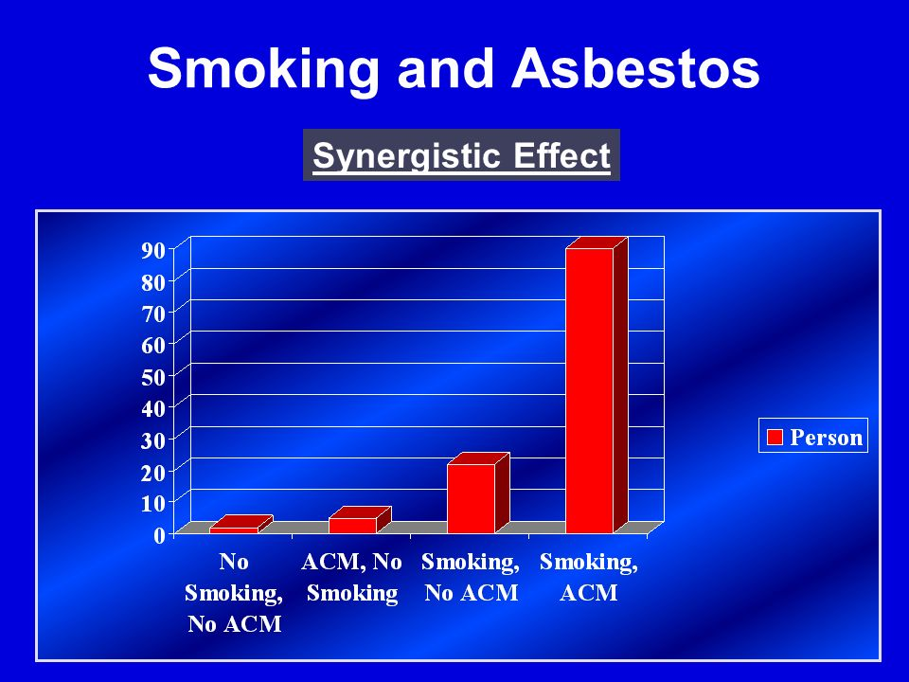
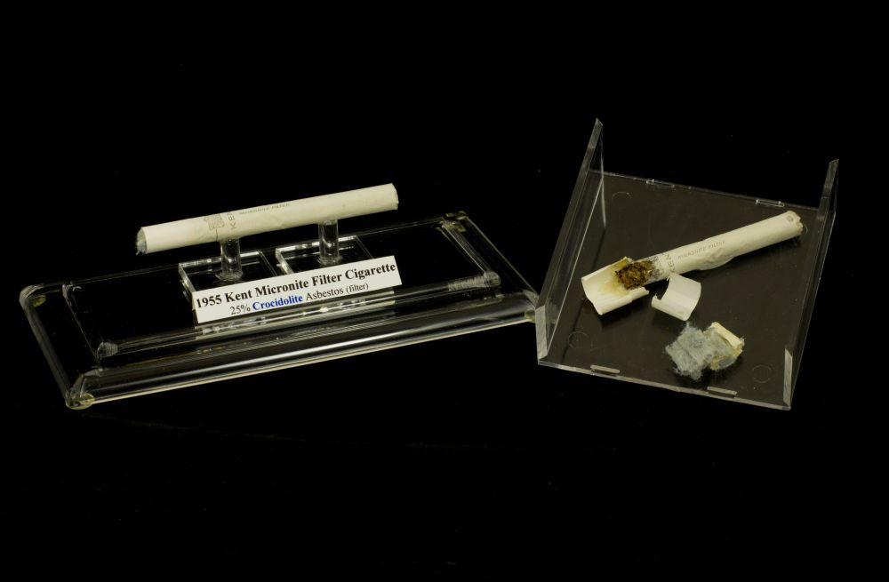
Lung Cancer
Risk of lung cancer increases with asbestos exposure
Up to 90x more likely to develop lung cancer if smoking combined with asbestos exposure compared to non-smokers with little to no exposure
Smoking can inhibit the body’s natural defenses.
Notes:
Lung Cancer
Lung cancer causes the largest number of deaths related to asbestos exposure. The incidence of lung cancer in people who work in mining, milling, manufacturing and use asbestos is much higher than in the general population. Smokers that are exposed to asbestos are about 90 times more likely to develop lung cancer as non-smokers.

Slide 19
Mesothelioma
Form of cancer manifested on the protective tissue of the lungs, abdomen, and/or heart cavities
More rare, but often fatal
Treatment available, but cure improbable
No documented direct connection between smoking and risk of mesothelioma
Notes:
Mesothelioma
Mesothelioma is a rare form of cancer often occurring in the thin membrane lining of the lungs, chest, abdomen and heart (rarely). Most cases of mesothelioma are linked to asbestos exposure.

Slide 20
Asbestosis
Chronic non-cancerous lung disease caused by fiber inhalation
Fibers aggravate lung tissue
and cause scarring
Scar tissue prevents lungs from contracting and expanding normally & inhibits oxygen exchange
Can increase risk of developing lung cancer
Notes:
Asbestosis
Asbestosis is a serious, chronic, non-cancerous respiratory disease. Inhaled asbestos fibers aggravate lung tissues (alveoli) leaving scar tissue, which prevents the oxygen/blood exchange and removal of carbon dioxide.

Slide 21
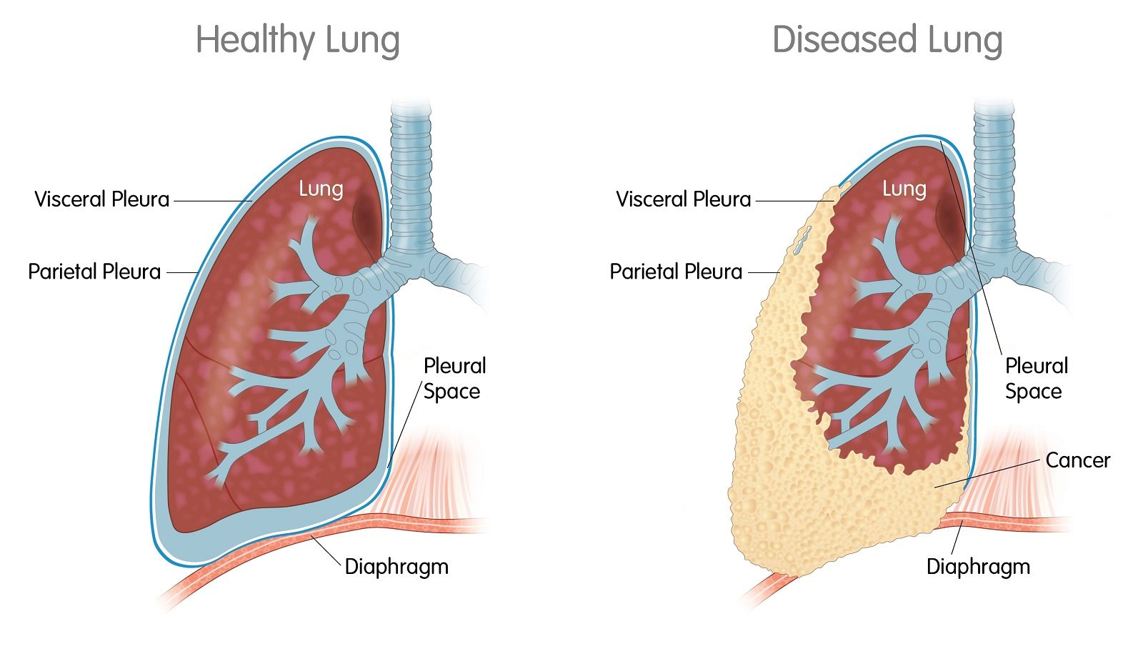

Slide 22
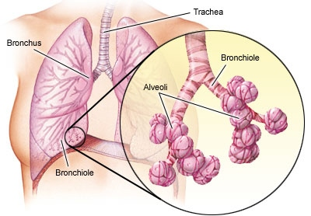

Slide 23
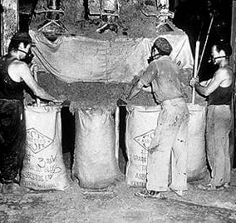
Uses & Materials
Used in ~3,000 different materials
Wood, Glass, and Metal are the only non-suspect materials. All other materials should be sampled prior to impact (even newly-installed).

Slide 24
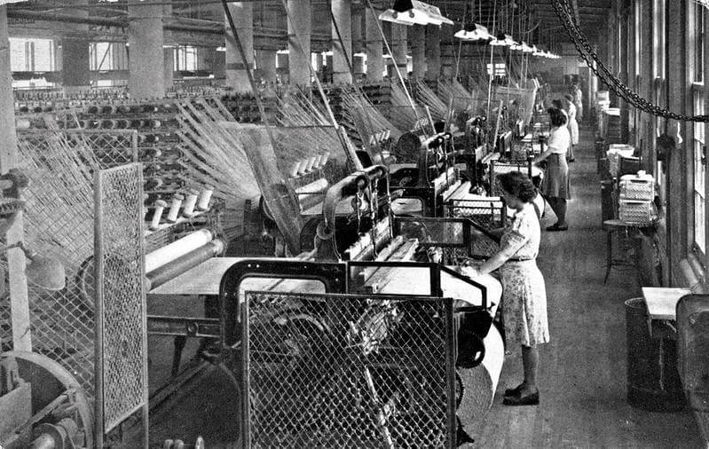
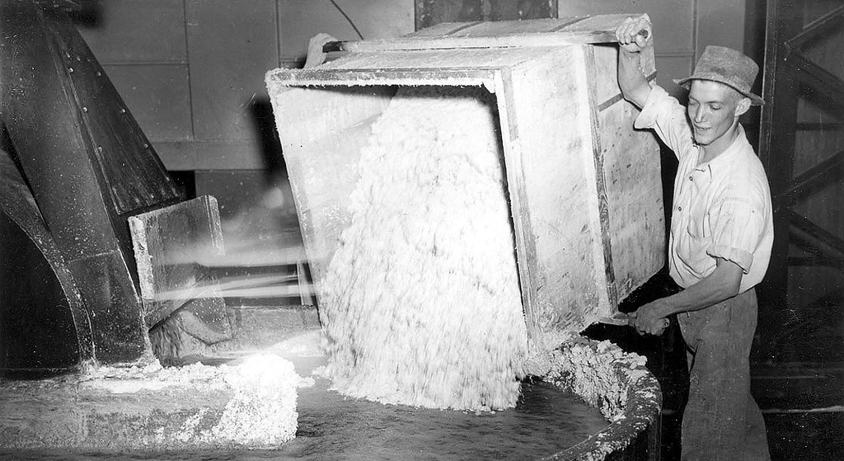
Uses & Materials
Intentionally added to product:

Slide 25

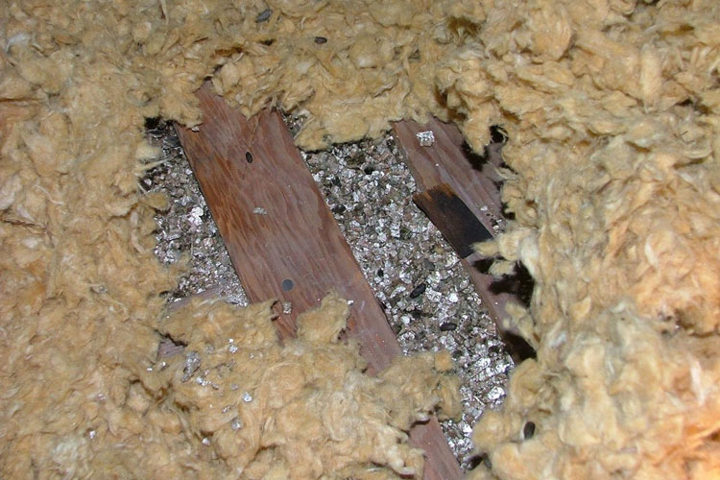
Uses & Materials
Product contaminated during mining

Slide 26
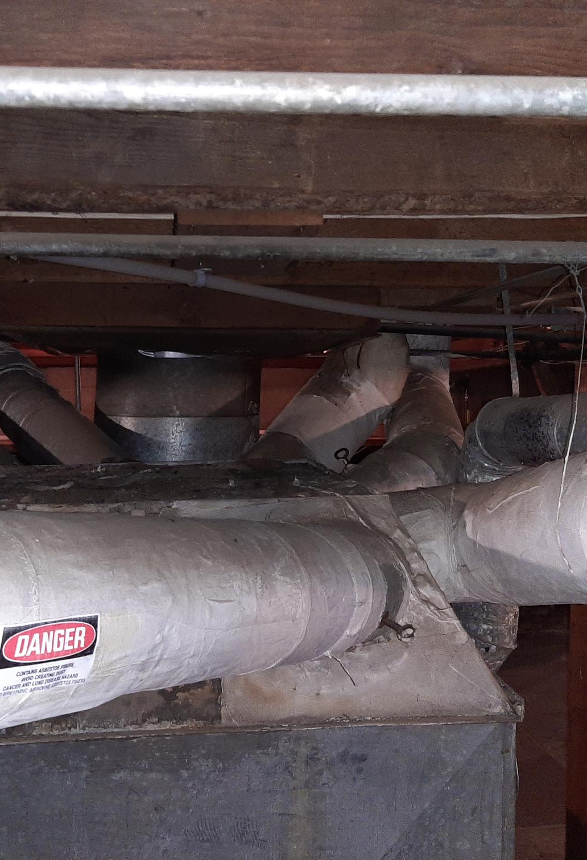
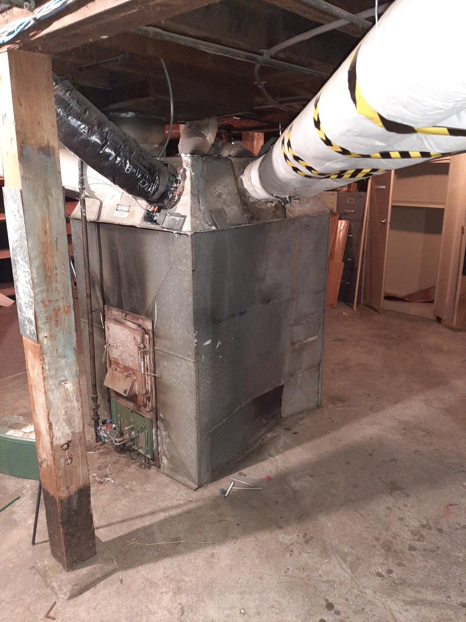
Thermal System Insulation (TSI)
Heating and cooling applications
pipe, boiler, tank insulation
Air duct insulation
chiller/condensate insulation

Slide 27
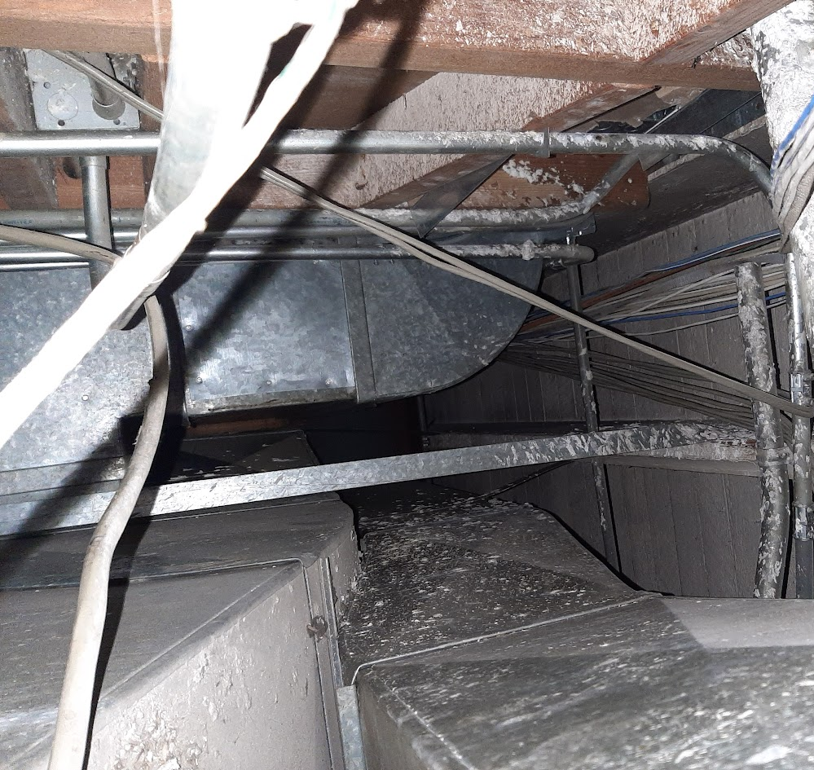
Surfacing Materials
Troweled or sprayed-on applications
Structural steel fire proofing
Textured applications – “popcorn” ceilings, e.g.
Stucco
Plasters

Slide 28
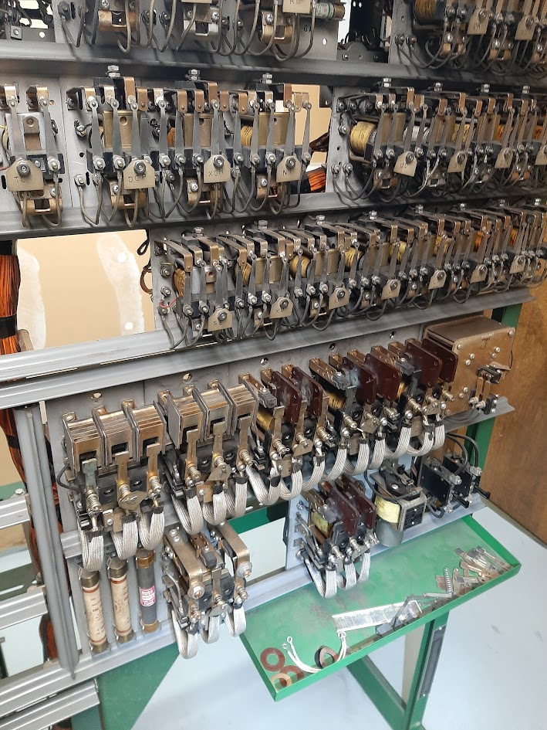
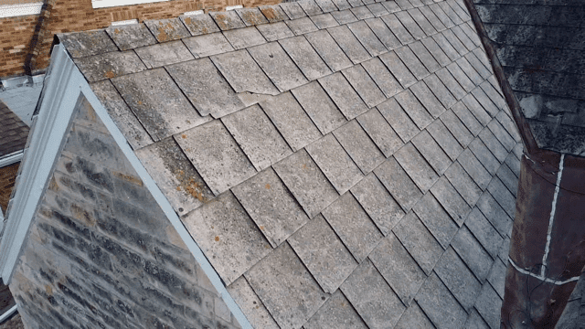
Miscellaneous Materials
Flooring
Roofing
Wallboard
Mastics
Gaskets
Cement asbestos pipe & sheeting

Slide 29
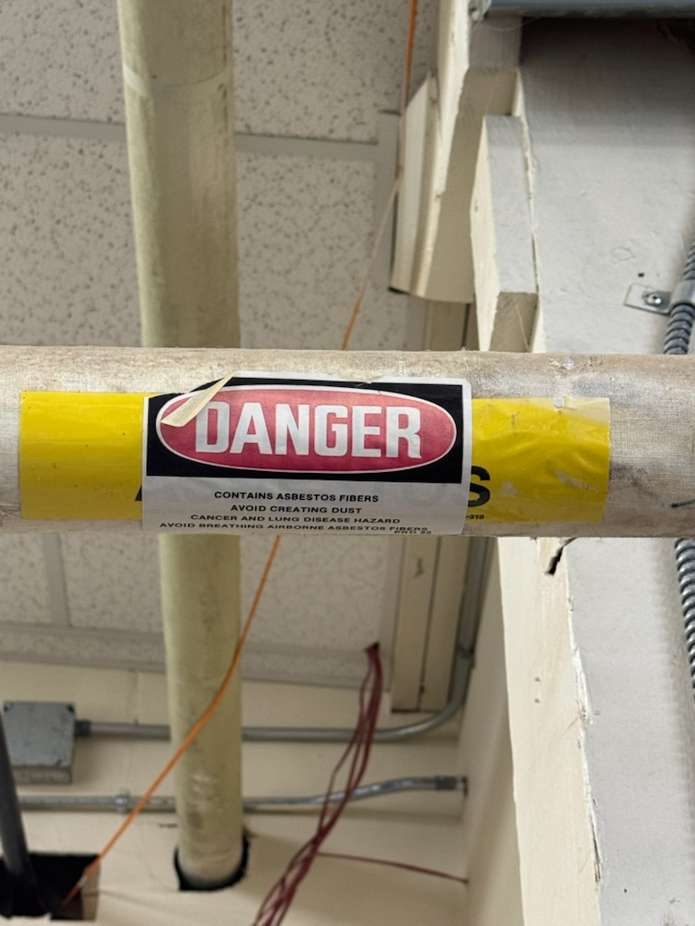
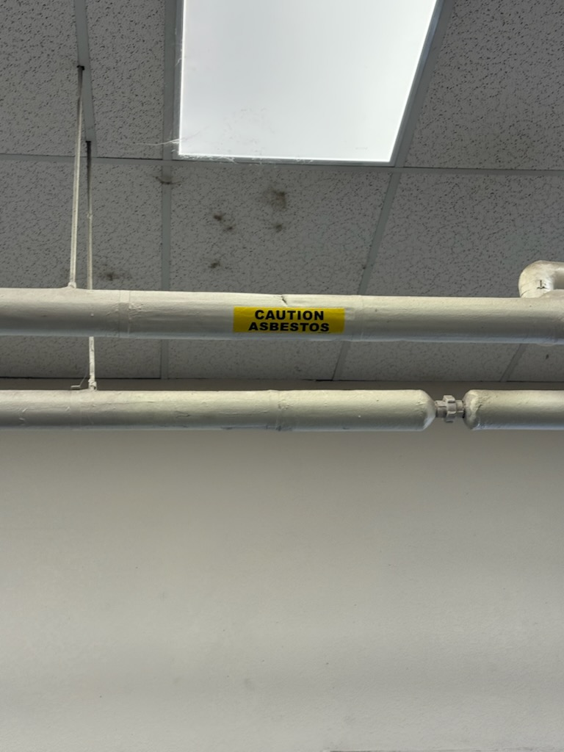
Kingsley Bldg. 220
Kingsley Bldg. 220

Slide 30
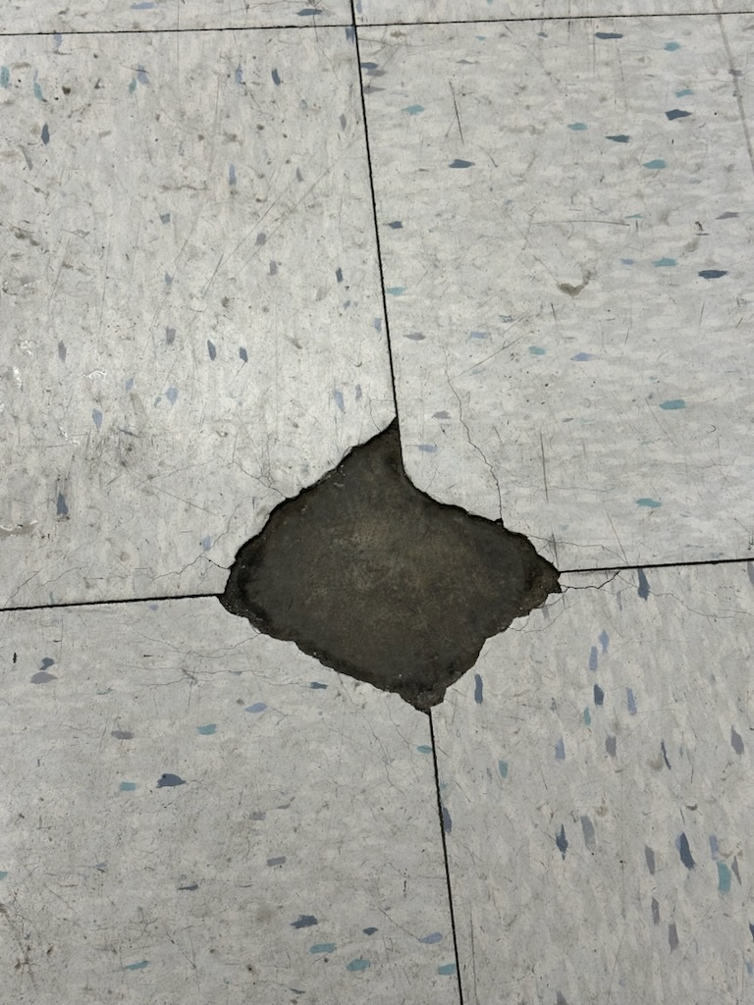
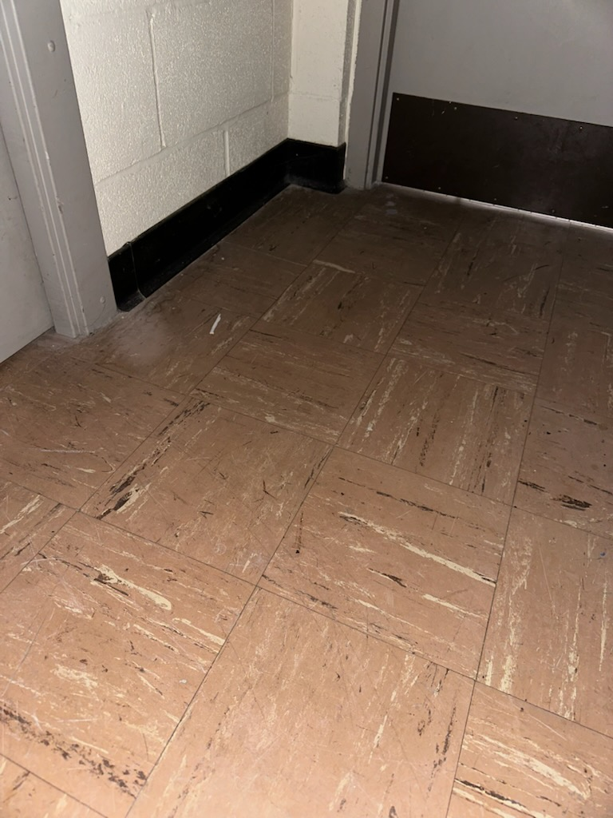
Kingsley Bldg. 302 BX
Kingsley Bldg. 229 Theater

Slide 31
Uses & Materials
Flooring
Floor tiles, mastics, sheet vinyl
Walls
Joint compound, wall texture & coatings
Ceilings
Ceiling tiles, textured ceilings
Other
Pipe & boiler insulation, cement-asbestos pipes
Caulking, roofing, window glazing, electrical components

Slide 32
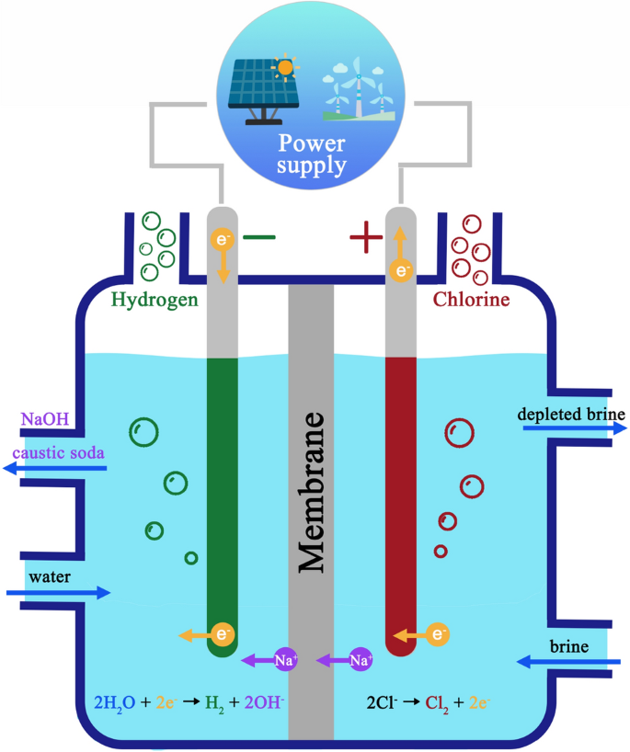

Asbestos in the U.S.
> 1 million-significant occupational exposures
construction
renovation/remodeling
general industry
fire fighters
March of 2024 – EPA ban of on-going uses of Chrysotile
5 years for chlor-alkali plants to comply
Bans brake blocks, aftermarket auto components, and other gaskets within six months
Notes:
The Environmental Protection Agency (EPA) officially classifies the six asbestiform varieties in the Asbestos Hazard Emergency Response Act (AHERA). Efforts to ban the mineral began in the 1980s. In 1989, the EPA attempted to ban all asbestos-containing products, but the ban was overturned. However, mining in the United States has stopped. The last U.S. asbestos mine, located in California, closed in 2002. Just in 2024, the EPA banned the on-going uses of Chrysotile.
Chlorine plants were given more time to develop a new process or find a new solution.

Slide 33

Response to Damaged Materials
Response
Do not attempt to clean up
Leave the area immediately
Contact supervisor
Isolate area (close doors, etc.)
Contact your Operations and Maintenance Manager when damaged suspect materials are discovered
When you need to confirm the status of a building material
When you need consultation for abatement or specific project tasks

Slide 34
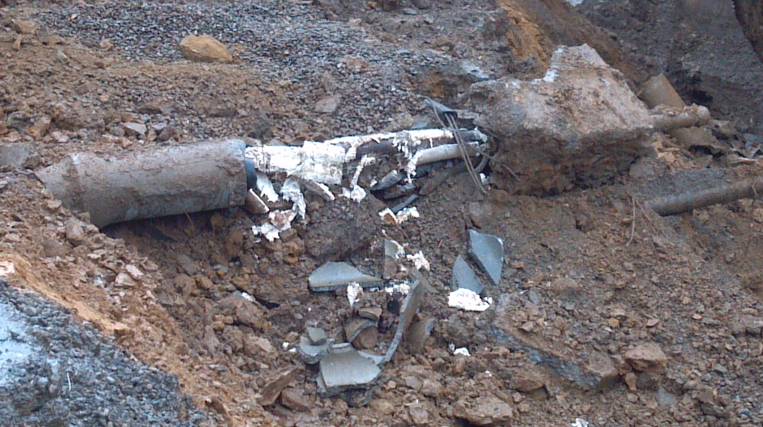
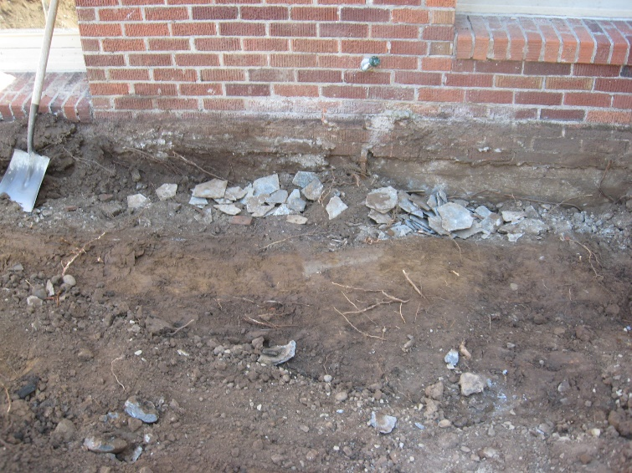
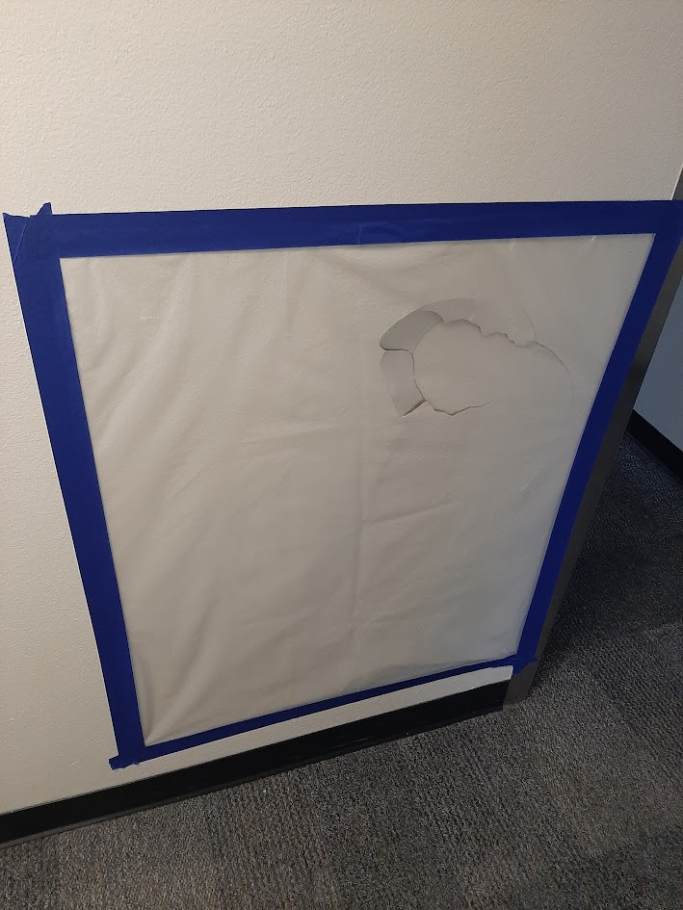
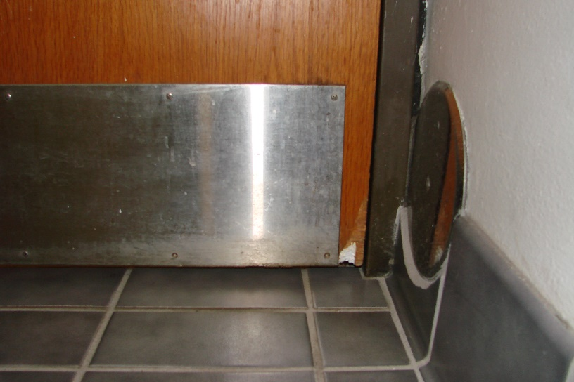
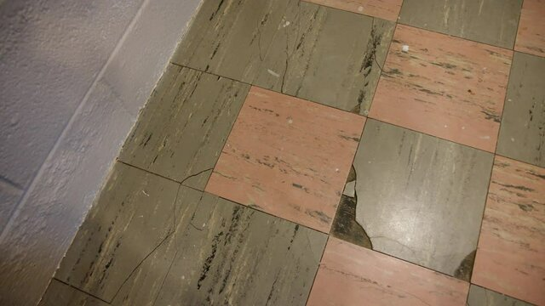
Damaged Materials
Notes:
Top left- pipe damaged during excavation work
Top right- old roofing materials buried during remodeling in the 70s/80s
Bottom left- Drywall damaged during workplace violence incident
Bottom center- Fireproof door damaged over time, exposing ACM
Bottom right- Asbestos floor tiles

Slide 35
Visual Asbestos Identification
Age of building: If the building was built before the 1980s, the likelihood of asbestos-containing materials is higher.
Appearance: Look for materials that appear fibrous.
Damage: Look for signs of damage, deterioration, or disturbance. Damaged asbestos is more likely to release fibers.
Notes:
Different types of asbestos looks different, each has its own appearance. Other types of non-ACM material can resemble asbestos.
Visual identification not definitive. Only way to 100% confirm asbestos and type is through laboratory testing or through licensed professional.

Slide 36
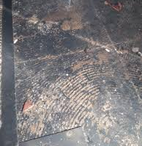
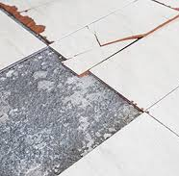
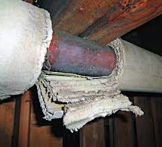
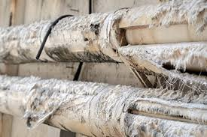

ACM

Slide 37
Avoid Exposure
In order to avoid exposure to asbestos, you must be aware of where ACMs are located in your facilities.
If you are uncertain whether something is ACM, assume it is ACM and do not disturb it until evaluated by an AHERA accredited inspector.
If you or others need to do work that might involve ACM or PACM, coordinate first with your Operations and Maintenance Manager.

Slide 38

Avoid Exposure
Never do the following to ACM or PACM:
Drill
Hammer
Cut
Saw
Break
Grind
Sand
Damage
Move
Disturb

Slide 39
Avoid Exposure
Care of Asbestos-Containing Flooring Material:
Sanding of asbestos-containing flooring material is prohibited.
Stripping of finishes shall be conducted using low abrasion pads at speeds lower than 300 rpm and wet methods.
Burnishing or dry buffing may be performed only on ACM flooring which has sufficient finish so that the pad cannot contact the ACM.

Slide 40
Locations of ACM and PACM
Asbestos surveys have been completed for OMD Installations and are available through multiple sources including AGI Training Site Managers or Operations and Maintenance Branch Chief or the Construction and Maintenance Manager at Kingsley Field and Portland Air National Guard Base, respectively.

Slide 41


Project Time, Now What?
Are there impacts to something other than wood/glass/metal?
Yes
No
Do I have a Regulated Building Material Survey?
Yes
No
Asbestos Identified?
Contact AGI Training Site Manager, O&M Branch Chief, or Construction and Facility Maint. Mgr.
Yes
No
Impacts to ACM Required?

Slide 42
Asbestos Reporting Process
1) Project gets requested through Job Request Form.
2) Authorized Asbestos Management Coordinator conducts necessary survey and submits Maintenance Work Authorization Form to project requester
Bulk sample if necessary
3) Approved Contractor (or authorized staff) conducts work with Maintenance Work Authorization on site.
Notes:
THIS SLIDE NEEDS TO BE MADE SPECIFIC TO OMD AND SPECIFIC OMD LOCATIONS

Slide 43

Job Request Form

Slide 44

Maintenance Work Authorization Form
Notes:
THIS SLIDE NEEDS TO BE MADE SPECIFIC TO OMD AND SPECIFIC OMD LOCATIONS

Slide 45
Expanding Scopes
Carefully review asbestos memo to make sure everything within the Scope is addressed, especially if there are changes.
Call your Point of Contact on the next slide with any questions

Slide 46
Regulatory Requirements
Oregon Occupational Safety and Health Division:
OAR 437-002-1910.1001 General Industry
OAR 437-003-1926.1101 Construction
OAR 437-005-1915.1001 Shipyards
OAR 437-004-9050 Agriculture
Oregon Department of Environmental Quality:
OAR 340-248-0005 Abatement, Licensing, Accreditation

Slide 47
Regulatory Requirements
U.S. Environmental Protection Agency Laws:
Asbestos Hazard Emergency Response Act
Asbestos School Hazard Abatement Reauthorization Act
ORARNGR 385-16
Asbestos Management Plan and Appendices
Notes:
Asbestos Hazard Emergency Response Act- Regulates asbestos in schools requiring inspections, management plans and response actions; and accrediting requirements for asbestos inspectors all public (government) and commercial buildings.
Asbestos School Hazard Abatement Reauthorization Act is a Law included the Model Accreditation Plan, which expanded the accreditation requirements to cover asbestos projects in all public (government) and commercial buildings.
Most importantly, we have OR ARNGR 385-16 which details personnel and management responsibilities, training requirements, respiratory protection and medical surveillance programs, notification and record-keeping requirements, and maintenance work practices.

Slide 48
Points of Contact
Oregon Military Department:
Tim Gilbert, Chief, AGI – Operations & Maintenance Branch, 503-507-3433 Cell
Nic Kotz, AGI – Training Site Manager, RTC, 971-453-2184 Cell
Henry Idica, AGI – Training Site Manager, CRO, 503-508-1367 Cell
Mike Jones, Construction & Maintenance Manager, Kingsley, 971-719-1161 Cell
Tod Hyland, Construction & Maintenance Supervisor, PANG, 541-740-9914 Cell
Steve Wolfe, Deputy Director, OYCP, 971-428-7548 Cell
Chris Richardson, AGI-Environmental Branch, 971-599-9138 Cell
Amanda Casteel, OMD Safety Specialist, 503-798-3951 Cell

Slide 49
QUESTIONS / DISCUSSION

