Slide 1
OMD Safety Training
Permit Required Confined Space (PRCS)

Slide 2
Learning Objectives
At the end of this training, you will:
Know the difference between a confined space and a permit required confined space
Know the entry requirements for each type of space
Know the training requirements and levels for each space
Understand hazards, testing, and permit requirements
Know what the rescue and retrieval requirements are for each space
Notes:
This training is intended to give attendee an awareness level on confined spaces. Will not meet the training requirements set by OR-OSHA

Slide 3

Danger Zone
OSHA estimates:
There are 96 confined space fatalities per year
A fatality occurs every 4 days on average in a confined space
61% occurred during construction, repair, or cleaning
60% of fatalities were rescuers
Notes:
Stock photo ID:135455672
Discuss why 60% of fatalities were rescuers-See event and adrenaline causes higher respiration and heart rate, makes more susceptible to hazardous conditions and more quickly than what has affected person needing to be rescued

Slide 4
Confined Space
A confined space has all the following characteristics:
It is large enough to bodily enter and perform work, and
It has a limited means of entry and/or exit that hinder the ability to escape or perform rescue, and
It is not designed for continuous human occupancy
If the space does not qualify as a confined space, that does not mean it is safe to enter without preplanning and monitoring

Slide 5

Permit Required Confined Spaces
A permit required confined space has any of the following characteristics:
Has, or has the potential for a hazardous atmosphere, or
It contains a material that could entrap or bury a person, or
It is shaped so that a person could become trapped or asphyxiated
It has any other safety or health hazard that could harm a person
Notes:
Has all the characteristics of a confined space in addition to any of the above
Ask class to give what they think are examples of each characteristic

Slide 6
Examples of Confined/Permit Spaces
With depth and open tops
Pits
Wells
Vats
Bins
Hoppers
Degreasers
Kettles
Spaces with narrow openings
Ship compartments
Silos
Pipes
Tunnels
Tanks
Casings
Sewers

Slide 7
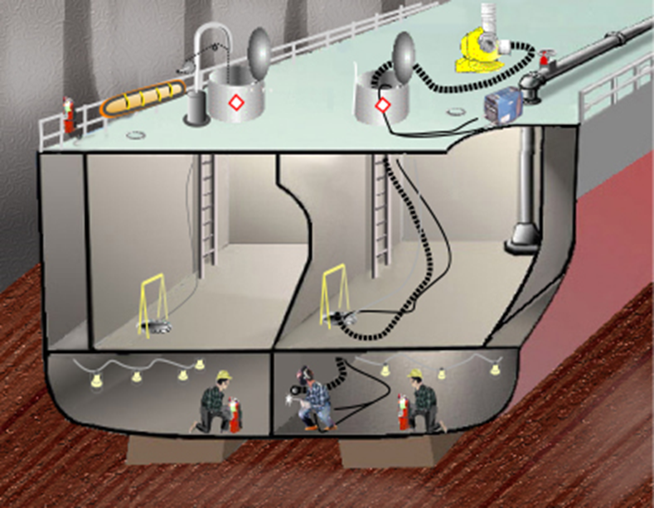
Permit Required Confined Space
Notes:
SOURCE: OSHA public domain

Slide 8
Facility evaluation
You must evaluate your workplace to determine if there are confined spaces and/or permit required confined spaces
PRCS found must identify:
Known or anticipated hazards
Determinations from any previous evaluation
Precautions and procedures previously implemented for entry
Must develop written program and permit system

Slide 9
Hazardous Atmospheres
Corrosive-immediate danger to skin and eyes, may cause cancer with prolonged exposures
Flammable or explosive gases, liquids, vapors, mists, fibers, or dusts
Inert-gases can be used to remove oxygen including nitrogen, helium, steam, Freon, argon, and carbon dioxide
Oxygen enriched (greater than 23.5% O2)-explosion/fire hazard
Toxic dusts, mists, fumes, smoke, vapors, fibers, or gasses

Slide 10
Immediately Dangerous to Life & Health
IDLH Conditions:
A hazardous atmosphere that poses a threat to life & health
Would cause irreversible adverse health effects
Would interfere with the ability to escape
Health effects from some hazardous atmospheres such as hydrogen fluoride gas and cadmium vapor may not occur until 12 to 72 hours after exposure

Slide 11
Controls
Understand if the hazards are from lighter or heavier than air gas
Monitor all levels and areas of the space
Control any fumes, gasses, or chemicals from entering space
Use forced air ventilation and exhaust(if available/possible) to maintain safe air quality

Slide 12
Atmospheric Testing
Air monitoring using a direct reading calibrated instrument
Oxygen content must be between 19.5-23.5%
Explosive atmosphere
Hazardous chemicals (H2S is a common hazard measured)
Monitoring must be continuous throughout entry into PRCS

Slide 13
Oxygen Levels
% Oxygen | Symptoms
19.5 | Minimum safe level
15-19 | Possible impaired coordination
12-14 | Respiration and pulse increase, impaired judgement/coordination
10-12 | Further increase in respiration and pulse
8-10 | Fainting, nausea, vomiting, blue lips
6-8 | Recovery possible if treated within 4-5 minutes 6 minutes-50% mortality 8 minutes-100% mortality
0-6 | Coma in 40 seconds or less-One breath may lead to unconsciousness

Slide 14
Physical Hazards
Access/egress problems
Chemical absorption
Corrosive chemicals
Falling objects
Illumination
Inwardly converging surfaces
Material that could trap or bury a person
Mechanical, electrical, hydraulic, and pneumatic energy (Lockout/tagout)
Noise
Slippery surfaces
Extreme temperatures

Slide 15
Controls
Lockout/tagout of equipment/hazards
Blanking and blinding piping systems
Physically separating piping systems from the space
Machine guarding
Always evaluate the space in its normal state before eliminating hazards
Why?

Slide 16
Personnel Classifications
Entrant-Person(s) who enter the space
Attendant-Person who continuously monitors the entrants and the space
Entry Supervisor-Person responsible to ensure safe entry can be made and who issues permit
Rescue Personnel-Trained personnel who are immediately available in the event entrants need to be removed from the space

Slide 17
Rescue Requirements
Must be immediately available to perform rescue
Must perform practice entry/non-entry rescue in the space or a representative space at least annually
If using a third-party rescue service, the agreement must be in writing
Calling 911 is not an acceptable rescue alternative. Fire services cannot guarantee they can be available at all times an entry is being made. Must be trained and train in the space where rescue may be needed

Slide 18
Training
Employees must have the understanding, knowledge, and skills necessary to safely perform their assigned duties
Training must be documented and provided:
For all new employees
Before an employee is assigned duties
Before there is a change on an employee’s assigned duties
When hazards are identified that have not previously been trained on
When there are changes to the permit program
When the permit audit shows deficiencies
When there is a deviation for established procedures or employee's knowledge is inadequate

Slide 19
Entry Permit
Must contain the following information:
The space to be entered
Purpose of the entry
Date, start and stop times of the permit
Hazards of the space
Acceptable entry conditions
Results of initial and periodic monitoring or for period of continuous monitoring

Slide 20
Entry Permit Continued
Appropriate measures used before entry to isolate or eliminate hazards
Names of entrants and current attendants
Signature of the original supervisor authorizing entry and current supervisor (if applicable)
Communication procedures for entrants and attendants
Equipment provided for entry
Rescue services and equipment
Additional Permits issued for work in the space

Slide 21
Alternate Entry Provisions
It is possible to enter a PRCS without a permit following the Alternate Entry Procedures
Must eliminate all physical hazards and hazardous atmospheres
Control hazardous atmosphere in the space with continuous forced-air ventilation. Must test atmosphere
Must have alternate entry procedures documented
Have 2-way communication
Rescue provisions not required

Slide 22
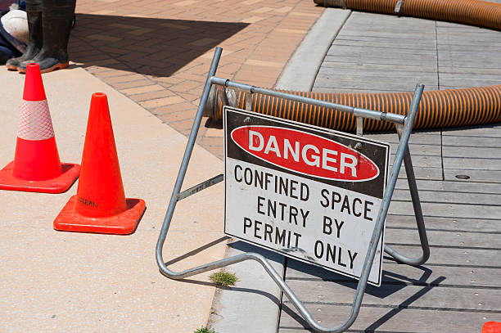
Space Labeling
Employers must evaluate workplace to determine if there are confined spaces or PRCS
Spaces must be identified by signs, labels, tags, or other effective methods
Take precautions to prevent unauthorized persons from entering the spaces
Notes:
Stock photo ID:471996963

Slide 23
Using Contractors
If using contractors to enter the PRCS you must inform them:
The workplace contains permit spaces and they must follow the applicable rules
Of identified hazards and your experiences with the PRCS
Of any precautions or procedures you require to protect employees in or near the spaces where work will be done
Review the entry operations after the work is completed

Slide 24
Written Program
Documentation of entry permit procedures
Measure taken to prohibit unauthorized persons from entering permit spaces
Designation of employee roles
Identification of designated employee duties
Training on the written program, entry permits, and roles
Instructions to identify and evaluate hazards
Instructions on equipment use and maintenance
Instructions to coordinate entry with another employer
Procedures necessary for concluding the entry and cancelling the permit after entry operations have been completed

Slide 25
Recordkeeping
Training records
Cancelled permits for at least one year

Slide 26
Knowledge Check
A confined space must meet (any/all) of the criteria
A Permit Space must meet (any/all) of the criteria
What are the two types of hazards associated with confined spaces?
Fire departments are a viable rescue provider T/F
Alternate entry procedures are a good option in many cases T/F
Notes:
All
Any
Atmospheric and physical hazards
False
True

