Slide 1
OMD Safety Policy Training
FALL PROTECTION

Slide 2
References
OSHA 29 CFR 1926
ORARNG Regulation 385-10
AGP 99.200.12 FALL PROTECTION
AGP 99.200.11 AERIAL LIFTS
AGP 99.200.10 LADDERS
OAR 437-003-1501
OSHA 29 CFR 1910.23 LADDERS
Notes:
This material was produces uner the Susan Harwood training grant number from the Occupational Safety and Health Administration under the Department of Labor.

Slide 3
Course Objectives
Identify the importance of fall protection.
Recognize fall hazards that are common in residential construction
Determine the appropriate fall protection system and method to use for a given hazard
Identify OSHA fall protection requirements
Identify safe work practices for framing operations, roofing operations, and other leading edge work activities
Identify safe work practices for ladders and scaffolding and aerial lifts

Slide 4
Course Agenda
Introduction: Overview of OSHA
Section 1: Overview of Fall Protection
Section 2: Fall Protection Systems
Section 3: Ladder, Scaffold and Aerial Lift Safety
Section 4: Alternative Fall Protection

Slide 5
Overview of OSHA
Occupational Safety and Health Administration (OSHA)
The mission of OSHA is to save lives, prevent injuries and protect the health of America’s workers
Notes:
Discuss the mission of OSHA, and the acronym that will be used throughout the presentation to refer to the Occupational Safety and Health Administration.

Slide 6
What does OSHA do?
Develops job safety and health standards and enforcing them through worksite inspections
Maintains a reporting and recordkeeping system to keep track of job-related injuries and illnesses
Provides training programs to increase knowledge about occupational safety and health
Notes:
Discuss the key tasks that the Agency performs on a daily basis.
Instructor: please encourage conversation by asking how many participants have seen an OSHA 300-log and also discuss its’ significance and reasons for reporting injuries and illnesses.

Slide 7
OSHA Standards
OSHA develops and enforces standards that both employers and employees must follow
OSHA has specific standards, rules and regulations on fall protection
Notes:
Discuss the various standards, i.e. 1926 Construction, 1910 General Industry. Introduce the differences between “construction” and “general industry” and the various regulations that apply to both industries. Focus primarily on fall protection regulations and even talk about the Subpart M, and the residential construction environment.

Slide 8
Employer Responsibilities
Provide a workplace free from recognized hazards and comply with OSHA standards
Provide training required by OSHA standards at the start of employment.
Keep records of injuries and illnesses
Provide medical exams when required by OSHA standards and provide workers access to their exposure and medical records
Notes:
Review the employer responsibilities under the OSH Act.

Slide 9
Employer Responsibilities
Not discriminate against workers who exercise their rights under the Act (Section 11(c))
Post OSHA citations and abatement verification notices
Provide and pay for PPE
Notes:
Review the employer responsibilities under the OSH Act.

Slide 10
What are Workers’ Responsibilities?
Follow the employer’s safety and health rules and wear or use all required safety equipment
Follow safe work practices for your job, as directed by your employer
Report hazardous conditions to a supervisor or safety personnel
Notes:
Discuss the rights and responsibilities of workers, and their involvement in safety for an organization. It is important to emphasize that safety is everyone’s responsibility, not only the employers’.

Slide 11
Workers’ Responsibilities
Report hazardous conditions to OSHA, if employers do not fix them
Cooperate with OSHA inspectors
Read the OSHA poster
Notes:
Read the worker rights bullet points, and answer any questions participants may have.

Slide 12
What are Workers’ Rights?
A safe and healthful workplace
Know about hazardous chemicals
Information about injuries and illnesses in your workplace
Complain or request hazard correction from employer
Notes:
Read the worker rights bullet points, and answer any questions participants may have.

Slide 13

Workers’ Rights
Training
Hazard exposure and medical records
File a complaint with OSHA
Participate in an OSHA inspection
Be free from retaliation for exercising safety and health rights
Notes:
Read the worker rights bullet points, and answer any questions participants may have.

Slide 14
Filing a Valid Complaint
Any employee who believes their job is unsafe because of unprotected hazards may file a complaint through OSHA, either:
Online (www.OSHA.gov)
By Fax or Mail
By Telephone (1-800-321-OSHA)
Note: it is unlawful to make any false statements in a complaint, and you may face a fine up to $10,000 for doing so
Notes:
Workers may file a complaint with OSHA if they believe a violation of a safety or health standard, or an imminent danger situation, exists in the workplace.
Workers may request that their name not be revealed to the employer.
If a worker files a complaint, they have the right to find out OSHA’s action on the complaint and request a review if an inspection is not made.

Slide 15
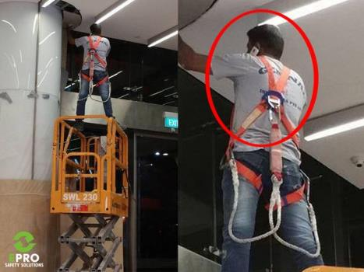
Section 1 Overview of Fall Protection
Notes:
Introduce the first section of the training program.

Slide 16
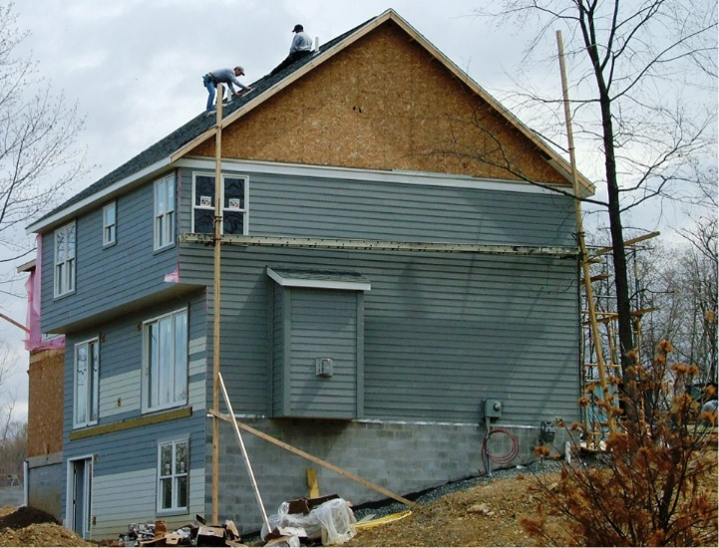
Fall Protection
Notes:
Briefly discuss the fall hazards present in the picture shown.

Slide 17
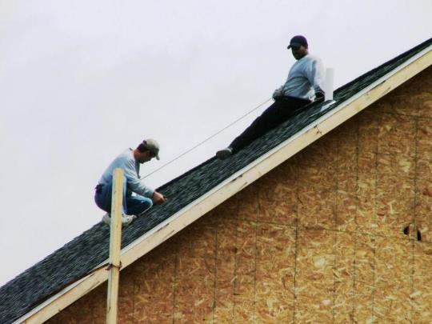
Fall Protection Safety
Notes:
Instructors: Use this slide as a discussion starter to highlight the lack of conventional fall protection (personal fall arrest system, guardrails, or safety nets) and also engage the audience to see if anyone has ever seen such an unsafe work practice in their career.

Slide 18
Introduction To Fall Protection
The goals of this course are to help you:
understand how to correct or eliminate fall hazards on your job sites
understand the OSHA fall protection requirements
gain a more thorough understanding of OSHA regulations applicable to home building
Notes:
Falls are the leading cause of fatal injuries in residential construction.
Falls also represent a significant portion of the serious injuries that occur in the industry.

Slide 19
Evaluate Fall Protection Systems
Competent person must evaluate the appropriate protective systems and:
Choose the appropriate system for each unique hazard and situation
Ensure employees are properly trained on fall protection systems chosen
Understand manufacturer’s recommendations and limitations of fall protection systems
Notes:
Discuss the important role the competent person plays in determining and evaluating the appropriate fall protective system for each fall-related hazard on the jobsite.

Slide 20
Fall Protection Training
Employers must train employees in:
Understanding the correct procedures for erecting, maintaining, disassembling, and inspecting the fall protection systems
The use and operation of guardrail systems, personal fall arrest systems, safety net systems, warning line systems, safety monitoring systems, controlled access zones, and other methods of fall protection to be used
Notes:
Note: Remember that you must evaluate the use of conventional fall protection systems prior to implementing alternative fall protection systems (i.e. warning lines, safety monitors, controlled access zones).
Discuss the many training requirements when workers are exposed, or have the potential to be exposed to fall hazards on a residential construction jobsite.
1926.501(b)(10)
"Roofing work on Low-slope roofs." Except as otherwise provided in paragraph (b) of this section, each employee engaged in roofing activities on low-slope roofs, with unprotected sides and edges 6 feet (1.8 m) or more above lower levels shall be protected from falling by guardrail systems, safety net systems, personal fall arrest systems, or a combination of warning line system and guardrail system, warning line system and safety net system, or warning line system and personal fall arrest system, or warning line system and safety monitoring system. Or, on roofs 50-feet (15.25 m) or less in width (see Appendix A to subpart M of this part), the use of a safety monitoring system alone [i.e. without the warning line system] is permitted.
Subpart M 29 CFR 1926.503 lists the training requirements for employees exposed to fall hazards.
State that the training must
Facilitate a short discussion from the audience about some of the training they conduct, successful methods of training, the length of the training, and the content.

Slide 21
Fall Protection Training (continued)
Employers must train employees on the proper use of fall protection equipment
For example: always inspect harness before each use and use approved anchor points
Notes:
Discuss the many training requirements when workers are exposed, or have the potential to be exposed to fall hazards on a residential construction jobsite.
Subpart M 29 CFR 1926.503 lists the training requirements for employees exposed to fall hazards.
State that the training must
Facilitate a short discussion from the audience about some of the training they conduct, successful methods of training, the length of the training, and the content.

Slide 22
Fall Protection Training (discussion)
Employers must train employees on:
The nature of fall hazards in the work area
Correct procedures for erecting, maintaining, disassembling and inspecting the fall protection systems to be used
The use and operation of conventional fall protection systems
The role of each employee in the fall protection system used
Notes:
Discuss the many training requirements when workers are exposed, or have the potential to be exposed to fall hazards on a residential construction jobsite.
Subpart M 29 CFR 1926.503 lists the training requirements for employees exposed to fall hazards.
State that the training must
Facilitate a short discussion from the audience about some of the training they conduct, successful methods of training, the length of the training, and the content.

Slide 23
Fall Protection Training (planning)
Employers must train employees on:
The limitations on the use of mechanical equipment during the performance of roofing work on low-sloped roofs
The correct procedures for the handling and storage of equipment and materials and the erection of overhead protection
The role of employees in fall protection plans
Notes:
Discuss the many training requirements when workers are exposed, or have the potential to be exposed to fall hazards on a residential construction jobsite.
Note: Remember that you must evaluate the use of conventional fall protection systems prior to implementing alternative fall protection systems (i.e. warning lines, safety monitors, controlled access zones).
Subpart M 29 CFR 1926.503 lists the training requirements for employees exposed to fall hazards.
State that the training must
Facilitate a short discussion from the audience about some of the training they conduct, successful methods of training, the length of the training, and the content.

Slide 24
Fall Protection Training (certification)
Employers must certify training:
Written certification must include:
Name of employee trained
Date of training
Signature of person conducting training
Latest training certification must be maintained
Retrain employees when employer has reason to believe it is necessary or changes have been made to fall protection
Notes:
Discuss the many training requirements when workers are exposed or have the potential to be exposed to fall hazards on a construction jobsite.
Subpart M 29 CFR 1926.503 lists the training requirements for employees exposed to fall hazards.
State that the training must identify the nature of fall hazards in the work area;
Facilitate a short discussion from the audience about some of the training they conduct, successful methods of training, the length of the training, and the content.

Slide 25
Competent Person Responsibilities
Designated competent person:
Responsible for identifying existing and predictable hazards
Has authority to eliminate fall hazards
Has authority to stop work if unsafe conditions exists
Has authorization to take prompt corrective actions to eliminate them
Notes:
Discuss the definition of a competent person, their varied roles and responsibilities on a jobsite.
Optional discussion, ask the audience if they have ever served, or are a competent person, and what they have done in their role to fix any fall hazards that may have been present.

Slide 26
Qualified Person
A qualified person:
Has a recognizable degree, experience, professional standing, or through extensive knowledge, training and experience has demonstrated proficiency in the use and maintenance of fall protection systems
Responsible for design, installation, use and supervision of anchorage points as part of a complete personal fall arrest system
Notes:
Define a qualified person, and some of the roles they are required to perform on a residential construction site, i.e. preparing a fall protection plan.
Anchorages shall be designed, installed and used under the supervision of a qualified person, as part of a complete personal fall arrest system that maintains a safety factor of at least two. Source: Subpart M- Fall Protection

Slide 27
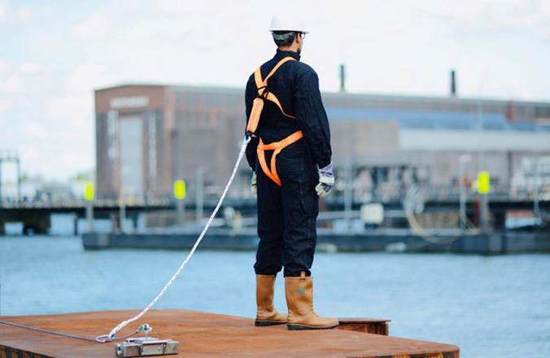
Section 2 Fall Protection Systems
Notes:
Introduce the second section, “Fall Protection Systems”.

Slide 28
Learning Objectives: Section 2
Identify when fall protection is required
Identify types of “conventional” fall protection systems
Determine which protection system to use for a given fall hazard
Identify key requirements and basic safety practices for each protection system
Notes:
Discuss the learning objectives for the second section of the training.
Allow time for the participants to thoroughly read and understand what they will learn in the second section.

Slide 29
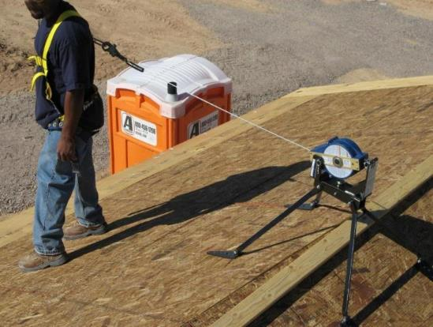
Fall Protection (lifeline)
Notes:
Explain that this is a self-retracting lifeline attached to a full body harness

Slide 30
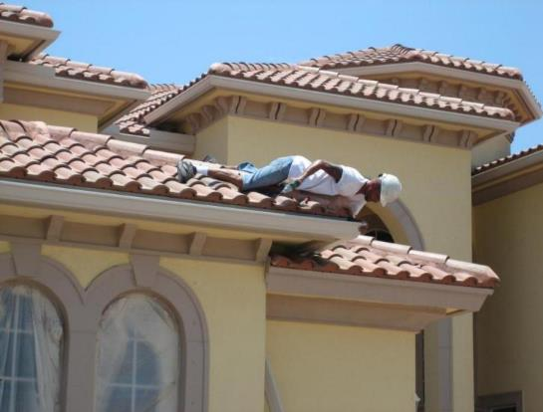
Fall Protection - Hazards
Notes:
Discuss the hazards here, and possible protective systems that can be used.

Slide 31
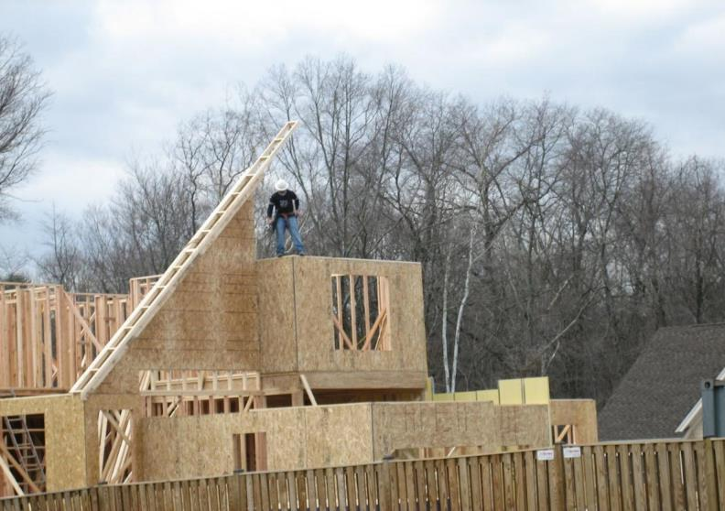
Fall Protection (discussion)
Notes:
Ask the audience if there is anything wrong with the worker standing on the second story top plate?
Discuss the obvious safety hazards that are present, and alternative work practices that should have been utilized.
Ask why the worker needs to be positioned on the top plate.

Slide 32
When Is Fall Protection Required?
OSHA §1926 Subpart M
Where workers on a residential construction site are exposed to vertical drops of 6 feet or more, OSHA requires that employers provide fall protection in one of three ways before work begins:
1) Conventional Fall Protection
2) Other Work Methods
3) Alternative Fall Protection
6’
Notes:
1926 Subpart M requirements of 6ft do not apply to scaffolds or stairways. Scaffold trigger height for fall protection is 10ft, while stairways require stairrail or handrail at 4 risers or 30 in. There is also no trigger height for when fall protection must be required on step-ladders or extension ladders.

Slide 33
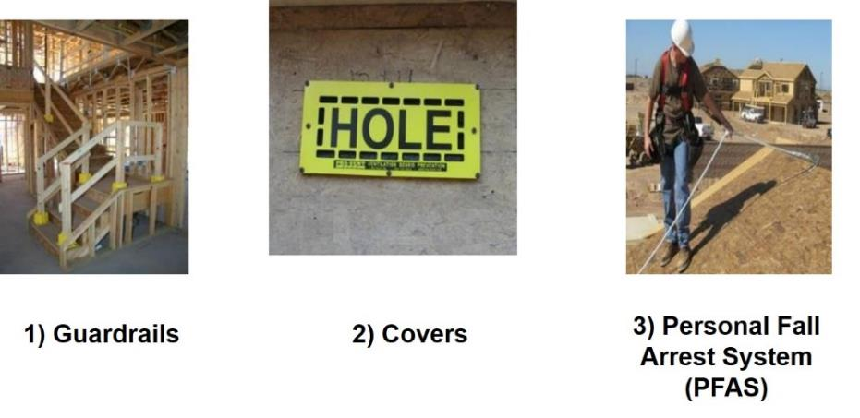
“Conventional” Fall Protection Options
We’ll look at each of these.
Notes:
For this purposes of this training seminar we will refer to hole covers as a form of conventional fall protection.
OSHA considers conventional fall protection to include the following three protective systems:
Guardrails
Personal Fall Arrest Systems (PFAS)
Safety Nets
Due to the limited use of safety nets in residential construction we will cover how to protect openings with hole covers.
Introduce each protective system and their various uses.

Slide 34
Guardrail Systems
Barrier built to OSHA specifications; constructed to prevent workers from falling to lower levels
Protects against these hazards:
Window and Wall Openings
Unprotected Sides and Edges
Floor Holes
Notes:
Define:
Window and Wall Openings
Unprotected Sides and Edges
Floor Holes

Slide 35
Guardrail Systems Are Needed For:
Stairwell Openings
Open-sided Wall Openings
Second and Third Story Non-loading Bearing Walls When the Studs Are 24” OC
Low (Less Than 39”) Sill Windows
Second and Third Story Deck Floor Holes for Open Foyers or Cat Walks
Sliding Glass and French Door Openings Onto Decks and Porches
Skylight Openings Cut Into the Roof
Notes:
Discuss the many uses of guardrails to protect workers from falls.

Slide 36
Requirements for Guardrails
Height Requirements
Toprail
42 in. (1.1 m)
Midrail
21 in. (50 cm)
Toe Board
Minimum of 3-1/2 in. (4 in. nominal) (10.2 cm)
Notes:
Top rail constructed of minimum of 2x4 and midrail 1x6 (typically midrails will be installed using 2x4).

Slide 37
Requirements for Guardrails, cont.
Vertical Supports
Install no more than every 8 ft. (2.4 m)
Weight Requirement
Must support at least 200 lbs. (90.9 kg) of force outward and downward along top edge
Notes:
Discuss the requirements for guardrails.

Slide 38
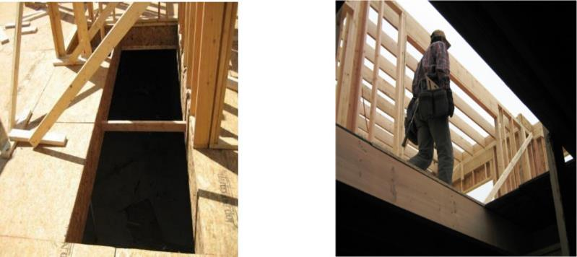
Unguarded floor openings
Notes:
Discuss ways to protect workers from unguarded floor openings, i.e. guardrails or floor covers.

Slide 39
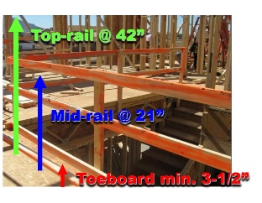
Rail Height Requirements
Notes:
This photo shows a properly installed guardrail system around a stairwell opening.
Top-rail = 42in.
Mid-rail = 21in.
Toeboard = 3 ½ in. (4in. Nominal)

Slide 40
Requirement for Window Openings
Window openings with a 6 ft. fall hazard (1.8 m) require the installation of a guardrail system, if the bottom sill height is less than 39 in. (1.1 m)
For all window openings, the sill height
determines the need for a guardrail
Notes:
Window openings with a 6ft fall hazard requires the installation of a guardrail system.

Slide 41
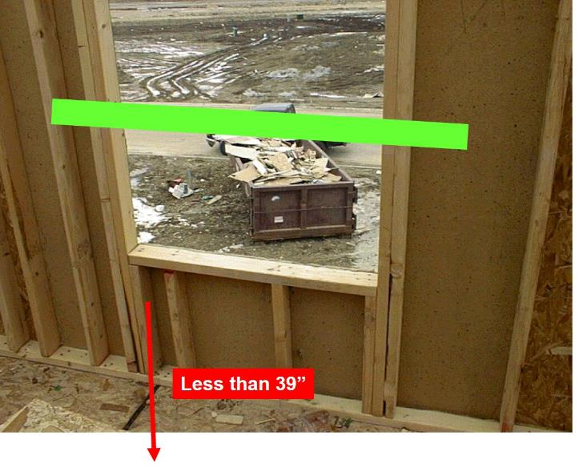
Fall Protection Hazard
Notes:
The guardrail was installed in this window at one point in time, but was removed to deliver material through the window and was never replaced.

Slide 42
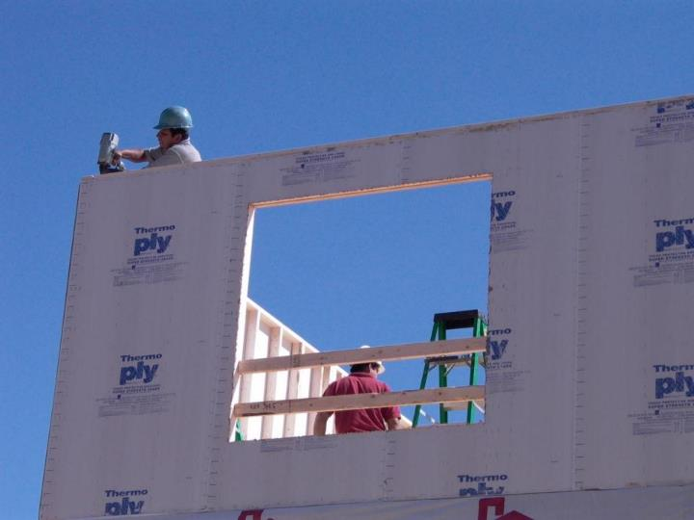
Fall Protection - ?
Notes:
Notice the ladder in the background. The use of the ladder near the window opening would require the height of the guardrail to be increased.
Discuss: The worker using the power nailer (nail gun) should be wearing protective eyewear (safety glasses) to protect from any flying object hazards.
In general OSHA requires employees to be protected from any potential eye or face injury from physical hazards.
Note: Safety glasses must meet the requirements specified in American National Standards Institute, Z87.1-1968, Practice for Occupational and Educational Eye and Face Protection.

Slide 43
Requirements for Handrails and Stair Rails
Toprail
36 in. (.9 m) above the tread vertically in line with the riser
Install handrail 3” from wall
Midrail
Halfway between toprail and stair stringer
Toe Board
Minimum of 3 1/2 in. (4 in. nominal) (10.2 cm)
Weight Requirement
At least 200 lbs. (90.9 kg)
Notes:
Review the requirements for handrails and stair rails.

Slide 44
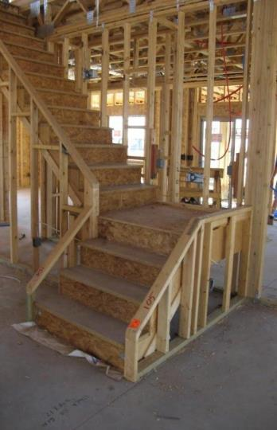
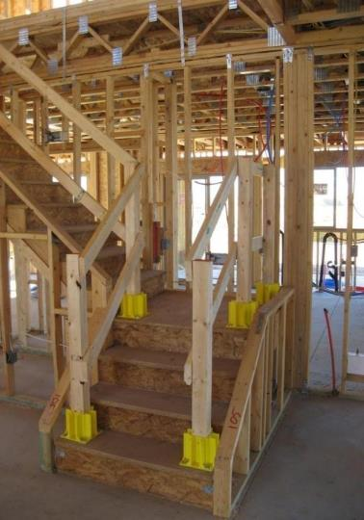
Rails
Notes:
Describe the properly installed guardrail boot system utilized on the picture on the right.

Slide 45
Hole Covers
Secured and marked cover which protects workers from tripping or stepping into or through a hole and keeps objects from falling through a hole
Protects against falls through hazards in this category:
Floor Holes
Notes:
A hole cover is a secured and marked cover which protects workers from tripping or stepping into or through a hole on walking/working surfaces and keeps objects from falling through a hole.

Slide 46
Hole Covers Are Needed For:
Any hole larger than 2” x 2”, such as:
Fireplace openings
Skylights
Basement stair openings
Floor heating, ventilating, and air-conditioning (HVAC) registers
Plumbing floor cutouts
Notes:
Explain when hole covers are needed.

Slide 47
Requirements for Hole Covers
Hole Covers must be:
Capable of supporting at least two times the maximum anticipated load
Secured from movement by nailing in place or other effective method
Clearly marked indicating the location of the hole
Notes:
Discuss the requirements for hole covers.

Slide 48
Personal Fall Arrest System (PFAS)
Equipment comprised of an anchorage point, connectors, and a body harness; used to keep a worker from free falling from an elevated surface
Protects against these hazards:
Unprotected Sides and Edges
Floor Holes
Leading Edges
Notes:
Discuss how a PFAS can be used to protect workers from unprotected sides and edges, floor holes, and leading edges.

Slide 49
PFAS - continued
Components of a PFAS
Requirements for Anchor Point
Using a PFAS
We’ll look at each of these in detail.
Notes:
Introduce the sections of a PFAS that will be covered.

Slide 50
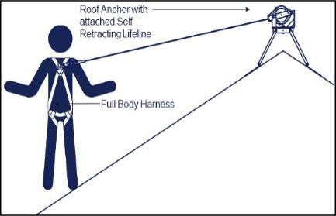
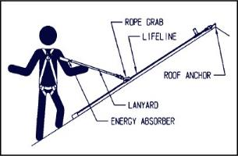
Components of a PFAS
OR
Anchor point
Lifeline
Rope grab
Shock absorbing lanyard
Full body harness
Anchor point
Self-retractable lifeline
In lieu of lifeline, rope grab, or shock-absorbing lanyard
Full body harness

Slide 51
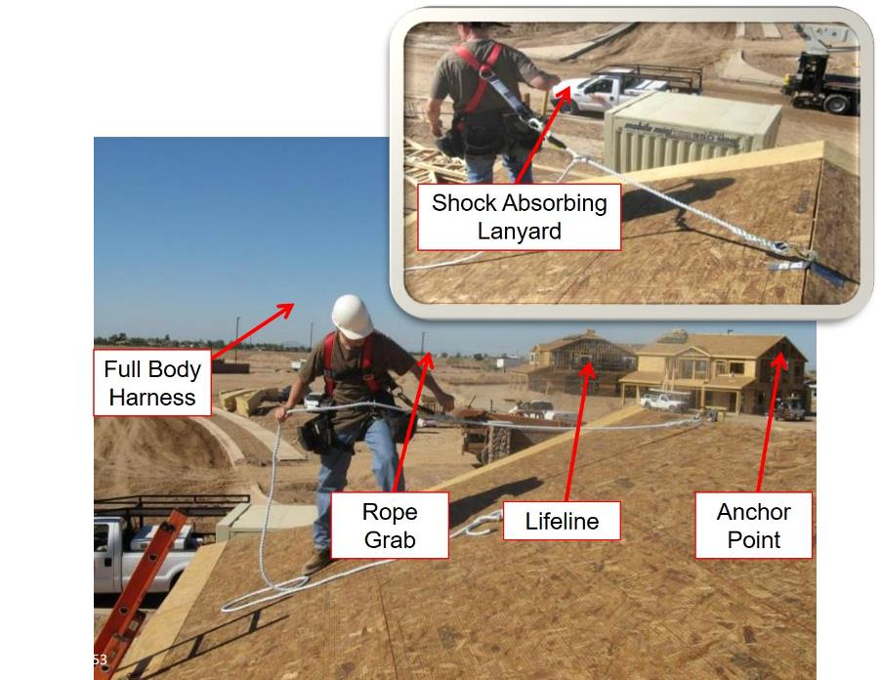
Rope grab system
Notes:
This picture shows a rope grab system on roof to protect a worker in the event of a fall.

Slide 52
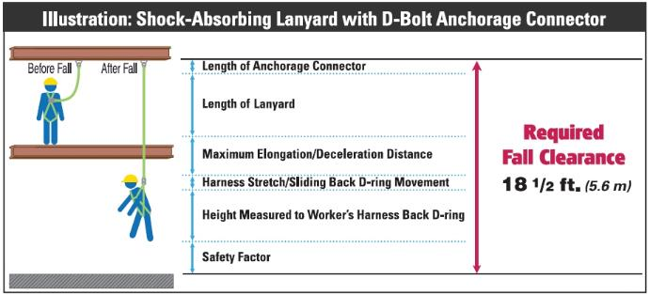
Calculating Fall Distance

Slide 53
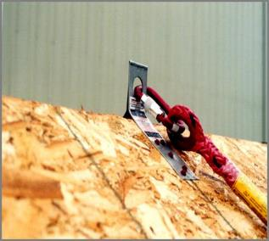
Requirements for Anchor Point
OSHA requires that anchor points must be capable of supporting 5,000 lbs (2,273 kg) or twice the intended load
The qualified person must determine that a structure is strong enough to support an anchor point for a PFAS

Slide 54
Requirements for Anchor Point (continued)
Follow the manufacturer’s specifications regarding proper installation
Check instructions on proper bracing techniques
Notes:
Read and discuss the bullet points on the slide.
Explain how following the manufacturers specifications ensures the anchor point will withstand 5,000lbs.

Slide 55
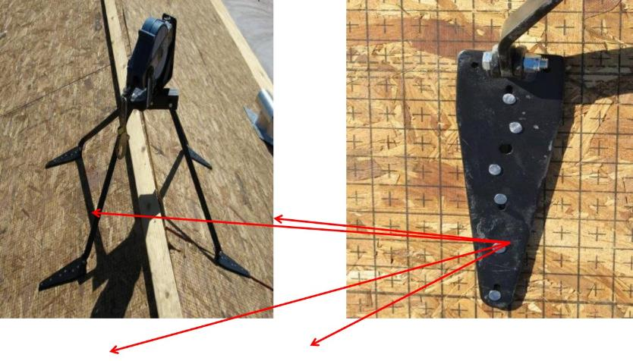
Anchor Points
Notes:
Explain how this picture shows properly installed anchor points for a self-retracting lifeline (SRL).

Slide 56
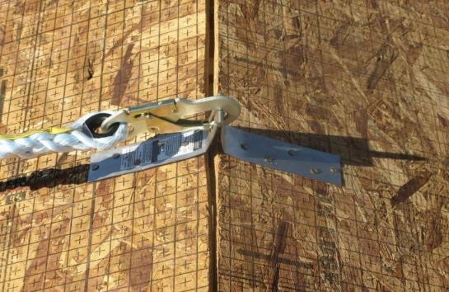
Anchor Points (continued)
Notes:
This picture shows an anchor point for a rope grab fall protection system.

Slide 57
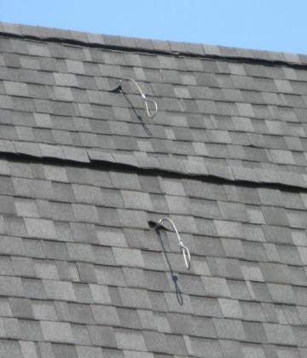
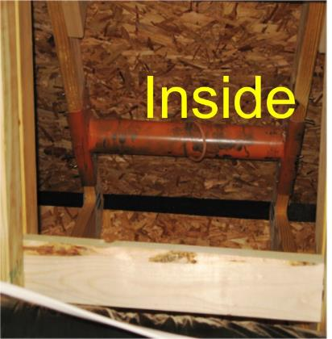
Anchor Points – Inside & Outside
Outside
Notes:
These pictures show how an anchor point is bridged between two trusses, and goes through the roof to be utilized by a worker.

Slide 58
Using a PFAS
Read the manufacturer’s information on proper use, installation, inspection, and limitations of the equipment and accessories
Inspect the components for damage and excessive wear
Don’t use a PFAS that is damaged, worn, or has previously arrested a fall
These systems should be repaired and recertified by the manufacturer before reuse or reissue
Notes:
Discuss how to properly follow the manufacturers recommendations, as well as inspecting the parts of a PFAS before each use.

Slide 59
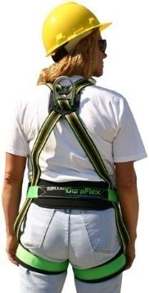
Using a PFAS
Proper Wear:
Locate the attachment of the body harness in the center of your back, near the shoulder level, or above your head

Slide 60
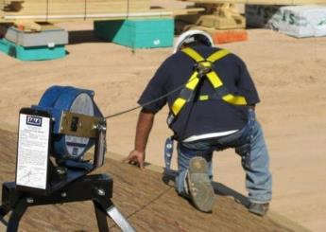
Using a PFAS – Proper Wear
Proper Wear:
If using a retractable lifeline attach it directly to the D-ring on the full-body harness

Slide 61
Inspecting a PFAS
Inspect the harness fully before each use. This includes:
Inspecting the buckles
Inspecting the lanyard
Carefully checking the webbing for distortions
Check the hardware (D-rings) connectors for defects
Inspect rope or lifeline for any rips, tears, or deformities

Slide 62
What if a Worker Falls? Need a Rescue Plan!
A rescue plan describes steps taken to rescue a fallen worker (even if they are wearing a PFAS). Steps include:
Contacting appropriate emergency personnel
Using ladders or other safe work methods to rescue worker if they are suspended by PFAS
Ensuring the plan can safely rescue a suspended worker within 3-4 minutes of falling

Slide 63
Safety Net Systems 1926.502(c)
System consisting of connectors and net installed below a working surface; designed to prevent a worker from contacting a lower level or structure in the event of a fall

Slide 64
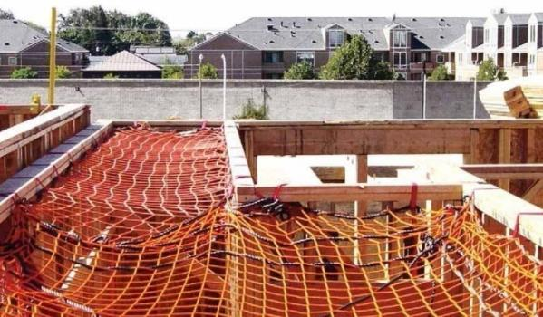
Safety Net Systems

Slide 65
Positioning Device System
A body belt or body harness system rigged to allow an employee to be supported on an elevated vertical surface and work with both hands free while leaning
Notes:
Discuss how a positioning device system may be used to stabilize a worker while working at heights.
There are limitations to this system in a residential construction environment.

Slide 66
Positioning Device System
Are used to safely position workers away from fall hazards, or in a working position where a fall cannot occur
NOT designed for fall arrest
Must be rigged such that a worker cannot free fall more than 2 feet
Must be secured to an anchor point capable of withstanding 3,000 pounds
Notes:
Discuss instances where a positioning system may be used. Examples include encroachment to floor holes or wall openings. This system is designed to prevent workers from ever reaching an area where a fall may occur. Also discuss using shorter lanyards attached directly to the D-ring and the anchor point to securely hold a worker in place to prevent falls from occuring.

Slide 67
Section 3 Ladders and Scaffolding

Slide 68
Learning Objectives: Section 3
Determine the proper ladder to use based on weight capacity and height
Calculate the proper pitch of extension ladders for proper set-up, and identify how to secure and stabilize ladders
Identify how to maintain a safe position when using a ladder
Identify safety requirements and practices for scaffolding, including aerial lifts
Notes:
Discuss the learning objectives for section 5, and allow the participants to thoroughly understand what they are expected to learn. Allow time to answer any questions.

Slide 69
Ladder Training Requirements
Each employee using ladders should be trained to recognize hazards related to their use. This includes:
Nature of the fall hazards in the work area
Correct procedures for placement, use, and maintenance
Maximum intended load-carrying capacities
Notes:
Discuss the training requirements when using ladders.

Slide 70
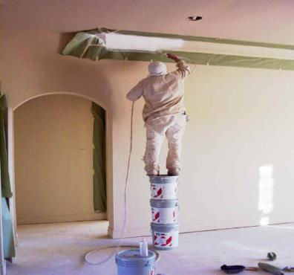
Ladder or Scaffold?
Notes:
Discuss the unsafe work practice that is utilized here.

Slide 71
Pick the Right Ladder
Before stepping onto a ladder, think about these things:
Duty rating of the ladder—what capacity can it hold?
Height of the ladder—too short or too tall?
Condition of the ladder and instructions unique to the ladder selected
We’ll look at each of these in detail
Notes:
Explain how to pick the right ladder for the task being performed.

Slide 72
Proper Duty Rating/Capacity
OSHA Requirement
Ladders shall not be loaded beyond the maximum intended load for which they were built nor beyond their manufacturer's rated capacity
Notes:
Discuss the proper duty rating capacity of ladders.

Slide 73
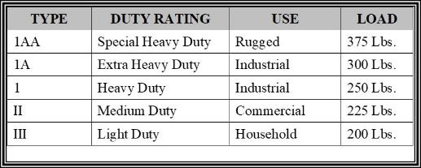
Proper Duty Rating/Capacity, cont.
Select a ladder with the proper duty rating for your weight and the materials you are handling

Slide 74
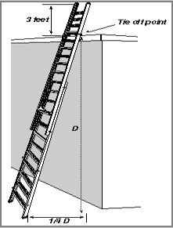
Pitch Extension Ladders
Extension ladders should be used at a 4 to 1 pitch (1.2 to .3 m)
For every 4 ft. (1.2 m) in height, the bottom of the ladder should be 1 ft. (.3 m) away from the structure
Example:
20 ft. (height) ÷ 4 ft. = 5 ft. pitch

Slide 75
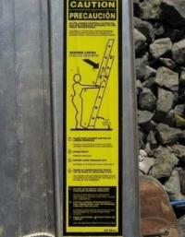
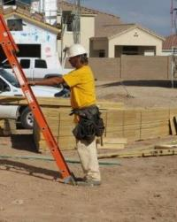
Pitch Extension Ladders, continued
Notes:
Setting up extension ladders properly can reduce slip and overload hazards. A quick and easy way to determine is and extension ladder is properly set up is:
1. Place toes against ladder side rails
2. stand erect
3. Extend arms straight out
4. Palms of hands should touch top of rung at shoulder level

Slide 76
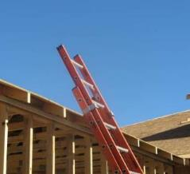
Proper Height Extension Ladders
When accessing another level, the ladder must extend at least 3ft. (0.9m) above the landing to provide a hand hold for getting on and off the ladder
Notes:
The spikes, or spurs, on the ladder safety feet allow for the ladder to be set up safely on loose soil to prevent slipping.

Slide 77
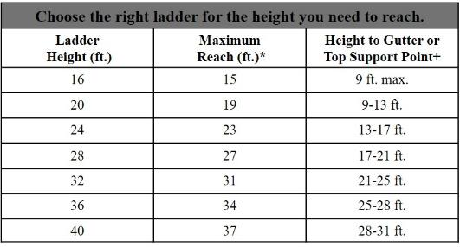
Proper Height for Extension Ladders – cont.
Notes:
*Assume a 5 ft.-6 in. person with a vertical reach of 12 in.
+Support points for extension ladders reflect section overlap, ladder angle, or 3-ft. extension above roof line

Slide 78
Secure and Stabilize Ladders
Extension ladders should be secured at the top or bottom to prevent movement
The base of an extension ladder must be secured in place by using the safety feet on the ladder or other effective means

Slide 79
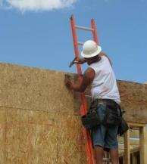
Secure and Stabilize Ladders – Tie Off Point

Slide 80
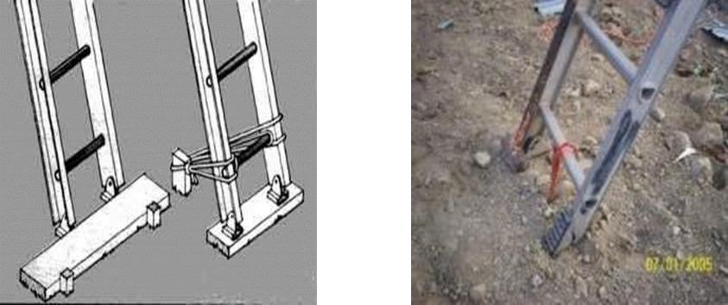
Secure and Stabilize Ladders - Safety

Slide 81
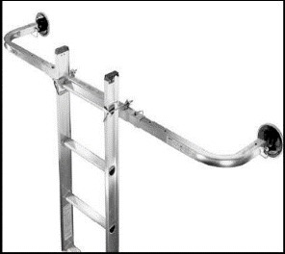
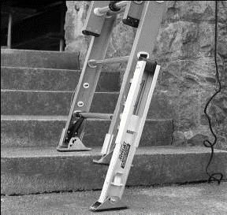
Secure and Stabilize Ladders

Slide 82
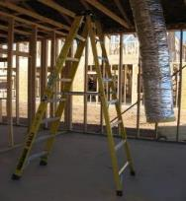
Step Ladders

Slide 83
Step Ladders Safety
Only use in the fully open position on firm level ground
Do not use a step ladder that is folded or in a leaning position
Never sit/stand on the top two rungs
Consider work height when selecting a step ladder

Slide 84
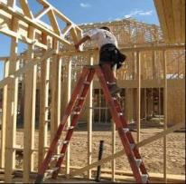
Step Ladders - Design
Step ladders are designed for use in an opened-and-locked position

Slide 85
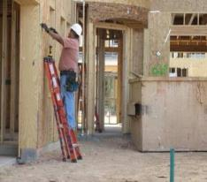
Step Ladders Hazard
Do NOT use a step ladder that is folded or in a leaning position
Notes:
This worker is using a stepladder in the folded, leaning position. This represents improper use of a stepladder and could possibly lead to injuries from the ladder failing.

Slide 86
Proper Height of Stepladders
Choose a step ladder that is no more than 4ft. shorter than the
height you want to reach

Slide 87
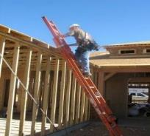
Maintain a Safe Position on a Ladder

Slide 88
Maintain a Safe Position on Ladders
Face the ladder when ascending or descending
Maintain three points of contact at all times
Keep your body centered on the ladder
Never let your belt buckle pass either side rail

Slide 89
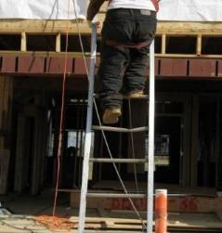
Ladder Inspections
Ladders must be inspected before each use
Broken or weak ladders or ladders that are not stable must be marked or tagged as defective and taken out of service
Look for cracks and weak points
Competent person must periodically inspect ladders

Slide 90
Additional Safe Work Practices: Ladders
Extension ladders should not be separated to create two ladders
Keep the areas around the tops and bottoms of all ladders clear to prevent trip-and-fall hazards
Avoid setting ladders up in high traffic areas or barricade the area around ladder

Slide 91
Additional Safe Work Practices
Ladders must be kept free of oil, grease, and other slipping hazards
Consider using a rope to raise/lower materials instead of carrying items while climbing a ladder
Do NOT use metal or aluminum ladders near exposed energized electrical equipment

Slide 92
Scaffolding
A safe alternative to using ladders is to use:
Interior and Exterior Scaffolding
Aerial Lifts
...if OSHA requirements and safety practices are followed
We’ll look at each of these in detail.
Notes:
Introduce the scaffolding section.

Slide 93
Interior and Exterior Scaffolding
Job-built scaffolding that is improperly constructed is extremely hazardous
Various types and brands of interior and exterior scaffolding are commercially available
Always, follow the manufacturer’s safety instructions
Notes:
Discuss the hazards associated with improperly constructed job-built scaffolds, and the types of interior and exterior scaffolding that is commercially available.

Slide 94
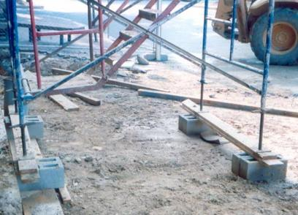
Masonry Blocks Are Not Acceptable
Notes:
Fabricated frame scaffold must have mud-sills as supports and masonry blocks are never acceptable.

Slide 95
Interior and Exterior Scaffolding Requirements
Scaffolding that is 10 ft. or higher must be equipped with guardrails
A competent person must supervise the set-up and take down of all scaffolding
Walls that support exterior scaffold must be capable of supporting, without failure, the weight of the scaffold and four times the maximum intended load on the scaffolding
Scaffolding must be fully planked, and planks must be secured so they cannot move
Notes:
Discuss the requirements for scaffolding.

Slide 96
Guardrail Requirements- Scaffolds
Toprails Between 38” and 45” High
Guardrails to 200 Lbs/Midrails to min. 75 Lbs – 150 lbs depending on Toprail capacity
Cross Bracing OK as Guardrail if Between 20” and 30” for Midrail 38” to 48” for Toprail
Protect from Falling Objects
All Workers on Scaffolds MUST Wear Hard Hats
Notes:
Discuss the requirements for guardrails on scaffolding.
OSHA states that the top edge height of toprails or equivalent member on supported scaffolds manufactured or placed in service after January 1, 2000 shall be installed between 38 inches (0.97 m) and 45 inches (1.2 m) above the platform surface. The top edge height on supported scaffolds manufactured and placed in service before January 1, 2000, and on all suspended scaffolds where both a guardrail and a personal fall arrest system are required shall be between 36 inches (0.9 m) and 45 inches (1.2 m).
Midrails, screens, mesh, intermediate vertical members, solid panels, and equivalent structural members of a guardrail system shall be capable of withstanding, without failure, a force applied in any downward or horizontal direction at any point along the midrail or other member of at least 75 pounds (333 n) for guardrail systems with a minimum 100 pound toprail capacity, and at least 150 pounds (666 n) for guardrail systems with a minimum 200 pound toprail capacity.

Slide 97
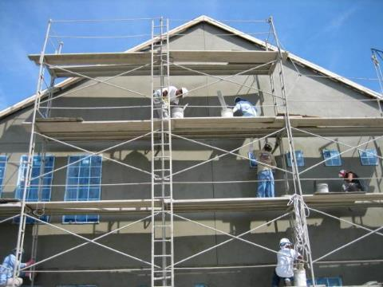
Scaffold
Cross Bracing OK as Toprail
Toprail
Midrail
Notes:
Overall, a pretty well built stucco scaffold with proper guardrails.
Braces are used as top rails with midrails installed approximately half way
Discuss the requirements for guardrails on scaffolding.
OSHA states that the top edge height of toprails or equivalent member on supported scaffolds manufactured or placed in service after January 1, 2000 shall be installed between 38 inches (0.97 m) and 45 inches (1.2 m) above the platform surface. The top edge height on supported scaffolds manufactured and placed in service before January 1, 2000, and on all suspended scaffolds where both a guardrail and a personal fall arrest system are required shall be between 36 inches (0.9 m) and 45 inches (1.2 m).
Midrails, screens, mesh, intermediate vertical members, solid panels, and equivalent structural members of a guardrail system shall be capable of withstanding, without failure, a force applied in any downward or horizontal direction at any point along the midrail or other member of at least 75 pounds (333 n) for guardrail systems with a minimum 100 pound toprail capacity, and at least 150 pounds (666 n) for guardrail systems with a minimum 200 pound toprail capacity.

Slide 98
Aerial Lifts
Aerial lifts (e.g., JLG boom lift) or approved personnel lift baskets on rough terrain forklifts is a safe alternative to working from:
Ladders, or
other types of scaffolding
An aerial lift can be used for the installations of:
windows
soffit
fascia
gutters
siding
Notes:
Introduce the use of aerial lifts and their many applications.

Slide 99
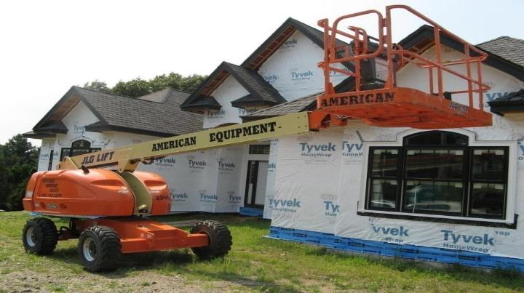
Aerial Lifts – Job Site
Notes:
Picture of an aerial lift on a residential construction jobsite.

Slide 100
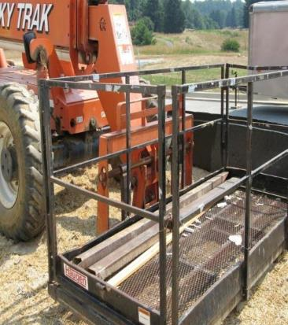
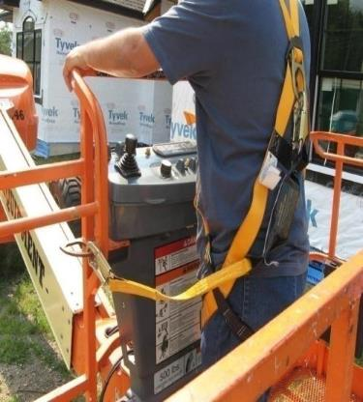
Aerial Lifts - Safety
Notes:
Picture showing a personnel basket attached to a forklift (left) and the use of a PFAS attached to an anchor point on an aerial lift (on the right).

Slide 101
Aerial Lifts – Competent Person
The competent person should:
Restrict operation of aerial lifts or forklift vehicles to trained and authorized personnel
Use only commercially built personnel baskets designed for lifting workers
Follow the American National Standards Institute’s (ANSI) standards for using personnel lift baskets
Make certain that homemade boxes lifted by a forklift are not used—homemade boxes are unacceptable
Notes:
Discuss the competent person requirements.
Discuss how homemade boxes are unacceptable to transport workers to a working level.

Slide 102
Aerial Lifts – Practices
When in the lift:
Wear a full body harness
Attach the lanyard to the boom or an approved anchor point inside the basket
Always stand on the floor of the basket
Do not sit or climb on the edge of the basket, lean over the edge, or climb out of the basket
Do not use a ladder or other objects to increase reach
Notes:
Explain safe work practices when using an aerial lift.

Slide 103
Aerial Lifts - Operating
When operating the lift:
Stay at the controls at all times
Do not move the vehicle while a person is in the elevated basket
Only use the equipment when it is on stable and level ground
Maintain the required minimum clearance of 10 ft. from power lines carrying 50,000 volts or less
Notes:
Discuss safe work practices when using aerial lifts.
***Please note that the clearance distances from overhead power lines may change.

Slide 104
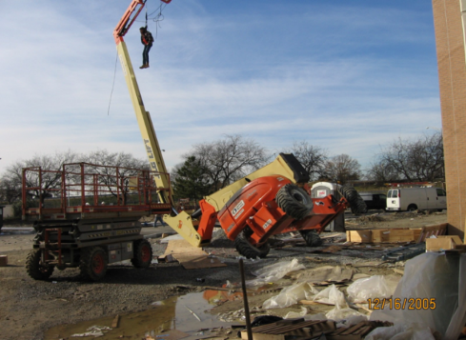
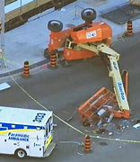
Saved By The Harness
Notes:
Picture showing a worker that has fallen out of lift basket and is restrained by his harness attached to the anchor point of the lift.

Slide 105
Section 4 Alternative Fall Protection
Notes:
Introduce Section 6, Alternative Fall Protection
Discuss: Employers must evaluate the use of conventional fall protection systems, and other work practices covered under OSHA standards (i.e. ladders, scaffolding or aerial lifts) prior to implementing any alternative work practices and establishing a written, site-specific fall protection program.
If an employer can demonstrate that conventional fall protection (i.e., guardrail systems, safety net systems, or personal fall arrest systems) is infeasible or presents a greater hazard, a written, site specific fall protection plan meeting the requirements of 1926.502(k) can be implemented.
The employer has the burden of establishing that it is appropriate to implement a fall protection plan.
Note: There is a presumption that it is feasible and will not create a greater hazard to implement one of the conventional fall protection methods (personal fall arrest system, guardrails, or safety nets); and accordingly the employer has the burden of establishing that it is appropriate to implement a fall protection plan that complies with 1926.502(k).

Slide 106
Learning Objectives: Section 4
Understand OSHA requirements to provide conventional fall protection during residential construction
Evaluate the use of conventional fall protection systems and other work methods during residential construction
Identify residential construction tasks that may require a fall protection plan that meets the requirements of §1926.502(k)
Notes:
Discuss the learning objectives for section 6 and allow time for the attendees to thoroughly understand and ask questions about them.
Instructors: Please clarify that this section shows alternative fall protection procedures that may be options to meet OSHA’s Subpart M-Fall Protection regulation only when all conventional fall protection systems have been evaluated and it has been determined that their use would be infeasible or create a greater hazard.
The alternative fall protection procedures listed in Section 6 are meant to provide guidance to employers on the type of information that is required to be discussed in fall protection plans.

Slide 107
When is fall protection required? Subpart M
In residential construction, workers must be protected by conventional fall protection (guardrails, safety nets, personal fall arrest system) if they can fall 6 feet or more to a lower level
Residential Construction Exception*
When employers can demonstrate that it is infeasible or creates a greater hazard to use “conventional” fall protection systems, they must develop and implement a fall protection plan, as needed, in accordance with §1926.502(k)
*29 CFR 1926.501(b)(13)
Notes:
Explain what the terms “infeasible or creates a greater hazard” refers to, as well as a few examples of circumstances where you may use a fall protection plan (as prescribed in Subpart M).
Emphasize the 6 feet rule in constriction and the duty and responsibility to provide fall protection.
If an employer can demonstrate that conventional fall protection (i.e., guardrail systems, safety net systems, or personal fall arrest systems) is infeasible or presents a greater hazard, a written, site specific fall protection plan meeting the requirements of 1926.502(k) can be implemented.
The employer has the burden of establishing that it is appropriate to implement a fall protection plan.
Examples of greater hazard – The installation of guardrails or safety nets could involve more risk, due to the nature or duration of the exposure, than the work for which protection is required, such as: 1) During the erection and bracing of roof trusses/rafters, conventional fall protection may present a greater hazard to workers; safety nets, guardrails and personal fall arrest systems will not provide adequate fall protection because the nets will cause the walls to collapse, while there are no suitable attachment or anchorage points for guardrails or personal fall arrest systems; 2) erection and dismantling of the scaffold would expose workers to a greater fall hazard than erection of the trusses/rafters; 3) for Roof Sheathing Operations, roof structures are unstable until some sheathing is installed, so workers installing roof sheathing cannot be protected from fall hazards by conventional fall protection systems until it is determined that the roofing system can be used as an anchorage point.
Examples of infeasible – OSHA considers compliance with a measure to be "infeasible" when it is technologically impossible to do what a standard requires or when following the standard would prevent performance of the work in question, such as 1) inability to provide safe anchorage; 2) danger of lifeline entanglement; 3) likelihood that lifelines, especially self-retracting lifelines, will be mired in grout; 4) likelihood that completion of work would be prevented by fall protection; and 5) inability of personal fall arrest systems to function due to the configuration of the work area.
OSHA believes it would be unreasonable to expect the home builder to rent a crane when the home site is difficult to access (terrain or remote location, such as in the mountains) or when the home builder has only a single roof to raise. In addition, OSHA does not expect home builders to erect scaffolds around the entire perimeter of a house, or to take other extremely burdensome measures such as erecting separate structures (telephone poles, e.g.) and stringing a lifeline to use as an attachment point for personal fall arrest equipment. OSHA considers these measures infeasible.
OSHA does not consider "economic infeasibility" to be a basis for failing to provide conventional fall protection for employees performing residential construction work.
OSHA has also consistently maintained that "impracticality" and "greater hazard" defense does not generally excuse a contractor from compliance with the requirements for fall protection.

Slide 108
What does “Infeasible” mean?
Infeasible means:
Impossible to perform construction work using conventional fall protection or
It is technologically impossible to use conventional fall protection
Source: 1926.500(b)
Notes:
These examples are found directly in OSHA’s Preamble to the 1994 Subpart M-Fall Protection rulemaking record.
Note: There is a presumption that it is feasible and will not create a greater hazard to implement one of the conventional fall protection methods (personal fall arrest system, guardrails, or safety nets); and accordingly the employer has the burden of establishing that it is appropriate to implement a fall protection plan that complies with 1926.502(k).

Slide 109
Establishing Infeasibility (1 of 4)
Contractor attempting to establish infeasibility will be required to:
Establish the worksite-specific circumstances that preclude reliance on conventional fall protection to protect employees from fall hazards
Establish that the available personal fall arrest systems cannot be used in a particular work area due to design or equipment constraints
Source: Preamble to Final Fall Protection Rule, Section 3 - III. Summary and Explanation of the Final Rule, August 9, 1994
Notes:
Discuss: Employers must evaluate the use of conventional fall protection systems, and other work practices covered under OSHA standards (i.e. ladders, scaffolding or aerial lifts) prior to implementing any alternative work practices and establishing a written, site-specific fall protection program.
If an employer can demonstrate that conventional fall protection (i.e., guardrail systems, safety net systems, or personal fall arrest systems) is infeasible or presents a greater hazard, a written, site specific fall protection plan meeting the requirements of 1926.502(k) can be implemented.
The employer has the burden of establishing that it is appropriate to implement a fall protection plan.
Note: There is a presumption that it is feasible and will not create a greater hazard to implement one of the conventional fall protection methods (personal fall arrest system, guardrails, or safety nets); and accordingly the employer has the burden of establishing that it is appropriate to implement a fall protection plan that complies with 1926.502(k).

Slide 110
Establishing Infeasibility (2 of 4)
The employer must indicate the particular problem, such as:
Inability to provide safe anchorage
Danger of lifeline entanglement
Likelihood that completion of work would be prevented
Inability of personal fall arrest system to function, due to configuration of work area
Source: Preamble to Final Fall Protection Rule, Section 3 - III. Summary and Explanation of the Final Rule, August 9, 1994
Notes:
OSHA does not consider "economic infeasibility" to be a basis for failing to provide conventional fall protection for employees performing residential construction work.
Note: There is a presumption that it is feasible and will not create a greater hazard to implement one of the conventional fall protection methods (personal fall arrest system, guardrails, or safety nets); and accordingly the employer has the burden of establishing that it is appropriate to implement a fall protection plan that complies with 1926.502(k).

Slide 111
Establishing Infeasibility (3 of 4)
Note: There is a presumption that it is feasible and will not create a greater hazard to implement one of the conventional fall protection methods (personal fall arrest system, guardrails, or safety nets); and accordingly, the employer has the burden of establishing that it is appropriate to implement a fall protection plan that complies with 1926.502(k)
Notes:
OSHA does not consider "economic infeasibility" to be a basis for failing to provide conventional fall protection for employees performing residential construction work.

Slide 112
Establishing Infeasibility (4 of 4)
It will not be sufficient for the employer to merely assert that it is impossible to use fall protection equipment
OSHA does not consider "economic infeasibility" or "impracticality“ to be a basis for failing to provide conventional fall protection for employees
Non-mandatory Appendix E provides guidance regarding the kind of considerations employers would take into account in attempting to comply with OSHA’s fall protection standard
Source: Preamble to Final Fall Protection Rule, Section 3 - III. Summary and Explanation of the Final Rule, August 9, 1994
Notes:
Discuss: Employers must evaluate the use of conventional fall protection systems, and other work practices covered under OSHA standards (i.e. ladders, scaffolding or aerial lifts) prior to implementing any alternative work practices and establishing a written, site-specific fall protection program.
If an employer can demonstrate that conventional fall protection (i.e., guardrail systems, safety net systems, or personal fall arrest systems) is infeasible or presents a greater hazard, a written, site specific fall protection plan meeting the requirements of 1926.502(k) can be implemented.
The employer has the burden of establishing that it is appropriate to implement a fall protection plan.
Note: There is a presumption that it is feasible and will not create a greater hazard to implement one of the conventional fall protection methods (personal fall arrest system, guardrails, or safety nets); and accordingly the employer has the burden of establishing that it is appropriate to implement a fall protection plan that complies with 1926.502(k).

Slide 113
Examples of Infeasibility
OSHA believes it would be unreasonable to expect a home builder to rent a crane when the jobsite is difficult to access (terrain or remote location) or when the home builder has only a single roof to raise
OSHA does not expect home builders to erect scaffolds around the entire perimeter of a house, or to take other extremely burdensome measures such as erecting separate structures (telephone poles, e.g.) and stringing a lifeline to use as an attachment point for personal fall arrest equipment
Source: Preamble to Final Fall Protection Rule, Section 3 - III. Summary and Explanation of the Final Rule, August 9, 1994
Notes:
OSHA does not consider "economic infeasibility" to be a basis for failing to provide conventional fall protection for employees performing residential construction work.
Note: There is a presumption that it is feasible and will not create a greater hazard to implement one of the conventional fall protection methods (personal fall arrest system, guardrails, or safety nets); and accordingly the employer has the burden of establishing that it is appropriate to implement a fall protection plan that complies with 1926.502(k).

Slide 114
What does “Creating a Greater Hazard” mean?
Hazards created by compliance with the standard are greater than those created by non-compliance
Source: Preamble to Final Fall Protection Rule, Section 3 - III. Summary and Explanation of the Final Rule, August 9, 1994
Notes:
If an employer can demonstrate that conventional fall protection (i.e., guardrail systems, safety net systems, or personal fall arrest systems) is infeasible or presents a greater hazard, a written, site specific fall protection plan meeting the requirements of 1926.502(k) can be implemented.
The employer has the burden of establishing that it is appropriate to implement a fall protection plan.
Note: There is a presumption that it is feasible and will not create a greater hazard to implement one of the conventional fall protection methods (personal fall arrest system, guardrails, or safety nets); and accordingly the employer has the burden of establishing that it is appropriate to implement a fall protection plan that complies with 1926.502(k).

Slide 115
Establishing Greater Hazard
OSHA is aware of construction situations where the installation of conventional fall protection systems could involve more risk, due to the nature or duration of the exposure, than the work for which protection is required
On the other hand, “greater hazard" defense does not generally excuse an employer from protecting its affected employees with conventional fall protection systems
Source: Preamble to Final Fall Protection Rule, Section 3 - III. Summary and Explanation of the Final Rule, August 9, 1994
Notes:
Discuss: Employers must evaluate the use of conventional fall protection systems, and other work practices covered under OSHA standards (i.e. ladders, scaffolding or aerial lifts) prior to implementing any alternative work practices and establishing a written, site-specific fall protection program.
If an employer can demonstrate that conventional fall protection (i.e., guardrail systems, safety net systems, or personal fall arrest systems) is infeasible or presents a greater hazard, a written, site specific fall protection plan meeting the requirements of 1926.502(k) can be implemented.
The employer has the burden of establishing that it is appropriate to implement a fall protection plan.
Note: There is a presumption that it is feasible and will not create a greater hazard to implement one of the conventional fall protection methods (personal fall arrest system, guardrails, or safety nets); and accordingly the employer has the burden of establishing that it is appropriate to implement a fall protection plan that complies with 1926.502(k).

Slide 116
Establishing Greater Hazard (continued)
OSHA acknowledges that, regardless of an employer's ability to preplan for fall protection, there may be cases where the installation or use of conventional fall protection systems poses a greater hazard than that to which employees performing the construction work would otherwise be exposed
OSHA expects an employer who seeks to make that case to indicate specifically how compliance with the requirement for conventional fall protection systems would pose a greater hazard
OSHA will assess each such case on its particular merits
Source: Preamble to Final Fall Protection Rule, Section 3 - III. Summary and Explanation of the Final Rule, August 9, 1994
Notes:
Discuss: Employers must evaluate the use of conventional fall protection systems, and other work practices covered under OSHA standards (i.e. ladders, scaffolding or aerial lifts) prior to implementing any alternative work practices and establishing a written, site-specific fall protection program.
If an employer can demonstrate that conventional fall protection (i.e., guardrail systems, safety net systems, or personal fall arrest systems) is infeasible or presents a greater hazard, a written, site specific fall protection plan meeting the requirements of 1926.502(k) can be implemented.
The employer has the burden of establishing that it is appropriate to implement a fall protection plan.
Note: There is a presumption that it is feasible and will not create a greater hazard to implement one of the conventional fall protection methods (personal fall arrest system, guardrails, or safety nets); and accordingly the employer has the burden of establishing that it is appropriate to implement a fall protection plan that complies with 1926.502(k).

Slide 117
Establishing Greater Hazard - OSHA
OSHA has found that, as with the "infeasibility" defense, the "greater hazard" defense does not generally excuse an employer from protecting its affected employees with personal fall arrest systems. In particular, the Agency has found that careful planning of a construction project enables the employer to erect buildings/structures into which the necessary anchorage points for personal fall arrest systems have already been engineered.

Slide 118
OSHA Requirements (Fall Protection Plan)
This option is available for those engaged in “residential construction” work who can establish that conventional fall protection is infeasible or creates a greater hazard
Note: It is OSHA’s presumption that conventional fall protection is feasible and will not create a greater hazard, and it is the employer’s burden to establish that it is appropriate to implement a fall protection plan
Notes:
Discuss: Employers cannot use alternative fall protective measures until it has been documented and proven that conventional fall protective systems are either infeasible/their use creates a greater hazard.
This includes OSHA’s Appendix E to Subpart M, employers must exhaust all conventional means of providing fall protection prior to implementing a fall protection plan that meets the requirements of 1926.502(k).

Slide 119
Fall Protection Plan
Site-specific and written plan that identifies and evaluates fall hazards on a jobsite, establishes the protection methods to be used, and assesses the ability of workers to follow related work rules and use equipment safely
A qualified person develops the plan
A competent person implements the plan
Notes:
Discuss: Employers must evaluate the use of conventional fall protection systems, and other work practices covered under OSHA standards (i.e. ladders, scaffolding or aerial lifts) prior to implementing any alternative work practices and establishing a written, site-specific fall protection program.
If an employer can demonstrate that conventional fall protection (i.e., guardrail systems, safety net systems, or personal fall arrest systems) is infeasible or presents a greater hazard, a written, site specific fall protection plan meeting the requirements of 1926.502(k) can be implemented.
The employer has the burden of establishing that it is appropriate to implement a fall protection plan.
Note: There is a presumption that it is feasible and will not create a greater hazard to implement one of the conventional fall protection methods (personal fall arrest system, guardrails, or safety nets); and accordingly the employer has the burden of establishing that it is appropriate to implement a fall protection plan that complies with 1926.502(k).

Slide 120
Fall Protection Plan Preamble
OSHA considers the implementation of a fall protection plan, outlining alternative fall protection measures, to be a “last resort”!
Allowed only where the other options for fall protection have been exhausted
Source: Preamble to Final Fall Protection Rule, Section 3 - III. Summary and Explanation of the Final Rule, August 9, 1994
Notes:
Discuss: Employers must evaluate the use of conventional fall protection systems, and other work practices covered under OSHA standards (i.e. ladders, scaffolding or aerial lifts) prior to implementing any alternative work practices and establishing a written, site-specific fall protection program.
If an employer can demonstrate that conventional fall protection (i.e., guardrail systems, safety net systems, or personal fall arrest systems) is infeasible or presents a greater hazard, a written, site specific fall protection plan meeting the requirements of 1926.502(k) can be implemented.
The employer has the burden of establishing that it is appropriate to implement a fall protection plan.
Note: There is a presumption that it is feasible and will not create a greater hazard to implement one of the conventional fall protection methods (personal fall arrest system, guardrails, or safety nets); and accordingly the employer has the burden of establishing that it is appropriate to implement a fall protection plan that complies with 1926.502(k).

Slide 121
Competent Person
Competent person is responsible for implementing the fall protection plan, as needed, in accordance with §1926.502(k)
Notes:
Discuss the competent person’s responsibilities for implementing a fall protection plan.
The competent person may be responsible for:
Identifying and evaluating fall hazards
Establishing fall protection system to use
Assessing workers use of fall protection system
Conducting safety inspections

Slide 122
Qualified Person Responsibility
A qualified person:
Responsible for preparing and approving any changes to the fall protection plan in accordance with §1926.502(k) specifically for the site where the work is being performed
Notes:
Define a qualified person, and some of the roles they are required to perform on a residential construction site, i.e. preparing a fall protection plan.

Slide 123
Fall Protection Plan §1926.502(k)
A fall protection plan that meets the requirements of §1926.502(k) must identify how and where fall protection will be used on the jobsite and also the safe work practices that will be used
OSHA Regulations Standards
29 C.F.R. §1926
Safety and Health Regulations for Construction
NOTE: Prior to implementing a fall protection plan (1926.502(k)) the employer has the burden to establish why the use of conventional fall protection is infeasible or creates a greater hazard

Slide 124
Fall Protection Plan §1926.502(k)
Documents reasons why the use of conventional fall protection systems are infeasible or their use creates a greater hazard
Includes a written discussion of other measures that will be taken to reduce or eliminate the fall hazard
Identifies locations where conventional fall protection cannot be used and then classify these areas as controlled access zones (CAZ)
Notes:
Discuss what is required in a fall protection plan, and refer back to the definition of “qualified person” and “competent person” (if needed).
Note: the employer has the burden to establish that conventional fall protective systems are either infeasible or their use creates a greater hazard.

Slide 125
Fall Protection Plan – Site Specific
Must be written and site specific
A written plan developed for the repetitive use for a particular style/model home would be considered site-specific with respect to a particular site only if it fully addresses all issues related to fall protection at that site
Notes:
Previously under OSHA’s Interim Fall Protection Compliance Guidelines for Residential Construction, employers had the option to utilize a fall protection plan without prior showing of infeasibility/greater hazard and without having a written site-specific fall protection plan.
Beginning June 16, 2011 employers engaged in residential construction that establish that conventional fall protection systems are either infeasible or create a greater hazard and implement a fall protection plan meeting the requirements of 1926.502(k) will be required to establish a written and site-specific fall protection plan.

Slide 126
Fall Protection Plan Discussion
Write it down & keep @ jobsite
Must be kept current and up-to-date
Implementation/supervision by designated individuals
Must include:
Reasons “conventional” fall protection are infeasible or create greater hazard
Alternative measures to reduce or eliminate fall hazards
Location of and who can work in Controlled Access Zone (CAZ)
Notes:
Discuss the requirements of a fall protection plan.
If an employer can demonstrate that conventional fall protection (i.e., guardrail systems, safety net systems, or personal fall arrest systems) is infeasible or presents a greater hazard, a written, site specific fall protection plan meeting the requirements of 1926.502(k) can be implemented.
The employer has the burden of establishing that it is appropriate to implement a fall protection plan.

Slide 127
Establishing a Controlled Access Zone (CAZ)
Designated/restricted work area that may have increased hazards related to otherwise unprotected fall hazards and/or falling material
Restricts access to processes found in this hazard category:
Leading Edges
Notes:
Explain the establishment of “Controlled Access Zones” and define.

Slide 128
Requirements for a CAZ
The competent person must:
Determine where to place the boundaries of a CAZ
Ensure that the requirements of the fall protection plan are in place before work begins in a CAZ
Monitor workers while they are in a CAZ; correct any unsafe practices or conditions immediately
The CAZ must be:
Posted at the perimeter in plain view
Clearly visible to a person approaching the area
Restricted to authorized personnel

Slide 129
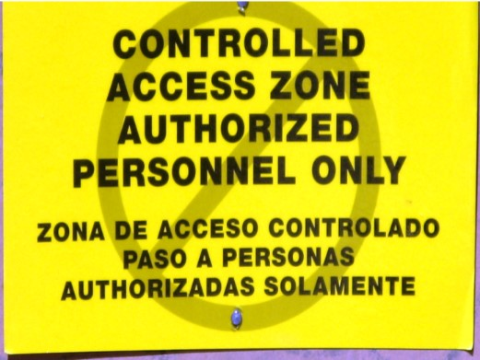
CAZ Must Be Clearly Identified
Notes:
Picture of a controlled access zone (CAZ) sign. This would be posted at the controlled access zone of a construction site.

Slide 130
Summary
Importance of Fall Protection
How to recognize hazards
What are the OSHA requirements
Types of Fall Protection
Conventional – guardrails, hole covers, PFAS
Other – ladders, scaffolds, lifts, safety nets
Alternative – fall protection plans, Controlled Access Zone

Slide 131

QUESTIONS

