Slide 1
OMD Safety Policy Training
Hazard Communication
For
OMD Employers & Workers

Slide 2
Disclaimer
References
OSHA 29 CFR 1910.1200
AGP 99.200.05 Hazard Communication Policy
ORARNGR 200-1
ORARNG PAM 200-1
ORARNGR 420-47
Notes:
OSHA has previewed materials used in class but is not responsible for its presentation or any omission(s) or incorrect statements.

Slide 3
Overview of Class
Overview of Class
Brief History of Workplace Safety in America
Introduction to OSHA
OSHA Rights & Responsibilities
Brief History of Hazardous Materials
OSHA Hazard Communication Standard
Container Labeling
Safety Data Sheets (SDS)
Worker Training
Notes:
Review class objectives of:
Trainer/Facilitators
Reduce and eliminate as much as is possible injury, illness and death due to exposure to hazardous materials in the workplace
Ask class about their objective in attending class
Write down any objectives beyond class objectives on note chart and
post on wall to review later if able

Slide 4
Glossary of Acronyms Used
Glossary of Acronyms Used
OSHA – Occupational Safety and Health Administration
HazCom – Hazard Communication
HCO – Hazard Communication Officer
HCP – Hazard Communication Plan
CDC – Centers for Disease Control and Prevention
NIOSH – National Institute for Occupational Safety and Health
NIH – National Institutes of Health
SDS – Safety Data Sheet
PEL – Permissible Exposure Limit
PPE – Personal Protective Equipment
AGP – Adjutant General Personnel
AGI – Adjutant General Installations
Notes:
Ask class to speak up if there are any acronyms they see but do not understand. Explain that although the OSH Act of 1970 created both OSHA and NIOSH (in the CDC) they are in different departments of the government. PEL is the total amount of a hazardous material a worker may legally be exposed to during their work shift. The PEL is a time weighted average typically over eight hours
Ask class to name items of PPE: safety glasses, hard hat, face shield, protective apron or glove a worker wears to try to protect themselves from injury.

Slide 5
Introduction to OSHA
Introduction to OSHA
With the Occupational Safety and Health Act of 1970, Congress created the Occupational Safety and Health Administration (OSHA) to assure safe and healthful working conditions for men and women by setting and enforcing standards and by providing training, outreach, education and assistance. The OSH Act covers most private sector employers /workers, as well as some public sector employers/workers in 50 states and certain territories/jurisdictions.
Public Law 91-596 Introduction
Notes:
Besides creating OSHA the OSH Act of 1970 also created the National Institute on Occupational Safety and Health (NIOSH) which is charged with determining how to protect workers from hazard exposure.
NIOSH is a part of the Centers for Disease Control and Prevention (CDC).
As such NIOSH makes recommendations to OSHA on what a “safe level of exposure to hazards” OSHA should use when promulgating a new standard or updating existing standards. What OSHA enforces is the legally allowable exposure to a hazardous material during a work shift. It is called the Permissible Exposure Limit (PEL).

Slide 6

The Occupational Safety and Health Act of 1970 sets out the rights and responsibilities of employers and workers. 5(a) Each employer
(1) shall furnish to each of his employees work and a place of employment which are free from recognized hazards that are causing or are likely to cause death or serious physical harm to his employees;
(2) shall comply with occupational safety and health standards set forth under this Act.
Together these are known as the
General Duty Clause.
Notes:
Section 5(a)(1) of the OSH Act of 1970 is commonly referred to as the General Duty Clause which means that if there is no specific standard for a given hazard employers are still required to protect their workers from the hazard.
Some examples would be ergonomic hazards, heat or cold working temperature hazards, workplace bullying or violence.

Slide 7
Introduction to OSHA
Some Worker rights under OSHA include:
Right to medical exam(s) or test(s) performed for work related purposes
Right to refuse work that could kill or seriously injure them (known as imminent danger)
Right to know about workplace injuries and illnesses
Right to hazard monitoring results
Right to know what kinds of chemicals are used in their workplace
Notes:
These rights relate directly to OSHA’s Hazard Communication Standard.
OSHA’s HazCom Standard is often referred to as the Right To Know law
Workers have the right to get this information but must ask for it. To ensure to protect yourself always make the request with at least one witness present.
Better protection is to mail your request with a “delivery confirmation” card and restricted delivery as it will show to whom and when the request was made.

Slide 8
Introduction to OSHA
Some Worker rights under OSHA include:
Right to file a complaint with OSHA
Right to get information
Right to have an OSHA inspection
Right to know about hazards
Right to health and safety training
Right not to be discriminated against for health and safety activities
Notes:
If you use any of your OSHA rights, encourage coworkers to use their rights, are injured on the job and terminated OSHA will fight for you to make you whole. What this means is that OSHA will fight to get you your job back, any/all lost wages, seniority, benefits you would have earned had you not been fired.

Slide 9

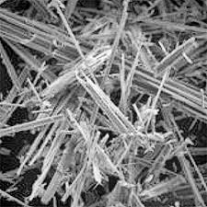

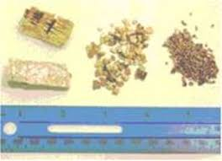
A Brief History of Hazardous Materials
Brief History of Hazardous Materials
The use of hazardous materials in the workplace is nothing new. Many of the hazards associated with a number of materials have been known for a long time.
Lead
Asbestos
Notes:
Many substances have been known to be detrimental to workers that use them or work around them. Mercury can cause permanent damage to your kidneys or your central nervous system. Lead can cause neurological affects, gastrointestinal affects, anemia and kidney disease. Asbestos is so hazardous that one fiber is considered an imminent threat to your health. It can take years or decades for asbestos-related illness to arise.
Ask participants if they can think of anything – chemical or otherwise – that might be hazardous to your health and/or safety at work?
Write any answers proffered on the note pad. If participants are slow to think of any try suggesting Mercury, sulfur, phosphorus, lye, cobalt, ...

Slide 10
Brief History Of Hazardous Materials
The use of hazardous materials in the workplace is nothing new. Other hazardous materials were not created or used until more “modern” times such as the 18th, 19th, or 20th century.
Benzene
Methylene Chloride
Vinyl chloride
4,4-Biphenol
Acetone
Acrylonitrile
Chromium (IV)
Cadmium
Diacetyl
Toluene
1,2-dibromo-3-chloropropane
Notes:
While the hazardous materials or chemicals in the modern workplace may be older or of recent design or creation they can often be protected against by simple, long standing methods. Occasionally more complicated procedures must be used. This workshop will help you learn how and where to find the information that will keep workers safe and the work environment healthy.

Slide 11
Introduction to Hazard Communication
Introduction to Hazard Communication
In order to help employers and workers OSHA created Subpart Z, otherwise known as the Hazard Communication Standard. It’s stated purpose being “to ensure that the hazards of all chemicals produced or imported are classified, and that information concerning the classified hazards is transmitted to employers and employees.”
29 CFR 1910.1200(a)(1)
Notes:
In 2012 OSHA updated the Hazard Communication Standard to align with the United Nations Globally Harmonized System of Classification and Labeling of Chemicals (GHS).
What this means is that regardless of where in the world the chemical is created/manufactured, shipped or stored it will be labeled the same. It also means that all labels will have the same format and the information will be quicker to find. The same goes for the SDS sheet for the chemical. All of the information will be found in the appropriate section and the SDS Sections will be in the same order regardless of manufacturer, shipper, warehouser or country of origin.

Slide 12
OSHA’s Hazard Communication Standard
OSHA’s Hazard Communication Standard
The Hazard Communication Standard has requirements of employers to train their workers concerning hazardous chemicals and materials in the workplace.
These requirements are the same in General Industry, Construction and Maritime Industries.
OMD AGP-99.200.05 policy states a Hazardous Communication Officer (HCO) for each site will be appointed by the site manager.
Facilities will be responsible for maintenance of SDS, labeling and inventory.

Slide 13
OSHA’s Hazard Communication Standard
OSHA’s Hazard Communication Standard
…is intended to address comprehensively the issue of classifying the potential hazards of chemicals, and communicating information concerning hazards and appropriate protective measures to employees
29 CFR 1910.1200(a)(2)
Notes:
Ask participants to name some of the chemicals used in their workplace.
Make list on chart paper. Post it on the wall
Ask if anyone brought a SDS sheet from their workplace
Our goal is to provide, in print, the verbatim standard so employees and employers know exactly what is expected for their safety and compliance

Slide 14
OSHA’s Hazard Communication Standard
Under it’s Hazard Communication Standard OSHA requires that employers provide effective information and training to employees
at the time of initial assignment
when new chemical hazards arise the worker has not previously been trained about is introduced into their work area
29 CFR 1910.1200(h)(1) AGP-99.200.05
Notes:
“At the time of initial assignment” means when the worker is first hired or changes work responsibilities.
“when new chemical hazards arise” refers to changes in chemicals used or in manner in which they are used or which worker is using them.

Slide 15
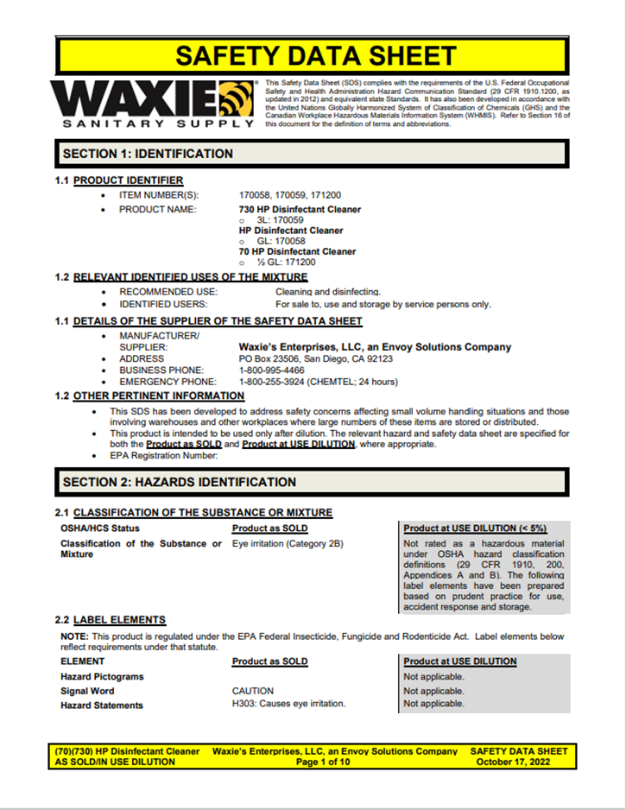
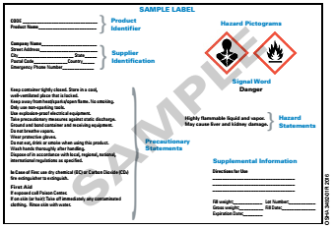
OSHA’s Hazard Communication Standard
While information and training may cover categories of hazards or specific chemicals used by the worker the employer must ensure that chemical specific information is made available through labels and Safety Data Sheets (SDS).
Notes:
Refer participants to GHS Labeling handouts:
Refer participants to SDS handouts:
Waxie SDS Current product used at <Insert Location>

Slide 16
Understanding Critical SDS Information
Section 2: Hazard(s) Identification: GHS pictograms, signal words (Danger, Warning), hazard statements.
Section 4: First-Aid Measures: What to do in case of exposure (eye contact, skin contact, inhalation, ingestion).
Section 5: Fire-Fighting Measures: Suitable extinguishing media, specific hazards arising from the chemical.
Section 6: Accidental Release Measures: How to contain and clean up spills.
Section 7: Handling and Storage: Safe handling practices, storage requirements.
Section 8: Exposure Controls/Personal Protection: Permissible Exposure Limits (PELs), appropriate PPE (gloves, eye protection, respirators).

Slide 17
Let's Look at a Real SDS
Insert an image of a Safety Data Sheet for a chemical used at your workplace.
Annotations: Point out the key sections discussed in the previous slide. Highlight the signal word, hazard statements, and PPE requirements.

Slide 18

Where to Find SDSs at Our Workplace
SDSs are located at your workplace. and in EESOH-MIS.
Explain the procedure for obtaining an SDS if one is missing.

Slide 19
Before You Use a Chemical
Always read and understand the SDS before using a new chemical or substance.
If you have questions, ask your supervisor.
Never use a chemical if you are unsure of its hazards or how to handle it safely.

Slide 20
OSHA’s Hazard Communication Standard
Labels and other forms of warning:
The chemical manufacturer, importer, or distributor shall ensure that each container of hazardous chemicals leaving the workplace is labeled, tagged, or marked.
29 CFR 1910.1200(f)(1)
Notes:
Refer participants to sample labels in folder.
This information reconfirms to the participants that it is the employers responsibility to ensure containers are labeled/etc, and this ultimately falls to the manufacturer and distributor to ensure that is the case. This slide shows where responsibility lies.
marked in accordance with this section in a manner which does not conflict with the requirements of the Hazardous Materials Transportation Act (49 U.S.C. 1801 et seq.) and regulations issued under that Act by the Department of Transportation
OSHA is not the only governmental agency that regulates hazardous chemicals and materials.
The Department of Transportation uses the NFPA 704 shield to convey, along with placards, health and safety information.
OSHA’s HazCom and the DOT NFPA704 systems convey similar information but in different ways. Caution must be used not to confuse the systems and the means used to convey important information.

Slide 21
OSHA’s Hazard Communication Standard
Where the chemical manufacturer or importer is required to label, tag or mark the following information shall be provided:
Product identifier
Signal word
Hazard statement(s)
Pictogram(s)
Precautionary statement(s)
Name, address, and telephone number of the chemical manufacturer, importer, or other responsible party
Notes:
29 CFR 1910.1200(f)(1)(i) – 1910.1200(f)(1)(vi) must be in English but may also be in other languages.
1910.1200(f)(6) contains the requirements for employers labeling hazardous chemicals in the workplace.

Slide 22









OSHA’s Hazard Communication Standard
Labels and other forms of warning
Pictograms – 9 are used in the GHS
29 CFR 1910.1200 App C.2.3
Notes:
A major new part of the HazCom Standard that was adopted with the inclusion of the Globally Harmonized System is the use of “pictograms” on the labels of hazardous chemicals and materials.
The idea behind the pictograms is to quickly convey important information to workers about the hazards associated with the chemicals or materials without having to reference SDS.
The pictograms are defined as to how they are shaped and colored as well as the specific hazard symbols and classes in Appendix C of the Hazard Communication Standard.
The NFPA 704 is not a part of OSHA’s HazCom Standard

Slide 23
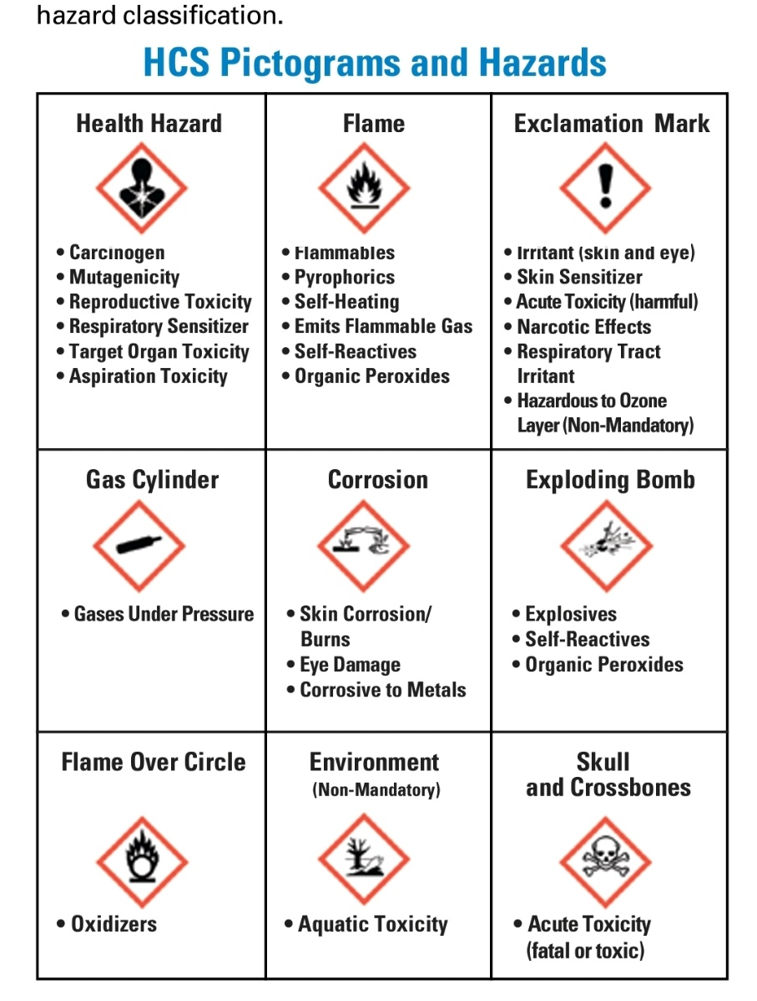
29 CFR 1910.1200 App C.2.3
Notes:
A major new part of the HazCom Standard that was adopted with the inclusion of the Globally Harmonized System is the use of “pictograms” on the labels of hazardous chemicals and materials.
The idea behind the pictograms is to quickly convey important information to workers about the hazards associated with the chemicals or materials without having to reference SDS.
The pictograms are defined as to how they are shaped and colored as well as the specific hazard symbols and classes in Appendix C of the Hazard Communication Standard.
The NFPA 704 is not a part of OSHA’s HazCom Standard

Slide 24

Recognizing Hazard Pictograms
Notes:
Explain each pictogram and the type of hazard it represents:
Exclamation Mark: Irritant (skin and eye), Skin Sensitizer, Acute Toxicity (harmful), Narcotic Effects, Respiratory Tract Irritant
Health Hazard: Carcinogen, Mutagenicity, Reproductive Toxicity, Respiratory Sensitizer, Target Organ Toxicity, Aspiration Toxicity
Skull and Crossbones: Acute Toxicity (fatal or toxic)
Corrosion: Skin Corrosion/Burns, Eye Damage, Corrosive to Metals
Environment: Aquatic Toxicity (non-mandatory)
Exploding Bomb: Explosives, Self-Reactives, Organic Peroxides
Flame: Flammables, Self-Reactives, Pyrophorics, Self-Heating, Emits Flammable Gas, Organic Peroxides
Flame Over Circle: Oxidizers
Gas Cylinder: Gases under pressure

Slide 25
OSHA’s Hazard Communication Standard
Labels and other forms of warning
Workplace labeling
The employer may use signs, placards, process sheets, or other such written materials in lieu of affixing labels to containers, as long as the alternative method identifies the containers to which it is applicable and conveys the information required to be on a label.
Notes:
The employer shall ensure the written materials are readily accessible to the employees in their work area throughout each work shift
Examples of other written materials might be signs directly above a safe usual and customary storing place for the chemical compounds if not directly attached to the container

Slide 26
OSHA’s Hazard Communication Standard
The employer is not required to label portable containers into which hazardous chemicals are transferred from labeled containers, and which are intended only for the immediate use of the employee who performs the transfer.
(1910.1200(f)(8))
Notes:
These chemicals in an unmarked container must not be used by anyone other than the worker that transferred the chemical(s) to the unlabeled container AND they must be completely used up by the end of the work-shift in which they were transferred into the unlabeled container.
For purposes of this section, drugs which are dispensed by a pharmacy to a health care provider for direct administration to a patient are exempted from labeling
Many healthcare professionals would consider medication to be a chemical but it is not under HazCom

Slide 27
OSHA’s Hazard Communication Standard
Labels and other forms of warning
Workplace labeling.
The employer shall not remove or deface existing labels on incoming containers of hazardous chemicals, unless the container is immediately marked with the required information
(1910.1200(f)(9))
Notes:
Reaffixing or applying labels that are removed or defaced cannot wait until a later time as marking mistakes could be made and/or failed to be reapplied. Always immediately mark with required information if existing labels are removed/defaced

Slide 28
OSHA’s Hazard Communication Standard
Labels and other forms of warning
Workplace labeling.
The employer shall ensure that workplace labels or other forms of warning are legible, in English, and prominently displayed on the container, or readily available in the work area throughout each work shift.
Employers having employees who speak other languages may add the information in their language to the material presented, as long as the information is presented in English as well
(1910.1200(f)(10))
Notes:
English is the most widely spoken language in America and therefore the information must be in English in order to reach the largest portion of the workforce. If there is room the same information can be marked on the container in another language(s).
While it is not a strict requirement to have material in additional language, it is the duty of employers to ensure that hazard communications can be understood by their employees, as such they should have materials in the language that is primary for their workforce. Contact OSHA or the manufacturer for materials on hazard communication or particular compounds in other languages

Slide 29
OSHA’s Hazard Communication Standard
Labels and other forms of warning
Workplace labeling.
Chemical manufacturers, importers, distributors, or employers who become newly aware of any significant information regarding the hazards of a chemical shall revise the labels for the chemical within six months
and shall ensure that labels on containers of hazardous chemicals shipped after that time contain the new information.
(1910.1200(f)(11))
Notes:
As has sometimes happened in the past it may be that a certain hazard was not associated with a particular substance as it was not used in the manner now being employed or there may not have been sufficient cases of injury previously to associate the injury, illness or death with the substance.
If the chemical is not currently produced or imported, the chemical manufacturer, importer, distributor, or employer shall add the information to the label before the chemical is shipped or introduced into the workplace again.
it is important for them to know that if new information about the material is determined, it is required for that information to be included for their safety. They know that as new info comes out, their safety is a focus

Slide 30
OSHA’s Hazard Communication Standard
Safety Data Sheets
The chemical manufacturer or importer preparing the safety data sheet shall ensure that it is in English (although the employer may maintain copies in other languages as well),
and includes at the required section numbers and headings, and associated information
(1910.1200(g)(2))
Notes:
It is urged that copies be available in the languages of the employees to ensure their safety
This information is relevant for further researching the compounds as needed, for example in determining how it might react with another chemical that is on site for those interested in these questions

Slide 31
OSHA’s Hazard Communication Standard
Safety Data Sheets
Retail (and Wholesale) distributors selling hazardous chemicals…shall provide a safety data sheet to employers upon request, and shall …inform them that a safety data sheet is available
The retail distributor shall provide the employer, upon request, with the name, address, and telephone number of the chemical manufacturer, importer, or distributor from which a safety data sheet can be obtained
(1910.1200(g)(7)(iv))
Notes:
This helps ensure that employers are aware of the chemicals and the inherent hazards associated with them so that they can look for and use the best product for their needs without exposing workers to undue hazard. The fewer hazards and the less hazardous they are the safer and healthier the workplace and the work.
This means that if you are running a retail store and an employer shops for hazardous chemicals in your shop you must either be able to provide them with a SDS sheet or help them get one from somewhere such as your supplier or the manufacturer.

Slide 32
OSHA’s Hazard Communication Standard
Safety Data Sheets
The employer shall maintain in the workplace copies of the required safety data sheets for each hazardous chemical, and shall ensure that they are readily accessible during each work shift to employees when they are in their work area(s)
Electronic access to the safety data sheets are permitted as long as no barriers to immediate employee access in each workplace are created by such options.
29 CFR 1910.1200(g)(8)
Notes:
What this means is that neither the Hazard Communication Program nor specifically the SDS sheets can be kept in an area that does not allow access to them anytime there is work being performed in the workplace.
It also means that if the SDS sheets are only available in electronic format that there must be a means of the workers to access them at all times which could include power outages.

Slide 33

OSHA’s Hazard Communication Standard
OSHA mandates that employees be informed of:
The requirements of this section
Any operations in their work area where hazardous chemicals are present
The location and availability of the written hazard communication program
Including the required list(s) of hazardous chemicals
Safety Data Sheets required by this section
Notes:
Ask if employees know where to find written hazard information/SDS in their worksite.

Slide 34
OSHA’s Hazard Communication Standard
Worker training must include at least:
New employees should be given a copy of the Hazard Communication Plan as part of orientation.
An overview of the requirements contained in the HAZCOM standard 29 CFR 1910.1200;
Methods and observations that may be used to detect the presence or release of hazardous chemicals in the work area (e.g. monitoring conducted by the employer, continuous monitoring devices, visual appearance or odor of hazardous chemicals when being released)
AGP-99.200.05 29 CFR 1910.1200(h)(3)(i)
Notes:
Workers who do not feel adequately trained should either alert the employer and inform them of their responsibility, or contact OSHA

Slide 35
OSHA’s Hazard Communication Standard
Worker training must include at least:
Chemicals present in their workplace operations and this office.
Location and availability of written HCP
Physical and health effects of the hazardous chemical listed on the inventory list of this program.
Methods and observation techniques used to determine the presence or release of hazardous chemicals in the work area.
How to lessen or prevent exposure to these hazardous chemicals through usage of control/work practices and PPE.
AGP-99.200.05 29 CFR 1910.1200(h)(3)(i)
Notes:
Workers who do not feel adequately trained should either alert the employer and inform them of their responsibility, or contact OSHA

Slide 36
OSHA’s Hazard Communication Standard
Worker training must include at least:
Steps taken to lessen or prevent exposure to the chemicals listed on the inventory list.
Emergency procedures to follow if exposed to chemicals
Location of SDS binders and location of hazardous inventories.
Proper labeling requirements for containers.
Explanation on how to read and interpret each SDS.
AGP-99.200.05 29 CFR 1910.1200(h)(3)(i)
Notes:
Workers who do not feel adequately trained should either alert the employer and inform them of their responsibility, or contact OSHA

Slide 37
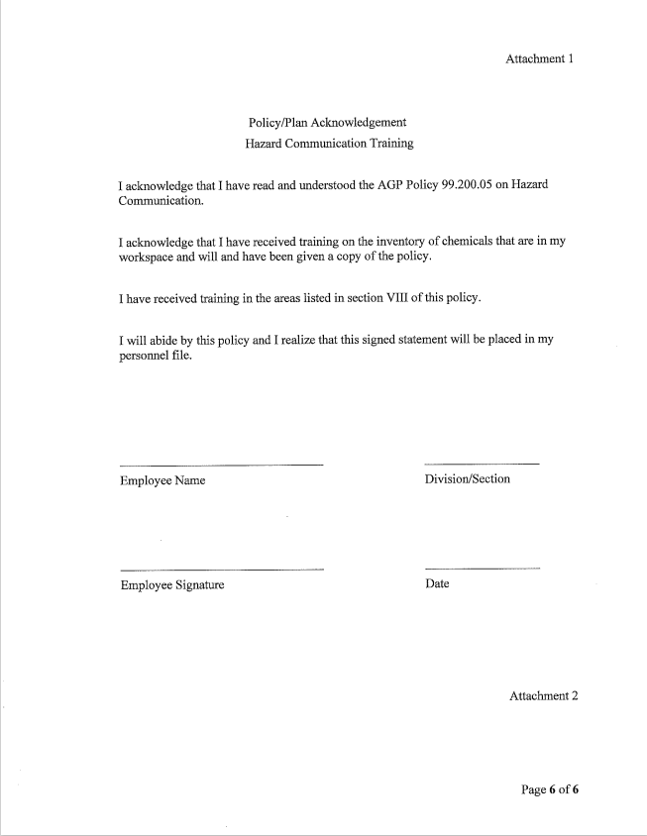
OSHA’s Hazard Communication Standard
Attachment 1 of OMD HazCom Policy:
AGP-99.200.05 Attachment 1 29 CFR 1910.1200(h)(3)(i)
Notes:
Workers who do not feel adequately trained should either alert the employer and inform them of their responsibility, or contact OSHA

Slide 38
PPE
Common types of PPE include:
Gloves (specify the types of gloves needed for different chemicals)
Eye protection (safety glasses, goggles, face shields)
Respirators (if required – discuss types and proper fit testing)
Protective clothing (aprons, coveralls)
PPE must be properly fitted, used, and maintained.
Inspect PPE before each use for damage or defects.
Wear PPE correctly.
Remove PPE carefully to avoid contaminating yourself.
Clean and store PPE properly.
Replace damaged or worn PPE immediately.
Know where PPE is located in the workplace.

Slide 39
Chemical Spills
In case of a spill:
Alert others in the area.
Evacuate if necessary.
Contain the spill if it is safe to do so.
Use appropriate PPE.
Clean up the spill according to the SDS and company procedures.
Report the spill to your supervisor or safety coordinator.
Never attempt to clean up a spill if you are not properly trained or equipped.
Report all chemical exposures to your supervisor or safety coordinator immediately.

Slide 40
Thank You!
Knowledge Check

Slide 41
Thank You!
When was the Occupational Safety and Health Administration Act established?
1970

Slide 42
Thank You!
How many sections are on the Safety Data Sheet?
16

Slide 43
Thank You!
When are employers required to provide training and information about the HAZCOM program?
At the time of initial assignment and When a new chemical is introduced into the work place

Slide 44
Thank You!
Can the SDS be stored in electronic form?
Electronic access to the safety data sheets are permitted as long as no barriers to immediate employee access

Slide 45
Thank You!
Where is the HCP located at Rees Training Center?
Bldg. 5026 Facilities Manager Office

Slide 46
Thank You!
How many pictograms are used within the Global Harmonization System?
9

Slide 47

Thank You!
What hazard is depicted in the Pictogram below?
Environment – Aquatic Toxicity

Slide 48
Thank You!
What language MUST be used for SDS?
English

Slide 49
Thank You!
Are SDS only required for domestic manufactures of chemicals?
No, The chemical manufacturer, importer, or distributor are required

Slide 50
What to Do If a Label is Missing or Damaged?
Do not use the chemical if the label is missing or damaged.
Report the missing or damaged label to your supervisor or safety coordinator immediately.
The container must be properly relabeled before it can be used.

Slide 51
Thank You!
What is the OMD Policy number and where can YOU find it, as it pertains to HAZCOM?
AGP-99.200.05
OMD Website-> State Personnel Office-> Safety-> Policies

Slide 52
Thank You!
Thank You!
Questions?
Please don’t hesitate to ask!

