Slide 1
OMD Safety Policy Training
HEARING CONSERVATION

Slide 2
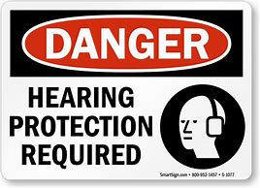
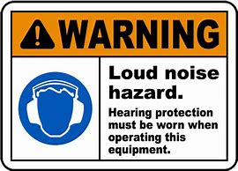
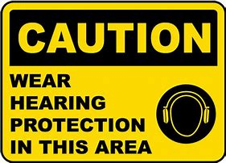
Hearing Conservation
Notes:
I. Background for the Trainer:
The Occupational Safety and Health Administration (OSHA) requires employers to administer an effective Hearing Conservation Program whenever employee noise exposure equals or exceeds an 8-hour time-weighted average (TWA) sound level of 85 decibels (29 CFR 1910.95(C)(1)).
Hand out copies of your company’s hearing conservation plan or tell the employees where or how they can obtain copies.
II. Speaker’s Notes:
Through monitoring, we have determined that some employees are exposed to occupational noise at levels where OSHA requires us to have an effective hearing conservation plan.
Our hearing conservation plan includes monitoring, employee notification and observation of monitoring, hearing testing, hearing protection, training, and recordkeeping.
This training program will cover:
Impact of workplace noise on hearing
Advantages and disadvantages of hearing protection devices
Use, care, and fit of hearing protection devices
Need for hearing testing and what to expect

Slide 3
Hearing Conservation
References
OSHA 29 CFR 1910.95
ORARNG Regulation 385-10
AGP 99.200.01 PPE Policy
AGP 99.200.07 Hearing Conservation Policy
Notes:
I. Background for the Trainer:
The Occupational Safety and Health Administration (OSHA) requires employers to administer an effective Hearing Conservation Program whenever employee noise exposure equals or exceeds an 8-hour time-weighted average (TWA) sound level of 85 decibels (29 CFR 1910.95(C)(1)).
Hand out copies of your company’s hearing conservation plan or tell the employees where or how they can obtain copies.
II. Speaker’s Notes:
Through monitoring, we have determined that some employees are exposed to occupational noise at levels where OSHA requires us to have an effective hearing conservation plan.
Our hearing conservation plan includes monitoring, employee notification and observation of monitoring, hearing testing, hearing protection, training, and recordkeeping.
This training program will cover:
Impact of workplace noise on hearing
Advantages and disadvantages of hearing protection devices
Use, care, and fit of hearing protection devices
Need for hearing testing and what to expect

Slide 4
Hearing Conservation
Lesson Objectives
Identify References and Policies
Define Hearing Loss
Identify signs of Hearing Loss
Identify Controls
Identify various Hearing Protection Devices
Understanding of the Hearing Conservation Program
Complete Assessment
Notes:
I. Background for the Trainer:
The Occupational Safety and Health Administration (OSHA) requires employers to administer an effective Hearing Conservation Program whenever employee noise exposure equals or exceeds an 8-hour time-weighted average (TWA) sound level of 85 decibels (29 CFR 1910.95(C)(1)).
Hand out copies of your company’s hearing conservation plan or tell the employees where or how they can obtain copies.
II. Speaker’s Notes:
Through monitoring, we have determined that some employees are exposed to occupational noise at levels where OSHA requires us to have an effective hearing conservation plan.
Our hearing conservation plan includes monitoring, employee notification and observation of monitoring, hearing testing, hearing protection, training, and recordkeeping.
This training program will cover:
Impact of workplace noise on hearing
Advantages and disadvantages of hearing protection devices
Use, care, and fit of hearing protection devices
Need for hearing testing and what to expect

Slide 5
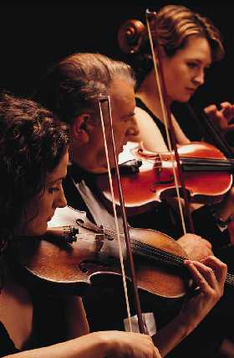
Hearing Loss
Can you imagine not being able to:
Hear music?
Listen to the sounds of nature?
Socialize with your family?
Can you imagine being afflicted with uncomfortable ringing or abnormal sounds that interfere with sleep?
Notes:
I. Speaker’s Notes:
Hearing health is an important part of the quality of life. Try to imagine if you could not hear. What would your life be like?
Many people with hearing loss experience constant uncomfortable ringing or abnormal sounds that even interfere with their sleep.
Don’t you think that if you work 35 to 40 years that you deserve to retire with complete hearing ability?
Continued exposure to noise above 85 decibels can result in hearing loss.

Slide 6
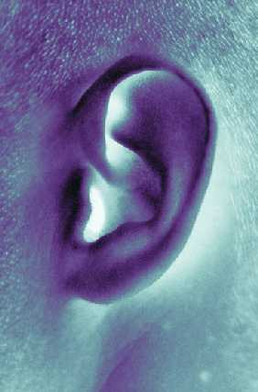
How We Hear Sounds
Sound waves enter the ear canal
Eardrum vibrations pass along tiny bones
Tiny hairlike cells flow back and forth
The auditory nerve sends signals that are registered as sound to the brain
Notes:
I. Background for the Trainer:
This information is important because most people do not understand how they hear sounds. This helps them understand how noise can damage their hearing.
II. Speaker’s Notes:
Sound waves enter the outer ear and travel down the ear canal where they strike the eardrum.
The eardrum vibrations are passed along by tiny bones, sometimes referred to as the hammer, anvil, and stirrup, into the inner ear.
The vibrations cause tiny hairlike cells in the inner ear to move back and forth, much the way a field of wheat or grass is moved by the wind.
The movement of the tiny hairlike cells stimulates the auditory nerve that sends the sound signal to the brain.

Slide 7
How Hearing Is Damaged
Hearing ability consists of delicate parts
Hairlike cells are flattened
You do not get used to noise; you gradually lose your hearing
Once hearing is damaged, it cannot be repaired or replaced
Notes:
I. Speaker’s Notes:
As discussed on the previous slide, you can see that the hearing process consists of many delicate parts. If one of those parts is damaged, then hearing will also be damaged.
The most common way of losing hearing is through gradual damage to the delicate hairlike cells.
Normal sounds cause the cells to move back and forth like grass in a gentle breeze.
Loud noise will cause the hair to lie flat. Once the noise stops, the hairs will spring back much the way a trampled field of grass will slowly spring back.
Eventually, over a long period of loud noise exposure, the tiny hairlike cells will take longer and longer to spring back until one day they are too damaged to return to their normal position.
Have you ever heard someone say “The noise doesn’t bother me; I’m used to it.”? The person is not getting used to the noise, but losing hearing function, so the noise doesn’t seem as loud and doesn’t bother him or her as much as it did in the past.

Slide 8

Signs of Hearing Loss
Difficulty hearing people speak
Inability to hear certain high-pitched or soft sounds
Noise or ringing in ears
Getting complaints that the radio or TV volume is too high
Notes:
I. Background for the Trainer:
Ask employees if they can think of any other possible signs of hearing loss that they or someone they know have experienced.
II. Speaker’s Notes:
Hearing loss often goes undetected because it is a gradual and pain-free process.
Do people have to repeat what they say for you to hear them?
Do you have trouble hearing certain sounds, such as the ticking of a clock or a watch?
Do you feel as if noise or ringing sounds always echo through your ears?
Do others tell you to turn down the volume of the TV when you think it is at a normal level? When they turn the volume down to a level that is comfortable for them, is it too soft for you?
People who answer yes to any of these questions may have damaged hearing.

Slide 9
Types of Noise
If Noise levels exceeds 90 dBA, OSHA requires Engineer and Admin controls
Pitch or frequency
Loudness
Whisper 10 decibels
Street sounds 70 decibels
Sander 85 decibels
Sporting event 100 decibels
Mowing the lawn 101 decibels
Motorcycle riding 112 decibels
Concerts 125 decibels
Shooting range 130 decibels
Notes:
I. Background for the Trainer:
Ask the employees if they can think of other activities that are loud.
II. Speaker’s Notes:
Pitch or frequency, which is measured in hertz, refers to shrill noises such as whistles, high-pitched screams, fingernails on a chalkboard, etc. These noises are much more likely to harm your hearing, especially when they are also loud noises.
Loudness is measured in decibels with a sound meter.
Hearing damage is risked when you are exposed to more than 90 decibels during an 8-hour time period without hearing protection.
140 decibels for any duration is considered very dangerous to your hearing.

Slide 10
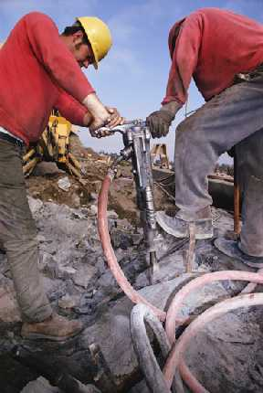
Does Noise Impact the Workplace?
Interferes with communication
Causes fatigue
Distracting or irritating
Reduces morale or efficiency
Notes:
I. Background for the Trainer:
Ask the employees if they feel that noise has impacted them at work.
II. Speaker’s Notes:
Verbal communication and the detection of warning shouts or signals are obviously reduced.
The strain from trying to hear or talk over the noise can cause you to become fatigued, increasing the risk of accidents.
Noise can be distracting or irritating and, therefore, increase the potential for workplace accidents because employees cannot focus on their job.
The constant physical or mental stress caused by noise can reduce employee morale and efficiency.

Slide 11
Noise Monitoring
Monitoring program and strategy
Sound level meters
Noise dosimeters
Repeat monitoring
Notes:
I. Background for the Trainer:
What was the monitoring strategy employed by your company? Who conducted the monitoring? Was it done internally or by an outside company? Discuss here.
Do you have a map that indicates all the high-noise areas and the results of your company’s noise monitoring? If so, pass it out.
II. Speaker’s Notes:
The first step of a Hearing Conservation Program is to conduct a noise level monitoring to determine what types of noise employees are exposed to. Employees or their representatives are provided the opportunity to observe any noise monitoring that is conducted. A typical noise monitoring strategy will:
Determine if noise hazards exist.
Identify employees who are impacted by high-noise levels.
Help prioritize noise control efforts and evaluate the success of those efforts.
Sound-level meters are used to conduct a survey of the workplace to determine which areas are impacted by high levels of noise and should be studied further.
Noise dosimeters are the most accurate way of determining an employee’s exposure to noise. Employees wear this while they are working. A microphone is attached to the employee’s collar, near the ear. The dosimeter records all the noise levels and computes the average noise exposure level for that particular employee. This information can be transferred to other employees that do similar jobs.
Monitoring is repeated whenever a change in production, process, or equipment influences noise level exposures.

Slide 12
Affected Employees
Each employee exposed to noise at or above the 8-hour time-weighted average (TWA) of 85 decibels must be notified.
Affected employees must be included in the Hearing Conservation Program.
Notes:
I. Background for the Trainer:
How do you notify the employees who are exposed to an 8-hour TWA of 85 decibels or greater? Do they receive a written letter, which they are required to acknowledge with a signature, and is placed in their file?
II. Speaker’s Notes:
Now that monitoring is complete, it is time to determine which employees are impacted or exposed to high levels of noise.
All employees exposed to 85 decibels or more for an 8-hour TWA are considered “affected employees” and must participate in this training program. Employees not exposed at that level may also be trained.
Inclusion in the Hearing Conservation Program means that you are impacted by the requirements of the program, which we will discuss in the following slides.

Slide 13
Hearing Tests
Audiometric testing offered
Conducted by qualified medical provider
Baseline tests
Annual testing – If noise level is 85 dBA Time-Weighted Average or greater, it is required the employer provide annual testing.
AGP 99.200.07 Attachment 2
Notes:
I. Background for the Trainer:
Set up an audiometric testing program with your local clinic or hospital. There are even some mobile companies that will bring the testing equipment to your worksite.
Consider scheduling your employees for hearing exams prior to the class and bring the schedule to the class.
How are your employees informed of the results of their hearing tests?
Employees should also be tested if reassigned out of the high-noise area or when terminated. This will provide extra defense against an unwarranted hearing loss claim.
II. Speaker’s Notes:
Hearing, or audiometric, tests are offered to all employees who are included in the Hearing Conservation Program (i.e., exposed to an 8-hour TWA 85 decibels or greater).
The hearing tests are conducted by a qualified medical provider who will also evaluate the hearing test results.
The first test, or baseline test, must be conducted within an employee’s first six months of inclusion in the Hearing Conservation Program. OSHA requires baseline hearing tests to be preceded by 14 hours without exposure to workplace noise.
Follow-up tests are conducted annually. The results are compared with your baseline to look for any signs of hearing loss.

Slide 14
Standard Threshold Shift
Hearing ability changed by an average of 10 decibels
Employee notification within 21 days
Revised hearing protection required
Further medical evaluation
Complete Workday Safety Incident for exposure indicating hearing loss
AGP 99.200.07 Attachment 1
Notes:
I. Speaker’s Notes:
The hearing tests are evaluated to determine if any hearing loss has occurred.
Standard threshold shift (STS) is a change in hearing relative to the baseline test of an average of 10 decibels or more at 2,000; 3,000; and 4,000 Hertz in either ear. When evaluating for STS, age is a factor.
You must be notified within 21 days of detection of an STS.
Hearing protecting for that employee must be revised. If not previously required to wear hearing protection (i.e., 8-hour TWA exposure between 85 and 90 decibels), then the employee is now required to wear hearing protection. If already required to wear hearing protection, then better protective equipment will be provided.
The hearing loss may also be attributed to a medical condition, so further medical evaluation may be required.

Slide 15
Noise Reduction Efforts
Engineering Controls
Reduce noise at the source
Interrupt the noise path
Reduce reverberation and structural vibration
Administrative
Operate noisy equipment on second or third shifts
Rotate employees through high-noise areas
Notes:
I. Background for the Trainer:
What kinds of engineering noise level controls does your company have in place? Describe these so that employees know what kind of effort your company is making to reduce noise.
Does your company utilize administrative controls? Describe them.
II. Speaker’s Notes:
Now that the company has conducted monitoring, determined affected employees, and initiated hearing exams, it is time to make efforts to reduce employee exposure to noise.
Engineering controls reduce the noise coming from the equipment and prevents the noise from affecting other areas of the workplace.
Mufflers reduce the noise at the source.
Acoustical curtains or walls block the path of the noise.
Sound-absorbing material is used to prevent noise from bouncing off walls.
Rubber mounts and lubrication may reduce noise from vibration.
Administrative controls attempt to reduce the number of people exposed to a noise or limit the amount of time employees can work in a high-noise area.

Slide 16
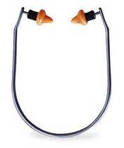
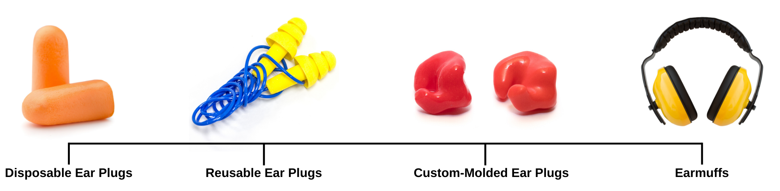
Hearing Protection Devices (HPDs)
PPE
Ear plugs
Disposable
Reusable
Custom-Molded
Canal caps
Earmuffs
Canal Caps
Notes:
I. Background for the Trainer:
What types of hearing protection devices does your company make available? Bring samples to the class, maybe even hand them out.
Describe how employees can obtain the hearing protection devices. Where do they go? What do they have to do?
II. Speaker’s Notes:
If noise exposure cannot be reduced with engineering or administrative controls, the next thing to do is to provide affected employees with hearing protection devices.
There are many different styles and brands of ear plugs, but they are all very similar. You can read the directions on the package, but basically you just squeeze one end, insert it into your ear, and allow it to expand and fill your ear canal. Ear plugs offer great protection from noise and are lightweight and unobtrusive. Just remember to make sure the plugs are clean before inserting them in your ear. Get a new pair at the beginning of each day.
Canal caps are useful for employees who are exposed to loud noise for short periods of time or someone who has to walk through a high-noise area to get from one department to another. They usually do not have the same protection as the plugs because they do not enter the ear canal; they merely cap the canal’s entrance.
Earmuffs are generally used as a supplemental protection from noise. They might be used in addition to ear plugs to help reduce noise exposure even further. If the earmuffs do not fit perfectly or seal adequately, they can actually increase noise exposure because noise may actually echo inside the “muff,” thus increasing in decibels, before entering the ear.
Headphones from portable radios do not count as a hearing protection device.

Slide 17
HPD Noise Reduction
HPDs must reduce employee noise exposure below an 8-hour TWA of 90 decibels
Employees with STS, noise exposure reduced below an 8-hour TWA of 85 decibels
Noise reduction ratio (NRR)
Lab versus real world
Ear plugs: use 1/3 of NRR
Earmuffs: use 1/2 of NRR
Notes:
I. Background for the Trainer:
What is the noise reduction ratio (NRR) of the hearing protection devices that your company is providing? Is it adequate?
II. Speaker’s Notes:
The purpose of hearing protection is to reduce your exposure to noise. The exposure must be reduced by the hearing protection device to at least an 8-hour time weighted average of 90 decibels.
If you who have suffered hearing loss and are classified as having experienced a standard threshold shift (STS), you must have hearing protection that reduces exposure to at least an 8-hour time-weighted average of 85 decibels.
Each hearing protection device is rated to reduce noise exposure by a certain number of decibels; this is called the noise reduction ratio (NRR). However, the listed NRR is a laboratory result. The real-world NRR will be significantly less because of inadequate fit and application.
For ear plugs, assume the real-world NRR is less than 1/3 of the NRR listed on the package.
For earmuffs, assume the real-world NRR is about 1/2 of the NRR listed on the package.
Note that removing hearing protection devices for short periods of the day (e.g., 30 minutes) will reduce the real-world NRR even further.

Slide 18
Hearing Protection Use
Voluntary use
Exposed to an 8-hour TWA of 85 decibels
Mandatory use
Exposed to an 8-hour TWA of 90 decibels
Exposed to an 8-hour TWA of 85 decibels but have not had a baseline hearing test
Employees who have suffered STS hearing loss and are exposed to an 8-hour TWA of 85 decibels
Notes:
I. Background for the Trainer:
The information on the slide is what OSHA requires. Your company may have internal rules that require the mandatory use of hearing protection by all employees if they are exposed to an 8-hour TWA of 85 decibels. This would be an easier program to manage.
In what areas and job functions of your company are hearing protection devices required?
The employer must provide a selection of hearing protection devices and train the employee in the proper selection and fitting.
II. Speaker’s Notes:
Now that we have learned about hearing protection devices and the noise reduction ratio, it is time to define the mandatory and voluntary use requirements of the hearing protection devices.

Slide 19
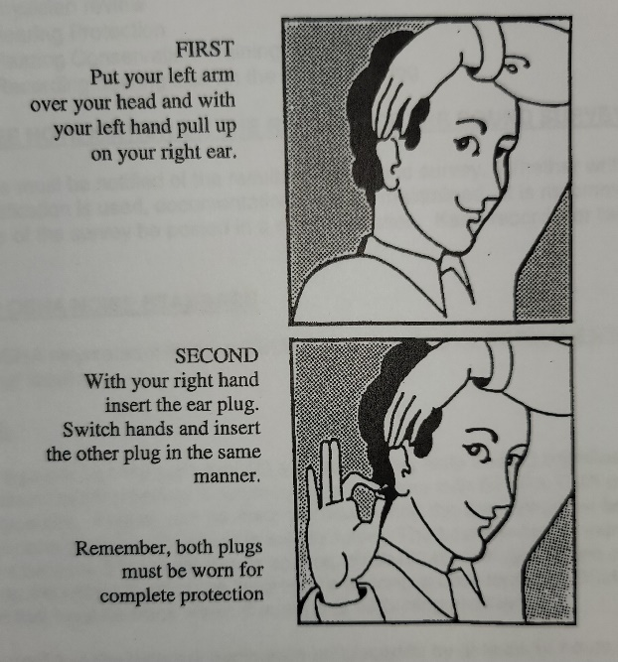
Management Responsibility
Provide hearing protection devices
Demonstrate commitment—wear HPDs
Provide hearing protection training
Enforce the use of HPDs
Knowledgeable in HPD selection and use
Encourage questions and solve problems
Notes:
I. Background for the Trainer:
Demonstrating your commitment to hearing protection is very important. Even if management is just walking through the shop for a few minutes, they must still wear hearing protection. If management doesn’t, employees are less likely to use hearing protection because they will doubt its importance when they see that their superiors aren’t using it.
II. Speaker’s Notes:
What are management’s responsibilities in the Hearing Conservation Program?
Enforcing the use of HPDs is just like the enforcement of any other safety rule or procedure.
Questions, suggestions, and problems that employees have must be passed along to management so that any issues can be resolved.

Slide 20

Training
Required annually
Topics must include:
How noise impacts hearing
Hearing protection devices
Hearing tests
Notes:
I. Speaker’s Notes:
Management is responsible for training according to the Hearing Conservation Program. This training must be conducted annually.
The topics required are the same topics we have discussed in this training session:
How noise impacts hearing
The care, use, and selection of hearing protection devices
Conducting and evaluating hearing tests

Slide 21
Recordkeeping
Noise monitoring results
Hearing test results – OMD Safety or HR office will provide a file for audiograms separate from other medical or personnel files. These files will be kept confidential.
Job assignments and noise exposure history
Hearing protection devices used
Records accessible
Notes:
I. Background for the Trainer:
OSHA requires recordkeeping for only noise exposure testing and the results of the hearing tests.
Worker’s job assignments, exposure history, and protection used are additional pieces of information that may be used for further evidence of your company’s due diligence and efforts to reduce the exposure to noise.
II. Speaker’s Notes:
The hearing conservation plan also requires management to maintain certain records.
The results of the noise monitoring, both area sound levels and individual dosimeter results, are maintained.
The results of the hearing tests are also maintained in each employee’s medical file.
Job assignments and exposure history will provide evidence of the type of exposure you have been subjected to.
Protection used helps prove that you were provided with adequate noise protection.
All records pertaining to this Hearing Conservation Program are available upon request to employees, former employees, and their representatives.

Slide 22
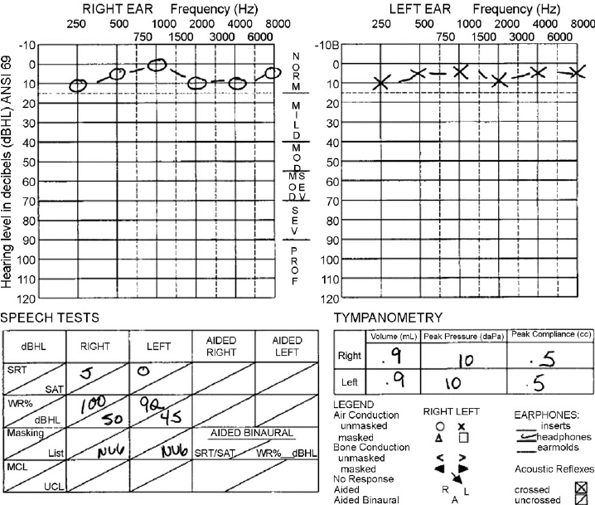
Recordkeeping
Notes:
I. Background for the Trainer:
OSHA requires recordkeeping for only noise exposure testing and the results of the hearing tests.
Worker’s job assignments, exposure history, and protection used are additional pieces of information that may be used for further evidence of your company’s due diligence and efforts to reduce the exposure to noise.
II. Speaker’s Notes:
The hearing conservation plan also requires management to maintain certain records.
The results of the noise monitoring, both area sound levels and individual dosimeter results, are maintained.
The results of the hearing tests are also maintained in each employee’s medical file.
Job assignments and exposure history will provide evidence of the type of exposure you have been subjected to.
Protection used helps prove that you were provided with adequate noise protection.
All records pertaining to this Hearing Conservation Program are available upon request to employees, former employees, and their representatives.

Slide 23
Employee Responsibility
Understand the need for Hearing Protection Devices (HPDs)
Wear HPDs and seek replacements
Encourage co-workers to wear HPDs
Communicate problems to supervisors
Notes:
I. Speaker’s Notes:
The Hearing Conservation Program also spells out requirements for employees.
After this class, you should understand the need for HPDs at work and at home.
Wear HPDs that are clean and in good condition. Get replacements when they become damaged or dirty.
As always, encourage your co-workers to be safe.
Communicate any problems with hearing protection devices or any concerns about potential new high-noise areas or equipment to your supervisor.

Slide 24
Summary
Constant exposure to noise over 85 decibels can cause hearing damage.
Hearing loss cannot be cured or repaired
Hearing tests are conducted annually
Hearing protection devices include ear plugs, earmuffs, and canal caps
Notes:
I. Background for the Trainer:
Consider adding an additional bullet point describing the areas of high noise in your company’s facility.
II. Speaker’s Notes:
Exposure to noise levels over 85 decibels for an extended period can cause permanent hearing loss.
Hearing tests are conducted annually.
Hearing protection devices must be worn to protect against hearing loss.

Slide 25
Knowledge Check
Employee participation in the Hearing Conservation Program is required when exposed to an 8-hour TWA noise level of _______ decibels.
True or False. Hearing damage can easily be repaired with surgery.
85
False. Hearing damage cannot be repaired or replaced. Hearing can only be aided once it is damaged.
Notes:
I. Background for the Trainer:
Remind employees that the quiz is to encourage further discussion and to help you, the trainer, be sure that everyone understands what was discussed.

Slide 26
Knowledge Check
3. Describe a sign of hearing loss:___________________.
4. Name two off-work activities that may expose you to high-noise levels: ______________, _______________.
Difficulty hearing people; noise or ringing; TV or radio is too loud for others.
Mowing the lawn, using a table saw, riding a motorcycle, attending a sporting event.
Notes:
I. Background for the Trainer:
Remind employees that the quiz is to encourage further discussion and to help you, the trainer, be sure that everyone understands what was discussed.

Slide 27
Knowledge Check
5. True or False. Your company keeps records of noise monitoring and hearing tests.
6. True or False. A noise dosimeter is used to test an employee’s hearing capability.
True. These records are available for employee review upon request.
False. Noise dosimeters are worn by employees to determine their level of noise exposure.
Notes:
I. Background for the Trainer:
Remind employees that the quiz is to encourage further discussion and to help you, the trainer, be sure that everyone understands what was discussed.

Slide 28
Knowledge Check
7. Describe one of the ways noise impacts the workplace:
____________________________________________.
8. Name two kinds of hearing protection devices:
________________________________________.
Disrupts communication, causes employee fatigue, distracts or irritates, reduces morale
Ear plugs, earmuffs, canal caps
Notes:
I. Background for the Trainer:
Remind employees that the quiz is to encourage further discussion and to help you, the trainer, be sure that everyone understands what was discussed.

Slide 29
Knowledge Check
9. In order to look for hearing loss, how often are hearing tests conducted? __________________________________
10. Name one of the ways management attempts to control employee noise exposure:__________________________________.
Hearing tests are conducted annually.
Engineering or administrative controls
Notes:
I. Background for the Trainer:
Remind employees that the quiz is to encourage further discussion and to help you, the trainer, be sure that everyone understands what was discussed.

Slide 30

Questions???

