Slide 1
OMD Safety Policy Training
HOT WORK

Slide 2
REFERENCE
AGP 99.200.14
29 CFR 1910.252
OAR 437-004-2310
Safety Committee Chairperson: <<insert>>

Slide 3
Hot Work Permits
Why are we here?
Notes:
Every year fires occur, which could have
been prevented had employees used appropriate
fire prevention measures.
OMD requires the use of the Hot Work Permit
system as a primary means of preventing fires due to non-routine open flame and high temperature processes.

Slide 4
Hot Work Permits
Goals and Objectives of this training:
Recognize
Familiarize
Realize
Notes:
Goals and Objectives:
At the end of this session, you will:
- Recognize work that requires the use of Hot Work Permits.
- Be familiar with the Hot Work Permit System.
- Pass a quiz with a score of 100%.

Slide 5
Hot Work Permits
Definitions:
Hot Work Any work that involves burning, welding, cutting, brazing, soldering, grinding, using fire or spark producing tools, or other work that produces a source of ignition.
Hot Work Permit Process for safely conducting hot work operations in areas where flammable atmospheres could exist.

Slide 6
Hot Work
Designated Areas
The following areas been designated as approved hot work areas. Hot work may be performed in these areas without the issuance of a hot work permit. Even though a permit is not required in these areas, authorized personnel must inspect this area for combustible and other hazards before beginning hot work operations. A functional extinguisher appropriate for the type of potential fire must be present at all times work is being performed.
Area 1: Bldg. 5033 NW corner of bldg.

Slide 7
Hot Work
Non-Designated
Areas
At a minimum, all the following precautions must be met before hot work in a non-designated area:
Wildland fire hazard
Building fire system
Combustible Materials moved
PPE
Fire watch
Permit
Notes:
For hot work with the potential for wildland fire, refer to the Open Burn Plan for your location.
If applicable, building fire system should be operational at the hot work location.
All combustible materials within 35 feet of the hot work area shall be moved to a safe distance.
If combustible materials cannot be moved, they must be protected by the fire-retardant covers or shielded with fire retardant metal guards.
Appropriate personal protective equipment (PPE), based upon a hazard assessment, is provided to employees performing hot work.
A fire watch is initiated during all hot work and for 30min after it has been stopped.
The hot work permit must be issued, and the area inspected, before work begins.

Slide 8
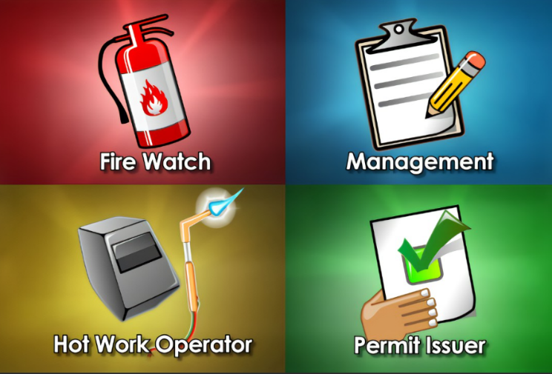
Hot Work Permits
Procedures include:
Hot permit request for approval
Approver inspection using permit checklist
Employees are informed
Communicating precautions
Once these necessary precautions taken:
Posting warning sign
Copies sent to manager
Firewatch for 30min
Approver informs workers of completed work
fire due to hot work (Hot work Safety ) - YouTube
Notes:
In order to ensure adequate controls and safety precautions are being used in non-designated hot work areas, a hot work permit system will be used.
Procedures:
Authorized person or supervisor will complete and submit hot work permit request (Attachment 1) for approval.
Hot work approver will review planned safety precautions and inspect the hot work site using the hot work permit checklist (Attachment 2).
Employees in the immediate area will be informed that hot work is going to be conducted and to avoid the area.
Hot work approver will communicate any additional special precautions that need to be taken prior to beginning operations.
If all necessary precautions have been taken and work can proceed, the hot work approver will complete the hot work permit (Attachment 3) and post the warning sign in a highly visible area (Attachment 4).
Copies of all hot work permit information will be sent to the manager.
Upon completion of the hot work operations and the 30 minute fire watch, the hot work issuer will inspect the completed job and ensure the area is clear and ready to return to normal operations.
Hot work approver will inform the employees in the immediate area that work is completed and to return to normal operations.

Slide 9
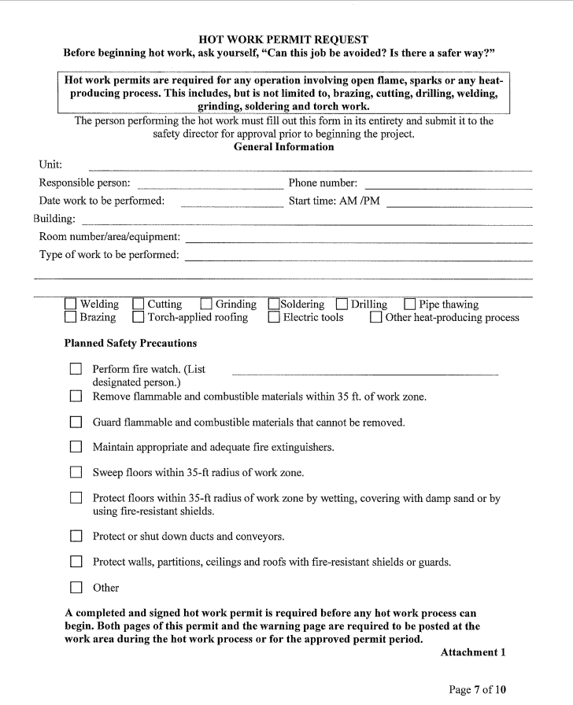
Notes:
Permits are issued for the
specific job being done, and
for a specific time period. The
time period is usually for the
working shift, but may never
exceed twenty-four hours.

Slide 10
Necessary Precautions
O Sprinklers are in service.
O Cutting and welding equipment in good repair.
Precautions within 35 ft. (10 m.) of work.
O Floors swept clean of combustibles.
O Combustible floors wet down, covered with damp sand or
fire-resistive sheets.
O Flammable liquids removed; other combustibles, if not
removed protected with fire-resistive tarpaulins or metal shields.
O Explosive atmosphere in area eliminated.
O All wall and floor openings covered.
O Fire-resistive tarpaulins suspended beneath work.
Work on Walls or Ceilings
O Construction is noncombustible and without combustible
covering or isolation.
O Combustibles moved away from other side of wall.
Work on Enclosed Equipment
O Enclosed equipment cleaned of all combustibles.
O Containers purged of flammable liquids.
Fire Watch
O Fire watch will be provided during and for at least 30 minutes
after work, and during any coffee or lunch breaks.
O Fire watch is supplied with suitable extinguishers, or charged
small hose.
O Fire watch is trained in use of this equipment and in
sounding alarm.
Notes:
The Fire Marshal, Safety Engineer, or Maintenance Manager has the responsibility to verify that all necessary precautions have been taken at the worksite.

Slide 11
Hot Work Permits
Necessary Precautions
O Sprinklers are in service.
Welding and other hot work have been found to be high
ranking causes of industrial fires. Sprinkler systems must
remain in service in the hot work area, unless specifically
approved by the Fire Marshal, Safety Engineer,
or Maintenance Manager.

Slide 12
Hot Work Permits
Necessary Precautions
O Cutting and welding equipment
in good repair.
Gas hoses, backflow preventers, fire resistive tarpaulins,
curtains and other cutting and welding equipment must be in
good repair before the permit is issued.

Slide 13
Hot Work Permits
Special Precautions
Floor Openings/Coverings.
Wall Openings.
Potentially Explosive Atmospheres.
Containers.
Protection of Personnel.
PPE
Notes:
Where any of the following conditions exist, additional precautions shall also be taken above the basic precautions. The protection measures will be determined by the hot work permit issuer prior to beginning work.

Slide 14
Hot Work Permits
Special Precautions
Floor Openings/Coverings.
Wall Openings.
Potentially Explosive Atmospheres.
Containers.
Protection of Personnel.
PPE
Notes:
Floor Openings/Coverings:
The floors shall be protected from exposure to flames, sparks, slag or other hot materials whenever there are combustible floors or materials on the floor, floor openings or cracks in the floors. Protections may include:
Fire-resistant shields or material.
Wetting down floors.
Covering floors with damp sand.
Sweeping combustibles from floor.
Additional protections deemed necessary by the hot work permit issuer.

Slide 15
Hot Work Permits
Special Precautions
Floor Openings/Coverings.
Wall Openings.
Potentially Explosive Atmospheres.
Containers.
Protection of Personnel.
PPE
Notes:
Wall Openings:
The walls shall be protected from exposure to flames, sparks, slag, or other hot materials whenever there are combustible walls, wall openings, pipe penetrations or ducts. Protections may include:
Fire-resistant shields or materials.
Shutting dampers.
Separate fire watch on the other side of the walls.
Additional protections deemed necessary by the hot work permit issuer.

Slide 16
Hot Work Permits
Special Precautions
Floor Openings/Coverings.
Wall Openings.
Potentially Explosive Atmospheres.
Containers.
Protection of Personnel.
PPE
Notes:
Potentially Explosive Atmospheres:
If there is a potential for mixtures of flammable gases, vapors, liquids or dust in the air, no hot work will be conducted until after the supervisor has completed a review and air monitoring has confirmed that there is no danger of an explosion.

Slide 17
Hot Work Permits
Special Precautions
Floor Openings/Coverings.
Wall Openings.
Potentially Explosive Atmospheres.
Containers.
Protection of Personnel.
PPE
Notes:
Containers:
No hot work will be performed on used drums, barrels, tanks or other containers until they have been thoroughly cleaned. A supervisor must determine that no flammable materials and no substance such as greases, tars, acids, or other material are present which might produce flammable or toxic vapors if exposed to heat.

Slide 18
Hot Work Permits
Special Precautions
Floor Openings/Coverings.
Wall Openings.
Potentially Explosive Atmospheres.
Containers.
Protection of Personnel.
PPE
Notes:
Protection of Personnel:
All personnel conducting hot work or assisting with hot work on elevated platforms, scaffolds, or runways will be protected from falling. The fall protection system will consist of either full railings or a fall arrest system with a full body harness, lanyard, and approved connection point. Hot work personnel will position all cables, hoses, and other equipment out of passageways and emergency egress paths whenever possible.

Slide 19
Hot Work Permits
Special Precautions
Floor Openings/Coverings.
Wall Openings.
Potentially Explosive Atmospheres.
Containers.
Protection of Personnel.
PPE
Notes:
PPE:
All personnel conducting hot work or assisting with hot work must wear the appropriate personal protective equipment. The appropriate protection is determined by the Personal Protective Equipment Program survey and outlined in the PPE Program document. Do not begin any hot work operations without obtaining and wearing the required protection.

Slide 20
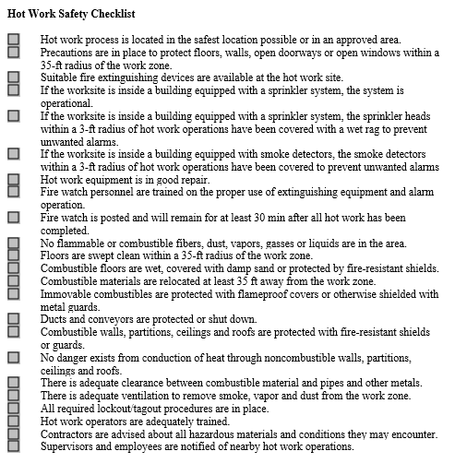
Notes:
Anything that can burn must be removed from the immediate work area.

Slide 21

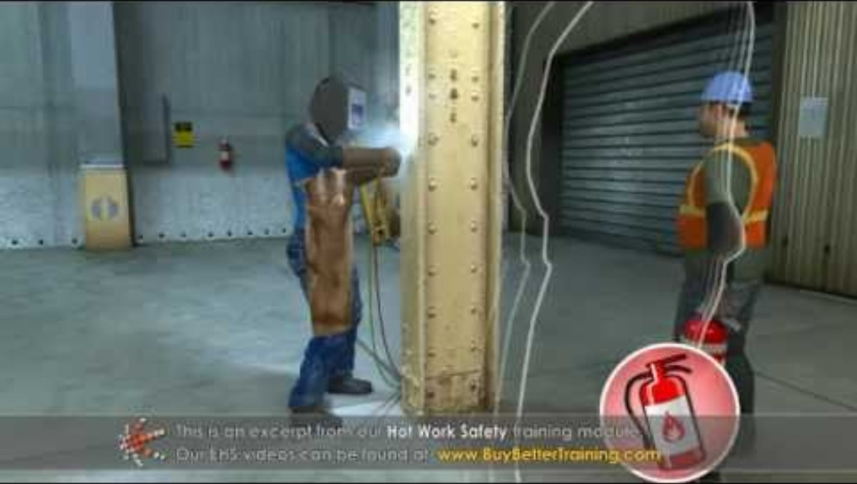
Necessary Precautions
Fire Watch
O Fire watch will be provided during and for at least 30 minutes after work, and during any coffee or lunch breaks.
O Fire watch is supplied with suitable extinguishers, or charged
small hose.
O Fire watch is trained in use of this equipment and in
sounding alarm.
Notes:
Should other precautions fail, trained personnel will be needed with fire fighting equipment to extinguish any fires which start. Personnel and equipment must be readily available before the permit is issued.

Slide 22
Necessary Precautions
FIRE WATCH
Fire watch will be provided during and for at least 30 minutes after work, and during any coffee or lunch breaks.
Fire watch is supplied with suitable extinguishers, or charged small hose.
Fire watch is trained in use of this equipment and in
sounding alarm.
Notes:
Fire Watch Personnel may not do other jobs which detract from their primary responsibility.
Fire Watch Personnel must be trained to use fire extinguishment media provided.
Fire Watch Personnel must be aware of how to report emergencies, and in emergency evacuation procedures.
Fire Watch Personnel must be identified and their qualifications verified, before permits are issued.

Slide 23
Necessary Precautions
CAN THE JOB BE AVOIDED?
IS THERE A SAFER WAY?
Notes:
Before beginning any hot work, ask yourself if the work can be
done a safer way. Hot work is very hazardous and should be
avoided if not absolutely necessary.

Slide 24
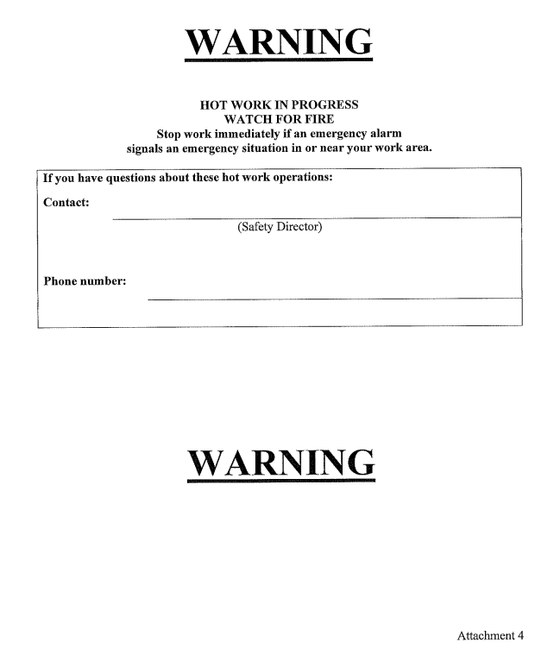
Hot Work Warning

Slide 25
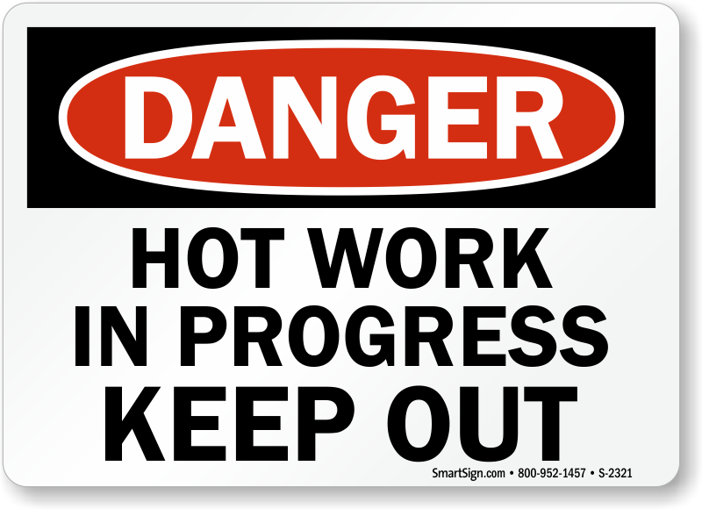
Hot Work Employee Training
Fire Prevention and protection
Basic precautions
Special precautions
Employee classifications and responsibilities:
Hot work approver
Authorized personnel
Supervisors
Fire watch personnel
Designated hot work areas
Non-designated hot work areas procedures
Protection of personnel
Hot work permit system
Handling and storage of hot work materials
PPE selection and use
Notes:
Before any employee designated as hot work permit approvers, authorized personnel or supervisors are allowed to perform any hot work operations, they must receive training. Periodic retraining will occur if an employee has a lack of knowledge, uses equipment improperly or if work tasks change. At a minimum, the training will include the following subjects:

Slide 26
Hot Work Responsibilities
All employees are required to follow these processes
Management:
Develop protocols
Provide training.
Designate areas
Establish permit system.
Designate individuals
Identify the proper PPE
Air monitoring
Educate contractors on protocols.
Retain records.
Review annually.
Notes:
Develop safe usage protocols for all heat, flame and spark producing equipment.
Provide appropriate training to all employees that perform or authorize hot work activities.
Establish designated hot work areas.
Establish procedures and a permit system for performing hot work in non-designated areas.
Designate individuals who can approve hot work activities and issue permits in non-designated areas.
Identify the proper personal protective equipment (PPE) needed during the hot work procedures.
Complete air monitoring in the event a potentially explosive atmosphere is identified.
Provide outside contractors working the OMD property with training and information on OMD hot work process and procedures.
Retain records of training and all hot work permits.
Review the program at least annually and when changes are needed or new equipment is added.

Slide 27
Hot Work Responsibilities
All employees are required to follow these processes
Supervisors:
Trainings and Qualifications
Employees with insufficient skills.
Ensure others comply.
Ensure work is in proper areas.
Identify dangerous situations.
Designate a fire watch.
Final inspections.
Notes:
Ensure that only qualified and trained employees perform hot work activities.
Ensure that employees who are found to have insufficient skills or understanding of hot work procedures receive retraining before conducting any further hot work assignments.
Ensure that employees comply with all procedures and policies.
Ensure that all hot work activities are approved prior to being performed in designated or non-designated areas.
Identify dangerous situations, not suitable for hot work.
Designate a fire watch employee for all hot work performed in a non-designated area during and for no less than 30 minutes after work is completed.
Conduct final inspections after a fire watch period has concluded.

Slide 28
Hot Work Responsibilities
***All employees are required to follow the processes outlined in this policy***
Supervisor or Approved Designee:
Combustibles removed and guards in place
Review precautions.
Post permits.
Fire Accident due to Hot Work - YouTube
Notes:
Ensure all combustibles are removed from the hot work area or if they cannot be removed, ensure that guards are in place to confine the heat, sparks and slag.
Inspect hot work areas and review planned safety precautions before hot work begins.
Post hot work permits.

Slide 29
Hot Work Responsibilities
***All employees are required to follow the processes outlined in this policy***
Authorized Personnel:
Duties of “Authorized” personnel include:
Complete all hot work training.
Approval
Follow designated procedure.
Inspect for combustibles and other dangers.
Inspect equipment.
Control equipment.
Notes:
Authorized Personnel:
Authorized personnel include employees or contractors who are trained to perform hot work activities such as: soldering, welding, pipe-cutting, heat-treating, grinding, thawing pipes, hot riveting, torch-applied roofing, or any other application involving heat, sparks, or flames. Duties of “Authorized” personnel include:
Complete all hot work training.
Seek approval and/or permit to perform hot work prior to beginning operations.
Perform hot work activities and procedures IAW the AGP 99.200.14 policy.
Inspecting designated hot work areas for combustible and other hazards prior to beginning hot work.
Inspecting hot work equipment to ensure it is in safe operating condition before beginning work.
Retain control of equipment while hot work is in progress.

Slide 30
Hot Work Responsibilities
***All employees are required to follow the processes outlined in this policy***
Fire Watch Personnel:
Duties of “Fire Watch” personnel include:
30 min watch.
Adjacent areas.
Use of extinguisher.
Alarm activation.
Permit signature after completion.
3 hour check
Final inspection and supervisor sign off.
Supervisor must assign another fire watch if designee leaves prior to this timeline.
Notes:
Fire Watch Personnel:
A fire watch is designated employee who monitors the hot work area for fires while work is being performed and for 30 minutes after its completion. Duties of “Fire Watch” personnel include:
Maintain continuous watch over hot work activity during and after (30 minutes).
Monitor adjacent areas for fires.
Extinguish small, controllable fires with extinguishing equipment.
Activate fire alarm if an uncontrollable fire occurs.
Sign the hot work permit 30 minutes after the work is complete and re-posting signed permit in hot work area.
After the hot work and 30 minute monitoring period is complete, periodically return to the area to check for fires for three hours.
Ensure that the supervisor has conducted a final inspection after the fire watch period has concluded and signs off on the permit.
If fire watch personnel must leave before the period is over, the supervisor must assign another trained employee for the remaining time.

Slide 31
Hot Work – Voiding Permits
Fire alarm sounds.
60minutes.
Shift ends or change in authorize personnel.
Danger or uncontrolled hazard
New permit required
Notes:
Hot work permits will be void and all hot work must not begin or must be immediately stopped if any of the following occur:
Fire alarm sounds.
Work has not begun within 60 minutes of approved time.
Work has been suspended for more than 60 minutes.
A work shift ends or there is a change in authorized or approval personnel.
At any time the authorized employee, supervisor or hot work approver detects a danger or uncontrolled hazard.
Whenever a hot work permit is voided, a new permit must be issued to begin or continue hot work operations.

Slide 32
Hot Work Permits - Summary
o Jobs like electric arc welding, brazing, gas soldering, and
oxygen-acetylene cutting and welding require hot
work permits be issued by the Fire Marshal, Safety Engineer,
or Maintenance Manager before work begins.
o Permits are issued for a specific job, for a
specific time frame, to a specific person.
o All necessary equipment must be on site and in
good working order before work begins.
o A fire watch must be present for the duration of hot work
and for at least 30 minutes after work is done.
o A fire inspection must be conducted by the person doing the hot work before
leaving the job site.
o Permits are to be returned to the person who issued them.

Slide 33

Knowledge Test
READY?

Slide 34
Knowledge Test
Why is the Hot Work Permit important?
Notes:
OMD requires the use of the Hot Work Permit system as a primary means of preventing fires due to non-routine open flame and high temperature processes.

Slide 35
Knowledge Test
What is Hot Work?
Notes:
Any work that involves burning, welding, cutting, brazing, soldering, grinding, using fire or spark producing tools, or other work that produces a source of ignition.

Slide 36
Knowledge Test
Where is our Rees Training Center Designated Hot Works Area?
Notes:
Area 1: Bldg. 5033 NW corner of bldg.

Slide 37
Knowledge Test
Who must be consulted when conducting Hot Work in a Non-Designated Area?
Notes:
Wildland fire, Management and the team helping during the Hot Work operation.

Slide 38
Knowledge Test
Who will submit the Hot Work Permit for Approval?
Notes:
The Authorized person or Supervisor.

Slide 39
Knowledge Test
Can Hot Work Permits be issued as a blanket to cover multiple jobs and or extended time period?
Notes:
No, They must be for a specific job and work shift but not to exceed a 24 hours time period.

Slide 40
Knowledge Test
How long will the Fire watch be provided at the Hot Work area?
Notes:
Fire watch will be provided during and for at least 30 minutes after work, and during any coffee or lunch breaks.

Slide 41
Knowledge Test
Can the Fire Watch multitask while assigned as the Fire Watch?
Notes:
No, Fire Watch Personnel may not do other jobs which
detract from their primary responsibility.

Slide 42
Knowledge Test
Please list some of the Duties of “Authorized” personnel.
Notes:
Duties of “Authorized” personnel include:
-Complete all hot work training.
-Seek approval and/or permit to perform hot work prior to beginning operations.
-Perform hot work activities and procedures IAW the AGP 99.200.14 policy.
-Inspecting designated hot work areas for combustible and other hazards prior to beginning hot work.
-Inspecting hot work equipment to ensure it is in safe operating condition before beginning work.
-Retain control of equipment while hot work is in progress.-

Slide 43
Knowledge Test
If a Fire Alarm is sounded, does that situation void the Hot Work Permit?
Notes:
Yes.

Slide 44
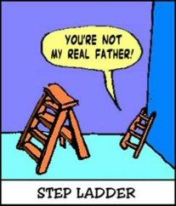
THANK YOU!!!

