Slide 1
OMD Safety Policy Training
LADDER TRAINING

Slide 2

Oregon Military Department Ladder Safety Training
Notes:
Introduce yourself and welcome everyone to Oregon Military Department’s Ladder Safety Training.

Slide 3


Introduction
Falls from ladders are a leading cause of serious and fatal injuries in residential construction.
The goals of this course are to help you:
understand how to correct or eliminate fall hazards on your job sites related to ladder use.
understand the OSHA ladder safety requirements.
Notes:
Falls from ladders are among the leading causes of fatalities and are a significant portion of serious injuries.

Slide 4
Course Objectives
Identify the importance of preventing falls from ladders.
Recognize fall hazards associated with ladder use.
Identify OSHA requirements for ladders.
Identify work practices for using ladders safely.
Notes:
By completing this course you will be able to: (here read each objective as it appears.)

Slide 5

Course Agenda
Section 1: Overview
Section 2: Ladder Safety
Section 3: Group Workshop
Section 4: Post Test and Review
Notes:
This course consists of four instructional sections. (Read each section as it appears on slide.)

Slide 6

Section 1: Overview
Notes:
In this section we will review:
1. The importance of ladder safety
2. Fatality statistics from the National association of Home Builders Fatality Study 2003 – 2006
3. Inspection and citation data from OSHA
4. Actual incidents involving ladders

Slide 7
Why is Preventing Falls from Ladders Important?
Falls continue to be the leading cause of fatalities in residential construction.
Falls (602) were responsible for 45% of residential construction fatalities from 2003 to 2006.
135 (22%) were falls from ladders.
Ladder Fails 2019 - YouTube

Slide 8
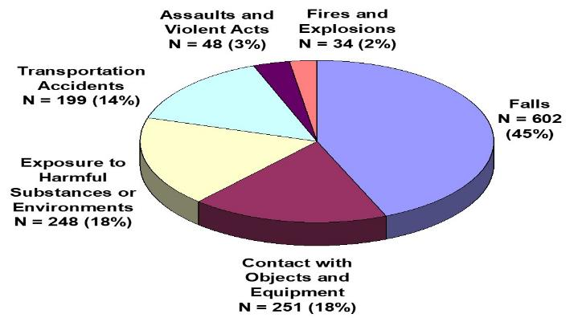
Fatalities by Event or Exposure: Residential Construction

Slide 9
Fall Fatalities: Residential Construction
Source: NAHB Residential Construction Industry Fatalities 2003-2006 (www.nahb.org/fatalitystudy )

Slide 10
OSHA Fall Protection Requirements
Subpart L - 1926.451(g)
Each employee on a scaffold more than 10’ (3.1M) above a lower level shall be protected from falling to a lower level.
Subpart X – Ladders
Fall protection is not required for workers climbing or working on portable ladders.
Subpart X – Stairways
Stairways having four (4) or more risers or rising more than 30 inches must be equipped with at least one handrail; and one stair rail system along each unprotected side or edge.
Notes:
Inform participants that OSHA has various requirements that address providing fall protection for workers.

Slide 11
OSHA Fall Protection Requirements cont.
Subpart M - 1926.501(b)(13)
Residential construction. Each employee engaged in residential construction activities 6’ or more above lower levels must be protected by conventional or alternative fall protection:
Exemption: When the employer can demonstrate the protection is infeasible or creates a greater hazard the employer must develop an alternative fall protection plan.

Slide 12
How do you prevent falls from ladders?
Implement a comprehensive safety program.
Understand OSHA ladder regulations.
Train workers to identify hazards associated with ladder use.
Use safe work practices.

Slide 13
Ladder Safety
Section 2: Ladder Safety

Slide 14

Learning Objectives: Section 2
Determine the proper ladder to use based on weight capacity and height.
Calculate the proper pitch of extension ladders for proper set-up, and identify how to secure and stabilize ladders.
Identify how to maintain a safe position when using a ladder.
Ladders & Falls - Safety Training Video - Prevent Fatal Accidents on Ladders - YouTube

Slide 15
Common Ladder Hazards
Improper set-up.
Portable ladders not 3 feet above landing surface.
Not securing ladder correctly.
Standing on the top two steps of a stepladder.
Overreaching when working from a ladder.

Slide 16
Choosing the Right Ladder
Before stepping onto a ladder, think about these things:
Duty rating of the ladder—what capacity can it hold?
Height of the ladder—too short or too tall?
Condition of the ladder and instructions unique to the ladder selected.
50 of the Most Extreme Ladder Safety Fails - Volume 1 - YouTube

Slide 17

Proper Duty Rating/Capacity
OSHA Requirement
Ladders shall not be loaded beyond the maximum intended load for which they were built nor beyond their manufacturer's rated capacity.

Slide 18
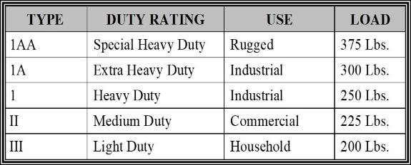
Proper Duty Rating/Capacity, cont.
Select a ladder with the proper duty rating for your weight and the materials you are handling.

Slide 19
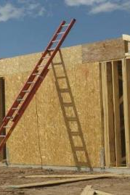
Extension Ladders

Slide 20
Proper Ladder Set-up
Consider placement and pitch of the ladder.
Secure and stabilize the ladder.

Slide 21
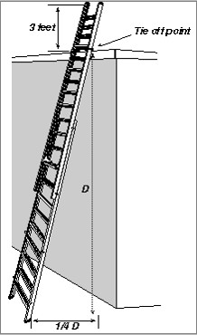
Pitch Extension Ladders
Extension ladders should be used at a 4 to 1 pitch (1.2 to .3 m).
For every 4 ft. (1.2 m) in height, the bottom of the ladder should be 1 ft. (.3 m) away from the structure.
Example:
20 ft. (height) ÷ 4 ft. = 5 ft. pitch

Slide 22
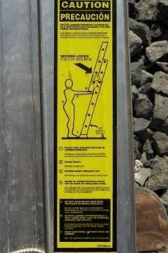
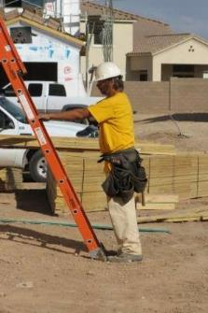
Pitch Extension Ladders, continued
Notes:
Setting up extension ladders properly can reduce slip and overload hazards. A quick and easy way to determine is and extension ladder is properly set up is:
1. Place toes against ladder side rails
2. stand erect
3. Extend arms straight out
4. Palms of hands should touch top of rung at shoulder level

Slide 23
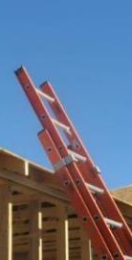
Proper Height Extension Ladders
When accessing another level, the ladder must extend at least 3ft. (0.9m) above the landing to provide a hand hold for getting on and off the ladder.
Notes:
The spikes, or spurs, on the ladder safety feet allow for the ladder to be set up safely on loose soil to prevent slipping.

Slide 24
Proper Height for Extension Ladders, continued Choose the right ladder for the height you need to reach.
Ladder Height (ft.) | Maximum Reach (ft.)* | Height to Gutter or Top Support Point+
16 | 15 | 9 ft. max.
20 | 19 | 9-13 ft.
24 | 23 | 13-17 ft.
28 | 27 | 17-21 ft.
32 | 31 | 21-25 ft.
36 | 34 | 25-28 ft.
40 | 37 | 28-31 ft.
*Assume a 5 ft.-6 in. person with a vertical reach of 12 in.
+Support points for extension ladders reflect section overlap, ladder angle, or 3-ft. extension above roof line

Slide 25
Secure and Stabilize Ladders
Extension ladders should be secured at the top or bottom to prevent movement.
The base of an extension ladder must be secured in place by using the safety feet on the ladder or other effective means.

Slide 26
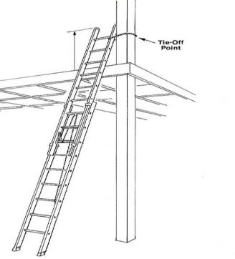
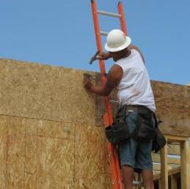
Secure and Stabilize Ladders, continued

Slide 27
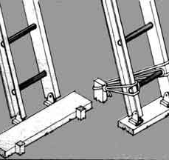
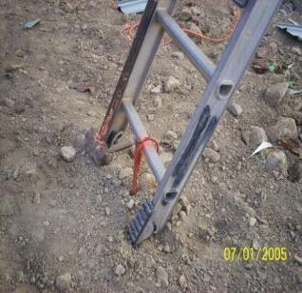
Secure and Stabilize Ladders - continued

Slide 28
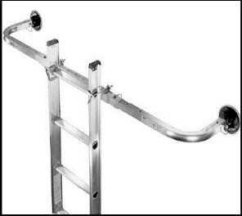
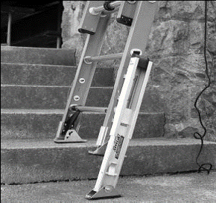
Secure and Stabilize Ladders, continued

Slide 29
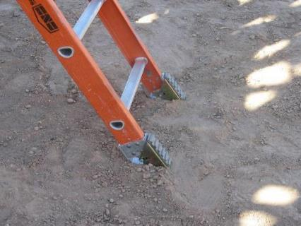
Loose Soil

Slide 30
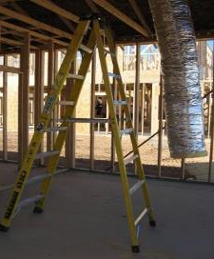
Step Ladders

Slide 31
Step Ladders, continued
Only use in the fully open position on firm level ground.
Do not use a step ladder that is folded or in a leaning position.
Never sit/stand on the top two rungs.
Consider work height when selecting a step ladder.

Slide 32

Step Ladders, continued
Notes:
Step ladders are designed for use in an opened-and-locked position.

Slide 33
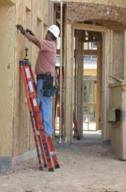
Step Ladders Hazard
Do NOT use a step ladder that is folded or in a leaning position.
Notes:
This worker is using a stepladder in the folded, leaning position. This represents improper use of a stepladder and could possibly lead to injuries from the ladder failing.

Slide 34
Proper Height of Stepladders
Choose a step ladder that is no more than 4ft. Shorter than the
height you want to reach.

Slide 35
Maintain a Safe Position on Ladders
Notes:
Face the ladder when ascending or descending.
Maintain three points of contact at all times.
Keep your body centered on the ladder.
Never let your belt buckle pass either side rail.

Slide 36
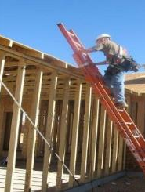
Maintain a Safe Position on a Ladder

Slide 37
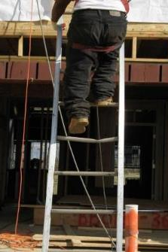
Ladder Inspections
Notes:
Ladders must be inspected before each use.
Use the OMD Ladder Inspection Form
Broken or weak ladders or ladders that are not stable must be marked or tagged as defective and taken out of service.
Look for cracks and weak points.
Competent person must periodically inspect ladders.

Slide 38
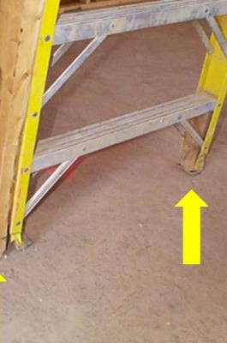
Ladder Inspection, continued

Slide 39
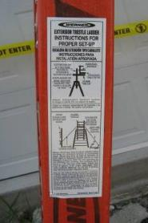
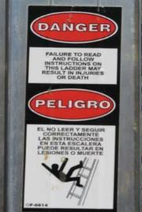
Review the Safety Labels on the Ladder

Slide 40
Additional Safe Work Practices: Ladders
Extension ladders should not be separated to create two ladders.
Keep the areas around the tops and bottoms of all ladders clear to prevent trip-and-fall hazards.
Avoid setting ladders up in high traffic areas or barricade the area around ladder.

Slide 41
Additional Work Practices: Ladder Safety
Ladders must be kept free of oil, grease, and other slipping hazards.
Consider using a rope to raise/lower materials instead of carrying items while climbing a ladder.
Do NOT use metal or aluminum ladders near exposed energized electrical equipment.

Slide 42

Workshop
Notes:
Section 4:
Group Workshop

Slide 43

Hazard Violation Workshop
Students will review a series of photographs of ladders and scaffolds in use on a jobsite. The assignment is to identify the hazards in each photo and discuss the corrective action required to correct the hazard. (Note: Some of the photos are of correct safe work practices.)
You Play OSHA!

Slide 44

Picture #1

Slide 45
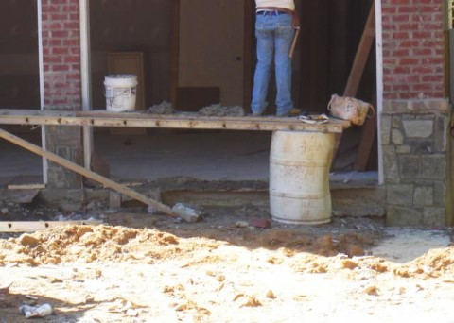
Picture #2

Slide 46
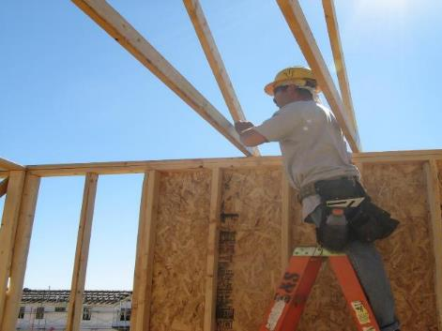
Picture #3
Notes:
This worker is positioned on the stepladder properly. His body is centered on the ladder while performing truss installation and he is below the top two rungs.

Slide 47

Picture #4
Notes:
This worker should use a taller stepladder to reach his task. He is not using the top two steps/rungs, but he is using the backside of the ladder to increase his reach. The back side of a stepladder is not permitted for use unless designed for such use.

Slide 48
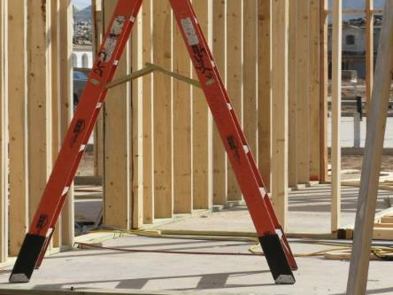
Picture #5
Notes:
Although no one is using the ladder, the metal spreader is not in the fully opened position.

Slide 49
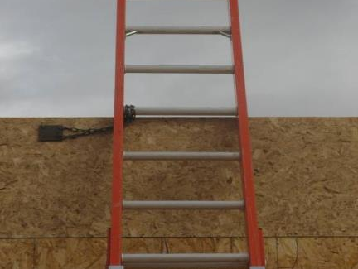
Picture #6
Notes:
This extension ladder is properly secured at the top to prevent displacement. This is one of many ways to secure extension ladders.

Slide 50
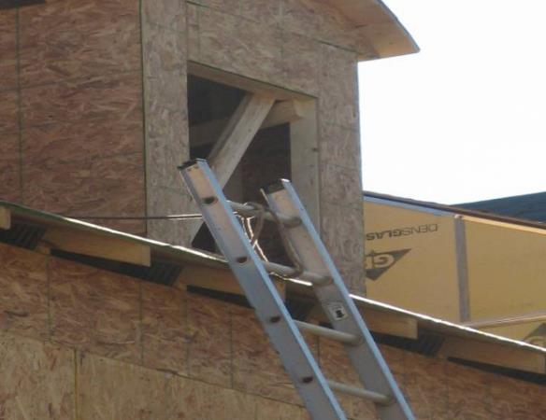
Picture #7
Notes:
This ladder is not positioned properly. When extension ladders are being used to access another level, they must extend at least 3 feet beyond the landing surface to provide a handhold for getting on and off the ladder.

Slide 51
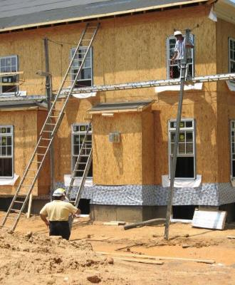
Picture #8
Notes:
The ladder is set up at an incorrect angle to provide access to the scaffold. The scaffolding is also set up incorrectly.

Slide 52
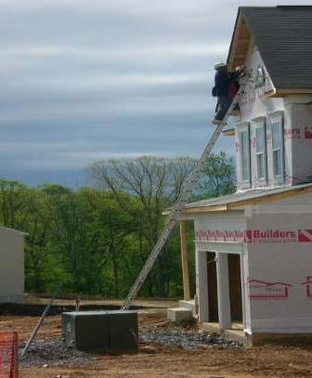
Picture #9

Slide 53

Questions ?

