Slide 1

OMD Safety Policy Training
PORTABLE FIRE EXTINGUISHERS

Slide 2
References OSHA 1910.157 (g) AGP-99.200.08 EFFECTIVE DATE 6.30.25 Oregon Administrative Rule 437-002-0187

Slide 3
AGENDA
Data and Statistics of Fires
OSHA Options for Fight or Flight
Purpose of a Fire Extinguisher
Fire Classification and Characteristics
Fire Extinguisher Types and Identification
How to Operate Fire Extinguisher
Hazards associated to incipient stage Fires
When Not to Fight a Fire
Maintenance, Testing and Inspection
Summary

Slide 4
National Fire Protection Association (NFPA)
During 2006-2010, an estimated 42,800 fires in industrial and manufacturing properties were reported to U.S. fire departments per year: These included:
30,200 outside or unclassified fires
8,600 structure fires
4,100 vehicle fires
These fires caused $951 million in property damage per year

Slide 5
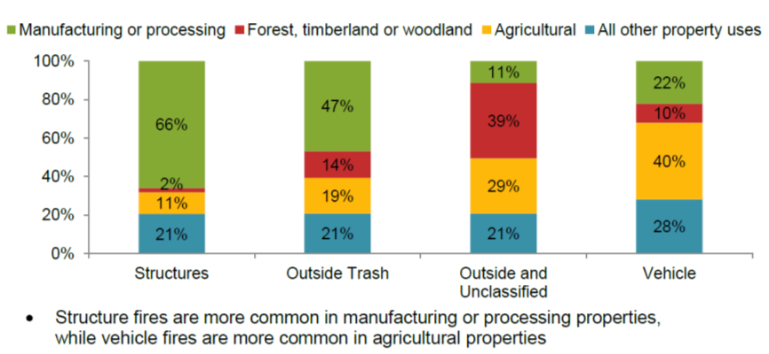

Slide 6
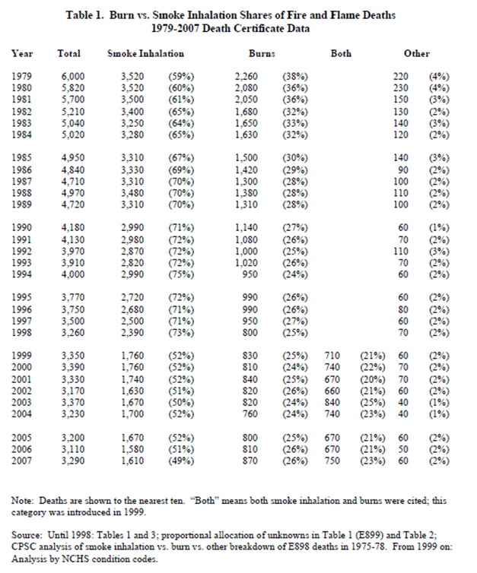


Slide 7
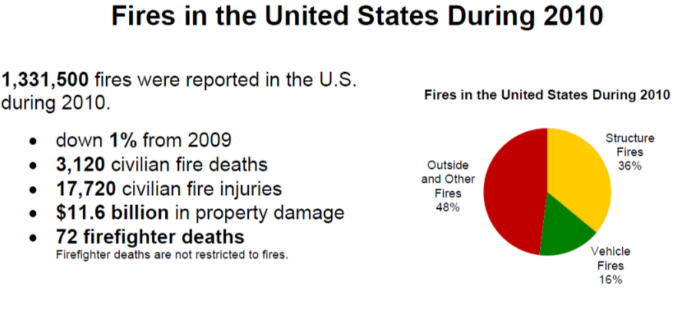

Slide 8
OSHA’s Position
It is OSHA's position that the decision to use fire extinguishers may not be left up to the employees but must be spelled out in an emergency action plan.
Emergency Action Plan, OSHA 1910.38
See AGP Safety Policy 99.200.18 for the OMD Emergency Action Plan.

Slide 9
Option 1
Fire Extinguishers are provided, but not intended for employee use
MUST Develop
1910.38, Emergency Action Plan
1910.39, Fire Prevention Plan
Must Do
(e) Inspection, Maintenance and Testing
(f) Hydrostatic testing

Slide 10
Option 2
Fire Extinguishers ARE NOT available in the work place.
MUST Develop
1910.38, Emergency Action Plan
1910.39, Fire Prevention Plan
Must Do
1) Provide Fire Extinguishers if a Standard Requires it.
Written Safety Policy, requiring complete and total evacuation upon hearing alarm.

Slide 11
Option 3
Employer has DESIGNATED CERTAIN EMPLOYEES to be the only ones authorized to use them in a fire.
MUST Develop
Must Do
Training Requirement
Notes:
MUST DEVELOP: 1910.38, Emergency Action Plan
Requires all other employees to evacuate upon ALARM activation.
MUST DO:
Not required to distribute fire extinguishers (d)
Training Requirement: 1910.157(g)(3) The employer shall provide employees who have been designated to use fire fighting equipment as part of an emergency action plan with training in the use of the appropriate equipment.

Slide 12
Option 4
Provide portable fire extinguishers and permit all employees to use them to fight fires. Extinguishers located at our facilities range in size from 2.5 to 20 lbs.
Must Do
.
Education Requirement
***This is OMD’s policy ***
Notes:
MUST DO:
* Requires the employer to comply with all the requirements in 29 CFR 1910.157 Placement, use, maintenance, testing, training and education
* Not required to distribute fire extinguishers (d)
* Employees must be trained in proper use of fire extinguishers.
* FMS will be directly responsible for monthly visual checks and annual maintenance checks of all portable fire extinguishers mounted in buildings, outside on or in equipment/vehicles
Education Requirement
99.200.08 - Responsibilities
Annual training will consist of: General methods and tactics of using a fire extinguisher. The hazards of using an extinguisher on early stage fires. Hazards associated with using standpipe hoses.

Slide 13
1910.157 Fire Extinguisher Training
1910.157(g)
Training and Education
(g)(1) and (g)(2)
General Use by all Employee’s
(g)(3) and (g)(4)
Designated (assigned) Employees
Initiates 1910.156, Fire Brigade
Requires Annual Training

Slide 14
Do you have any of these operations? See Appendix A for each standards reference.
1910.38 - Emergency action plans.
1910.66 - Powered platforms for building maintenance.
1910.106 - Flammable liquids.
1910.107 - Spray finishing using flammable and combustible materials.
1910.109 - Explosives and blasting agents.
1910.110 - Storage and handling of liquefied petroleum gases.
1910.119 - Process safety management of highly hazardous chemicals.
1910.120 - Hazardous waste operations and emergency response.

Slide 15
Do you have any of these operations? See Appendix A for each standards reference.
1910.125 - Additional requirements for dipping and coating operations that use flammable liquids
1910.146 - Permit-required confined spaces
1910.178 - Powered industrial trucks.
1910.179 - Overhead and gantry cranes.
1910.180 - Crawler locomotive and truck cranes.
1910.181 - Derricks.
1910.252 - General requirements.
1910.265 - Sawmills.
1910.266 - Logging operations.
1910.272 - Grain handling facilities.
1910.1047 - Ethylene oxide.
1910.1050 - Methylenedianiline
1910.1051 - 1,3-Butadiene.

Slide 16
Definitions
“Education” VS.
“Training” for designated employees
1910.157(g)(1)Where the employer has provided portable fire extinguishers for employee use in the workplace, the employer shall also provide an educational program to familiarize employees with the general principles of fire extinguisher use and the hazards involved with incipient stage fire fighting.
"Education" means the process of imparting knowledge or skill through systematic instruction. It does not require formal classroom instruction.
1910.157(g)(3)The employer shall provide employees who have been designated to use fire fighting equipment as part of an emergency action plan with training in the use of the appropriate equipment.
"Training" means the process of making proficient through instruction and hands-on practice in the operation of equipment, including respiratory protection equipment, that is expected to be used and in the performance of assigned duties.

Slide 17
Are live Fires required as part of Training?
Letter of Interpretation: JULY 2, 1991, 1910.155(c)(141)
“OSHA does not require that fires actually must be started and extinguished to simulate emergency fire conditions during employee training.
"Hands-on" training does not necessarily mean "live fire" demonstration. However, when conducted, live-fire demonstrations should be conducted under qualified supervision at a facility appropriate for the purpose.
As a minimum, hands-on training should include the actual discharging of fire extinguishers appropriate for the type of fires expected, unracking of standpipe hoses, and test-sounding of fire alarm boxes.”

Slide 18
Purpose of a Fire Extinguisher
Two functions:
To control or extinguish small or incipient stage fires and,
To protect evacuation routes that a fire may block directly or indirectly with smoke or burning/smoldering materials.

Slide 19
Where to find a Fire Extinguisher
Location and Requirements:
OSHA requires fire extinguishers to be at least four inches above the ground, meaning you cannot store them on the ground.
You should mark locations on the Evacuation Map of your fire extinguishers.
The distance between fire extinguishers depends on the type of fire that is likely to occur and the class of extinguishers you have. It ranges from 30 feet for some types of Class B extinguisher to within 75 feet for Class A and a maximum of 75 feet from a Class D hazard.
The National Fire Protection Association (NFPA) recommends, for Class A fire risks, one 2-A extinguisher for every 3,000 square feet.

Slide 20
Definitions
OSHA
NFPA
"Incipient stage fire" means a fire which is in the initial or beginning stage and which can be controlled or extinguished by portable fire extinguishers, Class II standpipe or small hose systems without the need for protective clothing or breathing apparatus.
“Incipient stage fire” A fire is considered to be beyond the incipient stage when the use of thermal protective clothing or self contained breathing apparatus is required or an industrial fire brigade member is required to crawl on the ground or floor to stay below smoke and heat.

Slide 21
1910.157 (d)
Selection and Distribution
1910.157(d)(1)
Portable fire extinguishers shall be provided for employee use and selected and distributed based on the classes of anticipated workplace fires and on the size and degree of hazard which would affect their use.
What to do….
1) Review your job, materials, task, equipment and tools.
2) Understand the type of fire that could start.

Slide 22
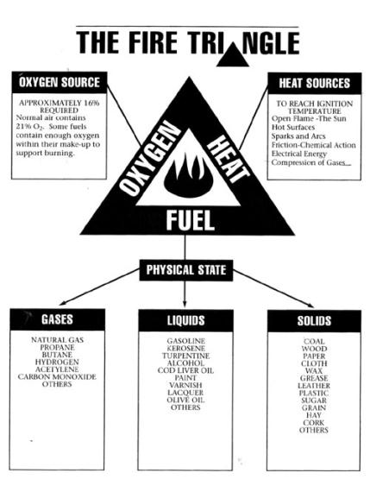
What type of Fire do I have?
Fire requires 3 Elements
Heat: Without sufficient heat, a fire cannot begin, and it cannot continue.
Fuel: Without fuel, a fire will stop.
Oxygen: Without sufficient oxygen, a fire cannot begin, and it cannot continue.

Slide 23
Match your Fire Extinguisher to the Type of Fire you are anticipating
Heat Source
Physical State
Type of Fire Extinguisher

Slide 24
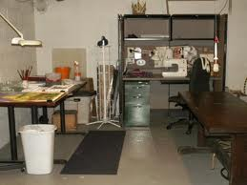
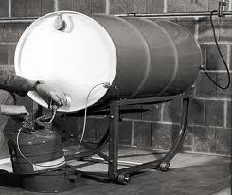
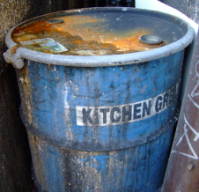
5 Categories of Fires
Class A Fires: Ordinary combustible materials such as wood, cloth, paper, rubber and many plastics.
Class B Fires: Flammable Liquids, combustible liquids, petroleum greases, tars, oils, paints, solvents, lacquers, alcohols and flammable gases.
Class C Fires: Involve electrical equipment.
Class D Fires: Involve combustible metals, such as magnesium, titanium, zirconium, sodium, lithium and potassium.
Class K Fires: Involve cooking appliances that involve combustible cooking media (vegetable or animal oils/fats)

Slide 25
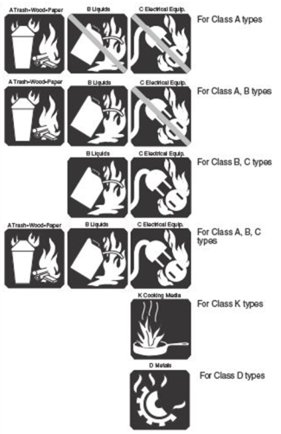

6 Types of Fire Extinguishers
Fire Extinguishers should be appropriately matched to work environment.
Use the symbols to quickly identify the Type of Fire Extinguisher.
6 Types of Fire Extinguishers
Class A – Wood, Paper, Plastics
Class AB – Wood, Paper and Flammable Liquid
Class BC (flammable liquid and electrical)
Class ABC Multipurpose
Class K – Kitchen Fire
Class D – Metal Fires

Slide 26
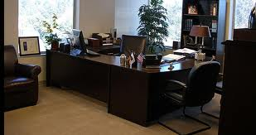
Learn to become aware of your surrounding…what’s in the room?

Slide 27

Most Occupancies have Electricity
Plastic Chair – Fuel
Lamp - Electrical
Computer - Electrical
Electrical Socket
Paper - Fuel
Wood Desk - Fuel
Phone - Electrical

Slide 28
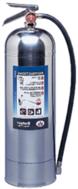

Type: | Class A Fire Extinguisher
Pressure Gauge: | Yes
Agent: | Water
Method: | Water Cools fire by removing heat.
Designated for: | Class A (wood, paper, cloth, rubber, and certain plastics.
Placement: | 75 feet or less
Safety and Health Precautions: | Never use water to extinguish flammable liquid fires. Never use on Metal Fire (water reactive). Water is a good conductor and may lead to electrocution if used to extinguish an electrical fire.

Slide 29
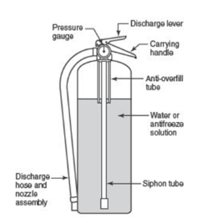

Slide 30
Type: | BC Fire Extinguisher
Pressure Gauge: | No (Must be weighed to determine leakage)
Agent: | Carbon dioxide is discharged as a white cloud of “snow”
Method: | Removes oxygen from fire
Designated for: | Class B and C (flammable liquid and electrical) fires only
Placement: | 50 feet or less
Health and Safety Precautions: | Carbon Dioxide is a clean, non-contaminating, odorless gas. After the CO2 dissipates, Class A fire may reignite. Never use CO2 extinguishers in a confined space

Slide 31
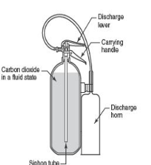
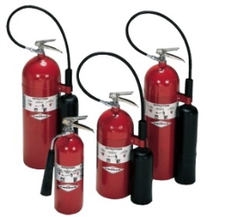


Slide 32
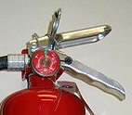
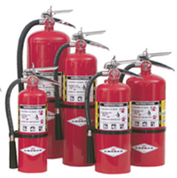

Type: | Multipurpose / ABC Dry Chemical
Pressure Gauge | Yes
Agent: | Mono ammonium phosphate, non-conductive, mildly corrosive
Method: | Fire retardant powder separates the fuel from the oxygen.
Designated for: | Wood, paper, Flammable Liquid, & Electrical Fire
Placement: | < 50 feet (based on B or C fire)
Safety and Health Precautions: | Mildly Corrosive – Sensitive to Electronic Equipment

Slide 33
Type: | Multipurpose / ABC Dry Chemical
Pressure Gauge | Yes
Agent: | Mono ammonium phosphate, non-conductive, mildly corrosive
Method: | Fire retardant powder separates the fuel from the oxygen.
Designated for: | Wood, paper, Flammable Liquid, & Electrical Fire
Placement: | < 50 feet (based on B or C fire)
Safety and Health Precautions: | Mildly Corrosive – Sensitive to Electronic Equipment

Slide 34
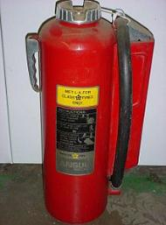


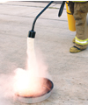

Slide 35
Type: | K – Kitchen Fire
Pressure Gauge: | Yes
Agent: | Mixture of dry and wet chemicals (Conductive)
Method: | Fires burn at extremely high temperatures
Designated for: | Vegetable or Animal Fat (not listed in OSHA)
Placement: | < 30 feet to cooking area
Safety and Health Precautions: | Whether or not under a hood, required for all solid fuel cooking appliances with a fire box of 5 cubic feet volume. Class K extinguishers are electrically conductive Electrical power to the kitchen appliance has been shut off.

Slide 36
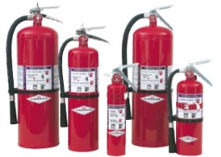
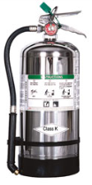
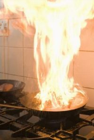


Slide 37
General Procedures for Responding To a Fire
SOUND THE FIRE ALARM and call the fire department, if appropriate.
IDENTIFY A SAFE EVACUATION PATH before approaching the fire.
Do not allow the fire, heat, or smoke to come between you and your evacuation path.
SELECT the appropriate type of fire extinguisher.
DISCHARGE the extinguisher within its effective range using the P.A.S.S. technique (pull, aim, squeeze, sweep).
BACK AWAY from an extinguished fire in case it flames up again.
EVACUATE IMMEDIATELY if the extinguisher is empty and the fire is not out.
EVACUATE IMMEDIATELY if the fire progresses beyond the incipient stage.

Slide 38
When it is Safe to Fight a Fire
FIRE
Is the Fire too Big?
Fire has not spread Beyond point of origin.
Flames are not higher than your head and you can safely approach the FIRE (room temperature is only slightly increased).
AIR
Is the AIR safe to Breath?
Smoke may be accumulating on the ceiling, but you can see the fire clearly.
Respiratory Protection is not needed.
EVACUATION PATH
Is there a Safe Evacuation Path?
You have a clear, unobstructed path behind you as you fight the fire. You know where you are and how to safely EXIT the building.

Slide 39
When it is NOT Safe to Fight a Fire
FIRE
Is the Fire too Big?
The Fire has spread beyond its point of origin, is hidden behind walls or a ceiling, or can not be reached from a standing position.
AIR
Is the AIR safe to Breath?
You can not see the FIRE due to rapidly accumulating smoke. The air is difficult to breath and can not be fought without respiratory protection.
EVACUATION PATH
Is there a Safe Evacuation Path?
You are not familiar with your surroundings.
You do not have a Safe EXIT Path, or you do not have an EXIT behind you.
The FIRE is not contained and is spreading.

Slide 40

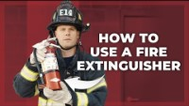
HOW TO USE

Slide 41
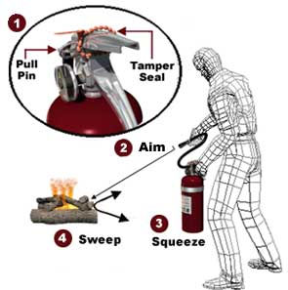
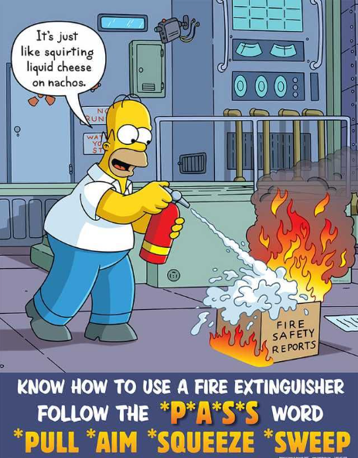
How to Extinguisher a Small Fire PASS
“P”ULL... Pull the pin. This will also break the tamper seal.
“A”IM... Aim low, pointing the extinguisher nozzle (or its horn or hose) at the base of the fire.
Note: Do not touch the plastic discharge horn on CO2 extinguishers, it gets very cold and may damage skin.
“S”QUEEZE... Squeeze the handle to release the extinguishing agent.
“S”WEEP... Sweep from side to side at the base of the fire until it appears to be out. Watch the area. If the fire re-ignites, repeat steps 2 - 4.
If you have the slightest doubt about your ability to fight a fire....EVACUATE IMMEDIATELY!

Slide 42
How to Extinguisher a Small Fire PASS

Slide 43
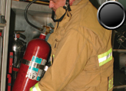
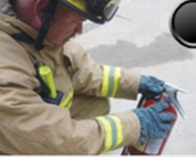
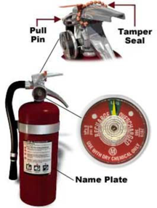
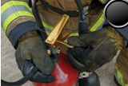
Pick up the Fire Extinguisher with your least favorite hand.
Support the bottom with your strong hand.
Quickly Check the Pressure Gauge
Pull the Pin (straight out)

Slide 44
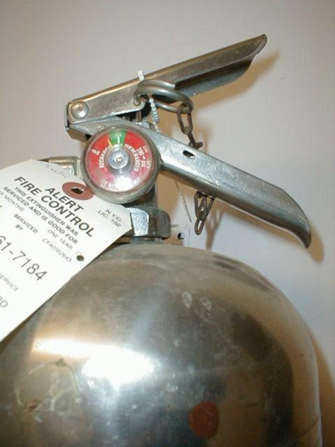
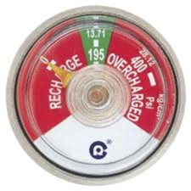
Know what you are looking for….
A fully charged Fire Extinguisher has the arrow in the green section…

Slide 45
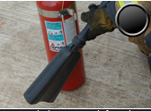

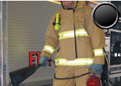
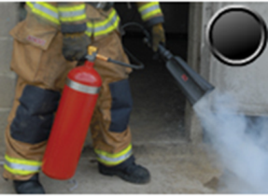
Remove the nozzle from the clip.
Hold the nozzle with your strong hand.
Carry the Extinguisher with your opposite hand.
Squeeze the handle gently to test the Extinguisher.

Slide 46
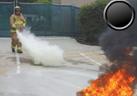
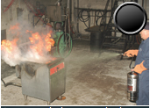
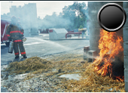
Begin your approach from a Safe Distance

Slide 47
Know the Limitations…….what you can and can not do.
Horizontal Range
Time of Discharge
What to do
Read the directions on the extinguisher

Slide 48
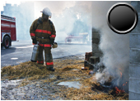
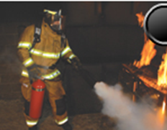
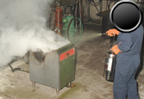
Aim at the Base of the Fire

Slide 49
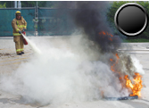
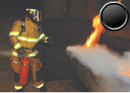

Sweep Back and Forth to cover the width of the fire

Slide 50
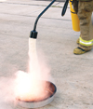
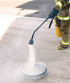
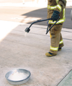
CLASS D FIRES (METAL)
Direct the nozzle so the agent falls directly onto the burning metal.
Close the nozzle valve to produce a soft, heavy flow and move closer to cover the fire area.
Do not disturb the agent and fire until it has cooled.
Source: NFPA

Slide 51

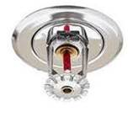
Does your facility have a sprinkler system?
Never put yourself in danger.
Let the sprinkler system do its job.
Ensure your Sprinkler System has been tested by a qualified 3rd party according to NFPA 25.
Look up, do you see these?

Slide 52
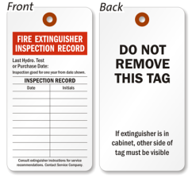
1910.157 (e) Inspection, maintenance and testing.
1910.157(e)(1)The employer shall be responsible for the inspection, maintenance and testing of all portable fire extinguishers in the workplace.
1910.157(e)(2)Portable extinguishers or hose used in lieu thereof under paragraph (d)(3) of this section shall be visually inspected monthly.

Slide 53
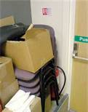
Monthly Inspection
Is the Fire Extinguisher in its designated place?
No obstruction to access or visibility?
Pressure gauge reading or indicator in operable range or position?

Slide 54
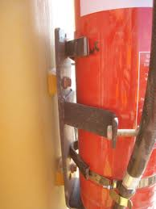
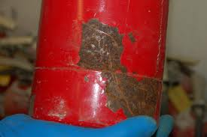
Monthly Visual Inspection
Cylinder Shell
Corrosion
Mechanical Damage (dent abrasion)
Paint Condition
Presence of repairs (welds, soldering)
Damaged Threads
Broken Hanger attachment
Broken Handle Lug

Slide 55
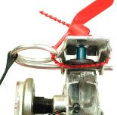
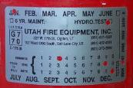

Monthly Visual Inspection
Name Plate, Instructions and Pull Ring
Illegible Wording
Corrosion or loose plate
Verifying operating instructions on nameplates are legible and face outward.
Broken, missing safety seals and tamper indicators.

Slide 56

Monthly Visual Inspection
Nozzle or Horn
Deformed, Damaged or Cracked
Blocked opening
Damaged threads
Hose obstruction
Hydrostatic test date

Slide 57

Monthly Visual Inspection
Pressure Indicating Device
Immovable, jammed, missing pointer
Deformed, or broken crystal
Illegible or faded dial
Corrosion
Dented case or crystal retainer
Immovable or corroded pressure indicating stem

Slide 58
Annual Maintenance Check
A fully charged Fire Extinguisher has the arrow in the green section…
Annual maintenance will involve a thorough examination of the fire extinguisher shell and its external mechanical parts. The maintenance will include:
All monthly inspection items.
Inspection of the hose and nozzle for cracks, blockages or other damage.
Inspection of extinguisher shell for corrosion, dents or other damage.
Weighing of K Type fire extinguishers IAW the label.
Determine when the fire extinguisher is due for its 6 year service and remove those that are due for service by a person or company acceptable to local fire authorities,

Slide 59
Key Elements to Remember
Be familiar with what your company’s policy and what is being asked of you in the event of a FIRE.
Be familiar with how to identify what type of Fire Extinguisher you have.
Know your work Environment, process, equipment, and what types of potential fires could start.
Understand the capabilities and limitations of your Fire Extinguisher
Know the general steps to responding to a Fire and when a Fire is not safe to put out.
Know how to operate a Fire Extinguisher (PASS)
Confirm if your facility has tested the sprinkler system.
Ensure your company has a monthly inspection procedure to ensure Fire Extinguishers are in a safe working order.
Ensure your Fire Extinguishers have an annual inspection and are hydrostatically tested by a qualified 3rd party.
Coordinate hands on training if you have been designated or assigned to use a Fire Extinguisher at your facility or place of employment.

Slide 60
KNOWLEDGE TEST

Slide 61
What is your company’s policy and what is being asked of you in the event of a FIRE?
Put out structural fires.
Wildland fire fighting.
Inspect and perform maintenance of a portable fire extinguisher.
Run out screaming in panic.
C. AGP-99.200.08, Ability to inspect and perform maintenance of a portable fire extinguisher.

Slide 62
How often should portable fire extinguishers be inspected?
Daily.
Weekly.
Monthly.
Annually.
C. Monthly.

Slide 63
What acronym is used in this training for the technique of the use of a fire extinguisher?
F.A.I.L. - Fire, Alarm, Identify and Leave
P.A.S.T. - Pull, Aim, Shoot and Tell
C.A.S.E. - Charge, Aim, Squeeze and Evacuate
P.A.S.S. - Pull, Aim, Squeeze and Sweep
D. Pull, Aim, Squeeze and Sweep

Slide 64
What are the 3 elements for fire?
Heat, Time and Air
Air, Intent and Heat
Heat, Oxygen and Fuel
Matches, Gas and Wood
C. Heat, Oxygen and Fuel

Slide 65
True or False. A fire can continue to burn without Oxygen?
False.

Slide 66
What is a Class A fire?
Non-Ordinary combustible materials such as metals, oils and many solvents.
Ordinary combustible materials such as wood, cloth, paper, rubber and many plastics.
Involve electrical equipment.
Involve cooking appliances that involve combustible cooking media
B. Ordinary combustible materials such as wood, cloth, paper, rubber and many plastics.

Slide 67
What is a Class B fire?
Flammable Liquids, combustible liquids, petroleum greases, tars, oils, paints, solvents, lacquers, alcohols and flammable gases.
Ordinary combustible materials such as wood, cloth, paper, rubber and many plastics.
Involve electrical equipment.
Involve cooking appliances that involve combustible cooking media
A. Flammable Liquids, combustible liquids, petroleum greases, tars, oils, paints, solvents, lacquers, alcohols and flammable gases.

Slide 68
What is a Class C fire?
Flammable Liquids, combustible liquids, petroleum greases, tars, oils, paints, solvents, lacquers, alcohols and flammable gases.
Ordinary combustible materials such as wood, cloth, paper, rubber and many plastics.
Involve electrical equipment.
Involve cooking appliances that involve combustible cooking media
C. Involve electrical equipment.

Slide 69
What is a Class D fire?
Flammable Liquids, combustible liquids, petroleum greases, tars, oils, paints, solvents, lacquers, alcohols and flammable gases.
Ordinary combustible materials such as wood, cloth, paper, rubber and many plastics.
Involve electrical equipment.
Involve combustible metals, such as magnesium, titanium, zirconium, sodium, lithium and potassium.
D. Involve combustible metals, such as magnesium, titanium, zirconium, sodium, lithium and potassium.

Slide 70
Where should a fire extinguisher be located?
Inside the nearest supply closet away from a place a fire is likely to occur.
On the floor, next to a place a fire is likely to occur.
Within 100 feet of a place a fire is likely to occur.
Within 30 to 75 feet of a place a fire is likely to occur.
D. Within 30 to 75 feet of a place a fire is likely to occur.

Slide 71
QUESTIONS ?

