Slide 1
SAFETY COMMITTEES
Sara Wassam
Safety Specialist / SAD Program Manager
OMD - AGP

Slide 2
AGENDA
Introduction
Oregon OSHA
Responsibilities
Functions and Duties
Safety Review Board
Resources
Final Thoughts

Slide 3

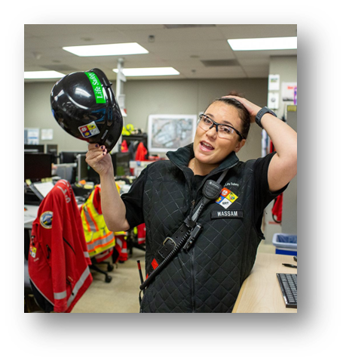
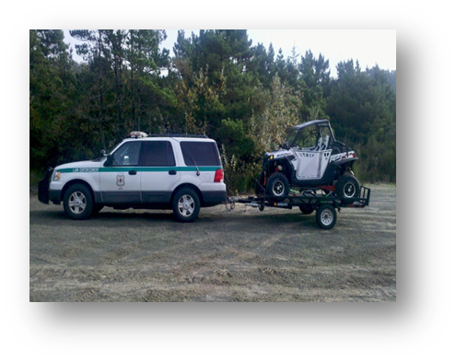
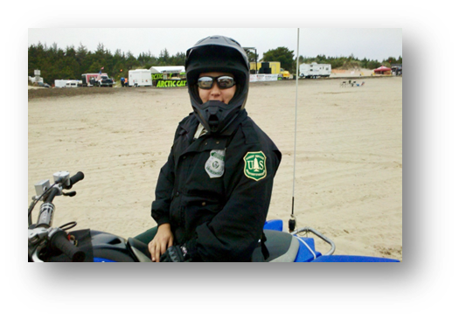
INTRODUCTION
Air Force/Air National Guard
  Currently Superintendent, Religious Affairs
  15 years Security Forces/LE
  21 years of service
Intel Corporation
  Life Safety Specialist
  Emergency Medical Responder
Federal Law Enforcement
  US Forest Service
  US Bureau of Prisons
Notes:
I wanted to take a few minutes and introduce myself… give you a little insight into my background because I feel it’s important for you to know who I am and what I bring to the agency. I have been serving in the Air Force and Air National Guard for nearly 21 years. I enlisted as a Security Forces troop and 15 years into that line of work I decided to cross train and finish out my service in Religious Affairs. I am currently the Superintendent of Religious Affairs at PANG and recently deployed in 2023 so I was away from OMD for some time. Throughout my Military service Safety has played a critical role in my positions and deployments around the continental united states and overseas.
As a civilian I started my career with the Federal Government as a Corrections Officer for the Bureau of Prisons. Learned a lot but quickly realized I did not want to be a CO for too long so I left and became a Federal Law Enforcement Officer for the US Forest Service. My main patrol area was the Oregon Dunes. You can see in the pictures I did a lot of patrol on an ATV and a Side x Side. Safety was paramount in my position and I did a lot of safety education with employees and the public. The number one type of incidents I dealt with were accidents. Some fatalities and many serious injury accidents.
I decided to leave Federal Law Enforcement but I still wanted to be a responder of sorts. I began working at Intel and moved into the Life Safety Systems Technician position. Essentially the Life Safety team responds to any emergency on campus to include medical events and we manage the safety systems. I was at the large campus in Hillsboro called Ronler Acres, a 500 acre property. I worked with Fire Systems, Hazardous Process Material systems, Gas systems, and responded to hazmat events, spills, anything related to safety I responded to. The work environment required me to use fall protection, ladders, man-lifts, elevated platforms, supplied air or air purifying respirators.
I say all of this so that you know I can relate to the employees in the field that have similar work environments and know the importance of ppe, training, and incorporating safety to our daily duties. Safety initiatives and programs have been critical in my work over the years and I am looking forward to bringing my experience to the Safety Specialist position and the Oregon Military Department. The members of this board have done an incredible job with the program and I’m thrilled to now be a part of it.

Slide 4
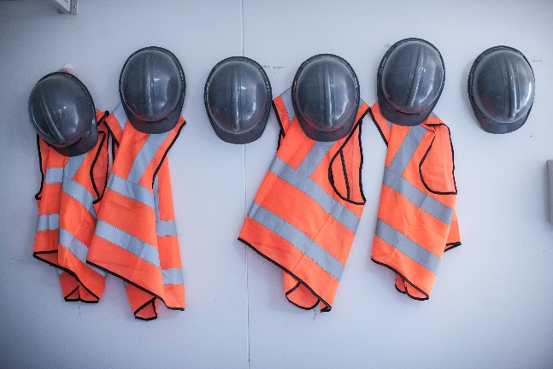


OREGON OSHA
The Rule OAR 437-001-0765
  Requires employers to establish and administer a Safety Committee, or hold Safety Meetings, to communicate and evaluate safety and health issues. The purpose is to get workers and management working together to prevent workplace injuries and accidents, ultimately producing a safer and healthier workplace.
Notes:
Read the rule to the attendees. Oregon OSHA requires our agency to have Safety Committees and we need to follow the rule.

Slide 5



SAFETY COMMITTEE PURPOSE
The OMD Safety Committee Policy 99.200.02
  Bring employees and management together in a non-adversarial, cooperative effort to promote Safety and Health in the workplace. Assist the agency and make recommendations for change.
Notes:
The OMD purpose. Andy Rohner, Senior SAIF Consultant and Julie Paris worked diligently in developing our OMD Safety Committee Policy which meets the Oregon OSHA rule.

Slide 6
RESPONSIBILITIES
HR Director
  Ensure OMD is compliant w/policy
Safety Review Board
  Monitors activities to ensure safety committees operate within OR-OSHA Health & Safety rules and regulations
  Provides policies, procedures, and resources
  Monitor and reduce costs associated w/work related injuries
Managers/Supervisors
  Responds in writing, within 15 calendar days, to all safety committee recommendations
Safety Committees
  Follows OR-OSHA Safety Committee Rules & Regulations
  Elect Chairperson/Secretary – Retains minutes for three years
  Integration of state safety committees w/Title 32 safety committee meetings are encouraged when management agrees
Notes:
Use AGP policy. Encourage your staff to participate and provide support.
We have Seven Committees. OYCP, Rees, Camp Rilea, PANG, Kingsley Field, Armories, Owen Summers.
Safety meetings must be held on company time and employees paid their regular rate of pay.

Slide 7
FUNCTIONS AND DUTIES
Develop a written agenda for conducting safety committee meetings
Hold quarterly meetings
Review annually and update safety programs
Identify and analyze safety trends within agency
Address escalated concerns that cannot be remedied in the traditional management structure
Notes:
The Safety Committee shall be composed of an equal number of management and non-management representatives when able. Employee representatives should be volunteers or elected by their peers. When agreed upon by non-management and management, the number of employees on the committee may be greater than the number of management representatives.
No fewer than 4 members.
Have a chairperson elected by the committee members.
Serve a continuous term of at least 1-2 years. Length of membership shall be alternated or staggered so that experienced members are always serving on the committee.
Ensure representation from all Job classifications.

Slide 8
SAFETY REVIEW BOARD
SRB shall consist of:
  Each Committee Chair, Deputy Director, Safety Representatives assigned by AGP HR Director, AGI Director, AGC Director, YCP Director, SAIF Representative, Chief Auditor, Federal Title 32 Safety Program Managers, PANG Site Manager, Kingsley Site Manager
Members serve a continuous term of at least one year
Have a chairperson elected by the committee members
Elect a secretary to take minutes
Meets Quarterly
Notes:
Cherie Cline takes our minutes.

Slide 9
RESOURCES
Oregon OSHA Safety Committee Fact Sheet
  https://osha.oregon.gov/OSHAPubs/factsheets/fs31.pdf
OSHA Safety Committees and Safety Meetings
  https://osha.oregon.gov/OSHAPubs/0989.pdf
SAIF Safety Committees and Meetings
  https://www.saif.com/safety-and-health/topics/be-a-leader/safety-committees-and-meetings.html
OMD AGP Safety Website
  https://www.oregon.gov/omd/employeeresources/Pages/Safety.aspx
OMD Safety Committee Policy 99.200.02
  https://www.oregon.gov/omd/employeeresources/SiteAssets/Pages/Policies/99.200.02%20Safety%20Committee%20Policy_01.31.2023.pdf
OMD Safety Specialist
  Sara Wassam, sara.wassam@omd.oregon.gov, 971-355-3986
Notes:
Discuss what each resource provides.

Slide 10
FINAL THOUGHTS
BOTTOM LINE
SUPPORT
SHOW APPRECIATION
THANK YOU SUPERVISORS/MANAGERS!!
QUESTIONS?

