Slide 1
OMD
SAFETY INCIDENT REPORTING
Notes:
<<Start recording>>
Thank you for this opportunity to speak with you today. My name is Amanda Casteel, I am backfilling the AGP Safety Specialist role for Sara Wassam. I am borrowed from the Oregon Dept. of Human Services were I worked as the unit’s Safety Manager for the last 3 years. I am excited to impart on you all what I know and have learned about working with the state process and systems to streamline safety incident reporting.
I invite you all to open another window within Workday and follow along to navigate to the fields and processes I’ll be covering. Not only is a good practice, the muscle memory will work better for you than just listening to my hypnotic voice.

Slide 2
AGENDA
Timeline of Injury Reporting
Workday “Report Safety Incident”
SAIF 801 Form
Accident Analysis Form
Basic Claims Management Overview
Time Card Entries
Notes:
Today we are going to cover injury reporting including how to input the Workday Safety Incident, how to complete the SAIF 801 Form, what and when an accident analysis is required, the basics of worker’s comp case review, and how to input time worked light duty or time off due to a related incident. I will move quickly so I encourage everyone to actively engage, I am not going to waste your time and I promise you everyone is going to learn something amazing and helpful with this training. I’ll be like The Wolf from Pulp Fiction, I mean fast fast fast. If you have a question, raise your hand. And finally, for the last of housekeeping items, please be aware of your closest fire exit and fire extinguisher as well as make sure your workspace is ergonomic and also has enough clearance under it to drop for cover in the event of the Big One.
If you had to step away for a biobreak and are devasted because you missed content, you can join us again next Tuesday Sept 16 at 1pm.

Slide 3
REPORTING INCIDENTS IS KEY TO IMPROVING SAFETY CULTURE
Notes:
Please take a moment to enjoy the AI images I have generated to encapsulate in importance of safety reporting within our workplace. Here are safety representatives really getting into why safety reporting is so vital and cosmically revealing, especially in light of the fact that this action is vital to improving safety culture and is proven to reduce the injury rate.
🔍 1. Identifies Hidden Hazards
Near misses often reveal underlying risks that haven't yet caused harm but could in the future.
By analyzing these events, organizations can identify patterns and correct unsafe conditions or behaviors before they lead to injuries.
📉 2. Reduces Injury Rates
Studies show that workplaces with robust near-miss reporting systems experience fewer recordable injuries.
Addressing near misses helps break the chain of events that could lead to serious incidents.
🧠 3. Promotes a Learning Culture
Encourages employees to share experiences and learn from each other.
Fosters a mindset of continuous improvement rather than blame.
🗣️ 4. Enhances Communication
Opens up dialogue between workers and management about safety concerns.
Builds trust when employees see their reports lead to real changes.
🛠️ 5. Drives Preventive Action
Enables safety teams to implement corrective and preventive actions (CAPAs).
Helps prioritize risk mitigation efforts based on real-world data.
📊 6. Supports Data-Driven Decisions
Near-miss data contributes to trend analysis, risk assessments, and safety audits.
Provides a leading indicator of safety performance, unlike lagging indicators like injury rates.
🧩 7. Strengthens Safety Culture
Demonstrates that the organization values safety and employee input.
Encourages shared responsibility for safety across all levels of the organization.

Slide 4
TIMELINE OF INCIDENT REPORTING
Notes:
I have created a simple timeline here as a visual to aid in what needs to be reported and within what timeframe.
-If the injured worker cannot report the incident in Workday immediately, a supervisor or coworker can initiate for them.
-Staying in touch with the injured worker is paramount. The employer (tasked to the Safety Specialist) is required to call OSHA within 24 hours when they are admitted into the hospital, when they lose an eye, when there is avulsion / or amputation, and when there is either a catastrophe (3 or more employee hospitalizations from one instance), or a fatality.
Trivia:
What is an avulsion? “Degloving” is a moderate avulsion. A body structure torn off by either trauma or surgery, all layers of skin are gone. Can be skin flaps (minor) update the amputation or a finger or limb.
-Get that completed 801 done and submission within 5 days of the incident. There are going to be times that having the worker sign and date it are not possible because they are too badly injured. In times like that, complete the information over the phone and leave it unsigned. As supervisors, the bottom must be done and signed however. We’ll get into that later in the presentation.
-Work releases every two week to every 30 days, set yourself a calendar reminder. SAIF usually reaches out to us (and/or the doc office) when it’s not sent in because they cannot send timeloss payments without it.
-Add the incident to the agenda for the safety committee. HIPPA does not apply to cases involving worker’s comp. The safety committee can talk about causation and motion of injury as well as brainstorm ways the incident could have been avoided.

Slide 5
Notes:
Let’s get into how to report a safety incident in Workday.

Slide 6
NAVIGATE TO MENU AND SELECT SAFETY

Slide 7
ALTERNATE APPROACH- FROM PROFILE PAGE, NAVIGATE TO ACTIONS, THEN
SELECT SAFETY INCIDENT

Slide 8
SELECT “REPORT SAFETY INCIDENT”

Slide 9
REPORT SAFETY INCIDENT
HOME SCREEN

Slide 10
LOCATION EXAMPLE
TYPE IN SEARCH “OMD”
SELECT THE OMD LOCATION WHERE THE INCIDENT OCCURRED

Slide 11
INCIDENT DATE AND TIME
Notes:
Do not ever use the comments section. Everything has a place within the incident as you get further into it.

Slide 12
TYPE OF SAFETY INCIDENTS
Notes:
On-site first-aid events do not require an 801, but they do require the Workday Safety Incident report.
Hazardous condition- inhalants, slippery surfaces

Slide 13
MUST CLICK “+Add”

Slide 14
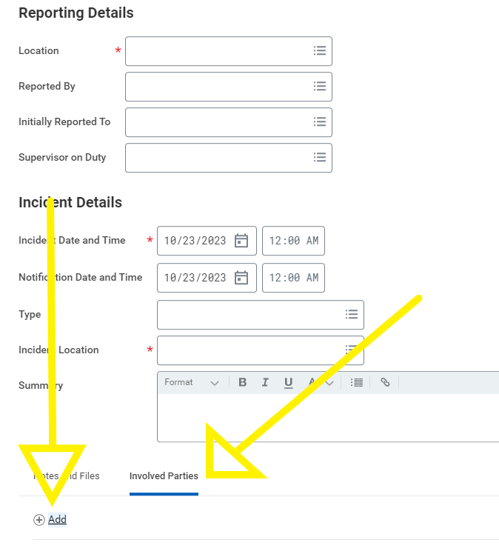
MAY NEED TO SELECT
“INVOLVED PARTIES” TO SEE THE “+Add”

Slide 15
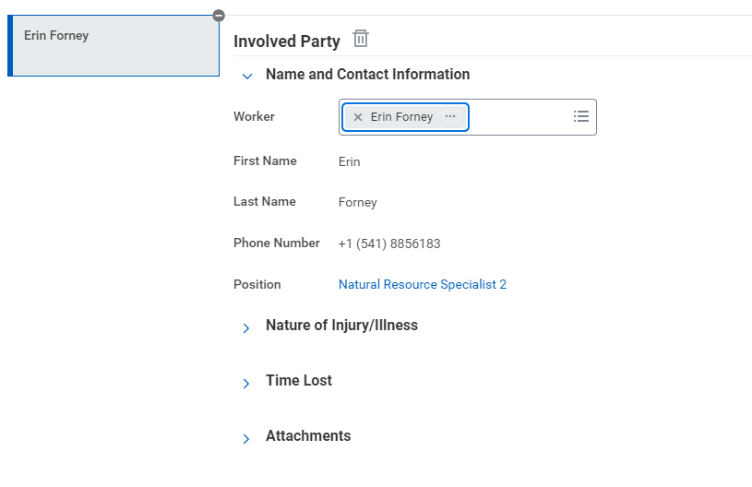
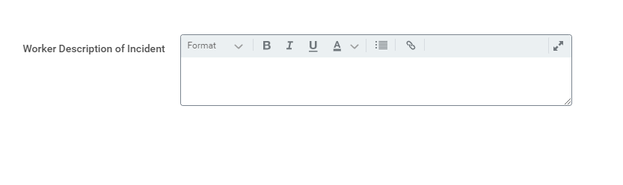
“INVOLVED PARTY” HOME SCREEN
INJURED WORKER’S DESCRIPTION OF WHAT HAPPENED TO CAUSE THE INJURY,
NOT WHAT PART WAS INJURED
Notes:
Enter Involved Party
Worker: Search your name and select. It will populate your information.
Worker description of incident: Type in your description of and details of incident. If a SAIF 801 was provided, match this to the description on the SAIF 801 form.

Slide 16
NATURE OF INJURY / ILLNESS HOME SCREEN
Notes:
Time arrived at work: self explanatory
Nature of Injury/Illness options (see next slide)
Body Part Code/Side: Type search for appropriate part of body that was injured (i.e, ankle, face, foot, hand, head)

Slide 17


Nature of Injury or Illness
Abrasion
Amputation
Bite
Blister
BBP Exposure
Bruise or Contusion
Burn
Cold Related
Concussion/Head Injury
Cut or Laceration
Dental Issue
Electric Shock
Emotional / Psychological
Fainting or Syncope
Foreign Body
Fracture or Broken Bone
Hearing Difficulty
Hearing Loss
Heat Related- Illness
Illness
Impaired Vision
Irritation
Multiple Major
Multiple Minor
NARCAN
Nausea or Vomiting
No Injury
Pain or Discomfort
Poisoning
Puncture
Sprain
Strain
Stress
Tear
Notes:
Let’s have a look at the nature of injury or illness types that can be selected from the drop down menu. Raise your hand to ask for clarification on any of these. Active participants in this exercise will be entered into a drawing for a prize of unspeakable value.
No. Irritation is not a psychological condition technically for the purpose of workplace injury, but I would enjoy the reporting none the less and bring it to the attention of the safety committee if it couldn’t be resolved between you and your manager, coworker, or customer that irritated you. Yes, stress is a psychological condition and will be taken seriously.
What the difference between a strain and a sprain? Anyone, anyone?? Sprain to the ligament, strain to the muscle/tendon. Strains= T for tendons. Sprains: P for popping sound associated with ligaments. Tear is more severe, involving a complete rupture of ligament or muscle.
What is the difference bw an abrasion and a cut? Abrasion is top layer scuffle, cuts are from objects and are usually a bit deeper

Slide 18
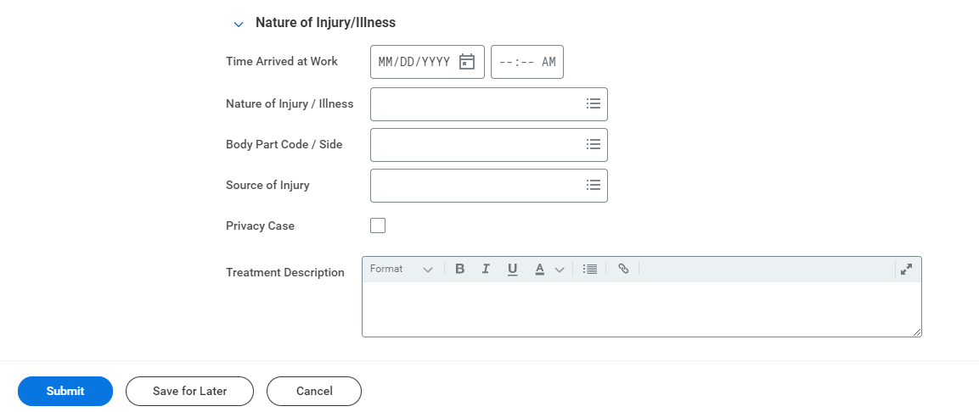
Nature of Injury or Illness Continued
Went to ER by ambulance
Example: “Went to ER by ambulance” or “will not seek treatment”
Notes:
Body Part Code / Side: type the name of the part and then select from the drop down.
Source of Injury: Search for appropriate source of injury, i.e., equipment malfunction
Privacy Case: Check this box if you don’t want notification to go to manager or you have injury to private parts. Other examples: mental health, work related stress, harassment. If you have additional questions on what a privacy case may be, contact OMD Safety.
Treatment Description: Example- went to ER/urgent care; will seek medical treatment after shift or, will not be seeking medical at this time.

Slide 19
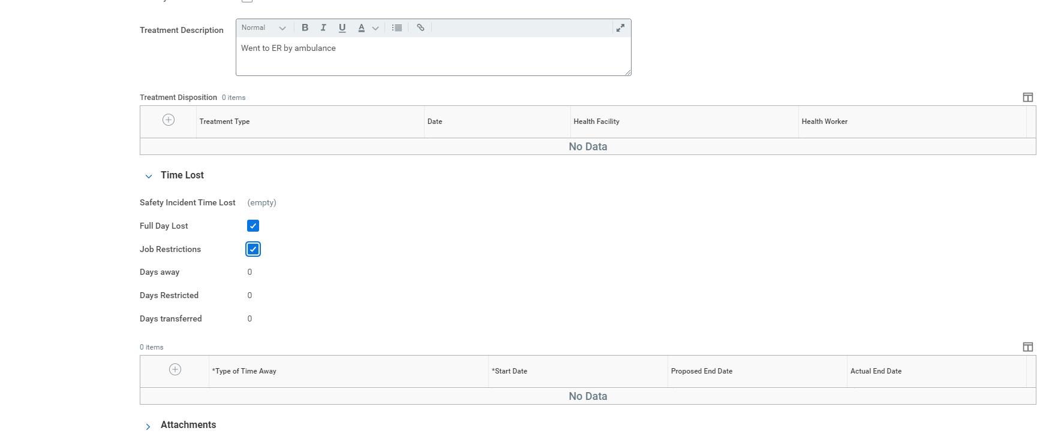
Time Loss Section
Went to ER by ambulance
Notes:
Select appropriate time lost (if known).
Add note for type of time away or restricted- if known. If they don’t know return date, leave blank
Time restricted is equal to light duty or modified work. It is the same thing. This field is required on all incidents since it’s where we pull information for the yearly OSHA 300 logs that are printed and posted on your safety boards Feb 1 thru April 30.

Slide 20
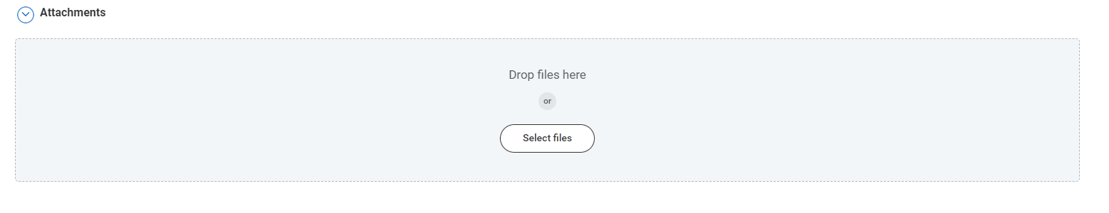
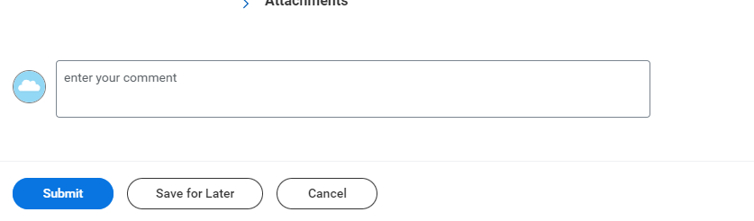
Attachments Section
Went to ER by ambulance
Do not use this comment box
You may now SUBMIT the completed incident report!
Notes:
Add any applicable attachments, including documentation from accident/incident report with pictures (i.e., something you tripped over that caused an accident/injury/ potential injury)
Do not use the comment box, ever. It does not save to the report when submitted.

Slide 21
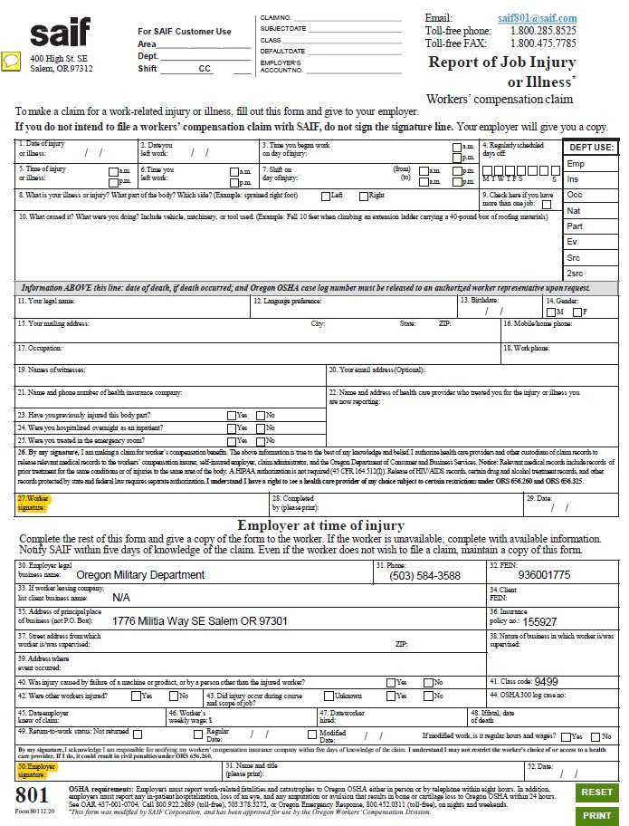
SAIF 801
Went to ER by ambulance
Notes:
Overview of the entire form and then we drill down a little further.
Employee fill out blocks 1-29
Supervisor fill out block 30-52
Email Level 3-Restricted Confidentiality Level Only to Amanda.E.Casteel@omd.Oregon.gov and cc: Tracy.Garcia@omd.Oregon.gov
OR
Fax to AGP 971-355-3988
If an employee is injured on the job, filing a claim quickly is important for the employee and the agency.
If you are injured on the job and seek medical treatment for the injury, and 801 must be filed. If the employee does not want to file a claim, they must email the AGP Safety Specialist and cc HR Director Tracy Garcia and document in writing from their email “I do not want to file a SAIF claim.”
An accident/incident report (A/I) must be filed through Workday for all on-the-job injuries whether they require medical treatment or not. If the employee seeks medical attention at a later date for this event, the A/I report could be critical.

Slide 22
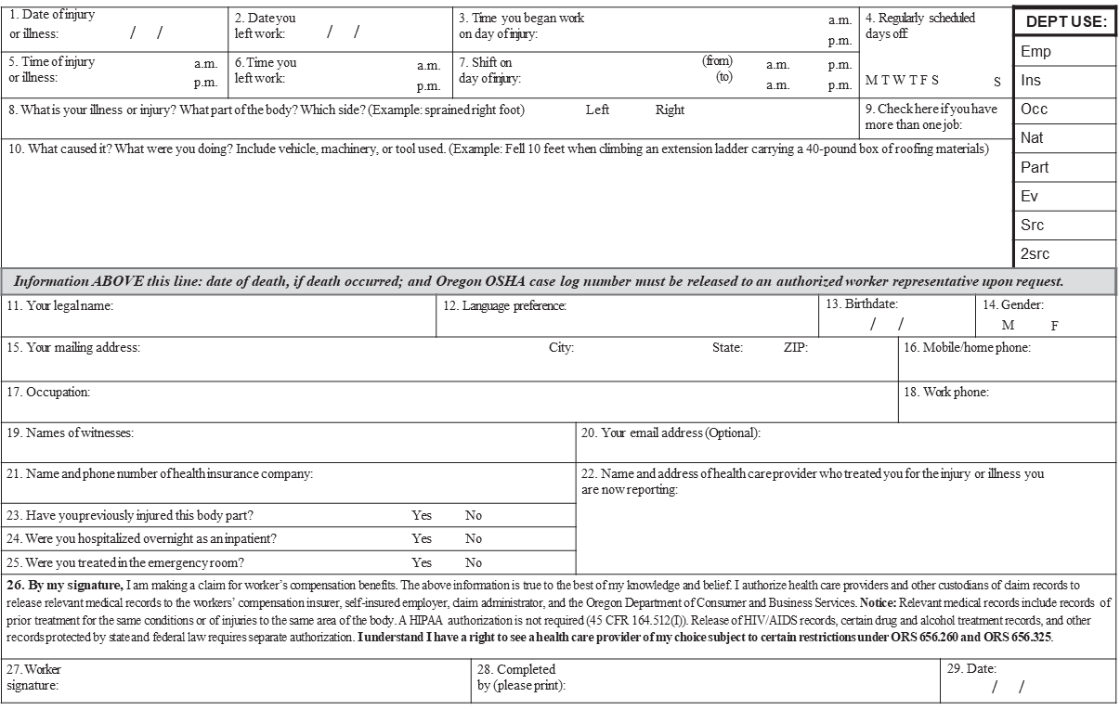
TOP SECTION OF THE SAIF 801
FOR THE EMPLOYEE
Went to ER by ambulance
Notes:
TOP SECTION
Back to the 801: Within 5 days, this completed document needs to be in the inbox for SAIF. If you are sending this to the Safety Specialist on Day 5, please cc saif801@saif.com.
If the worker cannot complete the top, someone else can fill in what they know, write “by phone” in the signature line, and get it to a manager for the bottom to be completed and signed.
Employee fill out blocks 1-29
Supervisor fill out block 30-52
Email Level 3-Restricted Confidentiality Level Only to Amanda.E.Casteel@omd.Oregon.gov and cc: Tracy.Garcia@omd.Oregon.gov
OR
Fax to AGP 971-355-3988
If an employee is injured on the job, filing a claim quickly is important for the employee and the agency.
If you are injured on the job and seek medical treatment for the injury, and 801 must be filed. If the employee does not want to file a claim, they must email the AGP Safety Specialist and cc HR Director Tracy Garcia and document in writing from their email “I do not want to file a SAIF claim.”
On-site first-aid events do not require an 801, but they do require the Workday Safety Incident report.
An accident/incident report (A/I) must be filed through Workday for all on-the-job injuries whether they require medical treatment or not. If the employee seeks medical attention at a later date for this event, the A/I report could be critical.

Slide 23
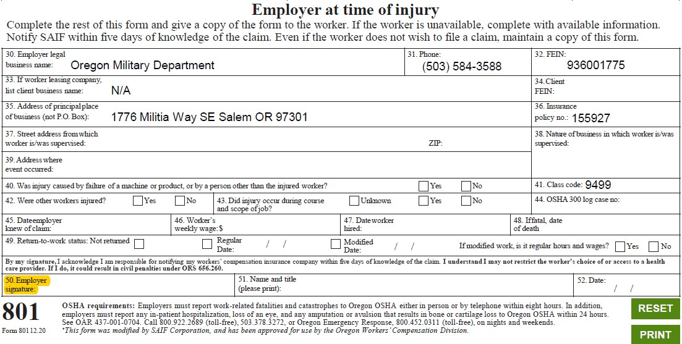
BOTTOM SECTION OF THE SAIF 801
FOR THE EMPLOYER
Went to ER by ambulance
Notes:
Here is the bottom section.
I have experience the hiccup associated with starting with a completely blank 801. You want an 801 that has the OMD information pre-filled. This is available on the OMD Safety Page (it’s within the OMD State Personnel link on the website)
Supervisor fill out block 30-52. For the address of where supervised, just write the name of the building unless they were injured off site then a cross street or community location name is needed.
Complete what you know: Don’t see compensation/worker’s weekly wage? Leave it blank.
Don’t know when they are coming back to work? Check not returned but definitely let the Safety Specialist know when they are back to work either modified or regular work, the EXACT date they returned (or plan on it)
Email Level 3-Restricted Confidentiality Level Only to Amanda.E.Casteel@omd.Oregon.gov and cc: Tracy.Garcia@omd.Oregon.gov
OR
Fax to AGP 971-355-3988
If an employee is injured on the job, filing a claim quickly is important for the employee and the agency.
If you are injured on the job and seek medical treatment for the injury, and 801 must be filed. If the employee does not want to file a claim, they must email the AGP Safety Specialist and cc HR Director Tracy Garcia and document in writing from their email “I do not want to file a SAIF claim.”
On-site first-aid events do not require an 801, but they do require the Workday Safety Incident report.
An accident/incident report (A/I) must be filed through Workday for all on-the-job injuries whether they require medical treatment or not. If the employee seeks medical attention at a later date for this event, the A/I report could be critical.

Slide 24
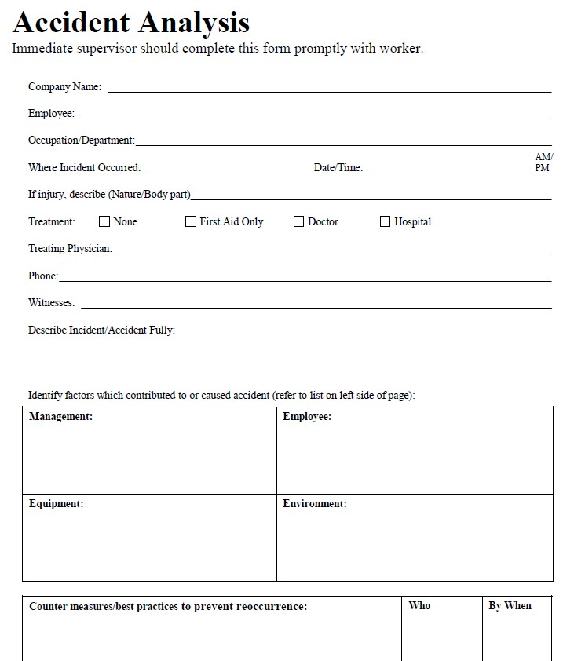
ACCIDENT ANALYSIS FORM
Went to ER by ambulance
Notes:
The accident analysis form is not the same as filing a safety incident report. In addition to this form when a critical incident occurs, you must also TAKE PICTURES and ask witnesses to send an account of the incident to your email. Normailize taking pictures of the injury if visible and the area where the incident occurred. This will come in useful to claims adjusters and SAIF investigators (not to mention OSHA) when understanding to Mechanism of Injury and making determinations to approve or deny a claim.

Slide 25
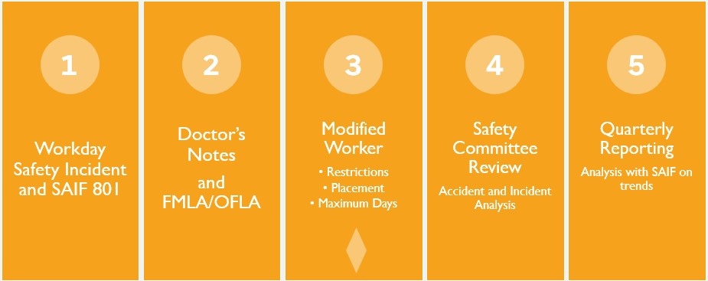
BASIC CLAIMS MANAGEMENT OVERVIEW
Went to ER by ambulance
Notes:
Here I present another useful timeline tool. We have covered #1 here and touched on #2. I will speak now on the importance of work release updates, concurrently FMLA protected leave when a worker is off work on SAIF worker’s comp, and considerations when placing modified/light duty workers.
First, the injured worker should be proactive in providing to you updated work releases throughout the process. If the worker can be accommodated to light duty/modified work but you are experiencing barriers to getting them back to work, notify the Safety Specialist and they will complete additional steps with SAIF (via a modified job description MJD signed by their doctor and Bonafide Job Offer BJO) to return them to work or their timeloss payments from SAIF will stop.
Every month, your local safety committee meets to discuss all safety incidents in the month prior. This includes ensuring the accident analysis was completed and filed / saved to the Workday Safety Incident.
Every quarter, the Safety Specialist meets with SAIF and their leadership teams to review safety incident trends and makes recommendations for improvements to reduce workplace injuries or improve related trainings, policies, best practices, and guidelines.

Slide 26
WORKDAY TIME CARD ENTRY FOR
INJURED WORKERS (LIGHT DUTY)
Time Entry: “Light Duty Worked”
Exact dates for light duty or regular work
10lb weight limit
120 day limit on modified work (calendar)
Went to ER by ambulance
Notes:
Let’s get into how to enter time in Workday as it relates to these cases:
Any time worked light duty or modified/accommodated must have worktag “Light Duty Worked” or be entered as “Light Duty Worked”
The injured worker and/or supervisor must notify the AGP Safety Specialist when modified work begins and ends.
Minimum10lb weight restriction for 8 hour days suggested for return to modified work.
There is a maximum availability of 120 days of modified work permitted.

Slide 27
WORKDAY TIME CARD ENTRY FOR
INJURED WORKERS (OFF-WORK)
Day 1 thru Day 3- use 8 hours Misc Paid Leave AND initial request for Protected Leave (8 hours). Must be entered concurrently with the first day off.
After Day 4 until return to work (regular or light duty), there will be 3 (three) entries to request for time off:
      2/3rd LWOP 5.33 hours
      1/3rd personal accrual (sick, vacation, personal business) 2.67 hours
      8 hours Protected Leave (FMLA)
Went to ER by ambulance

Slide 28
WORKDAY TIME CARD ENTRY FOR
INJURED WORKERS (OFF-WORK)
If the worker is going to be off work or light duty for more than 14 days, please notify the Safety Specialist immediately. The first 3 days off will be compensated by SAIF and the first 3 days can be coded LWOP 8 hours and Protected Leave 8 hours for each of the 3 days.
Went to ER by ambulance

Slide 29
CONTACT
To report safety concerns, notify your Supervisor, your Safety Committee Chairperson or member of your Safety Committee, or make a Safety report thru Workday.
To reach the AGP Safety Specialist, call 503-798-3951 or email Amanda.E.Casteel@omd.oregon.gov
Went to ER by ambulance
Notes:
If you had to step away for a biobreak and are devasted because you missed content, you can join us again next Tuesday Sept 16 at 1pm.

