Slide 1
OMD Safety Policy Training
REDUCING SILICA EXPOSURE

Slide 2
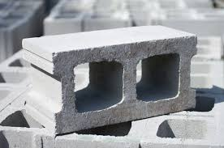
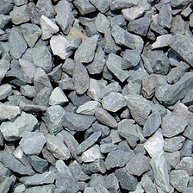
Crystalline Silica
Employee Safety Training

Slide 3


Training Requirements
Annual training
Materials will cover:
Hazards of silica exposure
Safe work practices
How to minimize or eliminate silica exposure
Proper use of N95 masks
Silica safety procedures

Slide 4

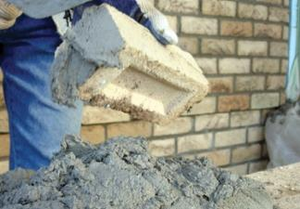
What is Crystalline Silica?
Crystalline silica is a material commonly found in industrial and construction processes.
There a 3 forms of crystalline silica: quartz, tridymite, and cristobalite.
Quartz is the most common form of crystalline silica. It is a component of sand, rock, brick, concrete, and many other common industrial materials.
Notes:
Verify that OMD employees have these exposures or use TYPES of saws that create dust
Common crystalline silica exposures occur from:
Abrasive Blasting
Construction (sawing, drilling, and crushing of concrete, brick, rock and stone)
Glass Manufacturing
Foundries
Dental Equipment and Supplies
Dental Laboratories

Slide 5
Site Specific Processes and Equipment that may expose workers to Crystalline Silica
Stationary masonry saws
Handheld power saws (any blade diameter)
Handheld power saws for cutting fiber-cement board (with blade diameter of 8 inches or less)
Walk-behind saws
Handheld and stand-mounted drills (including impact and rotary hammer drills)
Jackhammers and handheld powered chipping tools
Handheld grinders for mortar removal (tuckpointing)
Handheld grinders for uses other than mortar removal
Heavy equipment and utility vehicles used to abrade or fracture silica containing materials or used during demolition activities involving silica-containing materials
Heavy equipment and utility vehicles used for tasks such as grading and excavating but not including demolishing, abrading, or fracturing silica-containing material
Hazmat with silica

Slide 6
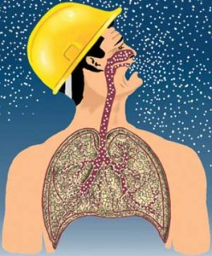
Routes of Entry
Primarily an inhalation hazard
Crystalline silica also has a contact eye and skin hazard, which may result in minor irritation.
Notes:
Primarily an inhalation hazard (breathing the particles in)
Larger particles get trapped in nose, throat, larynx, trachea, and bronchi. These particles can be coughed up or swallowed into digestive tract.
Smaller particles (respirable-sized particles) penetrate deeper into the lungs. Smaller sized particles are created typically when workers grind, cut, drill, mixing or handling raw materials, or crush materials.
It is critically important that you recognize potential pathways and understand the measures you can take to protect yourself.

Slide 7
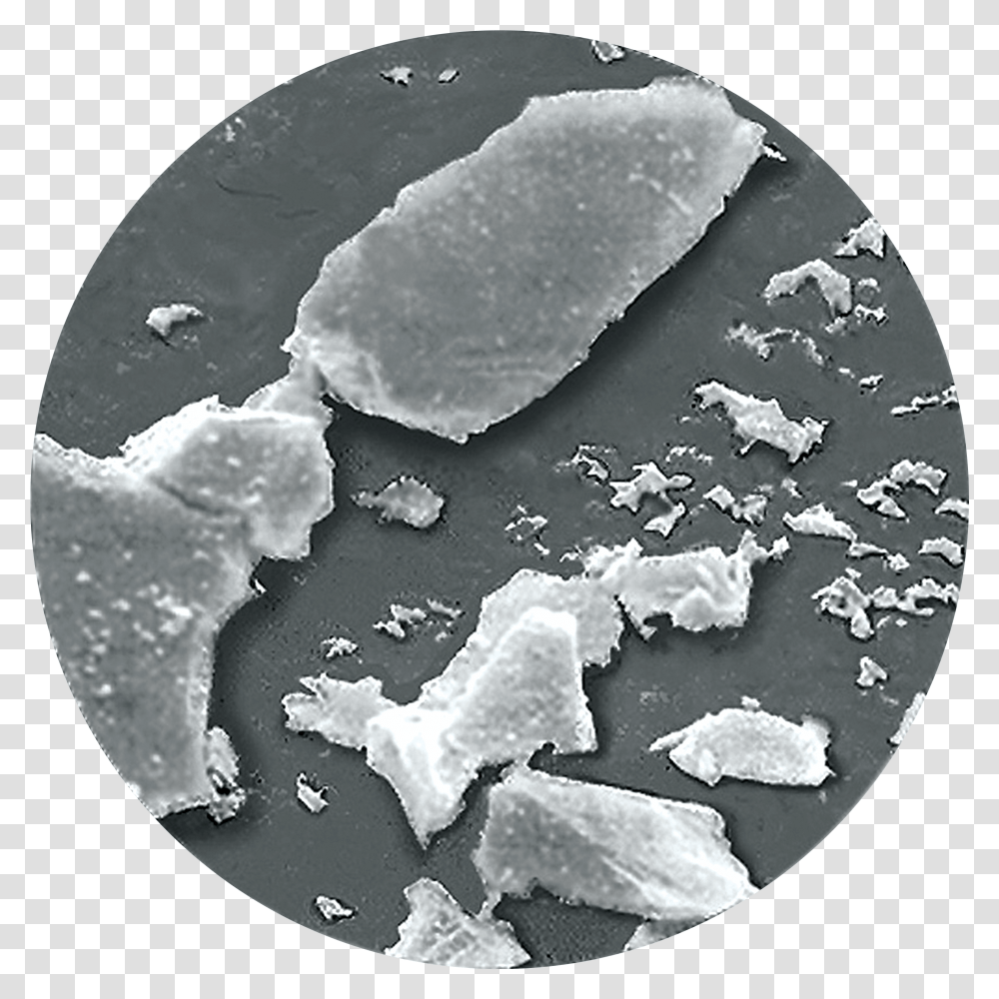
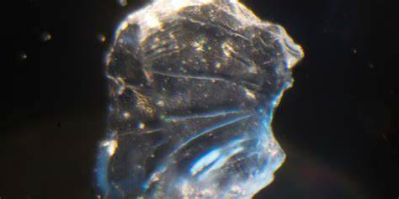
Health Hazards of Silica
Notes:
Crystalline silica has sharp edges that can damage living tissue. When silica is inhaled, it causes lung tissue to react and form fibrotic nodules and scarring around trapped particles.

Slide 8
Health Hazards of Silica
Formation of nodules can develop into a disease called silicosis.
Slowly progressive, irreversible, and potentially fatal.
Once established, it can continue to progress even if you’re no longer exposed.

Slide 9
Health Hazards of Silica
Three types of silicosis: acute, chronic, and accelerated.
Acute: worker exposed to extremely high levels and may show symptoms only after a few weeks.
Chronic: Low but frequent exposure.
Accelerated: Develops after worker is exposed to high levels for a shorter period of time.

Slide 10
Stages of Silicosis
Early stages: No symptoms
Disease progression: Symptoms appear.
Later stages: Symptoms worsen.
Advanced or severe cases: Terminal.
Notes:
Early stages: You may have no symptoms. Most workers who get silicosis don’t show any symptoms for 10 years or more.
Disease progression: Difficulty breathing, coughing, weight loss, weakness, fever, and night sweats.
Later stages: Significant loss of lung capacity and gas exchange function, airflow obstruction.
Advanced or severe cases: respiratory failure, death.
Lifespan of person with silicosis: average, approx. 11 years shorter than those without.

Slide 11
Other Increased Health Affects with Silicosis
Increased risk for lung infections, including tuberculosis
Chronic obstructive pulmonary disease (COPD), emphysema, chronic bronchitis
Cancer
Kidney and immune system diseases (autoimmune diseases i.e. rheumatoid arthritis, lupus)

Slide 12
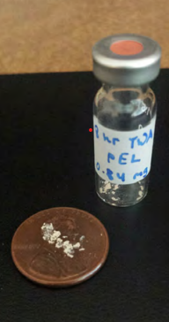
Respirable Crystalline Silica Action Level
Permissible Exposure Limit (PEL)
Ensure that no employee is exposed to an
airborne concentration of respirable crystalline
silica in excess of 50 μg/m3, calculated as an
8-hour time-weighted average (TWA)
In order to meet this requirement, control
methods and PPE are used.
Notes:
Use air quality monitors

Slide 13
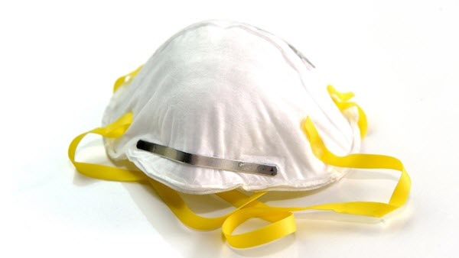
N95 Mask
APF- Assigned Protection Factor
APF 10 includes filtering facepiece like N95 masks.
An N95 mask will filter 95 percent of .3+ micron particles.
https://www.cdc.gov/niosh/topics/publicppe/use.html
Notes:
APF- Assigned Protection Factor. The workplace level of respiratory protection that a respirator is expected to provide.
APF 10 includes filtering facepiece respirators like N95 masks.
An N95 mask will filter 95 percent of .3+ micron particles. You can only use this type of mask in an environment where non-oil-based contaminants are present.

Slide 14
Silica Exposure Site Specific Processes and Equipment

Slide 15
Stationary Masonry Saws
Control Methods:
Water
Follow Instructions
Increased exhaust control
Respiratory Protection with control methods implemented:
Respiratory Protection is not required if using control methods.
If control methods cannot be implemented, must do air monitoring.
Notes:
??? Verify OMD employee use / exposure to these tools ???
Use a saw equipped with an integrated water delivery system that continuously feeds water to the blade.
Operate and maintain IAW manufacturer instructions.
If used indoors or enclosed space, you must have additional exhaust to minimize accumulation of visible airborne dust. This can be a fan or other means to increase air movement and disperse dust.
Respiratory Protection with control methods implemented:
Respiratory Protection is not required if using control methods.
If control methods cannot be implemented, must do air monitoring.

Slide 16
Handheld Power Saw (any blade diameter)
Control Methods:
Water
Follow Instructions
Respiratory Protection with control methods implemented:
Respiratory protection requirements
Additional exhaust required
Air monitoring
Notes:
Use saw equipped with integrated water delivery system that continuously
feeds water to the blade.
Operate and maintain tool in accordance with manufacturer’s instructions to minimize dust emissions.
Respiratory protection with a minimum assigned protection factor (APF) of 10 is required for outdoor work more than four hours per shift and for work done indoors or in an enclosed location.
When your employees use a handheld saw indoors or in an enclosed space, you must provide additional exhaust to minimize the accumulation of visible airborne dust.
If control methods cannot be implemented, must do air monitoring

Slide 17
Handheld power saws for cutting fiber-cement board (with blade diameter of 8 inches or less)
Control Methods for tasks performed outdoors only:
Follow instructions
Dust collection including proper air flow
Respiratory Protection (with control methods):
Not required
No Control Methods?
PPE and Air Monitoring
Notes:
Control Methods for tasks performed outdoors only:
Operate and maintain the saw in accordance with manufacturer’s instructions to minimize dust emissions.
Use a saw equipped with commercially available dust collection system. The dust collector must provide the air flow recommended by the tool manufacturer, or greater, and have a filter with 99 percent or greater efficiency.
Respiratory Protection with control methods implemented:
Respiratory protection is not required outdoors while cutting fiber-cement board with a specialty handheld power saw.
If control methods cannot be implemented, must do air monitoring.

Slide 18
Walk-behind Saws
Control Methods:
Water
Follow Instructions
Respiratory Protection with control methods implemented:
Indoors vs. Outdoors
No control methods?
Notes:
??? Verify OMD employee use / exposure to these tools ???
“Although these are not used by OMD employees… “
Control Methods:
Use a saw equipped with integrated water delivery system that continuously feeds water to the blade.
Operate and maintain the saw in accordance with manufacturer’s instructions to minimize dust.
Respiratory Protection with control methods implemented:
When employees are working outdoors, respiratory protection is not required for work with walk-behind saws. When employees are working indoors, or in an enclosed location, respiratory protection with a minimum APF of 10 is required.
If control methods cannot be implemented, must do air monitoring.

Slide 19
Handheld and stand-mounted drills
Control Methods:
Follow Instructions
Dust collection
HEPA Filter
Respiratory Protection (w/ control methods)
Not required with control methods in place
Additional exhaust
No Control Methods?
Notes:
Handheld and stand-mounted drills (including impact and rotary hammer drills)
Control Methods:
Operate and maintain the drill in accordance with manufacturer’s instructions to minimize dust emissions
Use a drill equipped with a commercially available shroud or cowling with dust collection system. The dust collector must provide the air flow recommended by the tool manufacturer, or greater, and have a filter with 99 percent or greater efficiency and a filter-cleaning mechanism
Use a HEPA-filtered vacuum when cleaning holes
Respiratory Protection with control methods implemented:
Respiratory protection is not required when employees use handheld or stand-mounted drills equipped with a dust collection system, including overhead drilling.
When your employees use handheld and stand-mounted drills indoors or in enclosed areas, you must provide additional exhaust to minimize the accumulation of visible airborne dust.
If control methods cannot be implemented, must do air monitoring.

Slide 20
Jackhammers and handheld powered chipping tools
Control Method Option 1:
Water
Control Method Option 2:
Follow Instructions
Dust Collection
Respiratory Protection:
Outdoors
Indoors
No Control Methods?
Notes:
Control Method Option 1:
Use a tool with water delivery system that supplies a continuous stream or spray of water at the point of impact.
Control Method Option 2:
Use a tool equipped with commercially available shroud and dust collection system
Operate and maintain tool in accordance with manufacturer’s instructions to minimize dust
The dust collector must provide the air flow recommended by the tool manufacturer, or greater, and have a filter with 99 percent or greater efficiency and a filter-cleaning mechanism
Respiratory Protection:
Respiratory protection with an APF of 10 is required when the task is done outdoors for more than four hours per shift, or when the task is done indoors or in an enclosed location regardless of task duration.
When your employees are working indoors or in an enclosed space, you must provide additional exhaust to minimize the accumulation of visible airborne dust.
If control methods cannot be implemented, must do air monitoring and wear PPE.

Slide 21
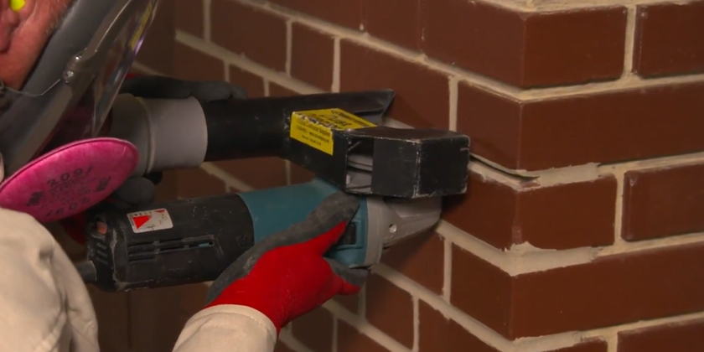
Handheld grinders for mortar removal (tuckpointing)
Control Methods:
Follow Instructions
Dust Collection
Respiratory Protection:
4 hours or less
4 hours or more
Additional exhaust
No Control Methods?
Notes:
Control Methods:
Use a grinder equipped with a commercially available shroud and dust collection system.
Operate and maintain the grinder in accordance with the manufacturer’s instructions to minimize dust.
The dust collector must provide 25 cubic feet per minute or greater of airflow per inch of wheel diameter and have a filter with 99 percent or greater efficiency and a cyclonic pre-separator or filter-cleaning mechanism.
Respiratory Protection:
Respiratory protection with a minimum APF of 10 is required for work with handheld grinders for mortar removal lasting four hours or less in a shift. Respiratory protection with a minimum APF of 25 is required for work lasting more than four hours per shift.
When employees use handheld grinders for mortar removal indoors or in enclosed areas, you must provide additional exhaust if needed to minimize the accumulation of visible airborne dust.
If control methods cannot be implemented, must do air monitoring.

Slide 22
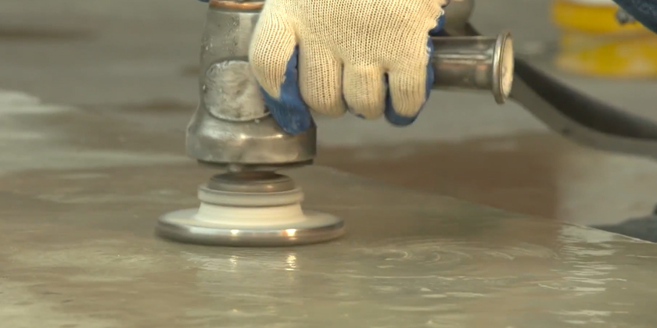
Handheld grinders for uses other than mortar removal
Control Methods:
Option 1:
Water
Follow Instructions
Option 2:
Dust Collection
Respiratory Protection:
Indoors/enclosed > 4 hours
Additional exhaust
No Control Methods?
Notes:
Control Methods:
Option 1:
Use a grinder equipped with integrated water delivery system that continuously feeds water to the grinding surface
Operate and maintain the grinder in accordance with manufacturer’s instructions to minimize dust
Option 2:
Use a grinder equipped with commercially available shroud and dust collection system
Operate and maintain the grinder in accordance with manufacturer’s instructions to minimize dust emissions
The dust collector must provide 25 cubic feet per minute or greater of airflow per inch of wheel diameter and have a filter with 99 percent or greater efficiency and a cyclonic pre-separator or filter-cleaning mechanism.
Respiratory Protection:
Respiratory protection is not required when water-based dust suppression systems are used regardless of task duration. When dust collection systems are used, respiratory protection with a minimum APF of 10 is required only when engaged in a task indoors or in an enclosed location for more than four hours per shift.
When your employees use handheld grinders indoors or in enclosed areas, you must provide additional exhaust as needed to minimize the accumulation of visible airborne dust.
If control methods cannot be implemented, must do air monitoring.

Slide 23

Heavy Equipment & Utility Vehicle Operators (used to abrade or fracture)
Control Methods:
Stay inside the cab
Respiratory Protection (w/ control methods)
Not required
No Control Methods?
Notes:
Heavy equipment and utility vehicles used to abrade or fracture silica containing materials or used during demolition activities involving silica containing materials
Control Methods:
Operate the equipment from within an enclosed cab.
When employees outside of the cab are engaged in the task, apply water and dust suppressants, or both, as necessary to minimize dust emissions.
Respiratory Protection with control methods implemented:
Respiratory protection is not required for heavy equipment operators and laborers who help heavy equipment operators during this task.
If control methods cannot be implemented, must do air monitoring.

Slide 24
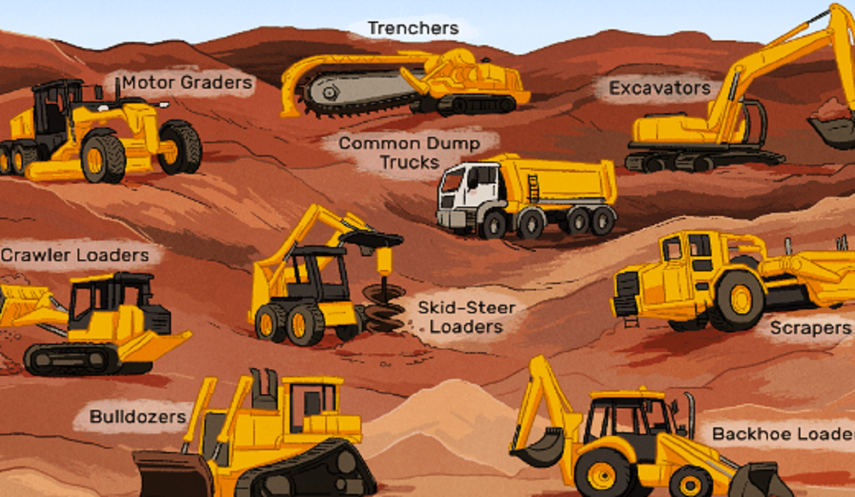
Heavy Equipment & Utility Vehicle Operators (used for grading and excavating)
Control Methods:
Both water and dust suppression
Or
Stay in the cab
Respiratory Protection:
Not required
No Control Methods?
Notes:
Heavy equipment and utility vehicles used for tasks such as grading and excavating but not including demolishing, abrading, or fracturing silica containing materials
Control Methods:
Apply water, dust suppressants, or both, as necessary to minimize dust emissions.
Or
When the equipment operator is the only employee engaged in the task, operate equipment from within an enclosed cab.
Respiratory Protection:
Respiratory protection is not required for work with heavy equipment when it is operated from within an enclosed cab, or when water or other dust suppressants are used.
If control methods cannot be implemented, must do air monitoring.

Slide 25
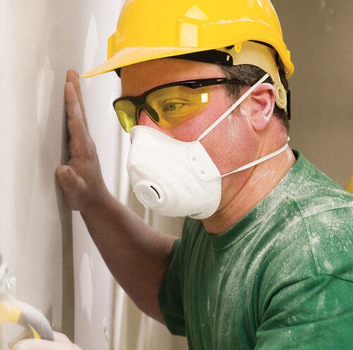
Respiratory Protection Summary
Handheld Power Saw:
APF 10 outdoor >4hrs (MORE THAN) or indoors/enclosed location
Walk behind Saw: APF 10 indoors/enclosed location
Jackhammers and handheld powered chipping tools:
APF 10 outdoor >4hrs or indoors/enclosed location
Handheld grinders for mortar removal (tuckpointing):
APF 10 <4hrs (LESS THAN) of work.
APF 25 outdoor >4hrs
Handheld grinders for uses other than mortar removal:
APF 10 outdoor >4hrs (MORE THAN) or indoors/enclosed location
Notes:
Handheld Power Saw: APF of 10 is required for outdoor work more than four hours per shift and for work done indoors or in an enclosed location
Walk behind Saw: When employees are working indoors, or in an enclosed location, respiratory protection with a minimum APF of 10 is required.
Jackhammers and handheld powered chipping tools: Respiratory protection with an APF of 10 is required when the task is done outdoors for more than four hours per shift, or when the task is done indoors or in an enclosed location regardless of task duration.
Handheld grinders for mortar removal (tuckpointing): Respiratory protection with a minimum APF of 10 is required for work with handheld grinders for mortar removal lasting four hours or less in a shift. Respiratory protection with a minimum APF of 25 is required for work lasting more than four hours per shift.
Handheld grinders for uses other than mortar removal: Respiratory protection with a minimum APF of 10 is required only when engaged in a task indoors or in an enclosed location for more than four hours per shift.

Slide 26
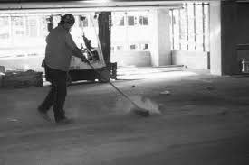
Housekeeping
Sweeping
No compressed air unless:
You have a ventilation system
OR
No alternative method is feasible.
Notes:
Do not allow dry sweeping or dry brushing where such activity could contribute to employee exposure to respirable crystalline silica unless wet sweeping, HEPA-filtered vacuuming or other methods that minimize the likelihood of exposure are not feasible.
Do not allow compressed air to be used to clean clothing or surfaces where such activity could contribute to employee exposure to respirable crystalline silica unless:
The compressed air is used in conjunction with a ventilation system that effectively captures the dust cloud created by the compressed air; or
No alternative method is feasible.

Slide 27
References and Resources
OR-OSHA Oregon Occupational Safety and Health : Silica
SAIF.com
NIOSH and CDC.com - Silica and Worker Health | Silica | CDC
Work Safely with Silica www.silica-safe.org
Your local safety committee

Slide 28
Thank you!
Questions?

