Slide 1
Task Force Leader Symposium
May 16, 2023
OSFM Breakout

Slide 2
Overview
Oregon Fire Mutual Aid System Mobilization Types
Pre-Positioning
Immediate Response
Conflagration

Slide 4
PRE-POSITIONING

Slide 5
Pre-Positioning of Resources
What Is Pre-positioning
Deployment of fire resources in advance of a declared conflagration or request for resources
Pre-positioning is intended to increase the available Oregon Fire Mutual Aid System (OFMAS) capacity to aid the fire service in a predicted or emerging incident

Slide 6
Pre-Positioning of Resources
Who Can Request Pre-Positioning
Fire Defense Board Chief (FDBC) through their Regional Mobilization Coordinator (RMC)
Oregon Department of State Fire Marshal (OSFM)
Example of Considerations
Potential for multiple days of extreme fire risk in your area
Significant weather event is predicted - such as abundant lightning or high wind

Slide 7
Pre-Positioning of Resources
Pre-deployment
Makeup of resources to be pre-positioned will be determined by OSFM, the hosting FDBC, and the RMC based on current and anticipated needs and complexity
A pre-positioning assignment will have an anticipated end date
Resources should be prepared to remain mobilized for up to 14 days should they be assigned to an incident – 72 hours self-sufficient

Slide 8
Pre-Positioning of Resources
Deployment
Resources will be assembled following the standard process
Before leaving the POD, OSFM will host a conference call with the responding TFL, hosting and receiving FDBC and RMC for a review of the assignment
Resources should be fully prepared to mobilize before that call occurs
Reimbursable time starts when the call begins – Resources are excepted to leave immediately following the call

Slide 9
Pre-Positioning of Resources
When to Contact the AOC
When departing POD with your ETA
When you arrive
If re-assigned to another county or IR with ETA
At the end of an assignment with your ETA
When arrived back at your home station

Slide 10
Pre-Positioning of Resources
Arriving at Assignment
Resources will be checked in by an RMC upon arrival
Standard paperwork should be provided by TF, including completed Resource Manifests
Lodging: OSFM will provide lodging; either at a hotel, fire station, or camping

Slide 11
Pre-Positioning of Resources
Understanding the Assignment
The hosting region will conduct an in-brief to include:
basic overview of the assignment,
communications plan,
area mapping,
contact information, and
logistical overview

Slide 12
Pre-Positioning of Resources
Additional Eligible Costs
Meals: reimbursement of meals is at the GSA per diem rate for the destination when meals are not provided. Receipts are not required
OSFM will provide a memo outlining the allowable per diem for deployed personnel during the reimbursement process. Incidental expenses are not authorized
If resources are assigned to a conflagration, they will no longer be considered pre-positioned and no longer eligible for per diem

Slide 13
IMMEDIATE RESPONSE

Slide 14
Immediate Response Mobilization
What is Immediate Response Mobilization
Intended to mobilize resources quickly to an emerging incident with the intention of preventing the need for conflagration or the loss of life or property
IR is requested by a FDBC through the RMC
There are two distinct types of IR response which can be provided by OSFM
Air Resources
OFMAS Resources

Slide 15
Immediate Response Mobilization
OFMAS Resources Preparedness
Personnel are expected to be trained to the Mob Plan standards and typing requirements
Immediate Response resources mobilized by OSFM should be prepared to remain at an incident for up to 72 hours
Fire camp will most likely not be established for IR
Resources mobilized through IR must meet all preparedness and logistical guidelines outlined in the Mob Plan
72 hours prepared – food/water/shelter/supplies

Slide 16
Immediate Response Mobilization
OFMAS Resources Deployment
Resources will follow the standard process and form for approval
Resources will be assembled following the standard processes at a POD
Resources mobilizing through Immediate Response should be prepared to muster and respond as quickly as possible
Ready to work when they arrive

Slide 17
Pre-Positioning of Resources
When to Contact the AOC
When departing POD with your ETA
When you arrive
At the end of an assignment with your ETA
When arrived back at your home station

Slide 18
Immediate Response Mobilization
OFMAS Resources Check-in
Resources will be directed to a staging location and will check-in with an RMC upon arrival
Standard paperwork should be provided by responding resources, including completed Resource Manifests

Slide 19
Immediate Response Mobilization
OFMAS Resources Hosting Region Responsibilities
The hosting region will conduct an in-brief to include:
basic overview of the assignment,
communications plan,
area mapping,
contact information, and
logistical overview

Slide 20
Immediate Response Mobilization
OFMAS Resources Assignment
Immediate Response resources will work under the command and control of the local on-scene Incident Commander and should be prepared upon arrival to engage immediately following the in-briefing
FDBC should communicate any information provided to them by OSFM with their TFL prior to departing POD

Slide 21
Immediate Response Mobilization
OFMAS Resources Claims
Claims for damage that occurs during an Immediate Response, must be between check-in time and demobilization and reported to the RMC
Any loss or damage should be noted on the Resource Manifest
Damage must be the direct result of the incident and not due to normal wear and tear
If damage or loss was not discovered at the incident, contact the OSFM as soon as possible after the discovery

Slide 22
Immediate Response Mobilization
OFMAS Resources Securing Items
Resources are responsible for securing items on their apparatus and for providing security of their equipment and personal items on their apparatus
In the event of criminal activity, TF should contact local law enforcement to report the crime and notify the RMC

Slide 23
Immediate Response Mobilization
OFMAS Resources Demobilization
Resources mobilized through IR will only remain at the incident for up to 72 hours
In the event the incident becomes a conflagration, IR resources will not be asked to stay and will be sent home within the 72 hour timeline

Slide 24
 | Pre-Positioning | IR - TF/ST | Conflagration
Length of assignment | Start/End Time Determined On Need | Up to 72 hrs. | Up to 14 days
Can be sent to IR or Conflagration | Yes | No | N/A
Reimbursement Start Time | Conference Call | Departure of POD | Departure of POD
Eligible for Meal Reimbursement | Yes, per diem | No | No
72 hours Self-Sufficient | Yes, needed if they are sent for IR or to a conflagration | Yes | Yes

Slide 25
RESOURCE MANIFEST

Slide 26
OSFM Mobilization
PRESS HARD!
Each Apparatus Should Have One Completed Manifest – Engines, CMD, Support Trailer
Even If There Are Multiple Agencies on The Apparatus
Engine Boss of each responding unit should start their Manifest at the time of mobilization

Slide 27
OSFM Mobilization
Name of Task Force (TF1)
Leave blank – for IMT members only
Order number issued by AOC
Name of the incident
Apparatus or vehicle number
Apparatus kind and type (T6 for Type 6 engine )
Agency owning the apparatus/vehicle

Slide 28
OSFM Mobilization
Enter the names of individuals on apparatus
Enter position for each individual (TFL, ENG, AO, FF)
Enter home agency for each individual on apparatus
Make A Copy If Home Agency Differs From Apparatus Agency
ALS Capable?

Slide 29
OSFM Mobilization
Enter date and time Task Force leaves the POD for incident
Upon arrival back at home station, enter date and time
TFL to call AOC when all resources have arrived back at their home station

Slide 30
OSFM Mobilization
New for 2023
Remob = New Manifest

Slide 31
OSFM Mobilization
CHECK-IN PROCESS

Slide 32
OSFM Mobilization
TFL Receives Packets:
TF/ST Leader Guidebook
ICS 212 – Demob Form (7)
Engine/Crew Eval Form (6)
ICS 214 – Unit Log (6)
After Action Review Form
Structural Protection Plan
Fuel prior to arrival (not reimbursable)
TFL contacts the AOC
TFL checks in with RESL

Slide 33
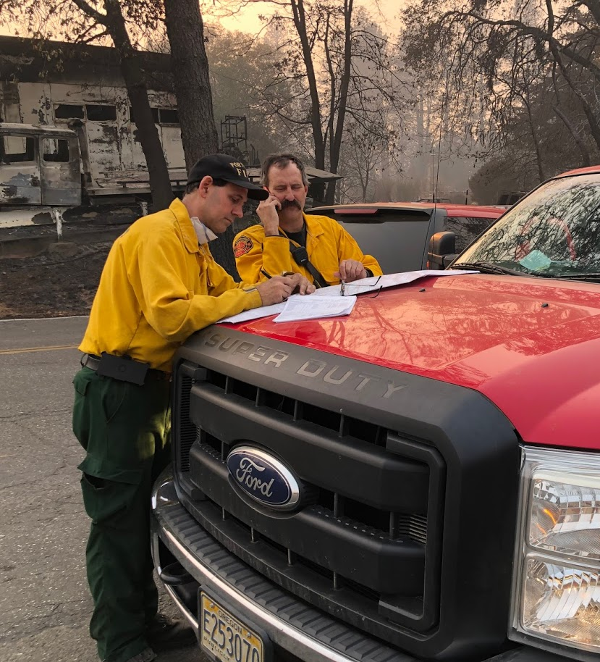
OSFM Mobilization
Check-In Logistics
TFL only
Staging
Radios
Briefing & Maps
Camp Layout

Slide 34
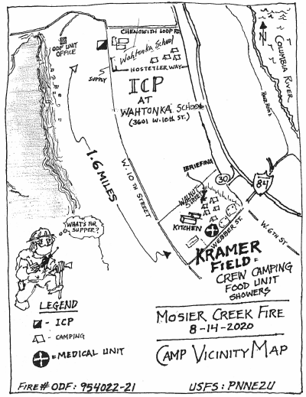
OSFM Mobilization
Fire Camp Layout
Meals
Food & Ice
Showers
Camping
Stay together
Briefings
Cache/Supply

Slide 35
OSFM Mobilization
Apparatus Form
This Form Is Part of The Check-in Process and Is Submitted to The RESL Upon Arrival
This Form Is Used by Both Safety and Operations

Slide 36
OSFM Mobilization
214 Unit Log
This Form Is to Be Completed by Each Unit Daily and Submitted to DIVS
Detail Actions, Accidents, Agreements, Contact with Homeowners, Lost Equipment, Injuries, And Other Pertinent Information

Slide 37
OSFM Mobilization
Claims
Start with your DIVS that day
Tell the story
Was it the ‘fault of the fire?’
More about the activity at the time than the result
Non-reimbursable
Criminal acts Mechanical
Negligence Operator error

Slide 38
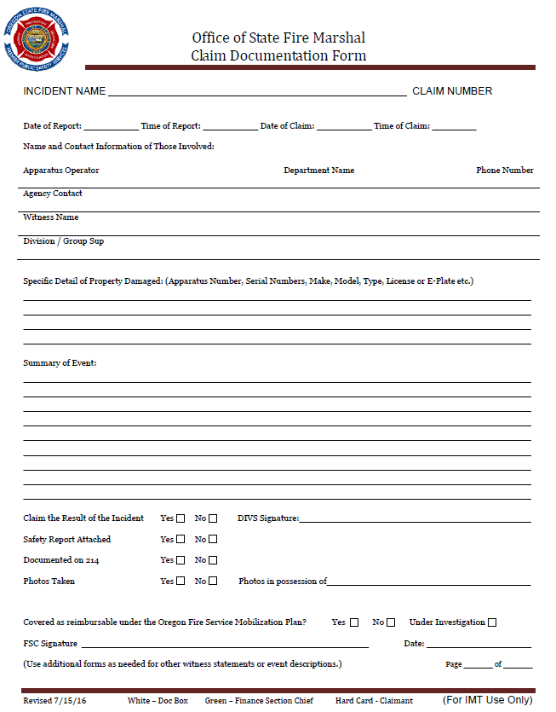
OSFM Mobilization
Claims
Start with your DIVS that day
Tell the story
Was it the ‘fault of the fire?’
More about the activity at the time than the result
Non-reimbursable
Criminal acts Mechanical
Negligence Operator error

Slide 39
OSFM Mobilization
Claims
Start with your DIVS that day
Tell the story
Was it the ‘fault of the fire?’
More about the activity at the time than the result
Non-reimbursable
Criminal acts Mechanical
Negligence Operator error

Slide 40
OSFM Mobilization
DEMOB PROCESS

Slide 41
OSFM Mobilization
Incident Demobilization Inspection Form
Each Apparatus Must Have a Demobilization Inspection Conducted by the AO

Slide 42
OSFM Mobilizations
Engine Company or Crew Performance Rating
Each Task Force/Strike Team Will Be Evaluated by Their DIVS
TF/ST Leaders Are Expected to Conduct Evaluations on Each Apparatus Under Their Direction
These Evaluations Are to Be Reviewed, Signed, And Provided to The IMT Prior To Demobilization
OSFM Forwards Copies of All Evaluations to The Fire Defense Board Chief

Slide 43
OSFM Mobilizations
Task Force After Action Review Form
Each TF/ST Leader Is Expected to Facilitate an After-Action Review Using the Provided Form, Which Is Provided to The RESL During the Demobilization Process
This Process Should Take Approximately 20 Minutes and The Intention Is to Identify Successes And Challenges, Both Operationally and Logistically

Slide 44
OSFM Mobilizations
Task Force After Action Review Form
Review the intent of the mission:
Key task assignments; desired “end state” (what does “Right” look like?)
Establish the facts:
Pool multiple perspectives to build a shared picture of what happened
Analysis of cause and effect:
Focus on WHAT, not WHO; draw out explanations of what occurred

Slide 45
OSFM Mobilizations
Task Force After Action Review Form
Correct Weaknesses
Focus on items you can fix, rather than external forces outside of your control
Sustain/Maintain Strengths
Identify areas where groups are performing well and should sustain. This will help repeat success and create a balanced approach to the AAR

Slide 46
OSFM Mobilization
Be Ready Per Demob Plan (Fueled & Fed)
Turn In Radios & Other Borrowed Equipment
RESL Will Sign Manifest & Include Departure Time
IC Or Agency Rep Addresses Group
TFL Will Call The AOC When You Leave & Arrive Home

Slide 47
OSFM Mobilization
REIMBURSEMENT

Slide 48
OSFM Mobilization
Reimbursement: How Anyone Can Help Expedite
Put The Exact Times On The Resource Manifest
Don’t Forget Return To Station Time!
Do Not Add Rehab Time To The Manifest
Whoever Does Your Reimbursement Packet Needs:
Approved Claim Forms Manifests
Receipts For Reimbursable Items

Slide 49
OSFM Mobilization
REIMBURSEMENT: MISC.
No fuel unless specifically instructed by IMT
No snacks; personal items; or required equipment
Everything must be documented & approved by IMT

Slide 50
OSFM Mobilization
QUESTIONS

