Slide 1
2023 Task Force Leader Symposium

Slide 2
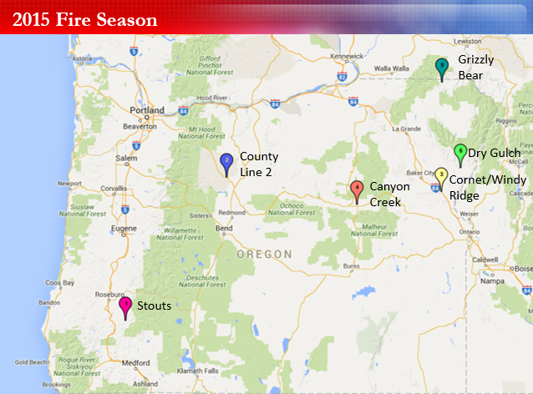
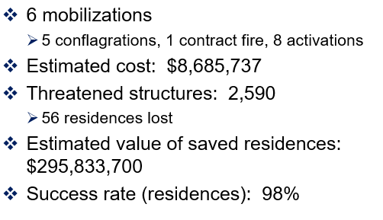
Symposium Origin Story

Slide 3
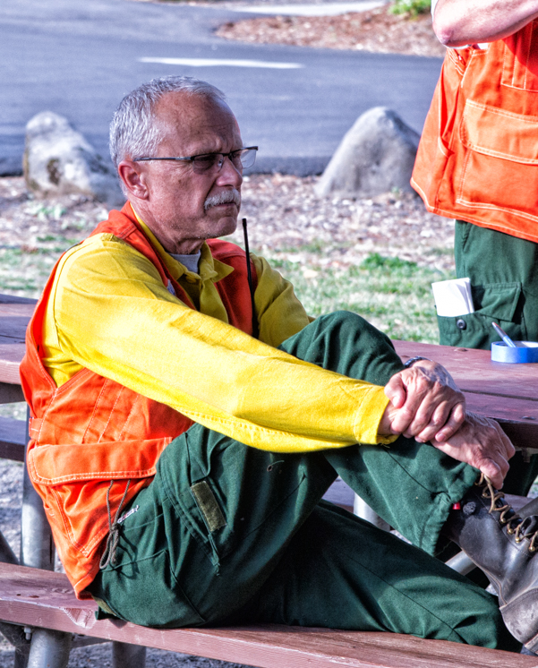
Symposium Origin Story

Slide 4
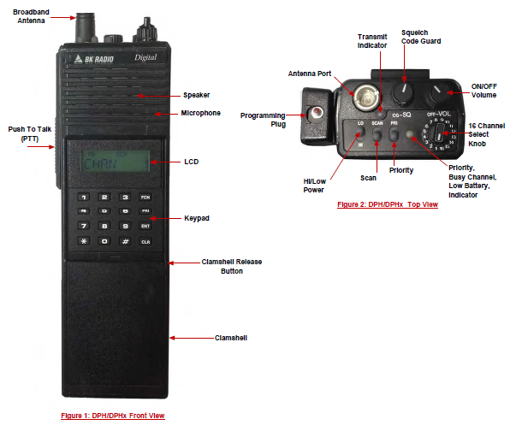
Symposium Origin Story
Photo Credit: NIFC-NIICD

Slide 5
Symposium Origin Story
Photo Credit: NIFC-NIICD

Slide 6
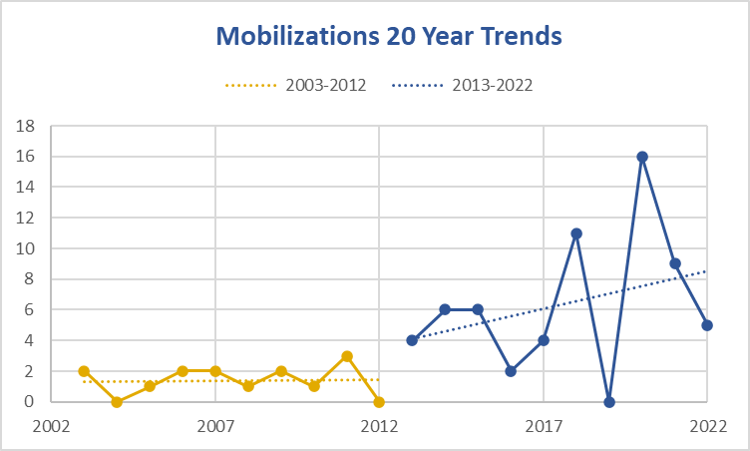
20-Years of Mobilization Data
6
Notes:
Oregon's mobilization data over the last 20 years.
Oregon's new reality- you can see the trend line in mobilization over the last decade and the drastic difference from the previous decade to the current.
The bar chart on the right shows average mobilizations over the last two decades.
This reality of more frequent mobilizations and greater risks to our communities has required we reimaging what response looks likes now and into the future. As the Chief mentioned in our Strategic Themes we have not had to think about the here and now and upcoming fire season, but also how to we proactively look around the corner 5 years from now and modernize and update how to we keep the pace and what is needed for this new reality.
I'd also like to highlight that significant as the 2021 and 2022 fire seasons were- things would have been much worse without new tools like pre-positioning and immediate response.

Slide 7
6 Pre-Positioning
TF1 Lane (Klamath; CO; Miller)
TF13 Marion (CO)
TF14 Benton (Klamath)
Washington EMAC (3 TFs)
Red Team (C&G)
TF35 Yamhill (Sturgill > Cedar)
Estimated cost: $472k
2021 was $3.1m
Big difference was CA/UT at $2.5m
12 Immediate Response
Cross Road
Corey Road
The Dalles Marina
Miller Road
MP87
Pendleton Flour Mill
Big Canyon
Exit 35
VanMeter
Vitae Spring
McIver
Hwy 730
Estimated cost: $808k
2021 was $1m
5 Conflagrations
Miller Road
Rum Creek
Double Creek
Sturgill
Cedar Creek
Estimated cost: $12.9m
2021 was $22.2m
Big difference was Bootleg at $11m

Slide 8
2022 Summer
# Mobed | Lead FDB
1 | Benton
2 | Rogue Valley
2 | Central OR
2 | Linn
2 | Polk
2 | Columbia
2 | Washington
2 | Lincoln
2 | Douglas
3 | Multnomah
4 | Clackamas
4 | Clatsop
5 | Marion
5 | Yamhill
8 | Lane
42 OFMAS Task Forces
4 OFMAS Strike Teams
3 CA Strike Teams
3 WA Task Forces
103 individual fire agencies
350 individual reimbursement packets
3 OFMAS Strike Teams to McKinney

Slide 9
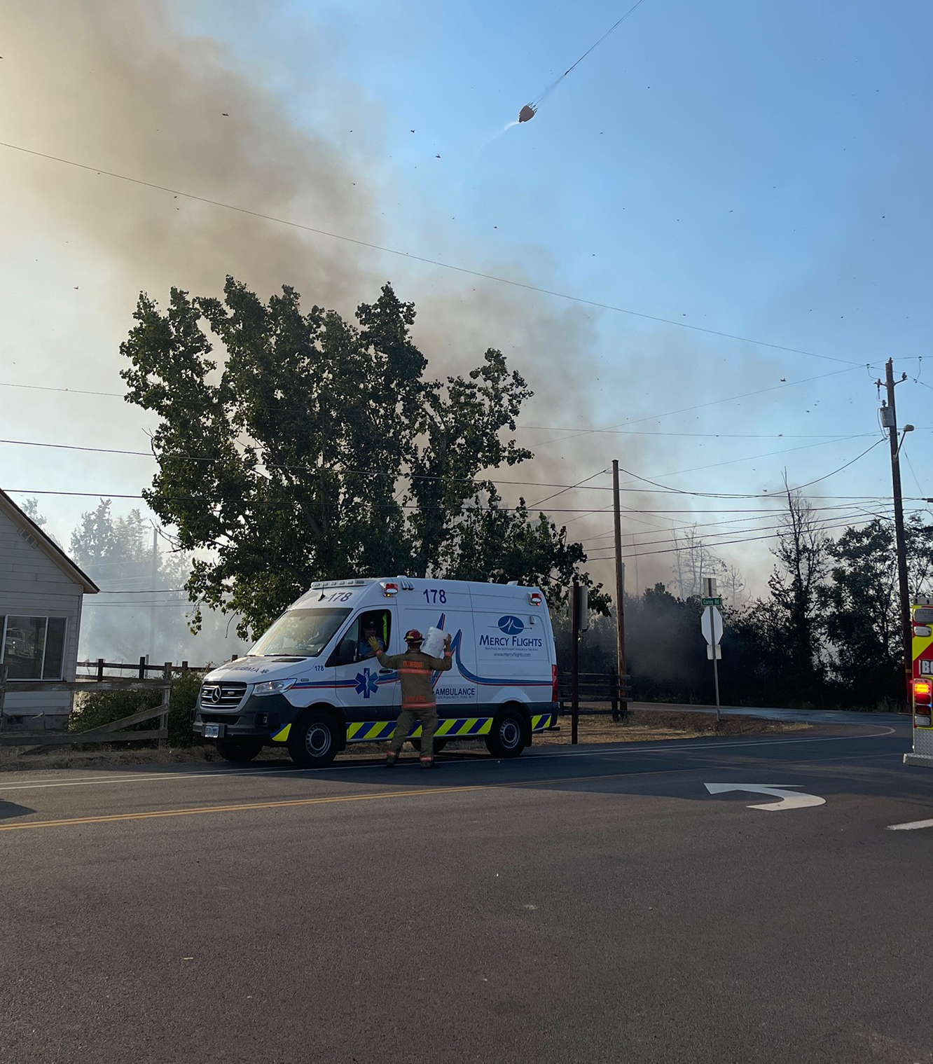
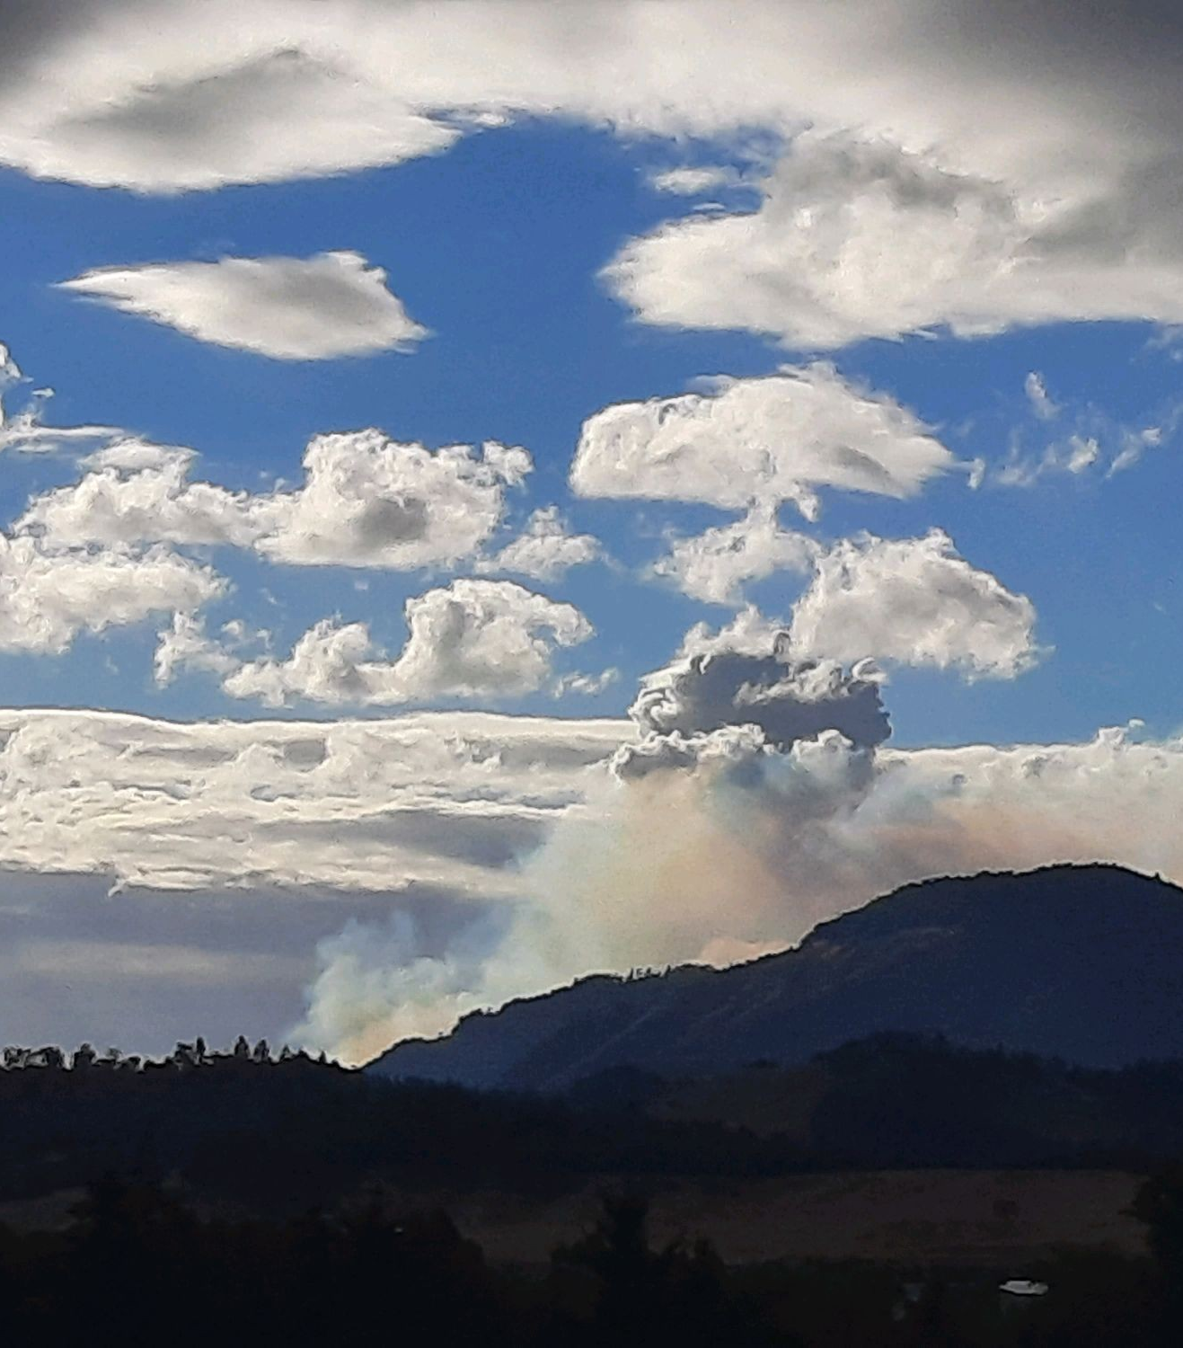
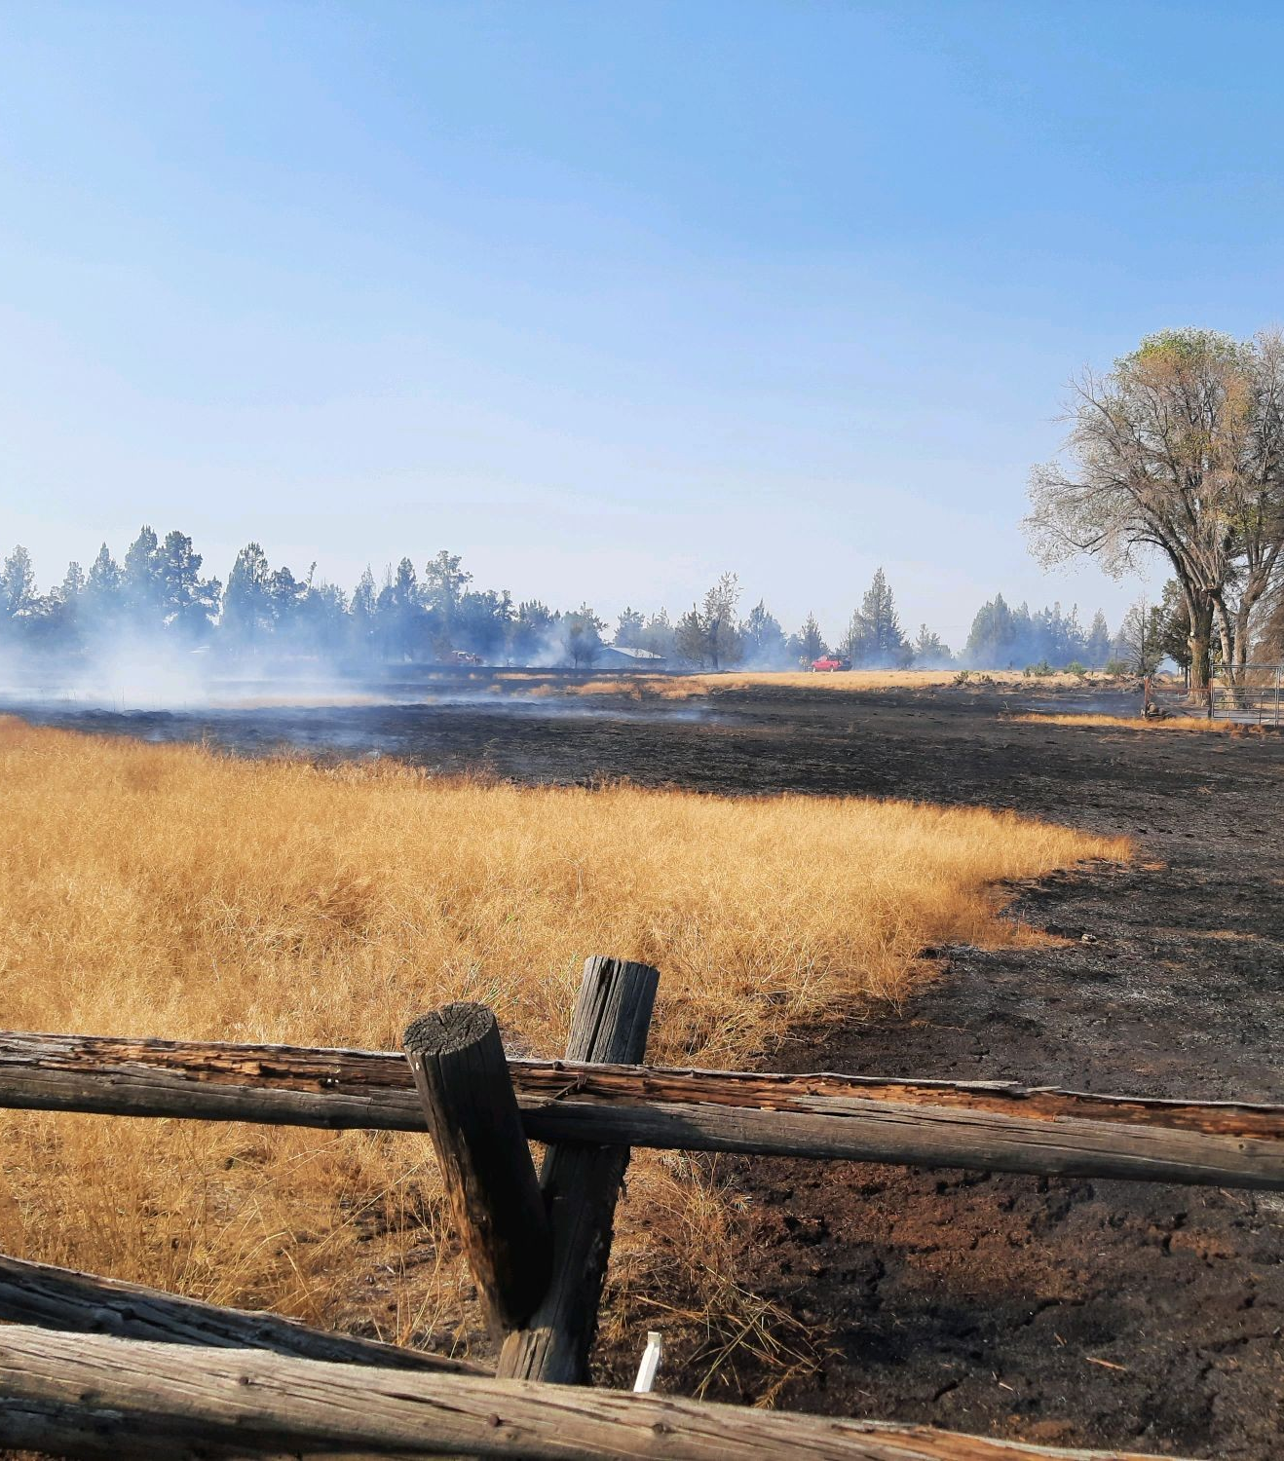
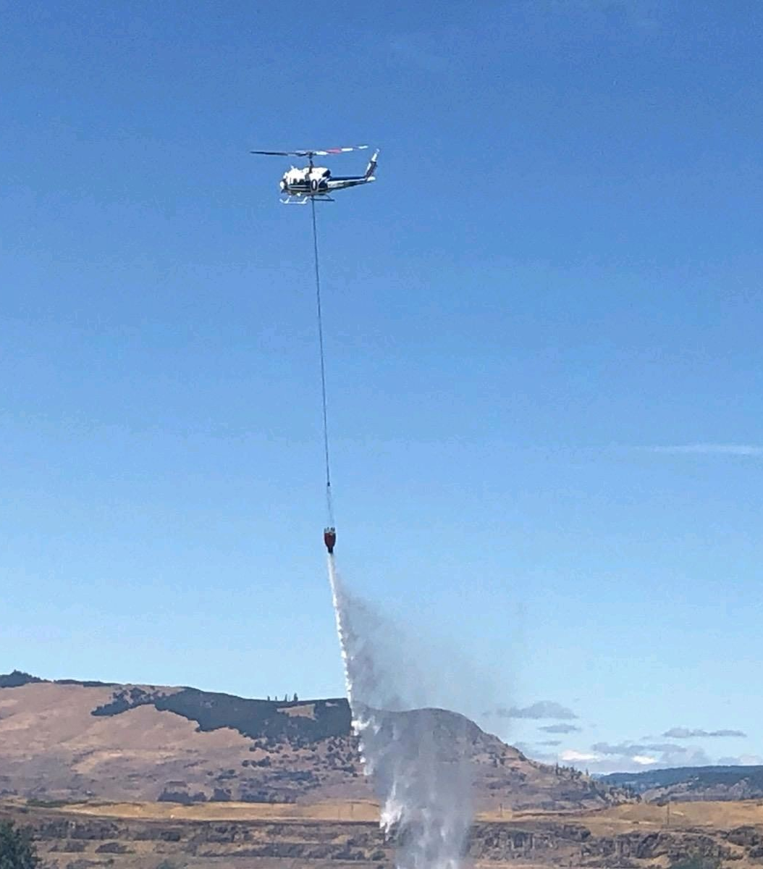
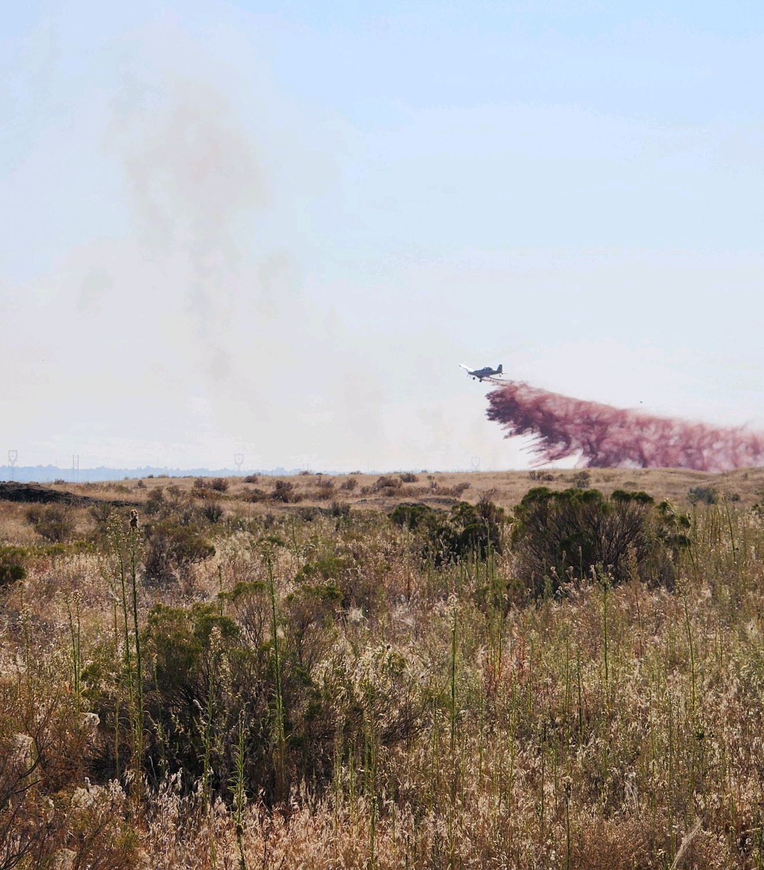
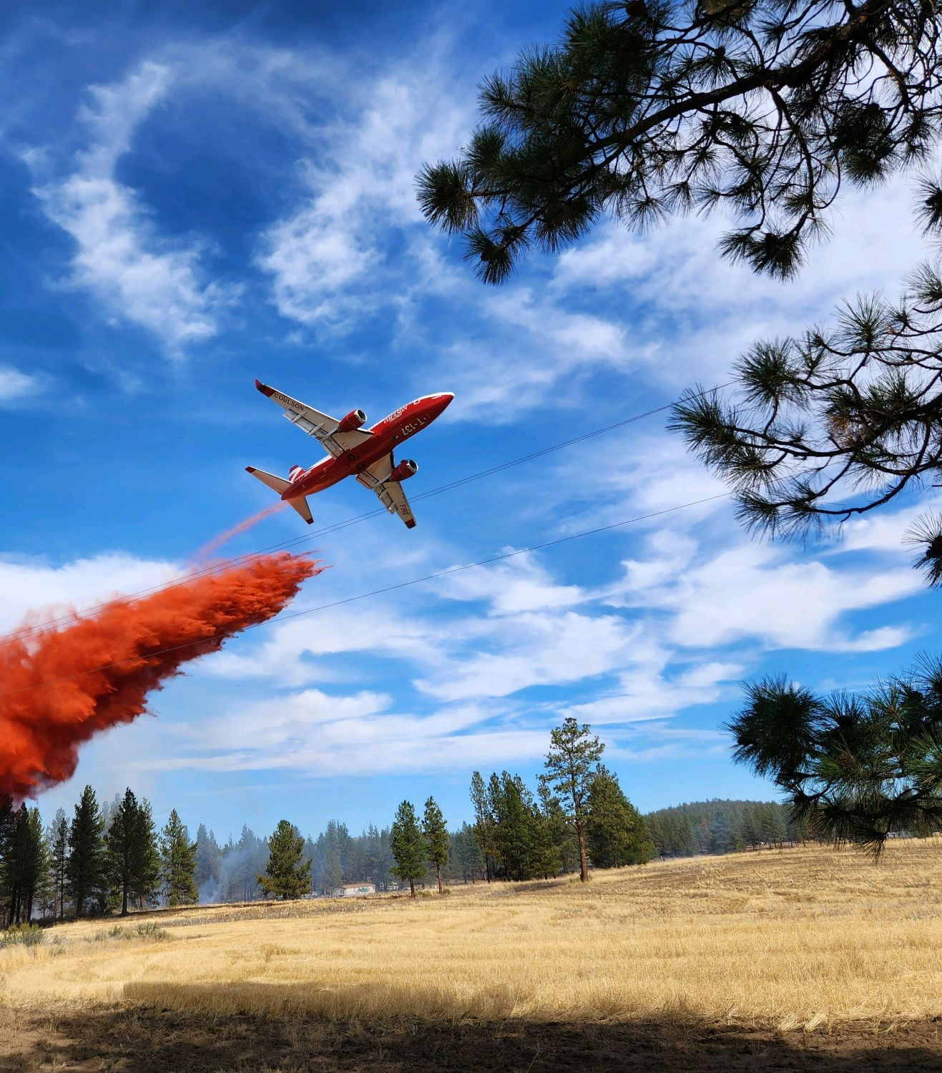
2022 Summer
Honorable mentions to Willowcreek, Tolo, Windigo/Potter, Big Rattlesnake, Crockets Knob, Cowboy, DeMoss, China Gulch…

Slide 10
SB762 & Response Ready Oregon
Keep Fires Small & Away From Communities!
Modernize systems and technology to support the Oregon Fire Mutual Aid System
Assist the Oregon Fire Service by creating and enhancing local and regional mutual aid plans
Assist the Fire Defense Board Chiefs during initial attack, assessing of fire, and requesting assistance if necessary
Fire season readiness reviews
Assist in determining OFMAS gaps and needs
Liaise with the emergency management community, ODF, and other state, tribal, and federal response partners

Slide 11
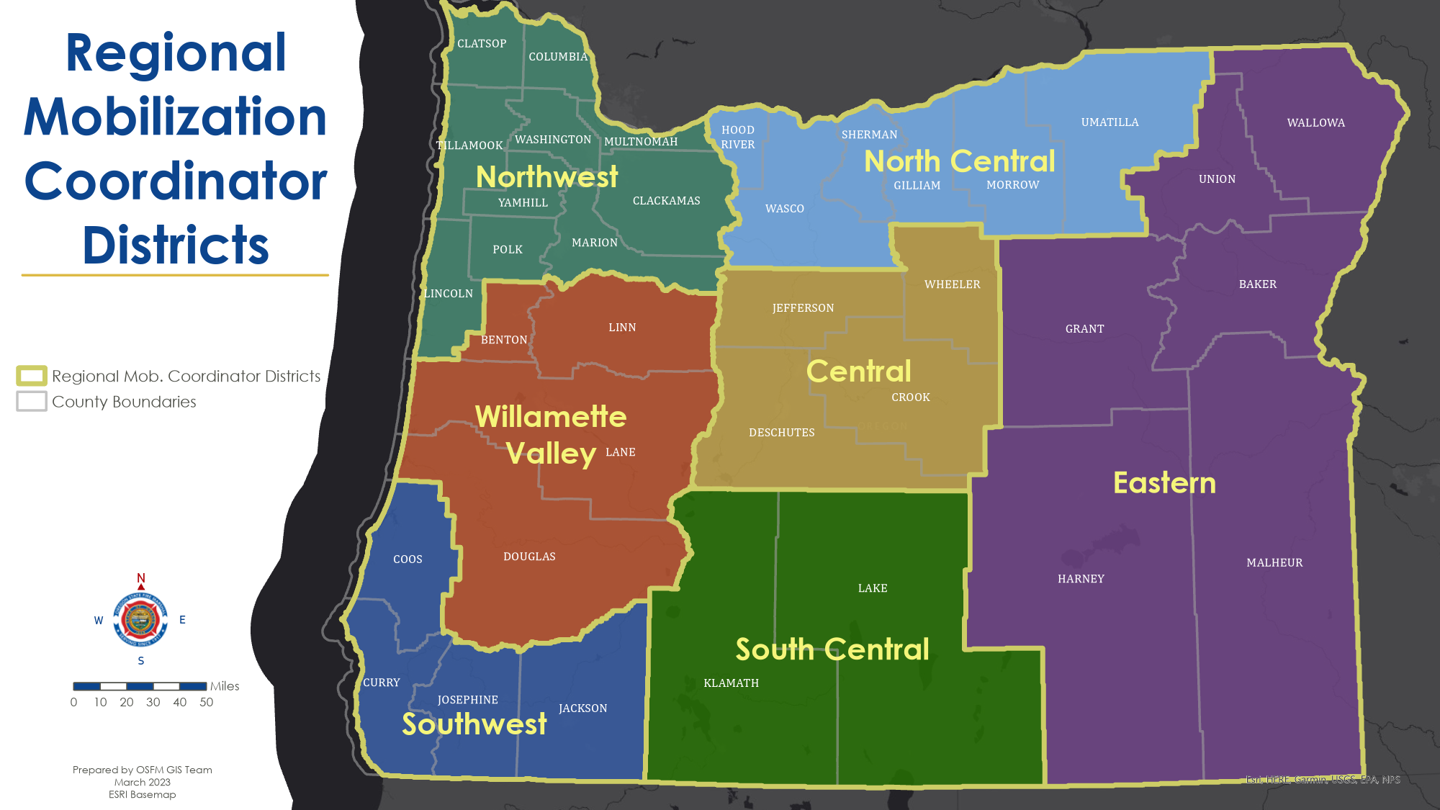
Emergency Response Unit

Slide 12
Keep Fires Small & Away from Communities
Pre-Positioning
Immediate Response
Forecasted weather
Resource drawdown
Known events
Increased risk
Aerial assets
Surge capacity during IA
Prevent conflagrations / structure loss
Gather SA for incoming resources

Slide 13
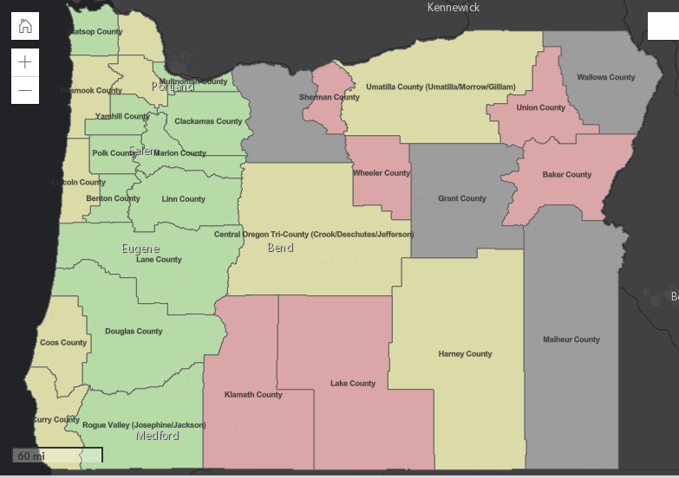
Response Ready Oregon
Resources:
Rural Metro
Warm Springs
Insurance rigs
FDB Availability
New ERU Manager

Slide 14
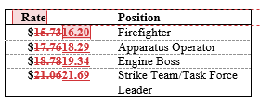
2023 Mobilization Plan
Delegation of authority
Defined & revised considerations to align with template
Recommend chainsaw for route evacuation purposes
Rates
Type III: 60 > 75 (pump to 150 gpm)
Types 4, 5, 7 increase
Tender: 70 > 80 (all; draft capable)
CMD: 35 > 45

Slide 15
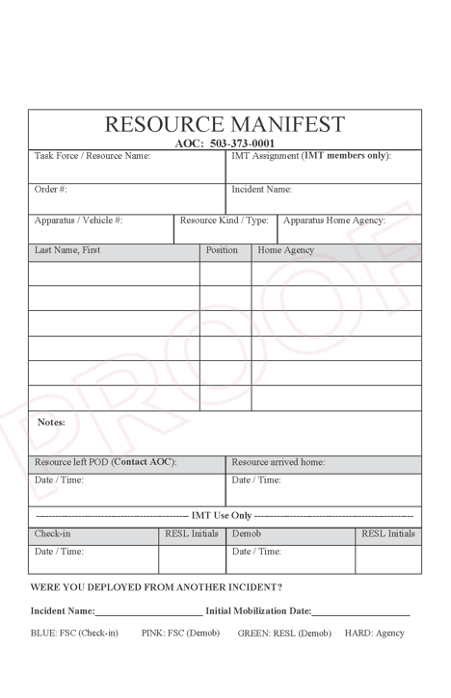
New Manifests
Continue Using What You Have
New Manifests for Movement
2024 full switchover

Slide 16
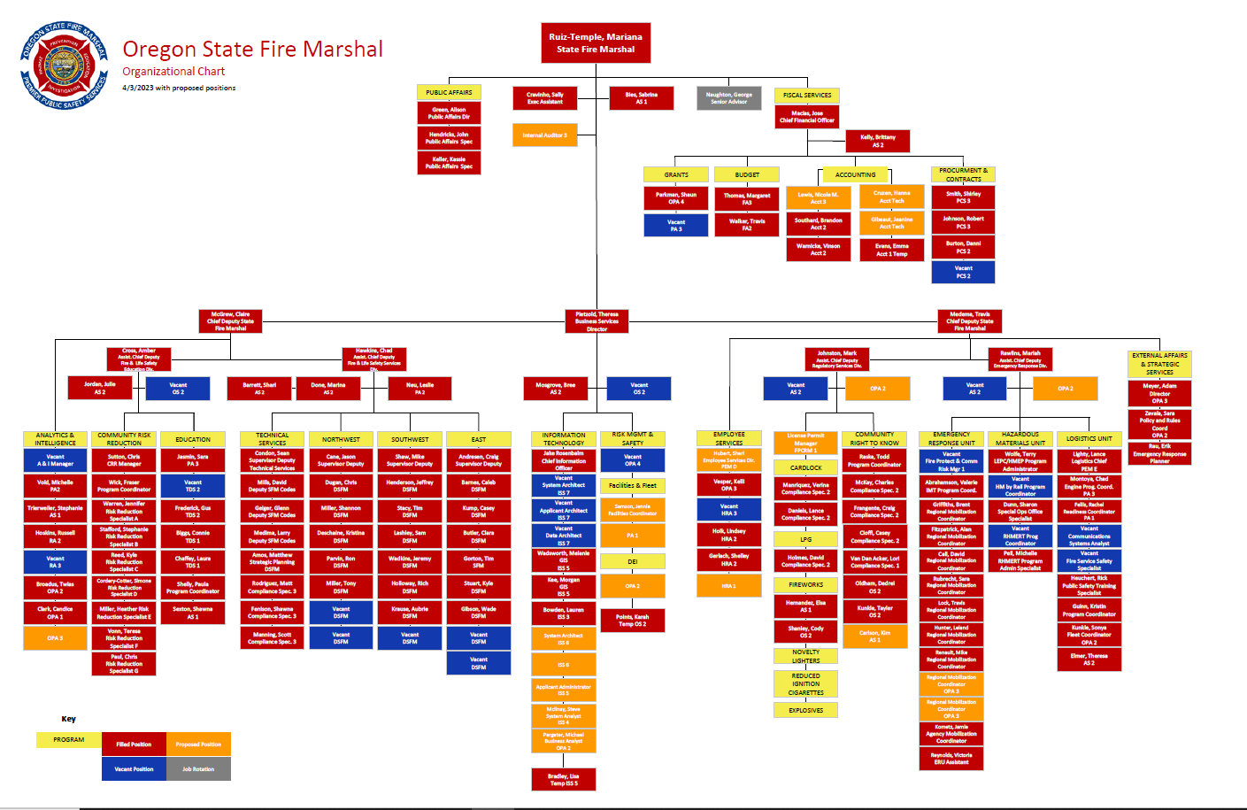
2019: 67 Staff
Today: 130 Staff
Future: 157ish Staff

Slide 17
Thank you!

