Slide 1
Boat Motor Usage and Potential Impacts to Critical Life Stages of Salmonids
Stan van de Wetering
Dylan Gorman

Slide 2
Discussion Topics
Scientific Information related to motor boats and sensitive life stages of salmon.
Fluid Pressures from Motorized Vessels
Siletz Specific Motor Boat Testing
Discussion

Slide 3
Motor Boat Effects on Critical Life Stages of Salmonids
The Best Available scientific information on boat motor usage related to critical life stages of salmonids tells us…
A boat propelled by a motor upstream creates an unnatural, focused strong fluid pressure that can dislodge bottom substrate and cause intra-gravel movement.
Intra-gravel movement and fluid pressure generated from a motor boat are linked to mortality of sensitive life stages of salmon (fertilized eggs in gravel, alevins and fry).
Notes:
Scientific rationale for restricting boat motor use on the Siletz River is based on the best available science, underwater video surveying, salmon spawn surveying data, observation of boat motors being used on river and information relayed to natural resource department from Tribal Members.
Sensitive Life Stages of Salmonids = Fertilized Eggs in gravel, alevins, fry and spawning adults. Spawning adults trying to build redds, eggs in gravel, fry emerging, fry living in shallow waters then later in slightly deeper water.
The best available scientific papers utilize jet boats in their studies. When you explore the methods and analysis sections of their Sutherland and Ogle, 1975 you learn that the steepest pressure gradients occur in two zones under a motor boat. One zone near the bow of the boat and another zone immediately behind the jet intake. The fluid pressure created from the bow moving through the water is higher than that of the jet immediately behind the jet intake. Fluid pressure near the bow of the boat will be generated regardless of propulsion type (jet, prop, turbine, etc.). This study highlights and discusses how the fluid pressure from the boat is causing damage to the gravel and salmon eggs.
This is a concern when boat propelled upstream by motors are being used in river zones that are also occupied by salmon during their sensitive life stages.
Other specific finding in our review of the literature:
Boat motor usage can negatively effect sensitive life stages of salmonids (Hill & Younkin, 2005; Sutherland & Ogle 1975).
Studies show boats moving upstream can cause mortality of eggs and alevins in gravel from intra-gravel movement caused by boat motor acceleration and deceleration (Sutherland, & Ogle, 1975).
Mortality of eggs, alevins, and fry can also occur from physical shock and/or impact onto bottom substrate from boat motor acceleration and deceleration (Sutherland, & Ogle, 1975).
Boat motors have been documented to impact salmon spawning gravel, moving gravel downstream of redds, again resulting in mortality of fertilized eggs (Horton, 1994).

Slide 4
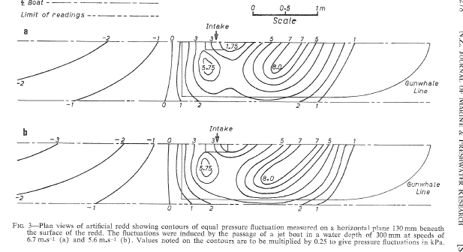
Fluid Pressure from a Motor Boat
Sutherland, A., & Ogle, D. (1975). Effect of jet boats on salmon eggs. New Zealand Journal of Marine and Freshwater Research, 9(3), 273–282. https://doi.org/10.1080/00288330.1975.9515566
Notes:
Kpa – Kilopascal Pressure Unit
If you dig into the methods and analysis section, you can see that Sutherland and Ogle, 1975 uses the pressure associated with the boat moving through the water and the pressure from the boat motor itself. If we consider that pressure on the river bottom will occur from a boat moving through the water regardless of motor type we can infer that a boat moving upstream can create pressure that dislodges and disrupts river substrate in areas there are sensitive life stages of salmonids (spawning adults, fertilized eggs, alevin and fry).

Slide 5
Citations
Hill, D.F., & Younkin, B.D. (2005). Biological impacts of hydraulic disturbances associated with jet boating on the Chilkat River, Alaska. Department of Civil & Environmental Engineering: The Pennsylvania State University. https://citeseerx.ist.psu.edu/document?repid=rep1&type=pdf&doi=5c14931a92ecca30315e5189545610acaa857db8
Horton, G. (1994). Effects of jet boats on salmonid reproduction in Alaskan streams. [Masters Thesis, University of Alaska Fairbanks]. https://scholarworks.alaska.edu/handle/11122/10019
Sutherland, A., & Ogle, D. (1975). Effect of jet boats on salmon eggs. New Zealand Journal of Marine and Freshwater Research, 9(3), 273–282. https://doi.org/10.1080/00288330.1975.9515566
Citations two and three are the same papers ODFW used to help draft comments leading to the newly adopted Motor Restrictions for the Upper Rogue River.
Notes:
This is the same research ODFW used to help draw proposed regulations for the Upper Rogue River boat motor restrictions.

Slide 6
What about the Siletz River? These studies have different motors and are totally different waterbodies??
Notes:
There is limited available scientific studies dealing with the varying types of boats and motors used on the Siletz River. The best available studies use jet boat motors or simulated jet motors to determine impacts on salmon.
Stan comments: I will comment on us not trying to do a formal study rather hey we had a day available lets go take a quick look and think about what it would take to do a more complete review of potential effects.

Slide 7
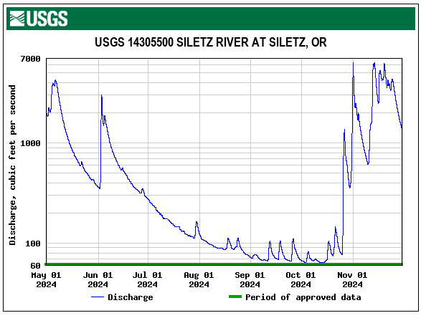
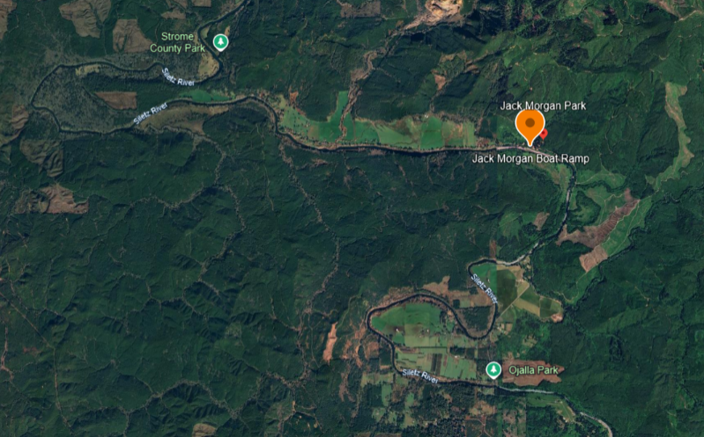
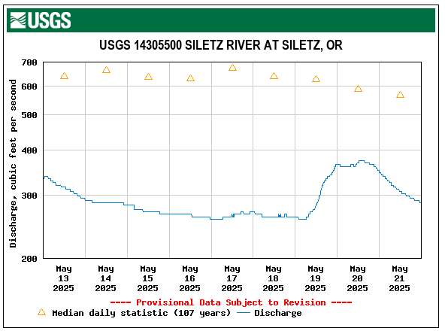
Underwater Video Surveying of Boat Motor Usage on Siletz River
Materials Used:
  Boat & Motor Combination: 17’ x 60” Aluminum Drift Boat with Suzuki 9.9 Horsepower Outboard Motor
Boat Operation Procedure
  Operate drift boat with an outboard motor upstream through a run and riffle to document effects on substrate and water turbidity. A USCG licensed Captain with local knowledge of the river and equipment was used to minimize damage to river bottom.
Location and Site Conditions
  Jack Morgan Park, Siletz, OR
  May 15th, 2025 - Siletz River Gauge Height – 275 CFS (2.96ft Gauge Height)

Slide 8
Videos
https://youtu.be/nKWnjmFPNW8
https://youtu.be/l7LkzngfhDQ
https://youtu.be/omGzbscbF-I
https://youtu.be/JCibUowkHXc
https://youtu.be/vtku170a4Vs

Slide 9
Discussion
A boat propelled upstream by a motor generates fluid pressures that can dislodge gravel on the river bottom and cause intragravel movement.
Boats being propelled upstream by motors are used in sections of the river that are known to have salmonids during sensitive life stages.
Overlap of Spawning Salmon and Boat Motor Usage

Slide 10
Questions?

Slide 11
Thank You

