Slide 1
Sample Diagram

Slide 2




(Dedicated Circuits)
VPN to Municipalities via Internet
See Figure C-1-D in CJIS Policy
WWW
CSA
Other
Municipalities
Remote Admin?
Other Relationships:
Fiber to other Facilities
SAN Storage (CJI ?)
Regional Provider
(CSA approved)
Internet
Router
Intrusion
Detection
Extranet
Router/Firewall/VPN
AA Server
CAD System (CJI) 128-bit TLS
LE
VLANs
Non-LE
VLAN (see following slide)
CAD Client w/AA
TLS Web App. hosted
by State with AA
See following slide
for more examples
Other Department workstations/Local 802.11X LAN
CAD Clients
TLS Web App.
hosted by State
Notes:
Make/Model/Version (IOS) of Routers?
Make/Model/Version (software) of Firewalls?
Type of AA (Advanced Authentication) in use?
IDS? NIDS/HIDS?
FIPS 140-2 Certificates for all traffic outside of the physically controlled areas?
All LE traffic separated by VLANs/Firewalls from other Non LE traffic?

Slide 3
What we would like to see

Slide 4
(Dedicated Circuits)
Other
Municipalities
VPN to Municipalities via Internet
(See Figure C-1-D in CJIS Policy)
WWW
CSA
Remote Admin?
Other Relationships:
Fiber to other Facilities
SAN Storage (CJI ?)
Regional Provider
(CSA approved)
CISCO
2800
IOS v6.1
IBM
Proventia
CISCO 2800/v6.1
CISCO ASA 5505
AA Server (RSA)
RMS System (CJI)
TriTech Perform
Netmotion
Mobility XE
CAD System (CJI) Tritech Perform 128-bit TLS
LE
VLANs
Non-LE
VLAN (see following slide)
CAD Client w/AA (RSA)
TLS Web App. hosted
by State with AA
See following slide
for more examples
Other Department workstations/Local 802.11X LAN
(if 802.11X used for CJI see CJIS Policy 5.5.7)
CAD Clients
TLS Web App.
hosted by State (Name of State System)
Notes:
Make/Model/Version (IOS) of Routers?
Make/Model/Version (software) of Firewalls?
AV?
Patching?
Type of AA (Advanced Authentication) in use?
IDS? NIDS/HIDS?
FIPS 140-2 Certificates for all traffic outside of the physically controlled areas?
All LE traffic separated by VLANs/Firewalls from other Non LE traffic?
Personally Owned Devices?
RMS and CAD?

Slide 5
5.5.7.1 All 802.11x Wireless Protocols
Segregate, virtually (e.g. virtual local area network (VLAN) and ACLs) or physically (e.g. firewalls), the wireless network from the operational wired infrastructure. Limit access between wireless networks and the wired network to only operational needs.
5.10.1.4 Voice over Internet Protocol
VoIP can be installed in-line with an organization’s existing Internet Protocol (IP) services. Among VoIP’s risks that have to be considered carefully are: myriad security concerns, cost issues associated with new networking hardware requirements, and overarching quality of service (QoS) factors.
In addition to the security controls described in this document, the following additional controls shall be implemented when an agency deploys VoIP within a network that contains unencrypted CJI:
1. Establish usage restrictions and implementation guidance for VoIP technologies.
2. Change the default administrative password on the IP phones and VoIP switches.
3. Utilize Virtual Local Area Network (VLAN) technology to segment VoIP traffic from data traffic.
VLANS

Slide 6
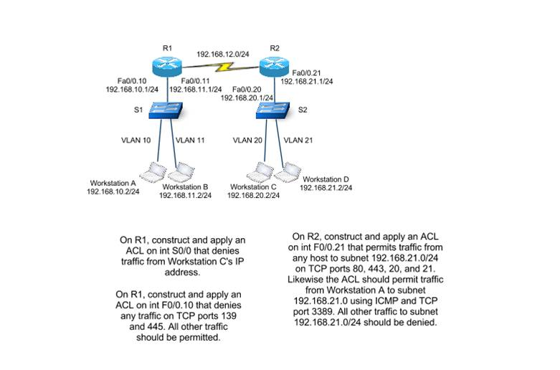
VLANs
Notes:
Segregate, virtually (e.g. virtual local area network (VLAN) and ACLs) or physically (e.g. firewalls), the wireless network from the operational wired infrastructure. Limit access between wireless networks and the wired network to only operational needs.
Utilize Virtual Local Area Network (VLAN) technology to segment VoIP traffic from data traffic.

Slide 7
Mobility XE examples

Slide 8
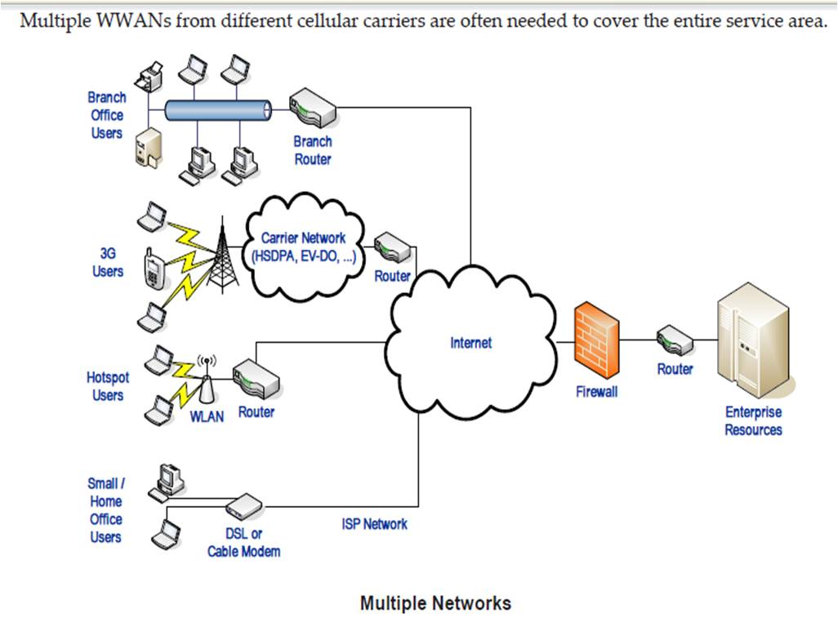
Source: http://discover.netmotionwireless.com/rs/netmotionwireless/images/NetMotion-Wireless_Security-Wireless-Networks_WP.pdf

Slide 9
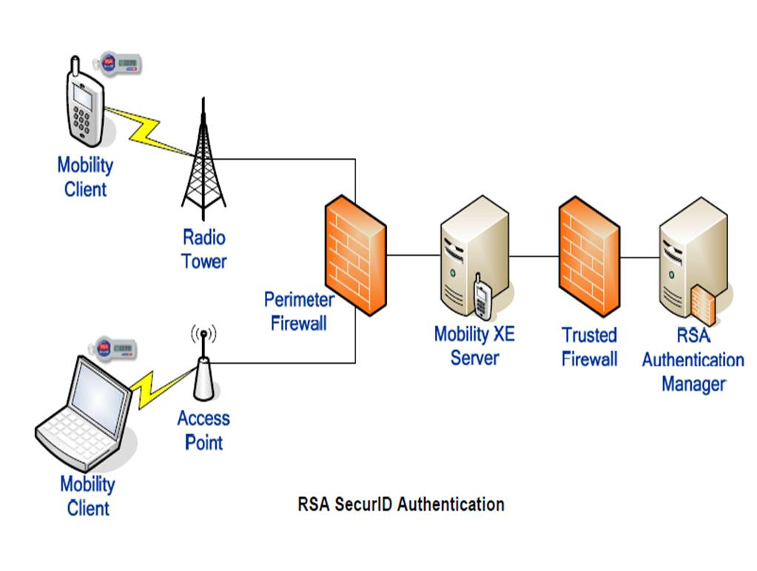
Source: http://discover.netmotionwireless.com/rs/netmotionwireless/images/NetMotion-Wireless_Security-Wireless-Networks_WP.pdf

