Slide 1
Oregon Defensible Space Standards
Town Hall Meeting
Chad Hawkins
Assistant Chief Deputy State Fire Marshal
Office of State Fire Marshal

Slide 2
Welcome & Objectives
Background
Defensible Space Definition
Oregon Office of State Fire Marshal Scope
Question and Answer

Slide 3
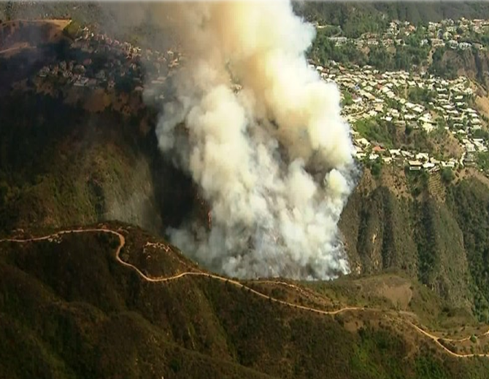
Background
Wildfire is not a new risk to Oregon
Increase in population and fire impacts to communities
More intense wildfires near communities
Urgency to protect communities

Slide 4
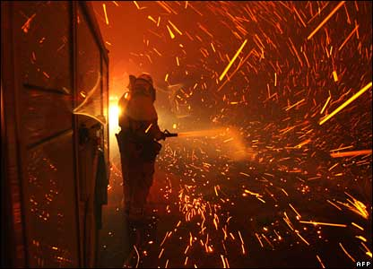
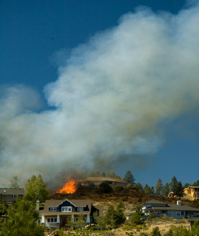
Defensible Space
Reducing fire intensity around what we value most
Three main ways homes can ignite during a wildfire:
Embers
Radiant heat
Direct flame contact
Notes:
Defensible space is the primary tool, amongst others, that can be implemented to reduce wildfire threat and increase the resiliency of a structure in a wildfire prone area.
Defensible space standards, as seen in the International Wildland Urban-Interface Code (IWUIC)
It is the “buffer” you create between a building and the grass, trees, shrubs, or any wildland area that surround it.
This space is needed to slow or stop the spread of wildfire and it helps protect structures from catching fire—either from direct flame contact or radiant heat.
Defensible space is also important for the protection of the firefighters defending your home.
Defensible space creates resiliency of homes and businesses in the event of wildfire.

Slide 5
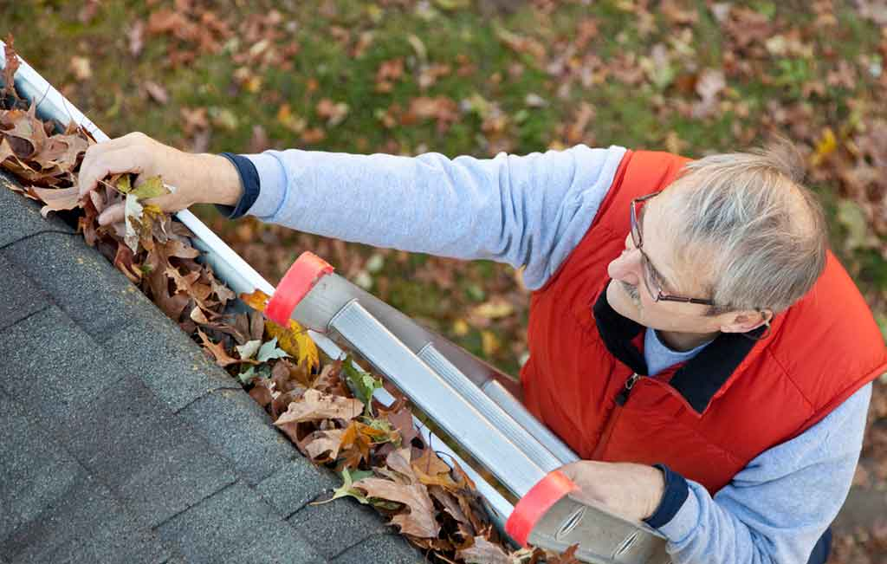
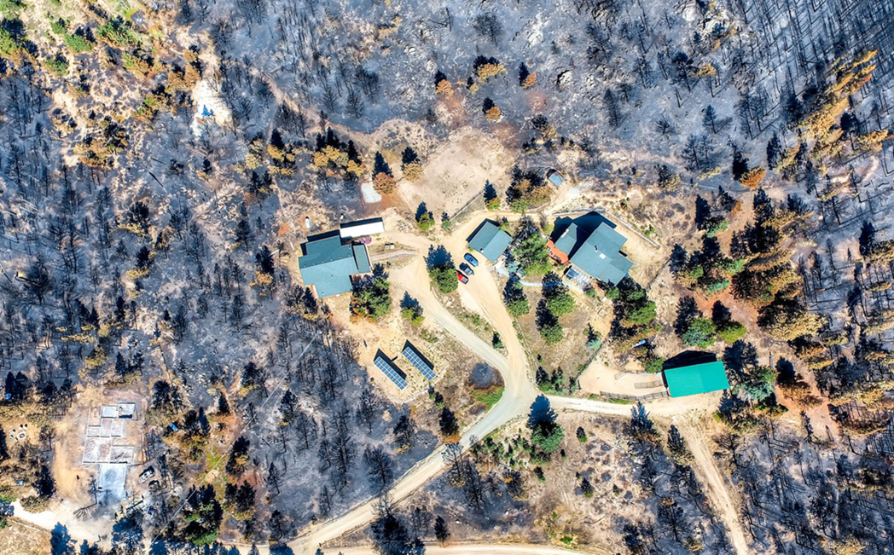
Defensible Space
Area around your home that can reduce the fire intensity from reaching your home during a wildfire
Increases your home’s chance of surviving a wildfire
Small actions make a big difference
Does not have to be a moonscape
Notes:
Defensible space is the primary tool, amongst others, that can be implemented to reduce wildfire threat and increase the resiliency of a structure in a wildfire prone area.
Defensible space standards, as seen in the International Wildland Urban-Interface Code (IWUIC)
It is the “buffer” you create between a building and the grass, trees, shrubs, or any wildland area that surround it.
This space is needed to slow or stop the spread of wildfire and it helps protect structures from catching fire—either from direct flame contact or radiant heat.
Defensible space is also important for the protection of the firefighters defending your home.
Defensible space creates resiliency of homes and businesses in the event of wildfire.

Slide 6
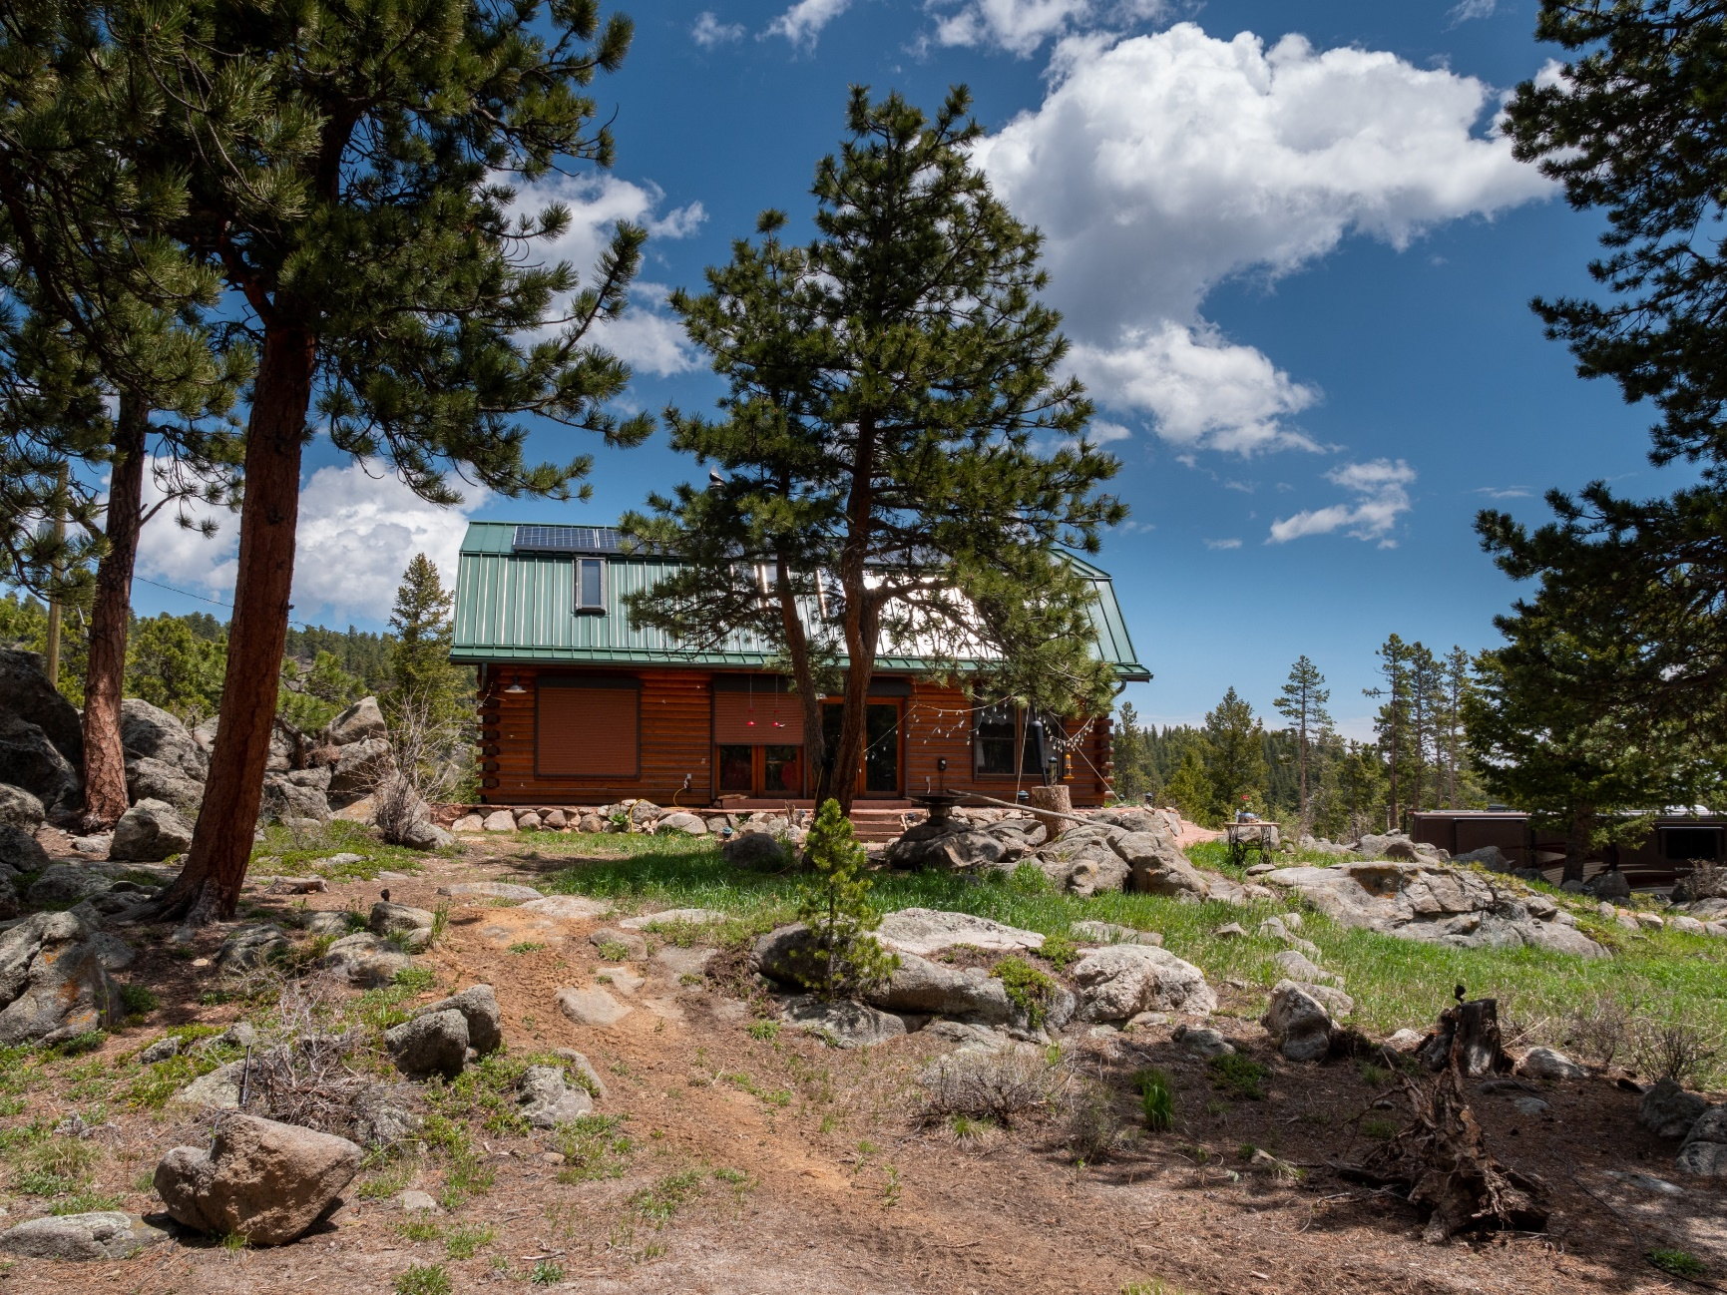
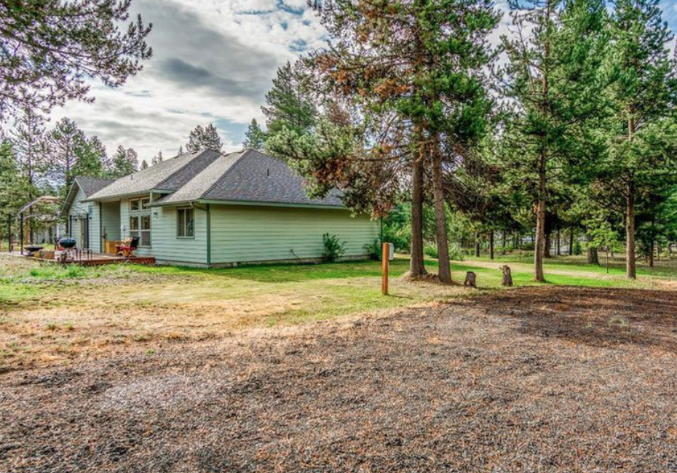
OSFM Defensible Space Scope
The OSFM is tasked with creating minimum defensible space requirements
New requirements won’t extend past 100 feet from home or business
Best management practices will be included to create flexibility for Oregonians
Developed language for irrigated or maintained crops, vineyards, agriculture, etc.
New code will apply to areas where folks are living and working
Certificate of Occupancy
Notes:
Certificate of occupancy will be a filter as well as risk.
½ acre parcel without a home or business on it.
Shall establish requirements that are consistent with and do not exceed the standards pertaining only to defensible space that are set forth in the International Wildland-Urban Interface Code published by the International Code Council, including the standards pertaining only to defensible space that are set forth in sections 603 and 604 of the code.
May consider best practices specific to Oregon in order to establish the requirements.

Slide 7
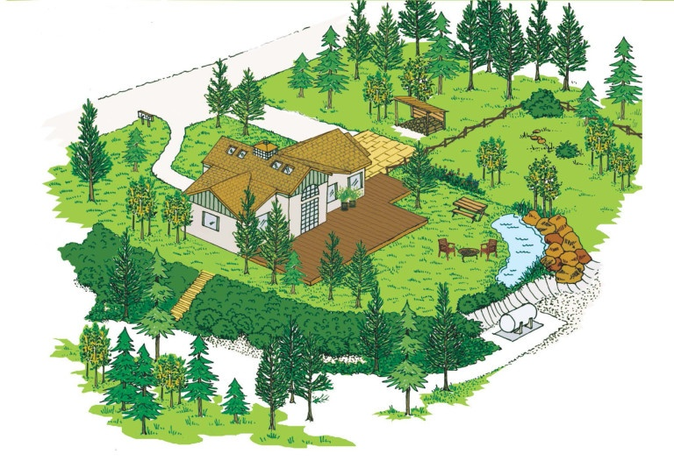
Grants and Community Assistance
Community Risk Reduction Fund
Educational property walkthroughs
Grants to support communities and landowners

Slide 8
Thank you for the opportunity to present.
Questions?

