Slide 1
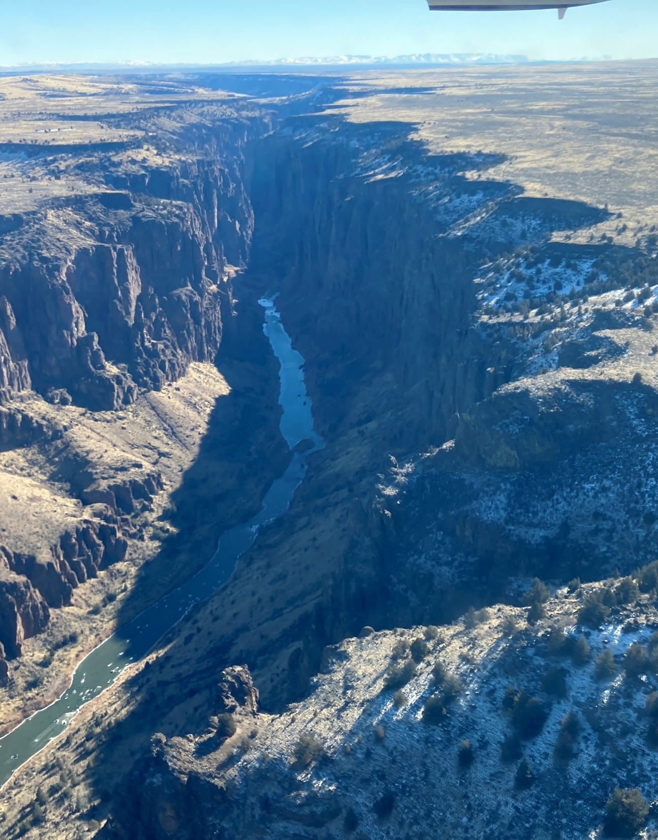
Division 512 Rulemaking
Groundwater Regulation for the Malheur Lake Administrative Basin
Rules Advisory Committee
Oregon Water Resources Department
March 5, 2025

Slide 2
Welcome, Introductions and Agenda Review

Slide 3
Ground rules
You are here to express your viewpoint.​
Treat others respectfully.​
If online, remain muted when not speaking.​
Use the “raise hand” feature to indicate that you would like to speak.​
If in person, raise your hand to indicate that you would like to speak.​
RAC only participates in RAC meetings, and the Public only participates in comment periods.

Slide 4
RAC operating guidelines
RAC Role​
Attend and participate in meetings at the horseshoe or online. ​
Provide input/advice and help the Department consider various perspectives.​
Public Role​
Listen only during the presentations and RAC discussions from the audience or online.​
Provide input/advice during the designated comment time.​

Slide 5
RAC operating guidelines
Department Role​
Foster meaningful dialog and conversation​
Consider RAC and public feedback.​
Draft final rules​
Facilitator Role​
Foster meaningful dialog and conversation by all RAC participants.​
Ensure all parties have a safe space to express their viewpoints in a respectful environment.

Slide 6
Morning meeting agenda
10:00 AM (10 min) | Welcome and introductions
10:10 AM (10 min) | Update on Schedule
10:20 AM (50 min) | SWMPA Rule Language
11:10 AM (5 min) | Public Comment
11:15 AM (40 min) | Classification Rule Language
11:55 AM (5 min) | Next Steps

Slide 7
Goals for today’s meeting
Provide an update on the RAC schedule
Gather input around the draft SWMPA rule language
Gather input around the draft classification rule language

Slide 8
Update on schedule

Slide 9
2025 rulemaking schedule
RAC meetings 4/2 & 5/15
Public comment begins
6/1
Public hearings
8/4 – 8/6
Public comment ends
8/7
Draft staff report
8/8 – 11/26
WRC meeting 12/11
Notes:
Public comment
Two months and 3 day
We in the process of planning out engagement during the public comment period. Right now we are planning on public hearings 8/4 – 8/6
Draft staff report
We will go radio silence at this point. During this time we will drafting up a report, within that report we will be responding to comments received during the public comment period, and make changes to the rules accordingly

Slide 10
RAC schedule
April 2, 2025, 8 AM to 3 PM At Harney County Community Center
May 15, 2025, 8 AM to 3 PM at the Harney County Community Center

Slide 11
Expected topics
April Meeting
Management Scenario
  Implementation
  Adaptive Management
CGWA Rule Language
Fiscal Impact
May Meeting
Proposed Rule Language for SWMPA, Classification, CGWA
Fiscal Impact
Notes:
What we have been working on (here)
We have been working on updating the management scenario we will be implementing in Harney
Reading and processing all the written comments the google form comments and making adjustments the plan
Outlining what implementation looks like (determining actual use, schedule reductions, contested case, engagement post rule adoption)
All of that is being written in rules
ECO northwest will begin the process to get the final impacts of the management scenario once we are ready to share with them.

Slide 12
SWMPA draft rule language

Slide 13
SWMPA rule language
Goals of Conversation
Gather input around the draft SWMPA rule language
Level of Participation
Consult

Slide 14
Theme of comments
SWMPA Boundary
ET
Frequency of reporting
Deadline for installation
Exceptions for installing flowmeters
Rule language changes suggestions
Specifications for flowmeter
Notes:
*Not encapsulating of all comments received, these comments come from our last meeting*
SWMPA Boundary:
RAC Recommended setting the SWMPA boundary as the Harney basin study area including parts of grant county specifically around Seneca
ET:
Reported data is inaccurate and installation of flowmeters is expensive, the Department should use ET to measure use
Asking Irrigators to report every year might be hard to get full compliance, ET would be an easier way to get the data
ET is not accurate, and should not be used for water use Reporting
Frequency of reporting:
OWRD can use the CGWA statutes to require more frequent reporting
Deadline for installation
The March 1, 2028 should be on a rolling basis until the department is ready to receive data.
Exceptions for installing flowmeters
There should be an exception for users who are going to be regulated off to require a flowmeter
If there is an exception there needs to be a line, for example if a well will be regulated off in 2 years they should be required to report.
Some rule language around an acception for someone who cannot install a flowmeter would be nice
Rule language change:
General comments on rule language
Specification for flowmeter
Five pipe diameters requirement might be contrary to the manufacturer’s specifications
Some systems cannot meet the 100 foot requirement.

Slide 15
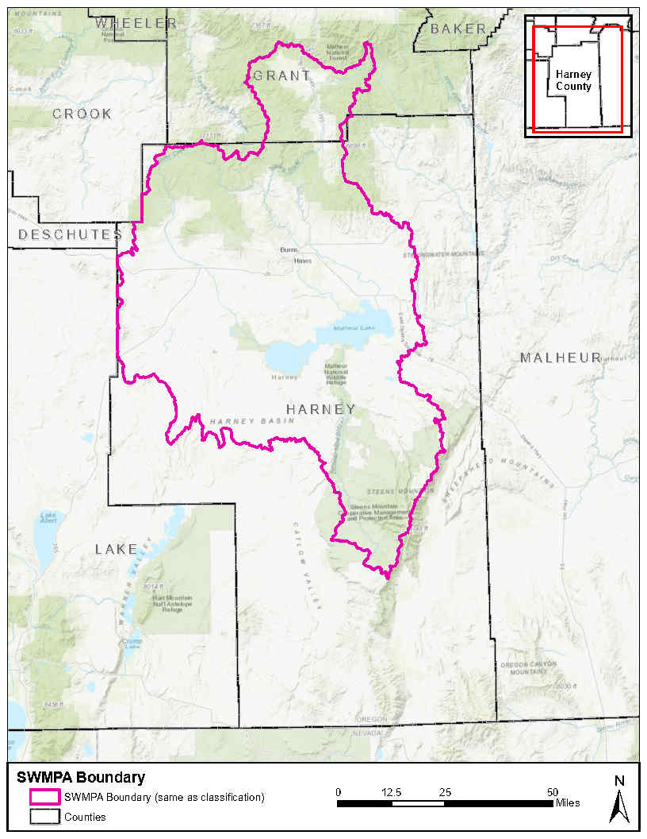
SWMPA Boundary Map

Slide 16
SWMPA implementation
Boundary
Deadline
Reporting
Specifications
Broken Flowmeter
Notes:
Boundary
The SWMPA boundary is the Harney basin groundwater study area and includes parts of Grant County around Seneca. Anyone who has a groundwater right what is not already measuring and reporting, will be required to install a flowmeter and report yearly.
Deadline
By no later then march 1, 2028 all groundwater rights are required to have a flowmeter installed
The Department may extend the deadline of the deadline, if that happens we will notify all groundwater rights users at least 60 days before march 1.
Failure to install and maintain the flowmeter will result in the watermaster controlling and regulating that well.
Reporting
Groundwater right holder, well owner or well operator will have to keep a record of the total volume of water appropriated each month and report that use by December 31 each calendar year for the water year which ended on September 31 of the same year.
Specifications
Flowmeters must be installed according to the specifications in the 512 rules
Broken Flowmeter
Water user must report that a flowmeter is broken within 48 hours after determining that the flowmeter is broken to the local water master.
A water user can appropriate water for 60 days after the flow meter is broken.
While the flow meter is broken the water use can be measured with either a power meter or the time of operation method.

Slide 17
Section 1

Slide 18
Section 1
Previous Rule Language | Current Rule Language
The SWMPA boundary is defined in 690-512-#### and meets the groundwater conditions defined in 690-085-0020(1)(a). and 690-085-0020(1)(f). | The SWMPA boundary is defined in 690-512-#### and meets the groundwater conditions defined in OAR 690-085-0020(1)(a) and 690-085-0020(1)(f).
Notes:
Implementation:
1. SWMPA boundary is the groundwater study area and portions of grant county mainly around Seneca

Slide 19
Section 1
Reasons for Change
OAR added to indicate that these are Oregon Administrative Rules

Slide 20
Section 1
Remaining Questions or feedback for the RAC
Are the rules clear and understandable?
Is there any other feedback you want to provide on this section?

Slide 21
Section 2

Slide 22
Section 2
Previous Rule Language | Current Rule Language
(2) By no later than March 1, 2028, each groundwater right holder, well owner, or well operator shall properly install and thereafter properly maintain a totalizing flow meter on each well within the Harney SWMPA boundary as defined in 690-512-#### listed as a point of appropriation on a valid water right. Totalizing flow meters shall be properly installed according to manufacturer’s specifications and must meet the specifications in subsection 5. | (2) By no later than March 1, 2028, each groundwater right holder, well owner, or well operator shall properly install and thereafter properly maintain a totalizing flow meter on each well listed as a point of appropriation on a valid water right within the Harney SWMPA boundary as defined in 690-512-####. The Department may extend the deadline as needed. If the deadline is extended, the Department will notify each groundwater right holder, well owner, or well operator at least 60 days before March 1, 2028. listed as a point of appropriation on a valid water right.
Notes:
Implementation
Groundwater right holder, well owner or well operators need to have a flow meter installed by march 1, 2028.
The deadline can be extended by the department if needed, and gw users will be notified at least 60 days before march 1, 2028

Slide 23
Section 2
Reasons for Change
Deadline extension added in response to comment about how the deadline should be rolling until Department is ready
Language changed for clarity

Slide 24
Section 2
Other comments considered but not included in rule
ET: Reported data is inaccurate and installation of flowmeters is expensive, the Department should use ET to measure use
Notes:
We have consulted with our hydrologist and they agree that ET does not currently meet the standard for reporting for water rights, its not accurate enough
Regulation: We need know what is coming out of a well, ET does not give you that.
SWMPA statutes currently do not allow for ET to be used the statutes only allow flow meter
ET is an indirect measure of water use, you can put 10 acre feet of water on a field and the plants will only consume what it can consume

Slide 25
Section 2
Remaining Questions or feedback for the RAC
Is 60 days an adequate time to notify?
Are the rules clear and understandable?
Is there any other feedback you want to provide on this section?

Slide 26
Section 3

Slide 27
Section 3
Previous Rule Language | Current Rule Language
There is no comparative section from the previous version of the rules. | (3) Totalizing flow meters shall be properly installed according to manufacturer’s specifications and must meet the specifications in subsection 5. Groundwater wells that are regulated off do not require installing a totalizing flow meter.

Slide 28
Section 3
Reasons for Change
Section was split from section 2 for readability
(3)(a) added to address concerns for water rights that are shut off

Slide 29
Section 3
Remaining Questions or feedback for the RAC
Are the rules clear and understandable?
Is there any other feedback you want to provide on this section?

Slide 30
Section 4

Slide 31
Section 4
Previous Rule Language | Current Rule Language
Totalizing flow meters and the method of flow meter installation may be subject to approval by Department staff. Once installed, totalizing flow meters must be maintained in good working order. Department staff shall have reasonable access to the totalizing flow meters upon request pursuant to ORS 537.780(1)(e). | Totalizing flow meters and the method of flow meter installation may be subject to approval by Department staff. Once installed, totalizing flow meters must be maintained in good working order. Department staff shall have reasonable access to the totalizing flow meters upon request pursuant to ORS 537.780(1)(e).

Slide 32
Section 4
Reason for Change
No changes made to rule language
Notes:
Reason for annual reporting:
We heard the input that there should be a requirement for more frequent reporting, For our regulatory purposed we do not need any more frequent reporting then annual
We are working on updating our water reporting system

Slide 33
Section 4
Remaining Questions or feedback for the RAC
Are the rules clear and understandable?
Is there any other feedback you want to provide on this section?

Slide 34
Section 5

Slide 35
Section 5
Previous Rule Language | Current Rule Language
The groundwater right holder, well owner, or well operator shall keep a complete record of the volume of water appropriated each month. The groundwater right holder, well owner, or well operator shall submit a report which includes water use measurements to the Department on an annual basis by December 31 of each calendar year for the preceding water year (October 1 to September 30). Reports shall be submitted on a form developed and maintained by the Department. | The groundwater right holder, well owner, or well operator shall keep a complete record of the volume of water appropriated each month. The groundwater right holder, well owner, or well operator shall submit annually a report which that includes water use measurements to the Department on an annual basis by December 31 of each calendar year for the water year which ended September 30 of the same year. (October 1 to September 30). Reports shall be submitted using on a form developed and maintained by the Department. Groundwater wells regulated off do not need to report use.

Slide 36
Section 5
Reasons for change:
Previous language was written to require reporting of the preceding year should be current year.
(5)(a) added to clarify that regulated groundwater wells do not need to report.

Slide 37
Section 5
Other comments considered but not included in rule
Requiring more then annual reporting
Notes:
We don’t have the capacity to process more than annual data
We won’t benefit from a regulatory perspective with measurement that are reported more then annually. Annually gives the ability to look at those rights that have gone over their limits or are approaching their limits.

Slide 38
Section 5
Remaining Questions or feedback for the RAC
Are the rules clear and understandable?
Is there any other feedback you want to provide on this section?

Slide 39
Section 6

Slide 40
Section 6
Previous Rule Language | Current Rule Language
(5) A totalizing flow meter shall meet the following specifications: A totalizing flow meter shall have a rated accuracy of plus or minus 2 percent of actual flow for all flow rates for which the meter is expected to measure. A totalizing flow meter shall measure the entire discharge from the well. A totalizing flow meter shall have a visual and recording, mechanical or digital totalizer located on or adjacent to the flow meter and shall be equipped with a sweep hand or digital readout so that instantaneous flow rate can be read. | (6) A totalizing flow meter shall meet the following specifications: A totalizing flow meter shall have a rated accuracy of plus or minus 2 percent of actual flow for all flow rates for which the meter is expected to measure. A totalizing flow meter shall measure the entire discharge from the well. A totalizing flow meter shall have a visual and recording, mechanical or digital totalizer located on or adjacent to the flow meter and shall be equipped with a sweep hand or digital readout so that instantaneous flow rate can be read.

Slide 41
Section 6
Reasons for change
No changes made to rule language

Slide 42
Section 6
Previous Rule Language | Current Rule Language
The totalizing part of the flow meter shall have sufficient capacity to record the quantity of water authorized to be pumped over a period of 2 years. Units of water measurement shall be in acre-feet, cubic-feet, or gallons, and the totalizer shall read directly in one of these units. Flow meters recording in acre-feet shall, at a minimum, read to the nearest 1/10th acre-foot, and the decimal multiplier shall be clearly indicated on the face of the register head. Totalizers on each meter shall not be field reset without notice to and written permission from the local watermaster. Prior to resetting the totalizers, the final reading must be recorded and reported. | The totalizing part of the flow meter shall have sufficient capacity to record at minimum the quantity of water authorized to be pumped over a period of 2 years. Units of water measurement shall be in acre-feet, cubic-feet, or gallons, and the totalizer shall read directly in one of these units. Flow meters recording in acre-feet shall, at a minimum, read to the nearest 1/10th acre-foot, and the decimal multiplier shall be clearly indicated on the face of the register head. Totalizers on each meter shall not be field reset without notice to and written permission from the local watermaster. Prior to resetting the totalizers, the final reading must be recorded and reported.

Slide 43
Section 6
Reasons for change
Language as previously written set the requirement to install a flow meter that will only have the capacity to measure the authorized use

Slide 44
Section 6
Previous Rule Language | Current Rule Language
The totalizing flow meter shall be installed in accordance with all manufacturer specifications. There shall be no turnouts or diversions between the well and the flow meter. The flow meter shall be installed not less than five pipe diameters downstream from any valve, elbow, or other obstruction which might create turbulent flow, or other provisions shall be made that meet the manufacturer’s specifications to control or eliminate turbulent flow. The totalizing flow meter shall be installed no more than 100 feet away from the well head. | The totalizing flow meter shall be installed in accordance with all manufacturer specifications. There shall be no turnouts or diversions between the well and the flow meter. The flow meter shall be installed not less than five pipe diameters downstream from any valve, elbow, or other obstruction which might create turbulent flow, or other provisions shall be made that meet the manufacturer’s specifications to control or eliminate turbulent flow. The totalizing flow meter shall be installed no more than 100 feet away from the well head unless an exception is approved by the watermaster in writing.

Slide 45
Section 6
Reasons for change
(6)(f) This section rule language was removed because of comments from RAC members that the language may go against manufacturer’s specification
(6)(g): More flexibility was added to this section in response to comments that some systems may not be able to meet this 100 feet requirement.

Slide 46
Section 6
Remaining Questions or feedback for the RAC
Are the rules clear and understandable?
Is there any other feedback you want to provide on this section?

Slide 47
Section 7

Slide 48
Section 7
Previous Rule Language | Current Rule Language
(6) A water user shall report broken flow meters to the local watermaster’s office within 48 hours after determining that the flow meter is broken. A water user shall not appropriate for more than 60 days without an operating flow meter. | (7) A water user shall report broken flow meters to the local watermaster’s office within 48 hours after determining that the flow meter is broken. A water user shall not appropriate water for more than 60 days without an operating flow meter.

Slide 49
Section 7
Reasons for change
The word water was added for clarity

Slide 50
Section 7
Remaining Questions or feedback for the RAC
Are the rules clear and understandable?
Is there any other feedback you want to provide on this section?

Slide 51
Section 8

Slide 52
Section 8
Previous Rule Language | Current Rule Language
(7) While the flow meter is broken, the water user shall use other methods of reporting as defined under OAR 690-085-0015(5)(a) –(c) until the flowmeter is replaced or repaired. The water user shall keep the monthly data and mail the data to the Department upon request of the Department. The data shall include a statement of the initial reading on the newly installed flow meter, the current power meter reading, and the time of operation. The water user shall notify the local watermaster within 48 hours of installing the repaired or replacement flow meter. | (8) While the flow meter is broken, the water user shall use other methods of reporting as defined under OAR 690-085-0015(5)(a) –(c) until the flow meter is replaced or repaired. The water user shall keep the monthly data and mail the data to the local watermaster Department upon request of the Department. The data shall include a statement of the initial reading on the newly installed flow meter, the current power meter reading, and the time of operation. The water user shall notify the local watermaster within 48 hours of installing the repaired or replacement flow meter.

Slide 53
Section 8
Reason for change
Section 7 requires reporting to the watermaster, language was changed to be consistent with section 7.

Slide 54
Section 8
Remaining Questions or feedback for the RAC
Are the rules clear and understandable?
Is there any other feedback you want to provide on this section?

Slide 55
Section 9

Slide 56
Section 9
Previous Rule Language | Current Rule Language
(8) Failure to have and maintain a properly installed, functioning totalizing flow meter by March 1, 2028 will result in the local watermaster regulating and controlling an unmetered well such that no groundwater may be pumped or appropriated until a flow meter is obtained and installed consistent with these rules. | (9) Failure to have and maintain a properly installed, functioning totalizing flow meter by the deadline March 1, 2028 will result in the local watermaster regulating and controlling an unmetered well such that no groundwater may be pumped or appropriated until a flow meter is obtained and installed consistent with these rules.

Slide 57
Section 9
Reason for change
Language was changed to align with section (2) of these rules.

Slide 58
Section 9
Remaining Questions or feedback for the RAC
Are the rules clear and understandable?
Is there any other feedback you want to provide on this section?

Slide 59
Section 10

Slide 60
Section 10
Previous Rule Language | Current Rule Language
(9) Consistent with ORS 536.900, ORS 183.745, and OAR 690-260, the Department may assess civil penalties for violation of these rules. | (10) Consistent with ORS 536.900, ORS 183.745, and OAR 690-260, the Department may assess civil penalties for violation of these rules.

Slide 61
Section 10
Reason for change
No changes made to the rules.

Slide 62
SWMPA implementation
Boundary
Deadline
Reporting
Specifications
Broken Flowmeter
Notes:
Boundary
The SWMPA boundary is the Harney basin groundwater study area and includes parts of Grant County around Seneca. Anyone who has a groundwater right what is not already measuring and reporting, will be required to install a flowmeter and report yearly.
Deadline
By no later then march 1, 2028 all groundwater rights are required to have a flowmeter installed
The Department may extend the deadline of the deadline, if that happens we will notify all groundwater rights users at least 60 days before march 1.
Failure to install and maintain the flowmeter will result in the watermaster controlling and regulating that well.
Reporting
Groundwater right holer, well owner or well operator will have to keep a record of the total volume of water appropriated each month and report that use by December 31 each calendar year for the water year which ended on September 31 of the same year.
Specifications
Flowmeters must be installed according to the specifications in the 512 rules
Broken Flowmeter
Water user must report that a flowmeter is broken within 48 hours after determining that the flowmeter is broken to the local water master.
A water user can appropriate water for 60 days after the flow meter is broken.
While the flow meter is broken the water use can be measured with either a power meter or the time of operation method.

Slide 63
General Feedback
Is there further feedback you would like to provide on the draft SWMPA rules?

Slide 64
Public comment

Slide 65
Classification draft rule language

Slide 66
Classification rule language
Goals of Conversation
Gather input around the draft classification rule language
Level of Participation
Consult

Slide 67
Theme of comments
Classification boundary
Allowed uses
Notes:
Classification Boundary
RAC Number 8, RAC recommend setting the boundary as previously stated
Allowed uses
Allowed for Crane to have a community well
Limited license for construction
Classifying for CREP use

Slide 68
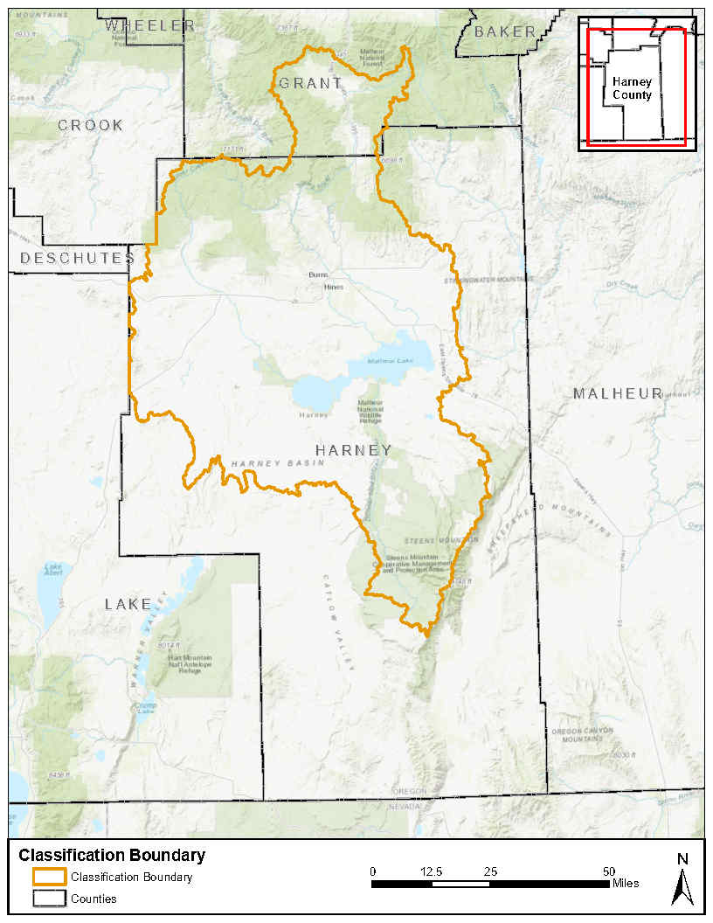
Classification Boundary Map

Slide 69
Classification implementation
Boundary
Allowed Uses
Notes:
Boundary
Classification boundary is the same as the swmpa boundary, the groundwater study area including parts of grant county mainly around Seneca. Within the classification boundary, only certain types of water are allowed to be used.
Allowed Uses
Within the classification boundary groundwater is classified for exempt uses and nonconsumptive geothermal uses below 250 degrees Fahrenheit.

Slide 70
Classification boundary

Slide 71
Classification boundary
Rule Language | Rule Language Explainer
The Groundwater Classification Boundary is defined as the Harney Basin within the Malheur Lake Basin and within portions of Grant and Harney Counties, as shown in Exhibit #. | Classification Boundary The classification boundary includes the Harney Basin Groundwater Study Area boundary and portions of Grant County, mainly around Seneca.

Slide 72
Classification boundary
Relevant Input Received
Discussed the classification boundary during the RAC 7 and 8 slides
Recommended the classification boundary that includes the groundwater study area and parts of grant county.
Decision:
Set the boundary as the recommendation from the RAC

Slide 73
Classification boundary
Remaining Questions or feedback for the RAC
Are the rules clear and understandable?

Slide 74
Section 1

Slide 75
Section 1
Rule Language | Rule Language Explainer
Except as provided in OAR 690-512-####(2), the groundwater and surface water of the Malheur Lake Basin are classified for direct appropriation of, or storage of surface water and use of, water for domestic, livestock, irrigation, municipal, quasi-municipal, industrial, mining, agricultural water use, commercial, power development, forest management, public uses, road watering, dust abatement, and wildlife refuge management. | Allowed uses within the Malheur Lake Basin: This section specifies what surface water and groundwater can be used for within the Malheur Lake Basin. These uses are allowed outside the classification boundary defined in 690-512-####(2).

Slide 76
Section 2: allowed uses in the classification boundary

Slide 77
Section 2
Rule Language | Rule Language Explainer
Groundwater in the Groundwater Classification Boundary defined in OAR 690-512-####(4) is classified for statutorily exempt groundwater uses as specified in ORS 537.545 and nonconsumptive geothermal uses below 250 degrees Fahrenheit. | Allowed uses within the classification boundary Groundwater can only be used for exempt uses within the classification boundary. Exempt uses are defined in ORS 537.545. OWRD has the authority to regulate geothermal groundwater uses under 250 degrees Fahrenheit.

Slide 78
Other uses considered

Slide 79
Other uses considered
Community Wells
CREP
Limited license for construction
Notes:
Allowing for temporary transfers
Explored allowing a community well by temporarily transferring a groundwater right
Temporary transfers do not allow the change of character of use
Way to get community wells
Permanent transfers are the only way to get a community well
Limited license for construction
We looked at using limited license for construction but water needs to be available, and by CGWA designation water is not available.
CREP
Looking classifying for CREP
Delayed cancelation of water rights by contract with Departent

Slide 80
Input
Remaining Questions or feedback for the RAC
Is there anything else we need to consider?

Slide 81
Next Steps
Next RAC April 2, 2025 8 am to 3 pm at Harney County Community Center

Slide 82
Discussion Groups
Are there any topics the discussion group should cover?

Slide 83
Thank you!
Kelly Meinz
Kelly.a.meinz@water.Oregon.gov| 971-718-7087

