Slide 1
SWIMS TAG
Meeting #3
April 7th, 2026
Notes:
We are recording and transcribing this meeting and will plan to post the recording on the OWRD webpage.
Hello and welcome. Here today to meet the Technical Advisory Group to the Surface Water Information Modeling System (SWIMS).
Introductions to the project team. My name is Jordan Beamer and I will be facilitating today’s meeting I’m the assistant manager in the OWRD SW section. Been working as a hydrologist at OWRD on water availability and water use since 2016, recently transitioned to management role.
Educational background in hydrology, remote sensing of ET, and hydrologic modeling. I am really excited to meet the TAG members, have some lively technical discussions, and work towards delivering SWIMS on time and on budget.
I’ll pass it to Ryan. Cortney, Cheng-Wei, Cameron, Junjie, Rachel, Annette.
Introduce the TAG Members (list)
Starting off – we want to express gratitude that people are volunteering their contributions and time

Slide 2
Agenda
1. Welcome (9:05 – 9:10)
2. Follow-up Meeting #2 (9:10 – 9:20)
3. Strategizing Modeling Approach (9:20 – 9:55)
4. Discussion (10:05 – 11:00)
Notes:
Acknowledge question about third-party data (not discussion topic for this meeting)
Series of presentations followed by facilitated discussion. Holding questions for the discussion section.
Any clarifying questions before we begin?

Slide 3
Meeting Rules
Use hand raise feature
Encourage interaction and cameras on (please ask questions to group)
Meetings will be recorded and posted to website
Notes:
Overview of how to use Zoom
Overview of ground rules for the meetings.
We want these meetings to be interactive – encourage asking questions and camera’s on
Use hand raise feature to ask question – take questions at end of segment? Order that they come up on the screen
Use the chat to ask questions and put comments in the chat
Reiterate that we are recording the meetings and will be posting them on the SWIMS website.
TAG guidelines and expectations/norms in the team charter
Encourage cameras on

Slide 4
SWIMS Status Report
Data acquisition
Continuing to publish flow records from gages of interest
Gage installation
Installed four gages to support SWIMS, two more awaiting install
System architecture
Established system to support model development including computer, secure server, and database
Will not be using third-party data that has not been reviewed and published by OWRD or USGS
Communications
Established internal and external working groups to strategize model development and implementation
Importing and processing environmental data
Notes:
Legislature provided OWRD with resources (staff and $$) to update the statewide Water Availability Reporting System (WARS) to a new base period and new computer programs
Specifically, the Department will update the Statewide Water Availability model over a six-year period to deliver accurate and up-to-date seasonal/monthly surface water budgets for basins throughout the state
Expected completion date January 2030

Slide 5
Follow-up Meeting #2

Slide 6
Recap Meeting #2
Theme
Selecting gages to establish reference conditions
Topics
Disturbance index to evaluate factors influencing flow records
Determining minimum data requirements
Analysis to determine tolerance for gaps in flow data
Analysis of streamflow trends to assess stationarity

Slide 7
Addressing Feedback
Groundwater use metrics
Estimated total groundwater withdrawals for gaged watersheds
Gap tolerance
Climate-normal windows: identified short-record periods of climate-normal conditions within base period to expand gage pool
Hydroclimate trends (stationarity)
Confirmed downward summer trends at many gages using AIC approach with ENSO and PDO
Relationship between precipitation and streamflow remains strong
Found relationship between some climate oscillations (i.e., PDO) and precipitation may be weakening over time
Characterized typical patterns of missingness in real gage data

Slide 8
For Further Discussion
Naturalized flow data from previous work
What must be considered when evaluating other naturalized mean daily flow records for use in model development?
Naturalizing flow records
What are the trade-offs of correcting mean daily flow records collected by ‘reference’ gages to represent natural flow?
Particularly interested in natural flow data below storage reservoirs (e.g., RMJOC, 2018)
When should records be corrected to account for upstream use and storage?

Slide 9
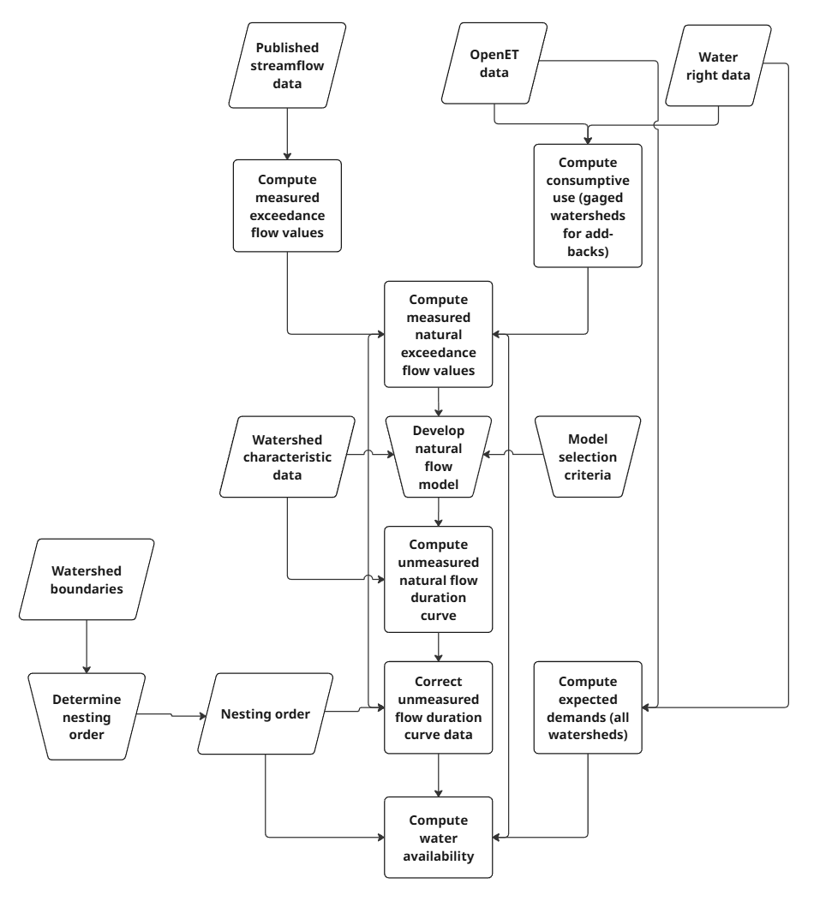
Model Workflow Overview
Meeting theme
Geospatial framework
Modeling approach
Predictor data
Climate impacts
Notes:
General workflow used to calculate water availability
Developed in 1990s and used to calculate water availability as in WARS today
Methods and data haven’t been updated
Not only calculating water availability with new data, wanting to understand changes to workflow as well
Hydrologic investigation series is series of analyses used to compare modeling approaches
Results and findings will be used to make informed decisions about the requirements of the modeling framework

Slide 10
Establishing the Geospatial Framework

Slide 11
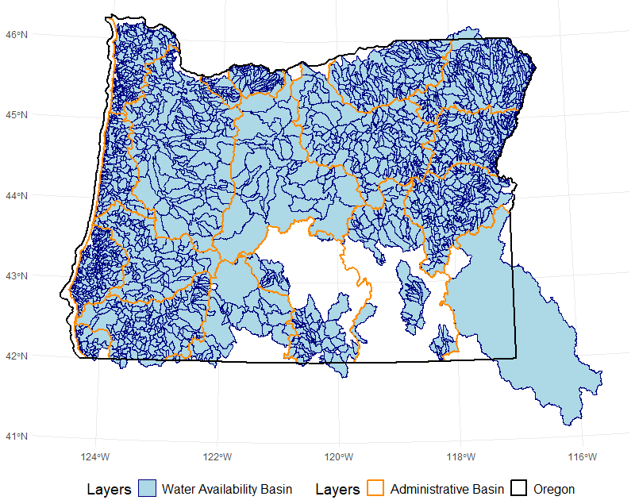
Current Framework in WARS
Water availability information is available for over 2,200 watersheds in Oregon
Locations defined based on physiography and management needs
Data gaps in areas with limited data, small coastal drainages
Relies on watershed delineation tool to interpolate natural flow
Figure: Water availability basins (blue) that define the current geospatial framework in WARS.

Slide 12
Evaluating Alternatives
Considered available data products in terms of:
  Watershed boundary data set
  Stream hydrography
  Flow routing information
  Tools to support business needs
  Computational requirements
Other influential factors:
  Available training data
  Consistency with scale of data sets or other hydrologic modeling products for comparing output
  Adaptable to advancements in modeling and computing
Products
Water Availability Basins
Streamcode watersheds
National Hydrography Dataset (NHD) Plus V2
NHD High-Resolution
National Hydrology Model

Slide 13
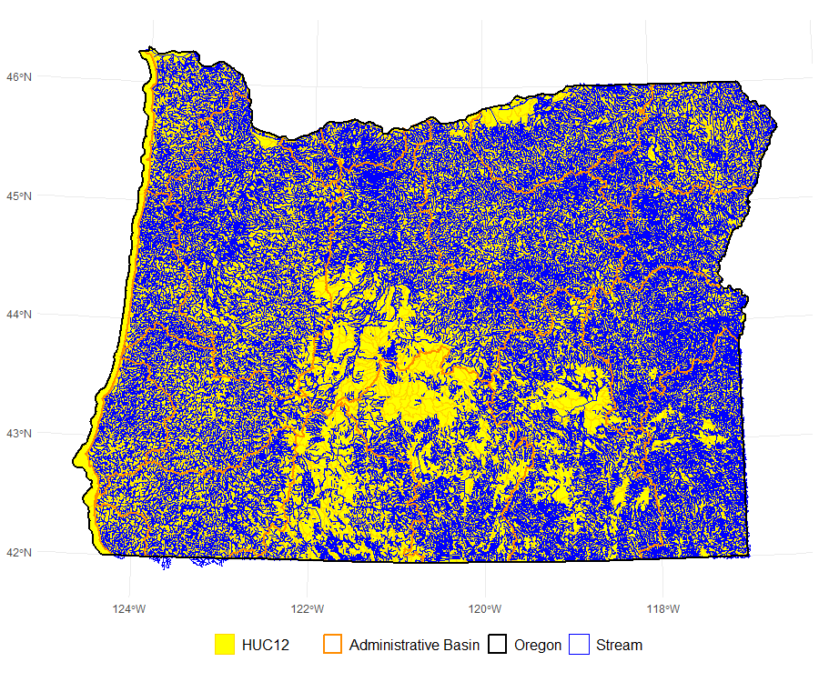
National Hydrography Dataset
National Hydrography Dataset (NHD) provides all necessary components of geospatial framework
Offers statewide coverage and improved resolution in problematic areas (coastal drainages, small tributaries to mainstem rivers)
Consistent and systematic definition of watershed boundaries – HUC-12 scale aligns well with other modeling and data products
Manageable via nhdplustools (R) or similar (Python, custom, etc.)
Adaptable to advancements in data and modeling
Figure: HUC12 watershed boundary dataset (yellow) with flowlines (blue) representing stream segments from NHDPlus V2.

Slide 14
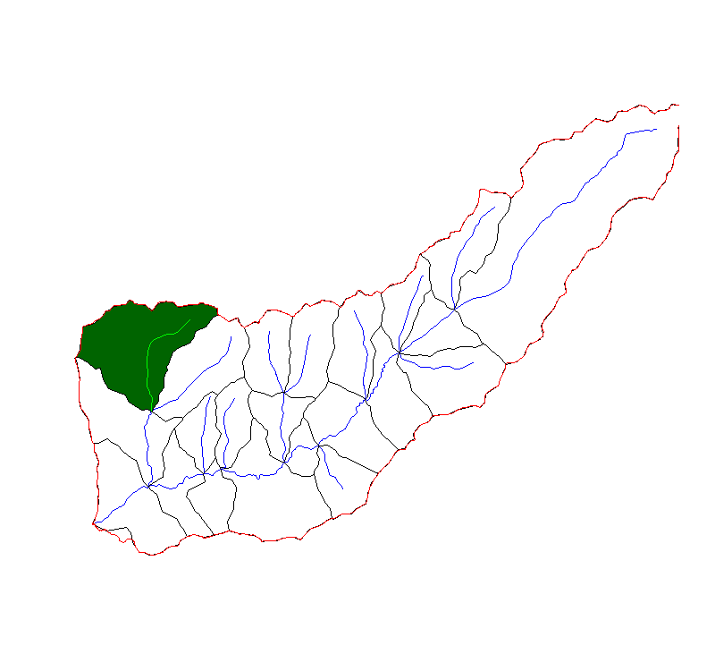
Discussion Questions
How does data availability constrain the ability to model at various scales?
What are the differences in modeling at the catchment scale compared to the watershed scale?
Do any products provide more stability in terms of their technical support or consistency with other hydrologic modeling efforts?
Figure: Example watershed boundary (red) from the NHD, with catchments (black) for tributaries and mainstem reaches nested within. Created with nhdplustools via R.

Slide 15
Environmental Data & Predictor Variables
Cortney Cameron

Slide 16
Purpose & Approach
💧SWIMS needs datasets as inputs for natural flow modeling
🛢️ Identify datasets covering these predictors
⬆️ Generally, prioritize datasets with these features:
Publicly accessible
Statewide coverage
Gridded or polygon format (i.e., not point-based)
➡️ Generally deprioritized:
Coverage of proposed base period
Sub-daily datasets
Human flow management indices
Higher spatial resolution
Performance or use in Oregon or the Pacific Northwest
🔍 Identify broad categories of predictors used in previous studies

Slide 17
Broad Predictor Categories
🌧️Climate
📐Watershed Morphology
🌋Soil & Geology
🌲Land Cover
⛓️Hydrologic Network
🔥Fire

Slide 18
Priority Datasets Selected
🌧️
Climate
📐
Watershed Morphology
🌋
Soil & Geology
🌲
Land Cover
⛓️
Hydrologic Network
🔥
Fire
PRISM – precipitation, temp
GridMET – PET
3DEP – elevation, derived variables (slope, etc.)
National Geologic Map Database
STATSGO: Schwarz & Alexander (1995) & Miller & White (1998)
NLCD – classes, impervious surfaces
NHD Plus v2
LANDFIRE – fire regime, return intervals
LANDFIRE – vegetation type, height, cover, etc.
Channel Geometry (Zarrabi et al., 2025)
BFI (Wolock, 2003)
UA SWE

Slide 19
General Limitations
🕓 Multiple datasets fall outside the proposed base period or are static
📏 Spatial resolutions vary
🗺️ Some datasets may have incomplete spatial coverage
🚰 Some datasets may inherently include some human flow management effects
📈 Multicollinearity and variable selection must be addressed
🎯 Dataset-specific accuracy generally not assessed

Slide 20
Discussion Questions
Are there any data sets you recommend?
Are there any considerations we should be aware of with proposed datasets?
Are there any variables or derived variables that you recommend?
Do you have any suggestions for approaches on identifying key predictor variables?

Slide 21
Modeling Approaches for Estimating Natural Flow
Cortney Cameron

Slide 22
Purpose & Approach
🔀 Overview certain model-related choices to be made as part of SWIMS model development
💬 Solicit feedback from experts on available options and best approaches
Recall: need to predict natural mean daily flow exceedances at lower (80th) and median (50th) percentiles for each month of the year (24 percentile-month combinations). For example, a March median would be calculated using 930 days in a WY1991-2020 base period.
Model options
Variable selection
Regionalization
Performance/selection

Slide 23
Model Options
📏 Multiple linear regression
🧊 Cubist regression
XGBoost
🗺️ Geostatistical methods (traditional/ML)
OLS, GLS, WLS, TLS, etc.
Random forest
Support vector regression
🤖 Machine learning (ensemble/kernel)
🗒️ Note on OHM

Slide 24
Other Decisions
📊 Time series vs. percentile modeling
📍 Regionalization
Expert prioritization
Variance inflation factors
Principal component analysis
LASSO
Forward/backward approaches
✂️ Variable selection
Generate daily time series and calculate percentiles
Predict percentiles directly
Define/refine regions, develop different models by region
See if ML can implicitly “identify” regions through variable combinations

Slide 25
Model Performance/Selection
🎯 Determining if model is fit for use
⚖️ Selecting among multiple decently-performing model options
Performance metrics
Benchmarking
Professional judgement
Performance metrics
Interpretability/accessibility

Slide 26
Discussion Questions
Do any model approaches offer significant advantages over others?
Are there other model approaches we should consider?
What types of model selection criteria should be applied?
How should regionalization be factored into the modeling approach?
What methods do you recommend for selection of predictor variables?

Slide 27
Climate Impact Assessment
Junjie Chen

Slide 28
Purpose
Objectives
Summarize observed climate trends in Oregon
Why it matters
Water availability estimates depend on climate-hydrology relationships
Document rationale for adopting PRISM as historical climate data for SWIMS
Assumed climate signals were stationary when developing WARS
Evidence now shows hydroclimate relationships are evolving
Explain how climate trends affect hydrologic stationarity and modeling water availability

Slide 29
Implications for Hydrologic Stationarity
Summarized from Oregon’s 7th Climate Assessment
🌧️Key Climate Signals
💬Key Take Away Relevant to SWIMs
Earlier peak streamflow timing
Reduced summer baseflows
Increased evapotranspiration demand
Shifting predictor relationships (e.g., SWE relevance)
💧Hydrologic Response
Sustained warming (dominant signal)
Precipitation: no clear annual trend (Increased variability and extreme events)
Observed climate trends are altering hydrologic processes that influence water availability
Weakening historical climate–streamflow relationships
Declining snowpack + earlier snowmelt
Shift from snow → rain (mid-elevation basins)

Slide 30
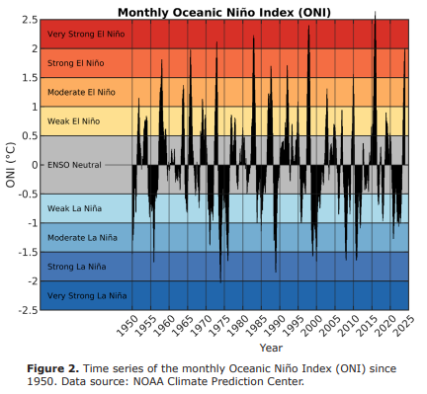
Stationarity, Variability, and Reliability
Traditional assumption
Stationary conditions – historical data represents future conditions
Climate variability (PDO &ENSO)
ENSO (2–7 yr)
What’s changing?
Non-stationarity arises from:
Fixed base period in WARS: 1958–1987
Controls interannual variability
Warm/dry vs cool/wet winters
PDO (20–30 yr)
Historically linked to multi-decadal streamflow patterns
Result
Watersheds reflect combined effects of variability and long-term trends
Climate indices alone are less predictive
Natural variability (PDO, ENSO)
Superimposed long-term warming
Reliability of historical data is declining due to weakening climate–streamflow relationships and shifting climate regimes
Monthly Oceanic Niño Index (ONI) since 1950, highlighting ENSO-driven variability that influences interannual hydroclimate patterns, but does not fully explain long-term changes in streamflow behavior.

Slide 31

Climate Data in SWIMS Framework
The PRISM dataset
📏Update & Recalibration Strategy
Climate-driven modeling:
PRISM → supply (streamflow drivers)
OpenET → demand (consumptive use)
📈SWIMS Improvement Over WARS
Spatially explicit climate inputs (P, T)
Data updates: as available
Model evaluation: every 5–10 years
Captures Oregon’s complex gradients
Enables ongoing dataset updates
Constraint: Data availability + QA lag (PRISM, OpenET) is limiting factor

Slide 32
Strategy to Adapt to Changing Climate
Tier 1: Routine updates
Incorporate latest PRISM/OpenET as available
Tier 2: Periodic evaluation
Test model performance every 5-10 years
Tier 3: Rebuild
Triggered by major structural shifts
💬How often should data be updated and the model re-calibrated to adapt to climate trends?
No recalibration
Reassess relationships

Slide 33
Discussion

Slide 34
Specific Discussion Questions
Follow-up Meeting #2
What must be considered when evaluating other naturalized mean daily flow records for use in model development?
Geospatial Framework
How does data availability constrain the ability to model at various scales?
Modeling approaches
Do you have any suggestions regarding data sets, base variables, or derived variables to consider when developing predictor variables?
Climate impacts
How often should data be updated to account for impacts of a changing climate?
What are the trade-offs of correcting mean daily flow records collected by ‘reference’ gages to represent natural flow?
What are the differences in modeling at the catchment scale compared to the watershed scale?
Do any modeling approaches offer significant advantages over others?
What types of model selection criteria should be applied?
What methods do you recommend when selecting predictor variables?

Slide 35
Questions?

