Slide 1
Psychiatric Security Review Board Preparing Early Discharge Requests
Alison Bort, JD, PhD PSRB Executive Director
October 13, 2021
&
January 21, 2022

Slide 2
Disclaimers
This presentation is not legal advice.
This module should not be used as a stand-alone training. It requires the person observing it to have proficient knowledge of the PSRB system.
The purpose of this module is to provide general pointers, tips, and considerations to community treatment teams who are considering requesting an early discharge; individual differences = individual results/outcomes.
Clients may request a hearing at any time without your support. This presentation focuses on the outpatient supervisor’s request, not the outpatient request.

Slide 3
Take Aways
Overview of PSRB Jurisdictional Criteria
Pre-Hearing Considerations
Preparing for the Hearing

Slide 4
Summary of Tips
Understand PSRB Goals and Establish Commensurate Program Goals and Criteria.
Build your Case: Sufficient and Consistent Documentation.
Understand the Law.
Seek Out a Jurisdictional Evaluation before Supporting Discharge.
Have you discussed the instant offense?
Have you considered all criminal history?
Develop a Realistic Discharge Plan.

Slide 5
GEI Early Discharges (by Year)
2020 (MD=0) (D=0)
2019 (MD=0) (D=2)
2018* (MD=3) (D=1) (3)
2017* (MD=3) (D=5) (6)
2016* (MD=18) (D=6) (20)
2015* (MD=7) (D=13) (18)
2014* (MD=16) (D=13) (24)
2013* (MD=18) (D=9) (21)
2012* (MD=21) (D=8) (17)
2011 (MD=8) (D=9)
2010 (MD=7) (D=8)
No QMD = Client has no qualifying mental disorder
No Danger = Client no longer poses a substantial danger to others
*Includes SHRP discharges
1/1/2012 - GEI clients split between PSRB and SHRP
6/30/2018 - All GEI clients returned to PSRB jurisdiction
Notes:
The reality. Early discharges are uncommon. For a brief period, there were discharges requested and granted following a reinterpretation of the law—essentially that clients had to be off of all medications in order to get a discharge. That interpretation of the law was fraught with concerns because the ultimate goal is to teach individuals how to accept and manage their mental health condition, not prove that they do not have one.
Yellow highlight represents the number PSRB (vs. SHRP) discharged
2018 (MD=2) (D=1)
2017 (MD=2) (D=4)
2016 (MD=14) (D=6)
2015 (MD=5) (D=13)
2014 (MD=13) (D=11)
2013 (MD=13) (D=8)
2012 (MD=11) (D=6)

Slide 6
Client-Centered, Trauma-Informed Goals
1
Accept mental health diagnosis, understand its impact on the instant offense, and learn how to prevent it from occurring again in the future.
2
Identify early warning signs and adopt coping skills, safety plans, or other means to handle them.
3
Achieve and commit to a lifestyle worth living with the least restrictive level of support and services.
4
Develop routines that include meaningful activities that they will continue to engage in following the end of jurisdiction.
5
Develop a social support system outside of our program that clients can rely on when experiencing a mental health episode in the future.
Notes:
But, thinking in terms of the 4Rs is rather pejorative and simplistic. If we look at this from a positive perspective, these same goals will assist us in with our 5 R goals.

Slide 7
Goals of PSRB
What is the ultimate goal of PSRB?

Slide 8
Tip 1:
Don’t Support a Discharge Until You’ve Considered the Information in This Presentation

Slide 9
PSRB
Program
Client
Tip 2:
Understand PSRB Goals and Establish Commensurate Program Goals and Criteria
This Photo by Unknown Author is licensed under CC BY-SA

Slide 10
PSRB: A Problem-Solving Court
Accept mental health diagnosis, understand its impact on the instant offense, and learn how to prevent it from occurring again in the future.
Identify early warning signs and adopt coping skills, safety plans, or other means to handle them.
Achieve and commit to a lifestyle worth living with the least restrictive level of support and services.
Develop routines that include meaningful activities that they will continue to engage in following the end of jurisdiction.
Develop a social support system outside of our program that clients can rely on when experiencing a mental health episode in the future.
Notes:
Our mission inherently sets us up to be a problem-solving court. I’ve spent time in other presentations speaking more in depth about the history and philosophy of problem-solving courts, but will briefly summarize that the goal of any problem solving court is to address and resolve the barriers that contributed to the person’s commission of the underlying offense. The ultimate goal will be that once the person is done with the program, they will have the skills necessary to manage those challenges in the future, at least to the extent that they will not recidivate, meaning commit a new act that will result in some sort of criminal action or legal trouble.
I’ve presented these goals in past presentations, but its worth reading through each one. I would hypothesize that anyone meeting all 5 of these goal areas would be in an excellent position to request and be successful at their discharge hearing. As we are moving through today’s presentation, I invite you to reflect on what sort of data you want to collect and document to demonstrate that these goals have been met. Read through each goal.

Slide 11
Program Goals
Successful discharges/
transitions start at admission!
Are there SMART benchmarks marking program successes/ movement?
How long has your program been in place?
Is there a philosophy or values that drive your program?
Are program goals consistent with PSRB’s goals?
Does the program employ evidence-based practice for forensic populations?
Do your clients understand the rationale of the system?
Notes:
In the light of the Board’s goals, I now invite you to reflect on your own programs. I’m sure you’ve all learned and heard the old social work adage that discharge starts at admission. That is no different for those entering the PSRB. When you first start working with PSRB, you may be a bit disarmed by the length of jurisdiction we have our clients. For those of you whove been around awhile, you may have become desensitized to lengthy EOJs. And with all of the demands of your job and pressures to get things done right now, you may lose sight of the very important work of planning for the future.
The tips on this slide recommend that programs develop the benchmarks and goals of your program—how will you know that someone is successful.
This first analysis is very important because you want to be thinking early on whether a person under you care might be a future candidate for a full discharge.
Please hear me when I say that not all individuals under the PSRB are going to be capable of getting an early discharge, particulary those who may continue to need residential treatment or more to support them in managing their mental health condition. Early discharges are for those who can independently manage their mental health condition to the extent that they would not be dangerous when their condition was in its active state.
The rest of the information in the presentation assumes that you have identified that the person under your care is someone who might be a candidate for full discharge.

Slide 12
Tip 3:
Build your Case: Sufficient and Consistent Documentation

Slide 13
Monthly Reports (FORM)
Submit them on time
Complete them with your clients when indicated
Share them with your clients when indicated
Avoid any copy/paste
Solicit feedback from all staff working with the client.
Ensure they are consistent with other documentation (incident reports, prescriber notes, medication letters, pass requests)
Integrate them into modification requests.

Slide 14
Monthly Reports
This is the case manager’s strongest advocacy tool.
Provides the Board with a real-time narrative of how the individual is doing over time.
Sets the stage for all future requests you are making on behalf of your client and to the Board.
Stepping/up, Revocation, Adding Conditions
Expanding privileges, moving to a lower level of care, removing restrictions
Is sometimes the only documentation supporting a request.
Attestation to the work you do and to your credibility as a case manager.

Slide 15
Significant Medication Changes Medication Change Letter/Safety Plan Template
Psychotropic Medication
PSRB does NOT approve medication changes.
Vital Components of the Medication Change Letters
Multi-disciplinary team communication (prescriber needs collateral info).
Identifying the early, early warning signs.
Communicating the safety plan to everyone working with the client
Estimating the time you expect to see a change.
Indicating whether the medication change recommended by the team versus being requested by client against recommendation.
Primarily concerned about psychotropic medication changes or physical health medications that dilute/impact psychotropic medications.
We approve changes to an individual’s conditional release, depending on identified risk factors, during a period of medication change.

Slide 16
Serious Incident Reporting
Abscond
Arrest
Report of relapse or positive UDS
Refusal of psychotropic medications
Psychiatric or medical hospitalization
Violent or dangerous behaviors
Other circumstances deemed to be serious
Residential Incident Reports Should be Submitted to PSRB

Slide 17
Take Home
It is easier to create good documentation in real time—develop your best practices early.
Review your exhibit file.
Identify if there are any gaps or discrepancies, past recommendations that have not been addressed/considered, significant departures in plans (secondary gain), or significant incidents that have no follow-up.
Add to the record as needed.

Slide 18
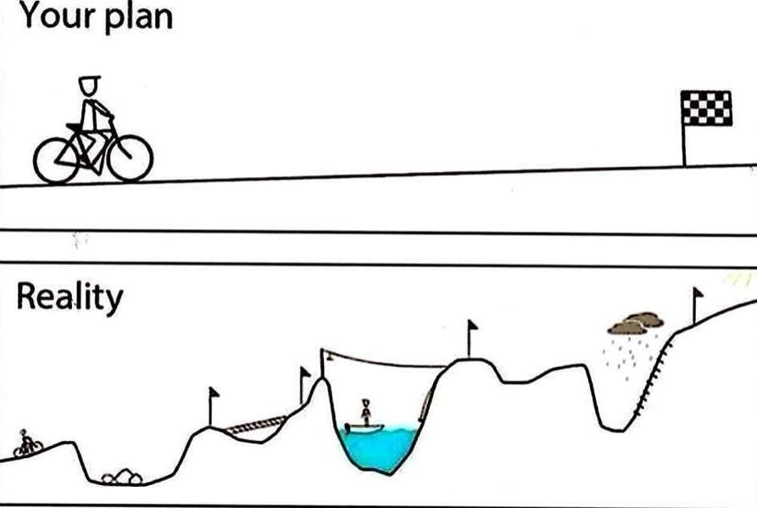
Tip 4:
Consider Client’s Demonstration of Gradual Success Over Time and Whether Additional Privileges/Reduced Restrictions Would Be Beneficial to the Client’s Sustained Recovery and also Strengthen the Request for Discharge.
What is the Purpose of Conditional Release?

Slide 19
What is the Purpose of Conditional Release?
The goal of conditional release is to protect the public while promoting a safe, gradual and supervised return to the community.
Provides enhanced coordination and support for transition from inpatient psychiatric services for individuals at high risk of decompensation if treatment is interrupted while maintaining care in the least restrictive settings.
Provides opportunity for least restrictive treatment with enhanced coordination of care in the community.
Reduces amount of time where patients are “lost” in the system in crisis unable to report past treatment, housing, or support system.
Decreases community costs through increased collaboration with PSRB because stabilized individuals equals decreased arrests, local hospitalizations, decreased 911 calls.
Increases continuity of care through providing conditional release information to PSRB to be forwarded to future providers.
Enables existing community-based resources, such as multi-disciplinary teams, Assertive Community Treatment, mobile outreach, and other agencies to coordinate with hospitals to support discharge plans and provide ongoing resource coordination with client.
Notes:
In the context of considering whether or not you should support a discharge, you should consider what opportunities the client may still have available to them while they are under the Board. Many of you may have clients who may be hyperfocused on a narrative that the Board is holding them back from something. When the Board hears things like this, they start to ask, like what? My impression is that this back and forth is often unconvincing.
As I mentioned earlier in the presentation, what is more convincing is that the person has achieved the lifestyle they plan to continue to live once they are no longer under the PSRB. While that is not the full analysis (we are about to talk about why the law may still prevent a discharge), I can’t emphasize enough how important it is for you to work with your clients to help them shift their focus on recovery from the PSRB to themselves. There is very little the Board won’t support when someone is demonstrating evidence of managing their mental health condition, particularly while monitoring and supervision is gradually reduced.

Slide 20
Periodic Modifications Demonstrating Continued Progress
Best practice is to review your conditional release orders a minimum of once per year to determine whether any modifications can be requested.
Documentation
Modification Request Form
START
Incident Reports
Clinical Notes
Modification Hearing
Notes:
Next month, I will be presenting on the topic of modification requests. For now, my message is that the best practice is to periodically review the current conditional release plan and make gradual steps toward discharge.
But if all of this information has not convinced you to hold off on supporting a discharge until your client achieves that level of care, hold that thought, and we will come back to it when we start talking about the law.

Slide 21
Structured Activities What are they, why are they mandated?
Activities that reduce criminogenic risk and promote community connection.
Provide opportunities for client to apply the skills they have learned in treatment to the community setting.
Better long-term success when clients engage in structured, meaningful activities while in treatment
Structured time provides opportunities to demonstrate readiness for a step-down.
Notes:
I’m throwing this slide in here because it relates to a person’s suitability for a discharge.

Slide 22
Structured Activities Strategies and Examples Adapted from OJJDP; Restorative Justice Practice
Work Experience in Jobs Involving Meaningful Skills. Meaningful skills are those that have value for the community and transfer competencies to clients that enhance the client’s ability to make future contributions to the community as a valued citizen.
Service Learning. Service learning involves doing worthwhile work in the community, with a purposeful outcome that the client can recognize. This work meets a real need in the community, is positively acknowledged by the community, and achieves clear educational outcomes. Service learning aids the development of work skills, social competencies, and reliability that the offender can transfer to compensated work.
Participation in Resource and Action Teams (Planning and Problem Solving for Real Issues). Rather than being viewed as recipients of services, clients are seen as true resources for and representatives of the community. Providers may facilitate a process where clients have the opportunity to identify needs in the community and work together to implement a needed service or change.

Slide 23
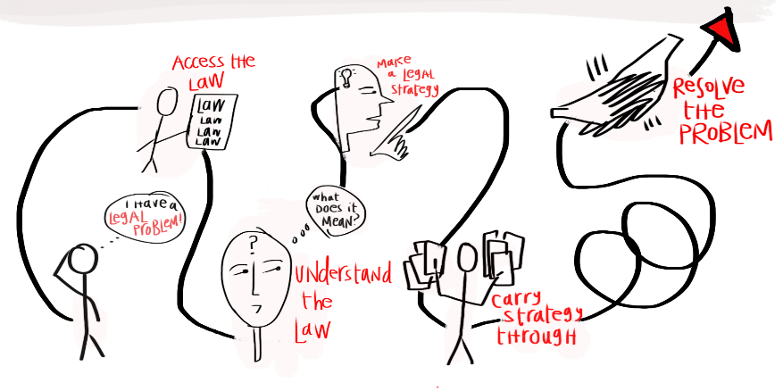
TIP 5: Understand the Law
Notes:
How will you know when your client is ready for a discharge?

Slide 24
PSRB Discharge Statutes
ORS 161.346 Application for Discharge or Conditional Release | ORS 161.351 Discharge by Board | ORS 161.336 Conditional Release by Agency; Termination or Modification of Conditional Release; Hearing
(1) …If the board finds that a person under the jurisdiction of the board: (a) Is no longer affected by a qualifying mental disorder, or, if so affected, no longer presents a substantial danger to others, the board shall order the person discharged from commitment and conditional release. | (1) Any person placed under the jurisdiction of the PSRB shall be discharged at such time as the board, upon a hearing…[when] that the person is no longer affected by a qualifying mental disorder or, if so affected, no longer presents a substantial danger to others that requires regular medical care, medication, supervision or treatment. (2) [Remission]. A person whose qualifying mental disorder may, with reasonable medical probability, occasionally become active and when it becomes active will render the person a danger to others may not be discharged. | (5)(a) Any person conditionally released under this section may apply to the board for discharge from…an order of conditional release on the ground that the person is no longer affected by a qualifying mental disorder or, if still so affected, no longer presents a substantial danger to others and no longer requires supervision, medication, care or treatment.
Notes:
Okay, so what you are seeing now is reference to the statute the Board must apply when it is determining whether or not to grant an early discharge.
My hope is that by better understanding the legal criteria, you can start so better understand how the Board arrives at their decisions.
When we are talking about these statutes, it might be helpful to share a brief lesson on standards of proof. Many of you are likely familiar with the term “beyond a reasonable doubt,” which is the highest standard of proof in our legal system and is required to find someone guilty of a crime—for the record, that is the standard of proof applied to all of our clients when they are prosecuted for their instant offense. In PSRB world, when the Board is weighing the evidence that supports or does not support jurisdiction, they apply the lowest standard possible in our legal system. That is known as the preponderance of the evidence—that is 50% plus a feather. In a case where you are supporting discharge, then the State must prove 50% plus a feather that your client continues to suffer from a qualifying mental disorder that, when active, renders them a substantial danger to others. When a client is not supported and it is not a statutory hearing, then the client must prove by 50% plus a feather that they are no longer affected by a qualifying disorder OR if they are affected, that they no longer present a substantial danger to others when that disorder is active.
The next thing to note is that we have three different statutes that mention discharge. As if this topic was not already incredibly complex, you may notice that each of these statutes are written a little differently. For example, 161.346 (read it); where as ORS 161.351 says (read it) and 161.336 (read it).
What you should know is that the Board reads these statutes together and so I will reiterate that the question they answer is whether a person has qualifying mental disorder, and if so, whether they are a substantial danger to others when that disorder is ACTIVE.
Okay, let’s now focus on the term “qualifying mental disorder.” The first thing to note is that
Analysis requires the Board to determine whether the person CURRENTLY has a qualifying mental disorder.
AND
Whether the qualifying mental disorder is active or in remission
If the answer is NO to both questions, the PSRB must discharge the person.

Slide 25
Defining Qualifying Mental Disorder ORS 161.295(2)
the term qualifying mental disorder does not include an abnormality manifested only by repeated criminal or otherwise antisocial conduct, nor do they include any abnormality constituting solely a personality disorder.

Slide 26
Qualifying Mental Disorder OAR 859-010-0005(11)
A developmental or intellectual disability, traumatic brain injury, brain damage or other biological dysfunction that is associated with distress or disability causing symptoms or impairment in at least one important area of an individuals functioning and is defined in the current Diagnostic and Statistical Manual of Mental Disorders (DSM V) of the American Psychiatric Association; or
Any diagnosis of a psychiatric condition which is a significant behavioral or psychological syndrome or pattern that is associated with distress or disability causing symptoms or impairment in at least one important area of an individuals functioning and is defined in the Diagnostic and Statistical Manual of Mental Disorders (DSM V) of the American Psychiatric Association.
QMD is broadly defined

Slide 27
What is a “Personality Disorder?”
What constitutes a “personality disorder” was somewhat defined by the Oregon Supreme Court in Tharp v. PSRB, 338 Or 413 (2005):
alcohol and/or drug dependency is a “personality disorder” as that term is used in ORS 161.295 (2).
The Court of Appeals indicated the same opinion re: sexual disorders in Beiswenger v. PSRB, 192 Or App 38 (2004), Sup Ct review denied.
The DSM-V’s definition of personality disorders.

Slide 28
Qualifying Mental Disorder Case Law
PSRB can find any qualifying mental disorder, it does not need to be the same QMD as at the criminal trial. Osborn v. PSRB, 325 Or 135 (1997).
QMD can be a cause—not the only cause—of the person’s dangerousness. The QMD can combine with the non-QMD to make the person more dangerous. Rinne v. PSRB, 297 Or App 549 (2019).
Non-QMD predisposed patient to use drugs, and drug use made it more likely that his QMD in remission would become active with a reasonable medical probability, and he was dangerous to others when his psychosis was active. Bahrenfus v. PSRB, 124 Or. App. 320 (1993).
The Court of Appeals recently ruled that a personality disorder includes transitory, episodic, drug-induced psychosis; however, it left open whether a long-term mental disorder or organic damage due to chronic substance use would be a QMD in State v. Folks, 290 Or. App. 94 (2018).

Slide 29
PSRB Discharge Statutes
ORS 161.346 Application for Discharge or Conditional Release | ORS 161.351 Discharge by Board | ORS 161.336 Conditional Release by Agency; Termination or Modification of Conditional Release; Hearing
(1) …If the board finds that a person under the jurisdiction of the board: (a) Is no longer affected by a qualifying mental disorder, or, if so affected, no longer presents a substantial danger to others, the board shall order the person discharged from commitment and conditional release. | (1) Any person placed under the jurisdiction of the PSRB shall be discharged at such time as the board, upon a hearing…[when] that the person is no longer affected by a qualifying mental disorder or, if so affected, no longer presents a substantial danger to others that requires regular medical care, medication, supervision or treatment. (2) [Remission]. A person whose qualifying mental disorder may, with reasonable medical probability, occasionally become active and when it becomes active will render the person a danger to others may not be discharged. | (5)(a) Any person conditionally released under this section may apply to the board for discharge from…an order of conditional release on the ground that the person is no longer affected by a qualifying mental disorder or, if still so affected, no longer presents a substantial danger to others and no longer requires supervision, medication, care or treatment.
Notes:
Okay, so the previous slides, we discussed the nuances of an active qualifying mental disorder and some of the considerations the Board weighs to determine that an active diagnosis is present.
Now, we will look at another basis for the Board finding that a qualifying mental disorder is present. ORS 161.351(2) provides information about when a QMD is in remission.

Slide 30
In Remission
Clinical Use of “In Remission”
A specifier that is added to certain diagnoses
Legal Interpretation (if there is one) of “Remission”
A period where symptoms of a particular diagnosis are not active
E.g. there is no “In Remission” specifier for PTSD; however, there may be evidence that the condition would recur for a particular individual.
E.g. no guidance on when MDD would go from “In Remission” to being removed as a diagnosis; therefore, the diagnosis may have been removed from the formulation, but there may be evidence that the person could become depressed again in the future.
Take home: The analysis is not whether or not the diagnosis includes the words “in remission,” but rather whether or not the condition may, with reasonable medical probability, occasionally become active.

Slide 31
Timing of a Qualifying Mental Disorder Einstein v. PSRB, 998 P.2d 654 (Or. 2000)
The appropriate factual inquiry is applicant's mental condition at the time of a hearing.
However, at the time of a hearing does not mean “right now.”
Notes:
We are now going to talk about an Oregon Supreme Court case from 2000. This was a case whereby Mr. Einstein was found GEI for Arson I. About 8-9 months after that adjudication, he requested a full discharge.
Issue in the case this case was whether or not Mr. Einstein’s qualifying mental disorder was in remission. The psychologist who testified at the hearing stated that he did not suffer from a qualifying mental disorder. However, the State argued its reliance on the records of his mental condition at the time of the instant offense, and the Board ultimately found that the preponderance of the evidence supported that he did have a qualifying mental disorder.
The first thing to note about the Supreme Court’s ruling is that we need to consider the person’s diagnosis at the time of the hearing--not at the time of the instant offense.

Slide 32
Witnesses at the Hearing Einstein v. PSRB, 998 P.2d 654 (Or. 2000)
The question therefore is whether there is substantial evidence in the present record from which a reasonable person could find, either directly or by permissible inference, that the person continues to suffer from a qualifying mental disorder.
Is the information in the history is so remote that a reasonable person could not, as a matter of law, give that evidence substantial weight.
Evidence of the illness 8 months prior
Long history of mental illness punctuated by periods of hospitalization
Mental illness goes through periods of remission
Evidence was sufficient to support a finding that his condition was in remission.
Notes:
Okay, so we know that the only new testimony that was provided at the hearing was the psychologist’s testimony. Some of you may leave a hearing scratching your heads as to why the Board did not discharge your client when all the testimony at the hearing supported a discharge.
In Einstein, the court made it clear that the Board was not limited to the testimony at the hearing. Rather, the Board can take a look at the total record and give the appropriate weight to the evidence.
In the present case, the record includes exhibits establishing that, as recently as eight months before the hearing, applicant had suffered from an episodic psychotic disorder that was triggered by cannabis abuse. The record also contains evidence on which PSRB relied that applicant has a long history of mental illness, punctuated by periods of hospitalization, but that his mental illness goes through periods of remission. The nature of applicant's disease and its recent flare-up that led to the underlying criminal charges could, in our view, lead a reasonable person to find that the absence of symptoms just eight months later was, at best, evidence that the condition was in remission. In other words, the evidence supported the inference that PSRB drew, viz., that applicant's underlying psychotic condition persists. (3) It follows that there was substantial evidence for the finding of fact that PSRB made and that the Court of Appeals' contrary ruling was error.
That is, the court in Martin suggested that evidence older than the evidence in the present case could be relied on by PSRB to make decisions respecting the status of a committed person's current mental health.
We might ask whether the information in the history is so remote that a reasonable person could not, as a matter of law, give that evidence substantial weight.

Slide 33
Requesting Discharge at Initial Hearing Einstein v. PSRB, 998 P.2d 654 (Or. 2000) Justice Van Hoomissen concurring
I should think that, if someone were found to be guilty except for insanity a relatively short time before a PSRB hearing, then the likelihood that that person no longer would be affected by [a qualifying mental disorder], or, if so affected, no longer would present a substantial danger to others at the time of the hearing would be, at best, doubtful.
Notes:
Another little golden nugget came out of Einstein.
The most liberal support I have seen is in a situation whereby a treatment team supports a discharge of a person at their initial hearing or even at the next hearing thereafter. It is highly unlikely that there would be a preponderance of the evidence that would support an early discharge at that point of the case process given the proximity of the instant offense.
First, it is not unusual for a petitioner on conditional release to request a full discharge from PSRB's jurisdiction within a relatively short time after his or her original commitment to PSRB. The record on review in such cases, however, frequently contains only the sketchiest evidence of the criminal conduct that resulted in the petitioner being found guilty except for insanity. I should think that, if someone were found to be guilty except for insanity a relatively short time before a PSRB hearing, then the likelihood that that person no longer would be affected by mental disease or defect, or, if so affected, no longer would present a substantial danger to others at the time of the hearing would be, at best, doubtful. For that reason, I should think that the state would want to present, and that PSRB would want to consider, the record of the petitioner's trial and evidence of the petitioner's entire psychiatric and criminal history. The judge went on to recommend that perhaps the State and the Board might want to consider admitting into evidence the record of the petitioner's trial and evidence of the petitioner's entire psychiatric and criminal history.
ORS 161.346(3) provides in part:
"The board shall consider all evidence available to it which is material, relevant and reliable regarding the issues before the board. Such evidence may include but is not limited to the record of trial, the information supplied by the attorney representing the state or by any other interested party, including the person, and information concerning the person's mental condition and the entire psychiatric and criminal history of the person. All evidence of a type commonly relied upon by reasonably prudent persons in the conduct of their serious affairs shall be admissible at hearings. * * *"
That kind of evidence has been missing in several of the PSRB cases recently reviewed by this court.

Slide 34
Defining Substantial Danger to Others OAR 859-010-0005
(7) "Danger"; "Substantial Danger"; or "Dangerousness" means a demonstration or previous demonstration of intentional, knowing, reckless or criminally negligent behavior which places others at risk of physical injury because of the person’s qualifying mental disorder.
Notes:
So, the second part of understanding the law is to understand what is meant by substantial danger to others.
1st Do your clients ever read the order and become upset, agitated or confused that the Board made a finding that they are a “substantial danger?” Do you feel equipped to talk to your clients about what that means?
Anyone in the presentation want to share how these discussions have gone for you? I’m happy to press pause on the recording.
So this is very tough and complicated, and it is the Board’s difficult task of weighing all of the evidence to determine whether or not a person meets this piece of its jurisdictional criteria.

Slide 35
Environmental Considerations Einstein v. PSRB, 998 P.2d 654 (Or. 2000) Justice Van Hoomissen concurring
Second, ORS 161.336(3) provides: “For purposes of this section, a person affected by a [qualifying mental disorder] in a state of remission is considered to have a [qualifying mental disorder] requiring supervision when the [disorder] may, with reasonable medical probability, occasionally become active and, when active, render the person a danger to others. The person may be continued on conditional release by the board as provided in this section."
“The fact that a person affected by a [qualifying mental disorder] in a state of remission presently is not evidencing conduct rendering him or her a danger to others might be the consequence of that person's current supervision, treatment, and medication. PSRB must be alert to the reality that a petitioner's discharge from PSRB's jurisdiction might result in the abrupt cessation of those ameliorating influences.”
Notes:
Lastly, and maybe most important for you all is the consideration of level of care at the time you request discharge.
Early in the presentation, I explained the importance of demonstrating gradual progress with increased privilges and decreased restrictions over time.
Arguments:
Client has not been prescribed medication for X period.
Client has not demonstrated any symptoms of mental illness in X period.
Conclusions:
Client no longer has a qualifying mental disorder and should be discharged from the Board.

Slide 36
TIP 6:
Seek Out a Jurisdictional Evaluation
before Supporting Discharge

Slide 37
Dangers of Relying on Your Clinical Opinion
Diagnostic impressions can vary over time.
Risk of future dangerousness is a complicated construct to measure and a specialty area of forensic practice.
Biases in Clinical Decision-Making
Counter-transference is real—the potential to overidentify or under-identify with your clients should be regularly discussed.
Confirmation bias: Tendency to seek out evidence that is consistent with one's hypotheses, and to deny, dismiss, or distort evidence that is not
Hindsight bias: Propensity to overestimate the predictability of events
Neglect/Missing Data: Other important clinician biases stem from the tendency to neglect or underweight missing data.
Bias Blind Spot: Refers to the fact that most people are unaware of their own biases although they can readily spot corresponding biases in others
Multi-disciplined input is key to the Board making a good decision!
Notes:
Recall the last section we just reviewed—understanding the law. Do you remember the Board’s jurisdictional criteria? If the person has a qualifying mental disorder that, when active, renders them a substantial danger to others, then jurisdiction is proper.
Diagnostic formulation. Remember, in order for a person to be found GEI, they must have had a qualifying mental disorder to begin with . Diagnosis is not a perfect science, and the law leaves room for the Board to consider the diagnostic opinions that came before you. Changing a diagnosis from a qualifying mental disorder to a non-qualifying mental disorder will be less persuasive in light of history. It will also be less persuasive if you arrived at that conclusion with solely a records review, particularly when a diagnosis is highly dependent on a client’s reporting of symptoms and there is little time spent in services. Similarly, recall Einstein, when a person is at a high level of care, the Board will consider how those supports impact the person’s psychiatric stability.
The Board is well-versed in best practices of risk, and so when they are reviewing a case that seems to ignore, overlook, or minimize information that is in the record, it can cause a serious credibility concern.
We can talk more about this when we discuss how to best prepare for a hearing, but you should ask yourself, how confident are you at your abilities to predict future violence.
But here are some other things to consider based in the research.
Given what the research says and how challenging this all is, it is really unrealistic for the Board or for you to expect you to independently come up with these opinions. We emphasize the importance of multi-disciplinary collaboration and shared decision making when it comes to all recommendations you make to the Board.
So….

Slide 38
Independent Evaluation
Jurisdiction Evaluation
Education & Experience
Not all evaluators have the experience to conduct these.
CCH
Collateral
Consider the entire record
Understand the psycholegal questions
Totality of the Record
Recommendations
Help the treatment team determine whether or not to support discharge.
Provide recommendations or information about what sorts of interventions should be considered to minimize risk.
Provide diagnostic clarification.
Best practice when considering a discharge is to request an independent, diagnostic and/or violence risk assessment.
An opinion in favor of discharge will not necessarily result in a discharge.
Notes:
With the tools being available and with such important and high stakes decision-making, why not seek out the evaluation prior to

Slide 39
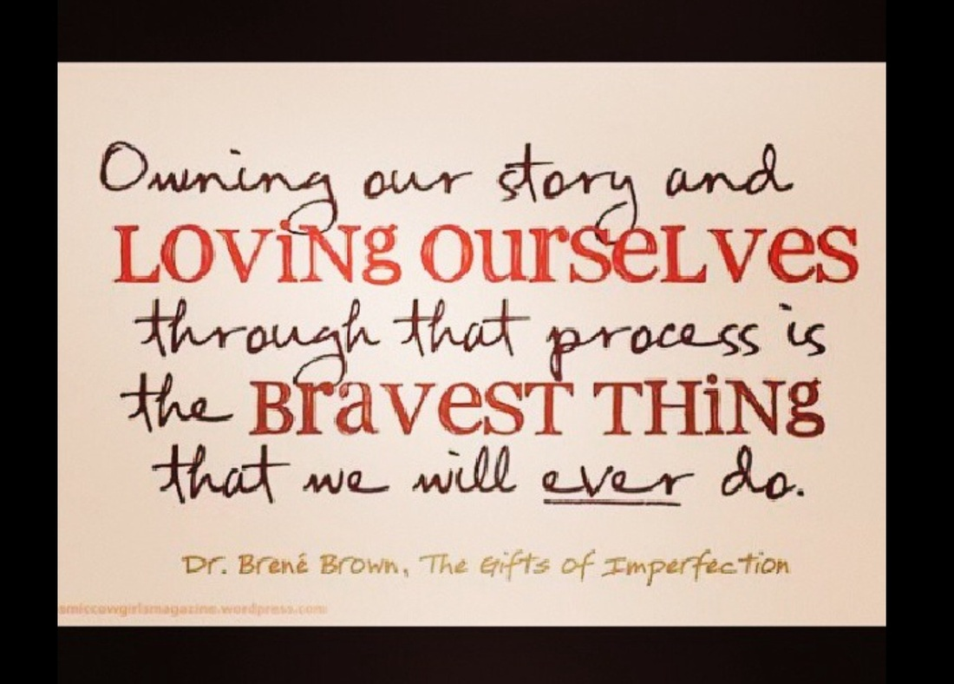
TIP 7:
Have you discussed the instant offense?
Have you considered all criminal history?

Slide 40
A Cautionary Tale Do Not Assume a Client has Processed Their Instant Offense

Slide 41
Criminal Responsibility vs. Accountability
Why did the Oregon Legislature adopt “Guilty Except Insanity”
Compare: NGRI (pre 1978), NRRI (1978-1983), GBMI
GEI is an AFFIRMATIVE DEFENSE
Prosecution proves all elements of the crime, including the culpable mental state.
Defense proves they meet the “insanity defense”
In Oregon, GEI means you are guilty in all respects, except that their qualifying mental disorder prevents a conviction.
A painful and difficult process given personal trauma and lack of control experienced at the time of the instant offense.
Opportunity for personal growth.
Reduce the likelihood of repeating the harmful behavior in the future.
Requires a support system to be in place.
Notes:
How many of you have had an experience like this. Your speaking with your client about the PSRB, and they something to the effect that PSRB is punishing them. That they are not a criminal, but they’re being sentenced longer than they would have if they had been convicted. That had they just pleaded guilty, they would be completely free by now. Or that they shouldn’t have any restrictions, that PSRB is criminalizing mental illness? Maybe is something slightly different, but in any case, the implication is that they are being punished.
I would regard this type of speech as a red flag, a thinking error, a cognitive distortion, and as a significant barrier to a person’s ability to achieve their recovery. Not to mention a significant barrier to any sort of early release. It is important for our clients to understand that by successfully asserting the GEI defense, the court ruled that they are not criminally responsible for the act. However, criminal responsibility is very different than good old fashioned accountability. Accountability is more about what changes you are going to make with the knowledge you now have? Accountability is reflecting on what contributed to your committing of the instant offense and what steps you will take to make sure that never happens again. Accountability is knowing that even though you were having a mental health crisis and perhaps were undergoing your very own traumatic experience, that your actions also caused another person to experience crisis and trauma.
Not being criminally responsible does not mean that you did not do the act—in fact, let’s look at the defense for a moment. (READ Slide—in Oregon, GEI means…)
Now, of course there must be room for a client to experience the very real emotions they may have about their instant offense—they may be wondering where the community or the police accountability was when they were seeking help for a mental health crisis. But both of these things can be true at the same time and the goal is to make meaning of what happened to them, similar to anyone trying to overcome a trauma, so
sort of incident—maybe it’s the instant offense, maybe it’s a recent relapse they had.
Oregon was the first state to adopt this. It was previously NGRI and then NR due to mental disease or defect.
1983—the process of naming of the defense was political and sparked heated debate in the legislature.
Perception that Not Guilty or Not Responsible meant an individual was getting away with it.
Some mental health professionals assert that labeling defendants' 'not responsible'' interferes with their treatment and therapy, during which therapists try to teach patients to take responsibility for their own actions.
The Board understands that not all clients need to have perfect insight into their instant offense to be conditional release ready. However, they are looking for what type of progress the client has made toward being accountable and what their capacity is for additional progress.

Slide 42
Notwithstanding your mental health, accountability means…
You acknowledge that you caused harm.
You recognize (in hindsight, with support) what contributed to the harm.
You understand the harm from other points of view—how that behavior affected other human beings (not just you, the courts, or officials).
To the extent possible, you acknowledge that the behavior resulted from a *choice* that could have been made differently.
You recognize prospectively what you would need to do in order to avoid or mitigate the severity of a mental health episode in the future.
You demonstrate that you have taken action to change.
Notes:
*Choice—someone found GEI proved that they were not capable of making a decision in that moment. We are not talking about that moment. We are talking about the moments leading up to a severe episode. Often, this includes stopping medication

Slide 43
Restorative Accountability Strategies
Formal restorative justice or facilitated dialogue referral
Formal engagement in letter of forgiveness intervention
Family therapy
Processing/Chain Analysis of the Instant Offense (and/or other situations that led to legal problems)
Moral Recongition Therapy
Community/public service or contribution to the community
Victim empathy groups or classes
Batterer Intervention Program
Notes:
Recommend these be done by professionals who are familiar with working with PSRB. Should be actively consulting with you, not depending on client report alone. Should have access to the exhibit file.
Remember, going through these, alone, does not demonstrate that they are accountable. The goal would be to provide them with opportunities to build insight into the impact of the instant offense, and subsequently demonstrate over time and through their actions that they have internalized that knowledge and apply those skills to their daily living.

Slide 44
Tips for Examining Criminal History
Problem:
PSRB is not able to provide criminal histories directly to our stakeholders.
Current Solutions:
Ask the client
ROI to get copy of a criminal background
Review the hospital reports
The instant offense is not the only type of danger that might be of concern.
Future Solutions!
Notes:
Educate that PSRB has access to this information and that it may ask questions during a hearing about it.
that you client that the PSRB has th

Slide 45
Tip 8:
The Discharge Plan
Notes:
I wanted to end where we began, which is that discharge planning should start at the beginning.
The Board wants to know what the person’s life will look like once it is no longer in place. Financials? Housing? Natural supports outside of the treatment team?

Slide 46
Before Requesting a Discharge, Ask…
Where will the client live?
Where will the client receive services?
What financial obligations does the client have and what financial supports does the client currently receive?
Will the client lose any financial support or resources when discharged?
How will their social support change post-discharge?
What social supports do they have outside of PSRB?
How will their daily routine change post-discharge?
Have you spoken with any of the natural supports about post-discharge?
Has the client developed a Mental Health Declaration?
This is not an exhaustive risk--different cases have different factors to consider
Einstein Again!
PSRB must be alert to the reality that a petitioner's discharge from PSRB's jurisdiction might result in the abrupt cessation of those ameliorating influences.”
Notes:
At the hearing, the plans for discharge will be question
“The fact that a person affected by a [qualifying mental disorder] in a state of remission presently is not evidencing conduct rendering him or her a danger to others might be the consequence of that person's current supervision, treatment, and medication. PSRB must be alert to the reality that a petitioner's discharge from PSRB's jurisdiction might result in the abrupt cessation of those ameliorating influences.”
ed.

Slide 47
PSRB Mission Statement
The primary purpose of the PSRB is to protect the public by working with partnering agencies to ensure persons under its jurisdiction receive the necessary services and support to reduce the risk of future dangerous behavior using recognized principles of risk assessment, victims' interest and person-centered care.
Notes:
Here is a slide you should be very familiar with. Read the statement. Next slide

Slide 48
THE BOARD IS YOUR PARTNER IN THIS JOURNEY!

