Slide 1

Five-Year IT Strategy
How IT will support Oregon Public Utility Commission’s organization strategy in 2025-29
Notes:
Need to fix background color.

Slide 2
Contents
1
2
Five-Year Strategy & Business Alignment
Five-Year IT Goals & Operating Model
IT Strategy on a Page
Message from the CIO
IT Mission, Vision, Principles & Planning Horizon
IT Team
Five-Year Business Support Initiatives
Five-Year IT Excellence Initiatives
Five-Year Innovation Initiatives
Five-Year Key IT Initiatives Summaries
Five-Year IT Roadmap
Five-Year IT Goals
Five-Year IT Metrics & IT Performance Management Goals
Five-Year IT Organization & Proposed Changes
Five-Year IT Budget & Proposed Changes
Next Steps & Refresh Strategy
Communication Plan
Business Value Matrix
Annual Progress Report
Notes:
Done

Slide 3

Five-Year Strategy & Business Alignment
This section includes:
IT Strategy on a Page
Message from the CIO
IT Mission, Vision, Principles & Planning Horizon
IT Team
Five-Year Business Support Initiatives
Five-Year IT Excellence Initiatives
Five-Year Innovation Initiatives
Five-Year Key IT Initiatives Summaries
Notes:
Done

Slide 4
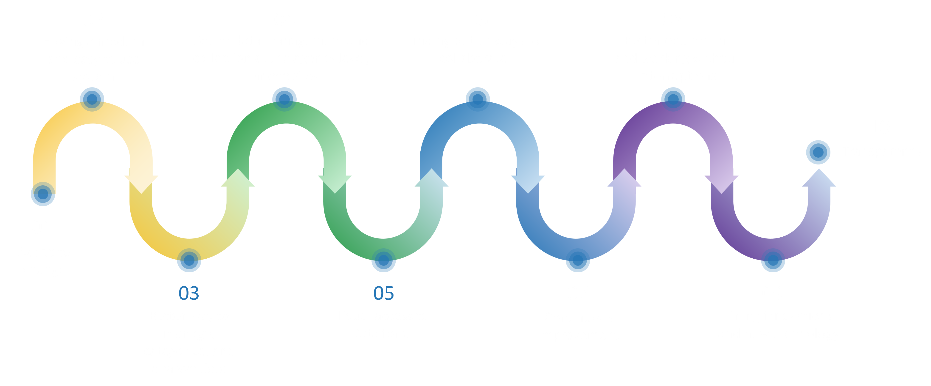
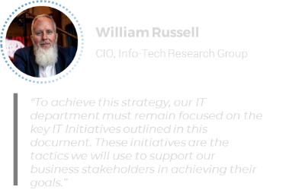





FY25-29 IT Strategic Plan
IT will support OPUC major business initiatives
Business Support
IT Goals | Initiative List | FY25 |  |  |  | FY26 |  |  |  | FY27 |  |  | 28 | 29
Modernize Legacy application | Modernize legacy applications
Improve Data Quality | Improve Data collection and Data management
 | Improve Data mapping, collection, and management
Raise End-User Satisfaction | Improve Internal and External collaboration
Improve Data Quality | Improve data access for the public
Modernize Legacy application | Improve external communication – web-site redesign
Improve Data Quality | Introduce Power BI to employees and provide training
IT Mission: Be a strategic and consultative partner, ensuring that technology is used effectively in support of the agency’s mission.
IT Vision: Enable stakeholders to focus on their expertise and core competencies by leveraging innovative technology and improved processes.
54%
IT Values
IT Current Maturity State
Security
Availability
Quality
Innovation
IT Excellence
INNOVATOR
IT Goals | Initiative List | FY25 |  |  |  | FY26 |  |  |  | FY27 |  |  | 28 | 29
Raise End-User Satisfaction | Complete and communicate an IT strategy
 | Implement Asset management System
 | Semi-annual meetings with sections to discuss challenges
23%
IT Goals
TARGET 2029
BUSINESS PARTNER
Improve Data Quality
Modernize Legacy Applications
Raise End-User Satisfaction
Research new Technology
CURRENT 2025
TRUSTED OPERATOR
Innovation
FIREFIGHTER
IT Goals | Initiative List | FY25 |  |  |  | FY26 |  |  |  | FY27 |  |  | 28 | 29
Research New Technology | Legacy Application Replacement
 | Digitize Order Books
 | Research New Technology
UNSTABLE
23%
Notes:
ff

Slide 5
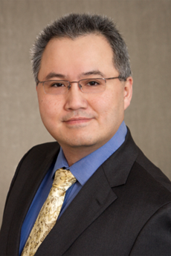
Message from the CIO
What is Oregon Public Utility Commission’s Five-Year IT strategy?
This IT Strategic Plan was first created in 2023 based on the PUC’s 2023-2025 Strategic Plan. It is updated periodically and provides a holistic view of where The OPUC Information Systems (IS) department will go in the next five years. The plan demonstrates how we align our resources, efforts, and budget to support the OPUC’s direction and top initiatives. It is our roadmap.
To achieve this strategy, our IS department must remain focused on the key IT initiatives outlined in this document. These initiatives are the tactics we will use to support our business stakeholders in achieving their goals.
A round of appreciations to the many business stakeholders and the input of IS employees in the creation of this plan. It is a combined effort we will use to gain alignment and buy-in from our staff. Thank you to all those who have helped assess our current state, envision our future state, and determine the gaps necessary to fill to achieve those goals.
I look forward to working with all of you in helping Oregon Public Utility Commission achieve its Five-Year Organization Goals!
Info-Tech’s insight for an effective IT strategy
Everything IT does should support the business. A list of projects is not a strategic plan. A good strategy clearly links IT initiatives to business goals.
Business stakeholders cannot translate how IT initiatives will help achieve their objectives. IT needs to work together with the business through the IT strategy development process.
A well-crafted IT strategy is critical to enhancing business stakeholder satisfaction and building relationships with business stakeholders.
Qing Liu
CIO, Oregon Public Utility Commission
Notes:
Done

Slide 6
IT supports Oregon Public Utility Commission’s mission and vision
Business
IT
Mission
Our mission is to ensure Oregonians have access to safe, reliable and fairly priced utility services that advance state policy and promote the public interest. We use an inclusive process to evaluate differing viewpoints and visions of the public interest and arrive at balanced, well-reasoned, independent decisions supported by fact and law.
Mission
Be a strategic and consultative partner, ensuring that technology is used effectively in support of the agency’s mission.
Vision
Enable stakeholders to focus on their expertise and core competencies by leveraging innovative technology and improved processes.
Vision
Our vision is to improve the lives of Oregonians through effective utility regulation and leadership in the utility sector.
Values
Security
Availability
Quality
Innovation
Values
Accountability
Integrity
Inclusion
Adaptability
Notes:
Done

Slide 7







The IT team provides depth and experience
Qing has been CIO at Oregon Public Utility Commission since 2014. His leadership team spans application development, help desk, infrastructure, and security. The team represents 150 years of combined experience at solving IT problems and delivering IT value.
Qing Liu
Chief Information Manager
Jonathan Felling
Jake Culley
Bill Grogg
Don Arct
Gabe Silva
Caleb Joiner
Database Admin/Dev
Network Administrator
Programmer Analyst
Programmer Analyst
System Administrator
Help Desk Analyst
Notes:
Done

Slide 8
IT’s key initiatives in 2025-30 can be categorized three ways
Support Major Business Initiatives
1
Business Support
Each organization initiative is supported by a major IT project and each project has unique IT challenges that require IT support.
+
IT Key Initiative Plan
Reduce Risk & Improve IT Operational Excellence
Our top initiatives collectively support our business goals and organization initiatives and improve the delivery of IT services.
2
IT Excellence
These projects will increase IT process maturity and systematically improve IT.
+
Drive Technology Innovation
3
Innovation
These projects will improve our future innovation capabilities and decrease risk by increasing our technology maturity.
Notes:
Done

Slide 9
IT will support OPUC major business initiatives
1a
02
04
06
08
Having a modern and easy to use system
Better data management and collection at the agency level, remove silos
Finding better ways to collaborate
Better equipment and working without interruptions
10
Transparency
01
Adapt to change
03
05
07
09
Better way to manage, categorize, and analyze data
Equal access to Data for all
Continuous improvement
Fining innovations and new technology
Notes:
Done

Slide 10
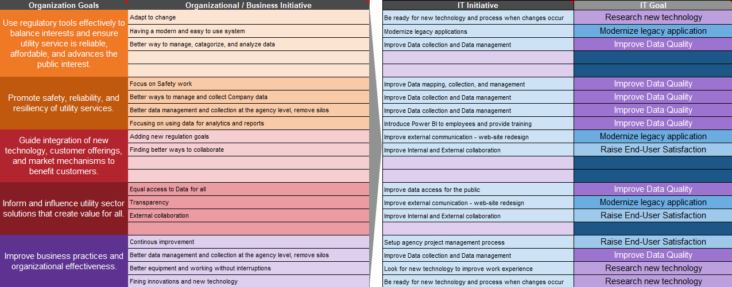
IT will enable all organization projects
1a
Notes:
Done

Slide 11
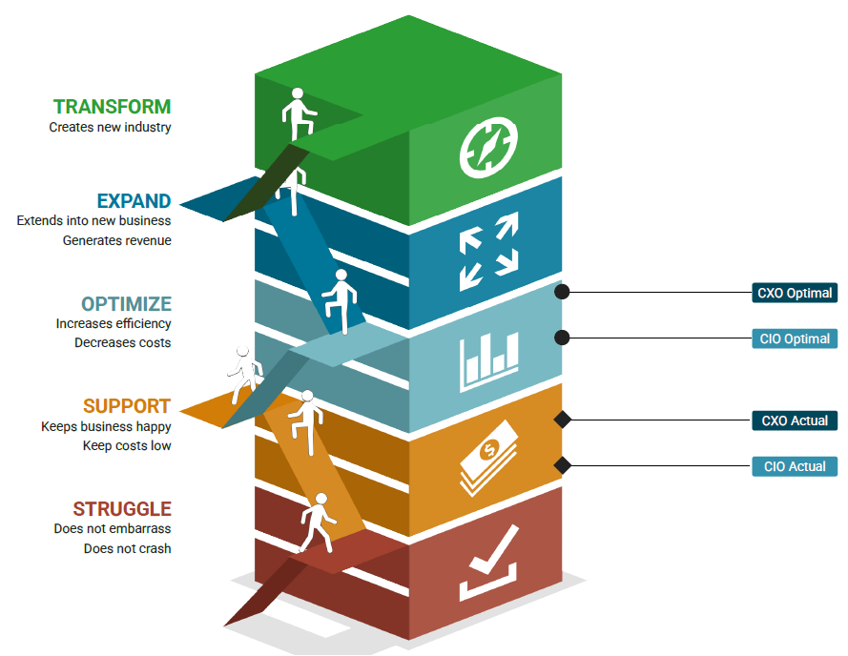
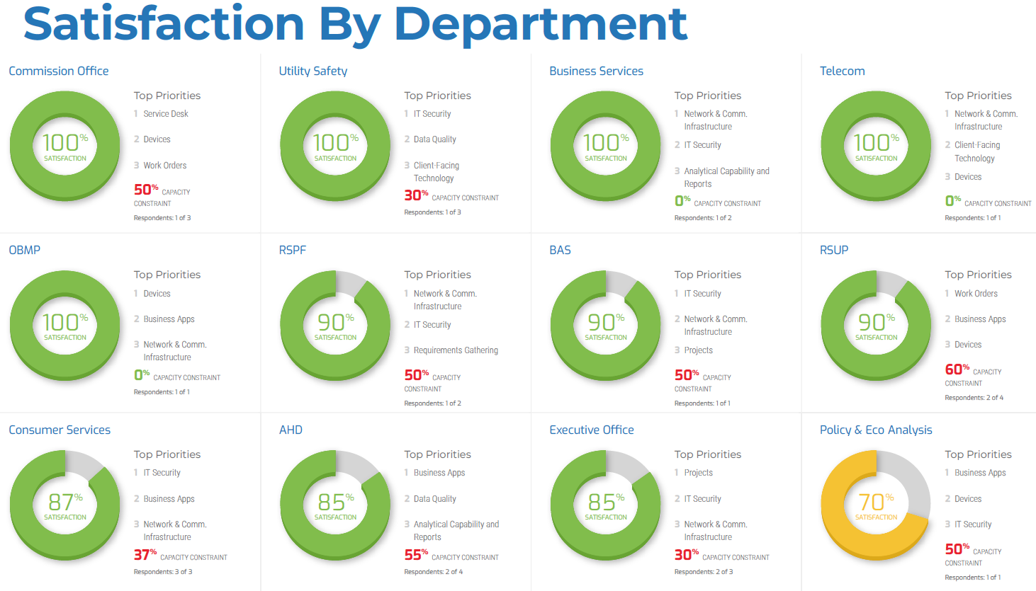
IT’s target is to attain Optimize status
1b
Stakeholder management is a critical aspect of running a successful IT department. IT’s most important and impactful metric to gauge our success is stakeholder satisfaction. IT is dedicated to understanding and improving stakeholder satisfaction across the organization.
*Source: Diagnostic analysis
of CXO-CIO Alignment report
and Business Satisfaction
scores.
Notes:
Done

Slide 12
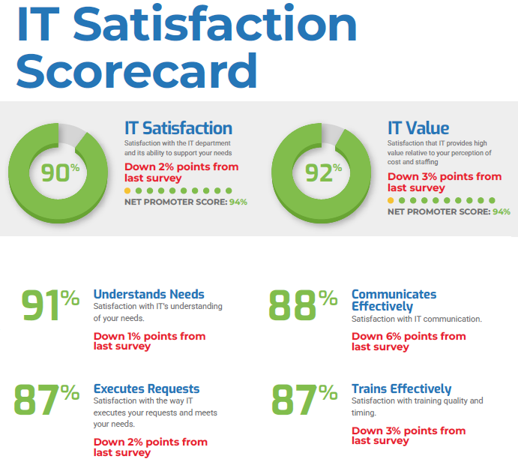
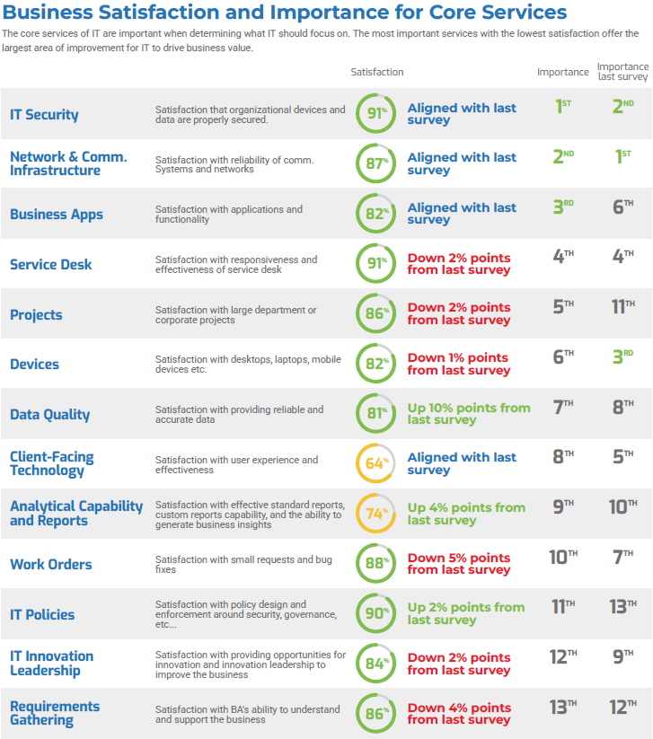
Improving IT’s maturity required a deeper understanding of our current state
1b
*Source: Diagnostic analysis
of Business Satisfaction
scores.
Notes:
Done

Slide 13
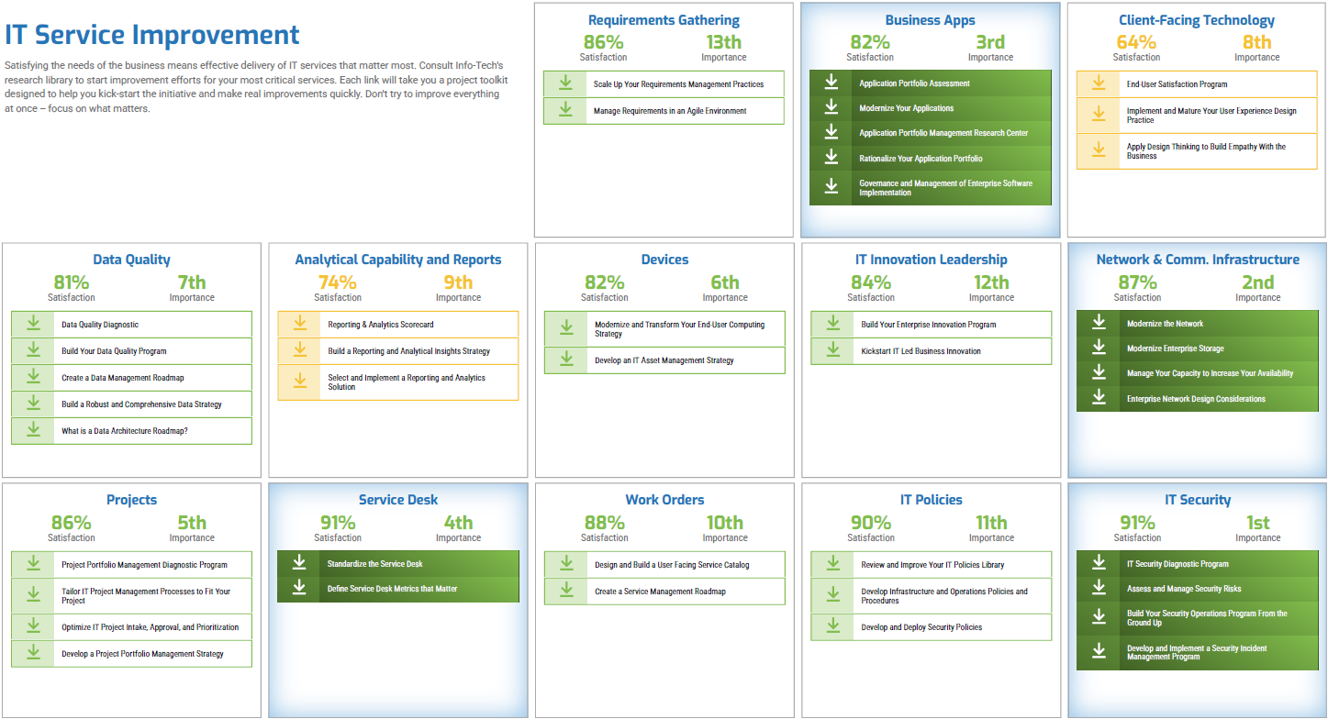
A focus on Analytical Capability and Reports and Client-Facing Technology will help us achieve the Optimize status
1b
Our Stakeholder Satisfaction Assessment* indicated that Analytical Capability and Report and Client-Facing Technology are extremely important IT services that our business stakeholders are not satisfied with these key IT capabilities. This is the same message from the previous year’s survey result. We will continue with the following two projects to our Key Initiative Plan:
Public Web-site Update
Power BI
*Source: Diagnostic analysis
of Business Satisfaction
scores.
Notes:
Done

Slide 14
A focus on data quality and business intelligence
Sample Department X Data
1b
IT Initiatives
High
Improve Data mapping, collection, and management
Our Stakeholder Satisfaction Assessment* indicated that Client-Facing Technology and Analytics are extremely important IT services that our organization stakeholders are not satisfied with these key IT capabilities. We will add two projects to our Key Initiative Plan:
High Priority | Maintain
Low Priority | Low Priority
Client-Facing Technology
IT Security
Analytical Capability & Reports
Network & Comm. Infrastructure
Improve external communication - web-site redesign
Importance
IT Policies
Introduce Power BI to employees and provide training
Work Orders
*Source: Diagnostic analysis
of Business Satisfaction
scores.
Low
Satisfaction
High

Slide 15
In summary, IT identified 7 major initiatives to support the business
Modernization
1a
Modernize legacy applications
Improve Data collection and Data management
Improve Data mapping, collection, and management
Improve Internal and External collaboration
Improve data access for the public
Improve external communication - web-site redesign
01
Business Support Initiatives
Become a Business Partner
1b
Introduce Power BI to employees and provide training
Notes:
Done

Slide 16
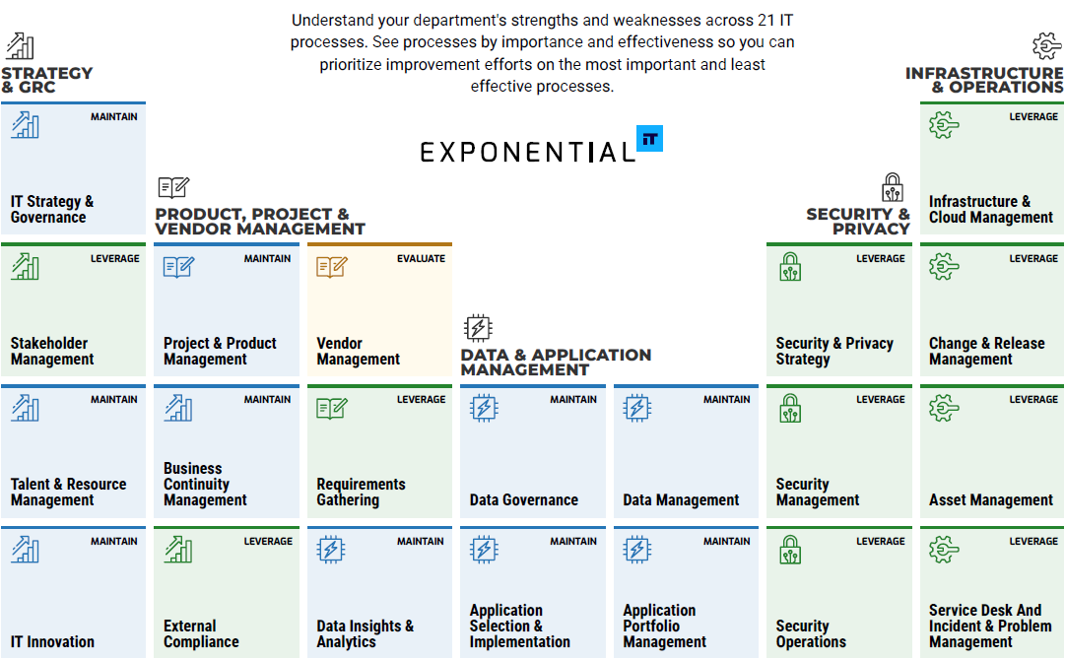
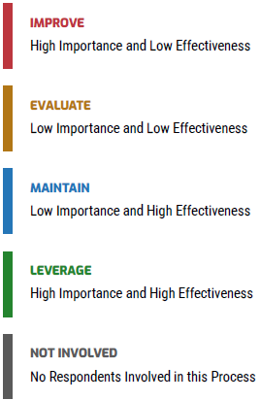
Analyzing diagnostic data helped us identify one low-maturity IT processes to focus on in 2023-25
2
02
*Source: Diagnostic analysis of
IT Management & Governance Diagnostic
scores.
Notes:
Done

Slide 17
Addressing low-maturity processes requires process, technology, and organization-related initiatives
02
IT Initiatives
High
 | Maintain
Low Priority | Low Priority
High Priority
Complete and communicate an IT strategy
Vendor Management
Security Management
Infrastructure & Cloud Management
Importance
Implement Asset management System
IT Innovation
Semi-annual meetings with sections to discuss challenges
Low
Effectiveness
High
*Source: Diagnostic analysis of
IT Management & Governance Diagnostic
scores.
Notes:
Done

Slide 18
In summary, IT identified 3 major initiatives to maintain & improve IT excellence and reduce risk
Core IT Process Initiatives:
02
Complete and communicate an IT strategy
Implement Asset management System
Semi-annual meetings with sections to discuss challenges
IT Excellence
Notes:
Done

Slide 19
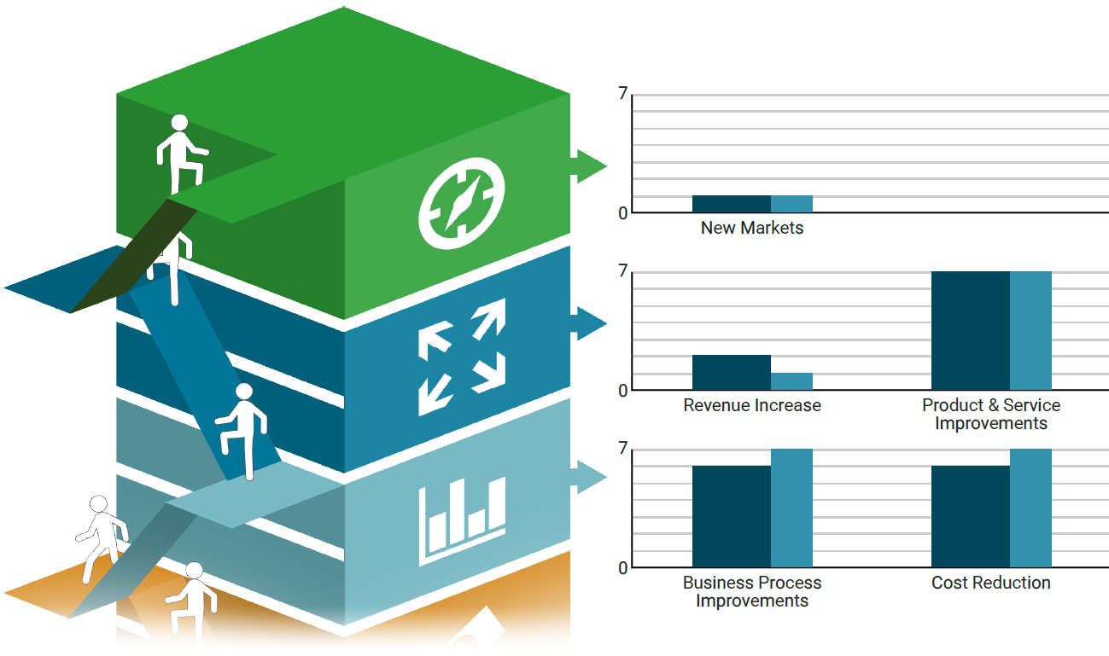
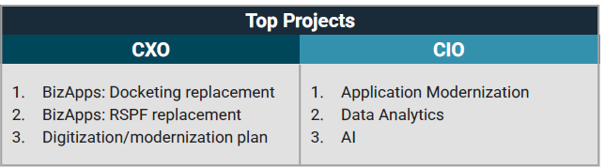
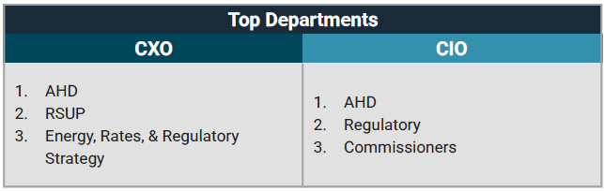
CEO-CIO Alignment
03
Notes:
Done

Slide 20
IT identified specific use cases that will align with the CEO
03
High
Medium Priority
High Priority
Digitize Physical Documents
Modernize Legacy Applications
IT Initiatives
Value
Legacy Application Replacement
Low Priority
Low Priority
Digitize Order Books
Low
Potential to Automate
High
Research New Technology
*Source: Diagnostic analysis of IT Management & Governance Diagnostic scores.
Notes:
Done

Slide 21
To drive technology innovation, we focused on CEO and CIO alignment that will have the most impact for Oregon Public Utility Commission
Drive Technology Innovation:
Legacy Application Replacement
Digitize Order Books
Research New Technology
03
Innovation
Notes:
Done

Slide 22
2023-25 IT Goals & Operational Strategy
This section includes
Five-Year IT Roadmap
Five-Year IT Goals
Five-Year IT Metrics & IT Performance Management Goals
Five-Year IT Organization & Proposed Changes
Five-Year IT Budget & Proposed Changes
Next Steps & Refresh Strategy
Communication Plan
Business Value Matrix
Notes:
Done

Slide 23
Our key IT initiatives will result in a Five-Year roadmap to success
 | Customer Support |  | 2025 | 2026 | 2027 | 2028 | 2029
Business Support | Business Support
1 | Modernize legacy applications
2 | Improve Data collection and Data management
3 | Improve Data mapping, collection, and management
4 | Improve Internal and External collaboration
5 | Improve data access for the public
6 | Improve external communication - web-site redesign
7 | Introduce Power BI to employees and provide training
IT Excellence | IT Excellence
8 | Complete and communicate an IT strategy
9 | Implement Asset management System
10 | Semi-annual meetings with sections to discuss challenges
Innovation | Innovation
11 | Legacy Application Replacement
12 | Digitize Order Books
13 | Research New Technology
Notes:
Done

Slide 24

IT’s key initiative plan comprises 13 initiatives to helps us achieve four main IT goals
Key IT initiatives
Modernize legacy applications
Improve Data collection and Data management
Improve Data mapping, collection, and management
Improve Internal and External collaboration
Improve data access for the public
Improve external communication - web-site redesign
Introduce Power BI to employees and provide training
Complete and communicate an IT strategy
Implement Asset management System
Semi-annual meetings with sections to discuss challenges
Legacy Application Replacement
Digitize Order Books
Research New Technology
Create a plan to modernize all legacy applications and improve User Interface for external facing applications.
Modernize Legacy Application
Data is the foundation of all analytical work at the PUC. We will focus on making high-quality, trustworthy information readily available to the agency.
Improve Data Quality
The current IT satisfaction rating is 90% for 2024. We can always improve on this score. Technology can be used to improve business processes and make employees’ lives easier. We plan to provide better communication to our customers.
Raise End-User Satisfaction
Technology is integrated to everything we do today. We need to replace our legacy applications and offer better technology to our end users.
Research New Technology
Notes:
Done

Slide 25
Progress towards IT goals will be judged against projected targets for three key metrics
Metric
Target
100%
Modernize legacy application
Identify all legacy applications and create modernization plan for each application
Create plan for 100% of the agency’s legacy applications by the end of 2026
100%
Follow industry best practice to inventory all PUC data
Identify 100% of the agency data and ensure by the end of 2026
Improve Data Quality
90%
Raise End-User Satisfaction
Overall stakeholder satisfaction
Increase CIO BV satisfaction scores from 90% to 94% for 2025
Research New Technology
Offer new technology to our employees
Digitize 100% Order Books by the end of 2027
100%
Notes:
Done

Slide 26
IT will require resources to deliver the follow key IT initiatives
Key IT initiatives
Modernize legacy applications
Introduce Power BI to employees and provide training
Digitize Order Books
Resource Addition Requirements
External contract and project management
External training
1 temporary employee, purchasing equipment
--
--
--
--
--
--
Functional Area of IT
Application Development
--
--
--
--
--
--
--
--
Notes:
Done

Slide 27
Next steps & refresh strategy
IT Planning
Plan Update
Finalize
We will put a process in place to review the IT strategy that makes us proactive to deal with any changes to the business’ strategy or direction.
Mar
May
Jun
Jul
Nov
Dec
Business Context Discovery
Review Approval & Revise
Survey Feedback
AUDIENCE
SCOPE
DATE
PUC leadership team
Resurvey, review/ validate, update schedule
IT is dedicated to frequent touch points throughout the year to ensure the strategy team and all stakeholders are on the same page about any changes or updates regarding strategic initiatives.
ANNUALLY
Nov. 2026
IT Planning
IT team
Status update, risks/ constraints, priorities
May. 2026
Finalize
IT leadership
Full planning
Dec. 2026
Notes:
Done

Slide 28
Communicating the IT Strategy
Audience | What | Mode Options | Owner | Timing
PUC Leadership | IT Strategy (final, full) | Meeting | Executive Director | Nov. annually
Executive Director | IT Strategy (final, full) | Meeting | CIO | Oct. annually
COO | IT Strategy (final, full) | Meeting | CIO | Oct. annually
All IS Staff | IT Strategy (draft, full) | Meeting | CIO | May. annually
PUC Employees | IT Strategy (summary) | Intranet | CIO | Nov. annually
EIS | IT Strategy (final, full) | Email submission | CIO | Dec. annually
Notes:
Done

Slide 29
2023-25 Accomplishments: PUC IT Success & Business Value Created
Outward
Value
External to IT
Stakeholders reach
Operational efficiency
Intune Migration
Project Valence
Agency Move
Setup SSO for multiple applications
Project Phoenix
Retiring Physical Servers
Created AI Usage Guide
Laptop Replacement
Semi-Annual challenge discovery
Improved
Capabilities
Network Equipment Upgrade
Financial Benefit
Service Enablement
Cost Reduction
RSPF Business Process Mapping
Implemented Network Monitoring
Migrated SCCM Server
Financial
Benefit
Employee ID sync with AD
Internal to IT
Inward
Value
Notes:
Done

Slide 30
Annual Progress Report
We set three goals in 2023:
Number | Goals | Result
1 | Identify and create plan for 100% of the agency’s legacy applications by end of 2024. | We identified 100% of the agency’s legacy applications. However we did not create plans to modernize these legacy applications.
2 | Identify 100% of the agency data and ensure at least 50% of the data is high quality by end of 2024. | With shifting priorities, we did not get a chance to identify the agency’s data nor had a chance to ensure the data is of high quality.
3 | Increase CIO BV satisfaction scores from 93% to 94% for 2024 | Our satisfaction score dropped from 93% to 90%. However, we are still 14% above industry average. Industry being State government.
We also had 9 IT initiatives identified:
Number | Goals | Result
1 | Website redesign for better transparency. | Due to shifting priorities, we have not started this initiative in 2024.
2 | Digitizing physical documents. | Due to shifting priorities, we have not started this initiative in 2024.
3 | Bring in new technology to meet business needs | We deployed a network monitoring tool, Elastic, implemented InTune for Mobile Device Management, and upgraded 60% laptops.
4 | Legacy application modernization. | We signed a contract with a vendor to upgrade our legacy business application Oct. 2024.
5 | Provide IT training on productivity applications. | We worked with Microsoft to create a training plan on M365 products. The training is scheduled for late 2025.
6 | Improve IS project intake and management process | Due to shifting priorities, we have not started this initiative in 2024.
7 | Job Shadow to understand business processes. | We started semi-annual meetings with our employees to talk about challenges and how technology could automate portions of their daily work.
8 | Improve data inventory and management. | Due to shifting priorities, we have not started this initiative in 2024.
9 | Enable Power BI. | We enabled Power BI licenses and installed Power BI desktop client for all employees.
Notes:
Done

