Slide 1
Oregon Racing Commission
Secretary of State (SOS) Audit Recommendations and Updates

Slide 2
1. Add requirement(s), either in policy or rule to evaluate, new and changes to, game and wagering operations to ensure there is no conflict with state constitution and statute
SOS Audit Recommendations to the ORC

Slide 3
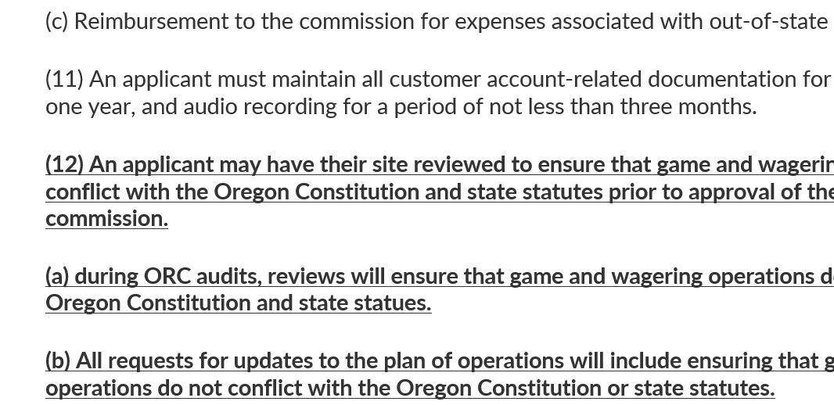
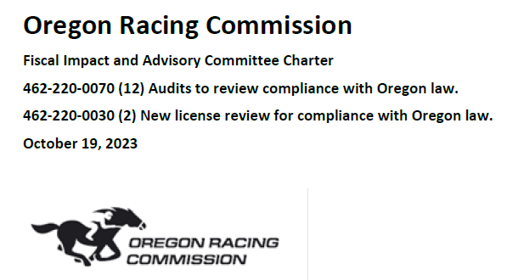
Two rule amendments have been drafted by the staff.
The commission has approved ORC Staff to begin rule making.
A Fiscal & Advisory Committee has been formed and are scheduled to meet and the rules will be filed accordingly.
Rules were reviewed both by DOJ and the SOS Auditing team.
Continuous annual review of process and rules

Slide 4
In addition, the Assistant Attorney General at the Department of Justice has been directed on our behalf to assess and confirm that the current licensees comply with Oregon statutes and the constitution.
Since the release of the SOS audit, we have had four meetings with our Assistant Attorney General (AAG) on this subject.

Slide 5
2. Enhance rules and develop policies and procedures for allocating and reviewing the use of Alternative Deposit Wagering hub funds.
SOS Audit Recommendations to the ORC

Slide 6
Soon after the new Director started, efforts began to correct the lack of accountability and documentation that was required for the non-fair meet hub fund distribution.
This included:
Immediate requirements for additional information on applications
Immediate scheduling and audit of the last fund distributions
Provided clear expectations that new rules and policies would be further developed
Before the SOS Audit was official, ORC Staff had already acted.

Slide 7
We have further filed an amendment to rules outlining our new requirements for hub fund accountability that is in process, including a fiscal advisory committee that will meet in a few weeks. In addition, we have created an audit assurance program and a robust application process.
Going Forward: Rules, Policies and Procedures

Slide 8
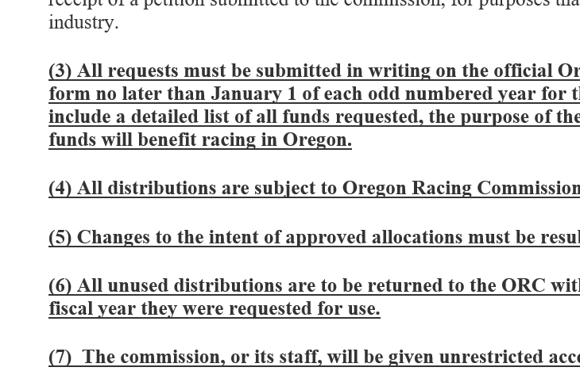
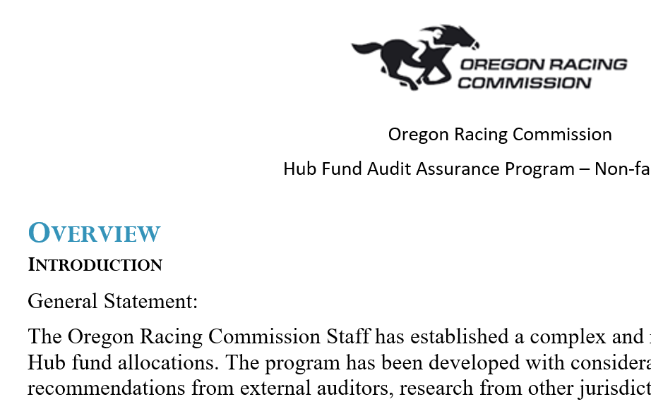
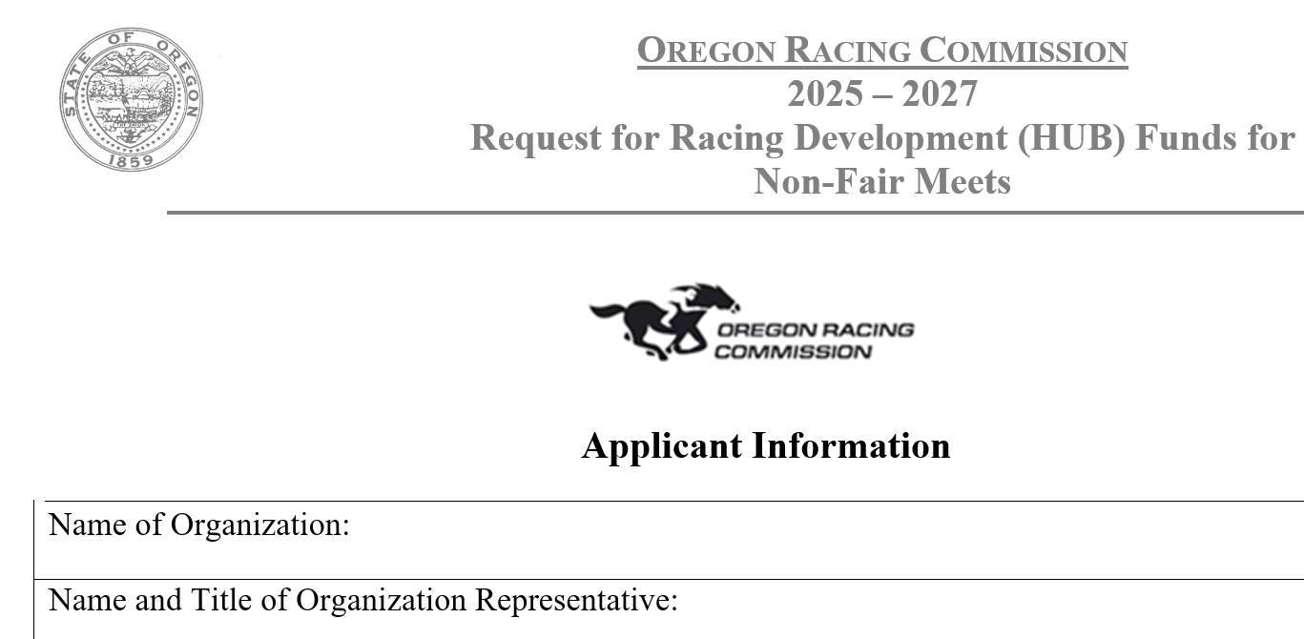
In addition to the rule changes ORC has:
Further increased requirements for the application
Developed an audit assurance program
Consulted with the SOS Audit Team and the Department of Justice to ensure we address all issues.

Slide 9
SOS Audit Recommendations to the ORC
3. Ensure commission meeting minutes provide clear and transparent communication approval detail, including attachments received by the commission to inform action approval.

Slide 10
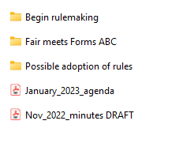
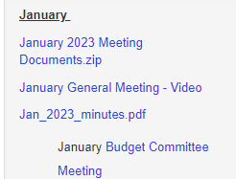
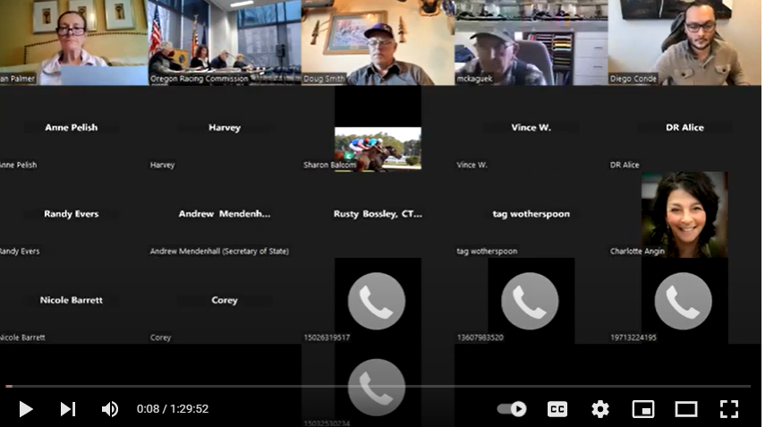
Beginning September of 2022, all attachments that were sent out to the commissioners were also sent to our distribution list of interested parties.
Beginning January of 2023, the ORC started posting:
Full meeting videos
Written materials (except for confidential documents as provided by law)
The approved written minutes

Slide 11
SOS Audit Recommendations to the ORC
4. Ensure documentation of its licensee reviews are maintained and safeguarded.

Slide 12
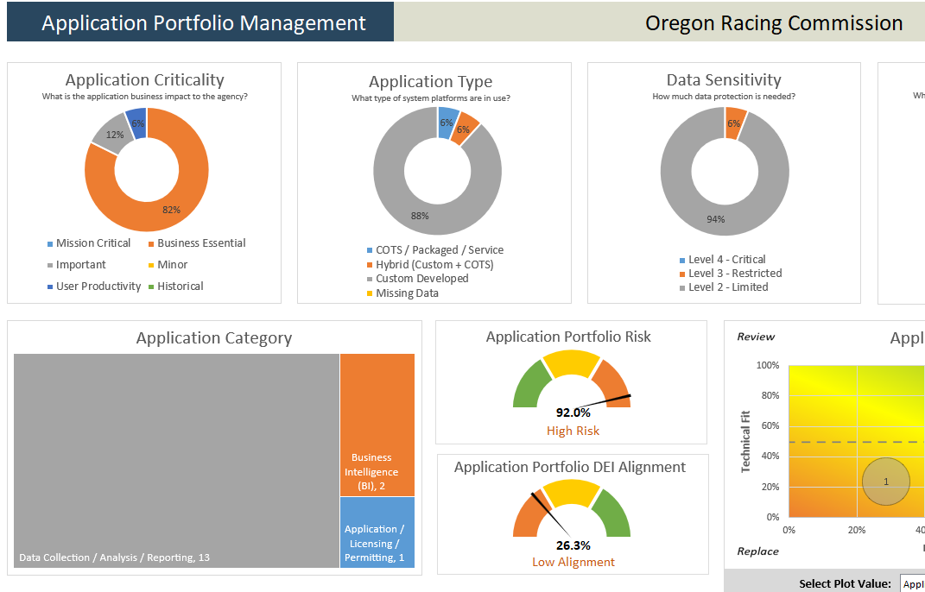
In addition, ORC has completed a technology strategic plan which includes further systems which would modernize this process.
In September, the ORC implemented a dual control storage system. The system requires all audit and sensitive documents that are not stored in other systems to be kept on two separate network drives for redundancy. This was a sufficient solution for the SOS Audit team.

Slide 13
A little more about the finding on documentation.
This finding was based on some of the historic horse racing annual checklists that were missing. The ORC does not take this finding lightly.
However, the auditing program ORC put together far exceeded any other jurisdiction at that time. No other jurisdiction used a similar checklist or had an independent audit assurance program.
The ORC will continue working towards improved documentation practices.

Slide 14
What do
we have?
Like all jurisdictions, the ORC used a third-party vendor to complete testing any time there was a change with the equipment, the software or any related technology. This included adding code to confirm that no additional changes had been made. All these reports have been maintained.
The ORC developed and used a comprehensive audit assurance program with expertise from Gaming Laboratories International (GLI). They are considered the gold standard.
We have maintained:
All GLI Audit reports
All the ORC Certification letters
All emails approving the verification of the code added to the programs with GLI for each machine
All third-party tote reports
All daily fee reports
All tax verification forms
For clarification, the SOS Audit stated they did not evaluate the Historic Horse Racing audit process that was used at Portland Meadows - not that it was unacceptable.

Slide 15
Questions?

