Slide 1
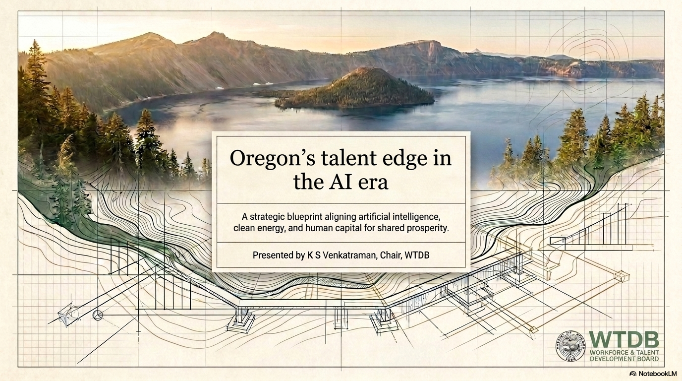

Slide 2
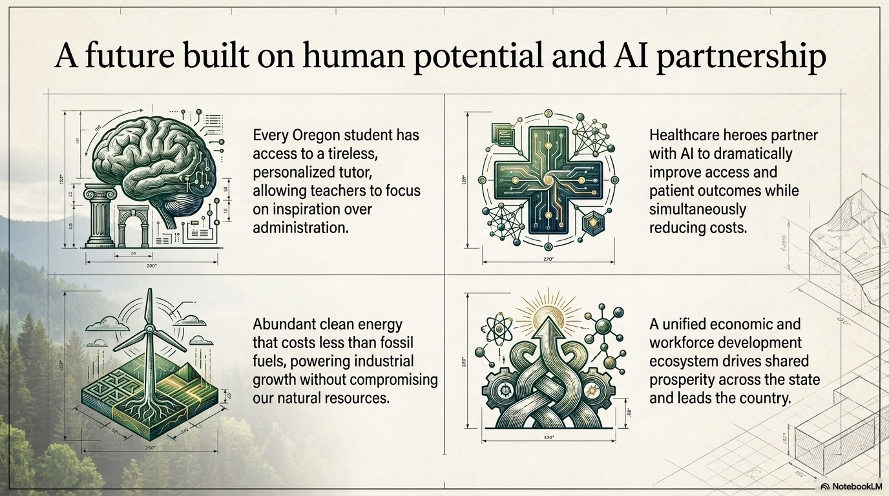

Slide 3
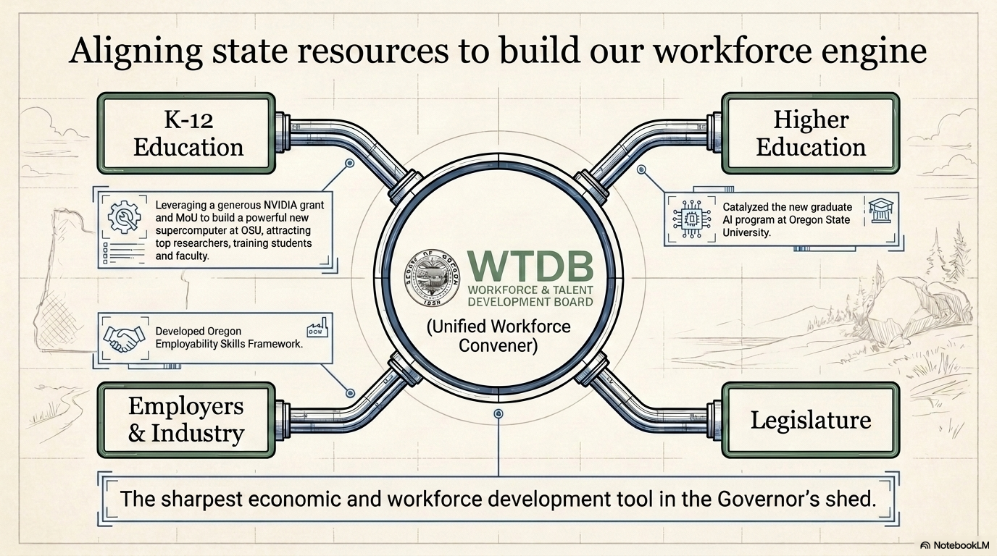

Slide 4
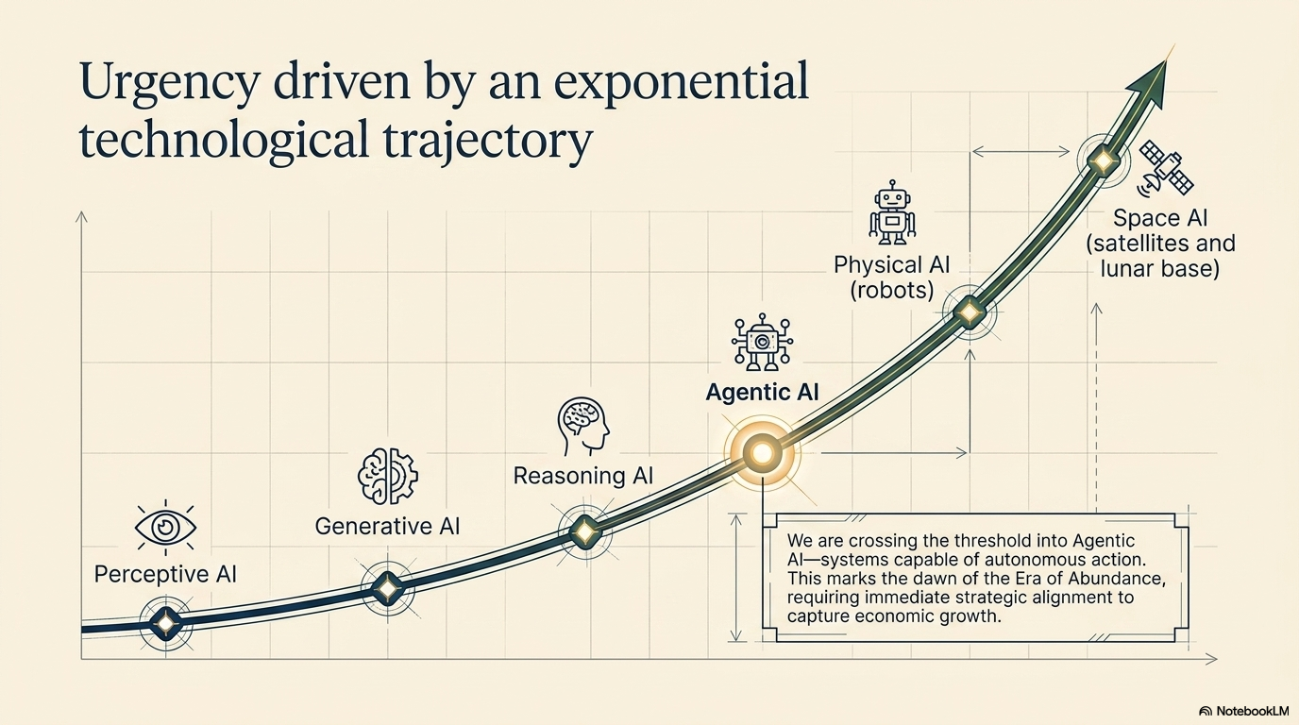

Slide 5
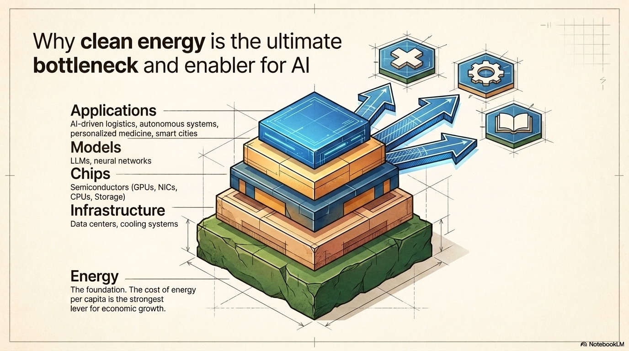
Notes:
lllllll

Slide 6
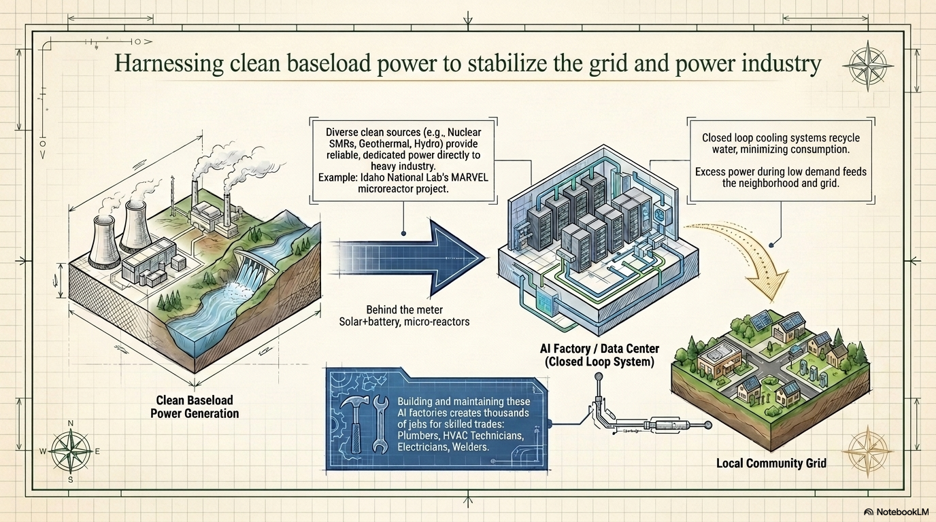

Slide 7
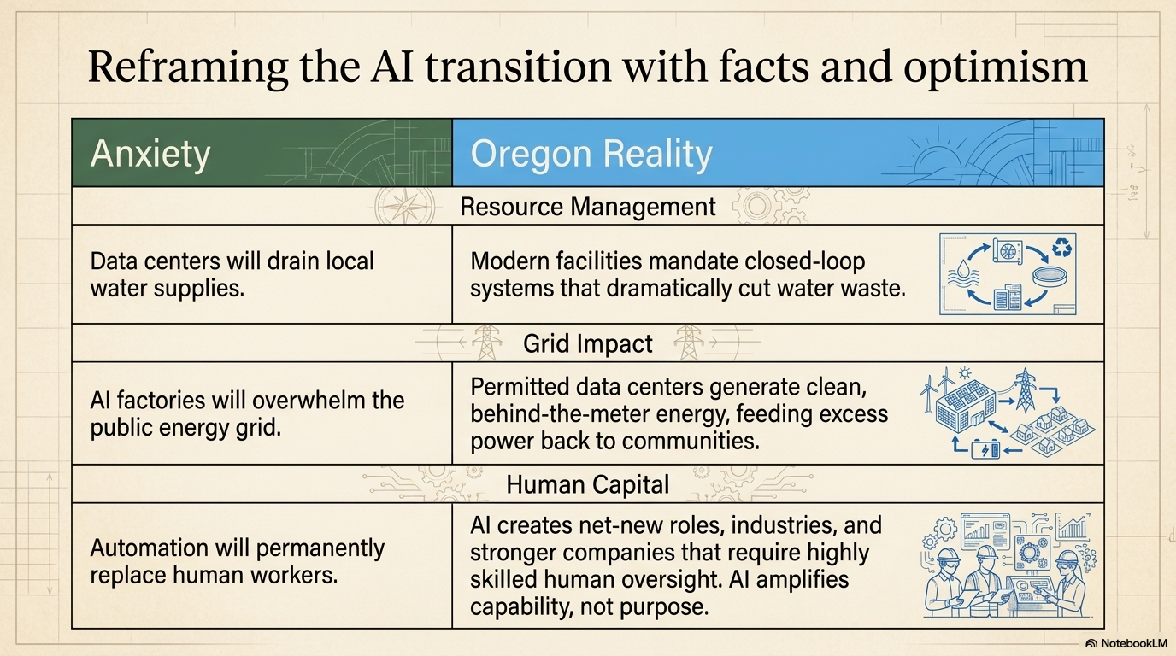

Slide 8
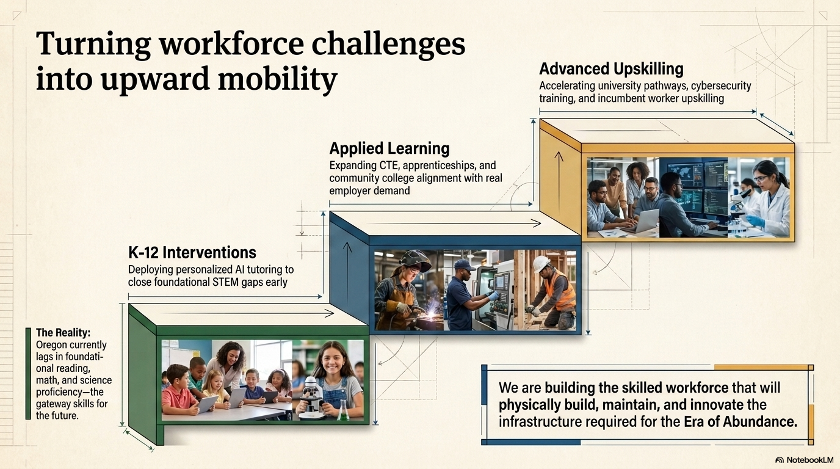

Slide 9
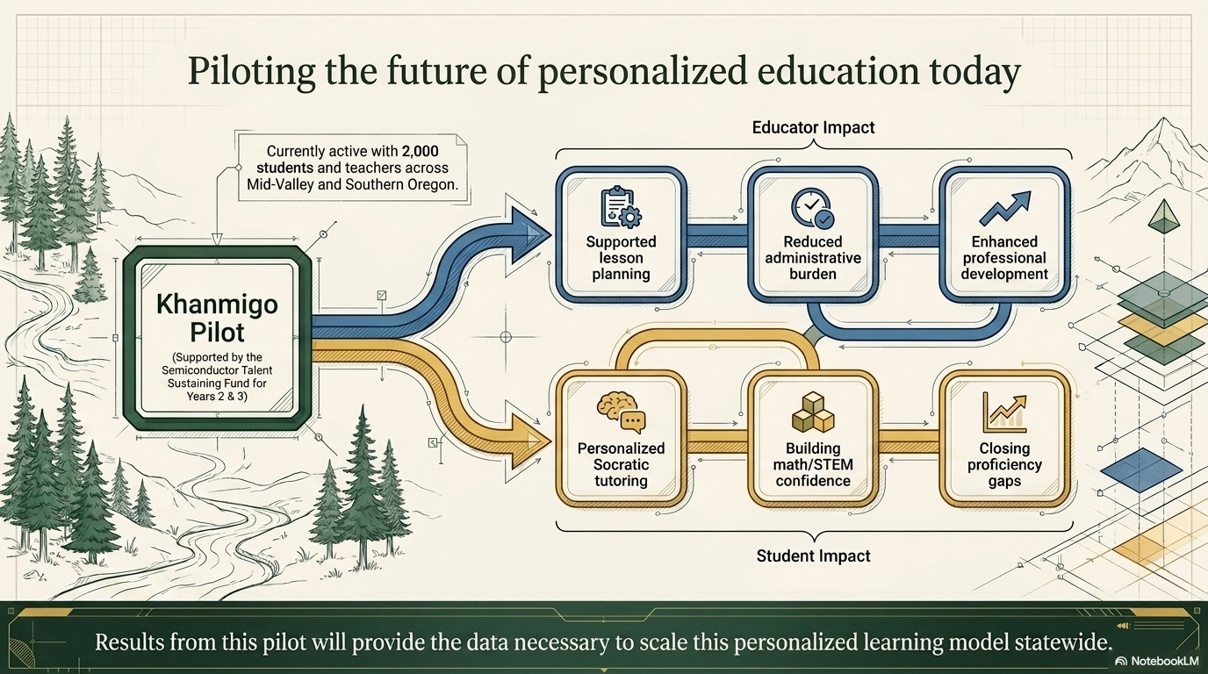

Slide 10
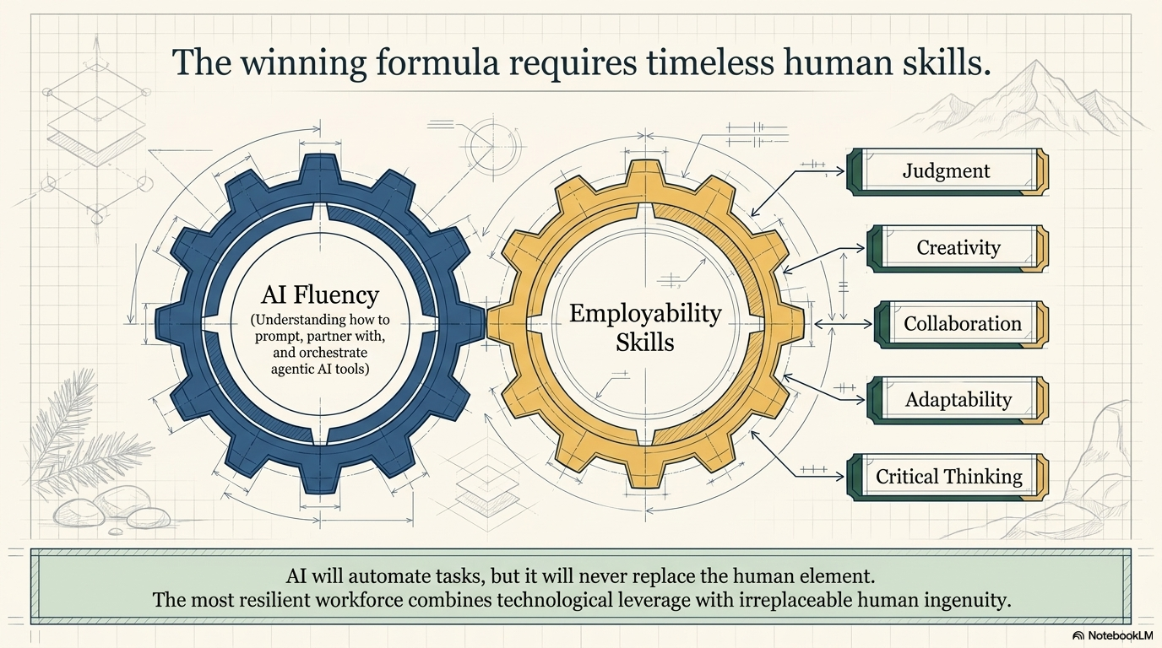

Slide 11



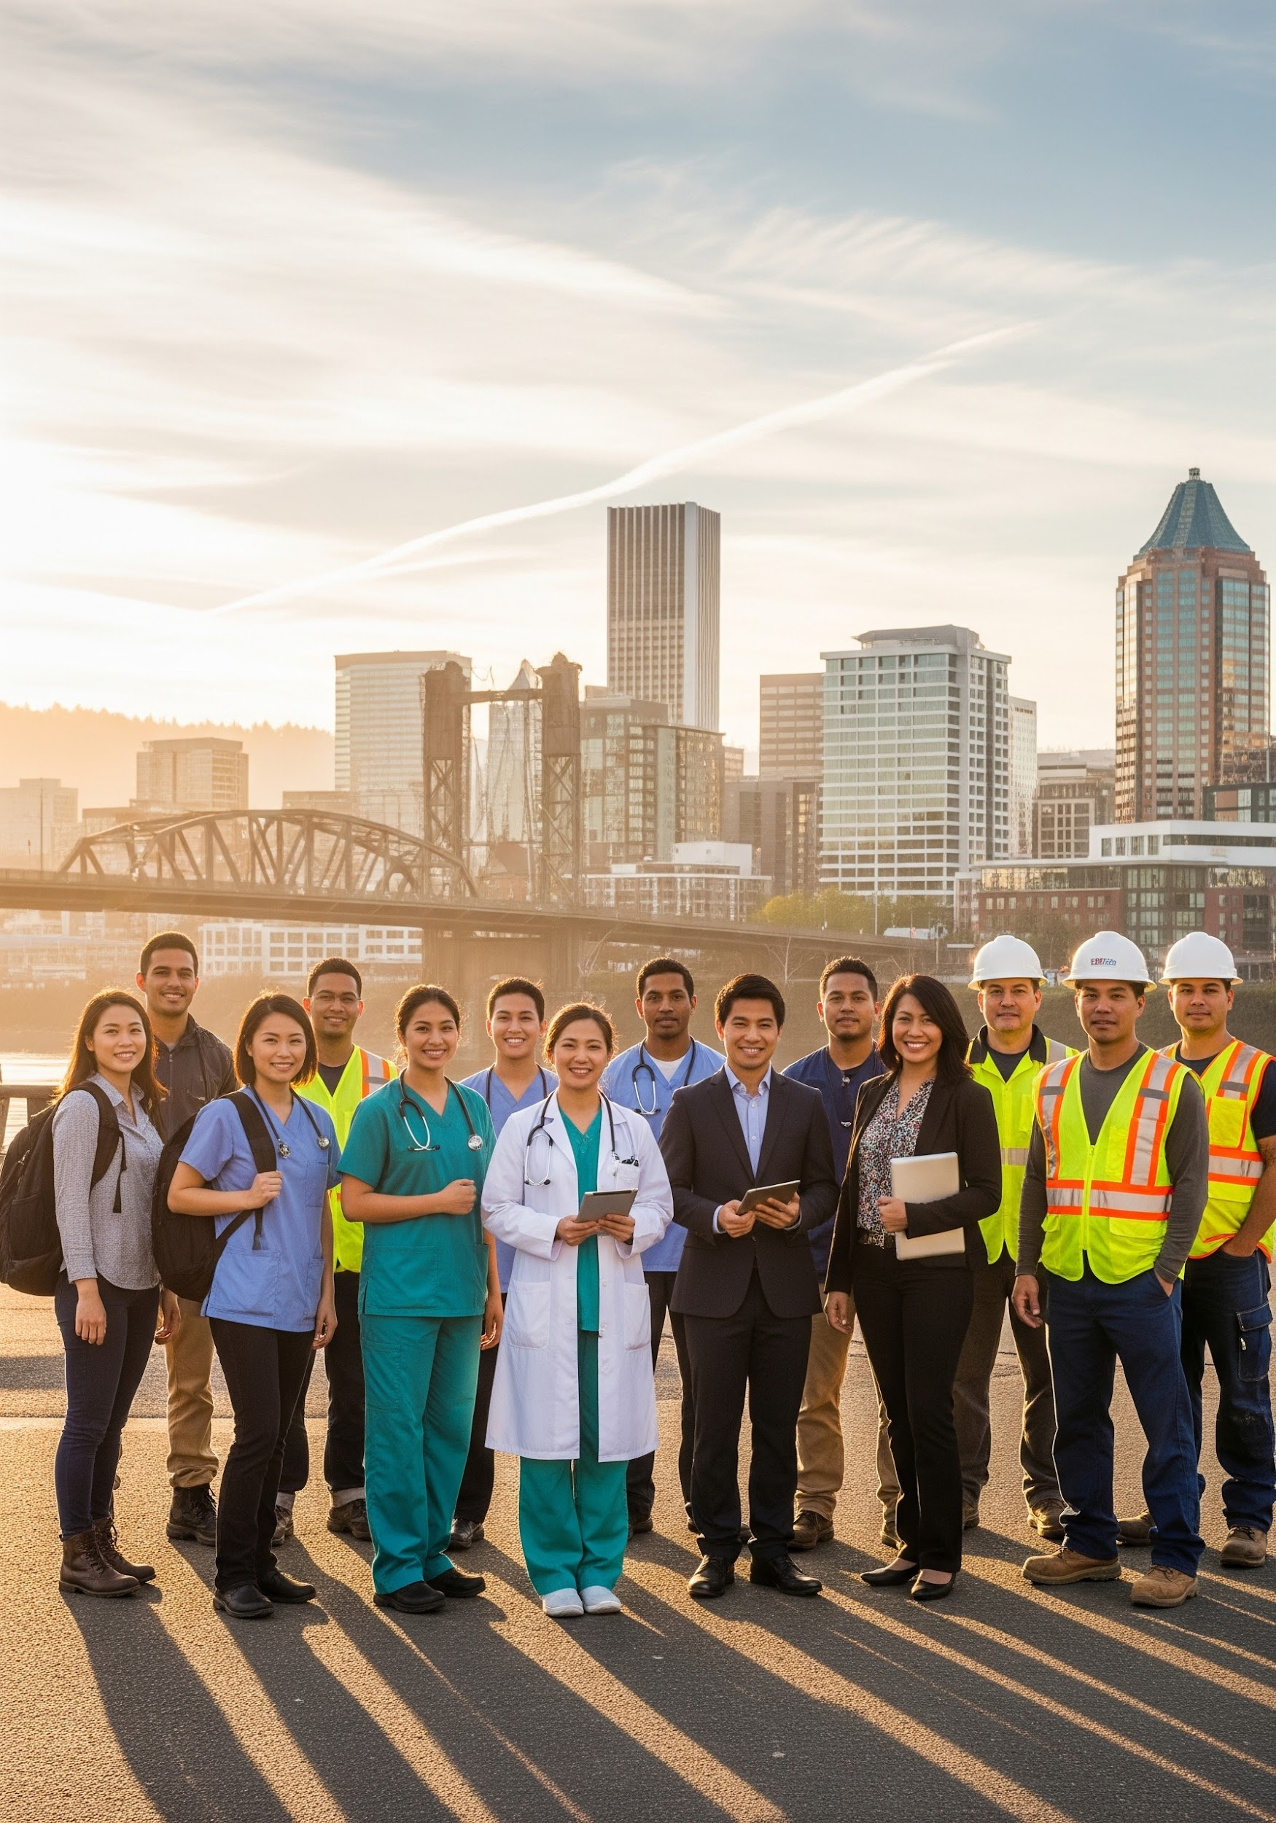
A once-in-a-generation opportunity
Embed AI fluency throughout the Talent pipeline, while doubling down on irreplaceable human skills.
Choose curiosity, courage, and collaboration over fear and overregulation that drives opportunity elsewhere.
Leverage the WTDB as the unified workforce and economic development coordinator across partners and restore our capacity to build towards prosperity.
"Oregon's best days are ahead, powered by our human talent and AI as our vehicle."

