Slide 1
Oregon’s Choice
Talent at a Crossroads

Slide 2
Two systems under strain. One uncertain future.
Oregon’s workforce challenges are usually framed as a pipeline problem.
But what we’re seeing is something more fundamental:
  Two core talent systems under strain—and a third force we don’t yet fully understand.

Slide 3
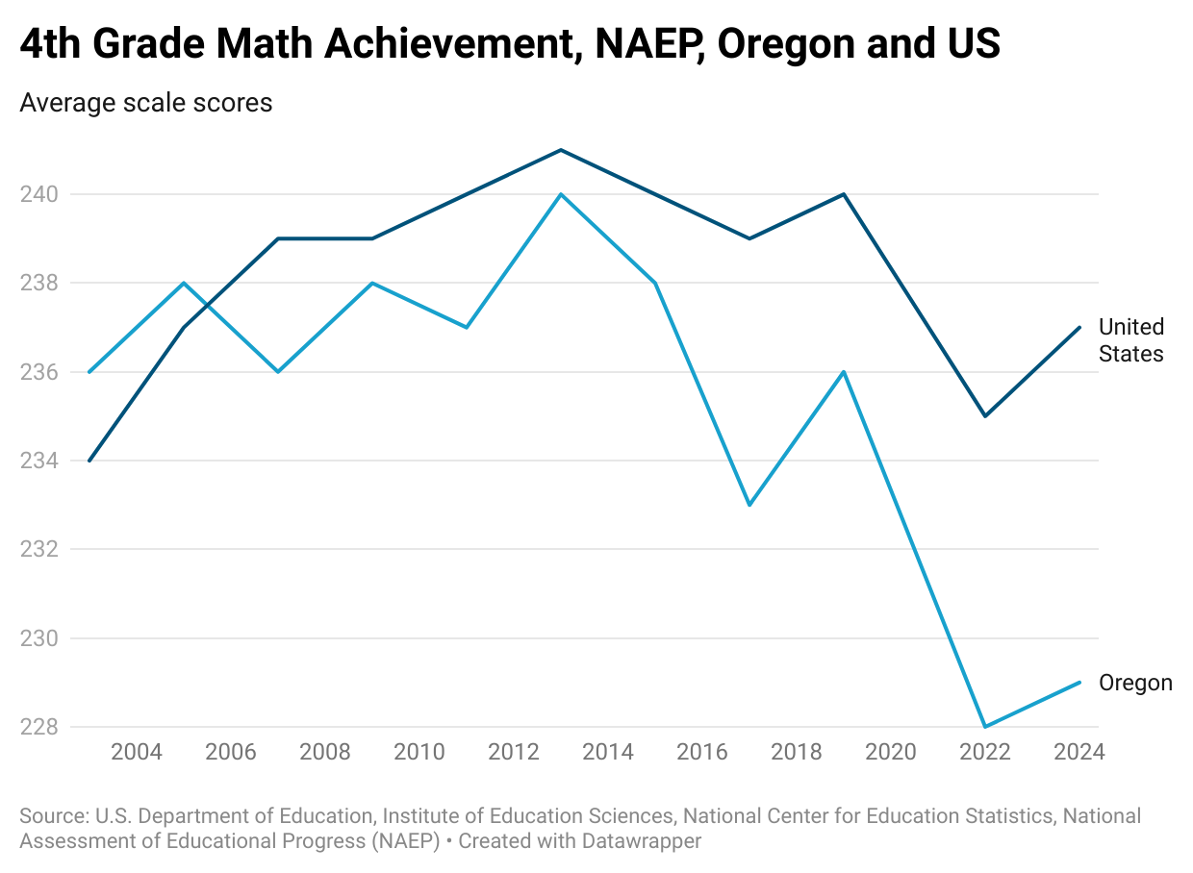
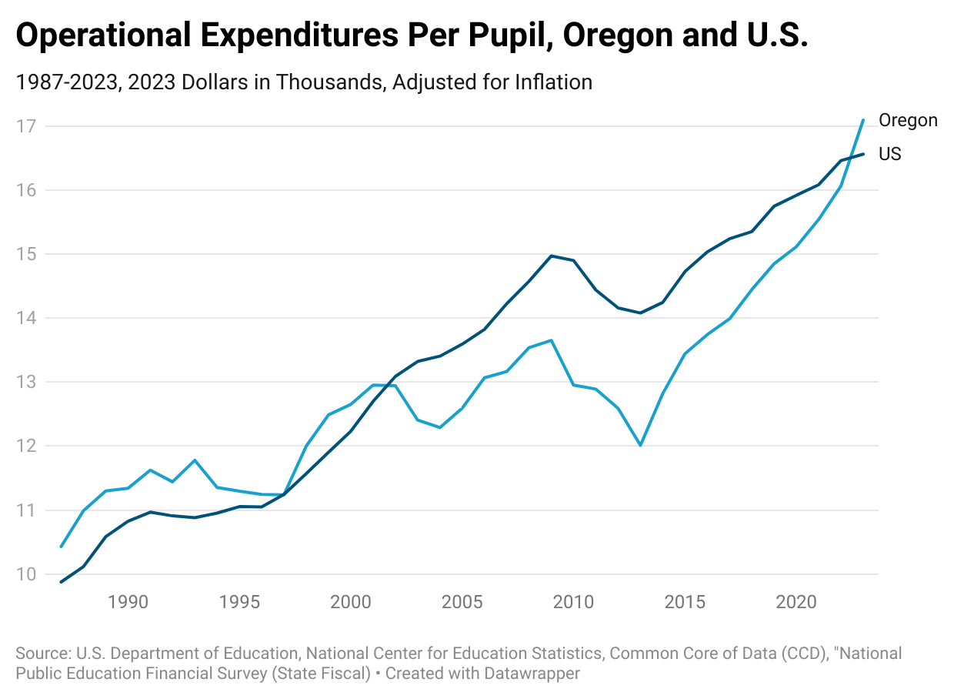
The K12 system isn’t working

Slide 4
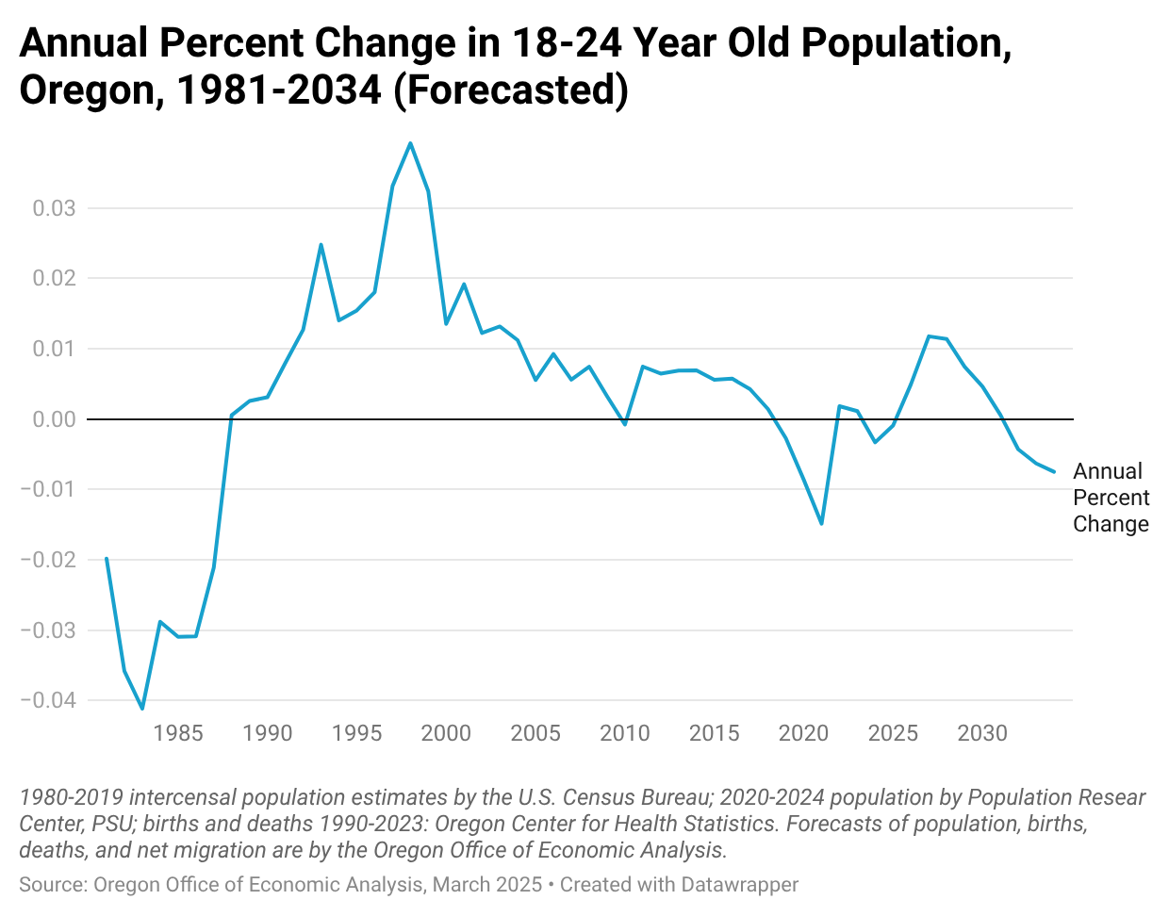
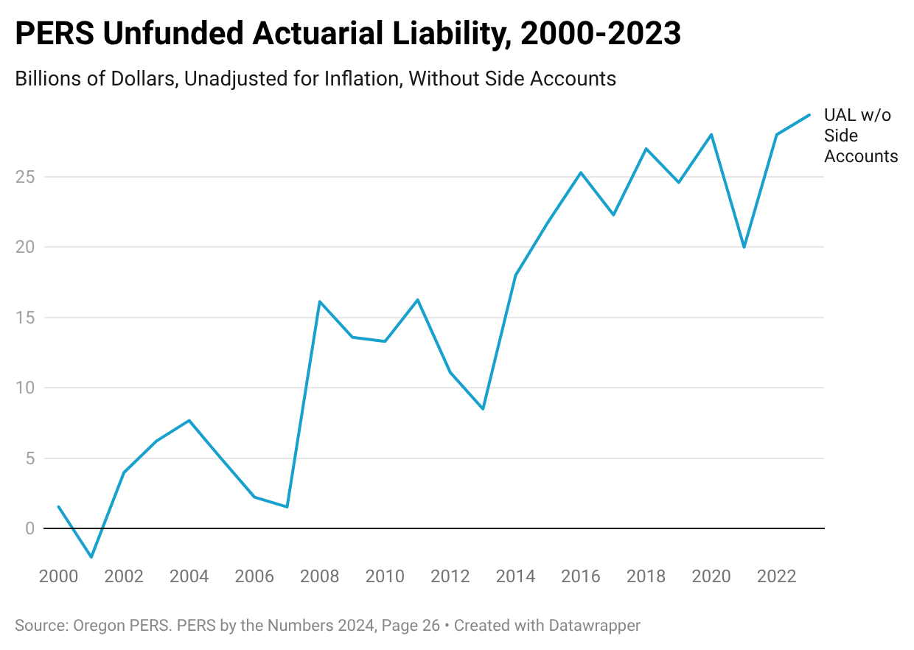
Higher education is in a vise

Slide 5
AI isn’t eliminating jobs, it’s closing the front door
Entry-level hiring is pulling back in AI-exposed sectors
Declines are driven by fewer hires—not layoffs
Impacts are concentrated among recent graduates and young workers
No clear rebound—early signs of a weaker pathway into work

Slide 6
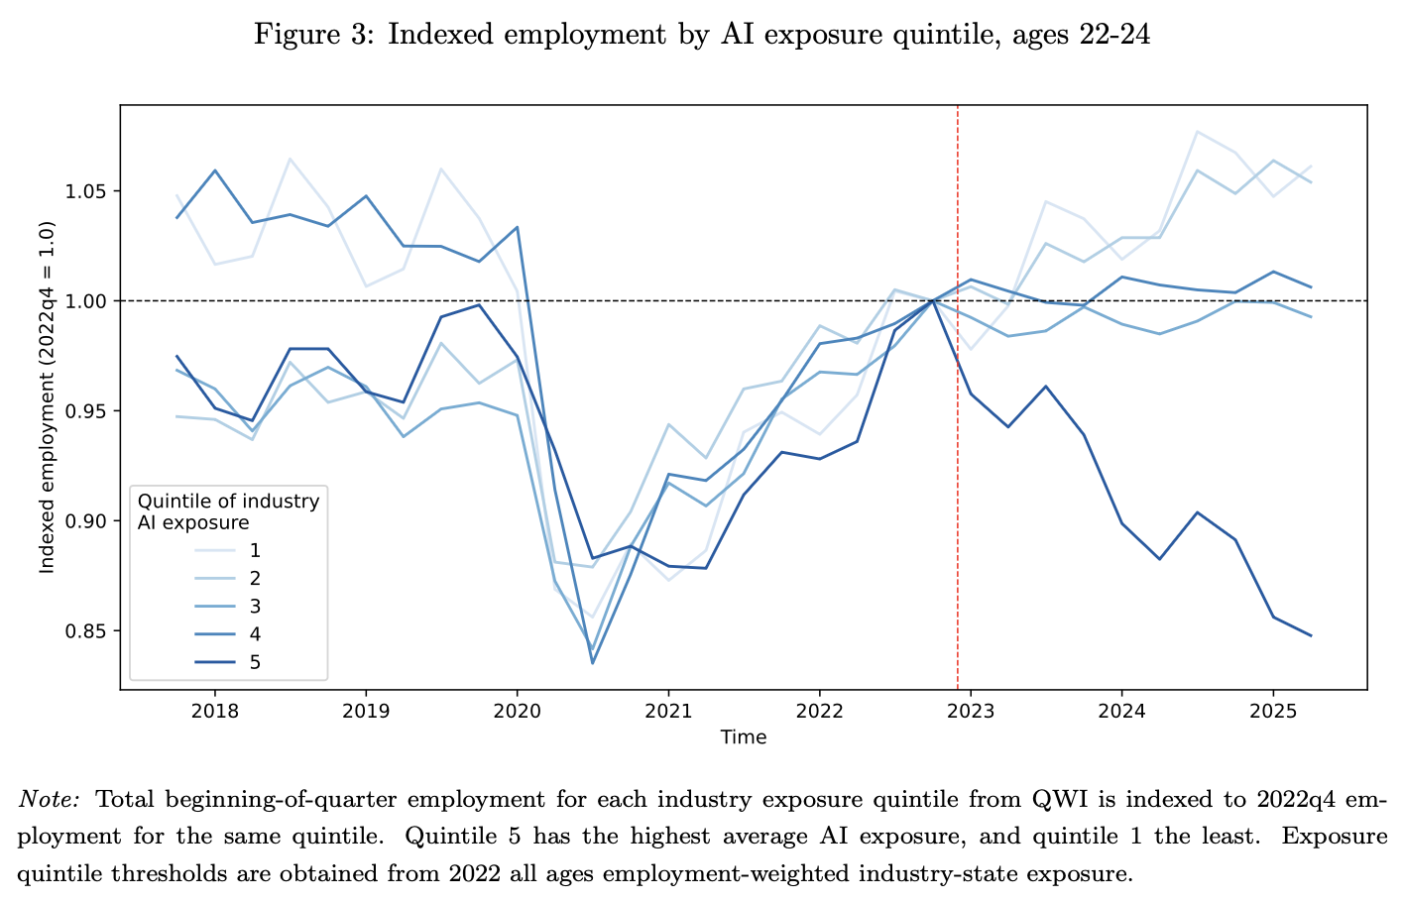
Fewer young workers in AI-exposed jobs
Source: U.S. Census Bureau, Center for Economic Studies
“You’re (not) hired: Artificial intelligence and early career hiring in the Quarterly Workforce Indicators” (CES Working Paper 26-27, April 2026)

Slide 7
AI threatens expertise more than jobs
Workers are paid for scarce expertise: coding, diagnosis, legal processes
AI can make the expertise abundant and less valuable
Disruption shows up through wage and roles, not unemployment
Source: David Autor, “How Is AI Shaping the Future of Work?”, Issues in Science and Technology, January 13, 2026

Slide 8
Two possible futures for work
Automation: weaker worker value
Augmentation: stronger worker capability
The future isn’t just predicted—it’s designed
Source: David Autor, “How Is AI Shaping the Future of Work?”, Issues in Science and Technology, January 13, 2026

Slide 9
Where to act
1. Rebuild the foundation (K–12)
Restore accountability
Test less, but better
Use the formula to incent time and attendance
2. Redesign higher ed for a new era
Move beyond efficiency plays to new delivery models
Build shorter, flexible, lower cost pathways
Align programs with industry-led talent consortia
Confront cost structure (PERS, healthcare)
3. Build parallel pathways into work
Apprenticeships and employer-led training
Technical and applied credentials
Faster, lower-cost entry points
4. Prepare for multiple AI futures
Invest in skills that complement AI, not compete with it
Focus on adaptability, not just credentials

