Slide 1


Oregon Talent Assessment
2026
May 2026

Slide 2
Project Success
Goal for the 2026 Talent Assessment: To build on past assessments with a focus on creating a more coordinated, data-driven, and adaptable workforce strategy across Oregon partners.
  The methodology for identifying in-demand industries and occupations is adopted for future biennial Assessments.
  Findings are rigorous and equity-aware, acknowledging methodological and data limitations.
  Recommendations are used in program design, funding allocations, and legislative testimony.
  The 2026 Talent Assessment strengthens Oregon’s ability to prepare residents for high-wage, high-demand, high-skill occupations.

Slide 3
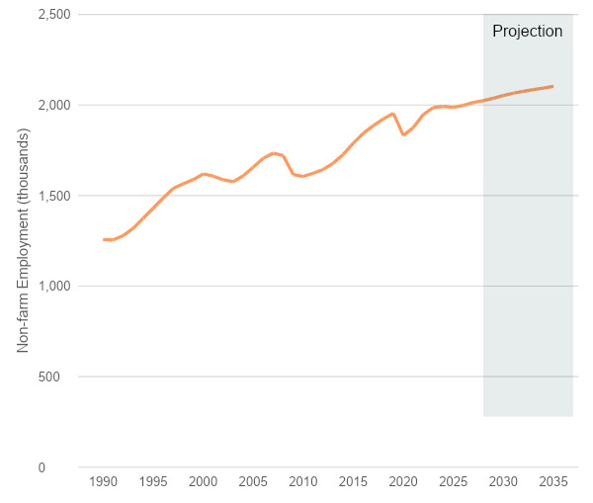
Context for this Assessment
Context
  Softening economic conditions
  Rising uncertainty
  Demographic strain
  Persistent inequities
  Workforce Pell

Slide 4

Components
Methodology development
Data analysis
Engagement
Outputs:
  In-demand sectors list
  Priority occupations list
  Report and recommendations

Slide 5
In-Demand Sectors

Slide 6
In-demand sectors
In-demand sectors will
  Support identification of focal occupations for the Assessment and for Workforce Pell eligibility
  Identify candidates for deeper sector-specific workforce studies
Collectively, the identified sectors will
  Reflect state and regional economic development priorities
  Include critical industries that support community and economic development not otherwise included
In-demand sectors are compiled from target sectors identified or supported by major state and regional entities and initiatives

Slide 7

In-demand sectors

Slide 8
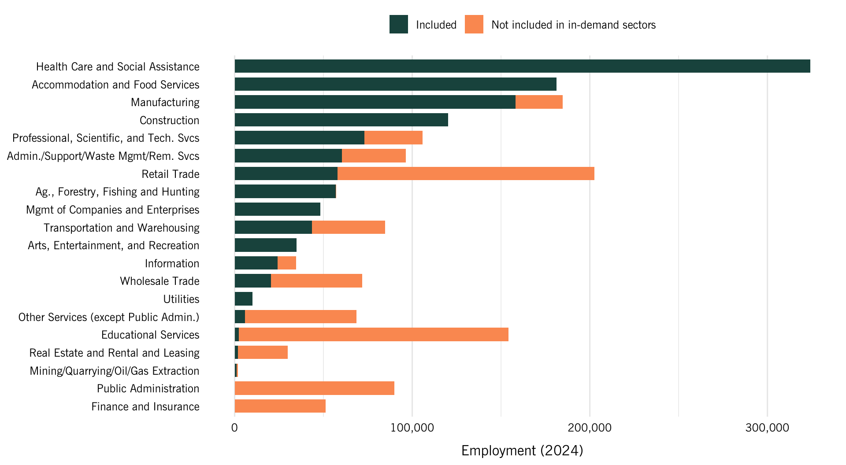
In-demand sectors

Slide 9
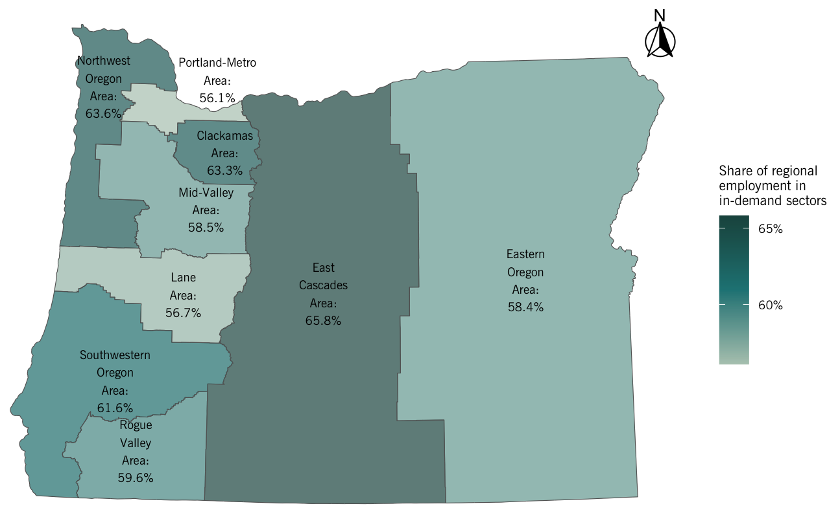
In-demand sectors: Geography

Slide 10
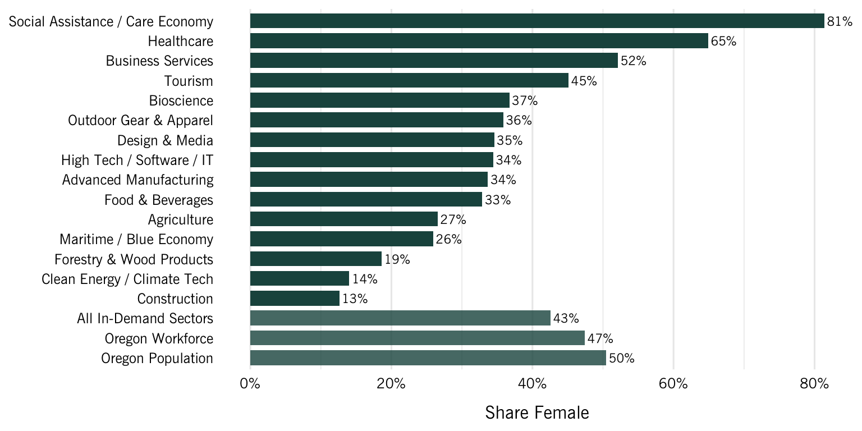
In-demand sectors: Workforce demographics

Slide 11
In-demand Sectors: Takeaways
Sector selection criteria are not always transparent
The same or similar sectors are not consistently defined across entities
Not all sectors are well-described by standard data sources

Slide 12
Priority Occupations

Slide 13
Priority occupations
Five criteria:
  In-demand: Projected openings
  High-wage: Median wage
  High-skill: Education/training requirements
  Growth potential: 75th and 25th percentile wages
  Industry critical: Prevalence within industry and expert input
Aligned with Workforce Pell
Additional criteria recommended to prioritize within the list

Slide 14
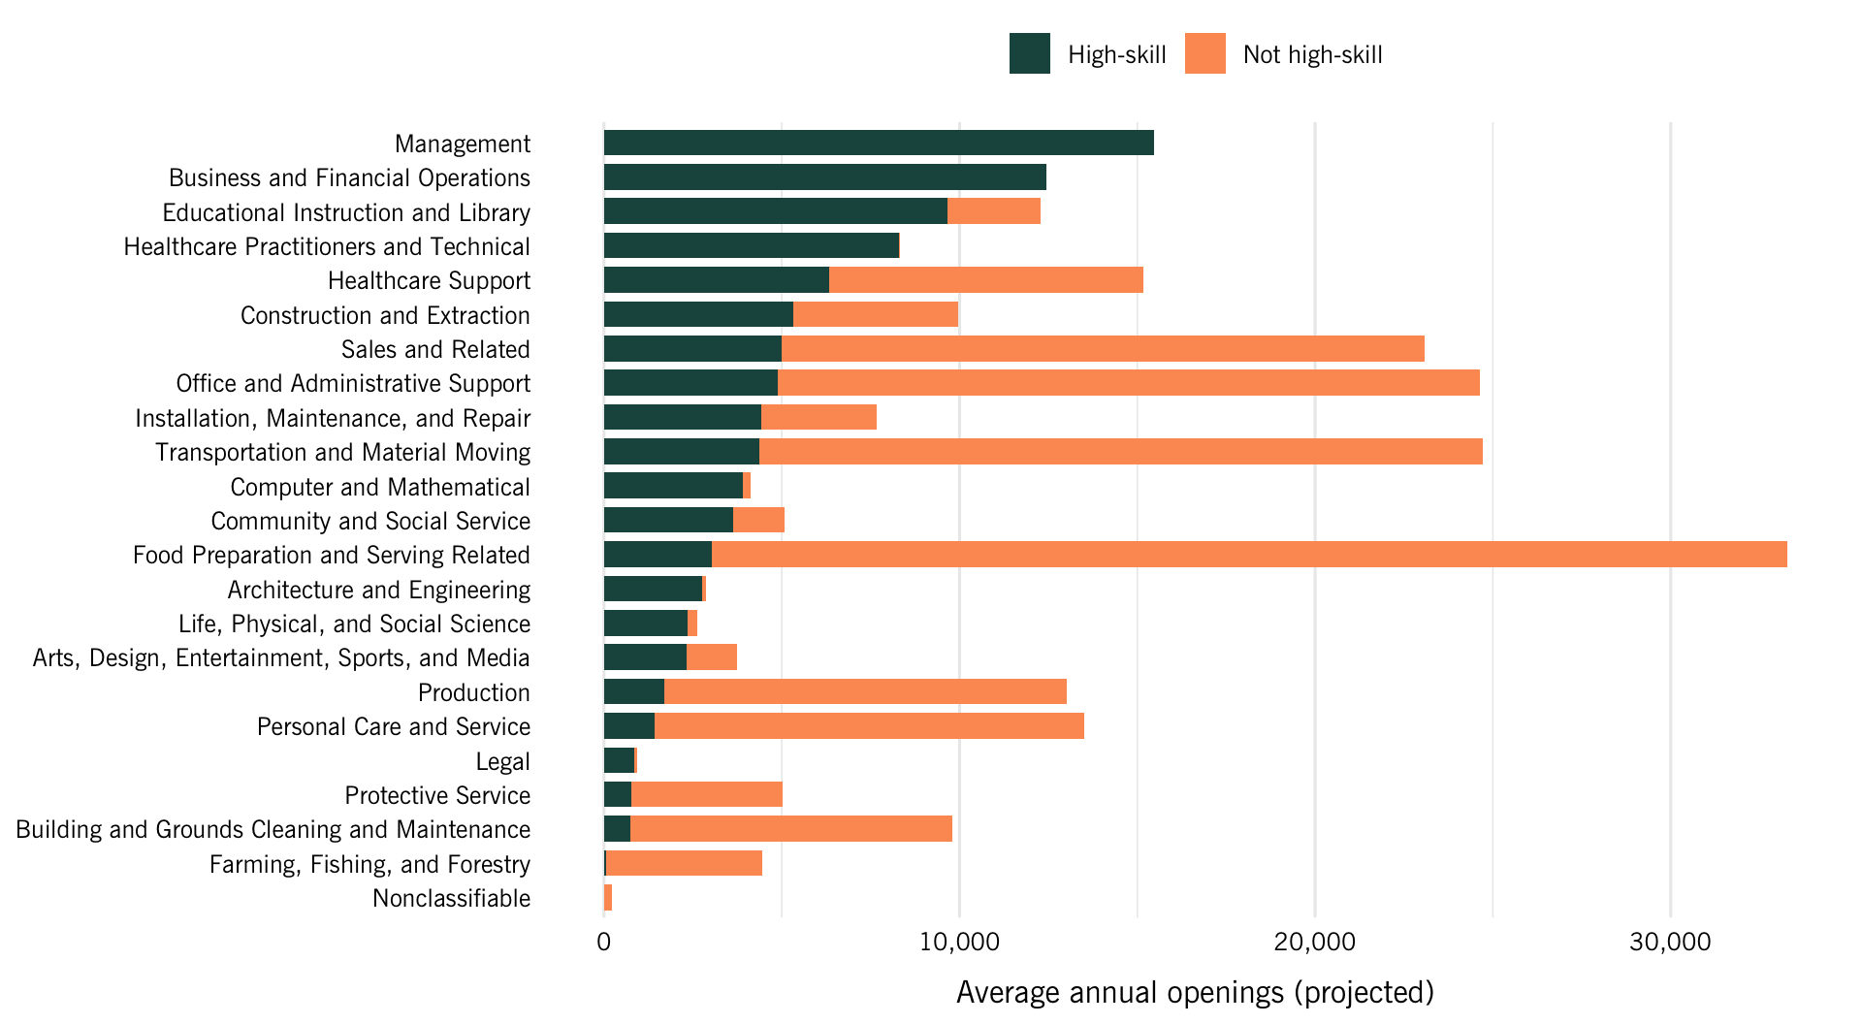
Priority occupations: High-skill example

Slide 15
Priority occupations
Criteria | Number of occupations meeting | Number of openings | Share of total annual openings
A. In demand | 402 | 243,484 | 96%
B. High skill | 483 | 108,082 | 42%
C. High wage | 458 | 88,517 | 34%
D. Advancement | 314 | 66,743 | 26%
(C) or (D) | 482 | 95,254 | 37%
E. Critical to priority sector | 11 | 5,609 | 2%
All criteria (deduplicated) | 209 | 84,172 | 33%

Slide 16
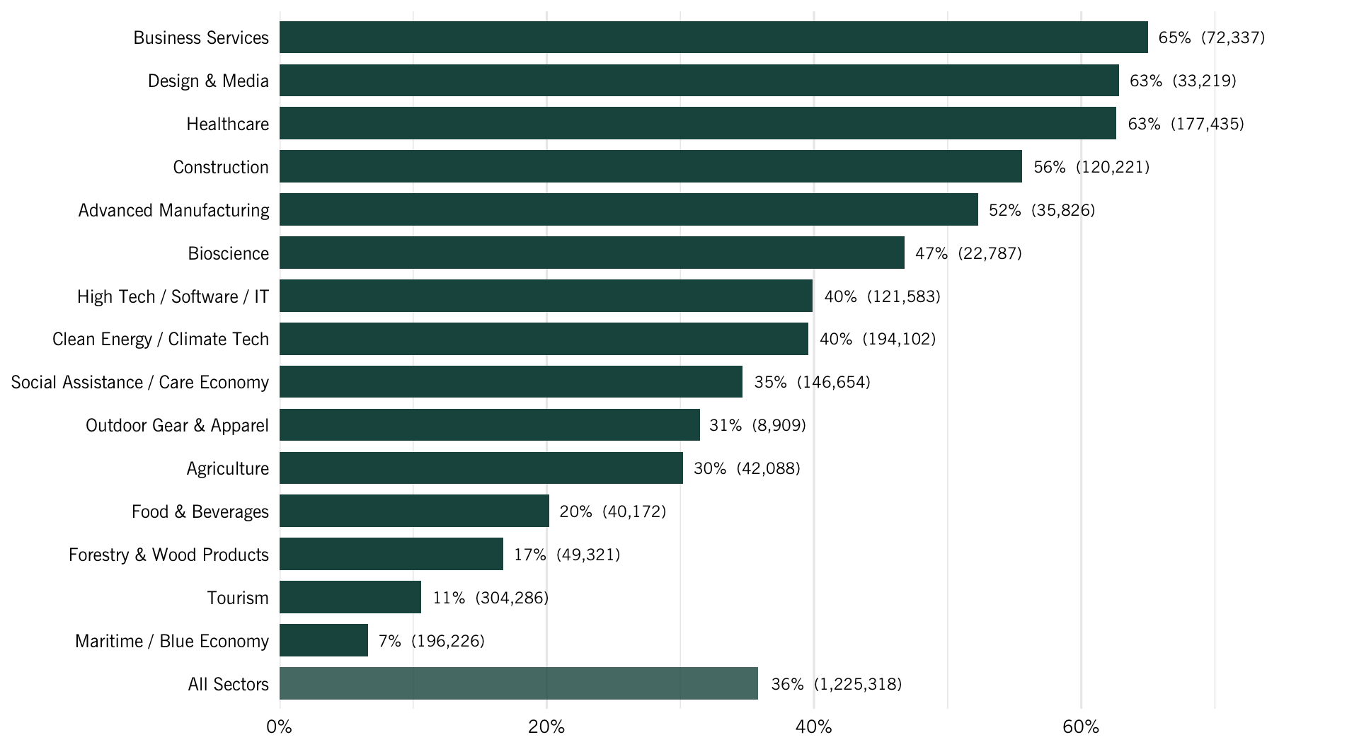
Priority occupations: Share of in-demand sector employment

Slide 17
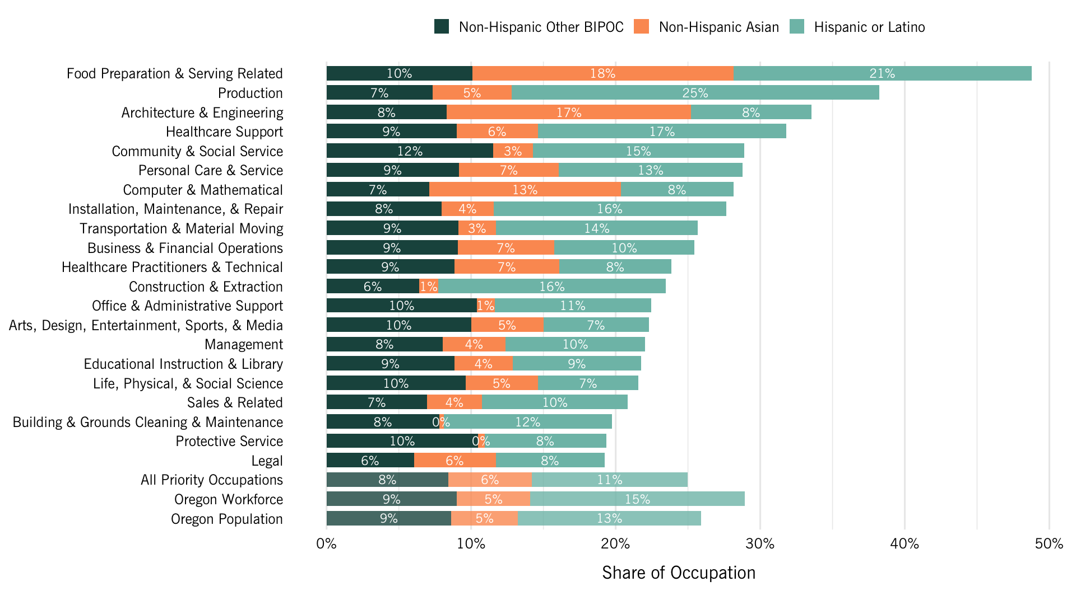
Priority occupations: Race and ethnicity

Slide 18
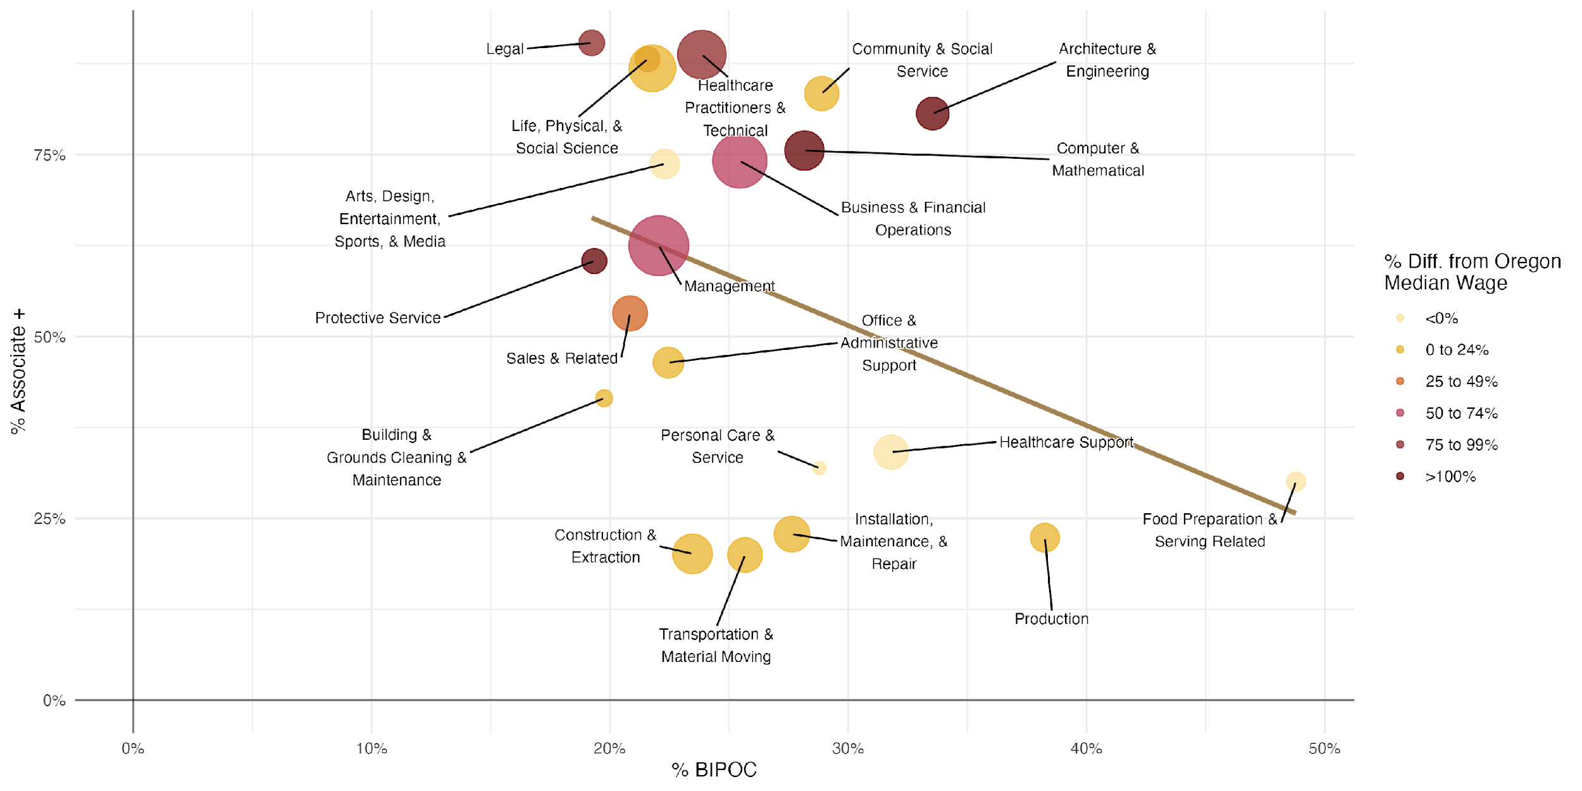
Priority occupations: Race and ethnicity

Slide 19
Gap Analysis

Slide 20
Gap Analysis
Link each priority occupation to related postsecondary programs of study
Count postsecondary credentials awarded in Oregon for each program
Gap metric: Calculated ratio of credentials to projected job openings across ALL occupations linked to the postsecondary programs

Slide 21
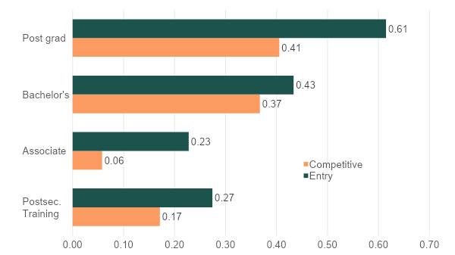
Gap Analysis: Credentials per opening by education level

Slide 22
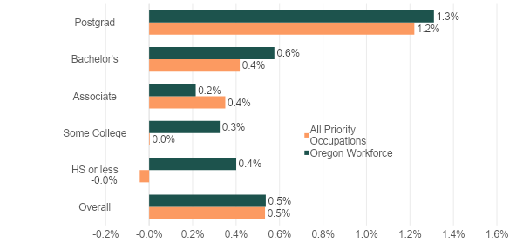
Gap Analysis: Interstate migration

Slide 23
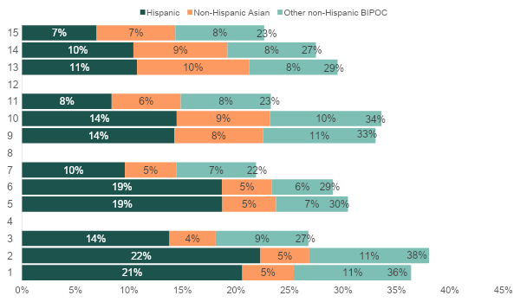
Gap Analysis: Race and ethnicity

Slide 24
Gap Analysis: Limitations
Gap analysis at this level is best treated as a data-informed guide for identifying opportunities to better align training pathways with workforce needs
  Future employer demand is likely more uncertain than usual
  Available data are imperfect measures of employer need
  Many occupations do not have a single, or any, path from classroom to employment
  Data for important training pathways are not readily available

Slide 25
Recommendations

Slide 26
Recommendations
Recommendations informed by:
  Data analysis
  Engagement participants
  Prior Talent Assessments, HECC Workforce Studies, and other documents
Three areas:
  System alignment
  Data and methodology
  Gap mitigation and equity improvements

Slide 27
Recommendations: System alignment
Work toward a statewide, unified, cross-sector workforce development coordination model
Use the Talent Assessment to drive implementation across systems
Put essential employability skills and digital fluency at the center
Move toward skills-first pathways while protecting credential quality
Align education and industry earlier, especially in CTE and technical fields
Expand work-based learning and employer-led training
Focus on retention and advancement in mid-level and hard-to-fill roles

Slide 28
Recommendations: Data and methodology
Continue to improve data collection about industry structure, composition, and training and education pathways
Continue coordinating with OED on terminology and benchmarks to improve statewide consistency and support Workforce Pell efforts
Continue working with BOLI, ODE, and OED on data access
Continue efforts to link and analyze CTE, apprenticeship, postsecondary, and employment data
Conduct quantitative analyses of participant-level education and employment outcomes for selected Oregon programs
Improve data transparency and career navigation tools
Develop an Oregon Talent Dashboard to serve as a central repository of useful metrics derived from centralized, common workforce datasets

Slide 29
Recommendations: Gap mitigation and equity improvements
Address credential shortages
Improve job quality, support worker well-being, and articulate career advancement pathways
Streamline licensure and bureaucratic processes
Prioritize diversity, equity, and inclusion
Mitigate structural barriers with wraparound supports
Enhance financial support for training and upskilling

Slide 30

www.econw.com
PORTLAND, OREGON
Power + Light Building
920 SW 6th Ave, Suite 1400
Portland, OR 97204
503-222-6060
WASHINGTON
Park Place
1200 Sixth Avenue, Suite 615
Seattle, WA 98101
206-823-3060
CALIFORNIA
9415 Culver Blvd
#248
Culver City, CA 90232
213-218-6740
BEND, OREGON
2863 NW Crossing Drive,
Suite 100
Bend, OR 97703
458-202-9016
DENVER, COLORADO
1200 17th Street
Floor 10
Denver, CO 80202

