Slide 1
Governor and Legislature
WorkSource Oregon System
Workforce and Talent Development Board (WTDB)
Oregon Employment Department (Agency)
Higher Education Coordinating Commission (Commission and Agency)
Department of Human Services (Agency)
Commission for the Blind
Employment Services for Job Seekers and Businesses
Veterans Services
Trade Adjustment Assistance
Migrant and Seasonal Farmworker Services
Reemployment Services (RESEA)
Adult, Dislocated Worker, and Youth Workforce Development Services
Adult Education and Family Literacy Services
Vocational Rehabilitation Program
Self-Sufficiency Programs (TANF and SNAP)
Senior Employment Program (SCSEP)
Commission for the Blind Workforce Program
Local Workforce Development Boards
WorkSource Oregon (WSO) Centers
Notes:
This slide represents the complexity of the workforce system and includes a high level overview of the state agencies and local partners who participate in the system. I don’t want to go into great detail here except to say that one of our main goals at the state level is to work with our partners and align this work so that we don’t have multiple programs delivering the same service – as you can see, we have a great deal of work to do in achieving that goal.
To move that forward, there is an effort happening over the next several months to start that alignment conversation State leaders from the Department of Human Services, Self-sufficiency programs and vocational rehabilitation along with the employment department and the office of Community Colleges and Workforce Development have been going around the state and convening a local conversation in each of the nine local workforce areas to make an action plan for a strong partnership, alignment of the system and streamlining services to job seekers and businesses.
This group will be developing a set of guiding principles for the system, providing their vision for governance and delivery of the system and supporting the local implementation.
As this work moves forward other partners will be included in the alignment work.

Slide 2
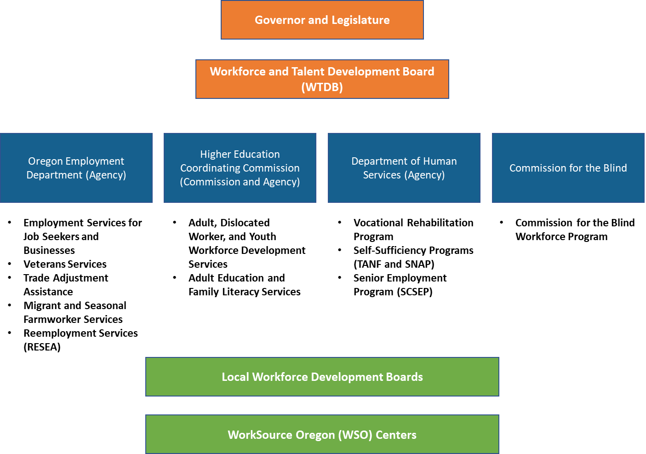
EDUCATION
----------
Higher Education Coordinating Commission
Oregon Department of Education
STEM Hubs
----------
Degrees, Diplomas, Certificates, and Credentials
Career Technical Education
Career Connected Learning
Oregon’s Entire
Workforce Development System
ALLIED PARTNERS
----------
Oregon Health Authority
Unemployment Insurance (OED)
Paid Leave Oregon (OED)
Business Oregon
Regional Solutions
ADDITIONAL PARTNERS
----------
Oregon Department of Corrections
Oregon Housing and Community Services
Job Corps Centers
U.S. Department of Housing and Urban Development
YouthBuild Grant Programs
COMMUNITY-BASED ORGANIZATIONS
----------
Education and Training
Supportive Services
Culturally-Specific Services
LABOR AND APPRENITCESHIP
----------
Bureau of Labor and Industries
Joint Apprenticeship and Training Committees
OREGON TRIBES
----------
WIOA Indian and Native American Programs
Tribe Programs
Notes:
This slide represents the complexity of the workforce system and includes a high level overview of the state agencies and local partners who participate in the system. I don’t want to go into great detail here except to say that one of our main goals at the state level is to work with our partners and align this work so that we don’t have multiple programs delivering the same service – as you can see, we have a great deal of work to do in achieving that goal.
To move that forward, there is an effort happening over the next several months to start that alignment conversation State leaders from the Department of Human Services, Self-sufficiency programs and vocational rehabilitation along with the employment department and the office of Community Colleges and Workforce Development have been going around the state and convening a local conversation in each of the nine local workforce areas to make an action plan for a strong partnership, alignment of the system and streamlining services to job seekers and businesses.
This group will be developing a set of guiding principles for the system, providing their vision for governance and delivery of the system and supporting the local implementation.
As this work moves forward other partners will be included in the alignment work.

